Slide 1
SURGICAL
ENDODONTICS

Slide 2
DEFINITIONS
Surgical procedure related to problem of the pulpless or periodontically involved tooth,requiring root amputation and endodontic therapy.
(John.I.Ingle)
Removal of tissues other than the contents of the root canal space to retain a tooth with pulpal and / or periapical involvement.
(Franklin Weine)

Slide 3
RATIONALE
Rationale for surgical endodontic treatment of a tooth is to attain a bacterial tight seal of root cannal by means of a filling placed in a retrograde fashion in the root canal.

Slide 4
OBJECTIVES
When an orthograde root cannal filling is expected to be ineffective or fail usually because of complication during conventional treatment
When conventional treatment has failed
due to presence of apical pathology refractory to conservative treatment may contain bacteria capable of substaining a periapical disease process independent of root cannal
Root inspection for knowing etiology of endodontic failure,fracture,accessory cannals,etc.

Slide 5
INDICATIONS
Ineffective conventional treatment.
Long post in Root Canal.
Procedural Error:
  Instrument fragmentation
  Non-negotiable ledging
  Root perforation
  Symptomatic overfilling
External Root Resorption.
Root Fracture

Slide 6
Anatomic Deviations:
Eg: Root dilaceration
Open apex
Biopsy
Corrective surgery:
  Root resorption defects
  Root caries
  Root resection
  Hemisection
  Bicuspidization

Slide 7
Replacement surgery:
  Intentional replantation
  Post-traumatic
Implant surgery:
  Endodontic
  Osseointegrated
Exploratory Surgery

Slide 8
CONTRAINDICATIONS
These are few contraindications for
endodontic sugery. Most conditions that
would eliminate surgery as a treatment
options are temporary and once corrected
surgery can be performed.
Can be classified into:
  Absolute contraindications
  Relative contraindications

Slide 9
Absolute Contraindications:
  Periodontal health of tooth:
  Most important factor in consideration.
  Periodontal pocket and Tooth mobility are two key
  elements that a surgeon must consider.
  Patient health consideration:
  In most cases systemic diseases do not perclude
  endodontic surgery.
  Conditions that perclude the patient from surgery are:
  Eg: Leukaemia,Neutropenia,Uncontrolled diabetes,Recent cardiac surgery.

Slide 10
Patient’s who recently had radiation
treatment of jaw are contraindicated for
surgery because radiation reduces blood
circulation to the bone leading to
osteoradionecrosis.

Slide 11
B. Relative Contraindications:
  Patients on Anticoagulent therapy
  First trimester of pregnancy
  Anatomic consideration
  These factors should be considered before surgery. A good illumination and high magnification has greatly reduced there concern.

Slide 12
Conditions:
Proximity to neurovascular bundles.
Eg: In mandibular premolar and first molar region presence of mental foramen.
In mandibular second molar region mandibular canal is present.
Proximity to maxillary sinus.
Greater palatine nerve and vessels.

Slide 13
d) Short root length in which removal of root
apex further comprises the prognosis.
Miscellaneous:
Non restorable teeth
Vertical fracture tooth.

Slide 14
CLASSIFICATION
To establish drainage
  Incision and drainage
  Trephination
Radicular Surgery
  Apical curettage
  Apicoectomy
Corrective Endosurgery
  Correction of perforation
  Correction of resorption

Slide 15
c) Correction of fracture instruments
d) Pulpoperiodontal problem correction
e) Reimplantation

Slide 16
BASIC PRINCIPLES FOR DOING ENDOSURGERY
Determines severity of infection
Evaluate host defense mechanism
Treat infection surgically
Support patient medically
Prescribe correct antibiotics
Evaluate patient frequently

Slide 17
TENETS OF HALSTED
Gently handle tissue during surgery.
Sharp incision on healthy tissue.
Follow asepsis throughout the surgery.
Do haemostasis preoperative and postoperative.
Proper suturing using fine non-irritating suture material.
Avoid dead space.
Avoid wound tension.
Rest.

Slide 18
PATIENT EVALUATION AND MEDICATION
Preoperative consultation
  Necessary inform consent that patient give to clinician after complete explanation of procedures.
Preoperative medication
  An appropriate antibiotic and anti inflammatory drug and analgesic should be prescribed before and after surgery.
  Oral rinse should be prescribed before and after surgery.
  In case of anxious patients some sedatives should be given before surgery.

Slide 19
PRESURGICAL INVESTIGATIONS
RBC count.
Haemoglobin %.
Total Leukocyte Count.
Differential Leukocyte Count.
Erythrocyte Sedimentation Rate.
Prothrombin Time.
Bleeding Time.
Clotting Time.
Platelet Count.
Blood Glucose Level.
ELISA Test For HIV.
Bilirubin Test For Jaundice.

Slide 20
SURGICAL INSTRUMENTS
Examination instruments.
Incision Blades.
Elevation instruments.
Tissue retraction instruments.
Curettage instruments.
Osteotomy instrument.
Inspection instruments.
Retrofill carriers.
Retrofill pluggers.
Miscellaneous instruments.

Slide 21
11) Artery forceps.
12) Tissue holding forceps.
13) Suturing instruments:
  Needles
  Needle holder
  Scissors
14) Suction tips.

Slide 22
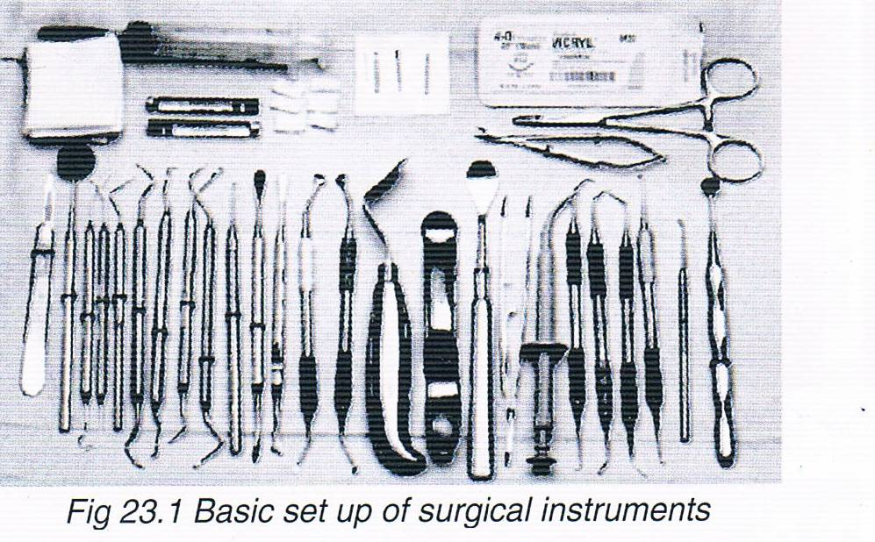

Slide 23
EXAMINATION INSTRUMENTS
MICROEXPLORER
  Specifically designed for microsurgery.
  Has 2mm tip bent at 90 degrees on one end and 130 degrees on other end.
  Short tip makes it easy to maneuver inside small bony crypt.
  Useful for exploring the site of microleakage on resected root surface.

Slide 24
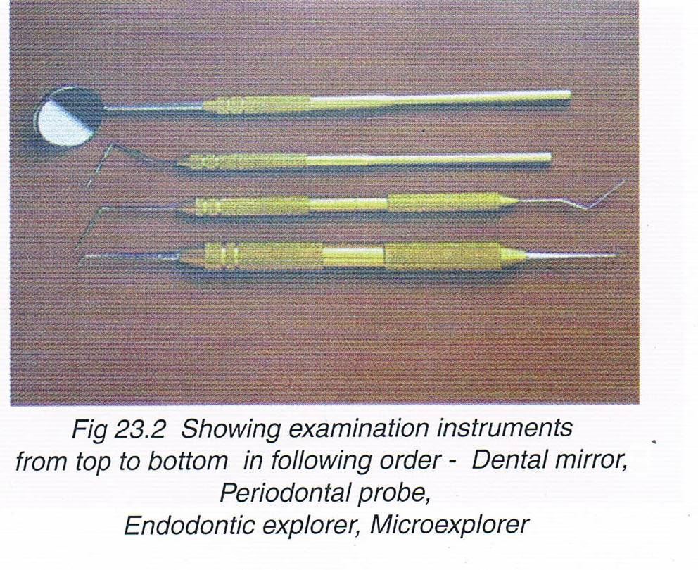
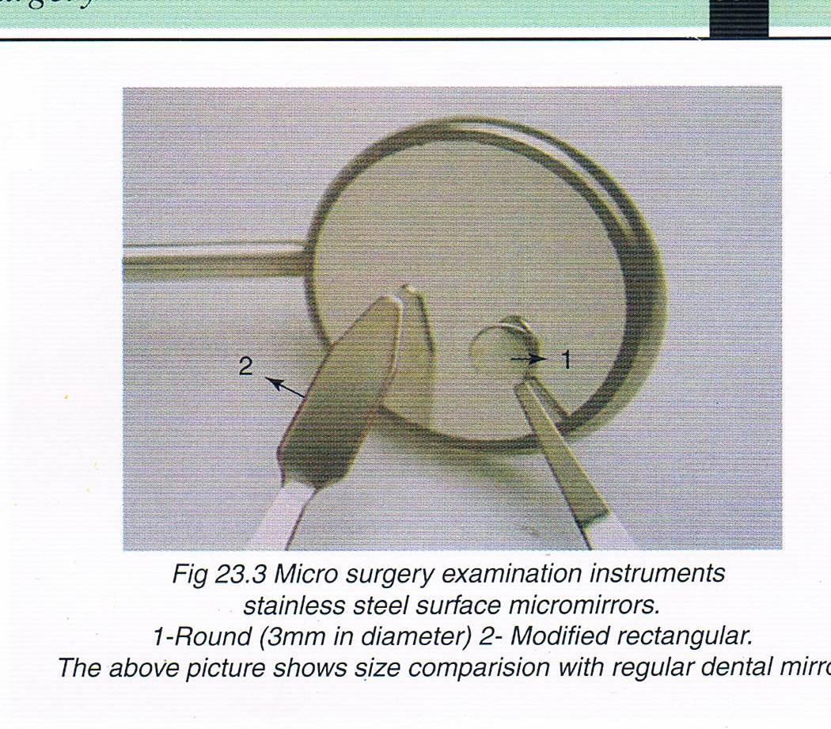

Slide 25
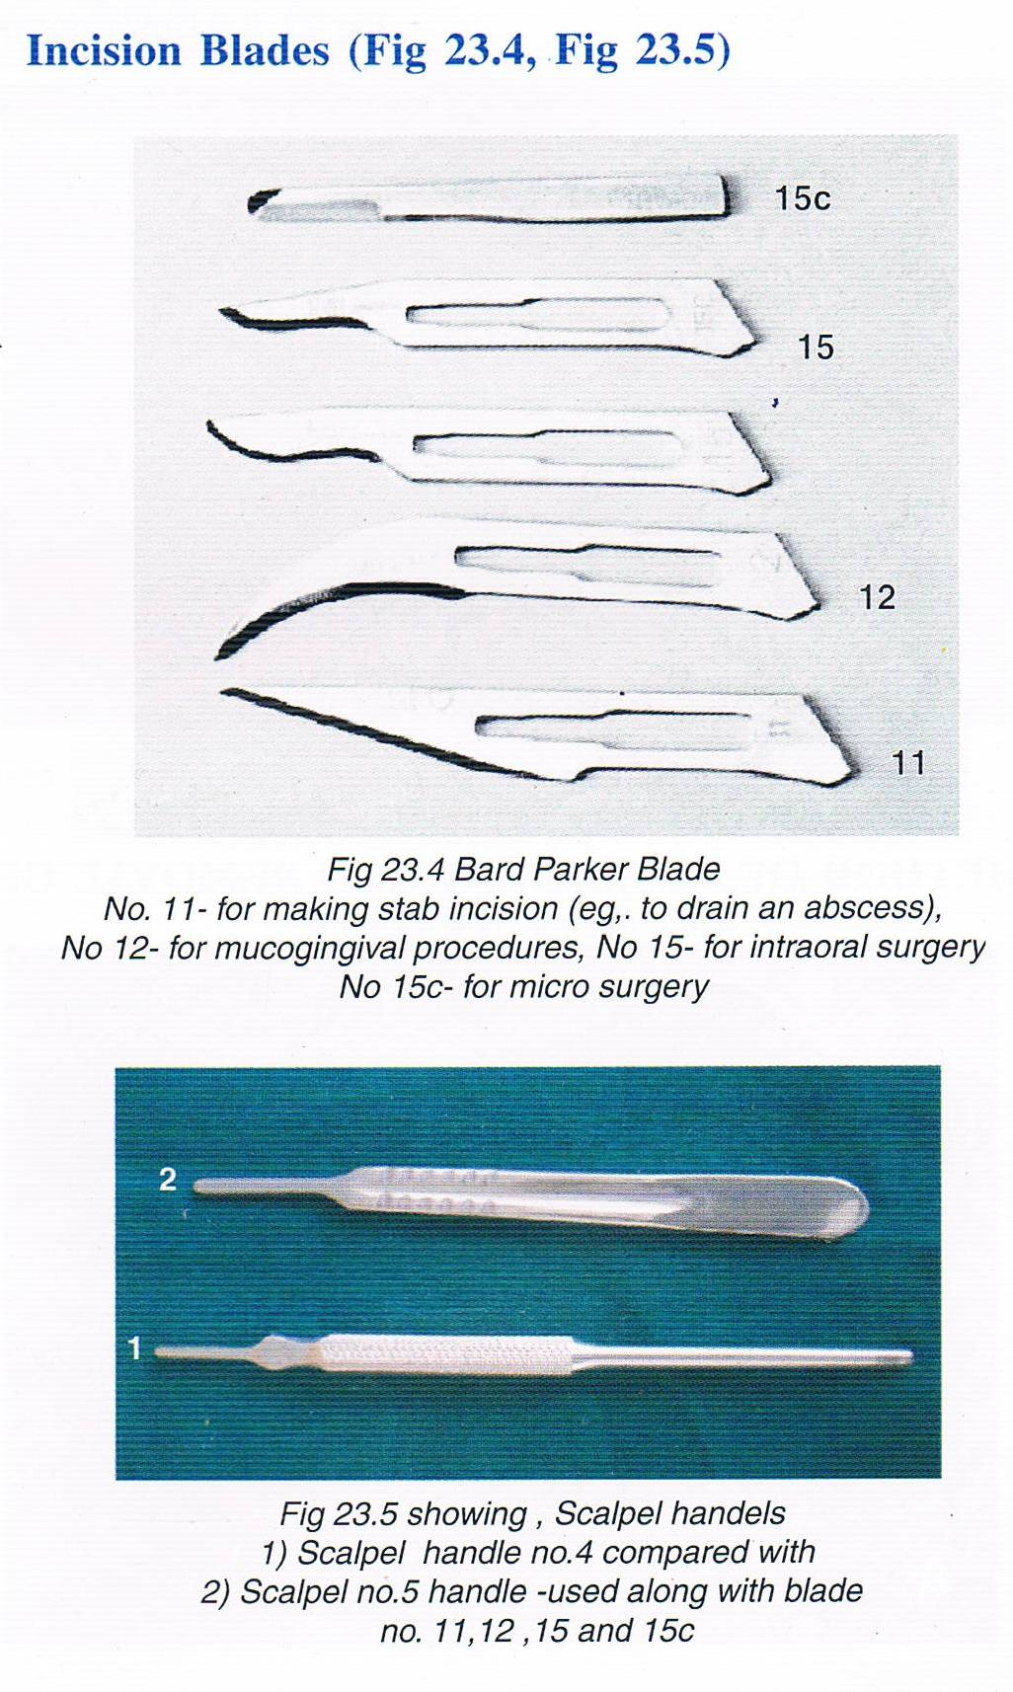

Slide 26
ELEVATION INSTRUMENTS
Soft tissue elevators designed to elevate the gingiva and tissue from underlying cortical bone with minimum trauma to tissue.
One end of instrument has thin,sharp triangular beak, and the other end has sharp rounded beak that varies in size. Unlike periosteal elevator new design incorporates thin sharp edges and points that allow the soft tissue to be elevated from the bone.

Slide 27
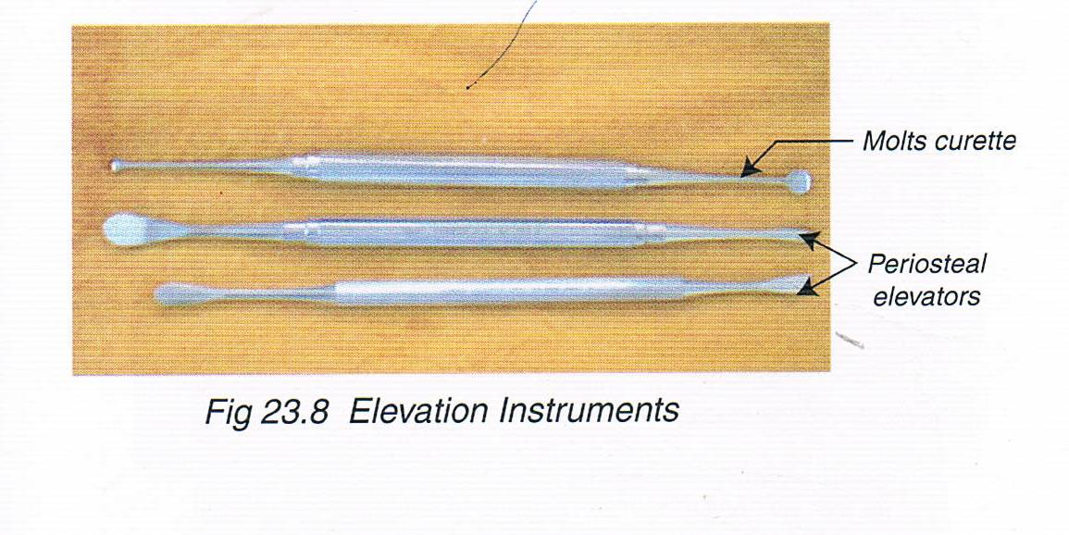

Slide 28
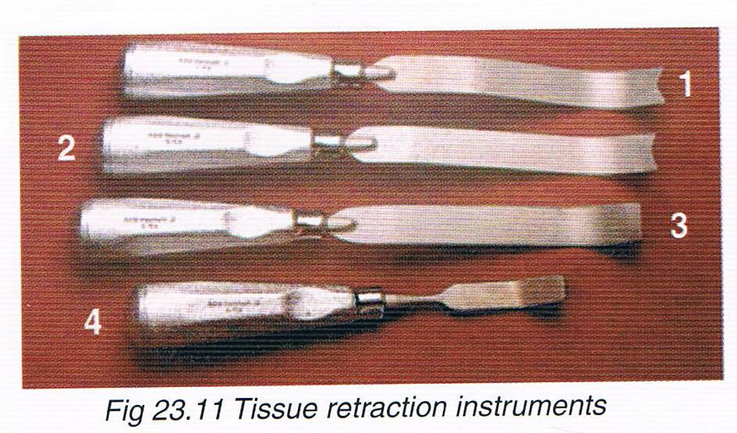

Slide 29
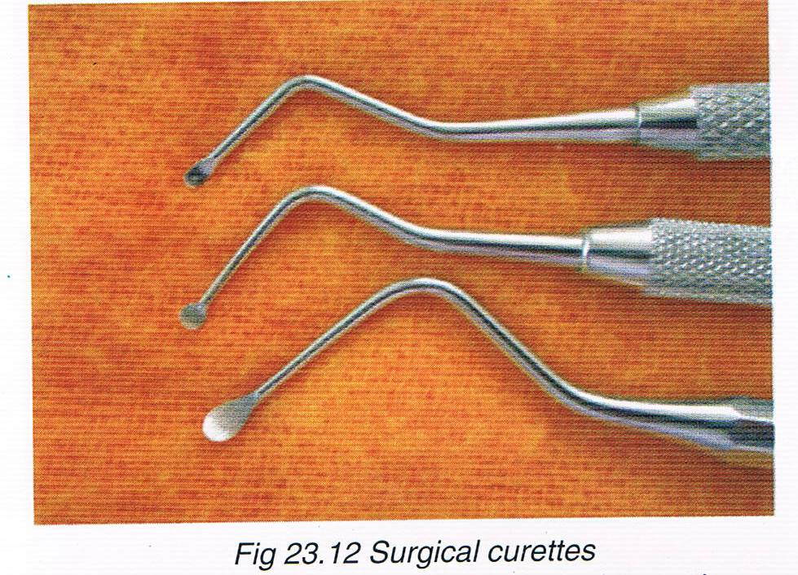

Slide 30
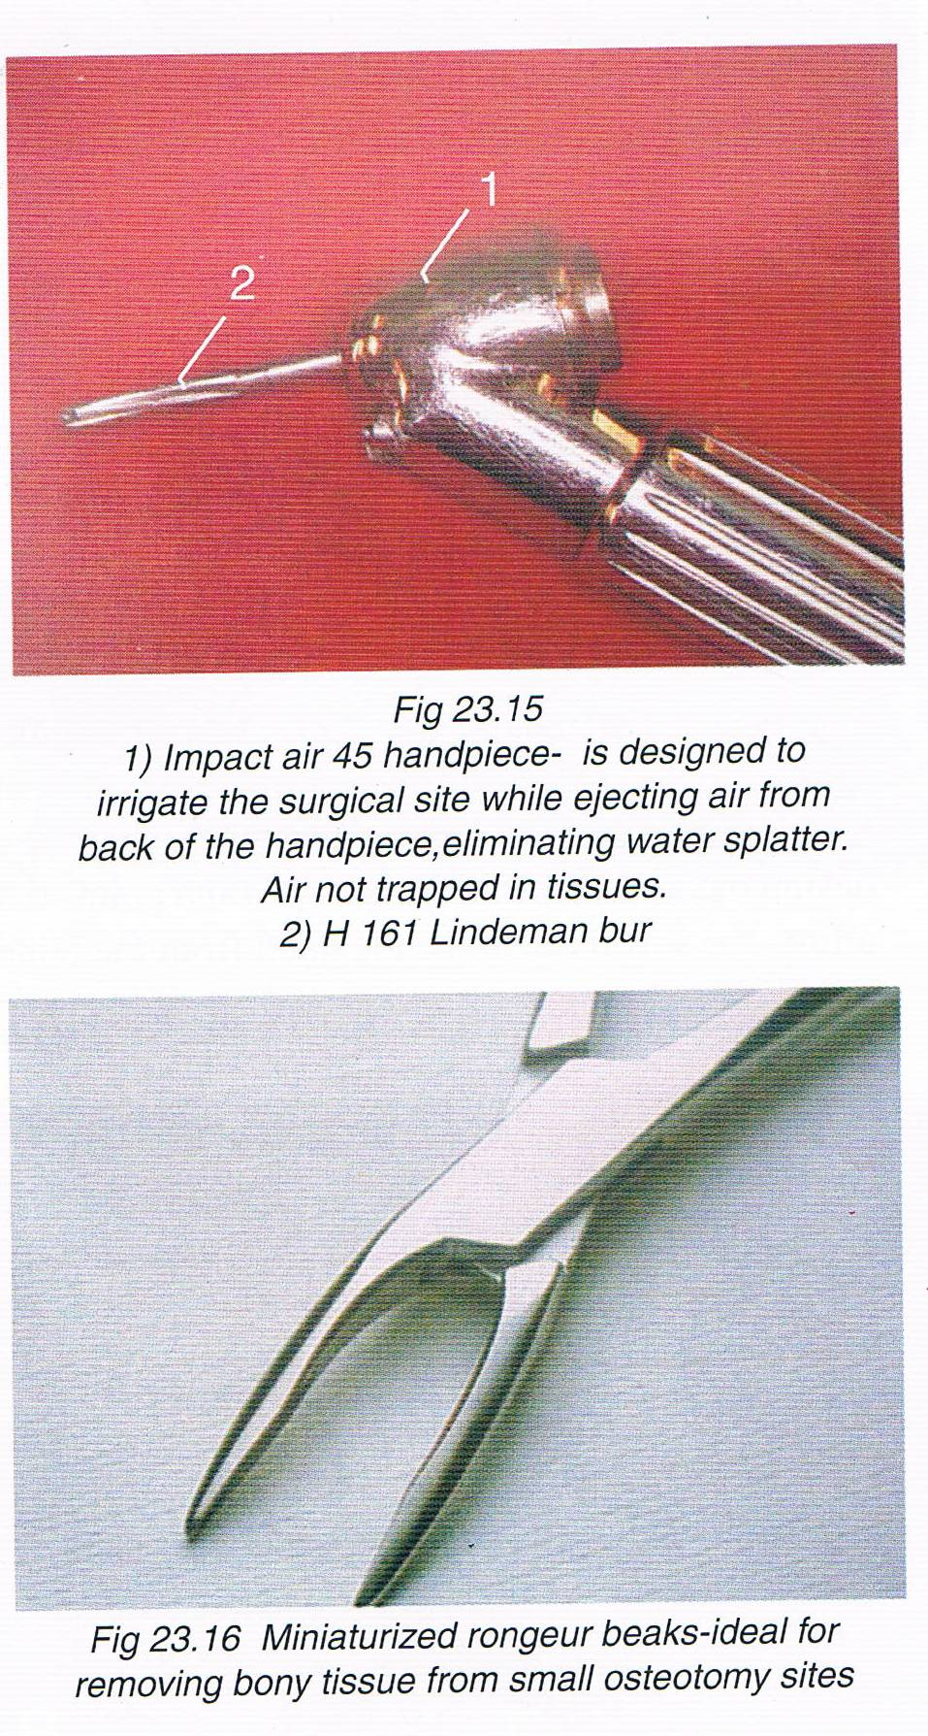

Slide 31
RETROFILLING CARRIERS
0.5mm diameter ball on one end and a 1mm wide blade on other.
Flat surface is designed to carry retrofilling material to retropreparation, ball end is designed for packing the material into the preparation.

Slide 32
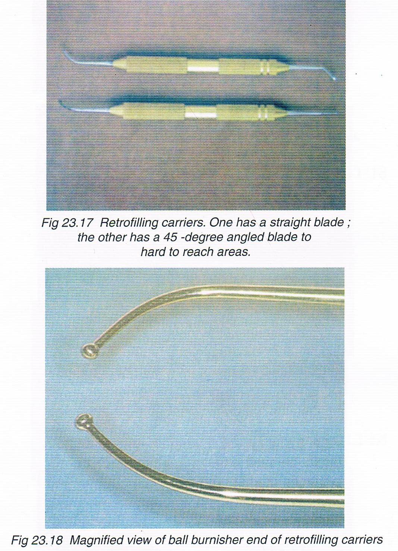

Slide 33
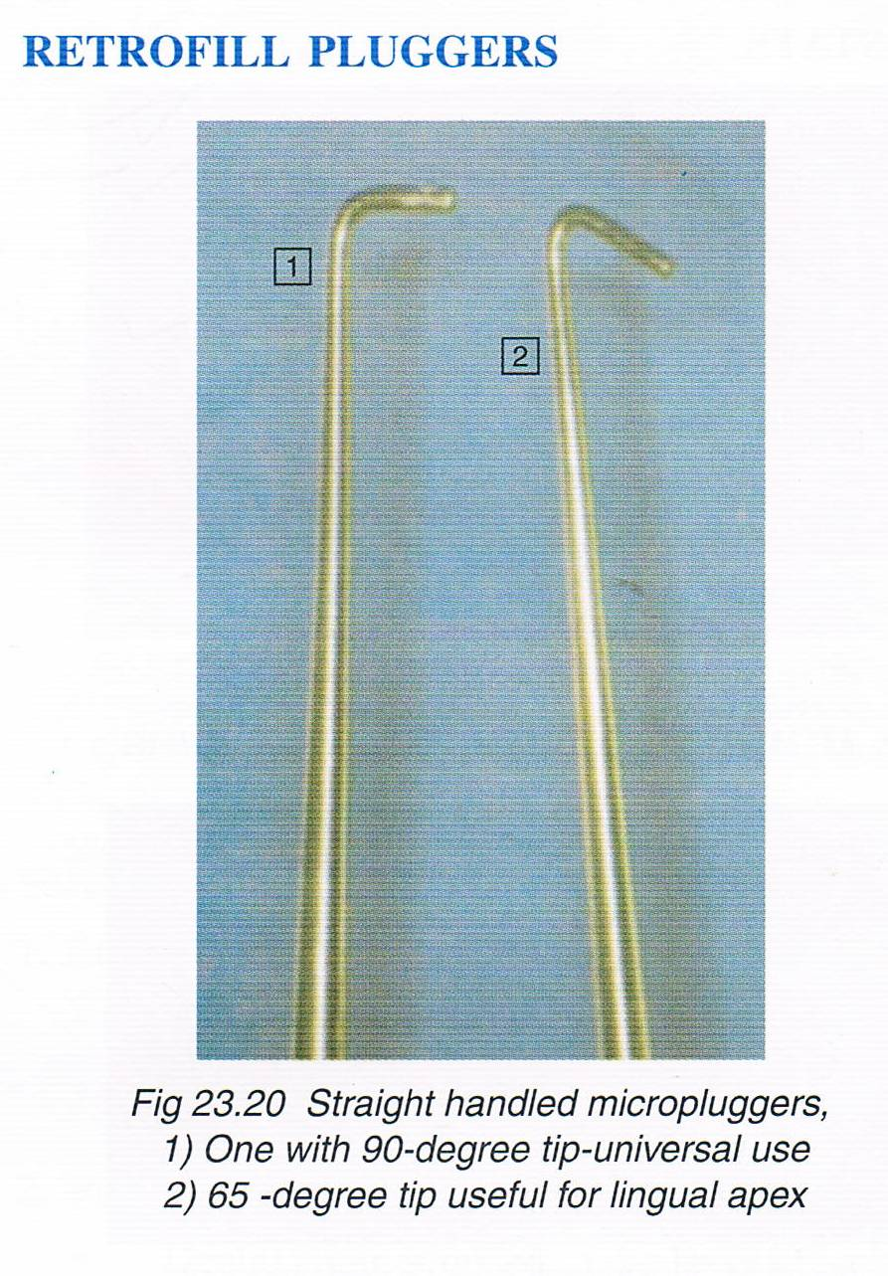

Slide 34
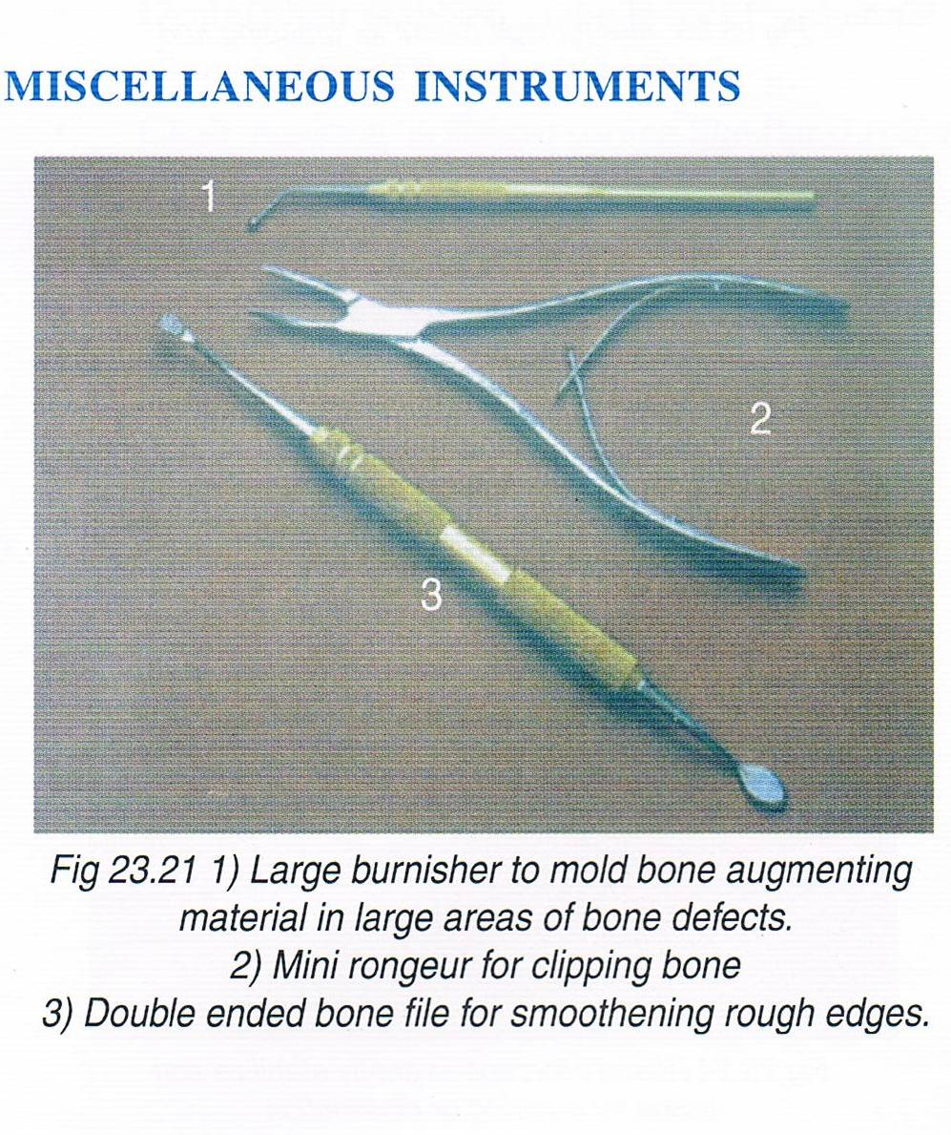

Slide 35
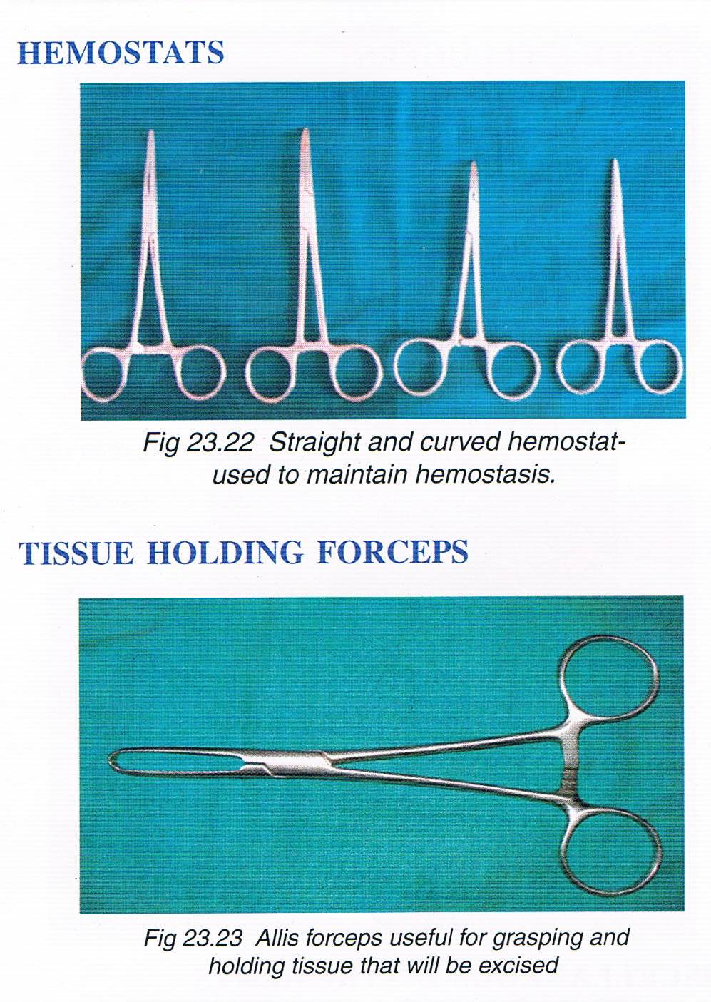

Slide 36
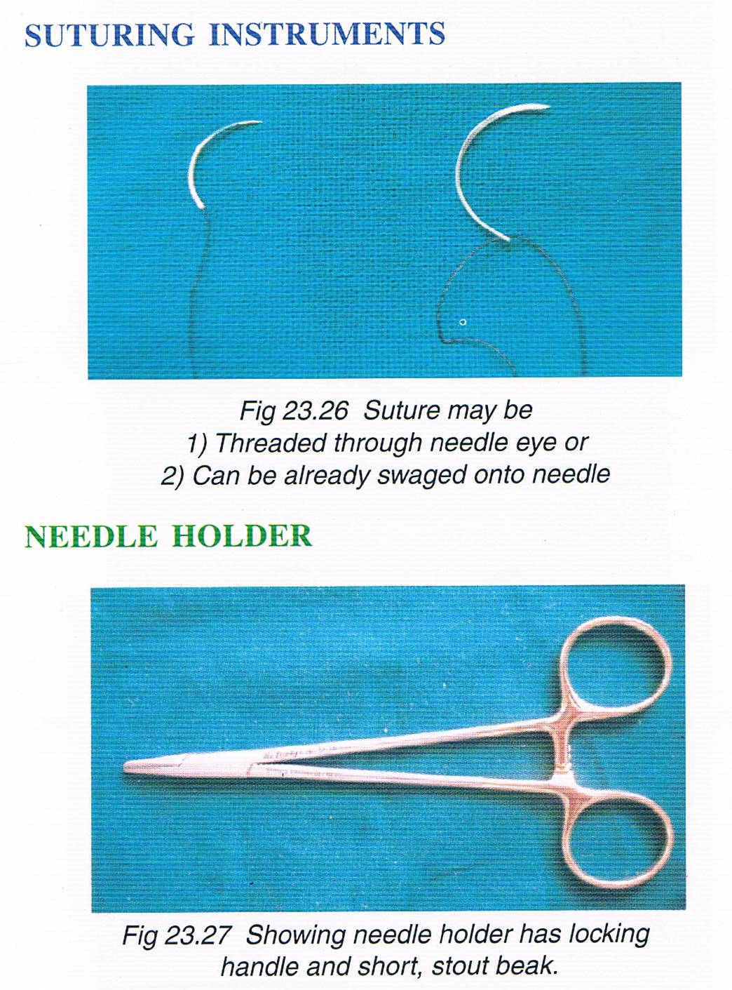

Slide 37
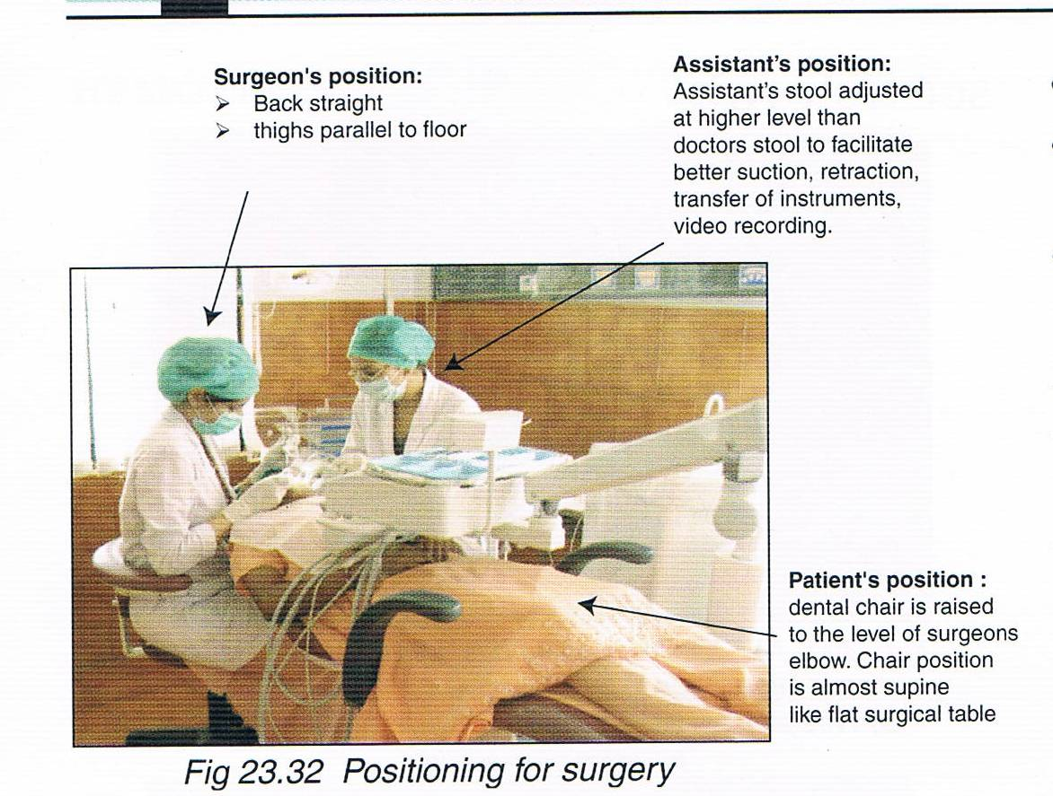

Slide 38
PRINCIPLES OF PERIRADICULAR SURGERY
Need profound local anesthesia and hemostasis
Surgical access, both visual and operative
Management of soft tissues
Management of hard tissues
Access to root structure
Periradicular curettage
Root-end resection
Root-end preparation
Root-end restoration
Soft-tissue repositioning and suturing
Post surgical care

Slide 39
LOCAL ANESTHESIA
OBJECTIVES:
  To obtain profound and prolong anesthesia
  To provide good haemostasis both during and after surgical procedure

Slide 40
SELECTION OF ANESTHETIC AGENT:
Local anesthetics with vasopressors are the main choice in surgical endodontic procedures to obtain profound anesthesia and optimal hemostasis.
Lidocaine with vasopressor adrenalin is the local anesthesia of choice for surgical procedures.
If amide is contraindicated, then ester agent, i.e. procaine, propoxicaine with levonprdeffrin is indicated.
Submucosal infiltration for hemostasis should be given with 30 gauge needle with the bevel towards bone and penetration just superficial to periosteum at the level of root apices.
0.25-0.5ml should be injected slowly at a place.

Slide 41
SELECTION OF VASOCONSTRICTOR:
Purpose:
  Influences duration of anesthesia
  Haemorrhage control at the surgical site
  DOSAGE OF ADRENALINE
  Varies according to surgical use
  concentration:
  1:50,000 1:1,00,000 1:2,00,000
  High concentration preferred as it produces long lasting effect

Slide 42
  INJECTION SITE AND TECHNIQUE
    For nerve block 2% lidocaine with 1:100000 or 1:200000 adrenaline is used
    Local infiltration with 1:50,000 , 2%lignocaine HCL 15min before injection
    Rate 1-2ml/min

Slide 43
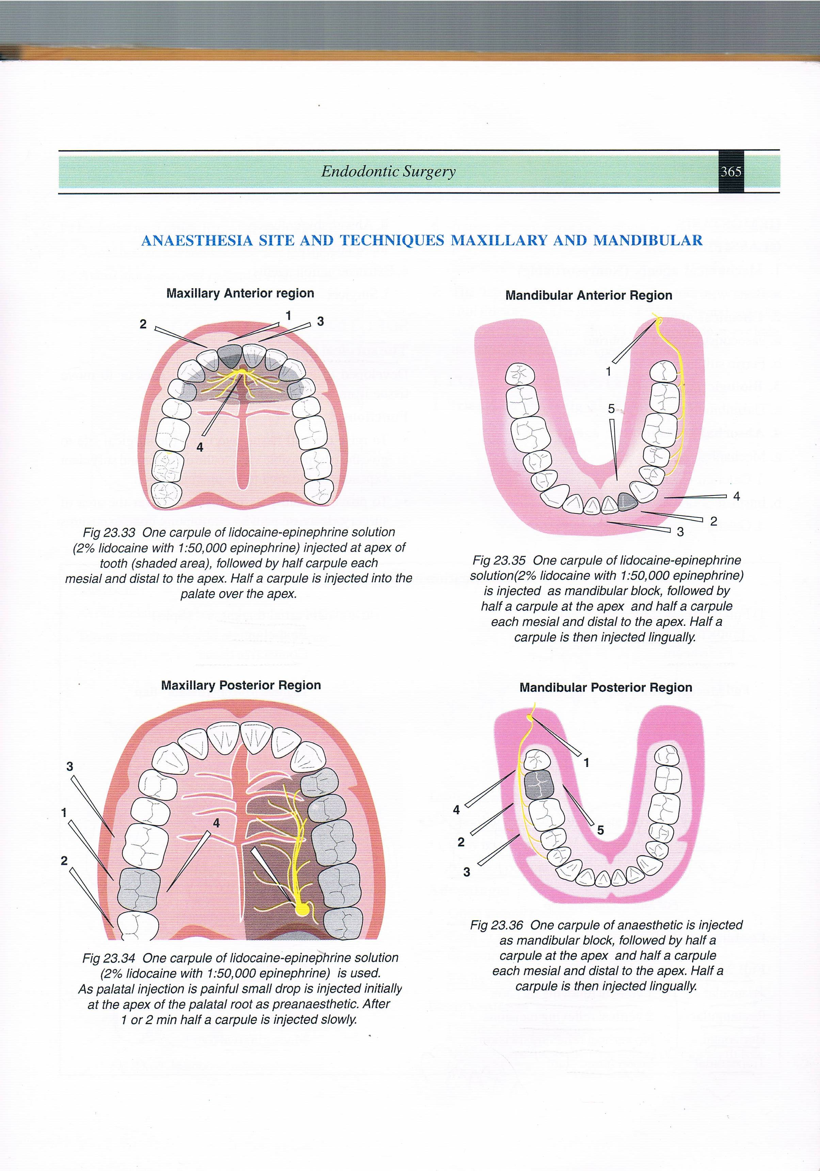

Slide 44
HEMOSTASIS CLASSIFICATION
Mechanical agents(nonresorbable)
  Bone wax
Chemical agents
  vasoconstrictors
  Ferric sulphate
Biologic agents
  Thrombin
Absorbable hemostatic agent
  mechanical agents
    Calcium sulfate

Slide 45
Intrinsic action
    Gelatin
    Absorbable collagen
    Microfibrillar collagen hemostasis
Extrinsic action agents
    Surgicel

Slide 46
CLASSIFICATION OF SURGICAL FLAPS
Full mucoperiosteal flap
Triangular
Rectangular
Horizontal
Trapezoidal
Limited mucoperiosteal flap
Semi-lunar/submarginal curved
Submarginal scalloped rectangular(Luebke-Ochsenbein)

Slide 47
PRINCIPLES AND GUIDELINES FOR FLAP DESIGN
In designing the flap the surgeon must take
into consideration various anatomic
feature,such as frenum muscle,the width of
Attached gingiva,bony eminence,crown
margins,supraperiosteal blood vessels of attached
gingiva which extend from alveolar mucosa and run
parallel to long axis of tooth lying in the reticular layer
superficial to the periosteum.

Slide 48
Avoid incision across major muscle attachment.
Incision should be placed directly above healthy bone.
Avoid incision in the mucogingival junction.
Avoid incision over root eminence as gingiva over it is thin and frail.
Incision shouldn’t extend beyond depth of vestibular sulcus.
Avoid horizontal and severely angled vertical incision:
Gingival blood supply occurs from supraperiosteal vessels which follow vertical course parallel to long axis of tooth.
Gingival fibers over crestal radicular bone are parallel to long axis of tooth

Slide 49
An incision made in the attached gingiva.
With this technique atleast 2mm of attached gingiva must be retained to prevent mucogingival degeneration.
The junction of horizontal sulcular and vertical incision should either include or exclude the involved interdental papilla.
Incision should be placed and flaps repositioned over solid bone.

Slide 50
Requirements for successful flap design
One healthy tooth on either side of flap is needed
Flap should be sutured on a sound bone
Anatomical structure around the flap should be normal
Best flap for endosurgery is full thickness flap
Length of flap should be enough so that it lies with out tension on solid cortical bone

Slide 51
Full mucoperiosteal flap
Triangular flap:
1st described by Fischer in 1940
intrasulcular incision along with horizontal & 1vertical incision
vertical incision usually placed towards the midline.
horizontal incision is submarginal curved incision placed along the crowns of teeth in attached gingiva.

Slide 52
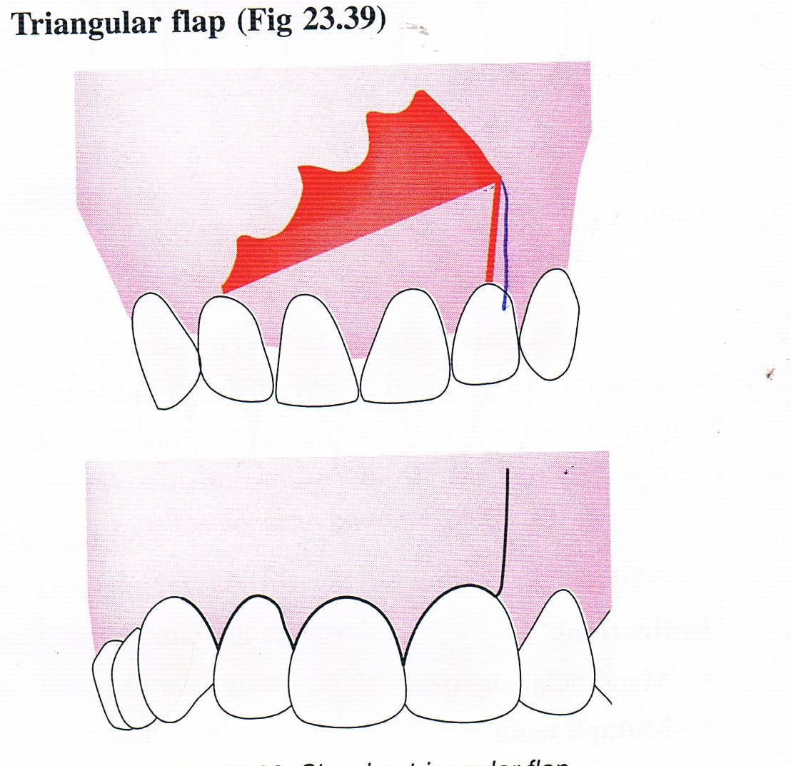

Slide 53
Indications:
Maxillary incisors and posterior teeth
Only recommended flap for posterior teeth
Advavtages:
Good wound healing
Ease of flap re-approximation
Disadvantages
Limited surgical accesss
Difficult to expose the root apices of long teeth e.g maxillary & mandibular canine

Slide 54
Rectangular flap
includes 2 vertical,horizontal,and intrasulcular incision.
Indications
Mandibular anteriors
Multiple teeth
Teeth with long roots
Lateral root repair
Large lesions

Slide 55
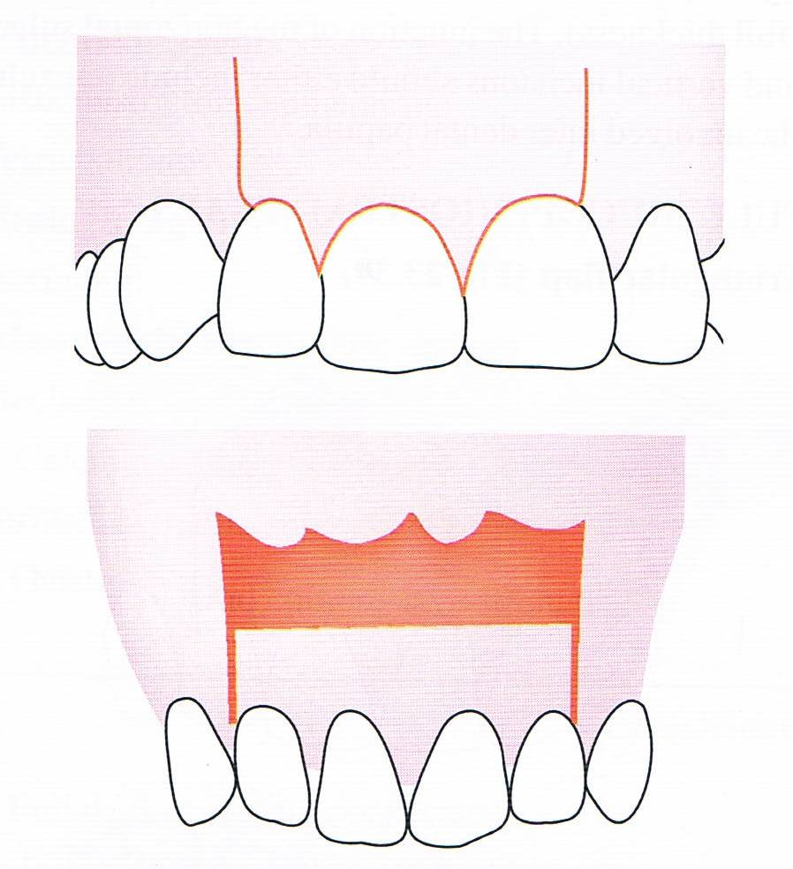

Slide 56
Contraindication
Posterior teeth
Advantages
Increased surgical accesss to root apex
Easier apical orientation
Disadvantages
Difficulty in approximation of flap margins.
Potiential of flap dislodgement is greater

Slide 57
Trapezoidal flap
Described by Neumann & Eikan in 1940
2 releasing incision with horizontal intrasulcular incision at obtuse angle
Advantages
Blood supply maintained
To expose palatal root
Disdvantages
Wound healing by secondary intention
Not indicated for buccal and facial areas

Slide 58
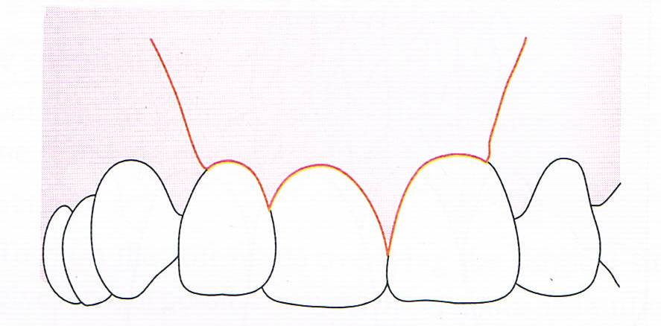

Slide 59
Envelop flap
single horizontal intrasulcular incision
recommended for corrective endodontic surgery
Indications
For repair of perforation defects
For root resection
Advantages
Improved wound healing
Easy wound closure
Disadvantages
Extremely limited surgical access

Slide 60
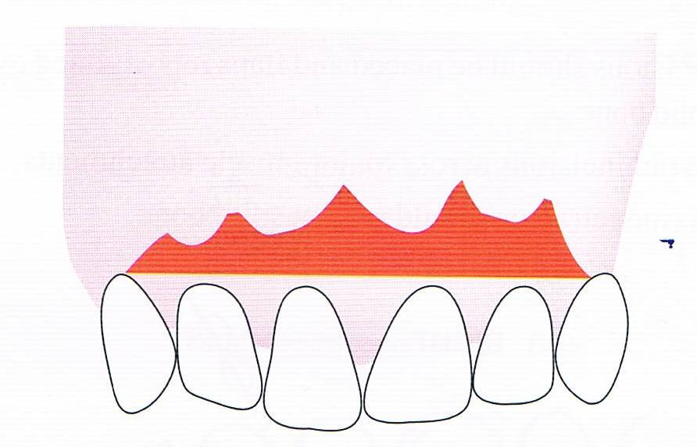

Slide 61
Limited mucoperiosteal flap
Semilunar(Submarginal Curved)
1ST given by Partsch
also known as Partsch incision
Formed by single curved incision
Resemble a half moon
NOT PREFERRED IN MORDERN ENDODONTIC
Indications
Aesthetic crown present
Trephination

Slide 62
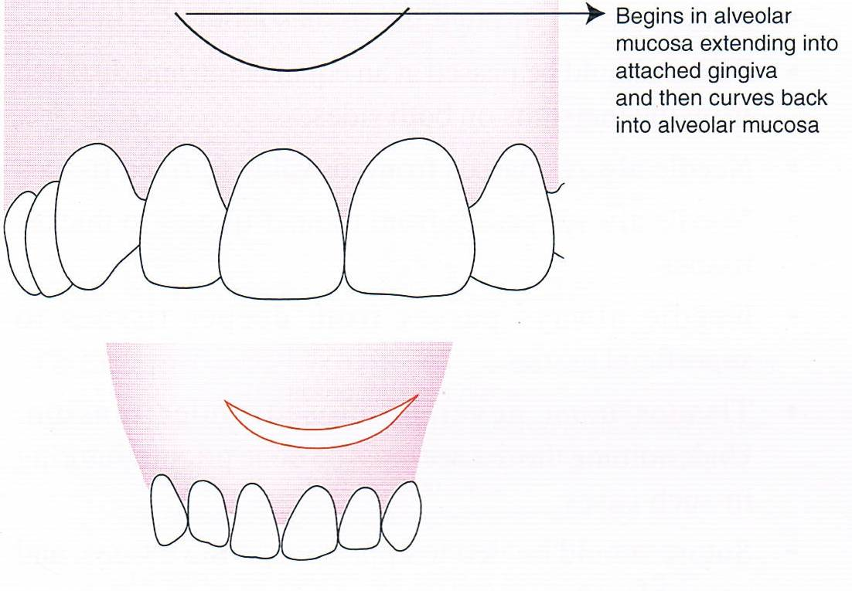

Slide 63
Advantages
Maintain integrity of gingival attachment
Reduces incision and reflection time
Disadvantages
Poor surgical access
Poor wound healing
Predisposed to stretching and tearing
Difficult to reposition

Slide 64
Submarginal Scalloped Rectangular flap
Also known as Ochsenbein-Luebke flap
modification of rectangular flap
Flap design
Scalloped horizontal incision is given in attached gingiva
2 vertical incision on each side of surgical site
bone not exposed
Advantages
Marginal & interdental gingiva not involved
Ease of incision & reflection
Crestal bone not exposed

Slide 65
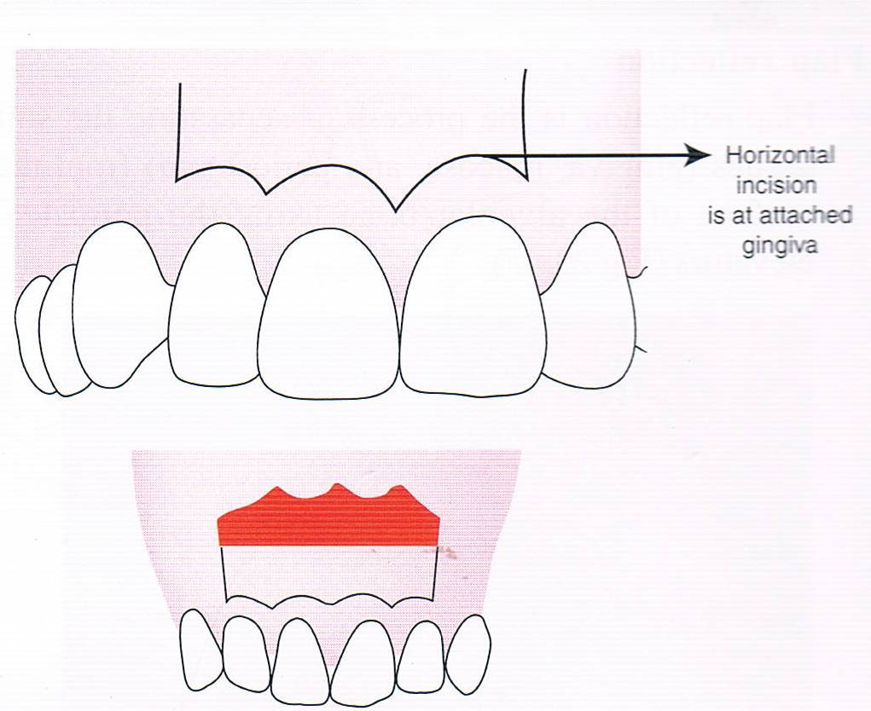

Slide 66
Adequate surgical access
Good wound healing
Disadvantages
Can’t be used in mandibular anterior region because of limited availability of attached gingiva width
Not indicated in gingival recession areas
Healing with scar formation
Flap shrinkage

Slide 67
Incision & Drainage
Procedure
When build up of exudate ‘pus’ is confined to hard tissue excruciating pain develops ,as the exudate penetrates the cortical plate swelling occurs pain diminishes
When swelling ‘points’that is localized into soft fluctuant palpable mass,it should be incised & drained
LA-block preferred over infiltration.More often topical anesthesia
Horizontal incision with no.11 or 12 B.P blade at the base of the fluctuant area – quick , sharp thrust of scalpel through the fluctuant mass down to cortical bone.

Slide 68
Trephination
Cortical trephination is a procedure involving the perforation of the cortical plate to accomplish the release of pressure from the accumulation of exudate within the alveolar bone
No.6 or 8 round bur used
Buccal approach .path of penetration should be in direct line to the periapical tissue surrounding the root apex.

Slide 69


