Slide 1
Principles and Rationale
Of Endodontics

Slide 2
contents
Principles of endodontic treatment:
Introduction
Moisture control
Isolation
Sterilization
Rationale of endodontic treatment:
Introduction
Inflammation
Endodontic implication: Fish concept
Conclusion

Slide 3
Principles of endodontic treatment: introduction
The basic principles underlying the treatment of teeth with endodontic problems are those underlying surgery in general.
An aseptic technique, debridement of the wound, drainage , and gentle treatment of the tissues with both instruments and drugs – all are the cardinal principles of surgery.

Slide 4
Principles of endodontic treatment
Moisture control
Isolation
Sterilization of instruments

Slide 5
Moisture control

Slide 6
A. Sources of moisture in the clinical environment:
i. Saliva:
- from salivary glands.(parotid, submandibular, sublingual)
ii. Blood:
- inflamed gingival tissues.
- iatrogenic damage.
iii. Gingival crevicular fluid:
-inflamed gingival tissues.
iv. Water/dental materials:
- from rotary instruments.
- water from triplex syringe.
-materials we may use during treatment [eg. etchants, irrigant solutions].

Slide 7
B. Why is moisture control important?
i. Patient related factors
• Comfort.
• Protects patients swallowing or aspirating foreign bodies.
• Protects patient soft tissues – tongue, cheeks by retracting them from operating field.

Slide 8
ii. Operator related factors
• Infection control; to minimise aerosol production.
• Increased accessibility to operative site, allowing greater convenience and efficiency of operator.
• Procedures (e.g. patient’s “need to swallow”) causes fewer problems.
• Improves visibility of the working field and diagnosis.
• Less fogging of the dental mirror.
• Prevents contamination of cavity preparation/ root canal.
• Haemorrhage from gingiva does not enter operative site.

Slide 9
iii. Task/technique being performed:
• Dental materials are moisture sensitive, success of adhesion and physical properties relies on a dry field.

Slide 10
C. Methods of moisture control
i. Aspiration
ii. Air-Water-Syringe
iii. Absorbent materials
iv. Rubber dam
v. Pharmacological methods
vi. Gingival retraction cord
vii. Electrosurgery
viii. Tricholoroacetic acid

Slide 11
i. Aspiration:
High volume aspiration:
High volume vacuum (large diameter tip, autoclavable or disposable).
Operated from vacuum unit.
Application:
Suitable to remove:
Large particulate matter
water from high speed drills

Slide 12
Saliva ejector.
Low volume, small diameter tip, usually disposable.
Flexible plastic tubing with protective flange.
Routine saliva control.
Can be placed under rubber dam.
Best used to remove small amounts of moisture.
Can be used in conjunction with other methods of moisture control

Slide 13
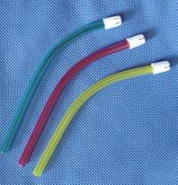
Saliva ejector

Slide 14
Advantages:
Cheap, easy to use (can be held by patient).
Some have flanges attached which can retract tongue and floor of mouth.
Disadvantages:
Can be uncomfortable for patient if used inappropriately.
May cause soft tissue damage; care must be taken not to suck in patients tissues into the tip.
Active tongues can make placement difficult.
Low volume aspirators don’t remove solids well

Slide 15
ii. Air-Water-Syringe:
Application:
Air blast useful to dry tooth or soft tissues during examination or used during operative procedures
Advantages:
Easy to use.
Disadvantages:
Needs greater caution with use as can dehydrate dentine and cause pain and discomfort to patient
Not effective if large volumes of moisture; can just transfer moisture from one tooth to another

Slide 16
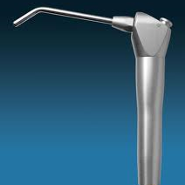
Air water syringe

Slide 17
iii. Absorbent materials
Cotton rolls, pellets, gauze, cellulose wafers.
Application:
Cotton rolls (placed in buccal or lingual sulcus) and cellulose wafers (placed in the buccal sulcus).
Can place cotton rolls over parotid duct to control parotid flow
Are used to absorb saliva and other fluids for short periods of time eg; any examinations, fissure sealants, polishing

Slide 18
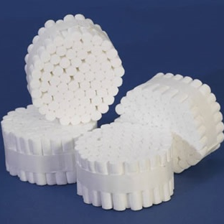
Cotton rolls

Slide 19
Advantages:
Effective to control small amounts of moisture
Retract soft tissues at same time
Disadvantages:
Only provides short term moisture control
Ineffective if high volumes of fluid
Active tongues and shallow sulci may make placement and retention difficult

Slide 20
iv. Rubber dam
Total moisture control method
Application:
Isolation of one or more teeth from the oral environment.
Rubber dam eliminates saliva from the working field and also retracts soft tissues

Slide 21
Rubber dam set
Rubber dam (green, blue and black)
Rubber dam punch
Rubber dam clamps
Rubber dam clamp forceps
Rubber dam frame/holder
Rubber dam stamp for marking the position of tooth
Rubber dam lubricant
Waxed dental floss
Scissors

Slide 22
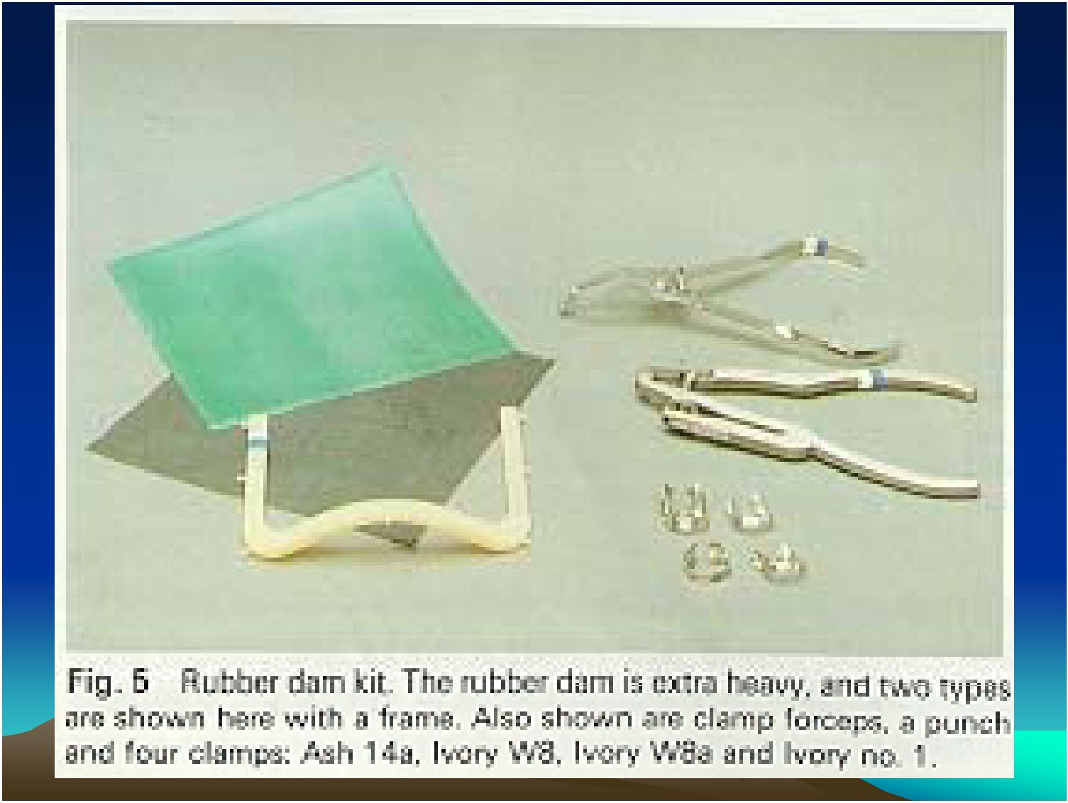
Rubber dam isolation

Slide 23
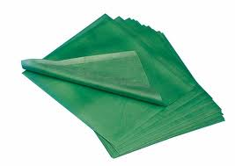
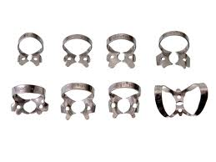
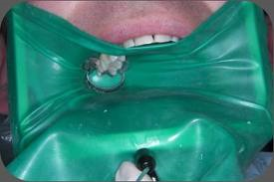

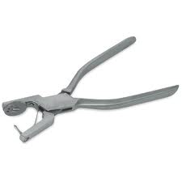
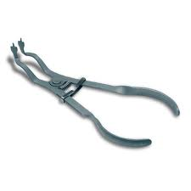
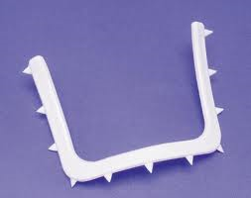

Slide 24
Advantages:
Complete, long term moisture control
Maximises access and visibility
Protection for both patient and dentist
Infection control measure
Prevents accidental swallowing or aspiration of foreign bodies
Retracts soft tissues
Increases operator efficiency
Improved properties of dental materials

Slide 25
Disadvantages:
Claimed that it takes time to apply
Communication with patient can be difficult
Incorrect use may damage porcelain crowns/crown margins/ traumatise gingival tissues
Patient may feel uncomfortable or phobic with it on
Insecure clamps can be swallowed or aspirated

Slide 26
v. Pharmacological methods
Use of local anaesthetic with a vasoconstrictor eg. Adrenaline: causes transient vasoconstriction of blood vessels in site of injection.
May control haemorrhage in some situations

Slide 27
Advantages:
Used as an adjunct to control gingival bleeding when use of retraction cord is not sufficient
Disadvantages:
Invasive, patient may not want LA needle
Will be numb for a while
Not effective if profuse bleeding

Slide 28
vi. Gingival retraction cord
Application:
Special type of cord either knitted or twisted that is placed gently into the gingival sulcus and stretches the circumferential gingival fibres.
Provides isolation and retraction of the gingival tissues eg when doing restorations in cervical area or when unable to apply rubber dam.
Absorbs gingival crevicular fluid and can also be soaked or impregnated with vasoconstrictors and thus be useful in controlling minor amounts of gingival bleeding

Slide 29
Advantages:
Effective in control gingival haemorrhage or gingival crevicular fluid and at same time retracting gingival tissues
Can be used as adjunct to other methods
Disadvantages:
Only effective if small amounts of gingival crevicular fluid
May need local anaesthetic prior to placement.
Can be difficult to insert
Can cause gingival damage if not inserted correctly

Slide 30
vii. Electrosurgery
Application:
Use of high frequency electric current to incise/coagulate tissues.
Used during crown-bridge procedures and also to access subgingival caries

Slide 31
Advantages:
Can be used to control small amount of bleeding.
Disadvantages:
Potentially can cause tissue damage if not used properly.
Can’t use if patient has a pacemaker.
Unpleasant smell.
Can’t use with metal instruments.

Slide 32
viii. Tricholoroacetic acid
Chemical method of controlling haemorrhage in local areas of tissue trauma.
Advantages:
Effective control of bleeding site.
Transient.
Disadvantages:
Caustic; need to use with care as can cause soft tissue damage if accidentally dropped on tissues.

Slide 33
Sterilization of instruments

Slide 34
Decontamination cycle
“Decontamination is a combination of processes, including cleaning, disinfection and/or sterilization, used to make reusable surgical instruments safe for further use. The effective decontamination of reusable medical devices is essential in reducing the risk of transmission of infectious agents”

Slide 35
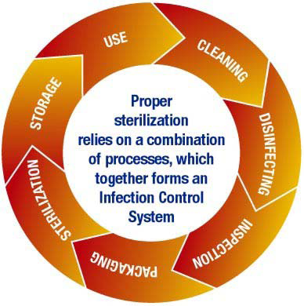

Slide 36
1. Cleaning
Cleaning can be achieved either by manual or mechanical means.
The mechanical method is considered preferable as it is more effective than manual cleaning and can be validated. Not only does it provide higher standards of cleanliness, it reduces the risk of infection for staff involved.
cleaning is vital to the overall efficiency of the disinfection and sterilization stages of the decontamination process.
If an item is not clean it cannot achieve sterility when autoclaved.

Slide 37
2. Disinfection
Disinfection is a process which uses chemical substances and/or heat to reduce the number of mirco-organisms present, but may not inactivate some viruses and bacterial spores.
Again mechanical disinfection is preferable as it is consistent and reduces the risk of injury from contact with hazardous chemicals used in manual disinfection.
Disinfection should not be used as a substitute for sterilization.

Slide 38
3. Inspection
Inspection should be performed before sterilization in order to ensure that appropriate safety levels are being maintained.
These items should be examined to ensure they are clean with no sign of debris remaining and there is no evidence of damage.
Sub-standard instruments should be removed from the cycle immediately.
If dirty, they should then be re-cleaned. If damaged, they should be sterilized before repair work is carried out. Alternatively, they should be destroyed if repair is not an option.

Slide 39
4. Packaging
Packaging is required for items which are to be stored for later use.
Packed items should only be processed in a vacuum autoclave.

Slide 40
5. Sterilization
Sterilization is a process to render an object free from viable micro-organisms, including bacterial spores and viruses.
Sterility, can be described theoretically as, "not more than one living microorganism present in 1 million sterilized units of the final product".
Sterilization of instruments can be achieved in a number of ways, including hot air, gas, irradiation and steam.
steam sterilization (autoclaving) is both quick and effective, offering a simple yet reliable method.

Slide 41
6. Storage
The storage of instruments should be suited to their subsequent use
In all cases storage areas should be clean and dust free.

Slide 42
7. Use - Levels of Risk
Whether an instrument needs to be sterile at the point of use will depend on the procedure to be carried out and the associated risk of infection to the patient.
Methods of processing and storage will also be affected by the level of risk associated with the procedure to be performed, (i.e. if the instrument is required to be sterile at point of use.)

Slide 43
Risk levels are categorised as low, medium or high.
Low Risk Procedures are those where items only come into contact with intact skin, such as stethoscopes, skin thermometers and blood pressure cuffs. It is not necessary to sterilize these items but they should be cleaned in accordance with manufacturers’ instructions.
Medium Risk Procedures are those where instruments will be in contact with intact mucous membranes or body fluids, such as gingiva and teeth. Examples will include mouth mirrors and probes used for routine examination.

Slide 44
These instruments must be cleaned and sterilized after use but do not need to be sterile at the point of use. They can therefore, be stored after autoclaving in a clean environment.
High Risk Procedures are those where instruments come into contact with breaks in the skin or mucous membranes, or when they will enter a sterile body cavity, such as dental implantology and surgical procedures. In this instance the instruments must be sterile at point of use, either being used immediately after autoclaving or taken from sterile storage.

Slide 45
Methods of Sterilization
Sterilization destroys all microbial forms, including bacterial spores. Sterile is an absolute term; there is no “partially sterile”
or “almost sterile.”
All reusable items (critical and semicritical instruments) that come into contact with the patient’s blood, saliva, or mucous membranes must be heat-sterilized.
The three most common forms of heat sterilization in the dental office are:
  Steam
  Chemical vapor
  Dry heat
Notes:
45
Liquid sterilization may not be used to avoid damage to instruments that may be able to withstand heat sterilization.
Critical and semicritical dental instruments must be sterilized with the use of steam, chemical vapor, or dry heat.

Slide 46
Steam Autoclave Sterilization
An autoclave is used to sterilize dental instruments and other items by means of steam under pressure.
Steam sterilization involves heating water to generate steam, producing a moist heat that rapidly kills microorganisms.
As the steam fills the sterilizing chamber, the cooler air is pushed from an escape valve, which then closes and allows the pressure to increase.
It is actually the heat, not the pressure, that kills the microorganisms.
(Cont’d)
Notes:
46
The autoclave is the tool for heat sterilization most commonly used in dental offices.
What dental instruments can be sterilized in an autoclave?

Slide 47
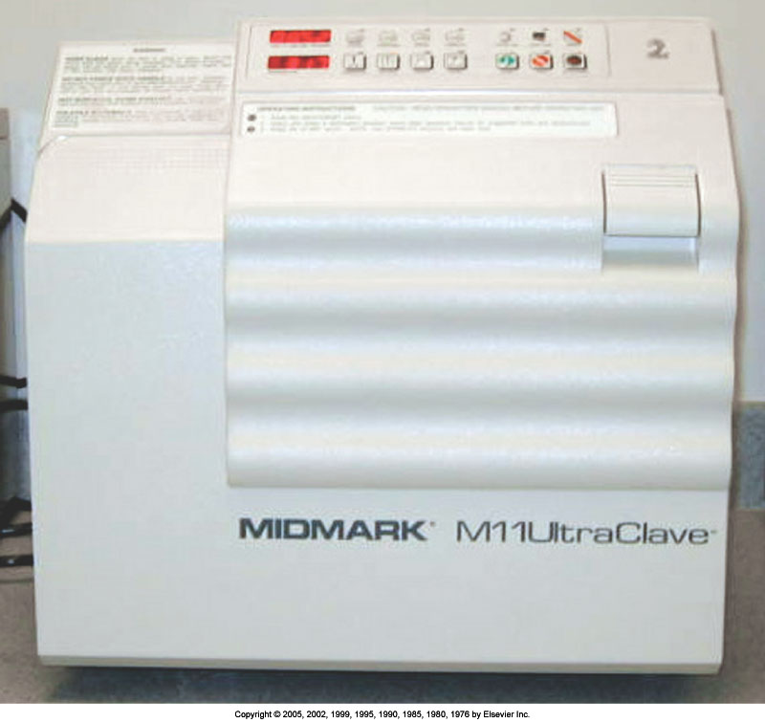
Steam autoclave.
Notes:
47
It is important to read the manufacturer’s guidelines before using an autoclave.
Different autoclaves will reach the proper temperature at different rates.
The recommended time of exposure to the temperature required for sterilization does not include the time it takes for the autoclave to reach the proper temperature.
Additional time is needed to allow depressurization of the chamber once the cycle has been completed.

Slide 48
Steam Autoclave Sterilization
(Cont’d)
Packaging material for steam sterilization must be porous enough to permit the steam to penetrate to the instruments inside.
The packaging material may be fabric but most often is sealed film or paper pouches, nylon tubing, sterilizing wrap, or paper-wrapped cassettes.
One disadvantage of steam sterilization is that the moisture may cause corrosion on some high-carbon steel instruments.
Distilled water should be used in autoclaves instead of tap water, which often contains minerals and impurities. Distilled water helps minimize corrosion and pitting.
Notes:
48
Proper maintenance of the autoclave is important.
Remember, allow the autoclave to complete the dry and cooldown cycles. The dry cycle will help prevent rust and corrosion of instruments, and the cooldown cycle will help prevent burn injury to the dental assistant.
Which bacterium discussed in Chapter 18 is found in water-distillation systems?

Slide 49
Autoclave Operation Cycles
Dental-office steam sterilizers usually operate in four cycles:
  Heat-up
  Sterilization
  Depressurization
  Drying
Notes:
49
The sterilization cycle involves the use of steam in a pressurized chamber, although it is the heat, not the pressure, that actually kills the microorganisms.
The usual recommended duration of action and temperature of a steam sterilizer is 121º C (250° F) at a pressure of 15 or 30 psi for 20 minutes.

Slide 50
Chemical-Vapor Sterilization
Chemical-vapor sterilization is similar to autoclaving, except that a combination of chemicals (alcohol, formaldehyde, ketone, acetone, and water) is used instead of water to create a vapor for sterilization.
Notes:
50
It is recommended that chemical solutions prepared by the manufacturer be used in the chemical-vapor sterilizer. Adequate chemical levels must also be maintained.
Sealed containers and aluminum foil should not be used in the chemical-vapor sterilizer.

Slide 51
Advantages of Chemical-Vapor Sterilization
The major advantage of the chemical-vapor sterilizer is that it does not rust, dull, or corrode dry metal instruments.
The low water content of the vapor prevents destruction of items such as endodontic files, and burs.
A wide range of items can be sterilized routinely without damage.
Other advantages include the short cycle time and the availability of a dry instrument after the cycle.
Notes:
51
Chemical-vapor sterilizers are as easy to use as steam sterilizers.

Slide 52
Disadvantages of Chemical-Vapor Sterilization
The primary disadvantage is that adequate ventilation is essential because residual chemical vapors containing formaldehyde and methyl alcohol may be released when the chamber door is opened at the end of the cycle.
These vapors can temporarily leave an unpleasant smell in the area and may be irritating to the eyes.
Notes:
52
Leakage of chemical vapors into the dental office can pose health risks to dental-care workers and patients.
Another disadvantage of the chemical-vapor sterilizer is the cost of the chemicals.

Slide 53
Pressure, Temperature, and Duration of Chemical-Vapor Sterilization
The three major factors in chemical-vapor sterilization are:
  Pressure, which should measure 20 psi
  Temperature, which should measure
  131° C (270° F)
  Time, which should measure 20 to 40 minutes
Notes:
53
What does “psi” stand for? (Pounds per square inch.)
If the proper pressure, temperature, and time are achieved during use of the chemical-vapor sterilizer, is it safe to assume that all microorganisms have been destroyed?

Slide 54
Dry-Heat Sterilization
Dry-heat sterilizers operate by heating up air and transferring that heat from the air to the instruments.
This form of sterilization requires higher temperatures than does steam or chemical-vapor sterilization.
Dry-heat sterilizers operate at approximately 160° to 190° C (320°-375° F) for 1-2 hours, depending on the type of sterilizer.
The advantage of dry heat is that the instruments will not rust if they are thoroughly dry before being placed in the sterilizer.
There are two types of dry-heat sterilizers: static-air and forced-air.
Notes:
54
It is important to use packaging materials designed for use in a dry-heat sterilizer.
Which packaging materials are acceptable for use in a dry-heat sterilizer?
Do not sterilize plastic items or adhesive tape in a dry-heat sterilizer.

Slide 55
Static-Air Sterilizers
The static-air sterilizer is similar to an oven: The heating coils are on the bottom of the chamber, and the hot air rises inside by way of natural convection.
Heat is transferred from the static (nonmoving) air to the instruments in 1 to 2 hours.
Disadvantages of static dry heat: The sterilization process is time-consuming, and it may not be effective if the operator errs in calculating the correct processing time.
The wrapping material must be heat-resistant. Aluminum foil, metal, and glass containers may be used. Paper and cloth packs should be avoided because they may burn or discolor in the intense heat.
Notes:
55
The dental office will need to have a large instrument inventory if this method of sterilization is used. Why?

Slide 56
Forced-Air Sterilizers
The forced-air sterilizer, also called the rapid-heat-transfer sterilizer, circulates the hot air throughout the chamber at a high velocity.
This action permits rapid transfer of heat energy from the air to the instruments, reducing the time needed for sterilization.
Exposure time in a forced-air sterilizer, after the sterilizing temperature has been reached, ranges from 6 minutes for unpackaged items to 12 minutes for packaged items.
Notes:
56
What makes the forced-air dry-heat sterilizer desirable for flash sterilization? (The short sterilization-cycle, 6 to 12 minutes, permits rapid sterilization when an instrument is needed quickly.)

Slide 57
Ethylene Oxide Sterilization
The use of ethylene oxide gas is a recognized method of sterilization. This method is carried out at low temperatures, which is an advantage for plastic and rubber items that would melt in heat sterilizers.
However, ethylene oxide sterilization requires 4 to 12 hours, depending on the sterilizer model, and at least 16 hours of poststerilization aeration is required to remove the gas molecules bound to plastic and rubber surfaces.
Ethylene oxide is ineffective on wet items. Toxicity is possible if the gas is not handled properly.
Ethylene oxide sterilizing units are often used in large clinics or hospital settings but are only rarely found in private dental practices.
Notes:
57
This method of sterilization is not common in dental offices.
Proper ventilation is required.
The equipment needed is often large and costly.
Toxicity is a problem, along with the time required for completion of the sterilization process.

Slide 58
Chemical-Liquid Sterilization
Not all items can withstand heat sterilization. Some types of plastics, such as some rubber dam frames, shade guides, and x-ray film–holding devices, are damaged by heat sterilization.
A liquid sterilant such as 2.0% to 3.4% glutaraldehyde must be used for sterilization of these items.
Sterilization in glutaraldehyde requires 10 hours of contact time; anything less than 10 hours is disinfection, not sterilization.
Notes:
58
Sterilization in glutaraldehyde is very time-consuming. The extended time required means that instruments may be unavailable for use for long periods.
What is another disadvantage of using glutaraldehyde?

Slide 59
Sterilization Failures
Sterilization may fail when direct contact for the correct time between the sterilizing agent (chemical or steam) and all surfaces of the items being processed is insufficient.
Several factors can cause the sterilization process to fail, including improper instrument cleaning or packaging and sterilizer malfunction.
Notes:
59
What is the best way to determine whether sterilization failure has occurred?
Can a system of physical monitoring or chemical monitoring be used to measure the success of the sterilization process?

Slide 60
Sterilization Monitoring
It is critical that dental instruments be properly sterilized.
  Because microorganisms cannot be seen with the naked eye, the major difficulty in sterilization is determining
  when an item is sterile.
Currently, three forms of sterilization monitoring are used: physical, chemical, and biologic.
  All three processes are unique, have different functions, and must be used consistently to ensure sterility.
Notes:
60
Today, more scientific monitoring systems are used, such as physical, chemical, and biologic systems.
The monitoring of these systems should be documented and records should be maintained in the log book kept in the processing area.

Slide 61
Physical Monitoring
Physical monitoring of the sterilization process involves looking at the gauges and readings on the sterilizer and recording temperatures, pressure, and exposure time.
Although correct readings do not guarantee sterilization, an incorrect reading is the first signal of a problem.
For this reason, problems with overloading or improper packaging would not be revealed by the reading on the gauges.
Notes:
61
Periodically after the start of the sterilizer the dental assistant should return to the processing area to check the gauges outside the sterilizer for accurate time, pressure, and temperature readings.
Why does overloading the sterilizer affect the temperature inside the instrument package?

Slide 62
Chemical Monitoring
Chemical monitoring (external and internal) involves the use of a heat-sensitive chemical that changes color when exposed to certain conditions.
There are two types of chemical indicators:
  Process indicators
  Process integrators
Notes:
62
Chemical indicators allow the dental team to determine that certain necessary parameters have been met.
Chemical indicators should be used with every package of instruments in the sterilizer; one indicator per load is not adequate.

Slide 63
Biologic Monitoring
Biologic monitoring, or spore testing, is the only way to determine whether sterilization has occurred and all bacteria and endospores have been killed.
The CDC, American Dental Association, and Office of Safety and Asepsis Procedures Research Foundation recommend at least weekly biologic testing of sterilization equipment.
Notes:
63
What are some additional reasons to use biologic monitoring?

Slide 64
Biologic Indicators
Also known as spore tests, biologic indicators (BIs) are vials or strips of paper that contain harmless bacterial spores (which are highly resistant
to heat).
Three BIs are used in testing. Two BIs are placed inside instrument packs, and the sterilizer is operated under normal conditions. The third strip is set aside as a control.
After the load has been sterilized, all BIs are cultured. If the spores survive the sterilization cycle (a positive culture), sterilization failure has occurred.
If the spores are killed (a negative culture), the sterilization cycle was successful.
The culturing of the spore test is usually handled with the use of a mail-in monitoring service.
Notes:
64
The spores used to test steam sterilizers are different than those used to test chemical-vapor sterilizers, as well as the bacteria used to test dry-heat and ethylene oxide sterilizers.
What would be the best way to check the BI if you use different sterilization methods in your office and to avoid placing the wrong BI into the wrong sterilizer? (Use dual-species BIs.)

Slide 65
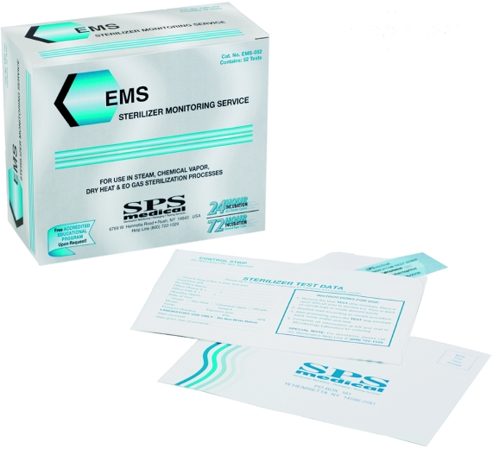
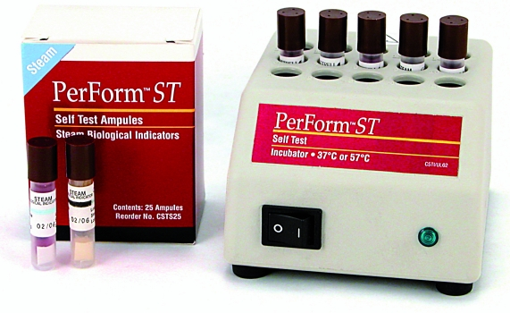
Use of a mail-in service is a convenient method of biologic monitoring
In-office biologic monitoring system
Notes:
65
All monitoring results and reports must be logged in the log book kept in the processing area.
Can you think of an advantage of using the in-office culturing system?
Can you think of a disadvantage of using the in-office culturing system?

Slide 66
Rationale of endodontic treatment

Slide 67
INTRODUCTION
The term “Rationale” can be defined as the fundamental reason or the justified basis for a procedure.
The rationale for endodontic therapy is based on the belief that a natural tooth function more efficiently and comfortably than a bridge, partial denture or an implant tooth.
Endodontic therapy allows the removal of vital or necrotic pulp from the canal system of an infected tooth and replaced by an inert filling material.

Slide 68
INFLAMMATION
Defined as a local physiologic reaction of the body to noxious stimuli or irritants.
OBJECTIVE: to remove or destroy the irritant & to repair damage to the tissue.

Slide 69
  Functions of Inflammation
  1. Destroy and remove pathogens
  2. If destruction is not possible, to limit effects by confining the pathogen and its products.
  3. Repair and replace tissue damaged by pathogen and its products.

Slide 70
SYMPTOMS OF INFLAMMATION-
1. Dolor (Pain): Caused by the action of cytotoxic agents released from humoral, cellular and microbial elements of the nerve endings.
2. Tumor (Swelling): Produced by infiltration of macromoleculars and fluids into the affected tissues.
Rubor (Redness)
4. Calor (Heat): Produced by vasodilatation of the vessels and the rushing of blood to the affected tissues.
5. Loss of function: was later added by Virchow resulting of from changes in the affected tissues.

Slide 71
In the dental pulp & periradicular tissues, inflammation may be – Acute or Chronic.
Main cells of Acute inflammatory lesion-
Polymorphonuclear leukocytes.
Cells of Chronic inflammatory lesion –
Lymphocytes
Plasma cells
Monocytes
Macrophages.

Slide 72
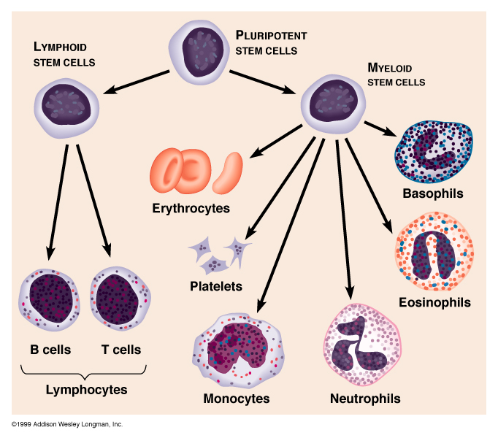
Phagocytic Cells: Macrophages (Monocytes), Neutrophils, and Eosinophils
(Macrophages)

Slide 73
POLYMORPHONUCLEAR LEUKOCYTES:
1. Their cells constitute 40-75% of Leucocytes.
2. Seen in acute inflammation.
3. They contain:
a. Nucleus having 2-4 lobes, which is connected.
b. Cytoplasm containing characteristic violet pink granules.
1. These cells get attached to the area of inflammation by chemotactic factors produced by bacteria or the complement system.
2. They then allow the binding of opsonised bacteria onto this surface.

Slide 74
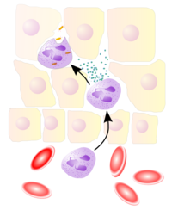
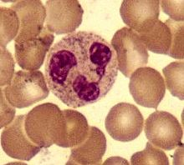

Slide 75
3.In the binding sites the bacteria are encapsulated into the neutrophils where lysosomal enzymes are released that kill the bacteria.
4. These PMNs have a narrow range of life. They are destroyed in the inflammatory site when the pH of the tissues falls to 6.5.
5. This change in pH is brought about due to the release and production of lactic acid by the neutrophil during phagocytosis.

Slide 76
6. Destruction of the PMN’s also cause the release of 2 proteolytic enzymes.
  Pepsin
  Cathepsin
These enzymes result in tissue lysis.
1. The PMN’s with the products of cellular lysis and debris are principal constituents of pus.

Slide 77
MACROPHAGES:
1. These cells are derived from circulating monocytes.
a. Macrophages are phagocytic cells that ingest cellular debris, microorganisms & particulate matter
b. They release mediation of inflammation such as lysosomal enzymes, complement proteins and prostaglandins.
c. They enhance the immunological reaction by ingesting processing and degrading the antigen before presenting it to the lymphocytes.

Slide 78
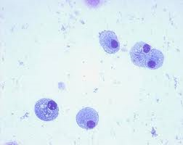
d. Their capacity to remove debris from area facilitates repair.

Slide 79
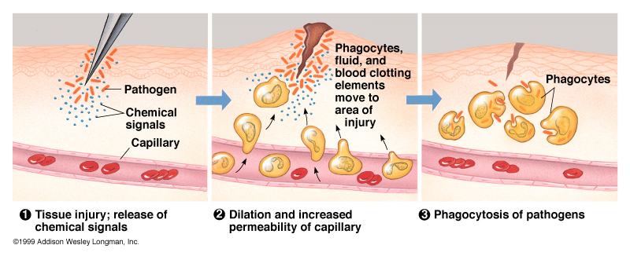
Phagocytes are Attracted to Site of Infection by Chemotaxis

Slide 80
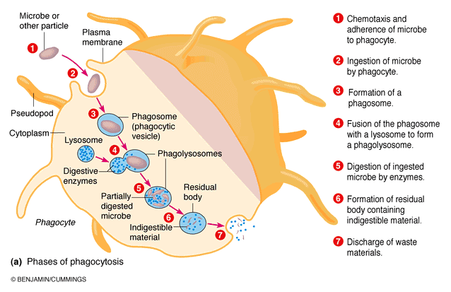
Process of Phagocytosis

Slide 81
LYMPHOCYTES:
These cells appear in the chronic stage of inflammation.
They have a large, spherical nucleus surrounded by thin band of granular cytoplasm.
2 types :
B cells
T cells
B cells become immunocompetent in bone marrow while T cells in thymus.
T cells are responsible for cell mediated immunity

Slide 82
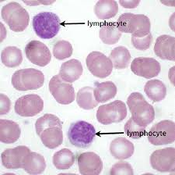
lymphocytes

Slide 83
When T cells are stimulated by an antigen, they show following immunologic manifestations:
a) Memory T-cells – Speed up immunological reaction when in contact with same antigen.
b) Helper or suppressor cells– stimulate or suppress the development of effects T or B cells.
c) Effector T cells – produce cell mediated immune reaction such as delayed hypersensitivity.
Cells release chemical mediations known as lymphokines which activate Macrophages ,PMNs & produce interferon which inhibits viral replication.

Slide 84
When B cells are activated by an antigen, they become larger cells called Plasmablasts.
These cells divide to form Plasma cells & Memory B cells.
The memory B cells speed up the immunologic reaction.
The plasma cells produce immunoglobulins – IgM, IgG, IgA, IgD & IgE.
These cause:
Neutralization of bacterial toxins by antitoxins.
Opsonization to facilitate phagocytosis.
Lysis of bacteria by complement activation.
Agglutination of bacteria.

Slide 85
EOSINOPHILS, BASOPHILS & MAST CELLS
Eosinophils arte found in allergic & parasitic reactions
During immune response they are involved in phagocytosis & detoxification of histamines.
Basophils & mast cells contain granules which when stimulated by antigen, degranulate & release chemical mediators:
Histamine, a vasodilator
Heparin, an anticoagulant
These initiate an inflammatory response.

Slide 86
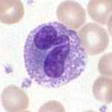
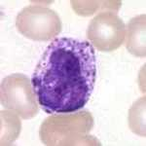
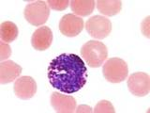

Slide 87
PERIRADICULAR MANIFESTATIONS
If the inflammatory response overwhelms the pulp, there is partial or total necrosis of the pulp in the root canal.
This serves as a pathway to the periradicular area for the noxious products of tissues necrosis and antigenic agents.
The inflammatory and immunologic reaction continue in the periradicular area as in pulp.
In the periradicular area the noxious products cause bone resorption & granulation tissue.
The affected tissue contains neutrophils, lymphocyte, plasma cells, macrophages, mast cells.

Slide 88
Also it contains immunoglobulins IgG, IgA, IgM, IgE and complement.
These may lead to anaphylactic, cytotoxic, antigen-antibody complex & delayed hypersensitivity reactions in periradicular tissues.
Reports indicate that-
Some endodontic flare -ups are mediated by IgE reactions
Bone resorption is mediated by lymphokine called ostoelastic activating factor.
These findings show that immunology plays an important role in the physiology, and pathology of the periradicular tissue.

Slide 89
TISSUE CHANGES FOLLOWING INFLAMMATION
Tissue changes following inflammation:
1. Degenerative
2. Proliferative
1. DEGENERATIVE CHANGES
i. Fibrous
ii. Resorptive
iii. Calcific
If the degeneration continues, necrosis occurs.

Slide 90
Another form of degeneration is Suppuration.
Injured PMNs release proteolytic enzymes with resulting liquifaction of the dead tissue.
This is known as Suppuration or formation of pus.
3 requisites for suppuration:
Necrosis of tissue cells.
Sufficient no. of PMNs
Digestion of dead materials by proteolytic enzymes.

Slide 91
PROLIFERATIVE CHANGES:
These are produced by irritants mild enough to act as a stimulant.
Within an area, a substance may be both irritant and a stimulant.
e.g. Ca(OH)₂ in the center of inflammatory area may act as an irritant strong enough the produce regeneration or destruction where as at the periphery it may be mild enough to stimulate proliferation.
When a gap is present between tissue parts, repair is made by granulation tissue.

Slide 92
The principal cells of repair are the fibroblasts which lay down cellular fibrous tissue.
Fibrous repair is the result even if, in some cases, collagen fibre is substituted by dense acellular tissue.

Slide 93
ENDODONTIC IMPLICATIONS
Fish described the reaction of periradicular tissues to noxious products of tissue necrosis, bacterial products, and antigenic agents from the root canal.
He established an experimental foci of injection, which he described as 4 zones.
Four zones of reaction are
1. Zone of infection
2. Zone of contamination
3. Zone of irritation
4. Zone of stimulation

Slide 94
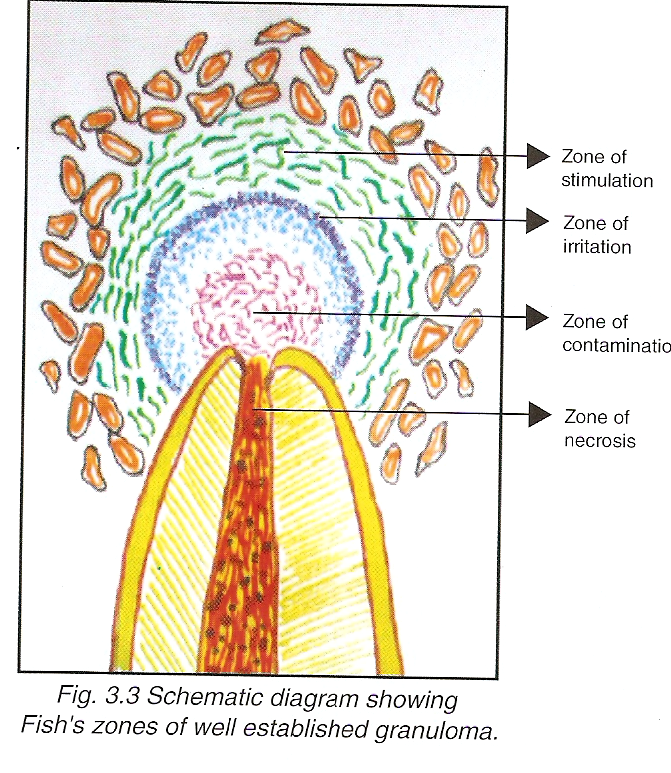

Slide 95
ZONE OF INFECTION
In Fish’s study, Infection was present in the center of the lesion & microorganisms are present only in that area.
2. Characterized by polymorphoneuclear leukocytes.
Micro-organisms are attacked by these leukocytes.
The only microorganisms not attacked by leukocytes are found in the Haversian canals or in the fissures of bone matrix made by bur.

Slide 96
ZONE OF CONTAMINATION
This zone is characterized by round cell infiltration.
Fish observed cellular distortion around the central zone from toxins discharged from the central zone.
Bone cells die and undergo Autolysis, thus the lacunae appear empty as opposed to that of the central zone.
Lymphocytes are prevalant everywhere.

Slide 97
ZONE OF IRRITATION
Characterized by macrophages & osteoclasts.
Fish found evidence of irritation from the central lesion as the toxins became more diluted.
The collagen framework was digested by phagocytic cells –macrophages while osteoclasts attacked the bone tissue.

Slide 98
ZONE OF STIMULATION:
Characterized by fibroblasts & osteoblasts.
At the periphery toxin was mild enough to be a stimulant.
In response, Collagen fibres are laid down by fibroblast which act as-
a. Wall of defence around zone of irritation.
b. Scaffolding on which osteoblasts lays new bone.
This new bone is irregular in pattern.

Slide 99
conclusion
The root canal is a site of infection.
The microorganisms from the root canal can multiply sufficiently enough to grow out of the root canal.
As the microorganisms gain entry into the periradicular area they are destroyed by the leukocytes.
This results in chronic abscess.
The toxic products of microorganisms and the necrotic pulp in the root canal acts as irritants and destroy the periradicular tissues along with proteolytic enzymes resulting in pus formation.

Slide 100
At the periphery of the lesion there is stimulation of fibroblasts to build the fibrous tissues and osteoblasts to limit the area with a wall of sclerotic bone.
This happens because of dilution of toxic products, which acts as a stimulant.
If in addition the epithelial cell rests of mallesez are stimulated, a cyst develops.
Once the root canal has been treated and the reservoir of bacteria or noxious products has been eliminated and the root canal thoroughly obturated the destroyed periapical bone undergoes repair.

Slide 101
REFERENCES
Textbook of Endodontics – GROSSMAN 12th Edition
Textbook of Endodontics – Ingle’s 6th Edition.
www.pdf-txt.com/principles-of-endodontic-treatment

Slide 102
Thank you

