Slide 1
FUNDAMENTALS OF TOOTH PREPARATION

Slide 2
TOOTH PREPARATION
Tooth preparation is defined as the mechanical alteration of a defective, injured, or diseased tooth such that placement of a restorative material re-establishes normal form and function, including esthetic corrections where indicated.

Slide 3
CONVENTIONAL PREPARATION
Conventional preparations require speciﬁc wall forms, depths, and marginal forms because of the properties of the restorative material. Eg- amalgam, cast metal, and ceramic restorations .

Slide 4
Modified Preparation -
The use of adhesive restorations, primarily composites and glass ionomers, has allowed a reduced degree of precision of tooth preparations. Many composite restorations may require only the removal of the defect (caries, fracture, or defective restorative material) and friable tooth structure for tooth preparation, without speciﬁc uniform depths, wall designs, retentive features or marginal forms.

Slide 5
The fundamental concepts relating to conventional and modiﬁed tooth preparation are the same:
All unsupported enamel tooth structures are normally removed.
Fault, defect, or caries is removed.
Remaining tooth structure is left as strong as possible.
Underlying pulpal tissue is protected.
Restorative material is retained in a strong, esthetic (whenever possible), and functional manner.

Slide 6
Objectives of Tooth Preparation
Remove all defects and provide necessary protection to the pulp.
Extend the restoration as conservatively as possible.
Prepare the tooth so that under the forces of mastication, the tooth or the restoration (or both) will not fracture and the restoration will not be displaced.
Allow for the esthetic and functional placement of a restorative material.

Slide 7
General Factors
DIAGNOSIS -
A careful examination must be performed and following factors would inﬂuence in determining an accurate diagnosis and to render subsequent appropriate treatment.

Slide 8
KNOWLEDGE OF DENTAL ANATOMY
The following factors all must be considered to facilitate appropriate tooth preparation:
Direction of the enamel rods
Thickness of enamel and dentin
Size and position of the pulp
Relationship of the tooth to its supporting tissues.

Slide 9
PATIENT FACTORS
The patient’s esthetic concerns, economic status, medical condition, and age should be taken into consideration when selecting the various restorative materials to be used in a given procedure.

Slide 10
CONSERVATION OF TOOTH STRUCTURE
Every effort should be made to create restorations that are as conservative as possible. smaller the tooth preparation is, the stronger will be the remaining unprepared tooth structure.

Slide 11
Affected and Infected Dentin
In tooth preparation, it is desirable that only infected dentin be removed, leaving affected dentin, which may be remineralized in a vital tooth after the completion of restorative treatment.
Infected dentin has bacteria present, and collagen is irreversibly denatured. It is not remineralizable and must be removed.
Affected dentin has no bacteria, and the collagen matrix is intact, is remineralizable, and should be preserved.
To clinically distinguish these two layers, the operator observes the degree of discoloration (extrinsic staining) and tests the area for hardness by the feel of an explorer tine or a slowly revolving bur.

Slide 12
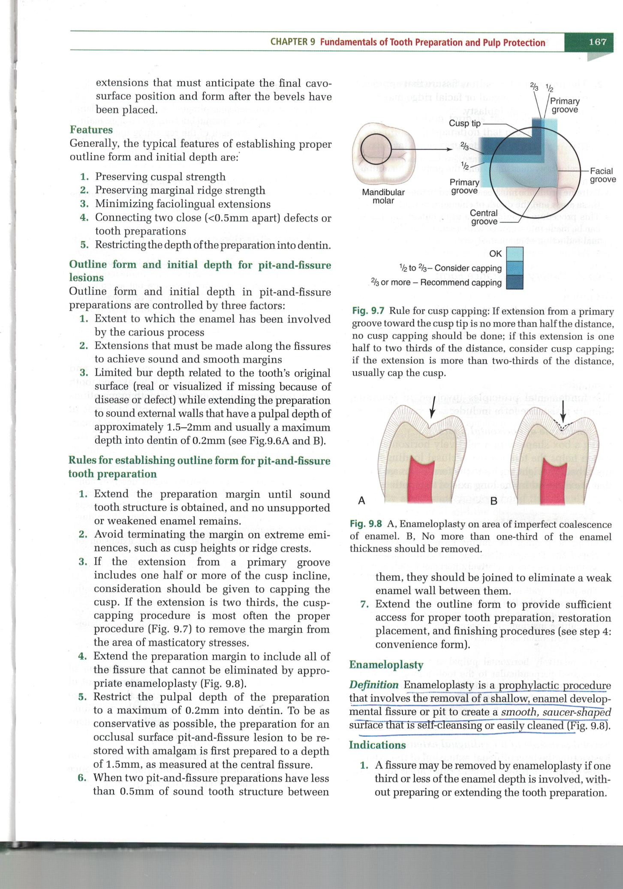
Enameloplasty
Enameloplasty is a prophylactic procedure that involves the removal of a shallow, enamel developmental ﬁssure or pit to create a smooth, saucer-shaped surface that is self-cleansing or easily cleaned.
Indications -1. A ﬁssure may be removed by enameloplasty if one third or less of the enamel depth is involved, with-out preparing or extending the tooth preparation.
2. The presence of a shallow ﬁssure that approaches or crosses a lingual or facial ridge may be removed by enameloplasty.

Slide 13
Restorative Material Factors
The choice of restorative-material affects the tooth preparation and is made by considering many factors.
The ability to isolate the operating area and the extent of the lesion or defect are factors that the operator must consider in presenting material options to the patient.

Slide 14
Tooth Preparation Terminology
Simple, Compound, and Complex Tooth Preparations -
A tooth preparation is termed simple if only one tooth surface is involved, compound if two surfaces are involved, and complex if a preparation involves three or more surfaces.

Slide 15
Abbreviated Descriptions of Tooth Preparations
For records and communication, the description of a tooth preparation is abbreviated as follows-
1. An occlusal tooth preparation is an ‘O’
2. A preparation involving the mesial and occlusal surfaces is a ‘MO’
3. A preparation involving the mesial, occlusal, and distal surfaces is an ‘MOD

Slide 16
Tooth Preparation Walls
1. Internal wall-
The internal wall is the prepared surface that does not extend to the external tooth surface.
2. Axial wall-
The axial wall is the internal wall parallel to the long axis of the tooth.
3. Pulpal wall (floor)-
The pulpal wall is the internal wall that is perpendicular to the long axis of the tooth and occlusal of the pulp.

Slide 17
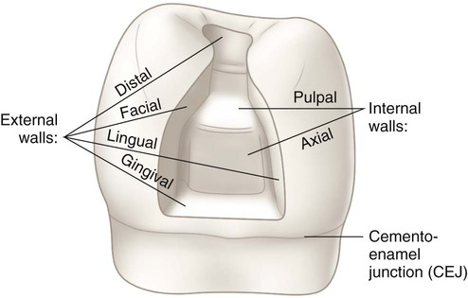
4. External wall-
The external wall is the prepared surface that extends to the external tooth surface.
5. Floor (or seat]-
The ﬂoor (or seat) is the prepared wall that is horizontal and perpendicular to the occlusal forces that are directed occlusogingivally. Eg- pulpal and gingival floors.
The external and internal walls (floors)

Slide 18
Tooth Preparation Angles
The junction of two or more prepared surfaces is referred to as an angle.
LINE ANGLE -
A line angle is the junction of two planar surfaces of different orientation along a line.
An internal line angle is the line angle whose apex points into the tooth.
The external line angle is the line angle whose apex points away from the tooth.

Slide 19
POINT ANGLE-
The point angle is the junction of three planal surfaces of different orientation.
CAVOSURFACE ANGLE AND CAVOSURFACE MARGIN -
The cavosurface angle is the angle of tooth structure formed by the junction of a prepared wall and the external surface of the tooth. The actual junction is referred to as cavosurface margin.

Slide 20
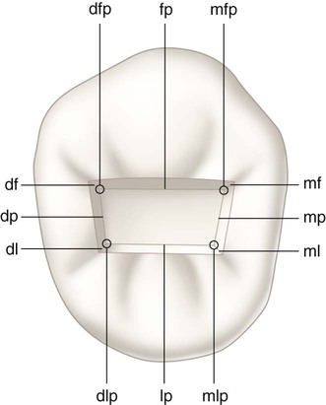
Schematic representation (for descriptive purpose) illustrating tooth preparation line angles and point angles. Line angles are faciopulpal (fp), distofacial (df), distopulpal (dp), distolingual (dl), linguopulpal (lp), mesiolingual (ml), mesiopulpal (mp), and mesiofacial (mf). Point angles are distofaciopulpal (dfp), distolinguopulpal (dlp), mesiolinguopulpal (mlp), and mesiofaciopulpal (mfp).

Slide 21
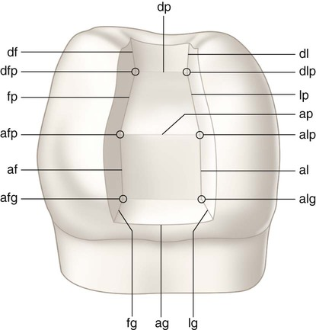
Schematic representation (for descriptive purpose) illustrating tooth preparation line angles and point angles. Line angles are distofacial (df), faciopulpal (fp), axiofacial (af), faciogingival (fg), axiogingival (ag), linguogingival (lg), axiolingual (al), axiopulpal (ap), linguopulpal (lp), distolingual (dl), and distopulpal (dp). Point angles are distofaciopulpal (dfp), axiofaciopulpal (afp), axiofaciogingival (afg), axiolinguogingival (alg), axiolinguopulpal (alp), and distolinguopulpal (dlp).

Slide 22
Classiﬁcation
Black’s Classiﬁcation- According to the diseased anatomic
areas involved and by the associated type of treatment.
1. Class I Preparations -
All pit-and-ﬁssure preparations are termed class I.
These include preparations on:
1. Occlusal surfaces of premolars and molars
2. Occlusal two-thirds of the facial and lingual surfaces of molars
3. Lingual surfaces of maxillary incisors.

Slide 23
2. CLASS II PREPARATIONS -
Preparations involving the proximal surfaces of posterior teeth are termed class II.
3. CLASS III PREPARATIONS-
Preparations involving the proximal surfaces of anterior teeth that do not include the incisal angle are termed class III.
4. CLASS IV PREPARATIONS-
Preparations involving the proximal surfaces of anterior teeth that include the incisal edge are termed class IV.

Slide 24
5. CLASS V PREPARATIONS-
Preparations on the gingival third of the facial or lingual surfaces of all teeth are termed class V.
6. CLASS VI PREPARATIONS-
Preparations on the incisal edges of anterior teeth or the occlusal cusp tips of posterior teeth are termed class VI.

Slide 25
Steps of tooth preparation
I- INITIAL TOOTH PREPARATION STAGE
Step 1: Outline form and initial depth
Step 2: Primary resistance form
Step 3: Primary retention form
Step 4: Convenience form
II- FINAL TOOTH PREPARATION STAGE
Step 5: Removal of any remaining infected dentin or old restorative material (or both), if indicated
Step 6: Pulp protection, if indicated
Step 7: Secondary resistance and retention forms
Step 8: Procedures for ﬁnishing external walls
Step 9: Final procedures—cleaning, inspecting, desensitizing

Slide 26
Step 1: Outline Form and Initial Depth
Deﬁnition - Establishing the outline form means:
1. Placing the preparation margins in the positions they will occupy in the final preparation except for ﬁnishing enamel walls and margins.
2. Preparing an initial depth of 0.2—O.5mm pulpally of the DE] position or 0.8mm pulpally to normal root-surface position (no deeper initially whether in the tooth structure, air, old restorative material, or caries unless the occlusal enamel thickness is minimal, and greater dimension is necessary for the strength of the restorative material.

Slide 27
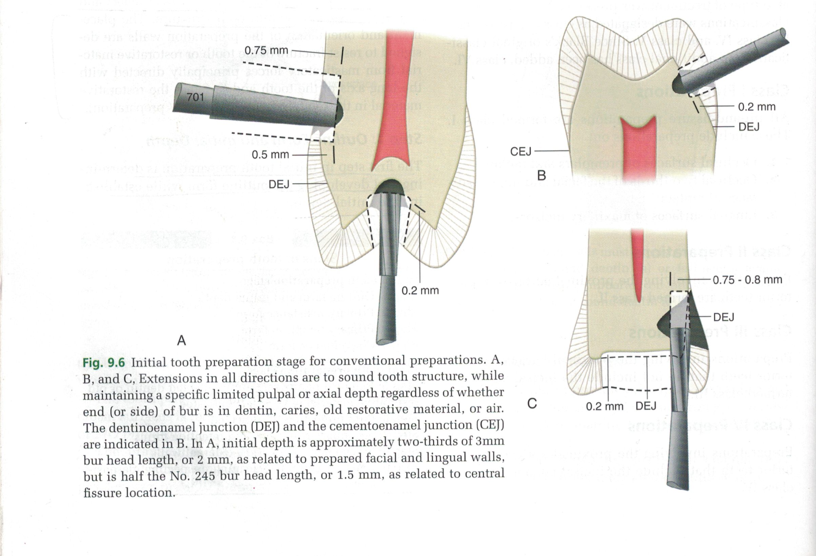

Slide 28
PRINCIPLES-
1. All unsupported or weakened (friable) enamel usually should be removed.
2. All faults should be included.
3. All margins should be placed in a position to allow finishing of the margins of the restoration.

Slide 29
Features-
Generally, the typical features of establishing proper outline form and initial depth are:
Preserving cuspal strength
Preserving marginal ridge strength
Minimizing faciolingual extensions
Connecting two close (<0.5mm apart) defects or tooth preparations
Restricting the depth of the preparation into dentin.
Outline form and initial depth for pit-and-ﬁssure lesions.

Slide 30
Step 2: Primary Resistance Form
Deﬁnition -
Primary resistance form may be deﬁned as the shape and placement of the preparation walls that best enable the remaining tooth structure and the restoration to withstand, without fracture, masticatory forces delivered principally along the long axis of the tooth.

Slide 31
PRINCIPLES-
1. First principle of horizontal ﬂoors- Using a box shape with a relatively horizontal floor helps the tooth resist occlusal loading by being at right angles to the forces of mastication that are directed in the long axis of the tooth.
It helps to resist forces in the long axis of the tooth and prevent tooth fracture from wedging effects caused by opposing cusps.

Slide 32
2. Second principle of buccolingual extension -
Restricting the buccolingual extension of the external walls to allow strong cusp and ridge areas to remain with sufﬁcient dentin support.
3. Third principle of rounded line angles -
Slight rounding of internal line angles to reduce stress concentrations in tooth structure.
Internal and external angles are slightly rounded so that stresses in the tooth and restoration from masticatory forces are not concentrated at these line angles.

Slide 33
4. Fourth principle of cusp capping -
Reducing and covering (capping) weak cusps prevents fracture of the tooth by forces directed along the long axis and obliquely (laterally) directed forces.
Cusp reduction should be considered when
1. the outline form has extended half the distance from a primary groove to a cusp tip
2. when the outline form has extended two-thirds the distance from a primary groove to a cusp tip.

Slide 34
5. Fifth principle of restorative material thickness
It is critical to provide sufficient bulk to the restorative material to be able to withstand the masticatory load.
The minimal occlusal thickness for appropriate resistance to fracture is as follows:
For amalgam: 1.5 mm
For cast metal: 1-2mm (depending on the region)
For ceramics: 2 mm
For composites: 1mm (occlusal non contact areas) ,

Slide 35
6. Sixth principle of bonding to the tooth
Amalgam and cast metal restorations need precise tooth preparations, which would inevitably remove some amount of sound tooth structure. Hence, adhesive restorations that bond the restoration to the tooth and which would require minimal tooth loss, should be preferred whenever the clinical indication is appropriate.

Slide 36
Features of Primary resistance form-
Relatively horizontal ﬂoors
Box-like shape
Inclusion of weakened tooth structure
Preservation of cusps and marginal ridges
Rounded internal line angles
Adequate thickness of restorative material
Reduction of cusps for capping, when indicated.

Slide 37
Step 3: Primary Retention Form
Deﬁnition -
Primary retention form is the shape or form of the conventional preparation that prevents displacement or removal of the restoration by tipping or lifting forces for non-bonded restorations.

Slide 38
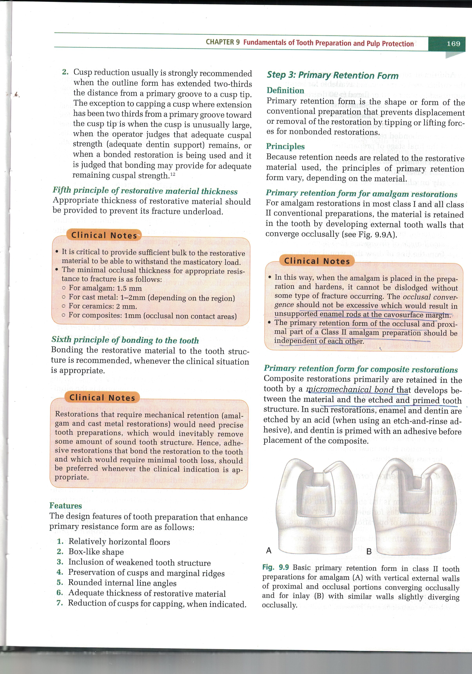
Principles
1. Primary retention form for amalgam restorations
For amalgam restorations in most class I and all class II conventional preparations, the material is retained in the tooth by developing external tooth walls that converge occlusally (see Fig)
The occlusal convergence should not be excessive which would result in unsupported enamel rods at the cavosurface margin.
CONVERGENT WALLS
VERTICAL WALLS

Slide 39
2. Primary retention form for composite restorations
Composite restorations primarily are retained in the tooth by a Micromechanical bond that develops between the material and the etched and primed tooth structure.

Slide 40
3. Primary retention form for cast metal restorations –
Cast metal intracoronal restorations rely primarily on almost parallel vertical walls to provide primary retention of the casting in the tooth. Or small angle of divergence 2-5⁰.
In class II preparations involving only one of the two proximal surfaces, an occlusal dovetail may aid in preventing the tipping of the restoration by occlusal forces.
The other primary retention form for cast metal restorations is the use of a luting agent that bonds the restoration to the tooth structure.

Slide 41
Step 4: Convenience Form
Definition-
Convenience form is the shape or form of the preparation the provides for adequate observation , accessibilty and ease of operation in preparing and restoring the tooth.
Obtaining this form may necessitate the extension of distal, mesiall, facial or lingual walls to gain adequate access to deeper portions of the preparation.
The occlusal divergence of vertical walls of tooth preparations for class II cast restorations also may be considered convenience form.
Extending proximal preparations beyond proximal contacts is another convenience form procedure.

Slide 42
Step 5: Removal of Any Remaining Enamel Pit or Fissure, Infected Dentin, or Old Restorative Material, Indicated
Deﬁnition
Removal of any remaining enamel pit or ﬁssure, infected dentin, or old restorative material is the elimination of any infected carious tooth structure or faulty restorative material left in the tooth after initial tooth preparation.
When a pulpal or axial wall has been established at the proper initial tooth preparation position, and a small amount of infected carious material remains, only this material should be removed, leaving a rounded, concave area in the wall. Ideally, removal of infected dentin should continue until the remaining dentin hardness approaches that of normal dentin.

Slide 43
Step 6: Pulp Protection, if Indicated
Pulpal irritation that occurs during or after operative procedures may result from:
Heat generated by rotary instruments
Some ingredients of various materials
Thermal changes conducted through restorative materials
Forces transmitted through materials to the dentin
Galvanic shock
Ingress of noxious products and bacteria through microleakage

Slide 44
Pulp protection can be provided by-
1. Use of liners
A liner is used to medicate the pulp when suspected pulpal inﬂammation has occurred. The desired pulpal effects include sedation and stimulation, the latter resulting in reparative dentin formation.
Liners may also provide:
A barrier that protects the dentin from noxious agents
Initial electrical insulation
Some thermal protection.
Liners may include suspensions or dispersions of calcium hydroxide, zinc oxide, or resin-modiﬁed glass ionomer (RMGI) that can be applied to a tooth surface in a relatively thin ﬁlm.
If the excavation extends into or within 0.5mm of the pulp, a calcium hydroxide liner usually is selected to stimulate reparative dentin (indirect pulp cap procedure).
Calcium hydroxide liners must always be covered with an RMGI to prevent dissolution of the liner over time when used under amalgam restorations.

Slide 45
2. Use of bases
Bases are materials, most commonly cements, that are used in thicker dimensions beneath permanent restorations to provide for mechanical, chemical, and thermal protection of the pulp.
Examples of bases include zinc phosphate, zinc
polycarboxylate, and the most common, resin modiﬁed glass ionomer (RMGI).
For composite restorative materials, which are thermal insulators, calcium hydroxide should be covered by an RMGI to protect the liner from dissolution from the etchant used for the composite placement.

Slide 46
Step 7: Secondary Resistance and Retention Forms
The secondary retention and resistance forms are of two types:
1. Mechanical preparation features
2. Treatments of the preparation walls with etching, priming, and adhesive materials.

Slide 47
I. Mechanical features
1. Retention grooves
Vertically oriented retention grooves are used to provide additional retention for the proximal portions of some conventional tooth preparations.
Horizontally oriented retention grooves are prepared in most class III and class V preparations for amalgam and in some root-surface tooth preparations for composite.
2. Preparation extensions
Additional retention of the restorative material may be obtained by arbitrarily extending the preparation for molars onto the facial or lingual surface to include a facial or lingual groove.

Slide 48
3. Beveled enamel margins
Cast metal and some composite restorations include beveled marginal conﬁgurations.
4. Pins and slots
These are incorporated into the preparations for amalgam restorations to slots increase retention and resistance forms.
5. Skirts-
Prepared in cast metal restorations

Slide 49
II. Placement of etchant, primer, or adhesive on prepared walls
Enamel and dentin surfaces may be treated with etchants or primers or both for certain restorative procedures.
1. Enamel Wall etching
Enamel walls are etched for bonded restorations that use ceramic, composite, and amalgam materials. This procedure consists of etching the enamel with an appropriate acid, resulting in a microscopically roughened surface to which the bonding material is mechanically bound.

Slide 50
2. Dentin treatment -
Dentinal surfaces may require etching and priming when using bonded ceramic, composite, or amalgam restorations. For most composite restorations, a dentin bonding agent is recommended.
Retention of indirect restorations may be enhanced
by the luting agent used.

Slide 51
Step 8: Procedures for Finishing the External
Walls of the Tooth Preparation
Definition-
Finishing the preparation walls is the further development, when indicated, of a speciﬁc cavosurface design and degree of smoothness or roughness that produces the maximum effectiveness of the restorative material being used.
Objectives
i. Create an optimal marginal junction between the restorative material and the tooth structure.
ii. Provide maximal strength of the tooth and the tooth at and near the margin.

Slide 52
Step 9: Final Procedures — Cleaning, Inspecting, and Desensitizing
CLEANING AND INSPECTING-
The usual procedure in cleaning is to free the preparation of visible debris with water from the syringe and then to remove the visible moisture with a few light bursts of air from the air syringe.
DESENSITIZING
The use of desensitizers (for non-bonded restorations) and dentin bonding agents [for bonded restorations) to limit postoperative sensitivity has been recognized.

Slide 53
Desensitizers are effective disinfectants, provide crosslinking of any exposed dentin matrix and occlude (‘plug’) the dentinal tubules by crosslinking tubular proteins.
Preparations designed for amalgam restoration should be desensitized with a solution that contains 5% glutaraldehyde and 35% 2-hydroxyethyl methaczylate [HEMA] before amalgam placement.
All bonded restorations (composites, amalgams, glass ionomer materials, and bonded indirect restorations) use various adhesive systems that not only bond the material to the tooth but also seal the prepared tooth structure

Slide 54
ADDITIONAL CONCEPTS
PREPARATION FOR AMALGAM RESTORATIONS-
Amalgam box- only tooth preparations-
It is advocated fpr some posterior teeth in which a proximal surface requires restoration. But the occlucal surface is not faulty.
Amalgam tunnel tooth preparations-
It joins an occlusal lesion with a proximal lesion by means of a prepared tunnel under the involved marginal ridge. In this way the marginal ridge remains intact.

Slide 55
C) Adhesive amalgam restorations-
the tooth is prepared almost similar to typical amalgam preparations except that a more weakened tooth structure may be retained.
Next, the preparation walls are treated with specific adhesive lining materials that mechanically bond to tooth and amalgam.
2. PREPARATION FOR COMPOSITE RESTORATIONS-
Similar box only and tunnel preparations can also be done for composite restorations.

Slide 56
Take home message
If the principles of tooth preparation are followed , the success of any restoration is greatly increased.
No two tooth preparations are same. Each time a tooth is to be restored the various factors determining the tooth preparation must be assessed.

Slide 57
THANK YOU

