Slide 1
Experimental/Intervention Studies
Dr. Rashmi Katyal
Notes:
Who is Betty C Jung?
Check out my Web site at:
<A HREF=“http://www.bettycjung.net/index.htm”>
Major index pages you may be interested in exploring are:
<A HREF=“http://www.bettycjung.net/Episites.htm”>Epidemiology Index</A>
<A HREF=“http://www.bettycjung.net/Statsites.htm”>Biostatistics and Statistics Sites</A>
<A HREF=“http://www.bettycjung.net/Phsitea.htm”>Public Health Sites A - Z</A>
<A HREF=“http://www.bettycjung.net/Study.htm”>Research Resources on the Internet</A>
<A HREF=“http://www.bettycjung.net/Sesites.htm”>Search Engines</A>

Slide 2
Learning Objectives
To understand:
  What are experimental studies
  The value of such studies
  Types of interventional studies
  The basic methodology
  Pros and Cons of such studies
Notes:
This lecture seeks to provide you with a basic understanding of Experimental Studies, the most respected type of research study used by Epidemiologists. Additional textbook resources can be found in the following annotated bibliographies on my Web site:
<UL>
<LI><B><A HREF= “http://www.bettycjung.net/Biostats.htm”> Annotated Biostatistics Bibliography </A></B></LI>
<LI><B><A HREF=
“http://www.bettycjung.net/Epi.htm”>Annotated Epidemiology Bibliography </A></B></LI>
<LI><B><A HREF=“http://www.bettycjung.net/Methods.htm”>Annotated Research Methods</A></B></LI>
<LI><B><A HREF=“http://www.bettycjung.net/Research.htm”>Annotated Research Practice (A - L)</A></B></LI>
<LI><B><A HREF=“http://www.bettycjung.net/Researc1.htm”>Annotated Research Practice (M - Z)</A></B></LI>
<LI><B><A HREF=“http://www.bettycjung.net/Stats.htm”>Annotated Statistics Bibliography </A></B></LI></LI></UL>
Sources for this lecture include:R.M. Page, G.E. Cole & T.C. Timmreck (1986) Basic Epidemiological Methods and Biostatistics, W.H.O. (1990) Basic Epidemiology, L.Gordis. (1996). Epidemiology; T. Greenhalgh’s “How to Read a Paper lecture series at: http://www.bmj.com

Slide 3
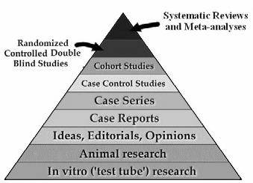
The hierarchy of evidence
Ecological studies
Cross sectional studies

Slide 4
Experimental Study Design
A study in which a population is selected for a planned trial of a regimen, whose effects are measured by comparing the outcome of the regimen in the experimental group versus the outcome of another regimen in the control group. Such designs are differentiated from observational designs by the fact that there is manipulation of the study factor (exposure), and randomization (random allocation) of subjects to treatment (exposure) groups.

Slide 5
Why Performed ?
Provide stronger evidence of the effect (outcome) compared to observational designs, with maximum confidence and assurance
Yield more valid results, as variation is minimized and bias controlled
Determine whether experimental treatments are safe and effective under “controlled environments” (as opposed to “natural settings” in observational designs), especially when the margin of expected benefit is doubtful / narrow (10 - 30%)

Slide 6
Examples of Experimental Epidemiologic Studies
Prophylactic vaccines tested on children populations to prove the efficacy of the vaccines in preventing the diseases (i.e., polio)
Prophylaxis with drugs in preventing disease (i.e., penicillin to prevent rheumatic fever)
Impact on health-related behavior and coronary heart disease in response to community-wide heart disease prevention intervention

Slide 7
Types of Intervention studies
Primary prevention
(Preventive trial)
  Avoid development of diseases
  Individual (Healthy person)
  Community
Secondary prevention
(therapeutic trial)
  Reduce morbidity and mortality in patients
  Individual (Patients)
Notes:
Terapeutiske studier vil selvfølgelig altid foregå på individ basis (Patienter) Hvorimod Forebyggelses studier både kan foregå på individ niveau eller i hele populationer.

Slide 8
Types of trials

Slide 9
1.Randomised control Trial a.Clinical trial b.Preventive trials c.Risk factor trials d.Cessation experiments e.Trial of etiological agents f.Evaluation of health services

Slide 10
Clinical trials
Evaluate therapeutic agents like drugs
Eg.use of beta blockers in reducing cardiovascular mortality in patients of myocardial infarction
Preventive trials
Related to the prevention or elimination of disease on experimental basis
Eg.Field trials conducted for vaccine efficacy

Slide 11
Risk factor trials
Risk factor modification to interrupt the sequence of development of disease
Eg. MRFIT(Multiple Risk Factor Intervention trial )
Cessation experiments
Termination of habit or removal of suspected agent considered to be causally related to the disease
Eg.Cessation of smoking related to the decrease in incidence of cardiovascular disease.

Slide 12
Trial of etiological agents
This is done to confirm or refute an etiological agent
Eg. Development of retrolental fibroplasia with the administration of oxygen.
Evaluation of health services
Used to assess the efficacy and effectiveness of health services.
Eg.such type of trial helped to demonstrate that domicillary treatment and hospital treatment are equally good in the control of T.B.

Slide 13
Non-randomised trial
A.Uncontrolled trials
B. Natural experiments
C.before and after comparisions
i.Before and after comparision without control
ii.Before and after comparision with control

Slide 14
Uncontrolled experiments
Uncontrolled studies on cervical cancer screening were done to establish the efficacy of pap smear. Implied ‘Historical controls’ are used in this type.
Natural experiments
When experimental studies are not possible in human populations, the epidemiologist seeks to identify ‘natural circumstances’

Slide 15
Before and after comparision studies
These studies compare the incidence of disease before and after introduction of preventive measure
Eg.Introduction of seat belt legislation for the prevention of head injuries.
This can be compared with a control group as well.

Slide 16
Experimental Design
outcome
RANDOMIZATION
Intervention
no outcome
Study
population
outcome
Control
no outcome
baseline
future
time
Study begins here (baseline point)

Slide 17
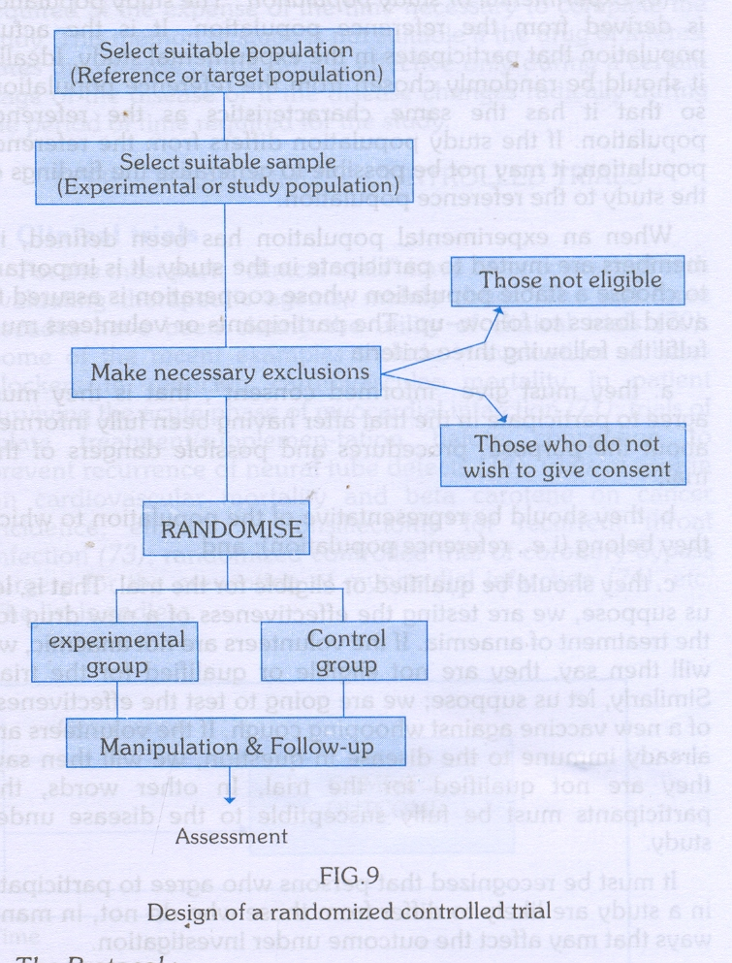

Slide 18
Design of a randomised controlled trial
The basic steps in conducting a RCT include the following:
1. Drawing up a protocol
2. Selecting reference and experimental populations
3. Randomization
4. Manipulation or intervention
5. Follow-up
6. Assessment of outcome

Slide 19
The protocol
It specifies the aims and objectives of the study, questions to be answered, criteria for the selection of groups, size of the sample, procedure for the allocation of subjects into study and control groups, treatment to be applied and evaluation of outcome.
Reference population
It is the population to which the findings of the trial are expected to be successful.
Study population
It is the actual population that participates in the experimental study which should be randomly chosen from the reference population to which the results can be generalisable. Eligibility and consent are important.

Slide 20
Randomisation
It is the heart of clinical trials.It helps to remove selection and confounding bias and allows comparability
Every individual has an equal chance to be allocated to either group.
Statified randomisation can be done by doing randomisation after subgrouping.

Slide 21
Manipulation
It creates an independent variable whose effect is then determined by measurement of outcome which constitutes the dependent variable.
Follow up
Follow up is done till the assessment of outcome
Attrition is avoided to increase the generalisability
Assessment of the outcome in the form of positive and negative results
Blinding is done to avoid bias due to subject,observer and statistician.

Slide 22
Intervention study
Advantages
As a cohort study: exposure → outcome
  Complete description of diease, incl incidence data
  Possible to study multiple effects
The exposure allocated by the investigator
  Allow large contrasts in exposure
  The exposure compared to no, other or placebo intervention
The randomised, controlled trial:
  Randomised – eliminate confounding
  Placebo-controlled – allow blinding
  Blinding – reduce bias, if neither participants nor investigator are aware
Strongest design to establish cause-effect relationships
risk among exposed
risk among not
risk ”if” exposed
risk ”if” not
RR =
~

Slide 23
Intervention study
Limitations
As a cohort study
  Expensive and time consuming
  Not useful for rare diseases and long induction time
May not be ethically justifiable
  insufficient belief to justify intervention – efficacy or saftey?
  insufficient doubt to justify placebo
  intervention too expensive or difficult to be implemented
  intervention already widespread in population
    even if little evidence of efficacy or safety
May not be feasible to have a true placebo group
  treatment already exist
  change in habits, surgery, zone therapy, etc

Slide 24
Randomisation
Active or placebo intervention allocated based on random principle
  random does not mean haphazard or alternating
  optimal tool to avoid confounding, since
  both known and unknown potential confounders will be balanced
Different types of randomisation:
  Simple: ABAAABABBAABABBAABBBABABABBBABBAABB
    Adequate with large sample sizes
  Blocked: ABBA BBAA ABAB AABB BBAA BABA BAAB
    Using permuted blocks, e.g. of 4, 10 or more
    Ensures balance at any time, and control for time effects
  Stratified, blocked:
    primigravidae: ABBA BBAA ABAB AABB BBAA BABA BAAB
    multigravidae: BABA BAAB BBAA ABAB BBAA ABAB AABB
    Ensures control of confounding due to to stratifying variable
Check adequacy of randomisation – and repeat if inadequate

Slide 25
Randomized Trial Methodology
Random allocation - Each subject has an equal chance of being assigned to any group in the study, so that all groups in a study are similar in all characteristics not controlled by other methods, such as subject selection.
Random allocation can be used with matching to ensure the study groups are comparable
Notes:
To cover the basics, I am trying to keep this as simple as possible. Randomized trials, especially clinical trials, can become very complex, with many groups (arms) involved in one study. Regardless of how many groups are in a study, random allocation (or randomization) is used to ensure the groups are comparable.
In matching, the researcher may match for, say, race and sex. So for a matched pair of white females, the researcher would then randomly assign one subject to the treatment group and the other to the control group. After all the matched pairs have been assigned, the two study groups would then have the same race and age distribution, as well as about the same distribution for other variables because of random allocation.

Slide 26
Randomized Trial Design
Time
Improved
R
A
N
D
O
M
I
Z
E
D
New
Treatment
Not Improved
Defined
Population
Improved
Current
Treatment
Not Improved
Notes:
This graphic shows when random allocation (randomization) should take place during the study process. Basically, the researcher starts with a defined population that is randomized to a new treatment or current treatment. The subjects are then followed to see how many improve for the new treatment and current treatment. Sometimes a treatment may be compared to no treatment, but this is very rare. If there is already a treatment in place, it is best to compare the new treatment to a treatment already in place.
Randomization increases the likelihood that the groups will be comparable in regard to characteristics that may affect prognosis. Such characteristics include sex, age, race and severity of disease.
Then again randomization isn’t a guarantee of comparability because chance does play a role in the process. In the long run, the groups tend to be similar. Finally, randomization is ethical only when we do not know whether one treatment is better than the other.

Slide 27
Radomised Controlled Trial Designs
1. Simple or Parallel trials (the most common form)
2. Factorial Trials (where there is more than two 'arms' to the trial, e.g. three different treatment groups and one control group)
3. Crossover Trials (participants swap treatments half-way through)
4. Within-persons Trials (participants may be given two different treatments on two different sites of their body and so act as their own control)
5. Cluster Trials (people are allocated in groups or clusters. Sometimes this is done by geographical area or health centre.
6. Historical Controls Trials
7. Equivalence Trials (where a new treatment or intervention is tested to see whether it is better or equivalent to the current treatment)
8. Non-inferiority Trials (where a new treatment or intervention is tested to see whether it is non-inferior to the current gold standard)

Slide 28
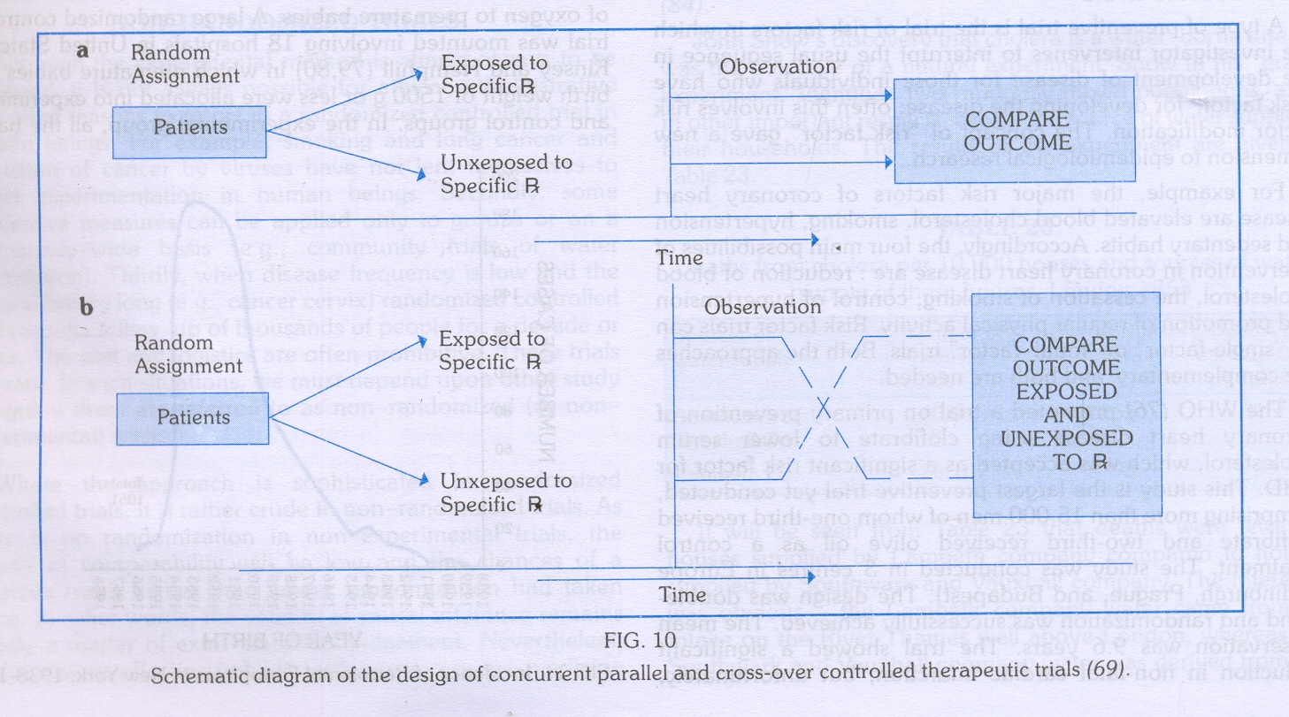

Slide 29
RCT Advantages (I)
  The “gold standard” of research designs. They thus provide the most convincing evidence of relationship between exposure and effect. Example:
    Trials of hormone replacement therapy in menopausal women found no protection for heart disease, contradicting findings of prior observational studies

Slide 30
RCT Advantages (Ii)
Best evidence study design
No inclusion bias (using blinding)
Controlling for possible confounders
Comparable Groups (using randomization)

Slide 31
RCT Advantages (IIi)
Helpful in assessing the value of new therapies to combat acute diseases in developing countries
Can evaluate a single variable in a precisely defined patient group
Prospective design
Allows for meta-analysis

Slide 32
RCT Disadvantages(i)
Large trials (may affect statistical power)
Long term follow-up (possible losses)
Compliance
Expensive
Public health perspective ?
Possible ethical questions

Slide 33
RCT Disadvantages(ii)
1. They are not always ethical.
2. Sample size can be too small. This wastes time and patients are included in a trial that is of no benefit to them or others. The larger the sample, the more successful the randomised procedure in removing confounding variables.
3. They can be statistically significant but clincially unimportant.
4. Significant tests can be misleading.
5. RCTs may not have external validity, that is, the results may not be able to be generalized to the broader community. Unlike the observational study, RCTs use volunteers. Those who volunteer tend to be different from those who do not.

Slide 34
RCT Disadvantages(iii)
Not always properly conducted – too few subjects, too short a time period
Influence of sponsorship
Use of surrogate endpoints may introduce “hidden bias”
Failure to randomize all eligible subjects
Failure to blind assessors to randomized status of subjects
Notes:
Despite the negatives, randomized controlled studies are still considered the gold standard of clinical research. If done right, results, whether good or bad, contributes to the collective scientific body of knowledge.

Slide 35
Intention-to-treat analysis
Always base analysis on intent-to-treat
  i.e. assigned, not actual treatment
    compare those assigned to active vs placebo
    then maybe repeat the analysis among compliant ptts only
    but never put non-compliant ptt into the placebo group!
Non-compliance does not occur randomly
Only intent-to-treat analysis benefits from randomization

Slide 36
Allocation concealment
Random sequence has to be concealed
Treatment allocation should be kept unpredictable
If allocation concealment is inadequate, then
  investigators are likely to decipher the code – sooner or later
  investigators next recruitement could then depend on prognosis
    patient could be hold back if allocated to perceived wrong treatment
Note, the following are distinctly different
  randomisation
  allocation concealment
  blinding

Slide 37
Loss to follow-up in RCT
Study participants may be lost to follow-up
  What is the problem?

Slide 38
Placebo and blinding
The purpose is to reduce bias
Blind – not aware of allocation to active or placebo
  Open label trial: neither participant nor investigator are blinded
  Single: only participant or investigator is blinded
  Double: both participant and investigator are blinded
  Triple: both participant, investigator and statistician are blinded
Double-blinding requires use of placebo
Single-blinding (examinator) does not require placebo

Slide 39
Special designs
cross-over
factorial
cluster

Slide 40
Special design: cross-over
All are given both treatments, but in sequence
Randomisation determines the treatment order
Advantages
  The effect is within- rather than between-subjects – more power
Disadvantages
  Cannot be used when condition is cured
  Only useful for short treatments, which can be assessed quickly
  Drop-out after first treatment a major problem
  Period effect – systematic differences between periods
  Carry-over effect – from first to second treatment (treatment-period interaction)
Analysis requires three tests

Slide 41
Special design: factorial
Two hypothesis/interventions assessed simultaneously
Different outcomes – interactions not expected
  Aspirin reduces risk of cardiovascular death
  β-carotene reduces risk of lung cancer
If the two interventions – as assumed - are independent:
  The effect of each intervention can be assessed independently
Aspirin
+ | -
 | +
 | -
 |  | 11 000
 |  | 11 000
11 000 | 11 000 | 22 000
β-caroten
PHSRG, NEJM, 1989

Slide 42
Special design: factorial
Same outcome – interaction may be expected:
  α-tocopherol reduces risk of lung cancer
  β-carotene reduces risk of lung cancer
If interaction:
  assess the effect of one intervention for each level of the other
If no interaction
  greater power or ability to detect smaller differences
α-tocopherol
+ | -
 | +
 | -
7 000 | 7 000 | 14 000
7 000 | 7 000 | 14 000
14 000 | 14 000 | 28 000
β-caroten
ATBC-CPSG, NEJM, 1994

Slide 43
Special design: cluster randomised
If unit of randomisation is a group, not individual
Questions
  Where is it useful?
  What is the problem?

Slide 44
Special design: cluster randomised
If unit of randomisation is a group, not individual
Where is it useful?
  If intervention is targetting groups
    Teaching methods, iodised table salt, etc
    Example: classes or households as unit of randomisation
  If effect on one may impact others
    The effect of STI treatment on HIV incidence
    Example: health-facility catchment area as unit of randomisation
  If more practically feasible
    Difficult to administer intervention to individuals
    Example: administrative unit (ward) as unit of randomisation
What is the problem?
  Individuals within groups are not independent – design effect
  sample size is number of groups
  use group measure as unit of observation or control for design effect

Slide 45
Community Trials
Communities rather than individuals comprise the treatment groups
Appropriate for diseases that have their origins in social conditions that can be influenced by intervention directed at group behavior as well as individuals

Slide 46
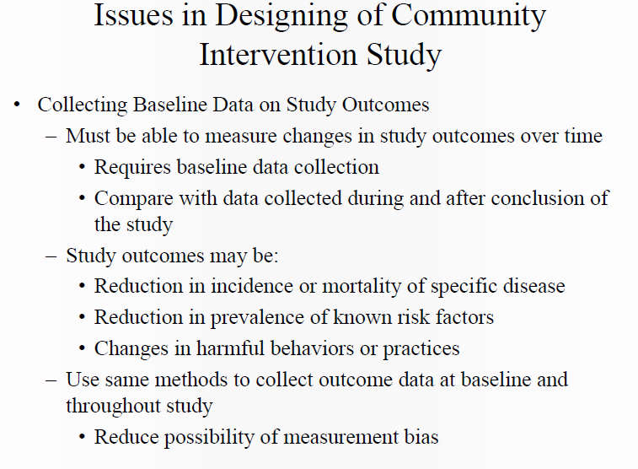

Slide 47
Limitations of Community Trials
Random allocation of communities is not practical
Only a small number of communities can be included
Other methods are needed to ensure any difference found can be attributed to the intervention rather than to any inherent differences between the communities studied

Slide 48
Clinical and field trials
Clinical trial
  therapeutic effect in patients
    Phase I: pharmakinetics and safety – in healthy individual
    Phase II: initial clinical evaluation – in few patients
    Phase III: full clinical evaluation thru RCT – in many patients
    Phase IV: post-marketing surveillance
Field trial
  preventive effect in healthy or high-risk individuals
    health-facility-based
    community-based

Slide 49
Field Trials
Involve people who are disease-free but presumed to be at risk
Data collection – “in the field” – among non-institutionalized people in the general population
Used to evaluate interventions that reduce exposure without measuring the occurrence of health effects.

Slide 50
Limitations of Field Trials
Hugh undertaking
Major logistic considerations
Major financial considerations
Think of how much work is required to randomize and allocate participants to various treatment groups!

Slide 51
Interim analysis
This is an analysis of data that takes place early on in the trial. The idea is that if there are clear benefits or harm, the trial should be stopped early. There is a Haybittle Peto Stopping Rule that states to stop the trial if p<0.001 at interim analysis(this is stringent to avoid type 1 error).

Slide 52
Thanks for your kind attention
and listening.

