Slide 1


Slide 2
Endodontic mishaps
Dr.ganesh

Slide 3
contents
Introduction
Classification
Mishaps during Isolation and Access Opening
Mishaps during Biomechanical Prepration
Mishaps during Obturation
Miscellaneous
Conclusion

Slide 4
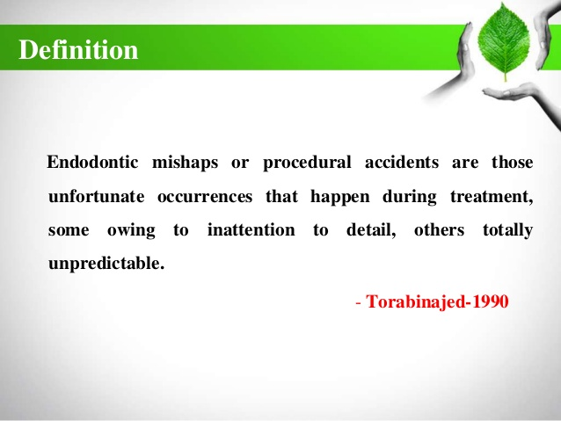
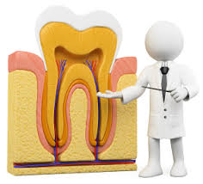
introduction

Slide 5
classification
a) Access related procedural errors
- treating wrong tooth
- incomplete removal of caries
- access opening through full coverage restoration
- missed canals
- iatrogenic perforations(cervical perforation)
B) Instrumentation related procedural errors
- ledge formation
- separated instrumentation

Slide 6
Classification (contd.)
Obturation related
- over/ under obturation
- vertical root fracture
Others
- post space perforation
- Irrigant related
- Tissue emphysema
- Instrument aspiration and ingestion

Slide 7
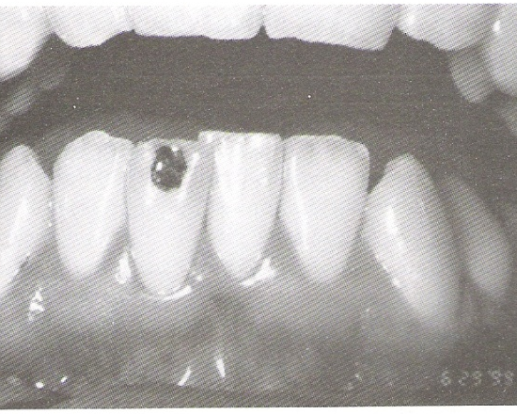
Mishaps occuring during access preparation
Treating wrong tooth
Cause - Negligence
Prevention - tooth marking on radiograph and also on tooth before application of rubber dam.
Alternatively,initial access cavity into enamel or dentinoenamel junction before application of rubber dam.

Slide 8
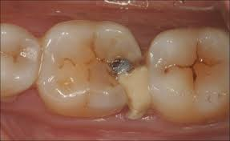
INCOMPLETE CARIES REMOVAL
Secondary caries occuring under an existing restoration is one of the reasons for need for endodontic therapy.
It is recommended that an existing restoration, especially involving occlusoproximal areas should be removed in total and access cavity designed accordingly.
Remember that secondary caries in an endodontically treated tooth ultimately leads to coronal leakage and ultimately endodontic failure.

Slide 9
Access opening through full coverage restoration
When a pt. presents himself with an existing crown in the tooth that is planned for endodontic treatment best solution is to remove the crown and proceed with endodontic treatment.

Slide 10

MISSED CANALS
Cause
- lack of knowledge about root canal
morphology
- incomplete deroofing of the pulp chamber.
Recognition
- instrument not in centre of canal.
- multiple radiograph in different angulation help the clinician to better understand the morphology of tooth
-use DG16 explorer or size 06/08/10 ISO K file instrument to locate the orifices.

Slide 11
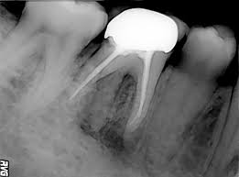
Correction- Retreatment first priority
- Surgical correction
Prognosis- poor
Prevention- locating all canals

Slide 12
- iatrogenic perforations(cervical perforation)
Etiology-due to directing the bur nonparallel to the long axis of tooth.
Managent of nonfurcal cervical perforations
The primary protocol is haemorrhage control with 1:50,000 epinephrine followed by perforation repair with MTA.
Prevention –
Study the crown root angulation of maxillary lateral incisior and mandibular first premolar teeth before proceeding with the treatment.
remove all caries

Slide 13
Management of cervical perforation in the furcation area
A electronic apex locator is very useful in differentiating a bleeding canal from a perforation .
MTA is the material of choice for sealing perforations.
PREVENTION
Access bur penetration for depth and angulation should be confirmed before proceeding with the help of radiograph.
While preparing access cavities if a ceramic crown or a metal crown is already present ,it is better to remove the crown and proceed with endodontic access and treatment.

Slide 14
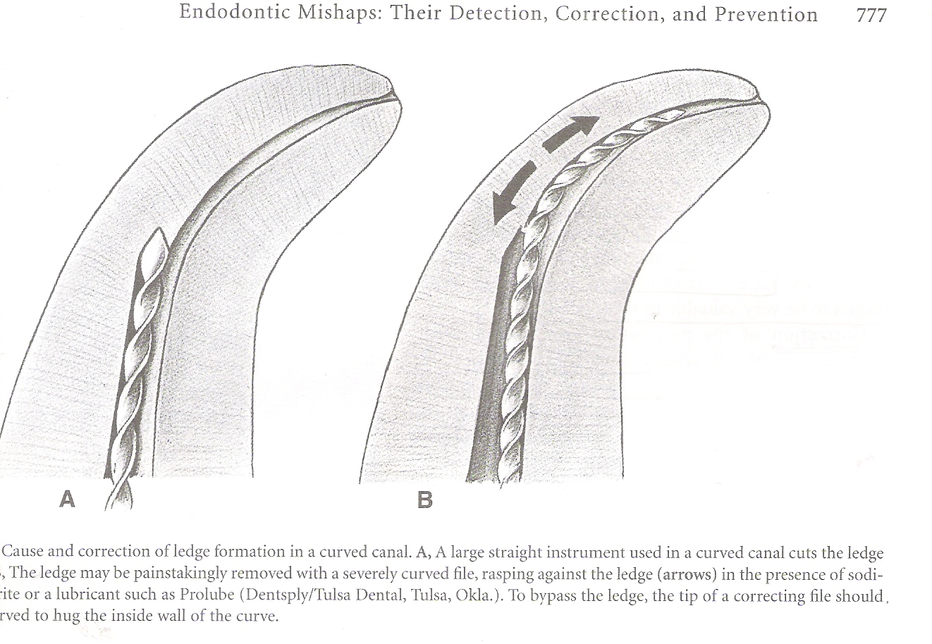
MISHAPS DURING INSTRUMENATION
LEDGE-it is an artificially created deviation of the root canal wall that prevents the passage of an instrument to the apex of an otherwise patent canal.
Ledge formation-
Causes
- inadequate straight line
access
- failure to maintain WL
- failing to pre curve
instrument in curved canals
- use of excessive apical
pressure

Slide 15
Inadequate irrigation during instrumentation
Attempting to retrieve broken instruments
Attempting to prepare calcified canal
Prevention- preoperative assessment of diagnostic radiograph
- obtaining straight line access
- pre curving instruments in curved canals
- sequential use of instruments
- periodic recapitulation
- passive instrumentation tech
never force and instrument apically

Slide 16
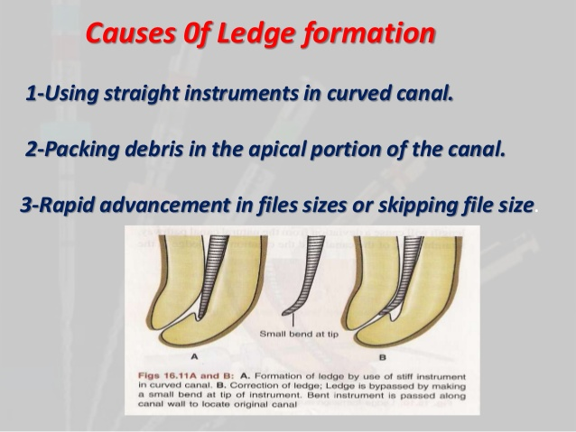
Management
- bypassing ledge
- instrumentation and obturation at new WL

Slide 17
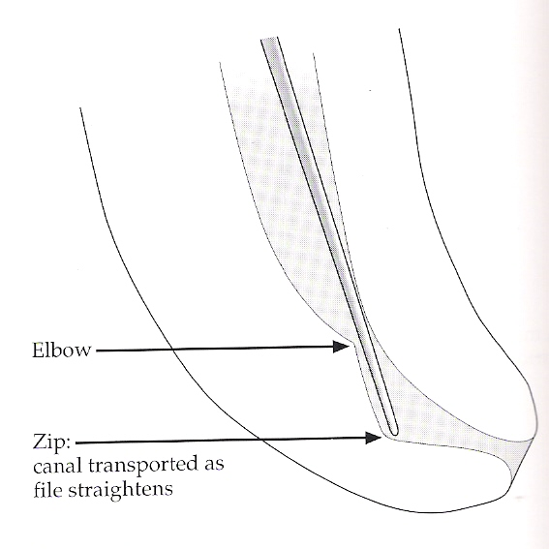
ZIPPING-apical transportation of curved canal caused due to improper shaping technique.
CAUSE-when a file is rotated in curved canal in apical area , a biomechanical defects result in the form of an elbow, less flexible instruments may overcut the outer surface of the curved canal and may produce an elliptical preparation in the apical third which is cone shape, with the apex of elbow towards the middle third of canal and the base or zip towards the cementum surface.

Slide 18
ELBOW-narrowest portion of zipped canal
MANAGEMENT-
prevention is the best form of management
In zipped ,any type of Obturation can be used but thermoplasticized Obturation techniques are the preferred method of Obturation.

Slide 19
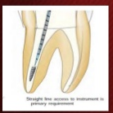
INSTRUMENT BREAKAGE
Causes- using stressed instrument
- placing exaggerated bends on
instruments
- rotating a bind instrument
- using corroded instrument
- overused instruments
Recognition- loss of WL
- shortened instrument
- radiographic confirmation

Slide 20
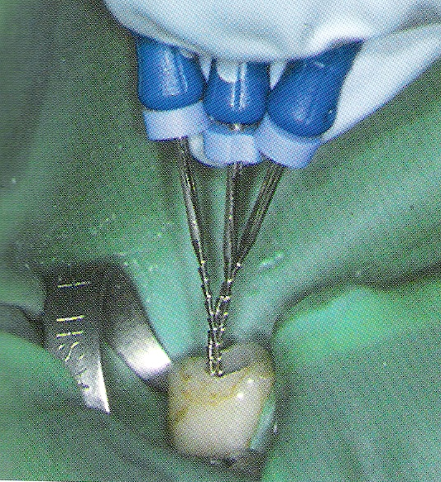
Correction- attempt to remove instrument
From middle third and apical third
- create space
- use ultrasonic vibrations

Slide 21
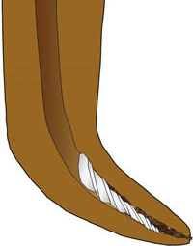
If instrument cannot be removed- bypass it using lubricants (in oval or irregular canal)
If not bypassed, instrument the canal till the level of broken instrument
If instrument extends beyond the apex- apical surgery

Slide 22
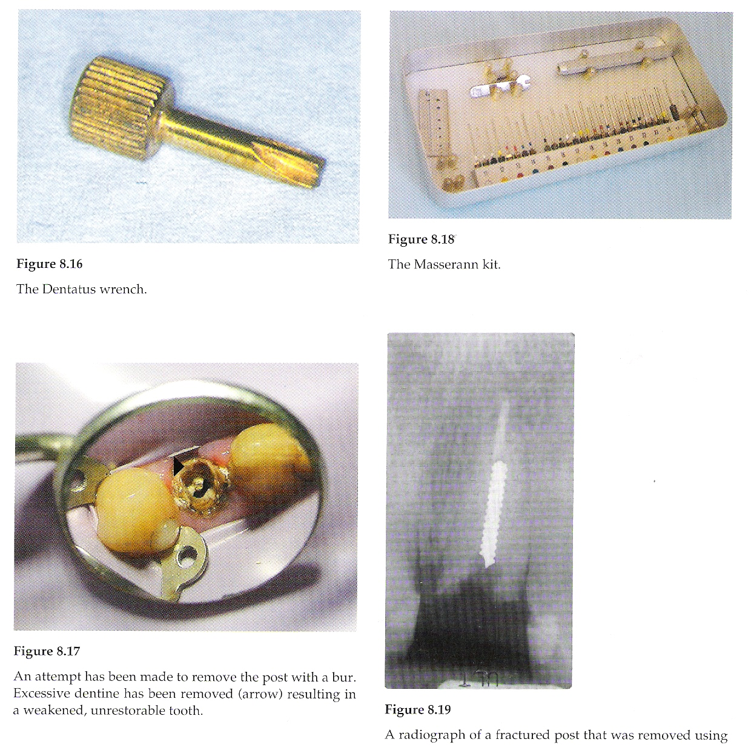
Masserann Kit
Trephine- to create space around
broken instrument
Extractor tube – inserted over the
fractured inst, gripped,
and removed

Slide 23
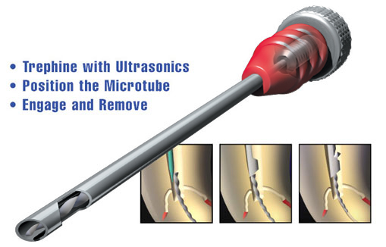
INSTRUMENT RETRIEVAL SYSTEM

Slide 24
OBTURATION RELATED PROCEDURAL ERRORS
Over/ under Obturation-
Cause- loss of apical constriction (over)
poor canal preparation (under)
poor master gutta percha fit
Recognition- radiographic confirmation

Slide 25
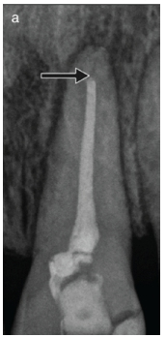
Correction- underextended- retreatment
overextended- surgical correction
Prognosis-
if apical seal is present - good
presence of apical lesion- questionable
Prevention- attention to details
- accurate WL
- selection of master cone
- creating apical barrier (open apex)

Slide 26
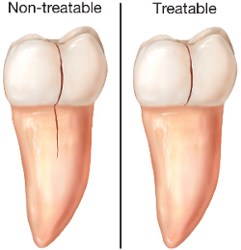
VERTICAL ROOT FRACTURES
Causes- excessive compaction pressure
- using large compactors
- over instrumentation
- post placement
Recognition- crunching sound (crepitus)
- pain
- radiographs (tear drop radioleucency)
Prevention- avoid overpreparing canals
using moderate pressure during obturation

Slide 27
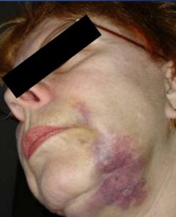
MISCELLANEOUS
IRRIGANT RELATED MISHAPS-
Cause- improper irrigation
techniques
Recognition- sudden pain
- swelling
- haemorrhage
- ecchymosis

Slide 28
Management
- antibiotics and analgesics
- antihistaminics
- ice packs followed by warm saline soaks
- observation
- steroids (systemic)
- hospitalization (severe cases)

Slide 29
INSTRUMENT ASPIRATION AND INGESTION
Cause- no rubber dam
Recognition- chest and abdominal radiographs
Management-
- if in throat- high volume suction,
with pharyngeal tip
- hemostat/ cotton pliers

Slide 30
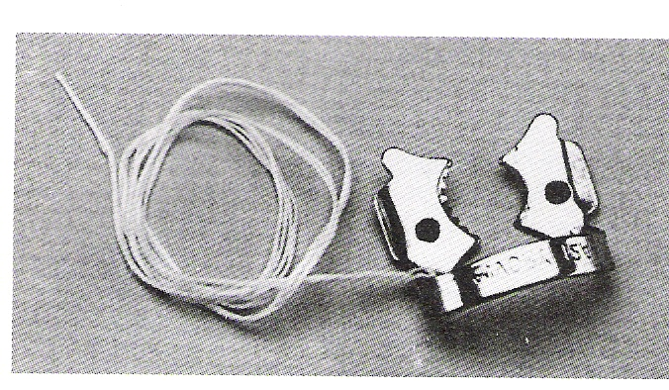
Prevention- use of rubber dam
- attaching floss to clamps
- use of throat shield

Slide 31
conclusion
Success in endodontic treatment is predicated on a
host of factors, many of which are controllable before
the clinician initiates treatment.
Proper and thorough preparation of both patient and
tooth for endodontic therapy should lay the groundwork for
a relatively trouble free experience that will increase the
chances for the ultimate success of the entire treatment

Slide 32


