Slide 1

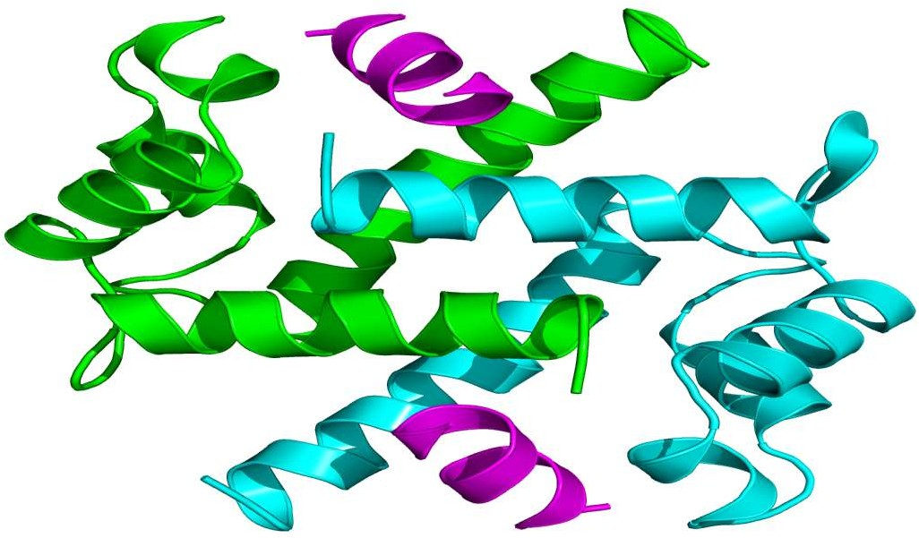
Presented By
Mohammad Shahrukh
M.Sc. Medical Biochemistry
(Ph.D. Scholar)

Slide 2
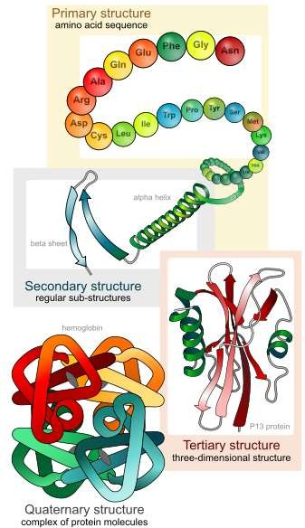
INTRODUCTION
Proteins are an important class of biological macromolecules which are the polymers of amino acids.
Biochemists have distinguished several levels of structural organization of proteins. They are:
  Primary structure
  Secondary structure
  Tertiary structure
  Quaternary structure

Slide 3
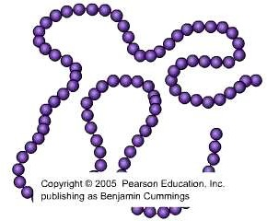
PRIMARY STRUCTURE
The primary structure of protein refers to the sequence of amino acids present in the polypeptide chain.
Amino acids are covalently linked by peptide bonds.
Each component amino acid in a polypeptide is called a “residue” or
“moiety”
By convention, the 1⁰ structure of a protein starts from the amino- terminal (N) end and ends in the carboxyl-terminal (C) end.
The concept of linear sequence of α amino
acids in protein structure was proposed by
Franz Hofmeister & Emil Fischer in 1902, and
the term “Primary structure of proteins” was first coined by Linderstrom-Lang (1951).

Slide 4
IMPORTANCE OF PRIMARY STRUCTURE
To predict 2⁰ and 3⁰ structures from sequence homologies with related proteins. (Structure prediction)
Many genetic diseases result from abnormal amino acid sequences. (e.g. sickle cell anaemia)
To understand the molecular mechanism of action of proteins.
METHODS OF AMINO ACID SEQUENCE DETERMINATION
End group analysis – Edman degradation (Edman’s reagent: Phenyl Isothiocyanate).
Gene sequencing method.

Slide 5
SECONDARY STRUCTURE
Localized arrangement of adjacent amino acids formed as the polypeptide chain folds.
α-helix
β-pleated sheet
β-bends
Non repetitive structures Super secondary structures
It consists of
Linus Pauling proposed some essential features of peptide units and polypeptide backbone. They are:
  The amide group is rigid and planar as a result of resonance. So rotation about C-N bond is not feasible.
  Rotation can take place only about N- C_{α} and C_{α} – C bonds.
  Trans configuration is more stable than cis for R grps at C_{α}
From these conclusions Pauling postulated 2 ordered structures α helix and
β sheet

Slide 6
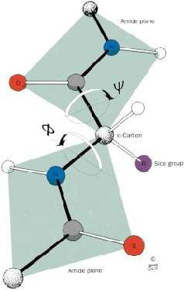
POLYPEPTIDE CHAIN CONFORMATIONS
The only reasonably free movements are rotations around the C α-N bond (measured as ϕ ) and the C α-C bond (measured as Ѱ).
The conformation of the backbone can therefore be described by the torsion angles (also called dihedral angles or rotation angles)

Slide 7
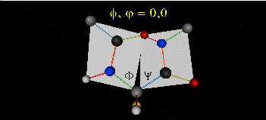
Animation showing Phi angle rotation at Psi = 0.

Slide 8
Animations showing Psi angle rotation at Phi = 0.

Slide 9
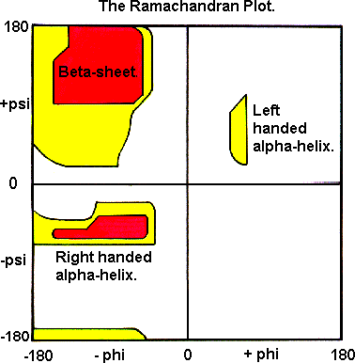
RAMACHANDRAN PLOT
A Ramachandran plot (also known as a Ramachandran diagram or a [φ,ψ] plot), originally developed in 1963 by G. N. Ramachandran.
White regions : Sterically disallowed for all amino acids except glycine.
Red regions : allowed regions namely the a-helical and b-sheet conformations.
Yellow areas : outer limit
•
•
•

Slide 10
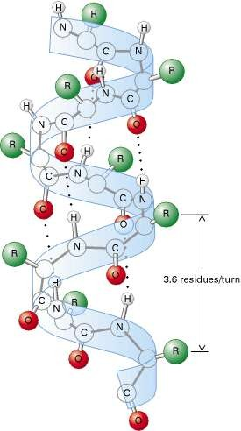
ALPHA HELIX
Spiral structure
Tightly packed, coiled polypeptide backbone core.
Side chain extend outwards
Stabilized by H bonding b/w carbonyl oxygen and amide hydrogen.
Amino acids per turn – 3.6
Pitch is 5.4 A
Alpha helical segments are found in many globular proteins like myoglobins, troponin- C etc.
H bonding

Slide 11
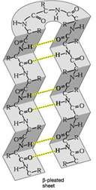
BETA PLEATED SHEET
Formed when 2 or more polypeptides line up side by side.
Individual polypeptide - β strand
Each β strand is fully extended.
They are stabilized by H bond b/w N-H and carbonyl grps of adjacent chains.
2 types
Parallel
Anti -Parallel
N N
C C
N C
C N

Slide 12
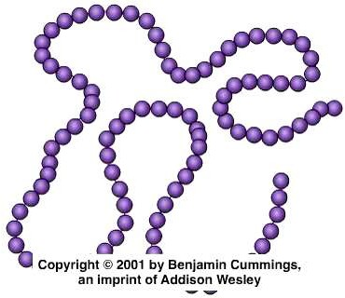
SECONDARY STRUCTURE

Slide 13

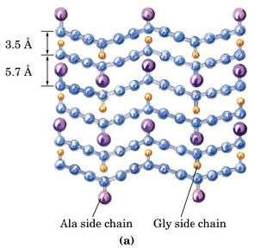
EXAMPLES
The collagen triple helix.
Silk fibroin beta sheet.

Slide 14
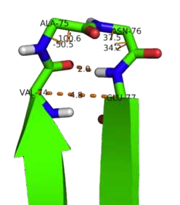
BETA BENDS
Permits the change of direction of the peptide chain to get a folded structure.
It gives a protein globularity rather than
linearity.
H bond stabilizes the beta bend structure.
Proline and Glycine are frequently found in beta turns.
Beta turns often promote the formation of antiparallel beta sheets.
Occur at protein surfaces.
Involve four successive aminoacid residues

Slide 15
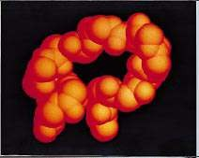
NON REPETITIVE STRUCTURES
A significant portion of globular protein’s structure may be irregular or unique.
They include coils and loops.
Segments of polypeptide chains whose successive residues do not have similar ϕ and Ѱ values are called coils.
Space-filling model of an Ω loop
Almost all proteins with more than 60 residues contain one or more loops of 6 to 16 residues, called Ω loops.

Slide 16
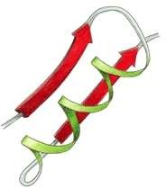
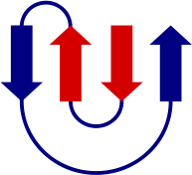
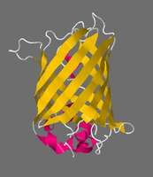
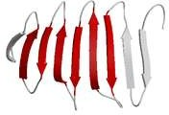
SUPER SECONDARY STRUCTURES (MOTIFS)
Certain groupings of secondary structural elements are called motifs.
beta-alpha-beta motif
Greek key motif
β-meander motif
Beta barrel

Slide 17
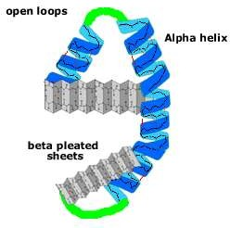
TERTIARY STRUCTURE
Tertiary structure is the three- dimensional conformation of a polypeptide.
The common features of protein tertiary structure reveal much about the biological functions of the proteins and their evolutionary origins.
The function of a protein depends on its tertiary structure. If this is disrupted, it loses its activity.

Slide 18
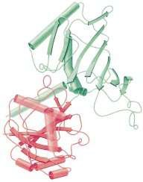
DOMAINS
Polypeptide chains containing more than ,200 residues usually fold into two or more globular clusters known as domains.
Fundamental functional and 3 dimensional structure of proteins.
Domains often have a specific function such as the binding of a small molecule.
Many domains are structurally independent units that have the characteristics of small globular proteins.
The two-domain protein glyceraldehyde- 3-phosphate dehydrogenase.
NAD+

Slide 19
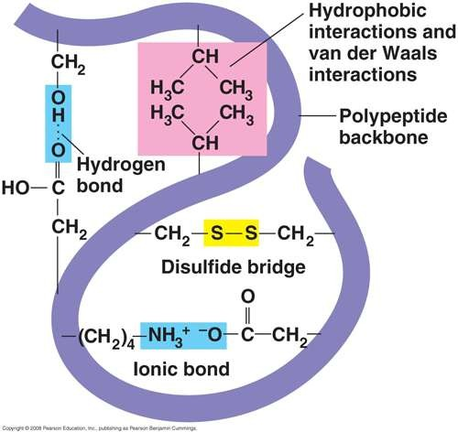
INTERACTIONS STABILIZING 3⁰ STRUCTURE
This final shape is determined by a variety of bonding interactions between the "side chains" on the amino acids.
Hydrogen bonds
Ionic Bonds
Disulphide Bridges
Hydrophobic Interactions:

Slide 20
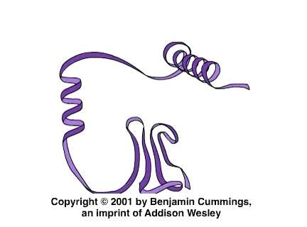
TERTIARY STRUCTURE

Slide 21
DETERMINATION OF TERTIARY STRUCTURE
The known protein structures have come to light through:
X-ray crystallographic studies
Nuclear Magnetic Resonance studies
The atomic coordinates of most of these structures are deposited in a database known as the Protein Data Bank (PDB).
It allows the tertiary structures of a variety of proteins to be analyzed and compared.

Slide 22
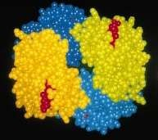
QUATERNARY STRUCTURE
The biological function of some molecules is determined by multiple
polypeptide chains –
multimeric proteins.
Arrangement of polypeptide sub unit is called quaternary structure.
Sub units are held together by non covalent interactions.
Eg: Hemoglobin has the subunit composition a₂b₂
Quaternary structure of hemoglobin.

Slide 23
RECENT DEVELOPMENTS
A team of scientists at The Scripps Research Institute and the National Institutes of Health (NIH) has discovered the structure of a protein – dynamin, that pinches off tiny pouches from cell’s outer membranes.
Scientists at the Institute of Structural and Molecular Biology have revealed the structure of a complex protein called FimD that acts as an assembly platform for the pili of cystitis bacteria.
Researchers from the Walter and Eliza Hall Institute have found a structural surprise in a type of protein, Bcl-w ,that encourages cell survival, raising interesting questions about how the proteins function to influence programmed cell death.

Slide 24
Properties of Protein
Solublity: forms colloidal solution instead of true solutions in water – large size of protein
Molecular Weight: Proteins Have high molecular weight (4000-440000) and its depends on number of amino acid (40-4000 AA).
Shape: there is wide variety in shape – globular(insulin), oval(albumin), fibrous or elongated (fibrinogen)
Acidic and basic: depends on ratio of (lysine + arginine) : (Glut + Asp). Ratios greater than 1 is basic and vice-versa

Slide 25
Properties of Protein : Charge
Acidic amino acid (Asp, Glu) and basic amino acid (His, lys, Arg) – determines the charge on protein
At isoelectric pH, the protein exist as Zwitter-ions
and dipolar ions
  Electrically neutral
  Minimum solubility
  Maximum precipitability
  Least buffering capacity

Slide 26
Classification
Proteins are classified on the basis of
  Chemical nature and solubility
    Simple
    Conjugates
    Derived
  Function
    Structural
    Enzyme or catalytic
    Transport
    Hormonal
    Contractile
    Storage
    Genetic
    Defense
    Receptor

Slide 27
Classification
  Nutritional Importance
    Complete
    Partially incomplete
    Incomplete

Slide 28
BASED ON CHEMICAL NATURE AND SOLUBILITY
SIMPLE PROTEINS:
They are composed of only amino acid residues
They are again classified as
  Globular Protein : spherical or oval in shape, soluble in water or other solvent and digestible
    Globulin: soluble in neutral and salt solution. Ex: serum globulin
    Albumin: soluble in water and dilute salt solutions and cogulated by heat. Ex: serum albumin, ova albumin, lactalbumin

Slide 29
BASED ON CHEMICAL NATURE AND SOLUBILITY
Globular Protein (Cont)…
  Glutelins : soluble in dilute acids, alkalies and mostly found in plants. Ex: Glutelin (wheat), oryzenin (rice)
  Prolamines: soluble in alcohol. Ex: gliadin(wheat), zein (maize)
  Histones: strongly basic proteins, soluble in water and dilute acids but insoluble in dilute ammonium hydroxide. Ex: thymus histone

Slide 30
BASED ON CHEMICAL NATURE AND SOLUBILITY
Fibrous Protein: fiber like in shape, insoluble in water and resistant to digestion. It again of 3 types
  Collagen: connective tissue protein lacking tryptophan. On heating with boiling water or acids it turns to soluble gelatin
  Elastin: elastic tissues such as tendons and ateries
  Keratin: present in the exoskeleton structures. Ex: hair, nails, horns

Slide 31
BASED ON CHEMICAL NATURE AND SOLUBILITY
CONJUGATED PROTEINS
Beside amino acid, it contains a non-protein moiety known as prosthetic group or conjugating group. Its again of 6 types
  Nucleoprotein: nucleic acid (DNA or RNA) e.g. histones and protamines)
  Glycoprotein: prosthetic group is carbohydrate which is less than 4 % and when it exceeds 4% its called
  Mucoprotein: e.g. mucin (saliva), ovamucid (egg white)
  Lipoprotein: found in the conjugation with lipids. Ex: serum lipoprotein, membrane lipoprotein

Slide 32
BASED ON CHEMICAL NATURE AND SOLUBILITY
CONJUGATED PROTEINS (CONT…..)
Phosphoprotein: Phosphoric acid as conjugate. Ex: casein(milk), vitelline (egg yolk)
Chromoprotein: prosthetic group is colored in nature. Ex: Hemoglobins, cytochromes
Metalloprotein: It contains metal ions such as Fe, Co, Zn, Cu, Mg (e.g. carbonic anhydrase with Zn, ceroplasmin with Cu, transferrin with Fe etc).

Slide 33
BASED ON CHEMICAL NATURE AND SOLUBILITY
Derived Protein: Derived proteins are Denatured or degraded product of simple or conjugated protein
Its of 2 types
Primary derived protein: denatured or cogulated or first hydrolyzed product of proteins. They are
  Cogulated proteins: denatured protein produced by agents such as heat, acids, alkalies
  Proteans: earliest product of protein hydrolysis by enzymes, dilute acids, alkalies etc. Insoluble in water
  Metaprotein: second stage of protein hydrolysis obtained by treatment with slightly stronger acids and alkalies (e.g. acid albuminates, trichloroacetic acid).

Slide 34
BASED ON CHEMICAL NATURE AND SOLUBILITY
  Derived Protein:
  2. Secondary derived protein: progressive hydrolytic product of protein hydrolysis. Ex: proteoses, peptones, polypeptides and peptides

Slide 35
Classification based on shape & Size
^{ϒ} Depend upon the axial ratio the protein are classify into two type of protein.
Globular protein
Fibrous protein

Slide 36
Fibrous Protein
Axial ratio of length:width more than 10. Long thread like molecule.
Their helical strands mainly form fibers.
These protein are insoluble in water.
Form structure of the tissue Present where support is required. Example
Collagen
Elastin
Keratin
ϒ
ϒ
ϒ
ϒ
ϒ
ϒ
ϒ

Slide 37
Globular Protein
Axial ratio of length:width less than 10.
Spheroid or ovoid in shape.
Enzyme are mostly globular in shape.
Subdivided into two type of protein…
Albumins: Water soluble.
Globulin: Soluble in dilute salt solution.

Slide 38
Classification based upon Function
Catalytic Protein: These are enzyme which may be simple or conjugated.
Alkaline phosphatase
Alanine trasaminase
Regulatory or Hormonal protein: Many protein and peptide acts as Hormone.
Insulin
Growth Hormone
Structural Protein: Contribute to the structure of the tissue.
Collagen
Elastin

Slide 39
Continue…
Transport Protein: Serve to carry substances
Transferrin carry Iron
Hemoglobin carry Oxygen
Immune Protein: Serve in defense mechanism
1. Immunoglobulin, IgG, IgA, IgM, IgD,IgE
Contractile Protein: Takes part in the muscle contrection.
Actin
Myosin

Slide 40
Continue…
Genetic Protein: Protein present in combination with nucleic acid.
1. .Histone Protein.
Storage Protein: To store protein for nutritional purposes.
Casein in Milk
Gliadin in Wheat.

Slide 41
Classification Based on Nutritive value
The nutritive value of proteins is depends upon the present of essential amino acids.
Its classified into three groups:
  Complete proteins: which have all the ten essential amino acid e.g. egg, meat, milk, cheese, fish etc.
  Partially complete proteins: Deficient one or more essential amino acids e.g. Glutelins ( wheat proteins), legumin ( Pulses proteins) etc.
  In-Complete proteins: Complete absence of essential amino acids e.g. Gelatin ( derived from Collagen) and Zein ( of Corn).

Slide 42
Denaturation
The phenomenon of disorganization of native protein structure
It results in the loss of secondary, tertiary and quaternary structure of proteins.
It involves the change of physical, chemical and biological properties
Agents of Denaturation
  Physical agents: Heat, UV radiation, X-rays and violent shaking (centrifuge)
  Chemical Agents: Acids, alkalies, organic solvents (ether, alcohol), salts of heavy metals, urea, salicylate

Slide 43
Denaturation
Primary structures remains intact i.e peptide linkage are not broken
Loses its biological activity
Insoluble in solvent which was previously soluble
Viscosity increases while its surface tension decreases
Its more easily digestible
Its usually irreversible, but careful denaturation (renaturation) is reversible. Ex: Hemoglobin is renatured on removal of salicylates

Slide 44
Denaturation
Coagulation
  Irreversible denaturation of protein to semi-solid viscous precipitate
  Albumins and globulins – coagulable proteins
Flocculation
  Protein precipitation at isoelectric pH.
  Precipitate is known as flocculum
  Casein – milk protein, prepared by adjusting isoelectric pH by dilute acetic acid
  Its reversible, but on heating it turns to be irreversible

