Slide 1
Protein metabolism and Urea cycle

Slide 2
Digestion of proteins
The dietary proteins are denatured on cooking and therefore more easily to digested by a digestive enzymes.
All these enzymes are hydrolases in nature.
Proteolytic enzymes are secreted as inactive zymogens which are converted to their active form in the intestinal lumen.
This would prevent autodigestion of the secretory acini.

Slide 3
The proteolytic enzymes include:
Endopeptidases:
They act on peptide bonds inside the protein molecule, so that the protein becomes successively smaller and smaller units. This group includes pepsin, trypsin, chymotrypsin, and elastase.
Exopeptidases:
This group acts at the peptide bond only at the end region of the chain. This includes carboxypeptidase acting on the peptide only at the carboxyl terminal end on the chain and aminopeptidase, which acts on the peptide bond only at the amino terminal end of the chain.

Slide 4
A. Gastric digestion of proteins:
•
In the stomach, hydrochloric acid is secreted. It makes the pH optimum for the action of pepsin and also activates pepsin.
The acid also denatures the proteins. But hydrochloric acid at body temperature could not break the peptide bonds.
Thus in the stomach, HCl alone will not able to digest proteins; it needs enzymes.
•
•

Slide 5
1) Rennin:
Rennin otherwise called chymosin, is active in infants and is involved in the curdling of milk. It is absent in adults.
Milk protein, casein is converted to paracasein by the action of rennin.
The denatured protein is easily digested further by pepsin.

Slide 6
2) Pepsin:
It is secreted by the chief cells of stomach as inactive pepsinogen.
The conversion of pepsinogen to pepsin is brought about by the hydrochloric acid.
The optimum pH for activity of pepsin is around
2. Pepsin is an endopeptidase.
By the action of pepsin, proteins are broken into proteoses.

Slide 7
B. Pancreatic digestion of proteins:
•
The optimum pH for the activity of pancreatic enzyme (pH 8) is provided by the alkaline bile and pancreatic juice.
•
The secretion of pancreatic juice is stimulated by the peptide hormones, cholecystokinin and pancreozymin.
•
Pancreatic juice contains the important endopeptidases, namely trypsin, chymotrypsin, elastase and carboxypeptidase

Slide 8
1) Trypsin:
Trypsinogen is activated by enterokinase present on the intestinal microvillus membranes. Once activated, the trypsin activates other enzyme molecules.
Trypsin catalyzes hydrolysis of the bonds formed by carboxyl groups of Arg and Lys.
Acute pancreatitis: Premature activation of trypsinogen inside the pancreas itself will result in the autodigestion of pancreatic cells. The result is acute pancreatitis. It is a life-threatening condition
•
•

Slide 9
2) Chymotrypsin:
Trypsin will act on chymotrypsinogen, so that the active site is formed. Thus, selective proteolysis produces the catalytic site.
3) Carboxypeptidases:
Trypsin and chymotrypsin degrade the proteins into small peptides; these are further hydrolyzed into dipeptides and tripeptides by carboxypeptidases present in the pancreatic juice. They are metallo-enzymes requiring zinc.

Slide 10
C. Intestinal digestion of proteins:
Complete digestion of the small peptides to the level of amino acids is brought about by enzymes present in intestinal juice (succus entericus).
•
•
The luminal surface of intestinal epithelial cells contains Amino- peptidases, which release the N- terminal amino acids successively.

Slide 11
Absorption of amino acids
The absorption of amino acids occurs mainly in the small intestine. It is an energy requiring process. These transport systems are carrier mediated systems.
These are five different carriers for different amino acids.
Moreover,
glutathione (gamma glutamylcysteinylglycine) also plays an important role in the absorption of amino acids.

Slide 12
Clinical applications:
The allergy to certain food proteins (milk, fish) is believed to result from absorption of partially digested proteins.
Partial gastrectomy, pancreatitis, carcinoma of pancreas and cystic fibrosis may affect the digestion of proteins and absorption of amino acids.

Slide 13
General metabolism of amino acids:
Anabolic pathway
Catabolic pathway
13

Slide 14
General metabolism of amino acids:
Dietary proteins and body proteins are broken down to amino acids. This is called catabolic reactions.
In transamination reaction, amino group of amino acid is removed to produce the carbon skeleton (keto acid). The amino group is excreted as urea.
The carbon skeleton is used for synthesis of non- essential amino acids.
It is also used for gluconeogenesis or for complete oxidation.
Amino acids are used for synthesis of body proteins; this is anabolic reaction.

Slide 15
Formation of Ammonia
The first step in the catabolism of amino acids is to remove the amino group as ammonia.
Ammonia is highly toxic especially to the nervous system.
Detoxification of ammonia is by conversion to urea and excretion through urine.
15

Slide 16
Transamination
Transamination is the exchange of amino group between amino acid and another keto acid, forming a new alpha amino acid.
The enzyme catalyzing the reaction as a group known as transaminases (amino transferases).
These enzymes have pyridoxal phosphate as prosthetic group.
The reaction is readily reversible.
16

Slide 17
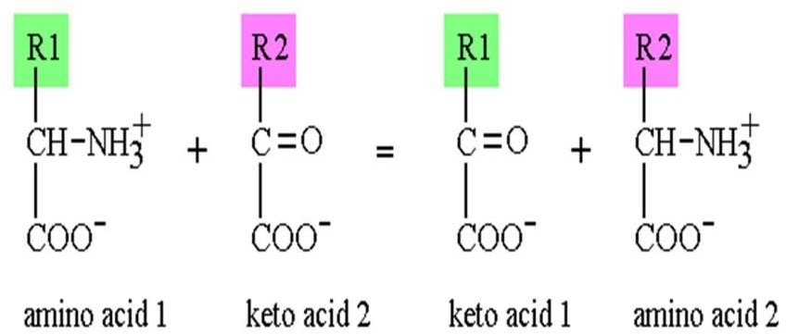
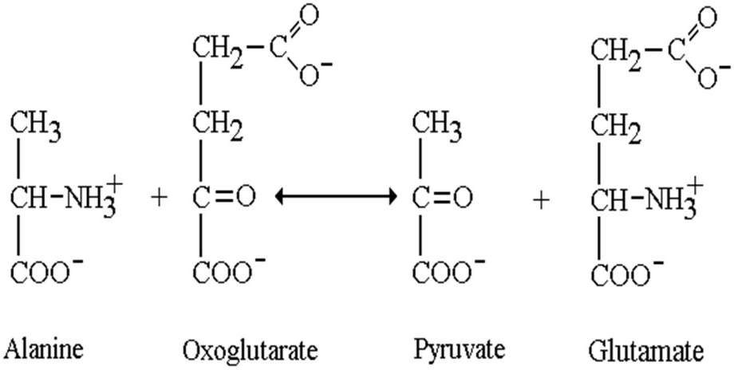
17

Slide 18
Biological significance of transamination
First step of catabolism:
Ammonia is removed, and rest of the amino acid is entering into catabolic pathway.
Synthesis of non-essential amino acids:
By means of transamination, all non-essential amino acids could be synthesized by the body from keto acids available for other sources
18

Slide 19
Clinical significance of
transamination
Aspartate aminotransferase (AST) is increased in myocardial infarction and alanine amino transferase (ALT) in liver diseases
19

Slide 20
B. Trans-deamination
It means transamination followed by oxidative deamination.
All amino acids are first transaminated to
glutamate, which is then finally deaminated.
Glutamate dehydrogenase reaction is the final reaction which removes the amino group of all amino acids.
Thus, the two components of the reaction are physically far away, but physiologically they are coupled. Hence, the term trans-deamination
20

Slide 21
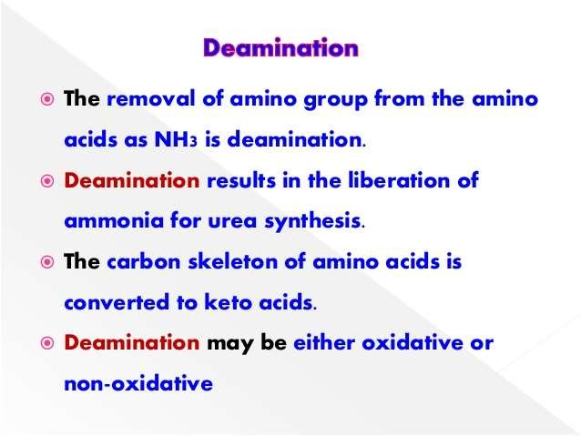

Slide 22
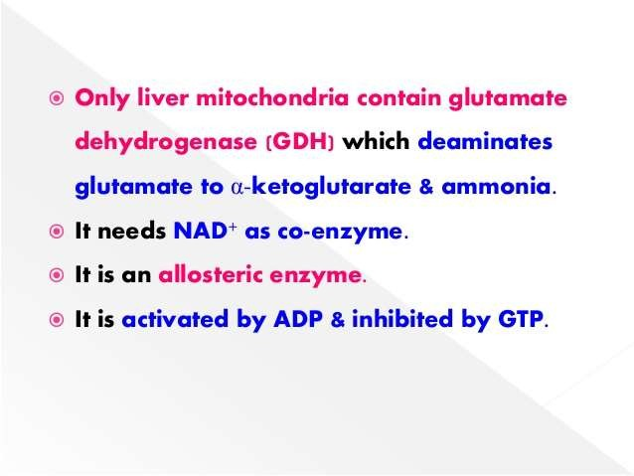

Slide 23
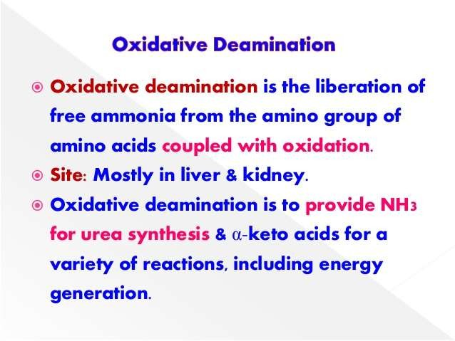

Slide 24
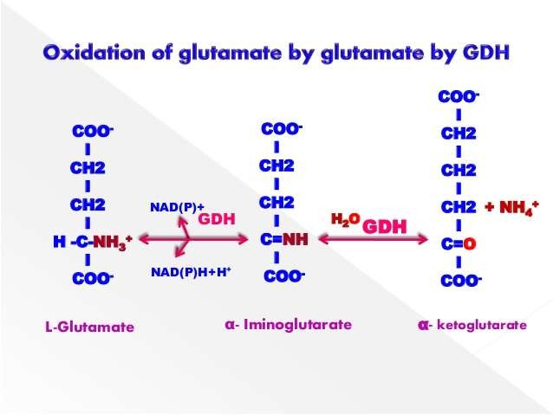

Slide 25
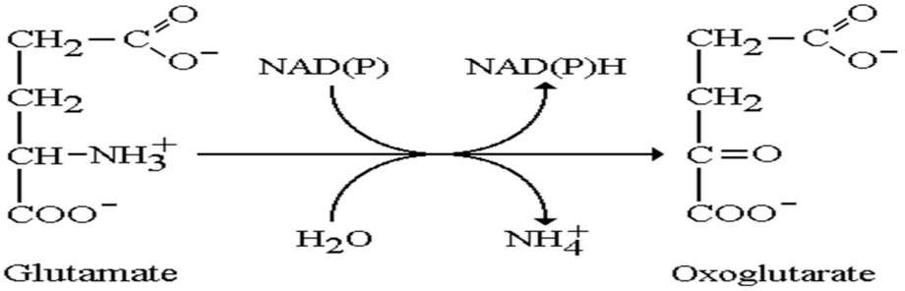
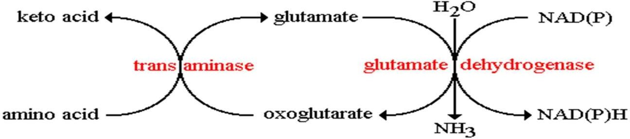
21

Slide 26
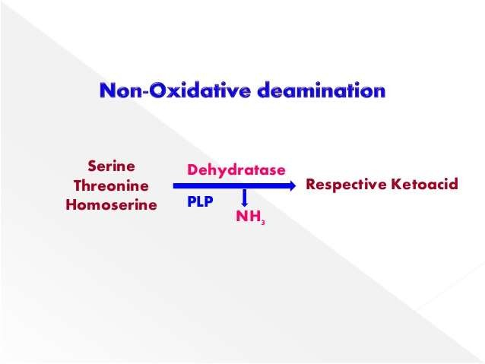
Some of the amino acids can be deaminated to liberate NH3 without undergoing oxidation

Slide 27
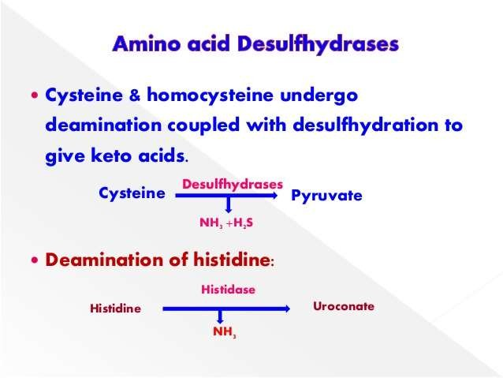

Slide 28
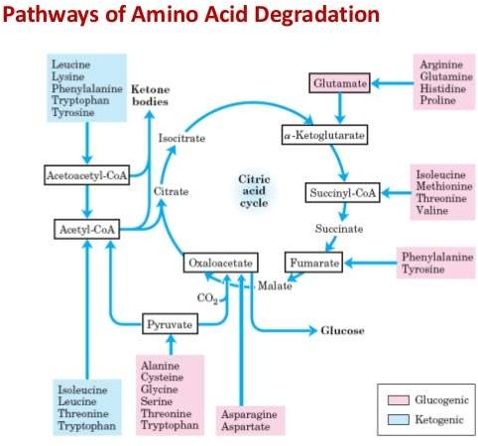

Slide 29
Disposal/Detoxification of Ammonia
1. First line of defense (Trapping of ammonia):
Even very minute quantity of ammonia may produce toxicity in central nervous system.
The intracellular ammonia is immediately trapped by glutamic acid to form glutamine, especially in brain cells.
The glutamine is then transported to liver, where the reaction is reversed by the enzyme glutaminase.
The ammonia thus generated is immediately
detoxified into urea.
22

Slide 30
2. Final disposal:
The ammonia from all over the body thus reaches liver.
It is then detoxified to urea by liver cells.
Then excreted through kidneys.
Urea is the end product of protein metabolism
23

Slide 31
Urea Cycle
The cycle is known as Krebs-Henseleit urea cycle.
As ornithine is the first member of the reaction sequences, it is called as Ornithine cycle.
The two nitrogen atoms of urea are derived from two different sources, one from ammonia and the other directly from aspartic acid.
24

Slide 32
Urea molecule
25

Slide 33
Steps of Urea Cycle
Formation of Carbamoyl Phosphate.
Formation of Citrulline.
Formation of Argininosuccinate.
Formation of Arginine.
Formation of Urea.
26

Slide 34
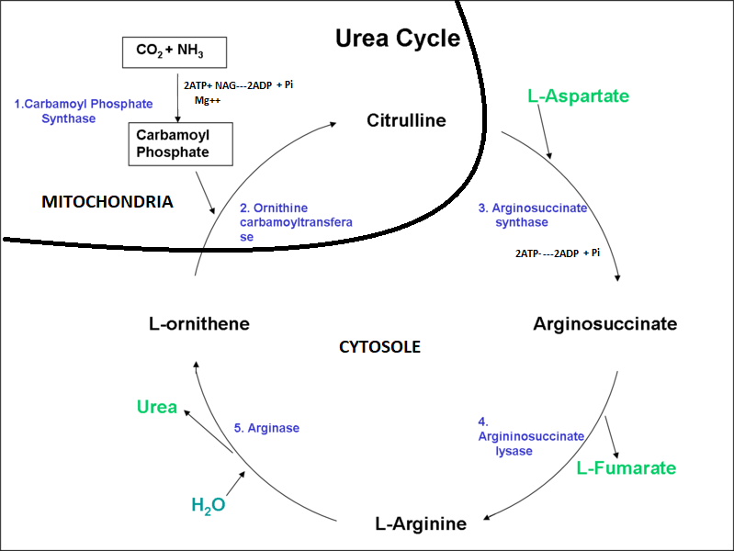

Slide 35


Steps of Urea Cycle
1
2 ATP + HCO₃⁻ + NH₃
Carbamoyl phosphate + 2 ADP + P_{i}
P_{i}
Mitochondrion
.
Ornithine
2
Citrulline
Citrulline
Ornithine
Urea cycle
ATP
3
Aspartate
Urea
H₂O
5
Cytosol
AMP + PP_{i}
Arginino-
succinate
Arginine
4
Fumarate
Malate
Oxaloacetate
27

Slide 36
Regulation of the urea cycle
During starvation, the activity of urea cycle enzymes is elevated to meet the increased rate of protein catabolism.
The major regulatory steps is catalyzed by CPS-I (Carbamoyl phosphate synthetase-I) where the positive effectror is N-acetyl glutamate (NAG).
29

Slide 37
Disorderers of urea cycle
Deficiency of any of the urea cycle enzymes would result in hyperammonemia.
If block occur in one of the earlier steps, the condition is more severe, since ammonia itself accumulates.
If deficiency occur in later enzymes, this result in accumulation of other intermediates which are less toxic and hence symptoms are less.
30

Slide 38
The accumulation of ammonia in blood (normally less than 50 mg/dl) and body fluids results in toxic symptoms.
Brain is very sensitive to ammonia.
Child may be put on a low protein diet and frequent small feeds are given.
Since Citrulline is present in significant quantities in milk, breast milk is to be avoided in Citrullinemia.
31

Slide 39
Urea level in blood and urine
In clinical practice, blood urea level is taken as an indicator of renal function.
The normal urea level in plasma is from 20 to 40 mg/dl.
Blood urea level is increased where renal function is inadequate.
Urinary excretion of urea is 15 to 30 g/day (6-15 g nitrogen/day).
Urea constitutes 80% of urinary organic solids.
32

