Slide 1
Ketone Body Metabolism
Presented By-
Mohammad Shahrukh
M.Sc. Medical Biochemistry
(Ph.D. Scholar)

Slide 2
OBJECTIVES
Ketone bodies and their biological significance.
Ketogenesis and its regulation.
Utilization of ketone bodies.
Disorders associated with ketone bodies.

Slide 3
Introduction
Ketone bodies are three chemicals (Acetone, Acetoacetate and β-Hydroxybutyrate) that are produced when fatty acids are broken down in excess.
Production of these compounds is called “ketogenesis”, and this is necessary in small amounts.

Slide 4

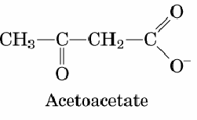
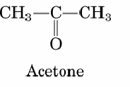
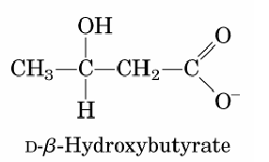
Ketone bodies
Acetone
Acetoacetate
β - Hydroxybutyrate

Slide 5
Introduction
Ketone bodies are produced from acetyl-CoA, mainly in the mitochondrial matrix of liver cells when carbohydrates are so scarce that energy must be obtained from breaking down of fatty acids.

Slide 6
Ketone Bodies as Fuel
water soluble
transported across the inner mitochondrial membrane as well as across the blood-brain barrier and cell membranes.
Source of fuel for brain, heart and muscle
Major energy source(75%) for brain during starvation

Slide 7
Introduction
when excess ketone bodies accumulate, this abnormal (but not necessarily harmful) state is called ketosis.
When even larger amounts of ketone bodies accumulate such that the body's pH is lowered to dangerously acidic levels, this state is called ketoacidosis.

Slide 8
Introduction
Ketone bodies are used for energy.
Ketone bodies are transported from the liver to other tissues, where acetoacetate and β-hydroxybutyrate can be reconverted to acetyl-CoA to produce energy.
The heart gets much of its energy from ketone bodies, although it also uses a lot of fatty acids

Slide 9
Introduction
The brain gets its energy from ketone bodies when insufficient glucose is available (e.g. fasting).
In the event of low blood glucose, most other tissues have additional energy sources besides ketone bodies (such as fatty acids) but the brain does not.

Slide 10
Ketone body synthesis
Liver – Mitochondria
Some of the Acetyl-CoA produced by fatty acid oxidation in liver mitochondria is converted to Acetone, Acetoacetate and β-hydroxybutyrate.
Transport of fatty acids through the mitochondrial membrane is an important regulatory point.

Slide 11
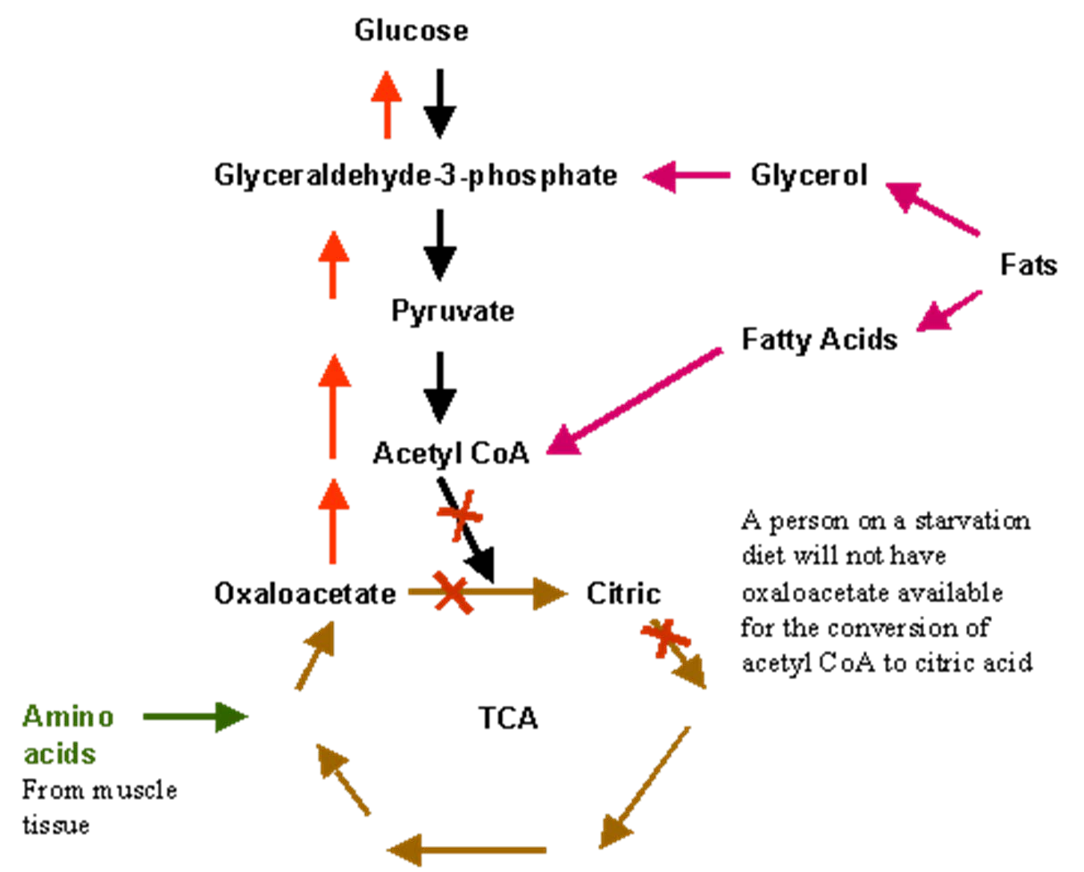
A person on starvation will not have oxaloacetate available for the conversion of acetyl CoA to citric acid

Slide 12


Slide 13
Ketogenesis
First step – Reverse of Thiolase.
Second step – Synthesis of HMG CoA.
These reactions are mitochondrial analogues of the (cytosolic) first two steps of cholesterol synthesis.
Third step – HMG CoA Lyase.

Slide 14
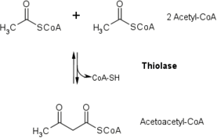
Ketogenesis
Reverse of Thiolase step
2 Acetyl CoA
Thiolase
CoA-SH
Acetoacetyl CoA

Slide 15
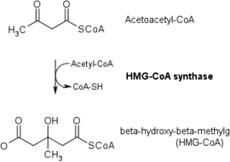
Ketogenesis
Synthesis of HMG CoA
Acetoacetyl CoA
Acetyl CoA
HMG CoA synthase
CoA-SH

Slide 16
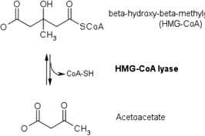
Ketogenesis
Lysis of HMG CoA
β-Hydroxy-β-Methyl Glutaryl CoA (HMG CoA)
HMG CoA Lyase
CoA-SH
Acetoacetate

Slide 17
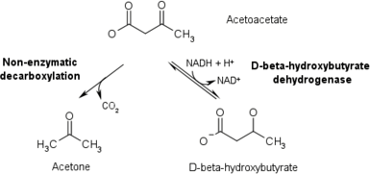
Ketogenesis
Parent ketone body producing other ketone bodies
Acetoacetate
Non-enzymatic decarboxylation
NADH+H⁺
β-Hydroxy butyrate dehydrogenase
NAD⁺
CO₂
Acetone
β-Hydroxy butyrate

Slide 18
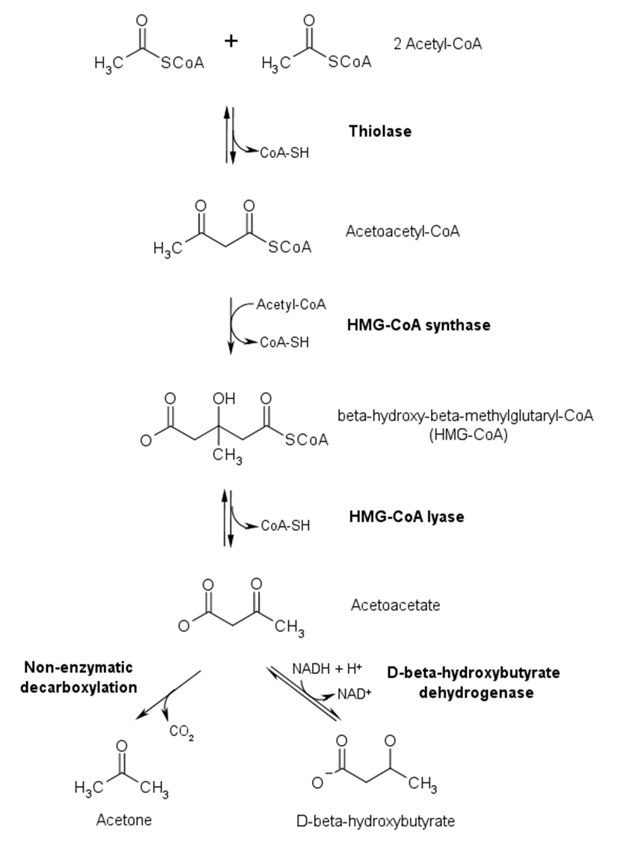

Slide 19
Acetone
Acetone is formed from spontaneous decarboxylation of acetoacetate.
In a corresponding manner, the levels of acetone are much lower than those of the other two types of ketone bodies.
Acetone is produced in small quantities; highly volatile. Hence it is not used by the body.

Slide 20
Acetone (Contd)
Acetone cannot be converted back to acetyl-CoA, so it is excreted in the urine and exhaled (it can be exhaled because it has a high vapor pressure and thus evaporates easily).
The exhalation of acetone is responsible for the characteristic "fruity" odour of the breath of persons in ketotic states.

Slide 21
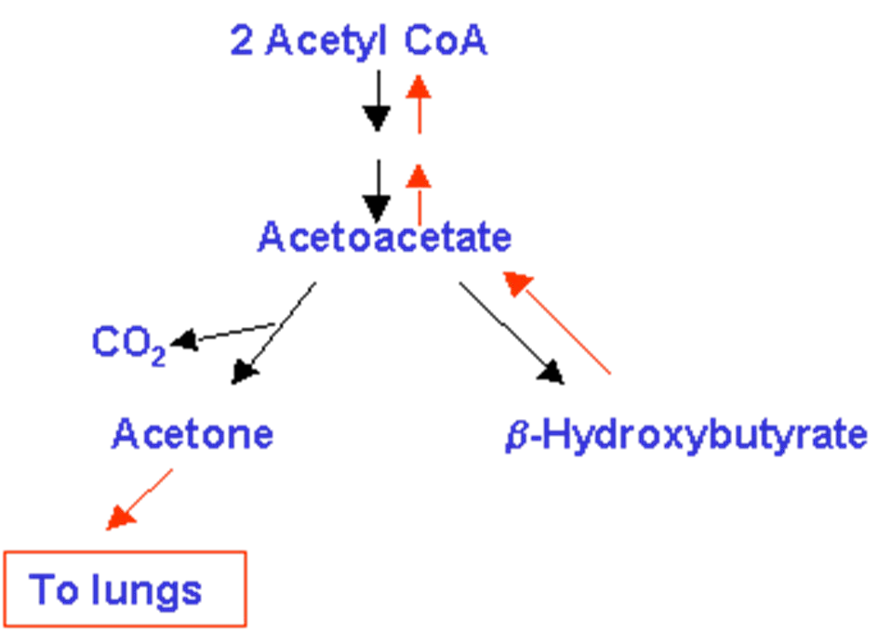

Slide 22
Utilization of Ketone bodies

Slide 23
Liver cannot utilizes ketone bodies
β-hydroxy butyrate is converted to acetoacetate for energy.
For oxidation of Acetoacetate, it has to be activated to Acetoacetyl CoA by “succinyl CoA-acetoacetate CoA transferase”.
This transferase is absent in liver.

Slide 24


Ketone Bodies As energy sources
β-Hydroxybutyrate
Acetoacetate
Succinyl CoA
Succinyl CoA-acetoacetate CoA transferase
Thiolase
Succinic acid
2 Acetyl CoA
Acetoacetyl CoA
TCA Cycle

Slide 25

Acyl CoA
β-oxidation Acetyl CoA
FFA
Acetyl CoA
Thiolase
Acetoacetyl
CoA
Succinate
HMG CoA
Acetoacetate
NADH+H⁺
NAD⁺
β-OH
butyrate
OAA
CoA transferase
TCA cycle
Succinyl
CoA
Citrate
Acetoacetate
NADH+H⁺ NAD⁺
β-OH
butyrate

Slide 26
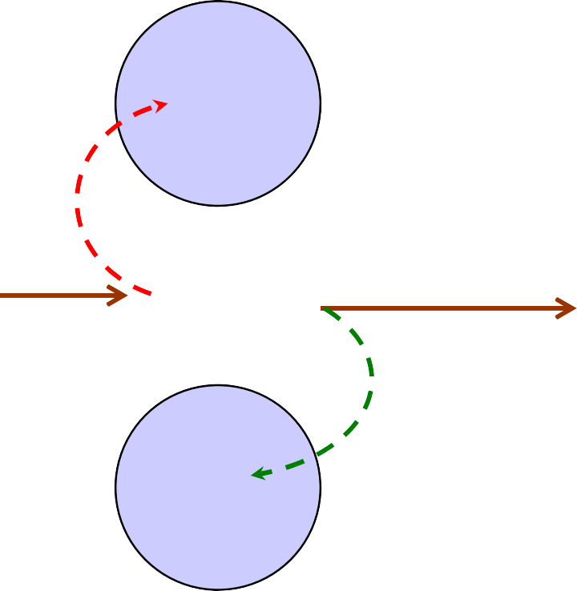
Liver
Blood
Extrahepatic Tissues
Acyl CoA
FFA
Glucose
Glucose
Acyl CoA
Urine
Acetyl CoA
Acetyl CoA
Ketone bodies
Ketone bodies
Ketone bodies
TCA
Cycle
Acetone Lungs
TCA
Cycle
2CO₂
2CO₂

Slide 27
Regulation of Ketogenesis

Slide 28
Triacylglycerol
1
Adipose tissue
FFA
Blood
FFA
Acyl CoA
Esterification
Liver
CPT I
gateway
2
β-oxidation
Acetyl CoA
Ketogenesis
Acylglycerols
Citric
3
acid cycle
Ketone bodies
CO₂

Slide 29
Regulation of ketogenesis in adipose tissue :
The factors regulating mobilization of FFAs from adipose tissue are important in controlling ketogenesis.
The liver, both in fed and in fatsing conditions, extracts about 30% of the FFAs passing through it.
At high concentrations of FFA, the flux passing through the liver is substantial.

Slide 30
Carnitine Palmitoyltransferase-I (CPT-I) Gateway
CPT-I activity regulates the entry of long chain acyl groups into mitochondria.
The activity of CPT-I is
  Low in the fed state – depression of FA oxidation.
  High in starvation – FA oxidation Increase.

Slide 31
Carnitine Palmitoyltransferase-I (CPT-I) Gateway
Malonyl CoA is formed by acetyl CoA carboxylase in the fed state – potent inhibitor of CPT – I .
In fed state, FFAs enter the liver cells in low conc. And are nearly all esterified to Acylglycerols and transported out of the liver in VLDL.
↓sed [ Insulin ] / [ Glucagon ] ratio in starvation inhibit ketogenesis.

Slide 32
Carnitine Palmitoyltransferase-I (CPT-I) Gateway
With the onset of starvation, conc of FFA increase, acetyl CoA carboxylase is inhibited by acyl CoA, and [ malonyl CoA ] decreases.
This decrease of [ malonyl CoA ] releases the inhibition on CPT-I, allowing more acyl CoA to be
β-oxidized.

Slide 33
Partition of Acetyl CoA between the pathway of ketogenesis and oxidation to CO₂
This partition is so regulated that the total free energy captured in ATP which results from the oxidation of FFAs remains constant.
Ketogenesis allows liver to oxidize increasing quantities of FAs within a tightly coupled system of oxidative phosphorylation, without increaing its total energy expenditure.

Slide 34
Partition of Acetyl CoA between oxidation and KB production
Complete oxidation of palmitate: 129 ATP
If acetoacetate is the end product :
7 cycles of betaoxidation of palmitate forms 8 acetyl CoA, which join to form 4 acetoacetate.
5 ATP for each cycle of betaoxidation. Total ATP formed 35.
2 are used for initial activation.
Thus 33 ATP are formed if acetoacetate is the end product.
If β-OH butyrate is the end product:
4 acetoacetate form 4 β-OH butyrate using 4 NADH(i.e.,12 ATP)
Thus 33-12= 21 ATP

Slide 35
KB in blood & urine
Normal KB in plasma: 0.2mmol/L
Starvation : 3-5 mmol/L
Diabetic ketoacidosis: >12mmol/L
KB of >12mmol/L, saturates all oxidative pathways.
Normal KB in urine: <1mg/day

Slide 36
Metabolic Acidosis due to KBs
Both acetoacetate and beta-hydroxybutyrate are acidic, and, if levels of these ketone bodies are too high, the pH of the blood drops, resulting in ketoacidosis.
This happens in untreated Type I diabetes, and also during prolonged starvation.

Slide 37
Excess of Ketogenesis (Cause)
Diabetes Mellitus (Untreated)
Extreme starvation
Gluconeogenesis (Liver)
Oxaloacetate (TCA cycle intermediate) is used Consumption of Acetyl CoA is slowed down
Excess of Acetyl CoA in Liver

Slide 38
Excess of Ketogenesis (Cause)– contd.
Liver catabolizes fatty acids to meet the energy demand by other tissues
Excess of Acetyl CoA is produced, which are destined to form ketone bodies.
Ketone bodies are transported by blood to Muscle and Brain.
Ketone body formation regenerates free CoA, which is required for β-oxidation.

Slide 39
Metabolic Acidosis due to KBs
CH₃COCH₂CO₂H pK_{a} = 3.6
Acetoacetic Acid
OH
CH₃CHCH₂CO₂H pK_{a} = 4.7
β-Hydroxybutyrate
Concentration of acetoacetic acid can result in metabolic acidosis (pH 7.1) affinity of Hb for O₂.

Slide 40

Metabolic Acidosis due to KBs
Ketone bodies being acidic in nature, release H⁺ ions into blood. They are buffered by HCO3–.
H⁺ + HCO₃ H₂CO₃ H₂O+CO₂
-
CA CA
Exhaled
Continuous production of ketone bodies depletes alkali reserve resulting in ketoacidosis.

Slide 41
Ketone bodies in Starvation
After the diet has been changed to lower blood glucose for 3 days, the brain gets 30% of its energy from ketone bodies.
After 40 days, this goes up to 70% (during the initial stages the brain does not burn ketones, since they are an important substrate for lipid synthesis in the brain).
The brain retains some need for glucose, because ketone bodies can be broken down for energy only in the mitochondria, and brain cells' long thin axons are too far from mitochondria.

Slide 42
Starvation ketoacidosis
Absence of intake of food
No stimuli from intestine to release insulin from pancreas.
Insulin &
glucagon
Lipolysis &
Oxidation of fatty acids
Ketoacidosis

Slide 43
Laboratory diagnosis of KA due to starvation.
Blood glucose: low, may be < 50 mg/dl
Serum bicarbonate:< 15 mEq/L
pH: <7.3
Urine glucose: Nil
Ketonuria: 3+

Slide 44
Diabetic ketoacidosis(DKA)
DKA is due to a marked deficiency of insulin in the face of hormones that oppose the effects of insulin, particularly glucagon. Even small amounts of insulin can turn off ketoacid formation.
Hormones that antagonise insulin action:
  Glucagon
  Cortisol
  Oestrogens
  Growth hormone
  Catecholamines

Slide 45
Ketone Bodies and Diabetes
"Starvation of cells in the midst of plenty"
Glucose is abundant in blood, but uptake by cells in muscle, liver, and adipose cells is low due to absence of insulin.
Cells, metabolically starved, turn to gluconeogenesis and fat/protein catabolism
In type I diabetics, OAA is low, due to excess gluconeogenesis, so Acetyl CoA from fat/protein catabolism does not go to TCA, but rather to ketone body production
Acetone can be detected on breath of type I diabetics

Slide 46
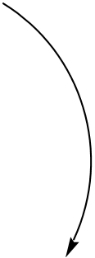
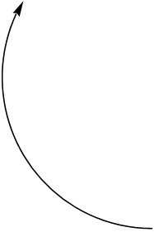

Ketones in Diabetes Mellitus
Ketogenic Amino Acids
Glycolysis
Fatty Acids
Glucose Oxaloacetate
Gluconeogenesis
Acetyl CoA
TCA
Cycle
Ketone Bodies
Glucogenic Amino Acids
Citrate
Glucose in cells
Gluconeogenesis
Oxaloacetate
Fatty Acid breakdown
Acetoacetyl CoA
Ketone Bodies

Slide 47
Laboratory diagnosis of DKA
Blood glucose:> 250 mg/dl
Serum bicarbonate:< 15 mEq/L
pH: <7.3
Urine glucose: +++
Ketonuria: 3+

