Slide 1
HMP Shunt
Or
Pentose Phosphate Pathway

Slide 2
HMP pathway or HMP shunt is also called as pentose phosphate pathway or phosphogluconate pathway.
HMP pathway is also known as lipman-warburg dickens pathway.
This is an alternative pathway to glycolysis and TCA cycle for the oxidation of glucose.
HMP shunt is more anabolic in nature.

Slide 3
It is concerned with the biosynthesis of NADPH & pentoses.
About 10% of glucose entering in this pathway/day.
The liver & RBC metabolise about 30% of glucose by this pathway.

Slide 4
Location of the pathway
The enzymes are located in the cytosol.
The tissues such as liver, adipose tissue, adrenal gland, erythrocytes, testes & lactating mammary gland, are highly active in HMP shunt.
Most of these tissues are involved in biosynthesis of fatty acids and steroids which are dependent on the supply of NADPH.

Slide 5
HMP shunt-unique multifunctional pathway
It starts with glucose 6-phosphate.
No ATP is directly utilized or produced in HMP shunt
It is multifunctional pathway, several interconvertible substances produced, which are proceed in different directions in the metabolic reactions

Slide 6
Reactions of the pathway
Reactions of the pathway:
Divided into Two phases oxidative & non – oxidative.
Oxidative phase
Step:1
Glucose 6- phosphate is oxidised by NADP- dependent Glucose 6- phosphate dehydrogenase (G6PD), 6- phosphogluconolactone is formed.
NADPH is formed in this reaction and this is a rate limiting step.

Slide 7
Step:2
6-phosphogluconolactone is hydrolysed by glucono lactone hydrolase to form 6-phosphogluconate.
Step : 3
The next reaction involving the synthesis of NADPH and is catalysed by 6 – phosphogluconate dehydrogenase to produce 3 keto 6 – phosphogluconate which then undergoes
decarboxylation to give ribulose 5 – phosphate.

Slide 8
Non-Oxidative Phase
Step: 4
The ribulose -5-phosphate is then isomerized to ribose -5-phosphate or epimerised to xylulose -5- phosphate
Step: 5 Transketolase reaction
Transketolase is a thiamine pyrophosphate (TPP) dependent enzyme.

Slide 9
It transfers two-carbon unit from xylulose 5- phosphate to ribose 5-phosphate to form a 7- carbon sugar, sedoheptulose 7-phosphate and glyceraldehyde 3 – phosphate.

Slide 10
Step: 6 Transaldolase reaction
Transaldolase brings about the transfer of a 3 – carbon fragment from sedoheptulose 7-phosphate to glyceraldehyde 3-phosphate to give fructose 6- phosphate & 4 – carbon erythrose 4 – phosphate.

Slide 11
Step: 7 Second transketolase Reaction
In another transketolase reaction a 2 – carbon unit is transferred from xylulose 5 – phosphate to erythrose 4 – phosphate to form fructose 6 – phosphate & glyceraldehyde 3 – phosphate.
Fructose 6 – phosphate & glyceraldehyde 3 – phosphate are further metabolized by glycolysis & TCA cycle.

Slide 12
HMP-Shunt pathway
Glucose 6-phosphate NADP+
Glucose 6P-
_{Mg}+2
NADPH + H⁺
dehydrogenase
6-phosphoglucanolactone
Glucanolactone
hydrolase
6-phosphogluconate NADP+
Phosphogluconate
dehydrogenase
_{Mg}+2
CO₂, NADPH + H⁺
Ribulose 5-phosphate

Slide 13




Ribulose 5-phosphate
Xylulose 5-phosphate
Fructose 6-
Phosphate
Xylulose 5-phosphate
Ribose 5-phosphate
Transketolase, TPP Glyceraldehyde 3-
phosphate
Transaldolase
Fructose 6- Phosphate
Transketolase,
TPP
Sedoheptolose 7- phosphate
Glyceraldehyde 3-
phosphate
Erythrose 4- Phosphate
Fructose 6-
Phosphate

Slide 14
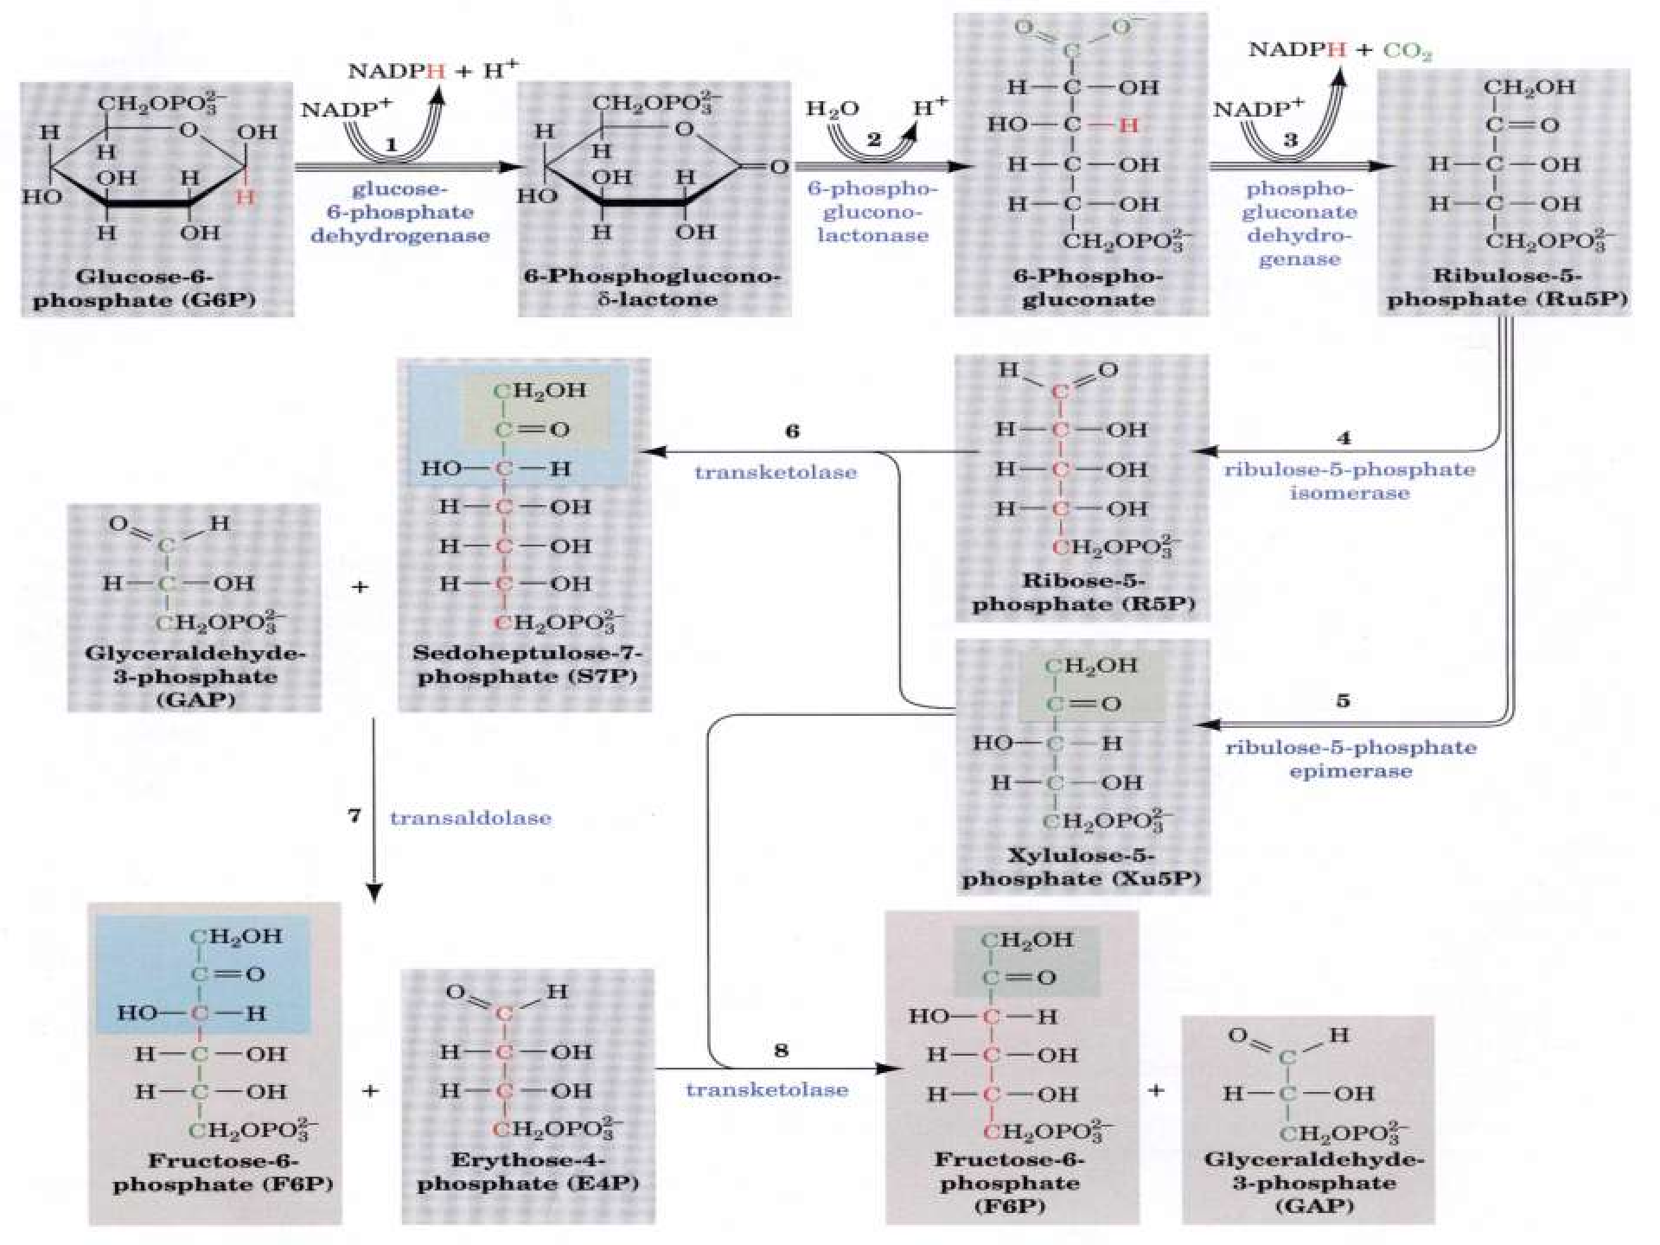

Slide 15
Significance of HMP Shunt
HMP shunt is unique in generating two important products- pentoses and NADPH
Importance of pentoses:
In HMP shunt, hexoses are converted into pentoses, the
most important being ribose 5 – phosphate.
This pentose or its derivatives are useful for the synthesis of nucleic acids (DNA & RNA)
Many nucleotides such as ATP, NAD⁺, FAD & CoA

Slide 16
Importance of NADPH
NADPH is required for the bio synthesis of fatty acids and steroids.
NADPH is used in the synthesis of certain amino acids involving the enzyme glutamate dehydrogenase.
Free radical Scavenging
The free radicals (super oxide, hydrogen peroxide) are continuously produced in all cells.

Slide 17
These will destroy DNA, proteins, fatty acids & all biomolecules & in turn cells are destroyed.
The free radicals are inactivated by the enzyme systems containing SOD, POD & glutathione reductase.
Reduced GSH is regenerated with the help of NADH.

Slide 18
Erythrocyte Membrane intigrity
NADPH is required by the RBC to keep the glutathione in the reduced state.
In turn, reduced glutathione will detoxify the peroxides & free radicals formed within the RBC.
NADPH, glutathione & glutathione reductase together will preserve the intigrity of RBC
membrane.

Slide 19
Prevention of Met-Hemoglobinemia
NADPH is also required to keep the iron of hemoglobin in the reduced (ferrous) state & to prevent the accumulation of met-hemoglobin.
Met-hemoglobin cannot carry the oxygen.

Slide 20
Detoxification of Drugs
Most of the drugs and other foreign substances are detoxified by the liver microsomal P450 enzymes, with the help of NADPH.
Lens of Eye:
Maximum concentration of NADPH is seen in lens of eye.
NADPH is required for preserving the transparency of lens.

Slide 21
Macrophage bactericidal activity:
NADPH is required for the production of reactive oxygen species (ROS) by macrophases to kill bacteria.
Availability of Ribose:
Ribose & Deoxy – ribose are required for DNA & RNA synthesis.

Slide 22
Ribose is also necessary for nucleotide co – enzymes.
Reversal of non – oxidative phase is present in all tissues, by which ribose could be made available.
What about ATP
ATP is neither utilized nor produced by the HMP shunt.
Cells do not use the shunt pathway for energy production.

Slide 23
Regulation of HMP Shunt
The entry of glucose 6-phosphate into the pentose phosphate pathway is controlled by the cellular concentration of NADPH
NADPH is a strong inhibitor of glucose 6-phosphate dehydrogenase (G6PD)
NADPH is used in various pathways, inhibition is
relieved & the enzyme is accelerated to produce more NADPH

Slide 24
 The synthesis of glucose 6-phosphate dehydrogenase is induced by the increased insulin/glucagon ratio after a high carbohydrate meal.

Slide 25
Glucose-6-phosphate dehydrogenase deficiency (G6PD)
It is an inherited sex – linked trait.
It is more severe in RBC.
Decreased activity of G6PD impairs the synthesis of NADPH in RBC.
This results in the accumulation of meth hemoglobin & peroxides in erythrocytes leading to hemolysis.

Slide 26
The deficiency is manifested only when exposed to certain drugs or toxins, e.g.intake of antimalarial drug like primaquine & ingestion of fava beans(favism) & sulpha drugs also parecipitate the hemolysis

Slide 27
Some patients developed severe symptoms
Jaundice, decrease in Hb, destruction of RBCs.
In deficiency of G6PD, Hb can no longer be maintained in the reduced form.
Hb molecules then cross-link with one another to form aggregates called Heinz bodies on membranes.
Membranes damaged by the Heinz bodies & ROS become
deformed & the cell undergos LYSIS → Hemolytic anemia

Slide 28
G6PD deficiency & malaria
G6PD deficiency is associated with resistance to malaria (caused by plasmodium infection)
The parasite requires reduced glutathione for its survival, which will not be available in adequate amounts in deficiency of G6PD.
Met – hemoglobinemia
G6PD deficient persons will show increased Met – hemoglobin in circulation, even though cyanosis may not be manifested.

Slide 29
Thiamine Deficiency
The transketolase activity is measured in RBCs is an index of the thiamine status of an individual.
The occurrence & manifestation of Wernickes korsakoffs syndrome (encephalopathy) which is seen in alcoholics & those with thiamine deficiency is due to a genetic defect in the enzyme transketolase.
The symptoms include mental disorder, loss of memory &
partial paralysis.

Slide 30




