Slide 1
Glycolysis

Slide 2

Metabolism
Metabolism is “the entire set of enzyme- catalyzed transformations of organic molecules in living cells.
Two broad classes: Catabolism & Anabolism Catabolic Pathways:
Transform fuels into cellular energy

Slide 3
Anabolic Pathways
Requires inputs of energy to proceed. Useful energy + small molecules complex molecules.
Pathways that can be either anabolic or catabolic, depending on the energy conditions in the cell are referred to as amphibolic pathways

Slide 4
Glycolysis
Glycolysis occurs in almost every living cell. It was the first metabolic sequence to be studied.
This pathway is also called Embden- Meyerhof pathway (E.M-Pathway).
It occurs in cytosol.

Slide 5
Definition
Glycolysis is defined as the sequence of reactions converting glucose to pyruvate or lactate, with the production of ATP.
Salient features:
Takes place in all cells of the body.
The enzymes of this pathway are present in the cytosomal fraction of the cell.

Slide 6
Glycolysis occurs in the absence of oxygen (anaerobic) or in presence of oxygen (aerobic).
Lactate is the end product under anaerobic condition.
In aerobic condition, pyruvate is formed, which is then oxidized to CO₂ & H₂O.

Slide 7
Glycolysis is a major pathway for ATP synthesis in tissues lacking mitochondria, erythrocytes, cornea, lens etc.
Glycolysis is very essential for brain which is dependent on glucose for energy.

Slide 8
The glucose in brain has to undergo glycolysis before it is oxidized to CO₂ & H₂O. Glycolysis is a central metabolic pathway with many of its intermediates providing branch point to other pathways.
The intermediates of glycolysis are useful for the synthesis of amino acids and fat.

Slide 9
Glucose entry into cells Glucose transporter-4 (GluT4) transports glucose from extracellular fluid to muscle cells & adipocytes.
This is under the influence of Insulin.
In diabetes mellitus, insulin deficiency hinders the entry of glucose into the peripheral cells.
GluT2 is the transporter in liver cell. It is not under the control of insulin.

Slide 10
Reactions of Glycolysis
Divided into three distinct phases.
Energy investment phase or priming phase Splitting phase
Energy generation phase.

Slide 11
Energy investment phase
Glucose obtained from
The diet through intestinal hydrolysis of lactose, sucrose, glycogen, or starch is brought into the hexose phosphate pool through the action of hexokinase.
Free glucose is phosphorylated to glucose 6 phosphate by hexokinase

Slide 12
Hexokinase splits the ATP into ADP & Pi, the Pi is added to the glucose.
Hexokinase Hexokinase is a key glycolytic enzyme.
Hexokinase or Glucokinase
Glucose
Glucose 6-Phosphate
_{Mg}+2
ATP
ADP

Slide 13
Phosphorylated sugar molecules do not readily penetrate cell membranes without specific carriers, this commits glucose to further metabolism in the cell.
In all tissues, the phosphorylation of glucose is catalyzed by hexokinase, one of the three regulatory enzymes of glycolysis.

Slide 14

Hoxokinase and glucokinase
Hexokinase Glucokinase
In all tissues Only in liver
10⁻² mmol/L 20 mmol/L
Occurrence
Km Value
Affinity to substrate High Low
Specificity
Acts on glucose, fructose
and mannose
Acts only on glucose
Induction
Not induced
Induced by insulin &
glucose
Acts only when blood glucose level is more then 100 mg/dl; then glucose is taken up by the liver cells for glycogen synthesis
Even when blood sugar level is low, glucose is utilized by body cells
Function

Slide 15
Isomerization of Glucose 6-P Glucose 6 P is a central molecule with a variety of metabolic fates- glycolysis, glycogenesis, gluconeogenesis and HMP pathway.
The isomerization of Glucose 6-P (an aldose sugar) to Fructose 6-P (a ketose sugar) is catalyzed by phosphohexose isomerase
It requires Mg⁺² ions.

Slide 16
The reaction is readily reversible, is NOT a rate limiting or regulated step.
Phosphohexose isomerase & Mg+2
Glucose 6-Phosphate Fructose 6-Phosphate

Slide 17
Phosphorylation of Fructose 6-P
Fructose 6- phosphate is phosphorylated to Fructose
1, 6- bisphosphate by Phosphofructokinase (PFK)
The PFK reaction is the rate-limiting step.
It is controlled by the concentrations of the
substrates ATP & Fructose 6-P
Phosphofructokinase
Fructose 6P
Fructose 1, 6-bisPhosphate
_{Mg}+2
ADP
ATP

Slide 18
Splitting Phase
The six carbon Fructose 1, 6- bisphosphate is split to 2 three carbon compounds.
Glyceraldehyde 3- phosphate & Dihydroxy acetone phosphate by the enzyme aldolase (Fructose 1, 6- bisphosphate aldolase).
The reaction is reversible is not subject to regulation.
Fructose 1,6- bisphosphate
Aldolase
Glyceraldehyde 3- Phosphate + DHAP

Slide 19
Isomerization of DHAP
Phosphotriose isomerase catalyzes the reversible interconversion of dihydroxyacetone phosphate & glyceraldehyde 3-phosphate.
Two molecules of glyceraldehyde 3-phosphate are
obtained from one molecule of glucose.
Phosphohexose isomerase
Glyceraldehyde 3-Phosphate
DHAP

Slide 20
Oxidation of glyceraldehyde 3P
Glyceraldehyde 3-phosphate dehydrogenase converts Glyceraldehyde 3-phosphate to 1,3- bisphosphoglycerate.
This step is important as it is involved in the formation of NADH +H⁺ & a high energy compound 1,3- bisphosphoglycerate.

Slide 21
In aerobic condition, NADH passes through the ET C and 6 ATP are synthesized by oxidative phosphorylation.
Glyceraldehyde 3P- dehydrogenase
Glyceraldehyde 3P
1,3-bisphosphoglycerate
NAD
NADH+H⁺
Pi

Slide 22
Formation of ATP from 1,3- bisphosphoglycerate & ADP
The enzyme phosphoglycerate kinase acts on 1,3- bisphosphoglycerate resulting in the synthesis of ATP and formation of 3- phosphoglycerate.
Phosphoglycerate kinase
1,3-bisphosphoglycerate
3P-glycerate
_{Mg}+2
ADP
ATP

Slide 23
This step is a substrate-level phosphorylation Production of a high-energy P is coupled to the conversion of substrate to product, instead of resulting from oxidative phosphorylation.
The energy will be used to make ATP in the next reaction of glycolysis.

Slide 24
The formation of ATP by P group transfer from a substrate such as 1,3- bisphosphoglycerate is referred to as a substrate-level phosphorylation.
Unlike most other kinases, this reaction is reversible.

Slide 25
3- Phosphoglycerate is converted to 2- Phosphoglycerate by phosphoglycerate mutase
This is isomerization reaction.
Phosphoglycerate mutase
3-Phosphoglycerate 2P-glycerate

Slide 26
The high energy compound PEP is generated from 2- Phosphoglycerate by the enzyme enolase.
This enzyme requires Mg⁺² or Mn⁺² and is inhibited by fluoride.
Enolase
2-Phoglycerate
Phosphoenolpyruvate
_{Mg}+2

Slide 27
The enzyme pyruvate kinase catalyses the transfer of high energy phosphate from PEP to ADP, leading to the formation of ATP. This step is also a substrate level phosphorylation.
Pyruvate kinase
Phosphoenolpyruvate
Pyruvate
_{Mg}+2
ADP
ATP

Slide 28
Glucose ATP
_{Mg}+2
ADP
Glucose 6-Phosphate
HK or GK
_{Mg}+2 Phosphohexose isomerase
Fructose 6-Phosphate
ATP
_{Mg}+2 ADP
Fructose 1, 6-bisphosphate
Phosphofructokinase
Aldolase
DHAP
Glyceraldehyde 3-Phosphate

Slide 29
Phosphohexose isomerase
Glyceraldehyde 3-Phosphate
DHAP
NAD
Pi
Glyceraldehyde 3P- dehydrogenase
Iodoacetate,
Arsenate
NADH+H⁺
1,3-bisphosphoglycerate
ADP
_{Mg}+2
ATP
Phosphoglycerate kinase
3P-glycerate
Mutase 2P-glycerate

Slide 30
2-Phoglycerate
_{Mg}+2
Enolase
Fluoride
H₂O
Phosphoenolpyruvate ADP
_{Mg}+2
ATP
Pyruvate
Pyruvatekinase
NAD
Lactate dehydrogenase
NADH+H⁺
Lactate

Slide 31
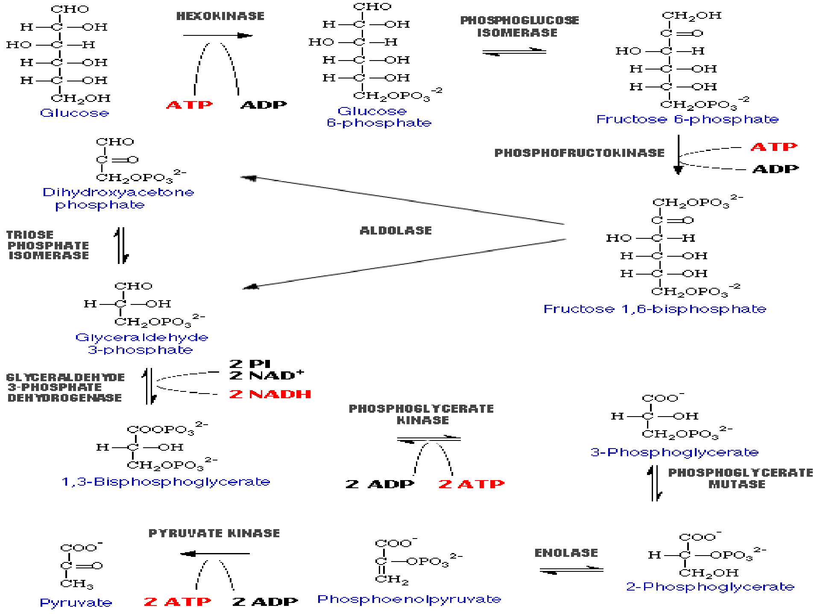

Slide 32
Regulation of glycolysis
Three regulatory enzymes: Hexokinase & glucokinase Phosphofructokinase Pyruvate kinase
Catalysing the irreversible reactions regulate glycolysis.

Slide 33
Hexokinase
Hexokinase is inhibited by glucose 6- phosphate.
This enzyme prevents the accumulation of glucose 6-phosphate due to product inhibition.

Slide 34
Glucokinase
Glucokinase, which specifically phosphorylates glucose, is an inducible enzyme.
The substrate glucose, probably through the involvement of insulin, induces glucokinase

Slide 35
Phosphofructokinase (PFK)
Phosphofructo kinase (PFK) is the most important regulatory enzyme in glycolysis PFK is an allosteric enzyme regulated by allosteric effectors ATP, citrate & H⁺ ions (low pH) are the most important allosteric inhibitors.
Fructose 2 ,6-bisphosphate, ADP, AMP & Pi are the allosteric activators.

Slide 36
Role of fructose 2,6-bisphosphate in glycolysis Fructose-2,6-bisphosphate (F2,6-BP) is considered to be the most important regulatory factor (activator) for controlling PFK & ultimately glycolysis in the liver.
F2,6-BP is synthesized from fructose 6-p by the enzyme phosphofructokinase called PFK-2 (PFK-1 is the glycolytic enzyme)

Slide 37

F2,6-BP is hydrolysed by fructose 2,6 - bisphosphatase.
The function of synthesis & degradation of F2,6-BP is brought out by a single enzyme (same polypeptide with two active sites) which is referred to as bifunctional enzyme.
The activity of PFK-2 & fructose 2,6- bisphosphatase is controlled by covalent modification which, in turn, is regulated by c AMP.

Slide 38
Cyclic AMP brings about dephosphorylation of the bifunctional enzyme, resulting in inactivation of active site responsible for the synthesis of F2,6-BP but activation of the active site responsible for the hydrolysis of F2,6-BP

Slide 39
Pyruvate kinase
PK Inhibited by ATP & activated by F1,6-BP. Pyruvate kinase is active (a) in dephosphorylated state & inactive (b) in phosphorylated state.
Inactivation of pyruvate kinase is brought about by cAMP-dependent protein kinase. The hormone glucagon inhibits hepatic glycolysis by this mechanism.

Slide 40
Energy yield from glycolysis
During anaerobic:
One molecule of glucose is converted to 2 molecules of lactate, there is a net yield of 2 molecules of ATP.
4 molecules of ATP are synthesized by 2 substrate level phosphorylation.
2 ATP molecules are used in steps 1 & 3, Hence, net yield is 2 ATP.

Slide 41
During Aerobic condition
2 NADH molecules, generated in the glyceraldehyde 3P-dehydrogenase reaction & enter ETC.
NADH provides 3 ATP, this reaction generates 3x2=6 ATP
Total ATP is 6+2=8 ATP.

Slide 42
Conversion of pyruvate to lactate
In anaerobic condition, pyruvate is reduced to lactate by lactate dehydrogenase (LDH).
LDH has 5 iso-enzymes.
The cardiac iso-enzyme of LDH will be increased in myocardial infarcts.

Slide 43
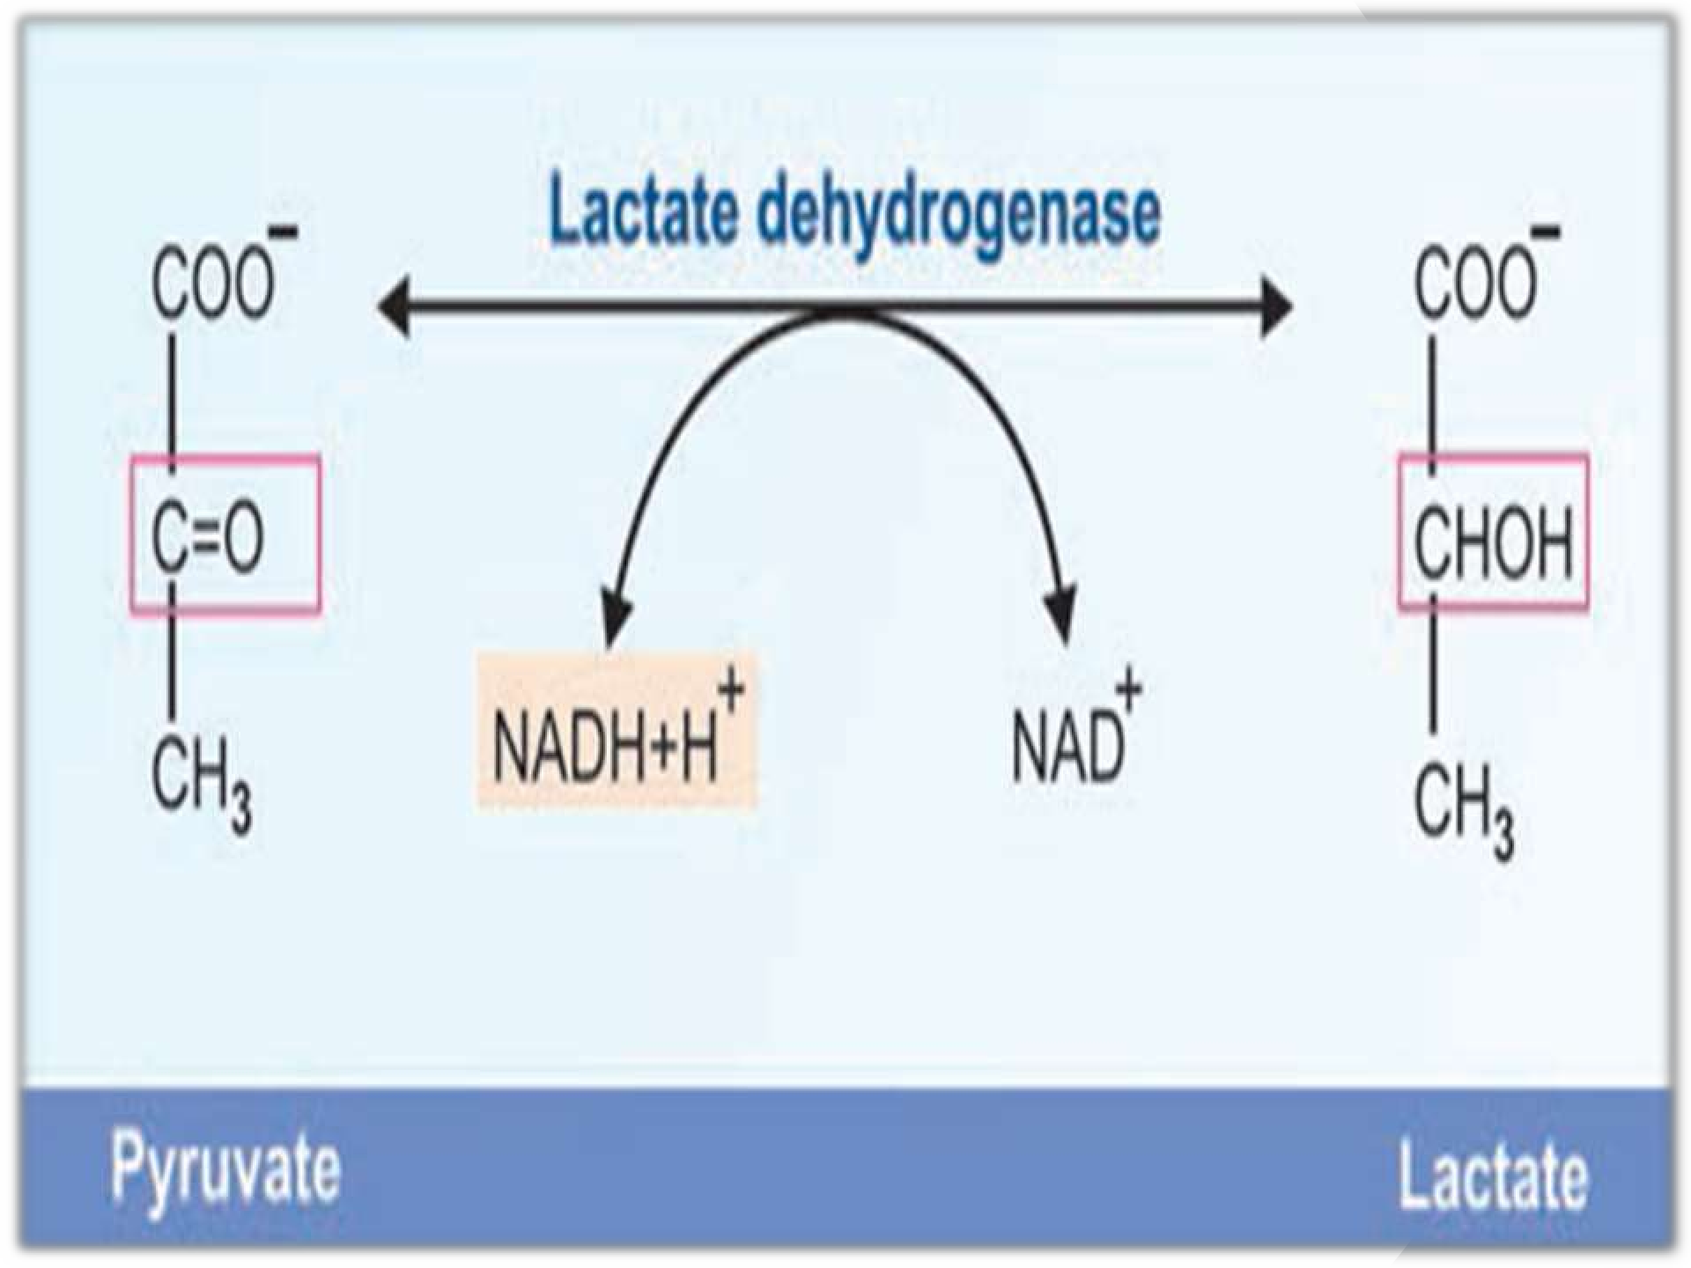
Conversion of pyruvate to lactate

Slide 44
Significance of Lactate Production
The NADH is obtained from the reaction catalysed by glyceraldehyde 3-phosphate dehydrogenase.
The formation of lactate allows the regeneration of NAD⁺ which can be reused by glyceraldehyde 3-phosphate dehydrogenase.
Glycolysis proceeds even in the absence of oxygen to supply ATP.

Slide 45
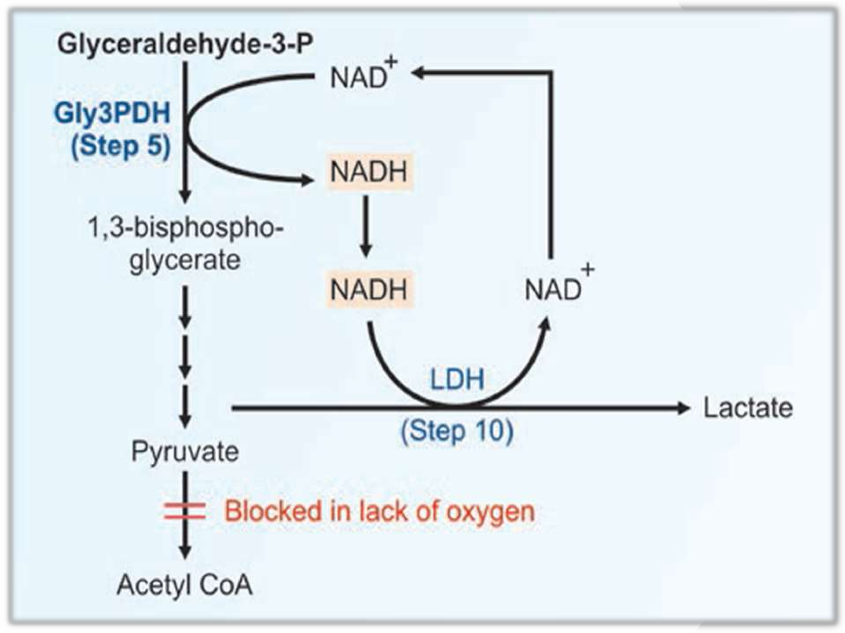
Reconversion of NADH to NAD⁺ during anaerobiasis

Slide 46
Glycolysis is very essential in skeletal muscle during strenous exercise where oxygen supply is very limited.
In RBCs, there are no mitochondria.
Glycolysis in the erythrocytes leads to lactate production
RBCs derive energy only through glycolysis, where the end product is lactic acid.

Slide 47
Lactic acidosis
Elevation of lactic acid in the circulation (normal plasma 4-15 mg/dl) may occur due to its increased production or decreased utilization.
Mild forms of lactic acidosis are associated with strenuous exercise, shock, respiratory diseases, cancers, low PDH activity, von Gierke's disease etc.

Slide 48
Severe forms of lactic acidosis are observed due to impairment/collapse of circulatory system -in myocardial infarction, pulmonary embolism, uncontrolled hemorrhage & severe shock.
This type of lactic acidosis is due to inadequate supply of O2 to the tissues with a drastic reduction in ATP synthesis, which may lead to death.

Slide 49
Oxygen debt refers to the excess amount of O2 required to recover.
Measurement of plasma lactic acid is useful to know about the oxygen debt, and monitor the patient's recovery.

Slide 50
Pasteur effect
The inhibition of glycolysis by oxygen (aerobic condition) is known as Pasteur effect.
Pasteur effect is due to the inhibition of the enzyme phosphofructokinase.
Glycolytic intermediates from fructose 1,6-
bisphosphate onwards decrease while the earlier intermediates accumulate.

Slide 51
Crabtree effect
Inhibition of oxygen consumption by the addition of glucose to tissues having high aerobic glycolysis is known as Crabtree effect. Opposite to that of Pasteur effect.
Crabtree effect is due to increased competition of glycolysis for inorganic phosphate (Pi) & NAD⁺ which limits their availability for phosphorylation & oxidation.

Slide 52
References
Textbook of Biochemistry – U Satyanarayana
Textbook of Biochemistry – DM Vasudevan Textbook of Biochemistry – MN Chatterjea

Slide 53


