Slide 1
Glycogenolysis

Slide 2
Glycogenolysis
The degradation of stored glycogen in liver & muscle constitutes glycogenolysis
The synthesis & degradation of glycogen are not reversible.
An independent set of enzymes present in the cytosol carry out glycogenolysis
Glycogen is degraded by breaking ɑ-l,4 & ɑ-1,6- Glycosidic bonds.

Slide 3
The ɑ-1,4-glycosidic bonds (from the non-
reducing ends) are cleaved sequentially by the enzyme glycogen phosphorylase to yield glucose 1–phosphate.
This process-called phosphorolysis- continues until four glucose residues remain on either side of branching point (ɑ-1,6 -glycosidic link).

Slide 4
 The glycogen so formed is known as limit dextrin which cannot be further degraded by phosphorylase.
 It is bound with one molecule of PLP.

Slide 5
The branches of glycogen are cleaved by two enzyme activities present on a single polypeptide called debranching enzyme,
It is a bifunctional enzyme.
Glycosyl 4 : 4 transferase (oligo ɑ-,1,4 l,4 glucantransferase) activity removes a fragment of 3 or 4 glucose residues attached at a branch & transfers them to another chain.

Slide 6
One ɑ -1,4 bond is cleaved & the same ɑ -1,4 bond is made, places are different.
Amylo ɑ-1,6-Glucosidase breaks the ɑ-1,6 bond at the branch with a single glucose residue & releases a free glucose.
The remaining molecule of glycogen is again available for the action of phosphorylase & debranching enzyme to repeat the reactions.

Slide 7
Formation of glucose 6-phosphate & glucose
Through the combined action of glycogen phosphorylase & debranching enzyme, glucose 1- phosphate & free glucose in a ratio of 8 : 1 are produced.
Glucose 1- phosphate is converted to glucose 6 – phosphate by phosphoglucomutase.
The fate of glucose 6-phosphate depends on the tissue.

Slide 8
Glucose-6-phosphatase in Liver
Hepatic glucose-6-phosphatase hydrolyses glucose-6-phosphate to glucose.
The free glucose is released to blood stream.

Slide 9
Muscle Lacks Glucose-6-phosphatase
Muscle will not release glucose to the blood stream, because muscle tissue does not contain glucose-6-phosphatase.
Provides ATP for muscle contraction via glycolysis.

Slide 10
The liver, kidney & intestine contain the enzyme glucose 6-phosphatase that cleaves glucose 6 –phosphate to glucose.
This enzyme is absent in muscle & brain, hence free glucose cannot be produced from glucose 6- phosphate in these tissues.

Slide 11
Liver is the major glycogen storage organ to provide glucose into the circulation to be utilized by various tissues.
In the peripheral tissues, glucose 6 – phosphate produced by glycogenolysis will be used for glycolysis.

Slide 12
Degradation by lysosomal acid maltase
Acid maltase or α-1,4-glucosidase degrades small quantity of glycogen.
Deficiency of this α-1,4-glucosidase results in glycogen accumulation, causing glycogen storage disease type II (Pompe’s disease)

Slide 13
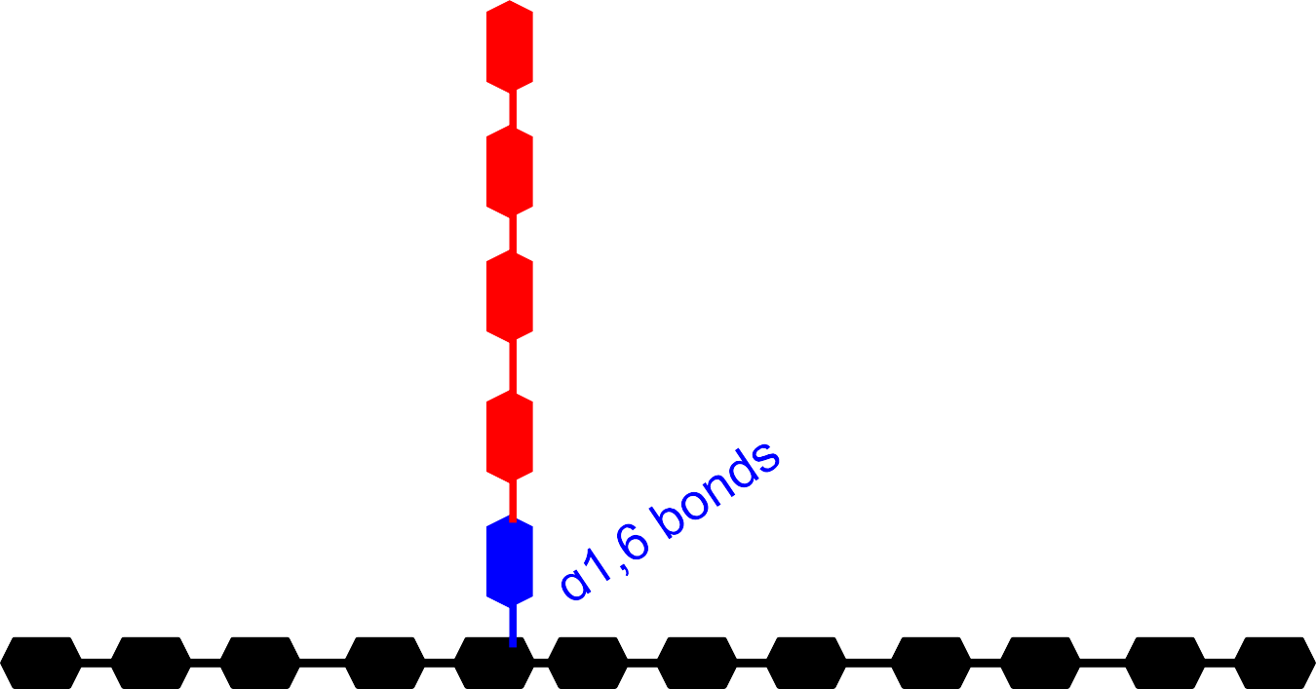
Glycogen
Pi
Glycogen Phosphorylase
Glucose-1Phosphate
Limit Dextrin

Slide 14
Limit Dextrin
Debranching enzyme (transferase activity)
Debranching enzyme (ɑ1,6 glucosidase activity)
Free glucose
Further action of phosphorylase
Glucose -1 Phosphate
Phosphogluco
Glycolysi s
mutase
Glucose -6
^{Phospha}G^{te}lucose-6 phosphatase ( in
liver)
Glucose

Slide 15
Regulation of glycogenesis & glycogenolysis
Glycogenesis and glycogenolysis are, controlled by the enzymes glycogen synthase & glycogen phosphorylase.
Three mechanisms
Allosteric regulation
Hormonal regulation
lnfluence of calcium

Slide 16
Allosteric regulation of glycogen metabolism
Certain metabolites that allosterically regulate the activities of glycogen synthase & glycogen phosphorylase.
The glycogen synthesis is increased when substrate availability and energy levels are high.

Slide 17
Glycogen breakdown is enhanced when glucose concentration & energy levels are low.
In a well-fed state, the availability of glucose 6 – phosphate is high which allosterically activates glycogen synthase for more glycogen synthesis.

Slide 18
Glucose 6-phosphate & ATP allosterically inhibit glycogen phosphorylase.
Free glucose in liver also acts as an allosteric inhibitor of glycagen phosphorylase.

Slide 19
Hormonal regulation of glycogen metabolism
 The hormones, through a complex series of reactions, bring about covalent modification, namely phosphorylation and dephosphorylation of enzyme proteins which, ultimately control Glycogen synthesis or its degradation.

Slide 20
The hormones like epinephrine, norepinephrine and glucagon (in liver) activate adenylate cyclase to increase the production of cAMP.
The enzyme phosphodiesterase breaks down cAMP.
The hormone insulin increases the phosphodiesterase activity in liver & lowers the cAMP levels.

Slide 21
Regulation of glycogenesis by cAMP
Regulated by glycogen synthase.
It exist in two forms glycogen synthase - a -not phosphorylated & most active.
Glycogen synthase - b - phosphorylated inactive form.
Glycogen synthase - a can be converted to 'b' form (inactive) by phsophorylation.

Slide 22
Phosphorylation is catalysed by a cAMP dependent protein kinase.
Protein kinase phosphorylates & inactivates glycogen synthase by converting 'a' form to 'b' form.
The glycogen synthase 'b' can be converted back to synthase' a' by protein phosphatase l.

Slide 23
 The inhibition of glycogen synthesis brought by epinephrine (also norepinephrine) & glucagon through cAMP by converting active glycogen synthase 'a' to inactive synthase 'b’.

Slide 24


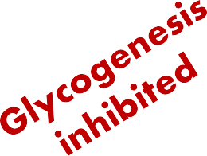
Regulation of glycogen synthesis by cAMP
Glucagon (liver) Epinephrine (liver, muscle)
Adenylate cyclase
(inactive)
Adenylate
cyclase (active)
Plasma membrane
Phosphodiesterase
ATP
cAMP
5’AMP
cAMP-dependent Protein kinase (inactive)
cAMP-dependent Protein
kinase (active)
ADP
ATP
Glycogensynthase – a (active)
Glycogensynthase – b (inactive)-P
Protein phosphatase-I

Slide 25
Regulation of glycogenolysis by cAMP
The hormones like epinephrine & glucagon bring about glycogenolysis by their action on glycogen phosphorylase through cAMP.
Glycogen phosphorylase exists in two forms
An active 'a‘ form – phosphorylated
Inactive form 'b' - dephosphorylated

Slide 26
The cAMP - activates cAMP dependent protein kinase.
Protein kinase phosphorylates inactive form of glycogen phsophorylase kinase to active form.
The enzyme protein phosphatase removes phosphate & inactivates phosphorylase kinase.

Slide 27
The Phosphorylase kinase phosphorylates inactive glycogen phosphorylase 'b' to active glycogen phosphorylase 'a' which degrades glycogen.
The enzyme protein phosphatase I can dephosphorylate & convert active glycogen phosphorylase 'a' to inactive 'b' form.

Slide 28
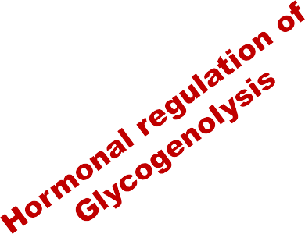

Epinephrine, (liver,
muscle)
Glucagon (liver) Adenylate
Adenylate cyclase (active)
Plasma membrane
cyclase (inactive)
Phosphodiesteras
e
ATP
cAMP
5’AMP
cAMP-dependent Protein kinase
cAMP-dependent Protein kinase (active)
(inactive)
Glycogen Glucose -1P
Glycogen Phosphorylase - a
(active -P)
ATP
ADP
Calmodulin phosphorylase
Protein phosphaase - I
Phosphorylase
Phosphorylase kinase
Glycogen Phosphorylase - b
Kinase
kinase
(inactive)
(active-P)
_{Ca}+2
Protein phosphatase-I
(inactive)

Slide 29
Effect of Ca²⁺ ions on glycogenolysis
When the muscle contracts, Ca²⁺ ions are released from the sarcoplasmic reticulum.
Ca²⁺ binds to calmodulin- calcium modulating protein & directly activates phosphorylase kinase without the involvement of cAMP-dependent protein kinase.
An elevated glucagon or epinephrine level increases glycogen degradation whereas an elevated insulin results in increased glycogen synthesis.

Slide 30
References
Textbook of Biochemistry – U Satyanarayana
Textbook of Biochemistry – DM Vasudevan

Slide 31

Thank you

