Slide 1
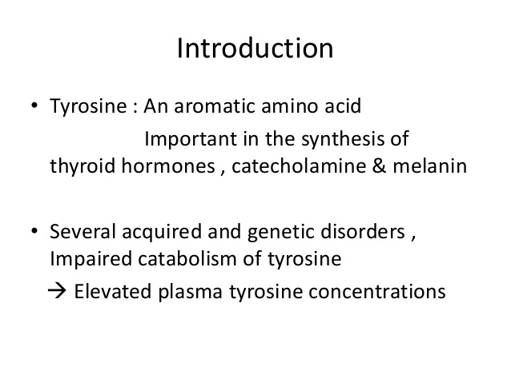

Slide 2
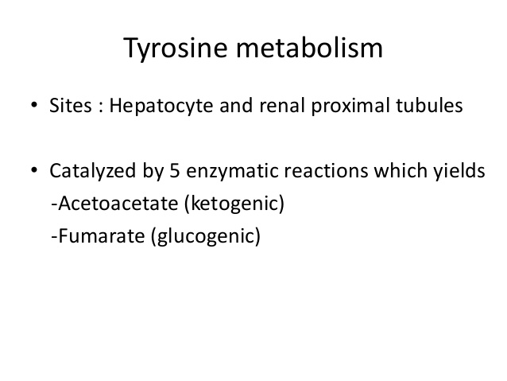

Slide 3
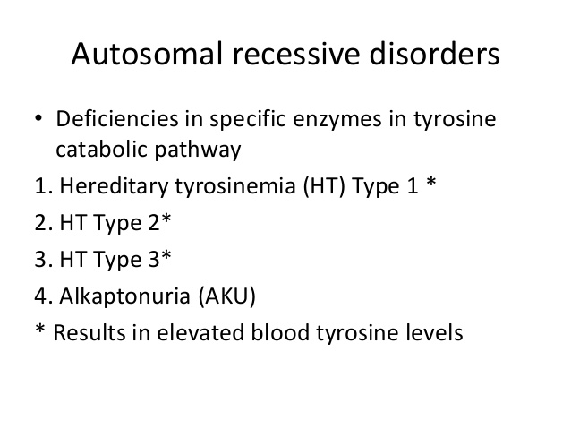

Slide 4
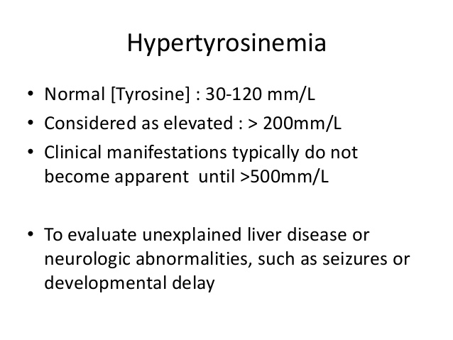

Slide 5
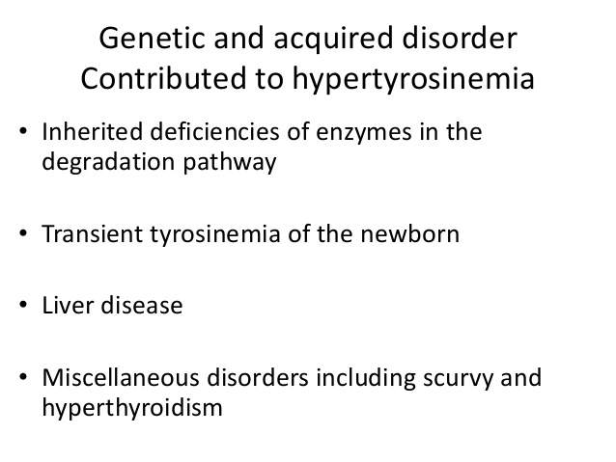

Slide 6
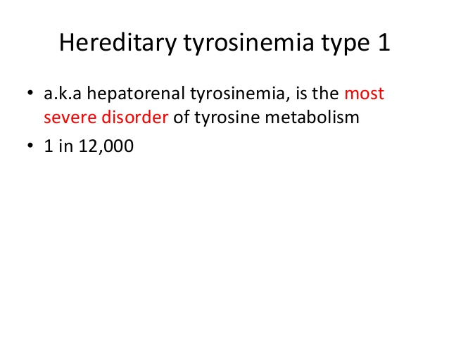

Slide 7
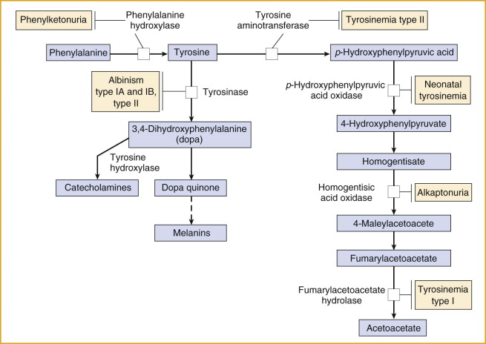

Slide 8
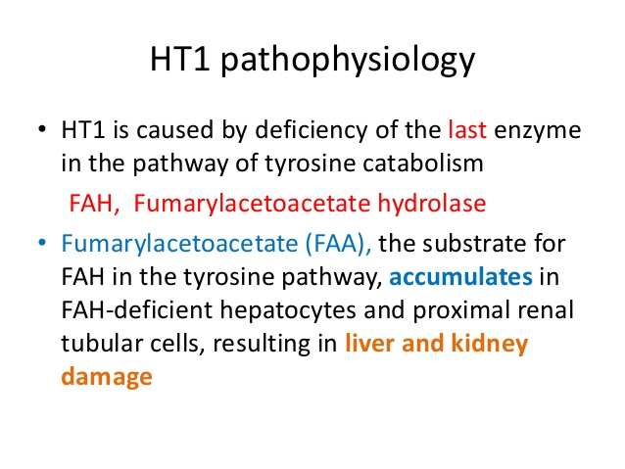

Slide 9
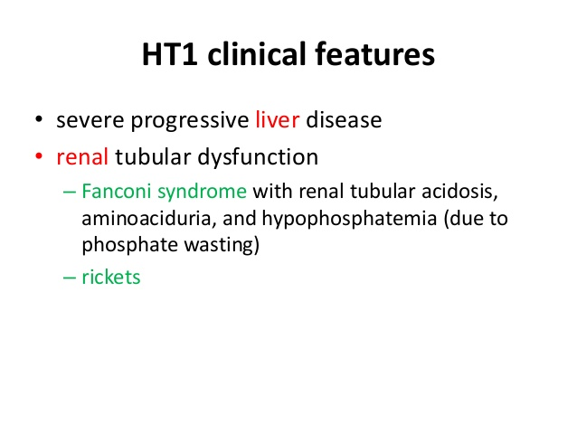

Slide 10
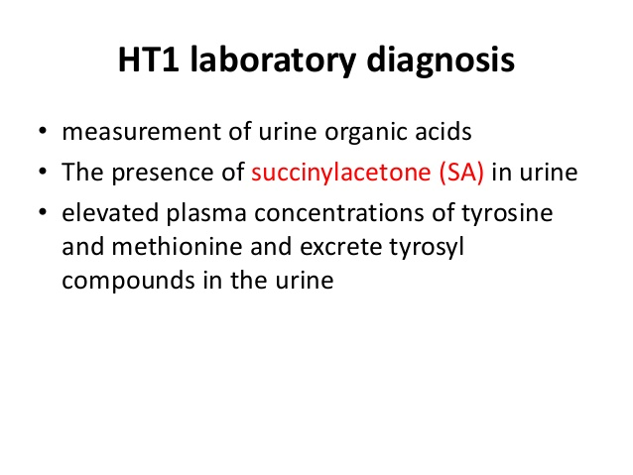

Slide 11
TREATMENT
Prompt indentification and treatment may prevent severe liver, kidney and neurological problems and child can experience a normal growth
1) Dietary treatment : Low protein diet that contains limited amounts of Phe and Tyr
2) Medical Treatment : Nitisinone, inhibitor of 4-
hydroxyphenylpyruvate dioxygenase.
3) Liver transplant : infants with end stage liver failure

Slide 12
TYROSINEMIA TYPE II
Also known as Oculocutaneous Tyrosinemia / Richner Hanhart Syndrome
Autosomal recessive inheritance
Deficiency of enzyme tyrosine aminotransferase due to mutation in the gene located on chromosome number 16
Incidence is 1 in 2,50,000
It affects the eyes , skin and mental development
Manifestations are due to accumulation of tyrosine and its metabolites by an unknown mechanism

Slide 13
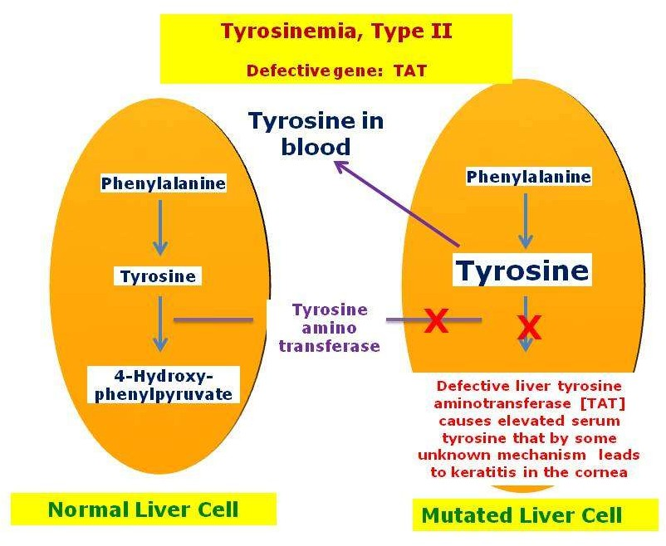

Slide 14
Clinical Manifestation
Excessive lacrimation, redness, corneal deposits, corneal ulcers followed by scarring
Usually manifest in the first year of age
Non-pruritic , hyperkeratotic papules and plaques principally located on palms and soles ( palmoplantar hyperkeratosis ).
The lesions are painful and progressive and associated with
hyperhidrosis
Usually manifest after 1 year of age
Central nervous system involvement is variable and usually manifests as intellectual deficit

Slide 15
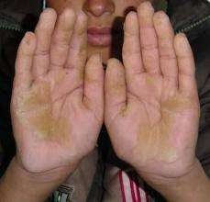
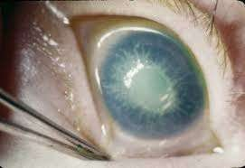
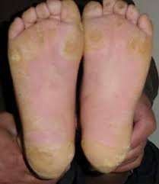

Slide 16
Diagnosis and Treatment
Detection of high levels of plasma and urinary tyrosine
Management :
Dietary limitation of Phe and Tyr. Oral retinoids for skin lesions.
Oculocutaneous manifestations resolve with dietary control.

Slide 17
TYROSINEMIA TYPE III
Very rare disorder
Autosomal recessive inheritance
Deficiency of enzyme 4-hydroxyphenylpyruvate dioxygenase, leading to accumulation of 4-hydroxyphenylpyruvate and its metabolites like 4-hydroxyphenylacetate and 4- hydroxyphenyllactate along with increased plasma levels of tyrosine
Deficiency is due to mutation in the gene coding for the enzyme , locate don chromosome number 12
It is characterized by mild mental retardation, seizures and intermittent ataxia observed during the infancy period
Not much is studied about the disease

Slide 18
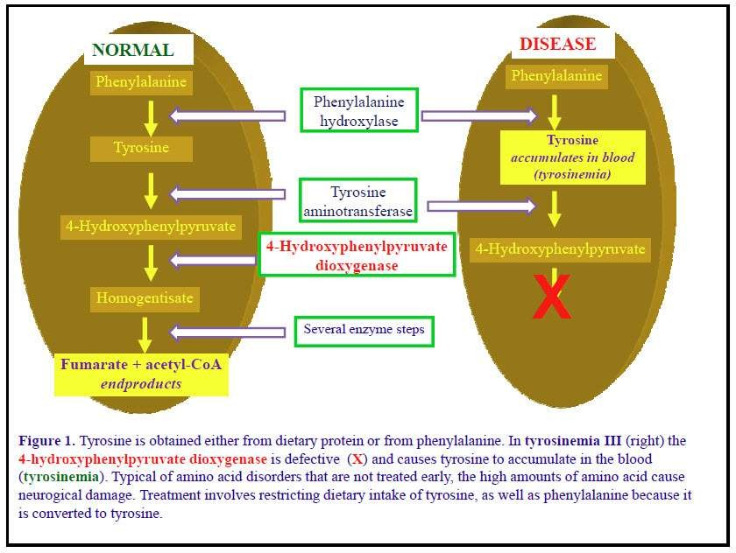

Slide 19


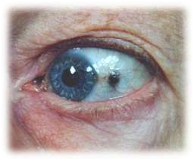
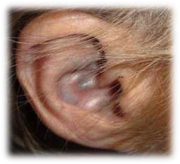


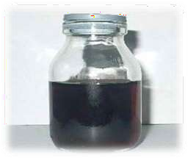

Slide 20
Its is also called black urine disease
It is an inherited genetic disorder of phenylalanine and tyrosine metabolism.
Ochronosis:
  A buildup of dark pigment in connective tissues such as cartilage and skin, is also characteristic of the disorder.
This condition is rare, affecting 1 in 250,000 to 1 million people worldwide. Alkaptonuria is more common in certain areas of Slovakia (where it has an incidence of about 1 in 19,000 people) and in the Dominican Republic.

Slide 21

Mutations in the HGD gene:
The gene defect makes the body unable to properly break down certain amino acids (tyrosine and phenylalanine).
As a result, a substance called homogentisic acid builds up in the skin and other body tissues.
The acid leaves the body through the urine. The urine turns brownish-black when it mixes with air.

Slide 22
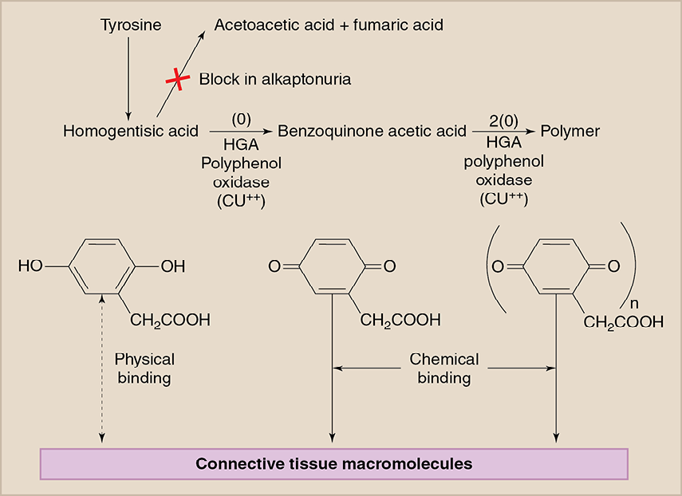

Slide 23


Urine in an infant's diaper may darken and can turn almost black after several hours. However, many persons with this condition may not know they have it until mid-adulthood (around age 40), when joint and other problems occur.
Arthritis (especially of the spine) that gets worse over time
Darkening of the ear.
Dark spots on the white of the eye (sclera) and cornea.

Slide 24

A urine test (urinalysis) is done to test for alkaptonuria. If ferric chloride is added to the urine, it will turn the urine a black color in patients with this condition.
Some patients benefit from high-dose vitamin C. This has been shown to decrease the build-up of brown pigment in the cartilage and may slow the development of arthritis.

Slide 25
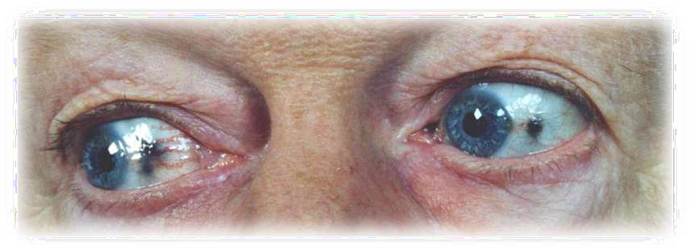
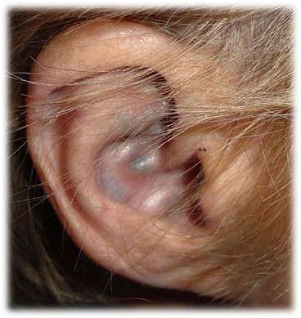
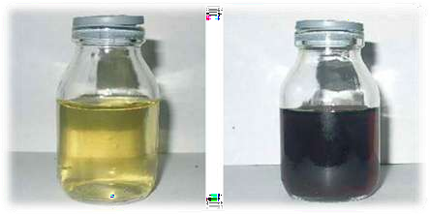

Slide 26
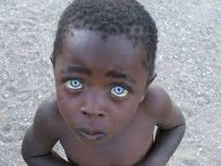
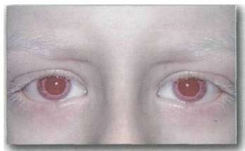
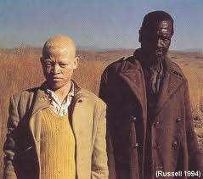
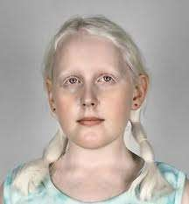
Albinism

Slide 27
What is albinism?
Albinism is a group of genetic conditions that causes a lack of pigment. It can effect only the eyes or both the eyes and skin. Most types of albinism are inherited when an individual receives the albinism gene from both parents. The exception is one type of ocular albinism, which is passed on from mothers to their sons.

Slide 28
Description
Due to the defect in tyrosine metabolism it results in a deficiency of melanin production and partial or full absence of pigment from the skin, hair, and eyes
It may be inherited by one of several modes: autosomal recessive, autosomal dominant, or Complete albinism
Affected people may appear to have white hair, skin & iris color. They may have vision defects and photophobia.
Oculocutaneous albinism is most severe form resulting from a deficiency of tyrosinase
activity, causing a total absence of pigment from the hair, eyes & skin

Slide 29
Detection
Detected at birth because of irregular pigmentation

Slide 30
Symptoms
Absence of pigment from the hair, skin, or iris of eyes
Lighter than normal skin and hair or complete albinism
Most forms of complete albinism have some of the following possible symptoms:
  Rapid eye movements
  Strabismus (eyes not tracking properly)
  Photophobia (avoidance of light because of discomfort)
  Decreased visual acuity
  Functional blindness

Slide 31
Causes
Albinism is caused by an alteration of the gene that regulates the melanin pigment synthesis.

Slide 32
Alternate names
Hypopigmentation
Ocular Albinism
Oculocutaneous Albinism

Slide 33
Prevalence
Approximately one in 17,000 people have one of the types of albinism. About 18,000 people in the United States are affected.

Slide 34
Diagnosis
The most accurate way to determine albinism and the specific type is genetic testing

Slide 35
Treatment
The skin and eyes must be protected from the sun. Sunglasses (UV protected) may relieve photophobia.

Slide 36
Prognosis
Albinism does not affect the expected lifespan. Activities may be limited by intolerance to the sun.

Slide 37
Complications
Skin cancer
Decreased vision, blindness

