Slide 1
EPIDEMIOLOGY AND PREVENTION OF STRESS AND SUCIDE

Slide 2
STRESS
From Latin word “Stringi”- “to be drawn tight”
English-prominence given to a syllable in a word or to a word in a sentence.
Psychology-feeling of strain and pressure or any unpleasant emotion and feeling.
Biomedics-physical and psychological (mental) reaction of body, experienced as a result of change in environment due to stimulus called stressor.

Slide 3
Stress from external environment (physical, psychological or social) or from internal environment(illness or surgical procedure).
Normal part of life.
Stress- adaptation/coping response that helps body to prepare for challenging situations

Slide 4
Richard L Lazarus- stress is a feeling experienced, when a person thinks that “the demand exceeds the personal and social resources the individual is able to mobilize”
Under stress- body responds as though he/she is under danger.
Corticosteroids released from adrenal gland and converted into cortisol-immune suppressive effect on body and through sympathetic nervous system-increase in heart rate, respiratory rate and burst of energy- “flight-or-fight response”

Slide 5
Stress- wear and tear of body while adjusting to continuously changing environment
No life without stress
Excessive or prolonged stress harmful.
Unique and personal.
Stressful for one may be challenging for others.

Slide 6
Stress can be positive- preparing for wedding, getting a job or promotion. Positive stress keeps us alert and ready to avoid danger.
Negative stress- faces continuous challenges without relief or relaxation between challenges, the person overworked and stress-related tension builds leading to physical symptoms and/or worsen certain diseases, becomes harmful to alcohol, tobacco or drugs to relive stress.

Slide 7
MAGNITUDE
About 43% adults suffer adverse effects from stress.
About 75-90% patient attending doctor’s office have stress-related ailments.
Stress played an important role in almost all diseases
Lifetime prevalence of an emotional disorder is more than 50%, often due to stress reactions.

Slide 8
TYPES OF STRESS
Acute
Chronic

Slide 9
ACUTE STRESS
For short time, usually due to work pressure, meeting deadlines pressure or minor accident, overexertion or increased physical activity.
Results in physical symptoms-vary due to handling stress differently.
PHYSICAL SYMPTOMS- Headache, body ache, elevated BP, intestinal symptoms-diarrhea or constipation, insomnia, rapid heartbeat, loss of sexual desire and/or ability.
Common among those take many responsibilities and overloaded with work or disorganized, always in hurry never in time, in position of importance at workplace and stressful life inherent.

Slide 10
2. EMOTIONAL SYMPTOMS- Easy agitation, frustration and mood changes, feeling overwhelmed or loosing control, difficulty in relaxing, feeling loneliness or depression and avoiding others.
3. COGNITIVE SYMPTOMS- Constant worrying, racing thoughts, forgetfulness and disorganization, inability to focus, poor judgment and being pessimistic or seeing only negative side.
4. BEHAVIORAL SYMPTOMS- Changes in appetite, avoiding responsibilities, increased use of alcohol, exhibiting nervous behavior, nail biting, fidgeting or pacing.

Slide 11
CHRONIC STRESS
Exists for weeks, months or years. Prolonged one.
Due to stressors-poverty, broken family, stressed marriage, chronic illness and successive failure in life.
People get it and may even not realize of chronic stress.
Very harmful to health.
Aviation is high stress industry.

Slide 12
CONSEQUENCES
Mental health problems-anxiety, depression, personality disorder, CVD, obesity, menstrual problem, sexual dysfunction, dermatological problems- acne, psoriasis, eczema, hair loss, GI Problems-heartburn, indigestion, gastritis, IBS etc.

Slide 13
MEASUREMENT OF STRESS
Holmes and Rahe stress scale-to rate stressful life events.
Depression, anxiety, stress scale (DASS) based on self report items.
Digital thermometer- to evaluate changes in skin temperature, which indicate activation of “flight-or-fight “ response.
Measuring cortisol from hair will give a 60-90- day baseline stress level.

Slide 14
STRESS MANAGEMENT
1. PRIMARY INTERVENTION- Elimination of stressors altogether.
2. SECONDARY INTERVENTION- Coping or overcoming of stress. Deep breathing exercises, progressive muscle relaxation, yoga and meditation help to relive stress, relax mind and body and improve everyday functioning.
3.TERTIARY INTERVENTION- Rehabilitation of stress altogether.

Slide 15
HEALTHY WAYS TO COPE WITH STRESS
Taking care of oneself- Healthy diet, regular exercise, good sleep.
Talking to others- Sharing problems with friends, parents, counselor, doctor, pastor.
Avoiding- Drugs, alcohol, tobacco, these things may help in initial stage to relieve stress but long term create additional problems and increases stress.
Other techniques- Cognitive therapy-music, reading novels, prayers, humor, spending time in nature with pets etc.
Process of stress management one of key to a happy and successful life.

Slide 16
SUICIDE
“An intentional determination to end one’s life, where willingness to die originates within the person with a known or unknown cause”
Whether completed, attempted or considered is also a state where available options and future possibilities are never considered before the act. It is an act of self destruction.
“murder of oneself”, “nothing less than a exist”, “an end to psychic conflicts”, “an act occurring after a battle between an unconscious death and a desire to live better”, “to live or not to live”.
Parasuicide-nonfatal act an individual deliberately causes self-injury.

Slide 17
Suicide is an index of disturbed society.
Leading cause of morbidity, mortality and phenomenal socio-economic losses and diminished quality of life.
Pubic health and social problem all over world.
Complicated and tragic but preventable.

Slide 18
PROBLEM
Throughout world, affecting individual of all nations, cultures, religions, genders and classes.
10th leading cause of death.
Around 8,00,000 to 1 million people commit suicide every year in world.
80% in low and middle income countries.

Slide 19
INDIA
Ranks 21 globally.
16.3 suicides/lakh population and on increase.
Day to day event in big cities.
More than 20 times-attempted suicides and people pass through suicidal thoughts.
Majority likely to repeat same within a year or two.

Slide 20
IMPACT OF SUICIIDE
Person committing suicide-varied and experienced by family members significantly.
Affect child’s growth, marriage, employment, income of family and family social interactions.
Stigma large and family usually change residence, job, school and other activities.
Act is over person who dies, survivors left with pain, suffering and trauma.
Mean for suicide-hanging, poisoning, self-immolation and drowning.

Slide 21
CRITERIA FOR SUICIDE
An unnatural death
Intension to die originated within person.
Reason for person to end his/her life. Reason may be specified in suicide note or unspecified.

Slide 22
AGE INCIDENCE
Age group of 15-29 years and 30-44 years contribute 30% and 35% respectively.

Slide 23
SEX DISTRIBUTION
More among males than female 1.1:1 (60% and 40% respectively)

Slide 24
HIGH RISK GROUP
1. Thinking (ideation) and feeling
Thinking, talking or writing about suicide, planning for suicide.
Feeling of self-hatred, feeling of guilty, worthless, ashamed, feeling a burden to others.
Feeling of loneliness, helplessness, hopelessness and worthlessness.

Slide 25
2. Behavioral changes
Expressing loss of confidence, self-esteem and faith.
Increased use of alcohol or drugs.
Withdrawing from activities.
Isolation from friends and family members.
Searching for materials and means to kill themselves.
Sleeping too little or too much.
Calling or visiting people to say goodbye.
Acting recklessly.
Aggression.

Slide 26
3. Changes in mood or personality
Depression, pessimism, apathy.
Loss of interest.
Irritability.
Anxiety, extremely sad.
Humiliation.
Rage, writing a will.

Slide 27
4. Other risk factors
Personal or family history of mental disorders.
Conflicts with family members of non-resolving nature.
History of previous suicidal attempts.
Family violence including physical or sexual abuse.
Having guns or firearms at home.
Too much pressure by family for economic gains-dowry or other gains, high achievement in academics.
Sudden loss of job or income or status.
Chronic pain.
Terminal illness-cancer, HIV/AIDS, TB, congenital health problems.
Sudden economic loss due to migration, crop failure, natural disasters etc.
Failure in examinations, love affair, severe property loss etc.
Lack of support system, decision making skills, help etc.
Recent release from jail.

Slide 28
INTERACTION AT HOME
Causes may be mutifactorial, repetitive, progressive and often interrelated to one another and cumulative over time period.

Slide 29
 | Issues | Actions
1 | Adolescence is a period of stress and strain. They are often left perplexed due to physical psychological, emotional and hormonal changes. | Every college should have at least 2-3 trained counselors. they should be able to identify students in distress and counsel them.
2 | The current system of education, emphasizing more an academics rather than overall development induces stress and when they are unable to handle the stress, they consider suicide as a matter to overcome the crisis situation | Current education system requires modification in teaching inculcation of value systems and should be skill oriented. Yield responsible citizens rather than mere academicians.
3 | Most of courses not job oriented-unemployment among youth leading to frustration-suicide | Job-oriented courses to increases employment opportunities.
4 | Current curriculum-not prepare student to handle effectively day today problems and limit personality development. | Life skill education incorporated as internal part of school curriculum.

Slide 30
 | Issues | Actions
5 | Youth-period with abundance of energy – wasted unproductive activity | Participate in personality development activities with NCC, NSS, Scouts and guides movements, collegiate and inter-collegiate program encouraged
6 | Due to generation gaps not able to discuss problem with parents. Compounded by fast paced life style of parents-communication gaps, distancing each other-resulting stress and stain. | Regular parent teacher meeting, appraising the parents about performances and limitation of student and emphasize children interaction at home in a friendly and participatory environment for a “healthy-happy” home.
7 | greater occurrence of smoking, alcoholism, drug abuse, promiscuous sexual activities, depression at an early age. | Should have trained counselor to handle psychological well being and act as liaison among student, parent and teacher.
8 | Limited opportunities for students to communicate with counselor on suicide prevention. | Better to have an exclusive suicide prevention help-line operated by trained volunteers round the clock

Slide 31
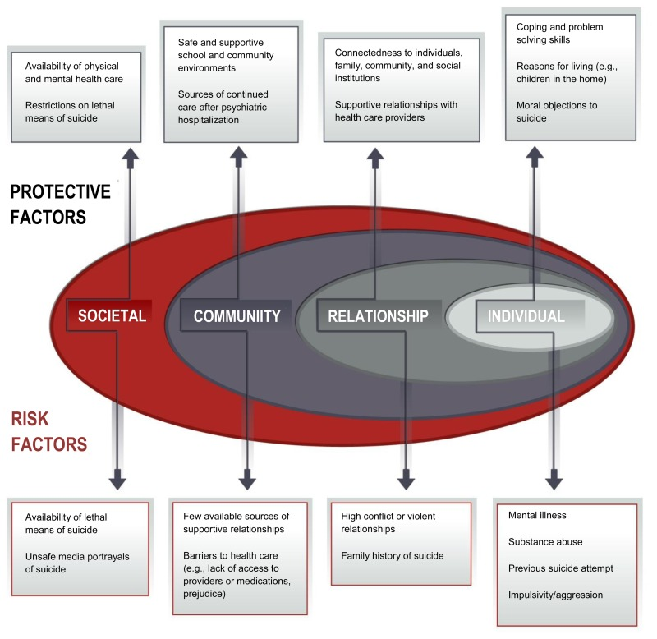

Slide 32
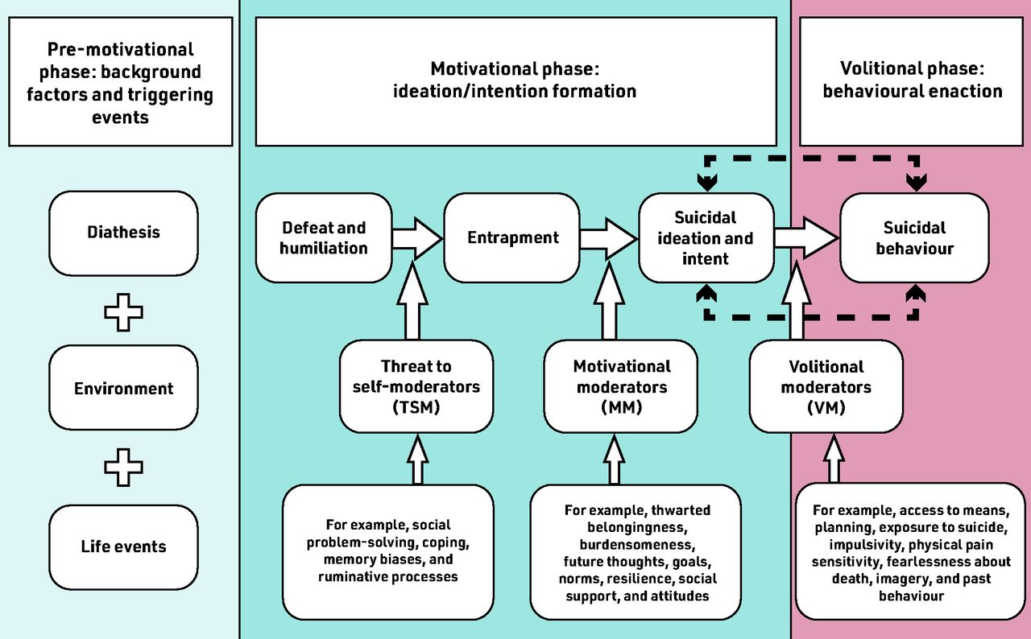

Slide 33
PREVENTION OF SUICIDES
POLICIES
Reducing social isolation
Preventing social disintegration
Treating mental disorders
Regulating sale of pesticides and scheduled drugs
Promoting psychological motivational session, meditation, yoga.

Slide 34
Suicidal thoughts and actions-sign of extreme distress and should not be ignored.
Suicidal person may not ask for help but does not mean that help in not wanted.
Desperate attempt to escape suffering that has become unbearable.
Knowing warning signs for suicide and how to get help can help save lives.

Slide 35
METHODS
Treating mental illness (depression with lithium in some cases)
Improving the coping strategies of people who consider suicide
Reducing the risk factors.
Giving people hope for better life after resolving current problem.

Slide 36
GENERAL METHODS
Talk therapy or psychotherapy
Responding quickly in crisis
Offering help and support

Slide 37
TALK THERAPY OR PSYCHOTHERAPY
Model approach for “direct talk” ICARE
I- Identify the thought
C- Connect with it
A- Assess evidence for it
R- Restructure the thought in positive light
E- Express feeling from restructured thought

Slide 38
Two types of psychotherapy
COGNITIVE BEHAVIORAL THERAPY (CBT)- For those suffering from variety of mental disorders. Dealing with stress and stressful life is adopted, will help in redirecting the suicidal thoughts.
DIALECTICAL BEHAVIOR THERAPY (DBT)- For those who have difficult or troubling situations

Slide 39
COPING PLANNING
Human response to unpleasant emotions. It supports people who are distressed and provides a sense of belongingness and resilience in treatment of illness.
Improves emotional regulation and decreases memories of unpleasant emotions.
A team based collaborative care-an effective way to treat depression and reduce suicidal thoughts.

Slide 40
DO’S (ADAPTING TALK THERAPY)
Be yourself- Person know that you care for him/her and that he/she is not alone.
Be patient- Listening them and acknowledge their feelings.
Listen- Let the person unload despair, vent anger.
Validate their feelings.
Ask- How you can help.
Be sympathetic- Let person feel that you are concerned.
Offer hope- Let person know that his life is important for you.
Keep in touch- Even no response, with supportive calls
Encourage person to seek help from health professionals.
Assure-suicidal feelings will pass with time

Slide 41
DONT’S (ADAPTING TALK THERAPY)
Argue with suicidal person.
Interrupt or speak over.
Act socked.
Jump with solutions.
Promise confidentiality.
Leave them out.
Offer ways to fix their problem or justify their feelings.
Blame yourself.

Slide 42
RESPONDING QUICKLY IN CRISIS
By calling a local crisis center.
Don’t not leave person alone in any circumstances.
Remove the potential means of suicide-drugs, poison, pistol, rope, knife etc. from vicinity.

Slide 43
OFFERING HELP AND SUPPORT
Getting professional help from psychiatrist.
Follow-up treatment.
Being proactive at offering assistance.
Encouraging positive lifestyle changes-healthy diet, exercise, meditation etc.
Making a safety plan by giving contact number of counselors or therapist.
Continuing support over long haul, by being in touch with him or her, - will help to be on recovering track.

Slide 44
APPROACHES FOR PREVENTION
Causes of suicide-multifactorial, extending to all spheres of life-prevention is also multisectoral.
Identify problems various dimension, understanding risk factors, developing interventions focused on risk factors and identifying what works in individual societies.
Solutions on an integrated and coordinated platform help in reducing problem, improving health of societies.
Long term solution is Intersectoral approach. Problem identified and inputs provided by all sectors.

Slide 45
Health sector to take lead role in developing, implementing, evaluating suicide prevention program.
Suicide-prevention strategies to be developed in all sectors and identify specific inputs from each sectors.
Timely help, constant observation, an empathetic understanding, appropriate care and support to persons attempting suicide, can help them to get over the death wish for rest of life.

Slide 46
NATIONAL STRATEGY FOR SUICIDE PREVENTION (NSSP)
Developing support groups led by professionally trained individuals for suicide prevention.
Promoting community based suicide prevention programs.
Screening and reducing at risk behavior through psychological resilience programs that promotes optimism and connectedness.
Education about availability of help through social campaigns.
Increasing the proficiency of health and welfare services to people in need.

Slide 47
6. Reducing domestic violence and substance abuse through legal measures-long term strategies.
7. Reducing access to convenient means of suicide and methods of self harm-toxic substances, poisons, handguns etc.
8. Reducing quality of doses of non-prescribing medicines-aspirin.
9. School based competency promoting and skill enhancing programs.
10. Ethical surveillance system targeted at high risk groups.
11. Media-linking suicide with negative outcomes-pain for suicide and survivors, prevents romanticizing of negative emotions.

Slide 48


Slide 49
National Suicide Prevention Lifeline
1-800-273- Talk.
World Suicide Prevention Day –September 10

