Slide 1
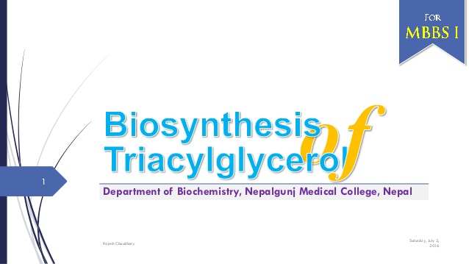

Slide 2
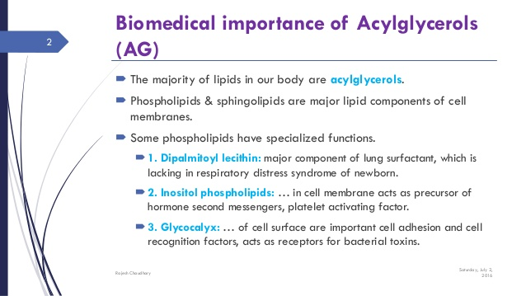

Slide 3
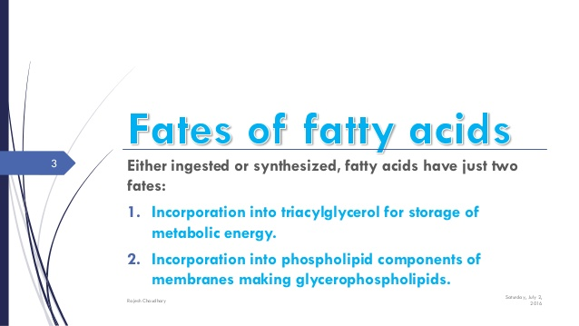

Slide 4
CONDITIONS THAT FAVOUR SYNTHESIS OF TGS
Increased diet of Carbohydrates and protein
High intake of Glucose in diet.
Insulin stimulate TGs synthesis in adipose tissues.

Slide 5
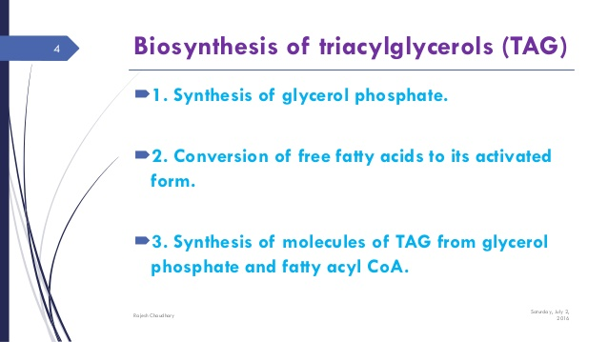

Slide 6
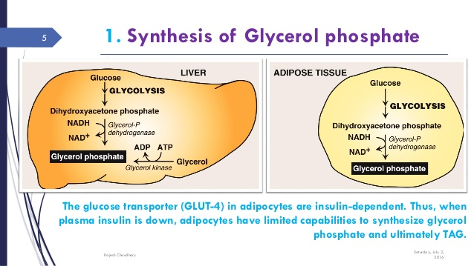

Slide 7
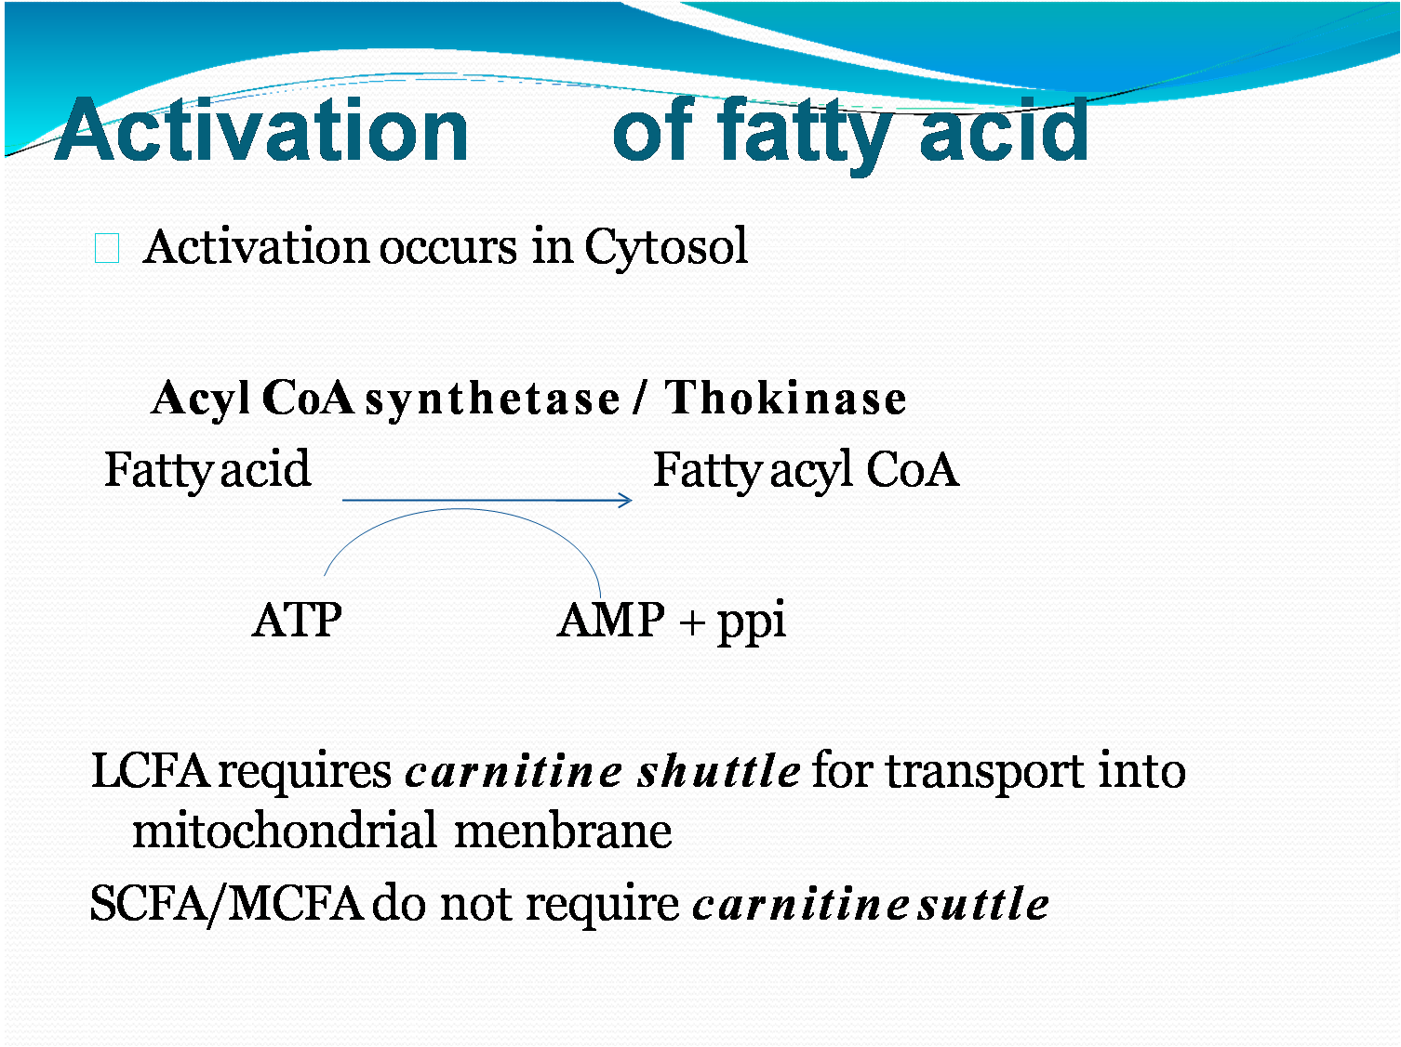
2. ACTIVATION OF FREE FATTY ACID TO FATTY ACYL Co A

Slide 8
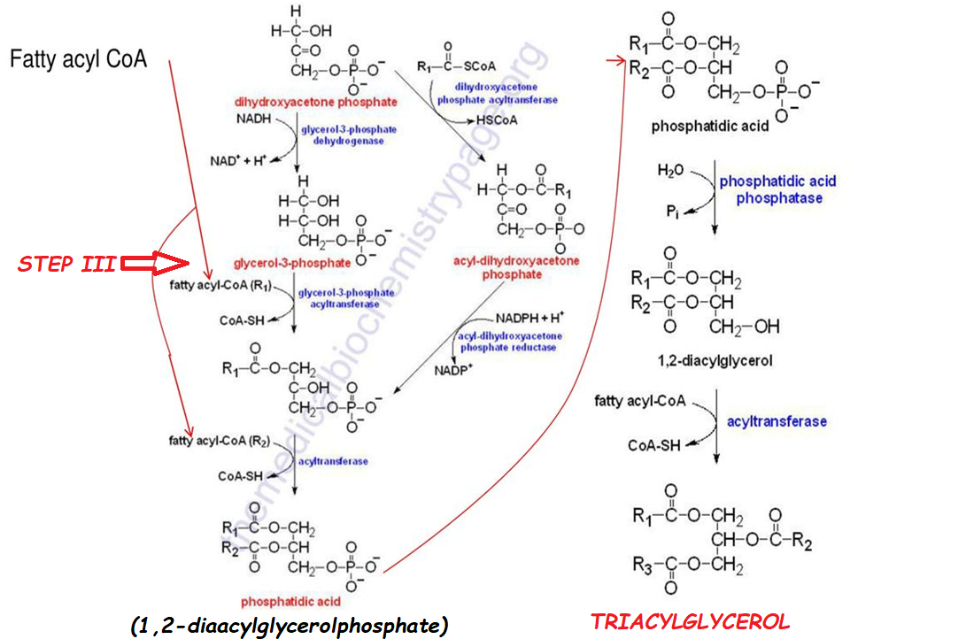

Slide 9
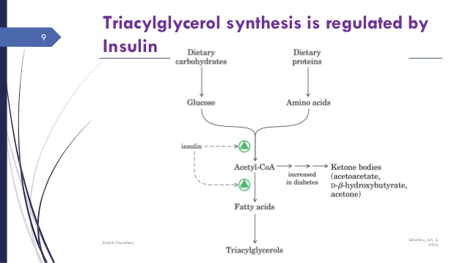

Slide 10
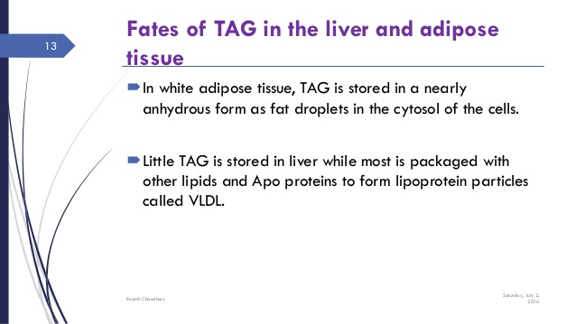

Slide 11
BIOMEDICAL SIGNIFICANCE OF TGs
Insulin stimulates TGs synthesis in adipose tissues by enhancing glucose transport in adepocytes.
DHAP, an intermediate metabolite in glycolysis and glycerol-3-P connect the Carbohydrates and lipid metabolism.
1,2-DAGP and DAG is intermediates of TGs synthesis. They can also be utilize for synthesis of Glycerophospholipids.

Slide 12
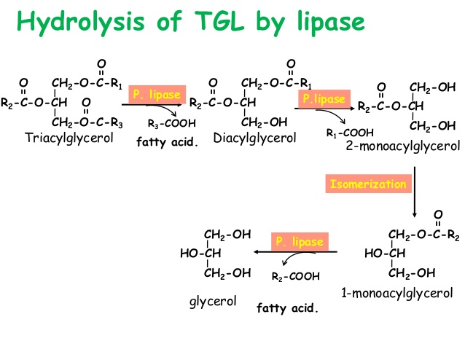

Slide 13
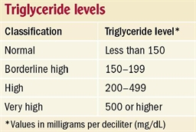
CLINICAL SIGNIFICANCE OF TRIGLYCERIDES

Slide 14
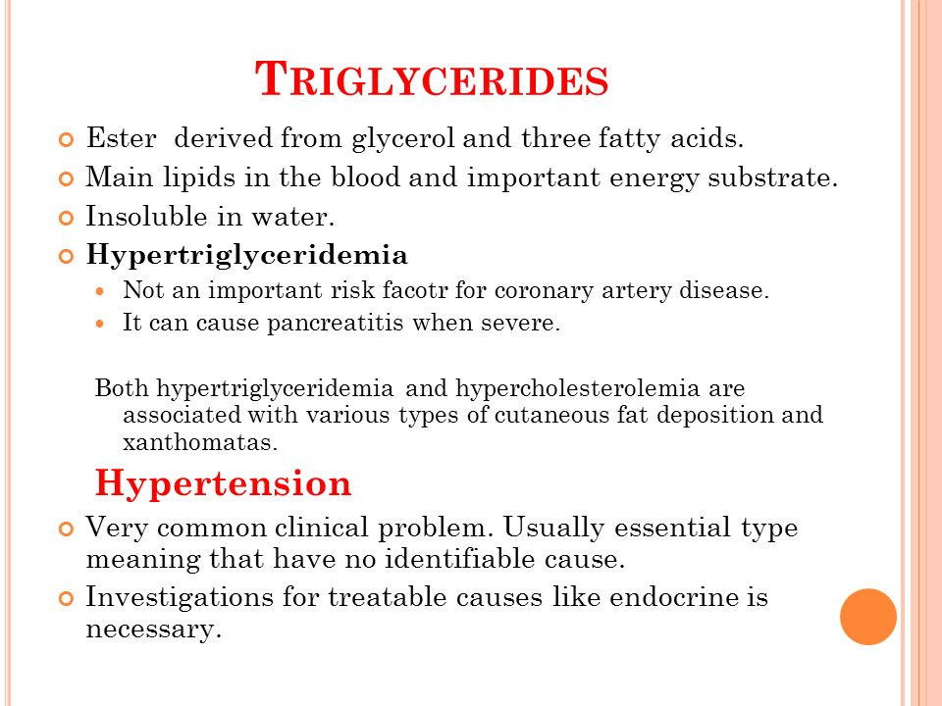

Slide 15
