Slide 1


BIOSYNTHESIS OF CHOLESTEROL

Slide 2
BIOSYNTHESIS OF CHOLESTEROL
Introduction.
Structure of cholesterol
Synthesis of cholesterol.
Transportation of cholesterol
Degradation of cholesterol
Excretion of cholesterol

Slide 3
INTRODUCTION
Cholesterol is Amphipatheic lipid.(of a molecule, especially a protein) having both hydrophilic and hydrophobic parts.)
Cholesterol is the most important sterols in the human Body
It is clearly essential to life, yet its deposition in arteries is associated with cardiovascular disease and stroke

Slide 4
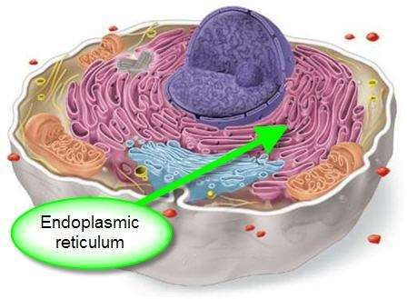
SITE OF CHOLESTEROL SYNTHESIS
Cholesterol is synthesized in the cytosol and
endoplasmic reticulum (ER).
Liver is the main site of cholesterol synthesis; also, it
It is synthesized in adrenal cortex, testis, intestine, skin and other nucleated
cells in the body

Slide 5
SOURCES
Diet
de novo synthesis and
from the hydrolysis of cholesteryl esters.

Slide 6
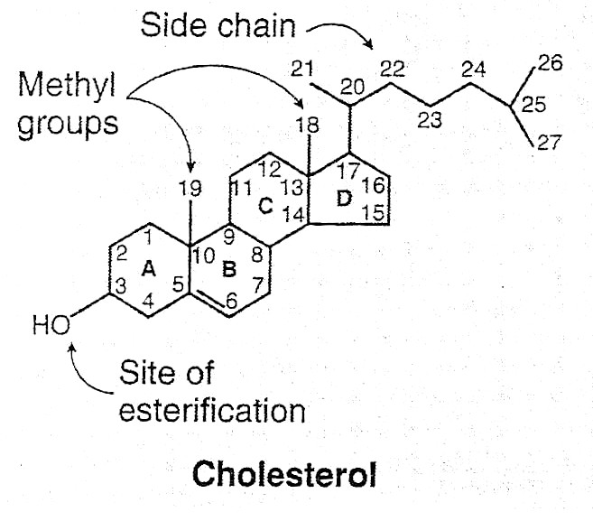
Structure of cholesterol
CYCLOPENTANOPERHYDROPHENANTHRENE RING

Slide 7
BIOSYNTHESIS OF CHOLESTEROL.
Biosynthesis of cholesterol can be studied into five stages :
1. Synthesis of mevalonate from acetyl coA.
2. Formation of isoprenoid unit from mevalonate by loss of CO2.
3. Condensation of six isoprenoid unit to form squalene.
4. Cyclization of squalene to give lanosterol.
5. Formation of cholesterol from lanosterol.

Slide 8
Biosynthesis of cholesterol.
Acetyl-CoA is the precursor.

Slide 9
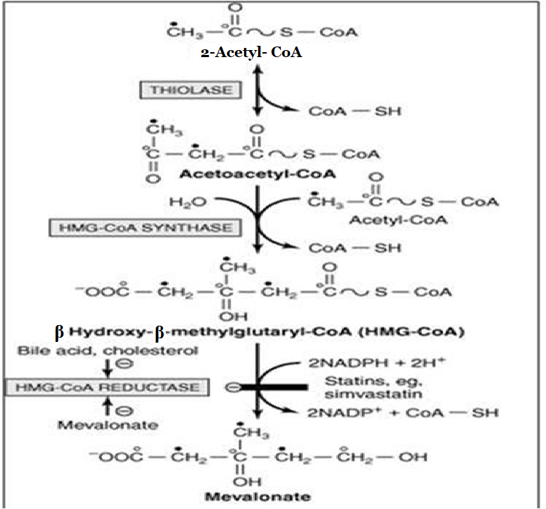

Slide 10
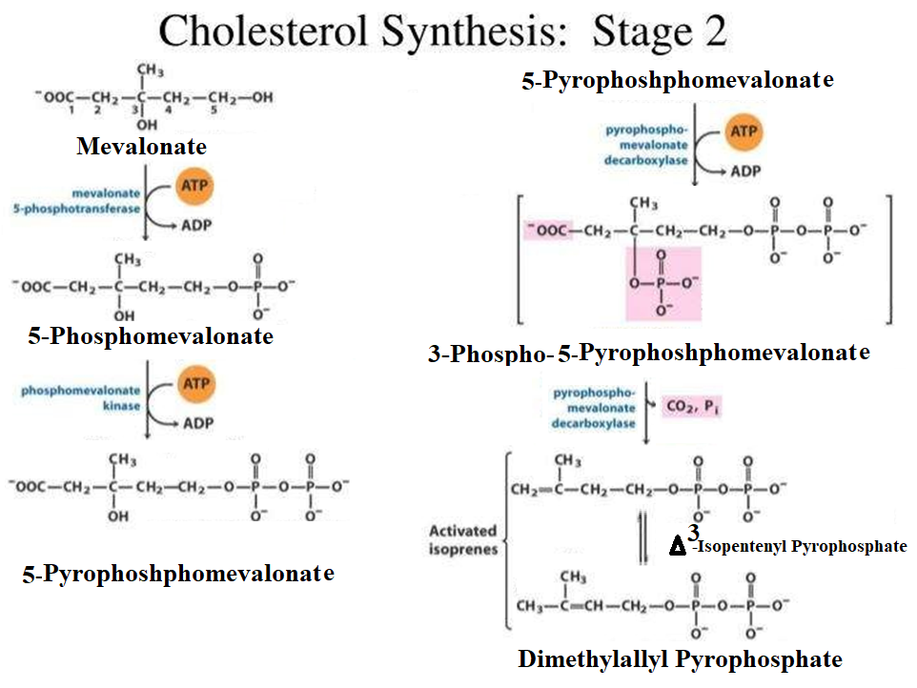

Slide 11
Step3: Condensation of six isoprenoid units form squalene

Slide 12
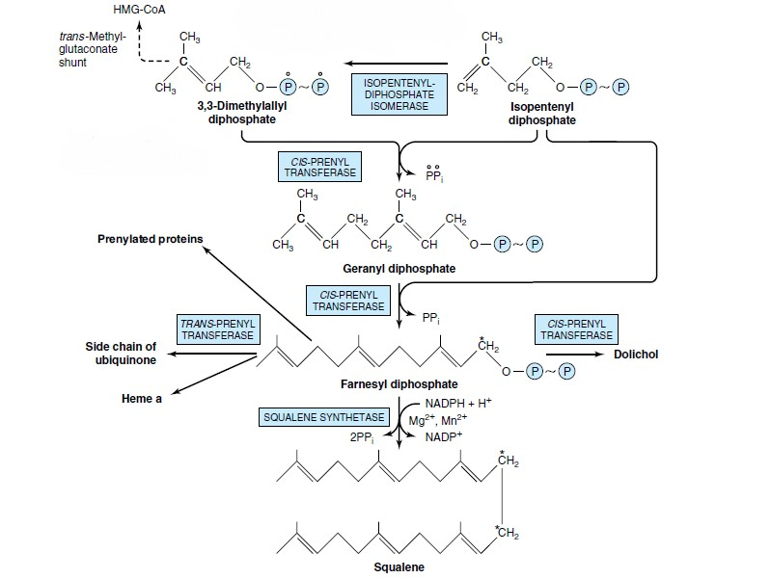


Slide 13
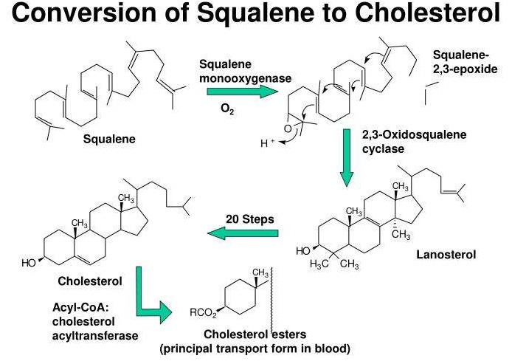

Slide 14
Transport of cholesterol
In plasma, 30% of cholesterol is free and 70% is in ester form.
Free cholesterol and most lipids are transported in the blood
as
part of soluble complexes called lipoproteins.
Five main classes of lipoproteins based on their size and
density called, in order of increasing density, Chylomicrons,
Very-low-density lipoprotein (VLDL), Intermediate-density
lipoprotein (IDL), Low-density lipoprotein (LDL) and Highdensity
lipoprotein (HDL).

Slide 15
REGULATION OF CHOLESTEROL BIOSYNTHESIS
Regulation of cholesterol synthesis is exerted near the beginning of the pathway, at the HMG-CoA reductase step.
Following mechanisms are involved at the regulatory step-
Competitive inhibition
Feed back inhibition
Covalent modification(Role of hormones)

Slide 16
REGULATION OF CHOLESTEROL BIOSYNTHESIS
Competitive inhibition
Statins (Lovastatin,Mevastatin, Atorva Statin etc.) are the reversible competitive inhibitors of HMG Co A reductase.
They are used to decrease plasma cholesterol levels in patients of hypercholesterolemia.

Slide 17
Feed back inhibition
HMG Co A reductase is inhibited by Mevalonate and Cholesterol.
Mevalonate is the immediate product of HMG Co A reductase catalyzed reaction whereas Cholesterol is the ultimate product of the reaction pathway.

Slide 18
Covalent modification
(Role of hormones)
Phosphorylation decreases the activity of the
reductase.
Glucagon favors formation of the inactive (phosphorylated form) form, hence decreases the rate of cholesterol synthesis
In contrast , insulin favors formation of the active(dephosphorylated )form of HMG Co A
reductase and results in an increase in the rate of cholesterol synthesis
Cholesterol synthesis ceases when the ATP level is low

Slide 19
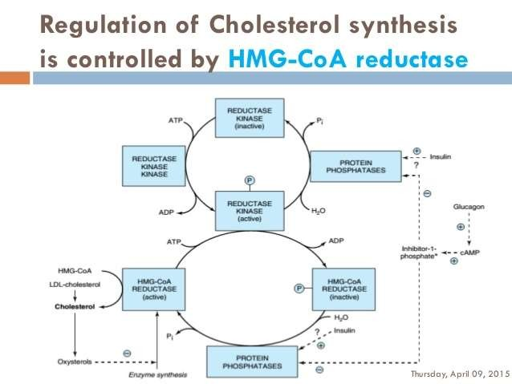

Slide 20
DEGRADATION OF CHOLESTEROL
Synthesis of bile acids
Synthesis of steroid harmones
from cholesterol
Synthesis of vitamin D

Slide 21

HYPERCHOLESTEROLEMIA
Serum cholesterol level is more than 250mg/dl it is considered
as hypercholesterolemia
CAUSES:
Diabetes Mellitus- due to increased cholesterol
synthesis the availability of acetyl CoA is increased.
Hypothyrodism- due to decrease in HDL receptors on
hepatocytes
Obstructive Jaundice- due to obstruction in the excretion
of cholesterol through bile
Nephrotic Syndrome- increase in plasma globulin
concentration
Hypercholesterolemia is associated with ATHEROSCLEROSIS
and CORONARY HEART DISEASE

Slide 22

FUNCTIONS OF CHOLESTEROL
Cholesterol is the most abundant sterol in humans and
performs a number of essential functions. For example-
It is a major constituent of the plasma membrane and of
plasma lipoproteins.
It is a precursor of bile salts,
It is a precursor of steroid hormones that include
adrenocortical hormones, sex hormones, placental
hormones etc

Slide 23



FUNCTIONS OF CHOLESTEROL
Also a precursor of vitamin D, cardiac glycosides,
It is required for the nerve transmission. Cholesterol is
widely distributed in all cells of the body but
particularly
abundant in nervous tissue.

Slide 24
Excretion of cholesterol.
Cholesterol
Cholesterol is excreted from the body via the bile
either in the unesterified form or after conversion
into bile acids in the liver. Coprostanol is the
principle sterol in the feces. It is formed from
cholesterol by the bacteria in the lower intestine.

Slide 25

THANK YOU

