Slide 1




1.Beta- Oxidation 2.Minor fatty acid oxidation
Alpha oxidation
Omega oxidation
Peroxisomal beta oxidation

Slide 2


Major and minor fatty acid oxidation
 Major oxidation: Mitochondrial beta oxidation
Minor Oxidation:
Alpha oxidation
Omega oxidation
Peroxisomal Beta oxidation

Slide 3

Beta- Oxidation
Beta –oxidation is defined as the oxidation and
splitting of two carbon units at beta carbon atom.
This results in sequential removal of 2 carbon fragments as acetyl CoA until the complete oxidation of fatty acids.
Beta oxidation occurs almost in all tissues except, erythrocytes and adrenal medulla.

Slide 4

Stages of beta-oxidation
Three major steps involved :
Preparative stage (Activation of fatty acid) occurs in cytosol.
Transport of fatty acyl CoA through carnitine shuttle, present in mitocondrial membrate
Beta – oxidation proper in mitochondrial matrix.

Slide 5

Activation of fatty acid
 Activation occurs in Cytosol
Acyl CoA synthetase / Thokinase
Fatty acid Fatty acyl CoA
ATP AMP + ppi
LCFA requires carnitine shuttle for transport into mitochondrial menbrane
SCFA/MCFA do not require carnitine suttle

Slide 6

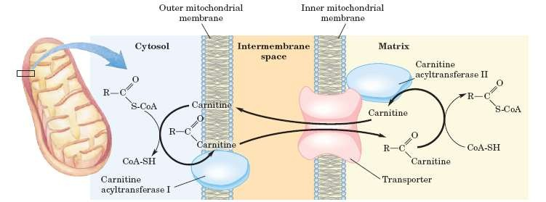
Transport of Fatty acyl CoA
Acyl CoA
Acyl CoA
Acyl carnitine
Acyl carnitine

Slide 7

Beta oxidation proper
Beta oxidation proper occurs in mitochondrial matrix and involves 4 steps:
Oxidation
Hydration
Oxidation
Cleavage

Slide 8

Steps of Beta–oxidation proper
Inner Mitochondrial Membrane
Fatty acyl CoA
FAD+ FADH2
Trans enoyl CoA
H2O
Acyl CoA dehydrogenase
ETC 2 ATP
Hydratase
B- hydroxyacyl CoA
NAD+
β- hydroxyacyl
CoA dehydrogenase
NADH
B –ketoacyl CoA
CoA
ETC 3ATP
Thiolase
AcylCoA +Acetyl CoA

Slide 9

FORMULA FOR CALCULATING ENERGETICS FOR EVEN CHAIN FATTY ACID
n= Number of carbon atoms present in fatty acid Number of acetyl CoA produced = n/2
Number of cycles for fatty acids= (n/2 -1)
Number of reduced coenzyme = (n/2-1) (FADH2 +NADH)
For example if 16C (palmitic acid) undergoes beta oxidation
No. of acetyl CoA produced= 8 {1 Acetyl CoA = 12 ATP in TCA}
8×12= 96 ATPs
No.of cycles for palmitic acid= 7
No.of reduced coenzymes produced= 7( FADH2 + NADH)
7(2+3)= 35 ATPs
Total no. of ATPs produced= 96+35= 131 ATPs
No. of ATPs utilized during activation= 2 ATPs
Net gain= 131-2= 129 (ATPs According to old energeitcs concept)

Slide 10

Regulation of beta-oxidation
Increased availability of FFA increases the rate of beta oxidation
Glucagon increases FFA and Insulin decreases FFA
CAT-I is inhibited by Malonyl CoA ( substrate for fatty acid synthesis).
Thus during denovo synthesis of fatty acid beta oxidation is inhibited.

Slide 11
Unexpected death of healthy infants, usually overnight
Due to deficiency of medium chain acyl CoA dehydrogenase.
Glucose is the principal source of energy, soon after eating or feeding babies.

Slide 12
After a few hours, the glucose level & its utilization decrease & the rate of fatty acid oxidation must simultaneously increase to meet the energy needs.
The sudden death in infants is due to a blockade in β -oxidation caused by a deficiency in medium chain acyl CoA dehydrogenase (MCAD)

Slide 13
Characterized by severe hypoglycemia, vomiting, convulsions, coma & death.
lt is caused by eating unriped ackee fruit- contains an unusual toxic amino acid, hypoglycin A.
This inhibits the enzyme acyl CoA dehydrogenase & β -oxidation of fatty acids is blocked, leading to various complications

Slide 14
Abnormalities in transport of fatty acids into mitochondria & defects in oxidation leads to deficient energy production by oxidation of long chain fatty acids.
Features:
Hypoglycemia, hyperammonemia, weakness & liver diseases.
Acyl carnitine accumulates when the transferases
or translocase is deficient.
Dietary supplementation of carnitine improve the condition.

Slide 15

Minor Fatty acid Oxidation
Alpha Oxidation
Omega Oxidation
Peroxisomal Beta Oxidation

Slide 16

Alpha - oxidation
Defined as the oxidation of fatty acid (methyl group at beta carbon) with the removal of one carbon unit adjacent to the α carbon from the carboxylic end in the form of CO2
Alpha oxidation occurs in those fatty acids that have a methyl group(CH3) at the beta-carbon, which blocks beta oxidation.
Substrate:-Phytanic acid, which is present in milk or derived from phytol present in chlorophyll and animal fat
peroxisomes is the cellular site.
No production of ATP

Slide 17

Steps of alpha oxidation
Activation of phytanic acid
Hydroxylation
Removal of formyl CoA( CO2)
Oxidation of Pristanal
Beta-oxidation of pristanic acid

Slide 18


Alpha Oxidation
Phytanic acid
ATP
AMP+ ppi
Phytanoyl CoA synthetase
Phytanoyl CoA
α KG + O2
Succinate +CO2
Phytanoyl CoA Hydroxylase
2-hydroxy phytanoyl CoA
Lyase
Formyl CoA CO2 Pristanal
NADP+ NADPH
Pristanic acid
Aldehyde
dehydrogenase

Slide 19

Pristanic acid undergoes beta oxidation
Pristanic acid
Activation
Beta oxidation proper
2- methyl propionyl CoA+ 3Acetyl CoA+ 3 Propionyl CoA

Slide 20

Significance of alpha oxidation
Oxidation of methylated fatty acid
Production of cerebronic acid which synthesizes cerebroside and sulfatides
Production of odd chain fatty acids

Slide 21

Adult Refsum’s Disease
Biochemical defect:
Defect in enzyme phytanoyl CoA hydroxylase
( Phytanic acid oxidase)
Autosomal reccesive disease.
Phytanic acid is acumulated in brain and other tissue
lab Findings
Plasma Level of phytanic acid > 200µmol/L Normal< 3oµmol/L

Slide 22

Infantile Refsum’s Disease
Biochemical defect
It is a disorder observed in zellweger syndrome. Congenital peroxisomal biogenesis disorder
Lab findings
Phytanic acid in the serum is More than 30µmol/L and less than 200µmol/L
VLCFA and LCFA in serum is increased

Slide 23

Molecular Toxicology of Refsum’s Disease
PA is directly toxic to ciliary ganglion cells and induces calcium –driven apoptosis in purkinji cells
Recent studies has found that PA has a Rotenone like action in inhibiting complex –I and producing reactive oxygen species
This is the reason why neuronal cells and retina rich in mitochondria are prime tissue affected in Refsum’s disease

Slide 24

Refsum’s Disease
 Clinical manifestations
Severe neurological symptoms such as
Polyneuropathy,
retinitis pigmentosa,
Nerve deafness
Cerebellar ataxia
Patients should avoid intake of diet such as green vegetables and milk.

Slide 25

Omega(ω) Oxidation
Cellular site: Endoplasmic reticulum
oxidation occurs at (ω-omega) carbon—the carbon most distant from the carboxyl group.
Substrates : Medium and long chain fatty acid
Importance: It is a minor pathway but becomes active
when beta oxidation is defective.
The product formed are di-carboxylic acid

Slide 26

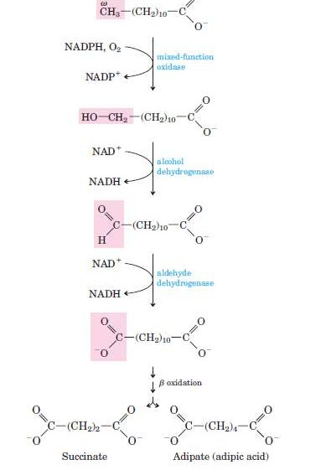

Slide 27

Peroxisomal Beta Oxidation
Beta oxidation occurs in modified form in peroxisomes.
Very Long chain fatty acids (>C22) are often oxidized in peroxisomes.
FADH2 produced by the action of Acycl CoA dehydrogenases pass electrons directly to oxygen.
This results in formation of H2O2.
H2O2 is again cleaved by peroxisomal catalase.
Subsequent steps are identical with their mitochondrial counterparts.
They are carried out by different isoform of the enzymes.

Slide 28
INITIAL STEP OF PEROXISOMAL BETA OXIDATION
Catalase
O2
H2O2
H2O+ 1/2O2
Acyl CoA dehydrogenase (ox, FAD)
Acyl CoA dehydrogenase (red, FADH2)
Fatty acyl CoA
Tans enoyl CoA

Slide 29

Zellweger syndrome
 Biochemical defect
Defect in the gene for peroxisome biogenesis
reduction or absence of Peroxisomes in the cells of the liver, kidneys, and brain.
VLCFA and LCFA are not oxidized and accumulates in tissue , particularly in brain ,liver and kidney.
Lab findings:
Increased level of VLCFA in serum Increased level of phytanic acid in serum

Slide 30

Medium chain acylCoA dehydrogenase deficiency (MCAD deficiency)
Most common inborn error of fatty acid oxidation.
Being found in 1:14,000 births worldwide.
Decreased ability to oxidize fatty acids with six to ten carbons.
MCFA accumulates in tissue and also excreted in urine.
Symptoms: Hypoglycemia Sleepiness
Vomiting
Fat accumulation in liver

Slide 31

DEFICIENCIES OF CARNITINE OR CARNITINE TRANSFERASE OR CARNITINE TRANSLOCASE
Causes:
Deficiency of carnitine
Inherited CPT-I deficiency affects only the liver.
CPT-II deficiency affects primarily skeletal muscle and, when severe, the liver.
Symptoms:
muscle cramps are precipitated by fasting, exercise and high fat diet.
Hypoglycemia

Slide 32

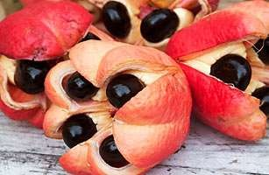
Jamaican vomiting sickness
Caused by eating unripe ackee fruit which contains unusal toxic amino acids hypoglycin A and B
It inhibits enzyme acyl CoA dehydrogenase .
Beta-oxidation is blocked leading to serious complications.
Symptoms :
Severe hypoglycemia vomiting Convulsions
Coma
Ackee fruit

