Slide 1
ATHEROSCELOROSIS

Slide 2
Objectives
Definition of atherosclerosis
Types of Lipoproteins
Stages of atherosclerosis
Myocardial infarction
Risk markers for atherosclerosis

Slide 3
Atheroma
Definition
Accumulation of lipid and fibrous tissue in the innermost coat of large and medium sized arteries.

Slide 4
Atherosclerosis
Definition
The thickening and hardening of arterial walls as a consequence of atheroma
It leads to the narrowing of arteries or complete blockage.

Slide 5
Consequences of Atherosclerosis
Coronary artery atherosclerosis –
  Myocardial infarction
Cerebral artery atherosclerosis –
  Stroke
Mesenteric artery atherosclerosis-
  Intestinal infarction
Peripheral vascular Atherosclerosis –
  Claudication & gangrene

Slide 6
Serum Lipids/Lipoproteins
Cholesterol: 40%
Phospholipids: 30%
TAG: 20%
Free fatty acids:10%

Slide 7
Types of Lipoproteins
Chylomicrons:
  Intestinal/Dietary origin
  TAG from intestines to muscle/adipose tissue
  Apo-B-48
VLDL:
  Liver origin
  TAG & cholestrol from liver to muscle/adipose tissue
  Apo-B-100

Slide 8
Types of Lipoproteins
LDL:
  VLDL product/liver origin
  Apo-B-100
  Transports cholesterol from liver to peripheral tissue
  Bad Cholesterol
HDL:
  Intestinal origin but developed in plasma
  ApoA-1
  Transports cholesterol from peripheral tissues to Liver
  (Reverse cholesterol transport)
  Good Cholesterol
Notes:
TAG removed from VLDL and then form LDL

Slide 9
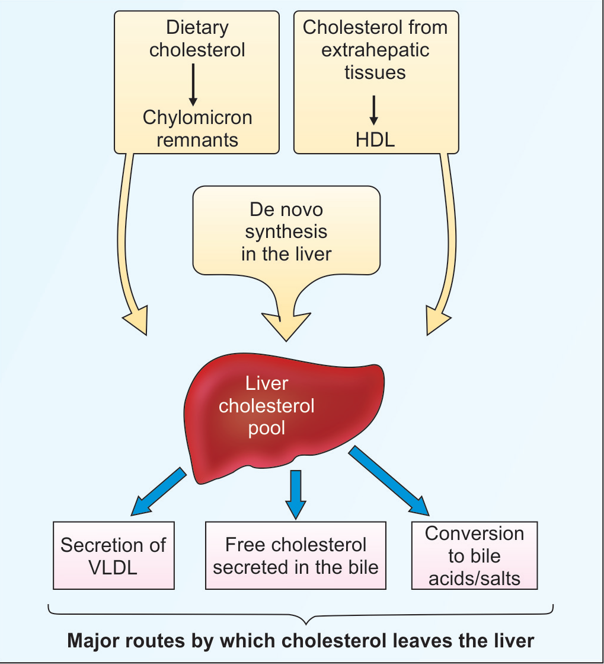
Cholesterol pool in liver

Slide 10
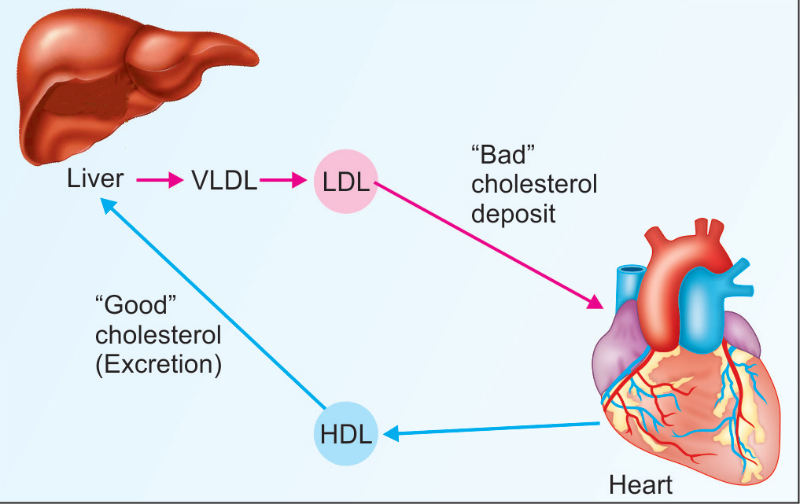
Forward and Reverse Cholesterol transport

Slide 11
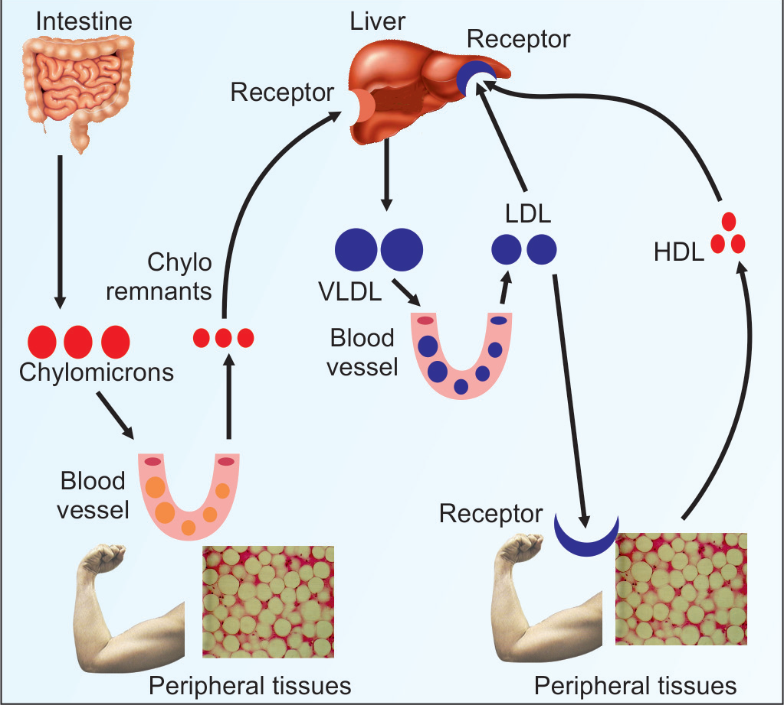
Summary of lipoprotein metabolism
Notes:
LDL is mainly catabolized by apo-B receptor mediated uptake by liver

Slide 12
Pathogenesis of Atherosclerosis
The main components are:
  Endothelial dysfunction
  Lipid deposition
  Inflammatory reaction in the vascular wall
  Remodeling of vessel wall

Slide 13
Pathogenesis of Atherosclerosis
Arterial wall has three layers:
Intima (subendothelial layer)
Media (middle layer) with smooth muscle cells (SMC)
Adventitia (outer layer) with connective tissue and nerves

Slide 14
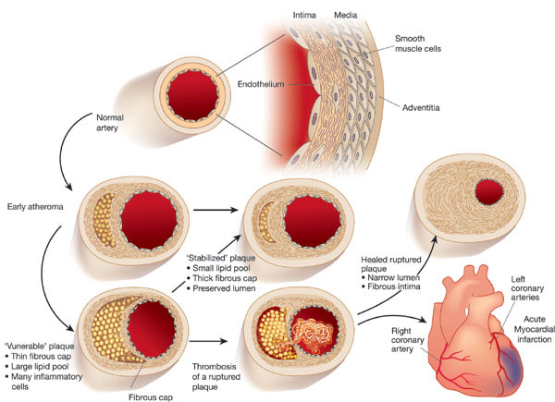
Normal arterial wall

Slide 15
Stages of Atherosclerosis
Stage 1: Formation of Fatty streak and Foam cells
Stage 2: Progression of Atherosclerosis
Stage 3: Fibrous proliferation
Stage 4: Advance fibrous plaque formation

Slide 16
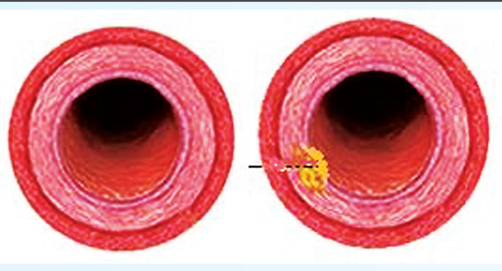
Stage 1: Fatty streak and Foam cells
Fatty streak/
Early plaque formation
Normal Artery

Slide 17
Stage 1: Fatty streak and Foam cells
The key event – damage to the endothelium caused by
  Excess cholesterol/lipoproteins
  Hypertension
  Diabetes
  Smoking
Deposition of LDL in intima of the vessel
VCAM-1

Slide 18
Stage 1: Fatty streak and Foam cells
Monocytes attracted & attached to VCAM-1
Secrete various cytokines
LDL gets converted to oxidised LDL
Oxidised LDL are ingested by macrophages
Appear as “foam cells” due to cytoplasmic lipid droplets
Appear as Fatty streak
Stage 1 is reversible if lipids level get controlled
Notes:
Foam cells are hallmark of atherosclerosis and appear as fatty steak

Slide 19
Foam cells
.
Macrophage Foam Cell
Macrophage
Lipid droplets
Oxidized LDL
Scavenger
receptor
(SR-A1)

Slide 20
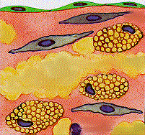
Stage 2: Progression of Atherosclerosis
SMCs migrate into the intima & become foam cells
Proliferation of smooth muscle cells
Platelets adhered to endothelium
Lesion progresses unchecked, becomes irreversible
Notes:
Continued accumulation of lipids i.e. LDL leads to more deposition and progression

Slide 21
Stage 3: Fibrous proliferation
Various growth factors liberated by;
  Foam cells
  Macrophages
  Platelets
Effect;
  More proliferation of SMC
  Production & accumulation of collagen, fibrous tissue & calcium salts
  Recruitment of more inflammatory cells
  Local damage & inflammation

Slide 22
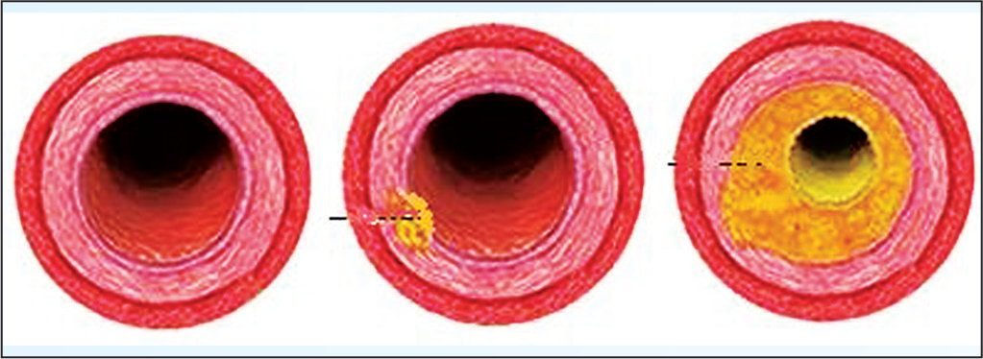
Progression of plaque formation

Slide 23
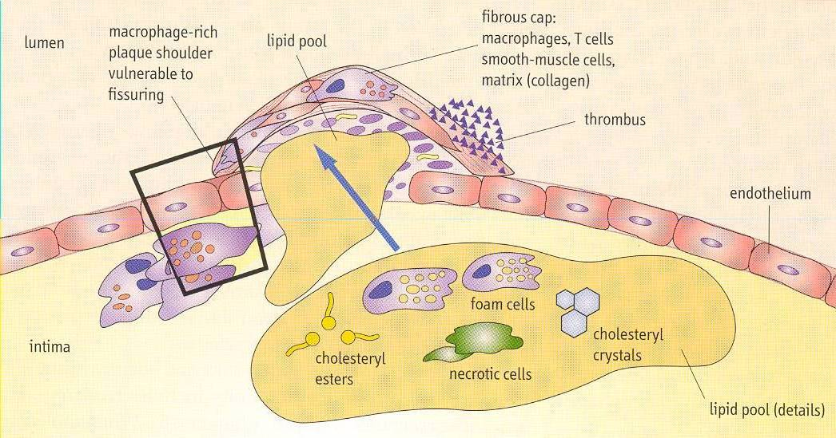
Stage 4: Advance fibrous plaque
Foam cells ruptured (apoptosis)
Lipid release to intima and becomes centre of atherosclerotic plaques

Slide 24
Advancing fibrous plaque
The fibrous cap is formed by SMCs, collagen, GAGs, macrophages, T-cells & Ca salts
This plaque is vulnerable and ruptures easily
Thrombus formed at the rupture site
Leading to blockage of blood supply
Tendency of embolus formation

Slide 25
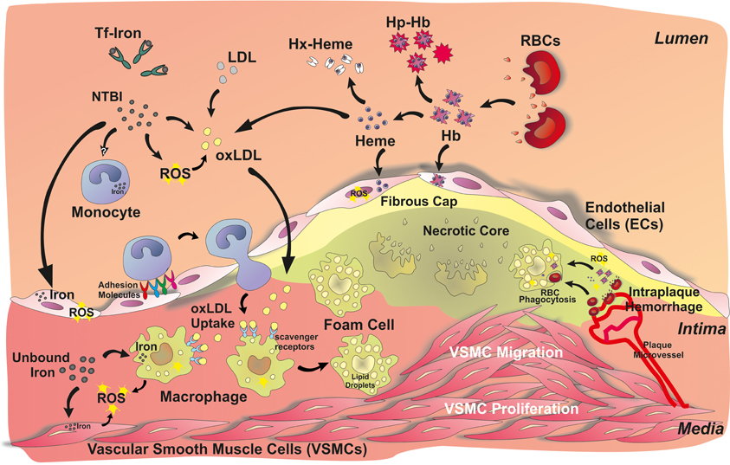
Advancing fibrous plaque

Slide 27
Myocardial infarction
Due to occlusion of one or more coronary artery
Ischemia of myocardium
Anaerobic glycolysis - ↓ ATP, ↑ Lactic acid ↓ pH – further damage
Inefficient contraction of cardiac muscle
Necrosis of myocytes & cardiac failure
Notes:
by thrombus on atherosclerotic plaque

Slide 29
The Role of Lipoproteins in Atherogenesis
HDL
High plasma
LDL
Endothelial
injury
(-)
LDL
+
VLDL
LDL infiltration
into intima
Adherence
of platelets
LCAT
APO-A1
Release
of PDGF
Liver
Oxidative
modification
of LDL
Other
growth
factors
+
Macrophages
Foam cells
Fatty streak
Cholesterol
excreted
Advanced
fibrocalcific
lesion
APO-A1=Apolipoprotein A1, HDL=High density lipoprotein, LCAT=Lecithin cholesterol acyltransferase, LDL=Low density lipoprotein, PDGF=Platelet-derived growth factor, VLDL=Very low density lipoprotein
Notes:
Pro-atherogenic lipoprotein particles such as LDL infiltrate into the intima of the arterial wall and undergo oxidative modification. Accumulation of these atherogenic particles attracts macrophages that engulf the cholesterol, causing formation of foam cells and subsequent fatty streaks. This process injures the epithelium of the arterial wall, promoting adherence of platelets, release of PDGF, and development of an advanced fibrocalcific lesion. Anti-atherogenic particles such as HDL and apo-A1 promote reverse cholesterol transport and cholesterol efflux from foam cells. They also help to prevent oxidation of LDL and other atherogenic particles.

Slide 30
Risk Factors for Atherosclerosis
Elderly Age
Family history of CAD
Smoking
Hypertension >140/90 mm Hg
Obesity >30% overweight
Diabetes mellitus
Inactivity/ lack of exercise
Notes:
men >45 years of age; women > 55 years of age

Slide 31
Risk markers for Athersclerosis
1. Total cholesterol level in serum
2. LDL cholesterol and Apo B100 level
3. HDL cholesterol and Apo A1 level
4. Plasma hsCRP (High sensitive C-Reactive protein)
5. Lp(a) level
6. Serum triglycerides
7. Blood HbA1c
8. Serum homocysteine level
Notes:
These are associated with coronary heart diseases and vascular didseases

Slide 32
Serum total Cholesterol
VLDL + LDL + HDL cholesterol.
• Normal range = 150 – 200 mg/dL
• Desirable < 200 mg/dL
• Borderline high = 200 – 239 mg/dL
• High ≥ 240 mg/dL
Notes:
Increase in TC is associated with atherosclerosis and coronary heart disease (CHD).

Slide 33
LDL-C/apo-B100
• Low risk = 100-129 mg/dL
• Moderate risk = 130 – 159 mg/dL
• High risk ≥ 160 mg/dL

Slide 34
HDL-C/apo-A1
• Desirable/Low risk range ≥ 60 mg/dL
• Moderate risk = 35 – 59 mg/dL
• High risk ≤ 35 mg/dL

Slide 35
Ratios
TC/HDL-C ratio:
  Low risk < 3.5
  High risk ≥ 3.5
LDL-C/HDL-C ratio:
  Low risk< 2.5
  High risk ≥ 2.5
Apo B/Apo-A1:
  Low risk< 0.4
  High risk ≥ 0.4

Slide 36
Triglycerides (TAG)
Measures TAGs of Chylomicrons & VLDL
↑ TAG → → ↑ VLDL → → ↑ LDL
High risk > 200 mg/dL

Slide 37
Lipoprotein (a)
Lip (a) > 30 mg/dL ~ strongly associated with
Atheroscelrosis/MI
Notes:
Present in some persons only. It binds to apo B100 by disulphide bond

Slide 38
hsCRP
Inflammatory marker
Low risk < 1.0 mg/dL
Moderate risk: 1.0-3.0 mg/dL
High risk > 3.0 mg/dL

Slide 39
HbA1c
HbA1c > 6.5% ~ High risk
Serum Homocysteine level
High risk > 15 mg/dL

Slide 40
Summary….

Slide 41
Deposition of lipids, fibrous tissue and inflammatory cells forms the atherosclerotic plaque
4 stages of athersclerosis
Stage 1 is formation & accumulation of foam cells and is reversible
Stage 2 is proliferation of SMCs
State 3 is formation of lipid core & fibrous cap
Stage 4 is advancement witrh plaque rupture and thrombus formation
Various risk markers for atherscelrosis:
  Lipid profile – TC, LDL-C, HDL-C & TAGs
  Lp(a)
  HbA1c
  Homocysteine level

Slide 42
Thank You

