Slide 1
AROMATIC AMINO ACID METABOLISM

Slide 2
Aromatic amino acid contains aromatic ring .
They are-
Phenylalanine(Benzene ring or phenyl)
Tyrosine(phenol)
Tryptophane(indole)

Slide 3
PHENYLALANINE
Essential amino acid
Partially glucogenic and partially ketogenic.
The only function of phenylalanine is its conversion to tyrosine.
For this reason ingestion of tyrosine can reduce the dietary requirement of phenylalanine. This phenomenon known as “spring action” of tyrosine on phenylalanine.

Slide 4
CONVERSION OF PHENYLALANINE TO TYROSINE
The degradation of phenylalanine mostly occurs through tyrosine.
The reaction involves addition of a hydroxyl group to the aromatic ring.
It needs NADPH,NADH,and tetra-hydrobiopterin as co-enzyme.
This is an irreversible reaction and tyrosine cannot replenish phenylalanine.

Slide 5
Metabolism of Tyrosine
P H E NY L AL A NI N E
T Y R O S I N E
MELANINE
Phenylalanine
DOPAMINE
hydroxylase
NOREPINEPHRINE
EPINEPHRINE
THYROXINE

Slide 6
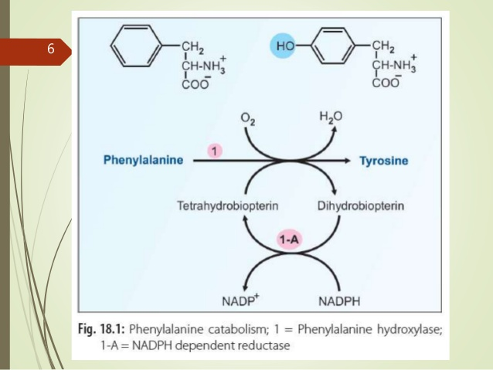

Slide 7
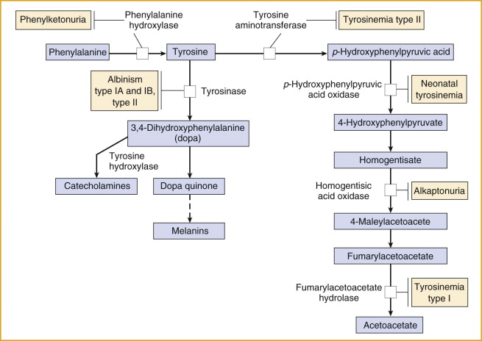
Cu2+

Slide 8
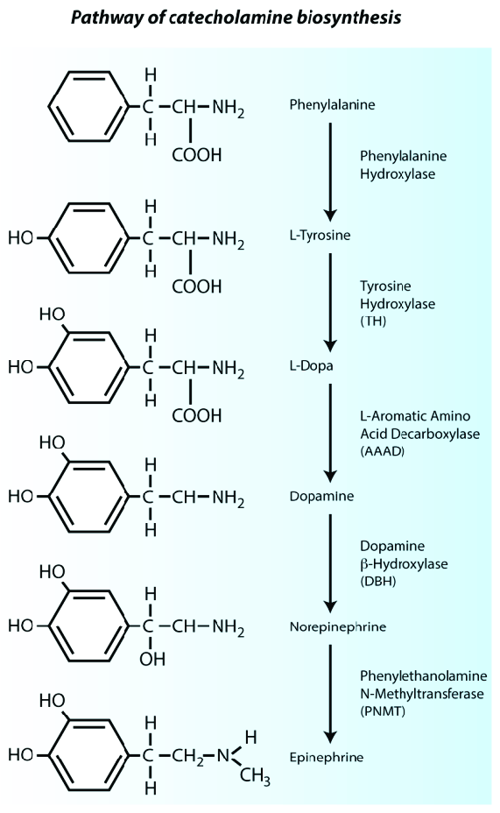

Slide 9
The metabolism of phenylalanine and tyrosine is considered together.
As phenylalanine is converted to tyrosine a single pathway is responsible for the degradation of both these amino acids,which mostly occurs in liver.
Tyr first undergoes transamination to give P- hydroxyphenylpyruvate. this reaction is catalysed by tyrosine transaminase.

Slide 10
P-hydroxyphenylpyruvate hydroxylase(dioxygenase)is a copper containing enzyme.
It catalyses oxidative decarboxylation as well as hydroxylation of phenyl ring to produce HOMOGENTISATE.
A shifting of OH group from Para to meta position occur,and incorporates a new hydroxyl group at para position.

Slide 11
This reaction requires ascorbic acid.
HOMOGENTISATE OXIDASE cleaves the bengene ring of homogentisate to form 4- maleylacetoacetate.
Maleylacetoacetate isomarised to form 4- fumaryl acetoacetate and this reaction is catalysed by maleylacetoacetate isomarase.

Slide 12
maleyl acetoacetate is get converted into fumaryl acetoacetate with the help of fumarylacetoacetase.
Fumaryl acetoacetate hydrolysed in to fumarate and acetoacetate with the help of enzyme fumarylacetoacetase.

Slide 13
SYNTHESIS OF MELANINE
It is pigment of skin,hair and eyes.
Tyrosine is the precursor of melanine.
Tyrosinase enzyme required for its synthesis.
Tyrosinase hydroxylas tyrosine to form 3,4- dihydroxyphenylalanine(DOPA).
Dopa is converted to dopaquinone.
A subsequent couple of reaction occurs.
Formation of leucodopachrome and indole 5-6 – quinone.

Slide 14
Tyrosine
Tyrosinase
DOPA
Dopamine
Cysteine
Melanin red polymers
Leucodopachrome
5,6-Dihydroxyindole Indole 5-6-quinone
Tyrosinase
melanochrome
Melanin black polymers

Slide 15
Cysteine condenses with dopaquinone and series of reactions results in synthesis of red melanines

Slide 16
Tyrosine is also required for thyroid hormone and catecholamine synthesis.
Tyrosine is precursor for the synthesis of dopamine,norepinephrine and epinephrine.
For the formation of dopa the enzyme required is TYROSINE HYDROXYLASE.

Slide 17
Melanin, a color pigment
Skin color is determined by the relative concentrations of black & red melanins
This is dependent on genetic and environmental factors
Formation of moles is due to hyperpigmentation caused by the hyperactivity of melanocytes and formation of white patches is due to localized absence or degeneration of melanoytes from the skin.
Albinism is an inborn error with generalized lack of melanin synthesis

Slide 18
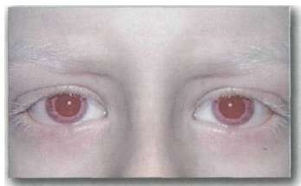
Albinism

Slide 19
What is albinism?
Albinism is a group of genetic conditions that causes a lack of pigment. It can effect only the eyes or both the eyes and skin. Most types of albinism are inherited when an individual receives the albinism gene from both parents. The exception is one type of ocular albinism, which is passed on from mothers to their sons.

Slide 20
Description
Due to the defect in tyrosine metabolism it results in a deficiency of melanin production and partial or full absence of pigment from the skin, hair, and eyes
It may be inherited by one of several modes: autosomal recessive, autosomal dominant, or Complete albinism
Affected people may appear to have white hair, skin & iris color. They may have vision defects and photophobia.
Oculocutaneous albinism is most severe form resulting from a deficiency of tyrosinase
activity, causing a total absence of pigment from the hair, eyes & skin

Slide 21
Detection
Detected at birth because of irregular pigmentation

Slide 22
Symptoms
Absence of pigment from the hair, skin, or iris of eyes
Lighter than normal skin and hair or complete albinism
Most forms of complete albinism have some of the following possible symptoms:
  Rapid eye movements
  Strabismus (eyes not tracking properly)
  Photophobia (avoidance of light because of discomfort)
  Decreased visual acuity
  Functional blindness

Slide 23
Causes
Albinism is caused by an alteration of the gene that regulates the melanin pigment synthesis.

Slide 24
Alternate names
Hypopigmentation
Ocular Albinism
Oculocutaneous Albinism

Slide 25
Prevalence
Approximately one in 17,000 people have one of the types of albinism. About 18,000 people in the United States are affected.

Slide 26
Diagnosis
The most accurate way to determine albinism and the specific type is genetic testing

Slide 27
Treatment
The skin and eyes must be protected from the sun. Sunglasses (UV protected) may relieve photophobia.

Slide 28
Prognosis
Albinism does not affect the expected lifespan. Activities may be limited by intolerance to the sun.

Slide 29
Complications
Skin cancer
Decreased vision, blindness

Slide 30
TRYPTOPHAN
Essential aminoacid.
Contains an indole ring.
It’s a alpha amino beta indole propionic acid.
Tryptophane is both glucogenic and ketogenic.
It is precursor of NAD+ and NADP+ serotonin and melatonin.

Slide 31
METABOLISM OF TRYPTOPHAN
Divided into-
1-kynurenine pathway
2-serotonin pathway

Slide 32
KYNURENINE PATHWAY
Mostly occurs in liver.
Tryptophan converted in to N- formylkynurenine with the help of enzyme tryptophan pyrrolase.
Formamidase hydrolases formyl kynurenine and liberates formate and kynurenine.
Kynurenine undergose NADPH-dependent hydroxylation to give 3-hydroxykynurenine.

Slide 33
Kynureninase, a pyridoxal phosphate dependent enzyme acts on the 3-hydroxy kynurenine and splits off alanine.
Due to the lack of PLP kynureninase reaction is blocked and 3-hydroxy kynurenine is diverted to form xenthurenate, serves as an indication of vitamin B6 deficiency.
3-hydroxy anthranilate is cleaved by an oxidase to form an unstable intermediate 2-amino 3carboxy muconate semialdehyde.

Slide 34
This compound has 3 fates-
1-Spontaneous cyclization to form quinolinate for NAD+ synthesis.
2-To produce picolinate.
3-To produce 2-aminomuconate for acetyl CO.A synthesis.

Slide 35
Tryptophan is also produces indole acetate.
Tryptophan is not precursor for the synthesis of niacin.
Quinolinate under gose decarboxylation and form nicotinate mononucleotide by the enzyme quinolinate phosphoribosyl transferase.

Slide 36
SEROTONIN PATHWAY
It is a neurutransmitter, syntheseized from tryptophan.
Only 1% of tryptophan is converted in to serotonin.
The production of 5HT occurs in the target tissues.

Slide 37
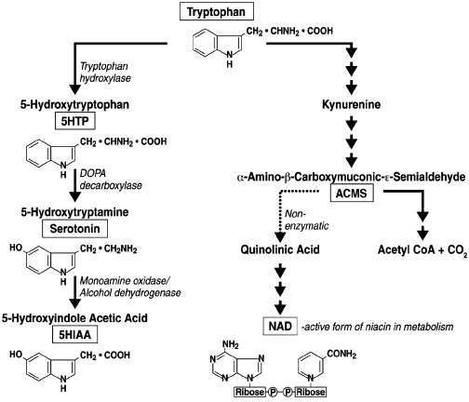

Slide 38
Synthesis of serotonin
Synthesized in the intestinal cells.
Tryptophane is first hydroxylated at 5th carbon by tryptophane hydroxylase.
This enzyme requires tetrahydrobiopterin as a co factor.
5-hydroxytryptophane is decarboxylated by aromatic amino acid decarboxylase to give serotonin.

Slide 39
Degradation and functions of serotonin
Monoamine oxidase degrades serotonin to 5- hydroxy indole acetate which is excreted in urine.
Functions-
1-as a powerful VASOCONSTRICTOR.
2-involves in regulation of cerebral activity.
3-controls beheviourals patterns,sleep,blood pressure and body temprature.

Slide 40
4-evokes the release of peptide hormones.
5-also necessary for the motility of GIT.

