Slide 1
MANDIBULAR
CANINES

Slide 2
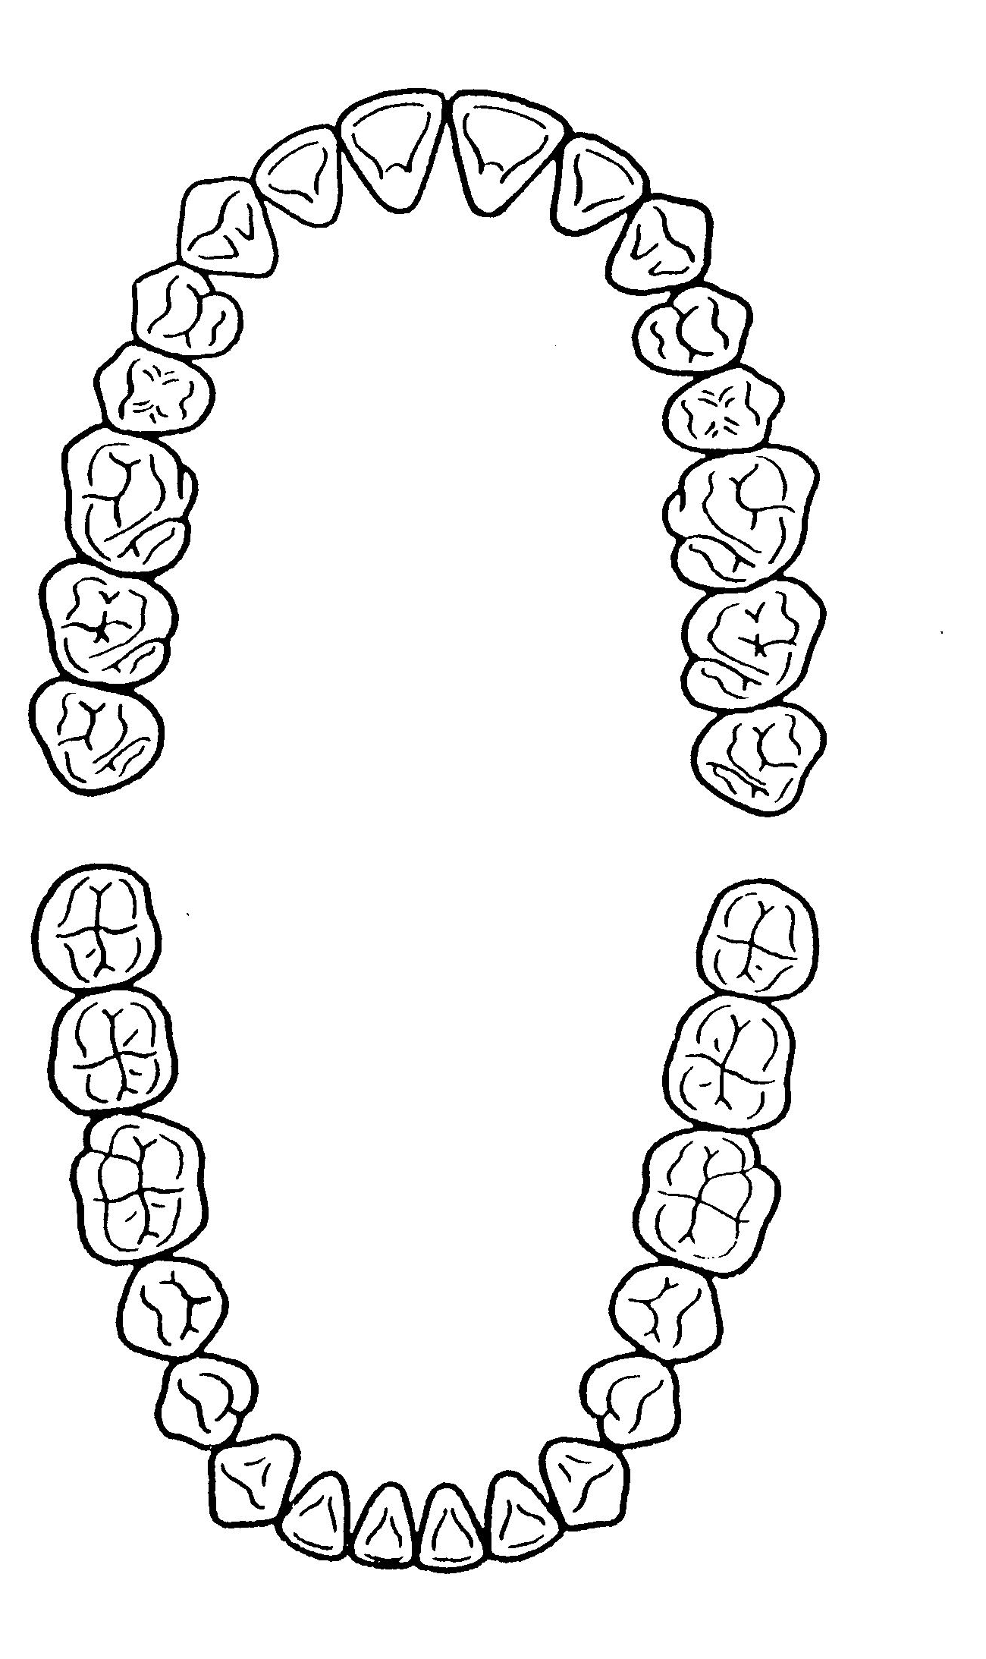
Mandibular CUSPIDS (Canine)
X
X

Slide 3
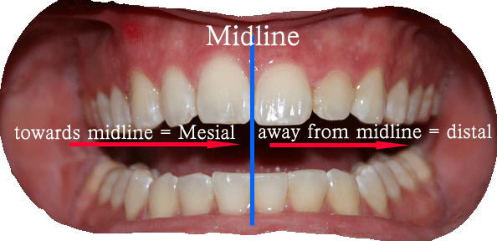

Slide 4
Patient’s Right
Patient’s Left
8,7,6,5,4,3,2,1
1,2,3,4,5,6,7,8
3
8,7,6,5,4,3,2,1
1,2,3,4,5,6,7,8
Permanent mandibular right canine
1,2,3,4,5,6,7,8
9,10,11,12,13,14,15,16
32,31,30,29,28,27,26,25
24,23,22,21,20,19,18,17
#27
Permanent mandibular right canine
18,17,16,15,14,13,12,11
21,22,23,24,25,26,27,28
48,47,46,45,44,43,42,41
31,32,33,34,35,36,37,38
33
Permanent mandibular left canine

Slide 5
Average Dimensions in millimeters
Crown Length
Root
Length
Mesiodistal
Diameter at
Contact Area
Mesiodistal
Diameter at
Cervical Line
Labiolingual
Diameter at
Crest of Curvature
Labiolingual
Diameter at
Cervical Line
Curvature of Cervical Line
M D
11
16
7
5.5
7.5
7.0
2.5 1.0
CHRONOLOGY
First evidence of calcification 4-5 months
Crown completion 6-7 years
Eruption 9-10 years
Root completion 12-14 years

Slide 6
The mandibular canine crown is narrower mesiodistally than that of the maxillary canine.
The root may be somewhat shorter.
The lingual surface of the crown is smoother, with less cingulum development and less bulk to the marginal ridges. The lingual portion of this crown resembles the form of the lingual surfaces of mandibular lateral incisors.

Slide 7
The cusp of the mandibular canine is not as well-developed as that of the maxillary canine.
Thinner cusp ridges.

Slide 8
Labial Aspect
The mesiodistal dimensions of the mandibular canine are less than those of the maxillary canine. The difference is usually about 1 mm, but broader than mand. C.I.& L.I.

Slide 9
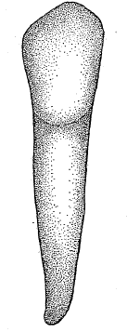
ESSENTIAL DIFFERENCES
The crowns of the mandibular canines appear longer.
The mesial outline of the crown of the mandibular canine is nearly straight with the mesial outline of the root.
The mesial contact area being near the mesioincisal angle.
The mesial cusp ridge is shorter.

Slide 10
The distal contact area of the mandibular canine is more toward the incisal aspect.
The cervical line labially has a semicircular curvature apically.
The mandibular canine root is shorter by 1 or 2 mm on average than that of the maxillary canine, and its apical end is more sharply pointed.

Slide 11
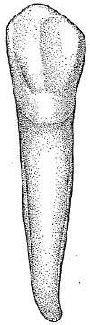
Lingual Aspect
In comparing the lingual aspect of the mandibular canine with the maxillary canine, the following differences are noted.
The lingual surface of the crown of the mandibular canine is flatter, simulating the lingual surfaces of mandibular incisors.
The cingulum is smooth and poorly developed.

Slide 12
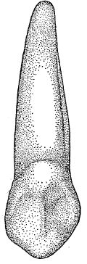
The marginal ridges are less distinct.
Generally speaking, the lingual surface of the crown is smooth and regular.
The lingual portion of the root is narrower relatively than that of the maxillary canine.

Slide 13
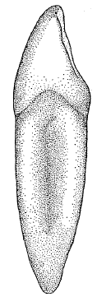
Mesial Aspect
The mandibular canine has less curvature labially on the crown with very little curvature directly above the cervical line.
The lingual outline of the crown is curved in the same manner as that of the maxillary canine, but it differs in degree.

Slide 14
The cingulum is not as pronounced, and the incisal portion of the crown is thinner labio-lingually, which allows the cusp to appear more pointed and the cusp ridge to appear more slender.
The tip of the cusp is placed lingually over the root.

Slide 15
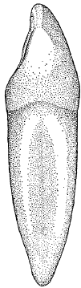
Distal Aspect
Not much difference from the distal aspect is seen.

Slide 16
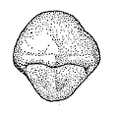
Incisal Aspect
The outlines of the crowns of mandibular and maxillary canines from the incisal aspect are often similar. The main differences to be noted are as follows:

Slide 17
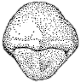
The mesiodistal dimension of the mandibular canine is less than the labiolingual dimension.
A similarity is evident in this, but the outlines of the mesial surface are less curved.
The cusp tip and mesial cusp ridge are more likely to be inclined in a lingual direction.

Slide 18
TRAITS TO DISTINGUISH MAXILLARY FROM MANDIBULAR CANINE: LABIAL VIEW

Slide 19
Thank you!!!

Slide 20
