Slide 1

SURESH BABU K

Slide 2
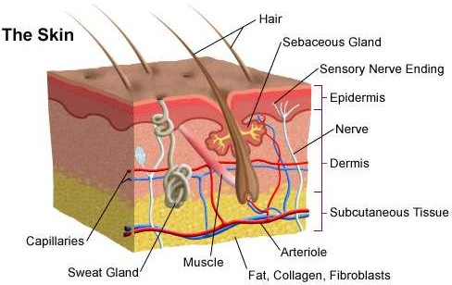
Largest sensory organ
THICKNESS- Thickest is on the Upper Back (5mm), thinnest on upper & lower eyelids (
<1mm)

Slide 3
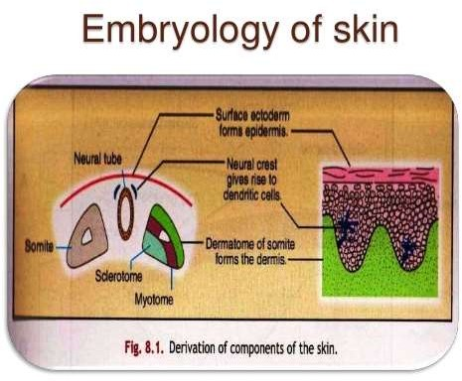

Slide 4



LAYERS OF SKIN
Epidermis
Dermis
Hypodermis/ Subcutis

Slide 5
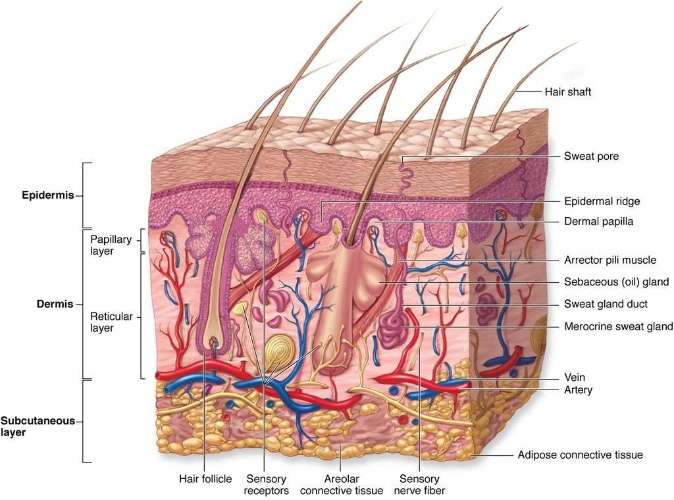

Slide 6
EPIDERMIS
Cells of the Epidermis – KERATINOCYTES.
Self regenerating Stratified Squamous Epithelium
Outer protective layer of KERATIN
Stratum Basale
Stratum Spinosum
Stratum Granulosum
Stratum Lucidum
Stratum Corneum

Slide 7

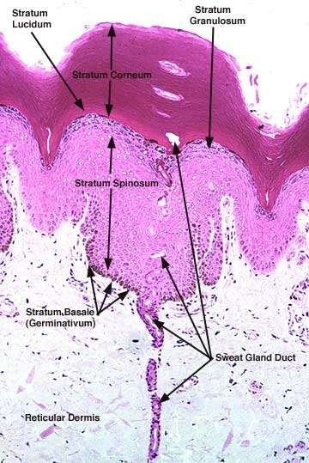

Slide 8
STRATUM BASALE
(GERMINATIVE LAYER OR STRATUM GERMINATIVUM)
Basal layer of Epidermis, more Basophilic cytoplasm
Proliferates continuously with repeated Mitotic division→ gives rise to all other Keratinocytes
Upward migration, Keratinocytes mature to form flattened cells.
Cuboidal or low Columnar cells

Slide 9
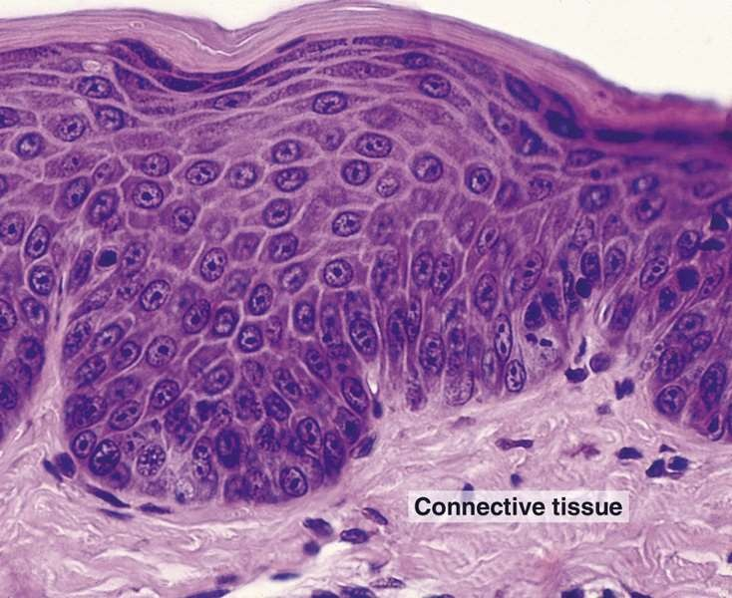

Slide 10
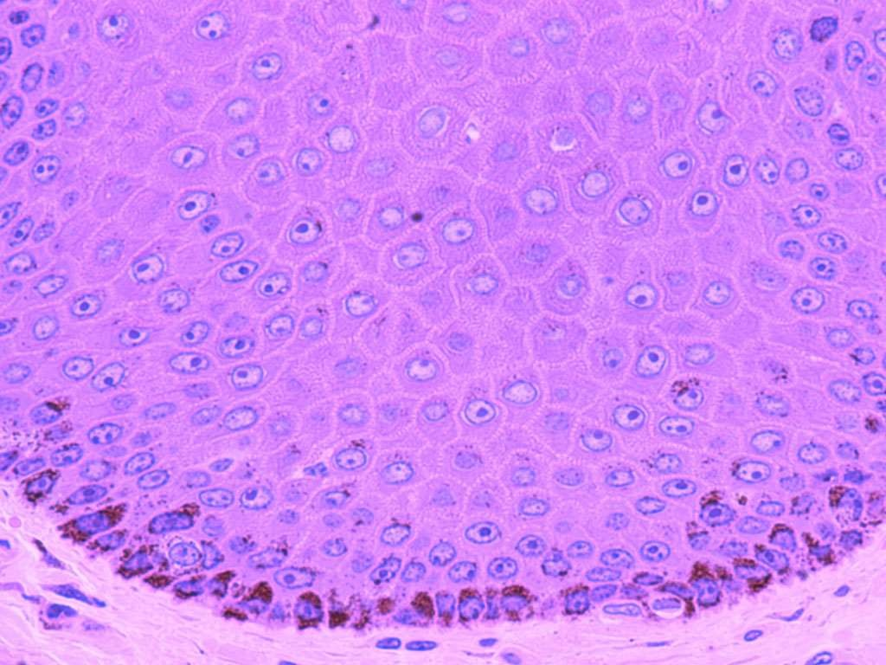

Slide 11
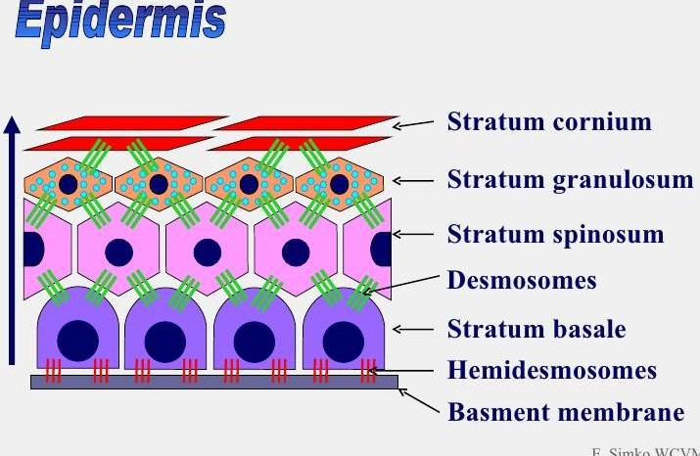

Slide 12
STRATUM SPINOSUM
(PRICKLE CELL LAYER)
Majority of the Epidermis, Multi- layered
Polyhedral shaped keratinocytes, round – oval nuclei, prominent nucleoli & cytoplasm.
Pavement like pattern
Synthesizes Cytokeratins- Cytoplasmic intermediate filaments.

Slide 13
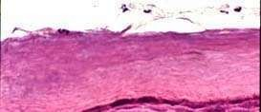

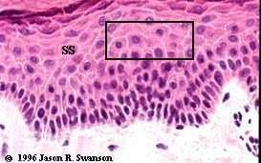
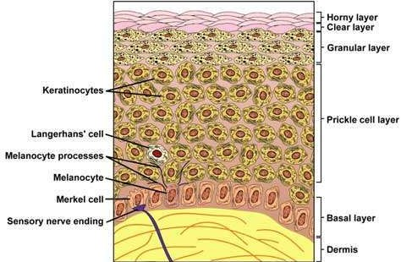

Slide 14
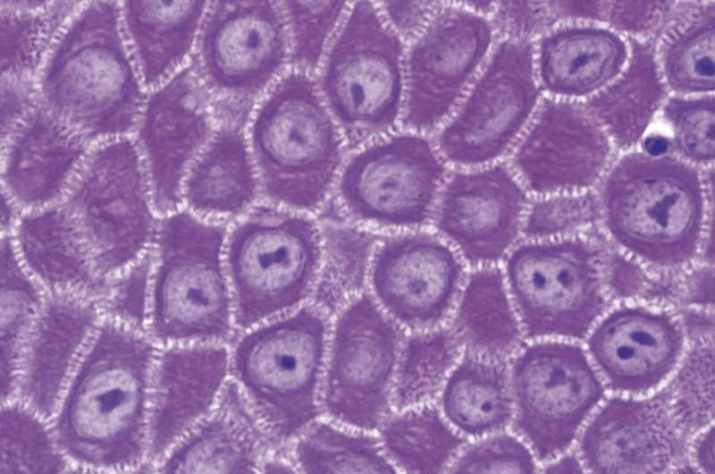
PRICKLE CELL LAYER
Desmosome junctions are seen as Sprickles or Spines between the cells, hence the name.

Slide 15
STRATUM GRANULOSUM
Keratinocytes mature into Stratum Granulosum
KERATOHYALINE GRANULES- in cytoplasm – dense, ovoid, basophilic
contains proteins, rich in Sulphur containing Amino acids CYSTEINE & HISTIDINE
proteins – INVOLUCRIN which interact with Cytokeratin Tonofibrils in the final maturation
Represent precursor of protein FILAGGRIN (resp for Aggregations of keratin filaments)

Slide 16
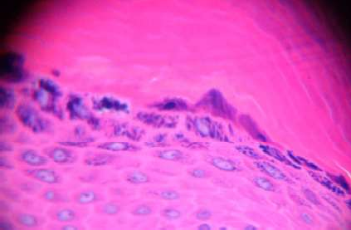
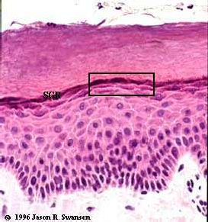
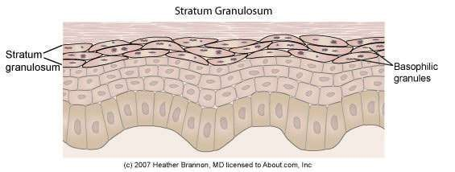

Slide 17
KERATINISATION- Combination of Tonofibrils with Keratohyaline granules produces Keratin.
KERATINISATION CYCLE – 30-45 days
ODLAND BODIES- Lamellated pale staining ovoid bodies.
Hydrophobic glycolipid which when released coats & binds together the Keratin flakes, rendering them relatively water repellent.

Slide 18
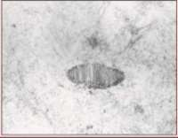
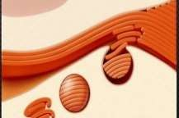
ODLANDBODIES

Slide 19
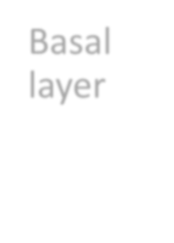
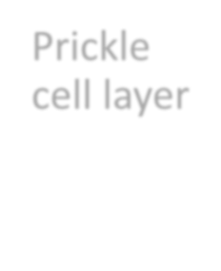
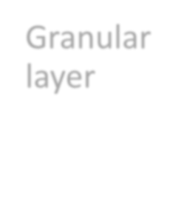





STRATUM MALPIGHII
Rete Malpighii
Basal layer
Prickle cell layer
Granular layer

Slide 20
STRATUM CORNEUM
Anucleate
KERATIN SQUAMES- Lose their nuclei →
flattened
ORTHOKERATOSIS- Keratin Squames connect at their edges→ folded Basket weave pattern. Except in Acral region (thick & compact)
Thickness- difficult to ascertain in formalin fixed specimen- some of the outer cell layers frequently detach themselves

Slide 21
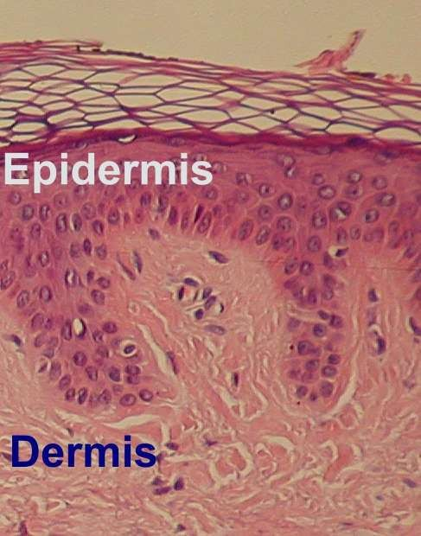
STRATUM CORNEUM
BASKET WEAVE PATTERN- Large intercellularspaces

Slide 22
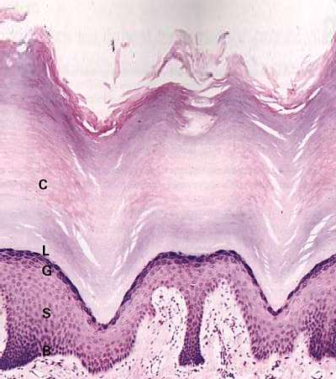

Slide 23
HYPERKERATOSIS:
-Thickening of the Stratum Corneum, often associated with qualitative abnormality of Keratin
PARAKERATOSIS:
-Keratinisation with retained nuclei in the Stratum Corneum.

Slide 24
STRATUM LUCIDUM
Between the Granular & Cornified layers
Skin from the Palms & Soles
Difficult to identify in H&E sections
Thin Homogenous eosinophilic zone

Slide 25
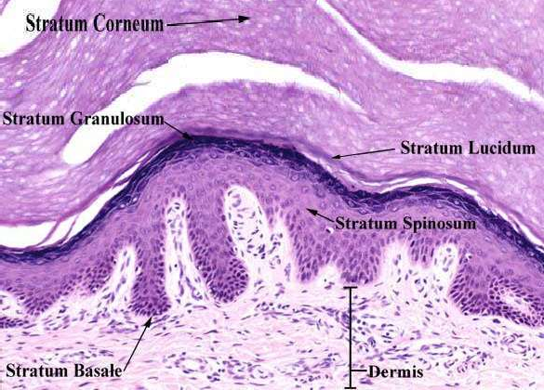
STRATUM LUCIDUM

Slide 26
DERMO- EPIDERMAL JUNCTION
Basement Membrane at the junction of Epidermis & Dermis
Folds of interlocking ridges of epidermis RETE RIDGES and DERMAL PAPILLAE

Slide 27
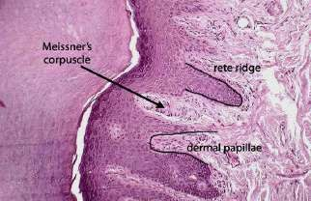
Downward projection
Upward projection

Slide 28
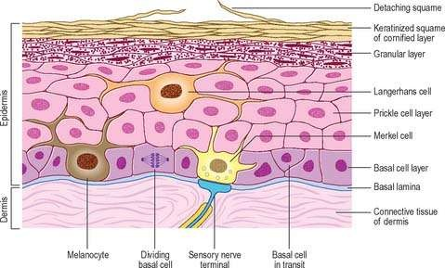



SPECIALISED CELLS IN EPIDERMIS
Melanocytes
Langerhan cells Merkel cells

Slide 29
MELANOCYTES
Neural crest derived cells
Basal layer of epidermis- between two Basal Keratinocytes
Rounded cell bodies, clear cytoplasm= MASSON CLEAR CELLS
Slender cytoplasmic processes (Dendrites)

Slide 30
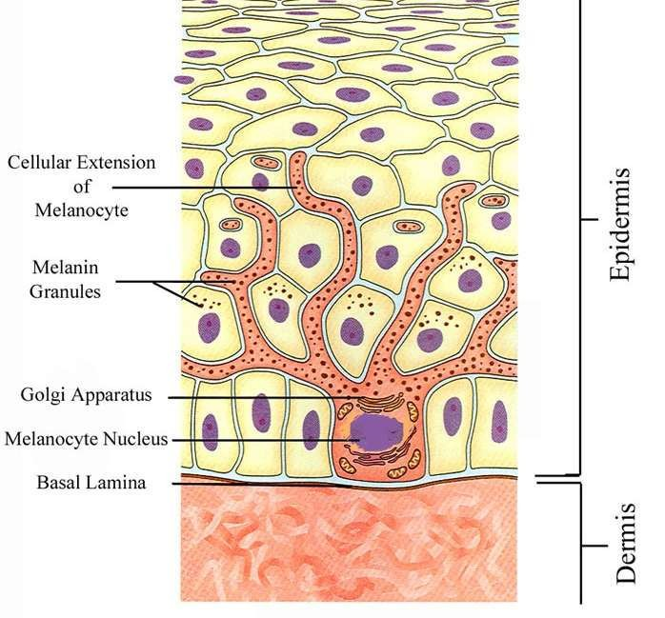
MELANOCYTES

Slide 31
Location of Melanocytes
Basal layer of Skin
Hair follicles
Most Squamous covered Mucosal membranes
Leptomeninges

Slide 32






Tyrosine
MELANIN- yellowish brown to black
DOPA
Melanin
Melanoprotein

Slide 34
LANGERHANS CELLS (Histiocytes)
Bone marrow derived Dendritic cells
Intra- epidermal Antigen Presenting cells
Difficult to see in routine H&E section
All layers of the Epidermis, PRICKLE CELL LAYER

Slide 35
LANGERHANS CELL

Slide 36
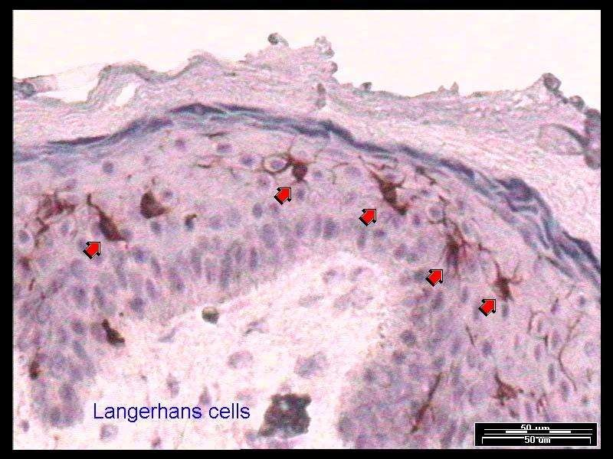
LANGERHANS CELL
IHC- express CD1a, langherin & S-100 protein

Slide 37

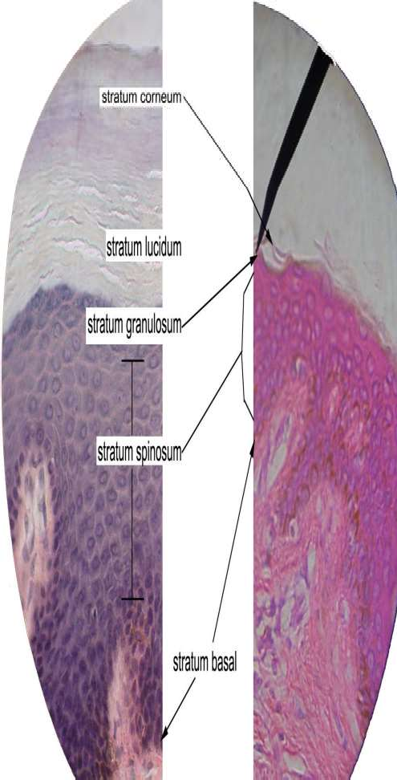
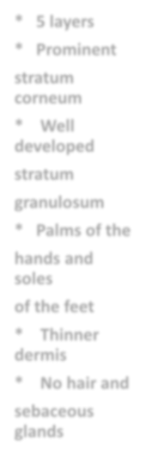

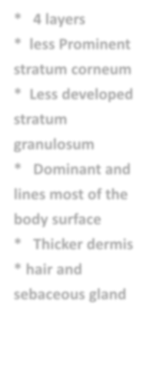
5 layers
Prominent
stratum
corneum
SKIN
4 layers
less Prominent stratum corneum
Less developed
stratum granulosum
Dominant and
lines most of the body surface
Thicker dermis
hair and sebaceous gland
SKIN
Well developed
stratum granulosum
Palms of the
hands and soles
of the feet
THICK
THIN
Thinner
dermis
No hair and
sebaceous glands

Slide 38
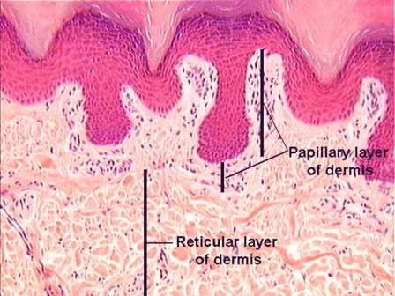
DERMIS
Bundles of Collagen Fibres & strands of Elastic Fibres embedded in scanty amount of acellular ground substance

Slide 39
PAPILLARY DERMIS
loose, very fine interlacing collagen (red) & elastic fibres (black) – EVG stain
Support avascular epidermis with vital nutrients
Provide network for Thermoregulation

Slide 40
RETICULAR DERMIS
Larger than Papillary Dermis
blood vessels, nerves & Skin appendages
Lymphocytes, mast cells & macrophages- scarce in N, increased in skin
disease
  Thickest on the Back & thinnest in the Eyelids

Slide 41
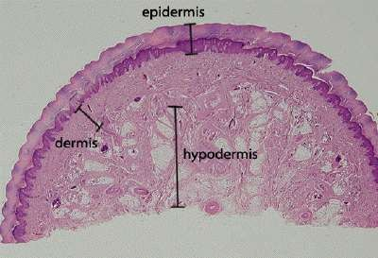
SUBCUTIS ( HYPODERMIS)
Lobules of mature Adipose tissue separated by thin bands of connective tissue-like interlobular septa
Varies from site to site
No hair follicles or apocrine glands

Slide 42



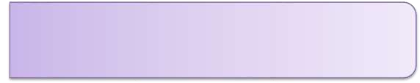
DERMAL BLOOD VESSELS
Superficial plexus
Papillary dermis
Capillary loops extend into Dermal papilla
Deep plexus
Reticular dermis
Acral Skin contains specialised arteriovenous anastomosis- SUCQUET HOYER CANAL
They are surrounded by a row of modified smooth muscle- the GLOMUS CELLS- round, clear cytoplasm & well defined cytoplasmic borders

Slide 43
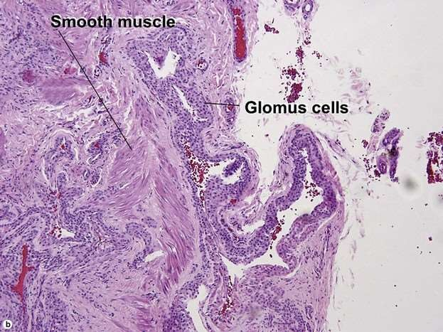
GLOMUS CELLS
GLOMUS CELLS- round, clear cytoplasm & well defined cytoplasmic borders

Slide 44
INNERVATION & NERVE ENDINGS
SENSORY NERVE ENDINGS IN SKIN:
Free nerve endings
Specialised encapsulated nerve endings ‘Capsule’- modifications of Schwann cells
  Meissners Corpuscles
  Pacinian Corpuscles
  Ruffini nerve endings

Slide 45
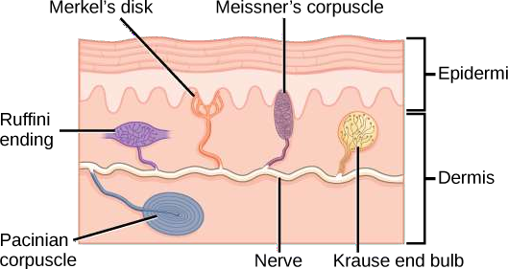

Slide 46
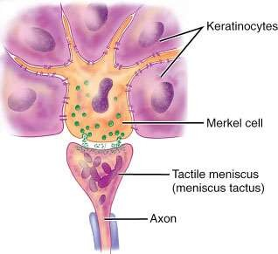
MERKEL CELLS
Intra- epidermal touch receptors
Contain Neuro endocrine type membrane bound vesicles (dense core granules) in their cytoplasm
Difficult to detect in H&E sections

Slide 47
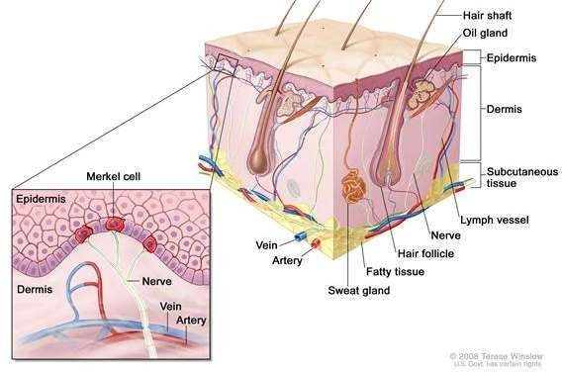

Slide 48
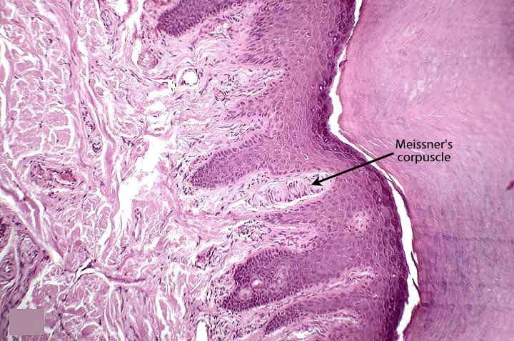
MEISSNERS CORPUSCLES
Rapidly adapting Mechanoreceptor
Touch sensation
Papillary Dermis – Pulp of the fingers and toes & soles and Palms

Slide 49
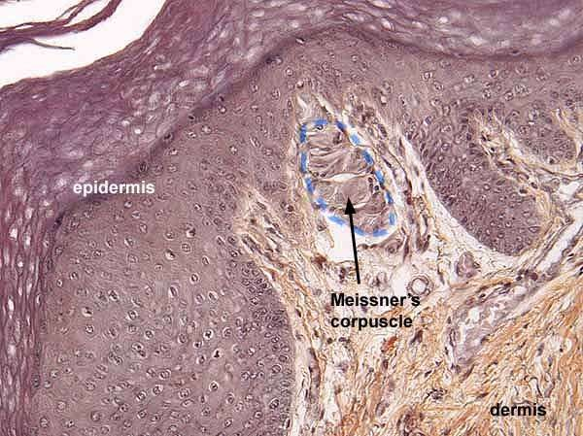

Slide 50
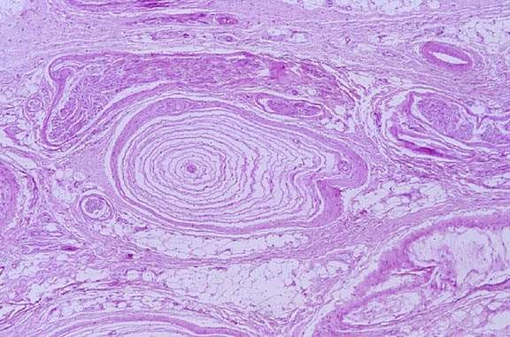
PACINIAN CORPUSCLES
Deep pressure & Vibration
Deep in the subcutis- singly or in clusters
Numerous in Palms & soles

Slide 51
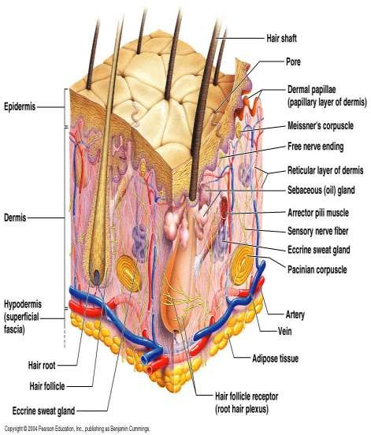










SKIN APPENDAGES (ADNEXA)
Hair Follicles
Sebaceous glands
Eccrine glands (Sweat glands)
Apocrine glands

Slide 52
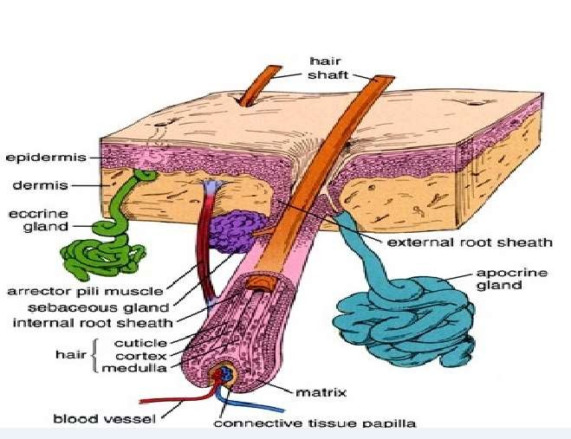
SKIN APPENDAGES (ADNEXA)

Slide 53





PILAR UNIT
Functional complex
Hair follicle
Sebaceous gland
Arrector pili muscle
Apocrine glands (certain region)

Slide 54
HAIR FOLLICLE
Tubular formed structure formed of Perifollicular connective tissue & epithelium
Hair papilla
Hair Matrix
Inner three epithelial undergo Keratinisation
→Hair Shaft
Outer two layers →Internal & External root sheath

Slide 55

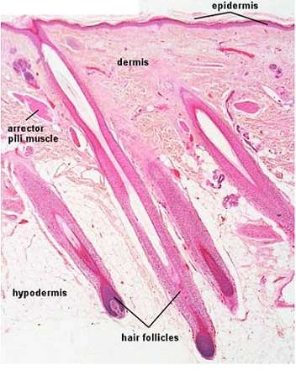
HAIR FOLLICLE
Long thin cylindrical structures (Hair Shafts)
Keratin arranged in an organised manner
HAIR SHAFT
Central MEDULLA
CORTEX
Surface CUTICLE- single layer of flattened scales

Slide 56

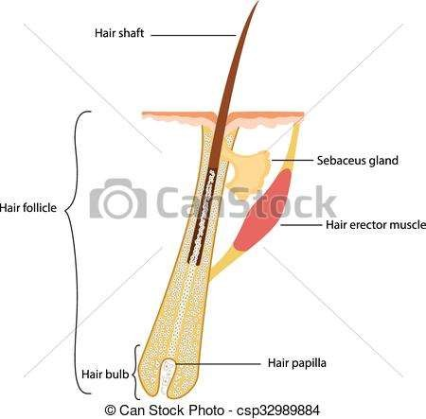
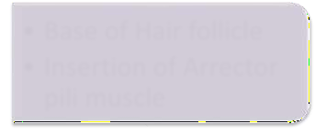

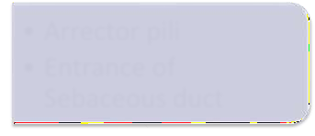

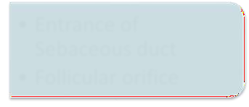
PARTS OF HAIR FOLLICLE
(in longitudinal section)
Base of Hair follicle
Insertion of Arrector pili muscle
LOWER PORTION
Arrector pili
Entrance of Sebaceous duct
ISTHUMUS
(middle portion)
Entrance of Sebaceous duct
Follicular orifice
INFUNDIBULUM
(upper portion)

Slide 57
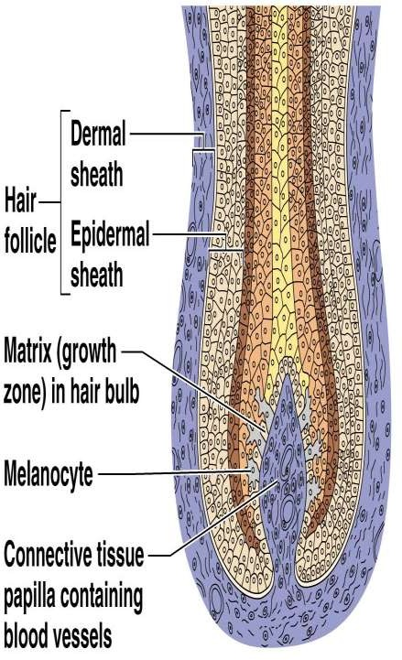
HAIR BULB- At the base, there is Bulbous expansion. Encloses HAIR PAPILLA
HAIR MATRIX- at hair bulb, all the layers merge
HAIR ROOT- epithelial mass surrounding the Dermal papilla

Slide 58
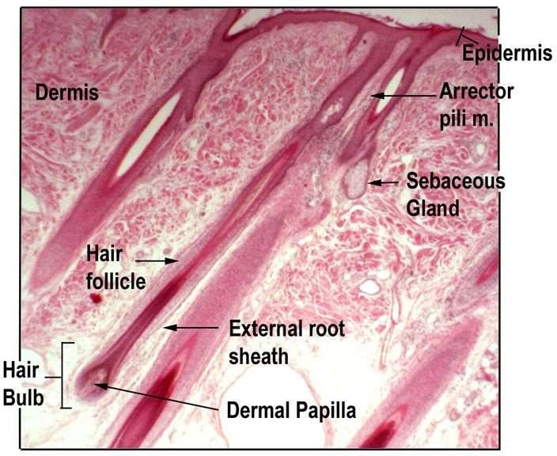

Slide 59
HAIR SHAFT
MEDULLA- innermost layer of the Follicle, moderate Keratinisation Not distinguishable in fine hairs
CORTEX- broad highly keratinised layer, Bulk of the Hair
CUTICLE- Keratinisation to form hard cuticle, on the surface of hair, Overlapping keratin plates to prevent matting of hair
INTERNAL ROOT SHEATH- lightly keratinised- HUXLEY & HENLE LAYER
EXTERNAL ROOT SHEATH- no Hair formation, this layer separated from sheath of connective tissue surrounding the Follicle by thick specialised basement membrane= GLASSY MEMBRANE

Slide 60
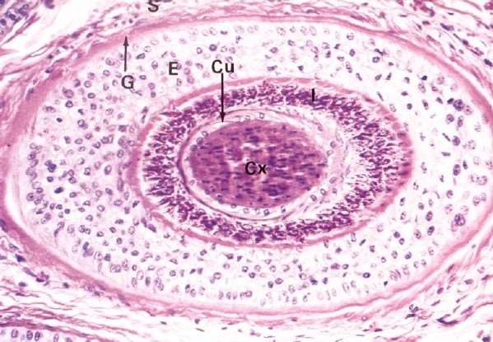

Slide 61
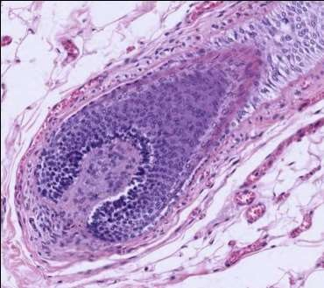

Slide 62


Slide 63


Slide 64






CYCLES OF HAIR GROWTH
TELOGEN
ANAGEN
CATAGEN

Slide 65






Hair Growth in Scalp- 0.4mm/day
ANAGEN
Growing phase
3 years in scalp
CATAGEN
Involuting phase / regression
3 weeks in scalp
TELOGEN
Resting phase
3 months in scalp

Slide 66
SEBACEOUS GLAND
Typical multi vacuolated appearance, centrally located nucleus
Each Hair follicle is surrounded by one or more Sebaceous gland
Excretory duct of the sebaceous glands opens into the Infundibulum of the Hair follicle.

Slide 67

SEBACEOUS GLAND

Slide 68
Lipid content of acinar cells increases→distended cells degenerate→releases the SEBUM= HOLOCRINE SECRETION
Cells lost are replaced by Mitosis in the basal layer of the acinus

Slide 69




SWEAT GLANDS
Eccrine sweat gland
Empty directly onto skin surface
Location: most all over body (esp. abundant on palms & soles
Clear, watery secretion
Merocrine secretion
Apocrine sweat gland
Empty into hair follicle
Location: armpits, groin, nipples
Viscous, cloudy secretion
Secretion begins at puberty and is stimulated during emotional distress

Slide 70

SWEAT GLAND

Slide 71

APOCRINE SWEAT GLAND

Slide 72

SWEAT GLAND

Slide 73

NAIL
Scale-like modifications of the epidermis Heavily keratinized
Stratum basale extends beneath the nail bed
Responsible for growth
Lack of pigment makes them colorless

