Slide 1
TRACHEA & LUNG
SURESH BABU K

Slide 2
INTRODUCTION
Lungs have “Four” main components:
Airways (Bronchi – Bronchioles)
Alveoli
Vessels (Arteries – Veins – Lymphatics)
Interstitium & Pleura
should be examined in every slide

Slide 3
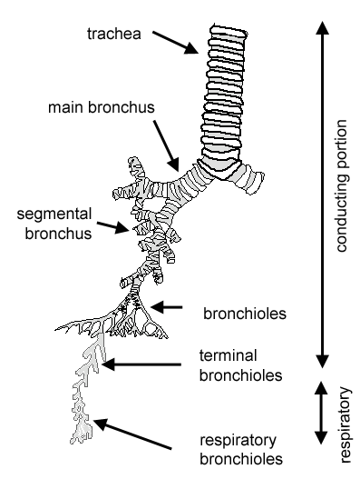
GENERAL
The main role of airways is to conduct the air to the alveoli for gas exchange
Trachea → main bronchi → lobar bronchi → segmental bronchi → small bronchi → bronchioles → respiratory bronchioles → alveolar ducts → alveoli
Respiratory bronchioles and alveolar ducts are not only conduct air but also participate in gas exchange with the alveoli

Slide 4
GENERAL
The delivered air should be:
Warm
  By the airways blood vessels
Moisten
  By watery secretion released by submucosal seromucinous glands
Clean
  By Ciliary movements (located at apical portions of mucosal epithelium)
  By Mucous secretion (released by mucosal goblet cells and submucosal seromucinous glands)

Slide 5
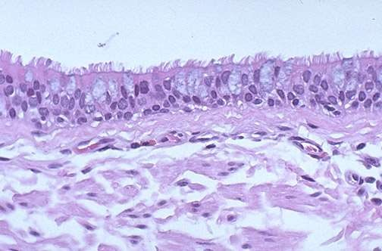
TRACHEA
Mucosa
Respiratory epithelium
  Pseudostratified Ciliated Columnar Epithelium
  Other cells
    Goblet cells
    Basal cells
    Brush cells
Neuroendocrine cells (Kulchitsky)
Basement membrane
Lamina Propria
– Connective tissue + elastic fibers
stratified appearance of the mucosa is because their nuclei are located on different levels, even though the cells are anchored on the same basement membrane

Slide 6
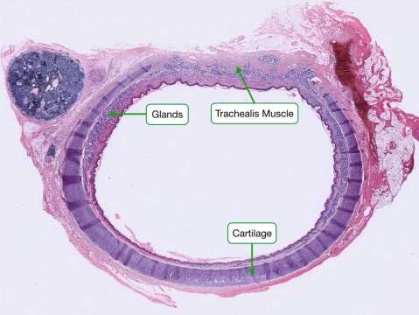
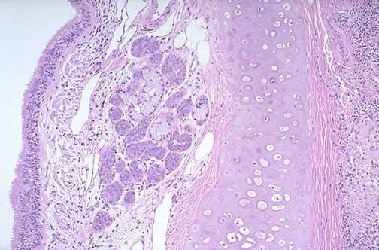
TRACHEA
Wall
Tracheal Seromucinous glands
Tracheal cartilage
  C-shaped rings of hyaline cartilages
  Number: 16 - 20
  Incomplete posteriorly (gap)
Trachealis muscle
  Filling the posterior cartilaginous gap
Also connective tissue + elastic fibers

Slide 7
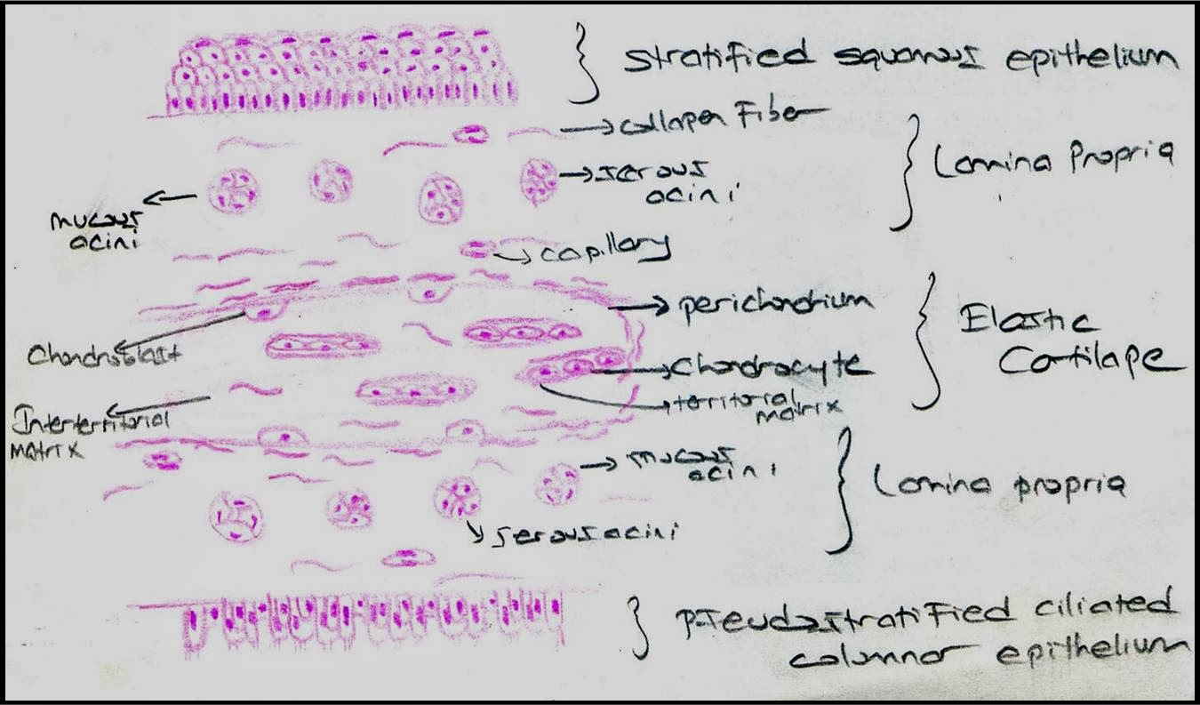
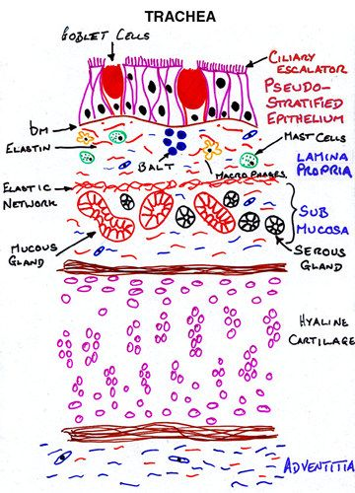

Slide 8
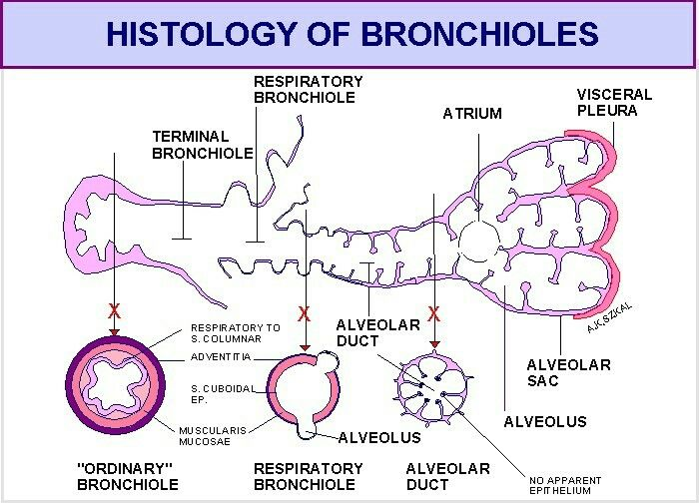

Slide 9
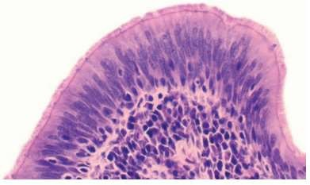
BRONCHI
Mucosa
Respiratory epithelium
  Pseudostratified Ciliated Columnar Epithelium
  Other cells
    Goblet cells
    Basal cells
    Brush cells
    Neuroendocrine cells (Kulchitsky)
Basement membrane
Lamina Propria
  Connective tissue + elastic fibers
stratified appearance of the mucosa is because their nuclei are located on different levels, even though the cells are anchored on the same basement membrane

Slide 10
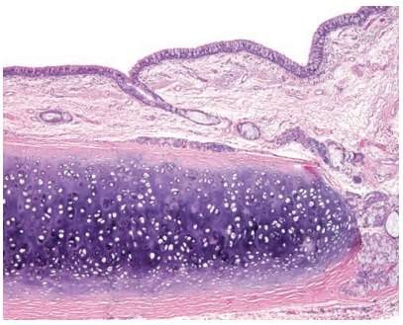
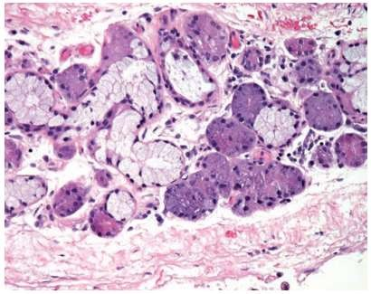
BRONCHI
Wall
Smooth muscle layer
  Just below mucosa
Bronchial seromucinous glands
Bronchial cartilage
  Incomplete plates
Also connective tissue + elastic fibers
Also bronchus-associated lymphoid tissue (BALT)
  Similar to (MALT) of GIT

Slide 11
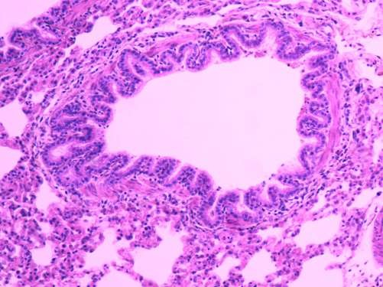
BRONCHIOLES
Mucosa
Bronchiolar epithelium
  Less pseudostratified to simple, Columnar Ciliated epithelium
  Other cells
    Clara cells
Basement membrane
Lamina propria
  Connective tissue + elastic fibers
In more distal airways, there are:
fewer goblet cells
more Clara cells

Slide 12
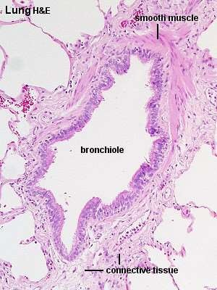
BRONCHIOLES
Wall
Smooth muscle layer
– Relatively thicker than bronchi
No glands
No cartilage
Also connective tissue + elastic fibers

Slide 13
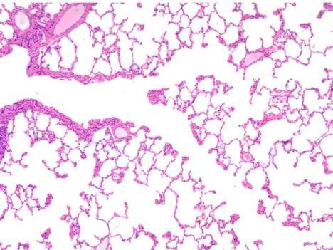
TERMINAL BRONCHIOLES
The last generation of conductive airways
  Then divide into respiratory bronchioles (gas exchange system)
Have thinner mucosa than other bronchioles
  Simple, Low columnar – Cuboidal epithelium
  Few ciliated cells
Clara cells
No Goblet cells
Have thinner wall than other bronchioles
– Thin smooth muscle and connective tissue
TB

Slide 14
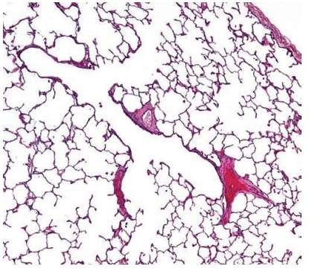
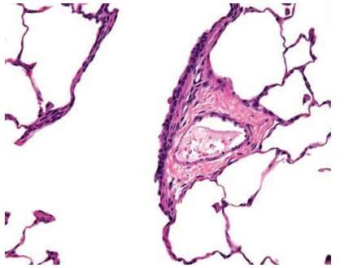
RESPIRATORY BRONCHIOLES
The beginning of gas exchange compartment
Lined by simple cuboidal – flat epithelium
Non-ciliated
Alveoli budding along their thin walls
In 2D longitudinal sections of glass slides, respiratory bronchiole lined on one side by simple cuboidal – flat epithelium and alveolar spaces on the other side

Slide 15
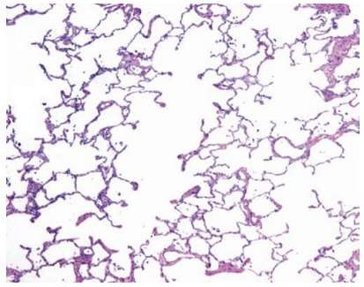
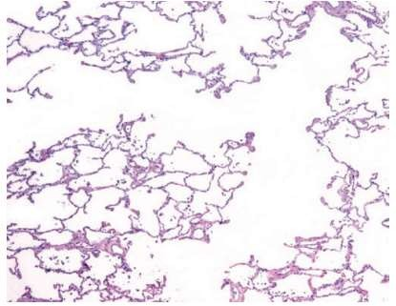
ALVEOLAR DUCTS
Straight tubular spaces
Bounded entirely by alveoli
– Alveoli protrude from their lumens

Slide 16
BRONCHI V.S. BRONCHIOLES
 | Bronchi | Bronchioles
Diameter | > 1 mm | < 1 mm
Mucosa:
Lining | Pseudostratified | Simple
Clara cells | Rare | Present
Goblet cells | Present | Rare
Wall:
Bronchial glands | Present | Absent
Cartilage plates | Present | Absent
Smooth Muscle | Thin layer | Thicker layer

Slide 17
MUCOSA
Large Bronchi
increase
Pseudo-stratification, columnar
Mucosal Height
decrease
Simple, cuboidal
Terminal Bronchioles
increase
Mucosal Cilia
decrease/absent
increase
Goblet Cells
decrease/absent
decrease/absent
Clara Cells
increase

Slide 18
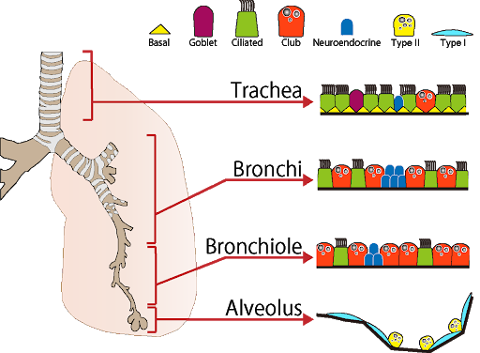

Slide 19
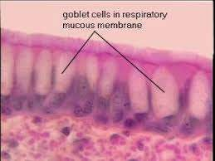
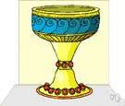
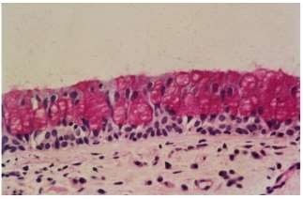
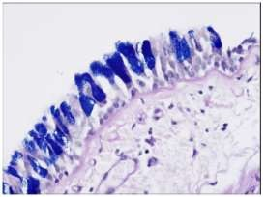
GOBLET CELLS
Non-ciliated, Columnar cells
Goblet = drinking glass with stem
  Wide apex “cytoplasm filled with mucin”
  Narrow base “nucleus”
Secretory cells
  Apical mucin vacuoles (PAS, Alcian-Blue)
Bronchi > bronchioles

Slide 20
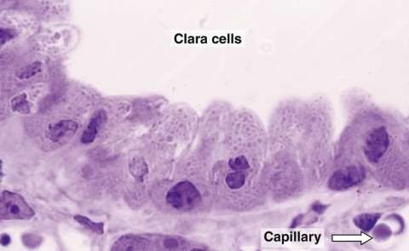
CLARA CELLS
Non-ciliated Columnar cells
Dome-shaped apical ends
Secretory cells
  Apical secretory granules (PAS + diastase resistant)
  Produce components of surfactants
Also Reserve cells
  Replace bronchiolar epithelium after injury
Bronchioles > Bronchi

Slide 21
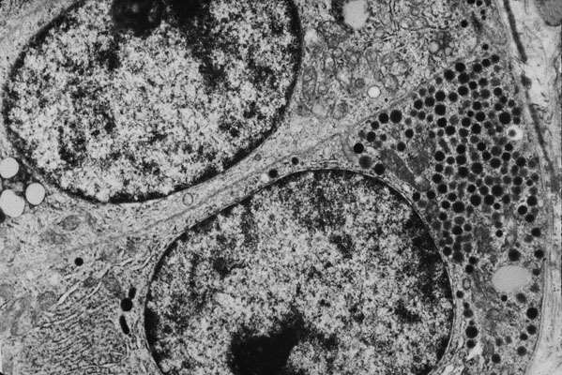
NEUROENDOCRINE CELLS
Also known as “Kulchitsky cells”
Scattered within airways epithelium
More evident in neonates
  Rarely seen in adults
Secretory cells
  Contain neurosecretory granules by E/M

Slide 22
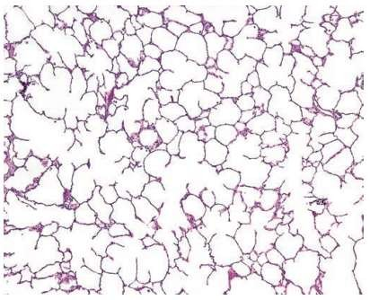
GENERAL
Alveoli are sac-like spaces arising from:
  Respiratory bronchioles
  Alveolar ducts
  Alveolar sacs
It provides a tremendous surface area for gas exchange between inhaled air and alveolar capillaries
The alveoli are protected from collapse during expiration by the action of
surfactant
  Mixture of phospholipids that reduce alveolar surface tension

Slide 23
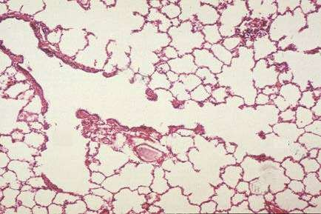
LUNG ACINUS
A functional unit (for gas exchange) composed of the structures distal to
a single terminal bronchiole
Respiratory bronchioles
Alveolar ducts
Alveoli

Slide 24
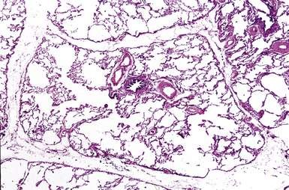
LUNG LOBULE
An anatomic unit consisting of the acini of 3 to 10 terminal bronchioles
that are bounded together by the interlobular septum

Slide 25
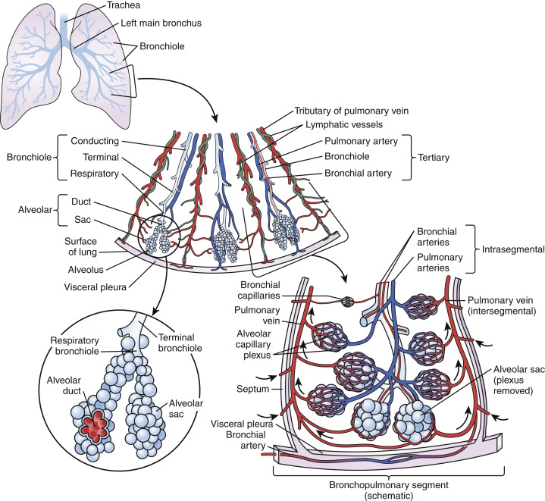

Slide 26
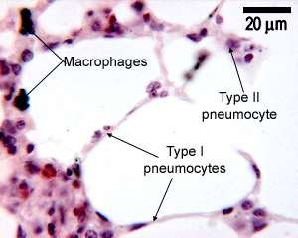
ALVEOLI
Lining (pneumocytes)
Type I
  Squamous “flat” epithelial cells
  Cover 90% of total alveolar surface area
  Very thin cytoplasm (to permit gas exchange)
  Incapable of division

Slide 27
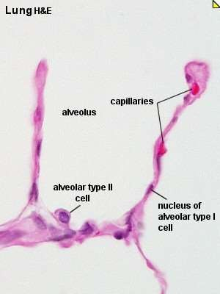
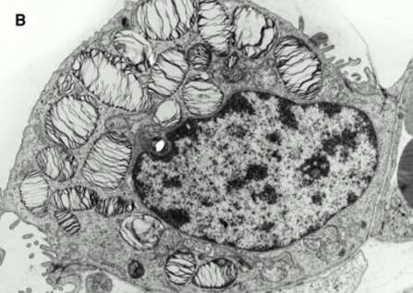
ALVEOLI
Lining (pneumocytes)
Type II
  Cuboidal epithelial cells
  More numerous than type I
    But cover only 10% of total alveolar surface area
  Capable of division
    Reserve cells for type I pneumocytes
    Alveolar damage/repair → type II hyperplasia
  Also produce surfactant
    Lamellar bodies by E/M

Slide 28
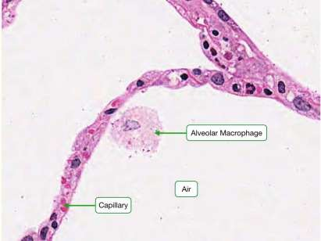
ALVEOLI
Wall
Very thin
Connective tissue + elastic & reticular fibers
Contains many types of cells (nuclei):
– Pneumocytes nuclei
Capillary endothelial nuclei
Macrophages nuclei
Fibroblasts nuclei
Alveolar macrophages help removing the
dust and foreign materials
They have the same role as airways cilia

Slide 29
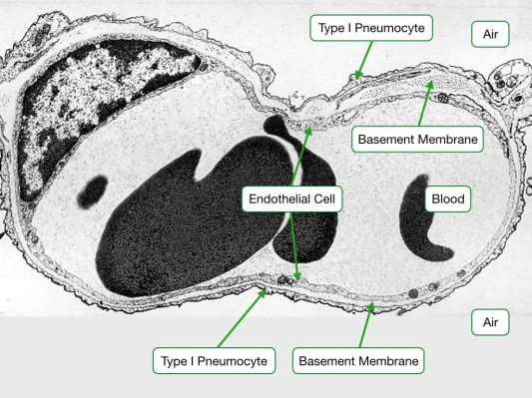
AIR-BLOOD BARRIER
Very thin to facilitate gas exchange
Formed of:
  Alveolar Epithelium (Type I Pneumocytes)
  Fused basement membranes
    Of both alveoli and pulmonary capillaries
  Capillary Endothelium

Slide 30
COLLATERAL VENTILATION
Means the ventilation of alveolar structures through passages or
channels that bypass the normal airways
Normally they are Non-functioning
They play an important role in cases of airways obstruction “to ventilate the collapsed area”
Also they may permit passage of bacteria and exudate between alveoli and bronchioles during pneumonia

Slide 31
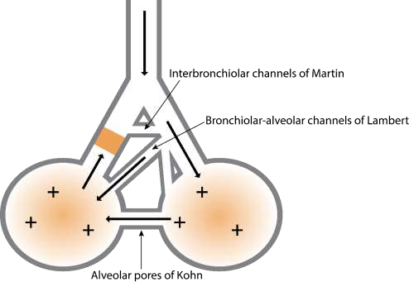
COLLATERAL VENTILATION
K → two alveoli
L → one bronchiole + one alveolus
M → two bronchioles
Three main routes
Channels of Martin:
  Communication between two adjacent bronchioles
Channels of Lambert:
  Communication between non-respiratory bronchiole and adjacent alveolus
Pores of Kohn:
  Communication between two adjacent alveoli through perforations in their walls

Slide 32
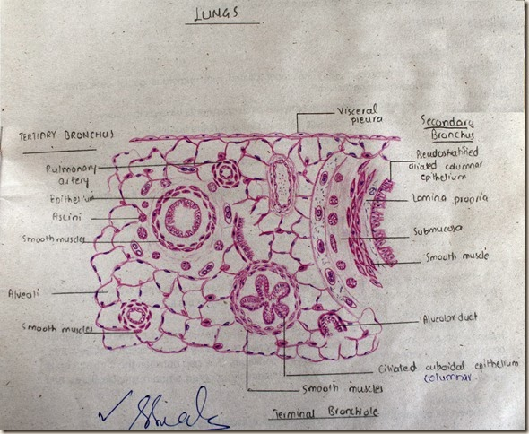

Slide 33
GENERAL
The lungs receive dual vascular supply
 | Pulmonary | Bronchial “Systemic”
Aim | Gas exchange “at alveolar capillaries” | Supply bronchi with O2 and nutrition
Arterial side | Low O2 High CO2 | High O2 Low CO2
Venous side | High O2 Low CO2 | Low O2 High CO2

