Slide 1
DOCTOR-PATIENT RELATIONSHIP

Slide 2
OBJECTIVE
Appreciate the social roles of doctors and patients
Understand the Types and Models of Doctor- Patient Relationship (DPR)
Understand the importance of effective Communication in DPR
Appreciate the changing scenario in DPR

Slide 3
NATURE OF DOCTOR PATIENT RELATIONSHIP
It is an clinical encounter between the doctor and a patient which arises when the doctor in a professional capacity; (interact with the patient)
It is usually related to clinical events, but it is important to realize the association beyond the clinical premise e.g. in the community (non clinical situation)
Such meetings are a frequent & regular occurrence
Depends not only on doctors clinical knowledge & skills but also the nature of the social relationship that exists between the doctor & patient.

Slide 4
The Doctor and The Patient are on two opposite ends
The Doctor has a high level of knowledge on a problem the patient almost knows nothing about
The Doctor is often concern with the disease diagnosis and treatment (find and fix approach)
The patient is concern with illness (disruption of life)
Its entirely different from mechanic-client relationship

Slide 5
DPR-WHY IS IT RELEVANT TO US?
Because of our understanding of:
The Clinical Iceberg phenomena
The decision making process in illness behaviour
The social triggers of decision to seek medical aid

Slide 6
PERCEPTIONS OF NEED
THE CLINICAL ICEBERG (ICEBERG THEORY, LAST 1963)
Refers to the gap between the need for medical care and the utilization of professional services.
Health care professionals only see the tip of the iceberg with respect to the volume of illness in the community

Slide 7

Public’s perceived need for care

Slide 8
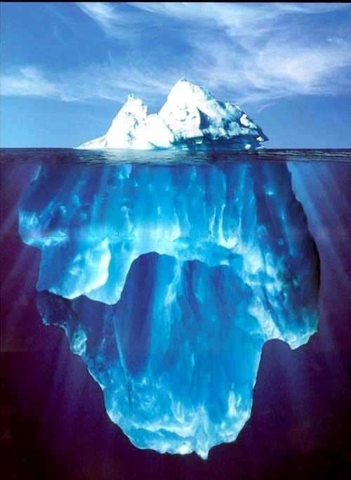
See GP
Public’s perceived need for care
Symptoms Do nothing
Note the difference between actual and perceived need
No
symptoms
Alternative med
Self-med,
19/10 Yusuf Misau-Doctor-Patient Relationship

Slide 9
IMPLICATIONS
Treated cases are not representative of sufferers as a whole and that knowledge of disorders obtained by the study of such cases is likely to be biased
To reduce the gap
  Appropriate education of both groups
  Successful Doctor-Patient Consultation

Slide 10
THE DECISION-MAKING PROCESS
10 variables important in seeking of professional advice (Mechanic,1968)
  By illness behaviour we mean the way symptoms are perceived, evaluated and acted upon by a person who recognises some pain, discomfort or other signs of organic malfunction
Social triggers (Zola,1973)
A model of Health and Illness behaviour in a multi- ethnic society (Jaafar,1995)

Slide 11
PARSONS’ MODEL OF SICK ROLE.

Slide 12
PARSONS IDEAL PATIENT (SICK ROLE)
RIGHTS (PERMITTED) TO:
Give up some activities and responsibilities
Regarded as being in need of care and unable to get well by his own decision & will
OBLIGATIONS (IN RETURN) :
Must want to get better quickly
Seek help from and cooperate with a doctor

Slide 13
PARSONS’ “DOCTOR” (DOCTORS’ ROLE)
Apply a high degree of skill & knowledge to the problems of illness
Act for welfare of patient and community rather then for own self interest, desire for money, advancement etc
Be objective and emotionally detached
Be guided by rules of professional practice.

Slide 14
DOCTOR’S RIGHT
Granted right to examine patients physically & to enquire into intimate areas of physical & personal life
Granted considerable autonomy in professional practice
Occupies position of authority in relation to the patient.

Slide 15
IMPLICATIONS OF PARSONS’ THEORY
Protection for the vulnerable
  From threatening symptoms
  From exploitation
  Doctor-patient relationship unequal
Correction of societal deviance
  Being sick is ‘social threat’
  Society may be exploited

Slide 16
PROBLEMS WITH PERSONS’ MODEL
Address acute problems (ignores chronic dx)
Clinically oriented
Rights do not always apply
Ignores ‘lay referral system’
Ignores differential treatment of pt by Doctors

Slide 17
FACTORS INFLUENCING DPR

Slide 18
FACTORS INFLUENCING DPR
Conflict of Interest
Interests of patient vs. society
Interests of patient vs. other patients
Problems of confidentiality

Slide 19
FACTORS INFLUENCING DPR
DIFFERENCES IN PERSPECTIVES
Social class
Ethnicity
Gender
Clinical-practice style
Types and models of doctor-patient relationships

Slide 20
What do you understand by DPR?
Why do you think it is important?
What are the factors influencing DPR?
What are the implications and flaws of Parsons’ Model of Sick role?

Slide 21
TYPES OF
DOCTOR-PATIENT RELATIONSHIP

Slide 22
TYPES OF DOCTOR-PATIENT RELATIONSHIPS
    Default
    Paternalism (Doctor-centred, Disease model)
    Consumerism (typical in private practice)
    Mutuality (Patient-centred, illness model)
    conflict

Slide 23
Types of doctor-patient relationships
PATIENT CONTROL | DOCTOR CONTROL
 | LOW HIGH
LOW | DEFAULT PATERNISM
 | COFLICTS
HIGH | CONSUMERISM MUTALITY

Slide 24
MODELS OF DPR
Szasz and Hollender 1956 - Parson’s concept
Activity-passivity Model
Guidance-cooperation Model
Mutual Participation Model

Slide 25
Szasz and Hollender 1956 - Parson’s concept
Activity-passivity Model
Doctor assumes complete responsibility for the pt’s treatment (Pt on the operating table )

Slide 26
Szasz and Hollender 1956 - Parson’s concept
GUIDANCE-COOPERATION MODEL
Paternalistic relationship (high physician control & low patient control)
Dr is dominant & acts as a parent figure
Decides for patient’s best interest
Traditional medical consultation
Reliance on doctors for decision making

Slide 27
Szasz and Hollender 1956 - Parson’s concept
MUTUAL PARTICIPATION MODEL
Active involvement of patients as more equal partners (‘meeting of experts’)
Both parties share power and responsibility, exchange of ideas & sharing of belief systems, need each other and will work towards choices and actions satisfying to them both

Slide 28
Transactional Analysis or TA (Eric Berne 1986)
Describes and explains how we relate to each other by looking at 3 ego states.
Ego states:
Parent
Adult
Child

Slide 29
Transactional Analysis
PATIENT
DOCTOR
RECIPROCAL
PARENT
PARENT
ADULT
ADULT
CROSSED
DUPLEX/COVERT
CHILD
CHILD

Slide 30
DOCTORS COMMUNICATION SKILL

Slide 31
A MODEL OF THE COMMUNICATION PROCESS
Transmit
Message
Message
Receive
SENDER
CHANNEL
RECEIVER
ENCODING
DECODING

Slide 32
COMMUNICATION
Between doctor and patient
Foundation for diagnosis and treatment (elicit & convey information)
Relationship has a therapeutic effect placebo effect of drug
Doctor-centred consultation (Paternalistic style)
  ‘Closed’ nature questions e.g. “How long have you had the pain? & is it sharp or dull?” Diseased centred model talk

Slide 33
COMMUNICATION
Between doctor and patient
‘Patient-centered’ approach (Mutuality)
  Encourage & facilitate their patients to participate
  Use of ‘open’ questions e.g. ‘tell me about your pain’, ‘how do you feel? & ‘what do you think is the cause of the problem?’
  Active listening skills, requires more time (participative style)

Slide 34
Why is there poor communication?
The influence of class and status Cognitive failure
Professional attitudes and interviewing styles
Professional power

Slide 35
Good Communication Skills In Consultation
Initiating the session ( initial rapport )
Gathering information (exploring the problem, understanding the patients views)
Building the relationship (involving the patient)
Explanation and planning (providing the appropriate amount & type of information, aiding accurate recall and understanding, achieving a shared understanding and planning)
Closing the session.

Slide 36
Non-verbal (Body language)
Verbal
☺ Greet patient, SMILE, polite and gentle
☺ Forewarn patient of your next action accordingly
☺ Facial expression question
Listening questions
☺ Eye contact on…”
Social exchanges
Address the patient
- Avoid compound
☺
- Open and focused
- Facilitate talking: “Go
☺
Posture
- Restating: repeat what patient say in your own words.
☺ Proximity
☺ Position clearly
Body contact
- Simple words and speak
☺

Slide 37
Advantages of improved communication
1. Compliance with medical instructions and advice
•
Low compliance Dr who do not seek pts’ active participation in the interview, are formal and distant in their mx of the pt by providing little in the way of feedback
2. Satisfaction with health care
Goals of pt – dx and tt of any oral problems, relief of fear & anxiety
3. The social dimensions of healing
•
•
•
Benefits of improved DPR – satisfactory recovery Significance of EMPOWERMENT

Slide 38
Changes in the DPR
Wersch & Eccles, 2001 (Development of clinical guidelines for practice)
Philosophy of patient-centred care
Shift towards shared treatment decisions
Greater access to high quality medical information on the internet will increase the no. of ‘information- rich’ pts

Slide 39
Changes in the DPR
▪
Ridsdale & Hudd, 1994
The widespread use of computers in the consultation
•
▪
▪
Position of pt from the screen
Drs’ ability to maintain their personal touch through verbal skills and eye contact
Confidentiality of data maintain TRUST
▪
▪
The use of telemedicine as a means of delivering health care

Slide 40
Strategies for improvement of DPR
Understanding illness
How pts and those around him view origin, significance & prognosis of the condition & how it affects other aspects of life
Info about pts’ cultural, religious, social & economic background, his previous experience of ill-health, & if possible his view of misfortune in general
Improving communication
▪
▪
“Language of distress” - culturally specific folk illnesses (Mechanic)

Slide 41
STRATEGIES FOR IMPROVEMENT OF DPR
Increasing reflexivity (self-awareness)
Treating ‘illness’ and ‘disease’
  Do not deal with physical abnormalities/malfunctions
  The many dimensions of “ILLNESS”
Respecting diversity – health beliefs and practices
Assessing role of context (social, economic, environmental factors - focus on who?)

Slide 42
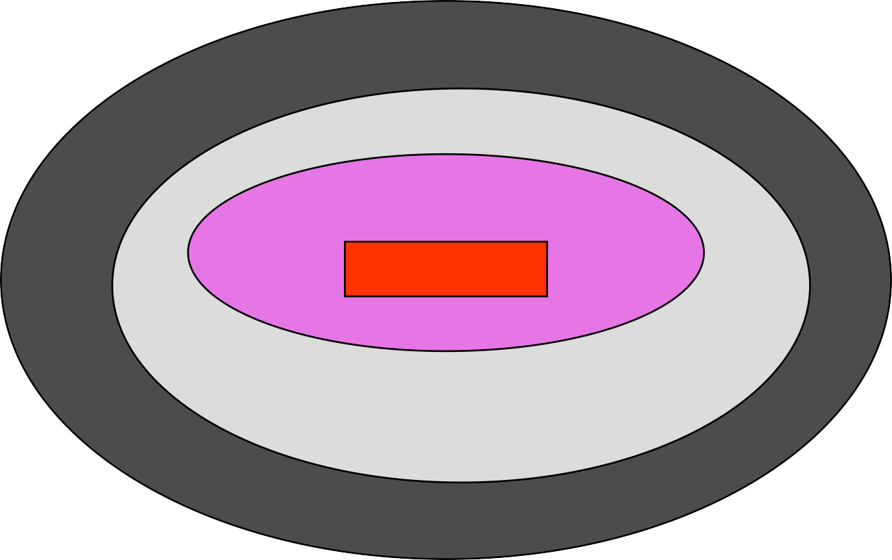
THE PROPOSED CONCEPTUAL MODEL
Patients preferences in dentist communication skills
CONFLICT RESOLUTION & NEGOTIATION
COGNITIVE & INFORMATION GIVING
SOCIOEMOTIONAL BEHAVIOUR
TECHNICAL COMPETENCY
INTERPERSONAL COMPETENCY
DPR
GOOD TREATMENT
  COMPETENT & SKILFUL
  CAREFUL & DON’T RUSH ++
  Accurate ++ decision
FRIENDLY
Ref: Zainal Abidin Z. MCD 1997

Slide 43
CONCLUSION
Goal of consultation is not only to arrive at diagnosis and formulating a treatment plan
But also, to develop common understanding between patient and doctor
To help patients develop self control over their illness and its course

