Slide 1
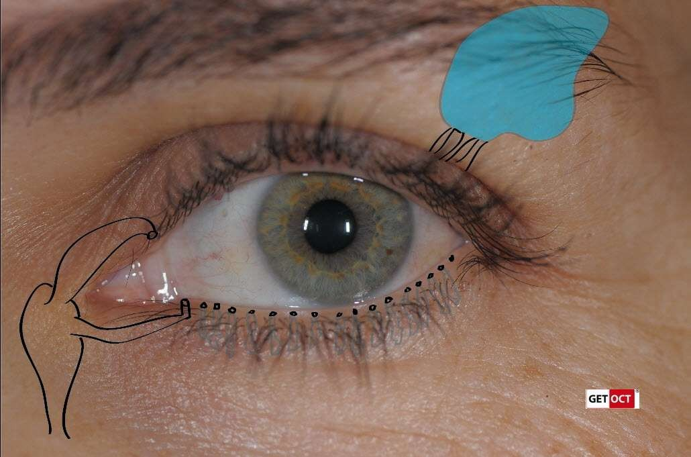
LACRIMAL APPARATUS
SURESH BABU K

Slide 2


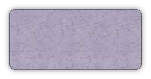
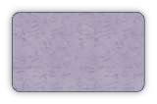



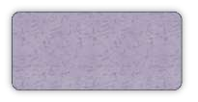

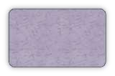

It is concerned with the tear formation & transport.
Lacrimal passage includes :
Lacrimal gland
Conjunctival sac
Lacrimal puncta
Nasolacrimal duct
Lacrimal sac
Lacrimal canaliculi

Slide 3
Conjunctiva = the mucous membrane of the eye.
A. Palpebral part = forms a crescentric fold or Plica semilunaris.
B. Bulbar( ocular ) = thin, transparent, slightly avascular over the sclera.
C. Conjunctival sac = with lids closed, a space between the eyeball and eyelids , lined by conjunctiva.
Lacrimal glands = secretes lacrimal fluids
Lacrimal ducts = conveys fluids from glands to the conjunctiva sac.
Lacrimal canaliculi = connection between lacrimal punctum

Slide 4
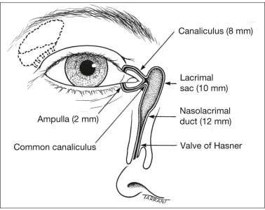

Slide 5


It includes lacrimal gland, accessory glands
Lacrimal gland is above & anterolateral to globe.
Secretes tears into superior fornix.
Tears moisten & lubricates the : cornea
, conjunctiva.
It contributes 43D of 50D of refractive power of eye .

Slide 6
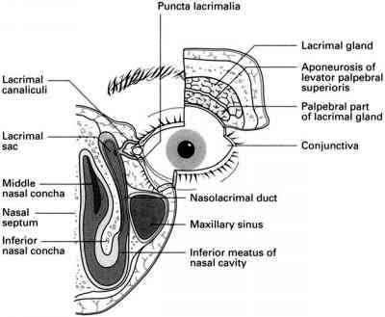


· It consists of
Large Orbital Part
Smaller Palpebral Part
· Lateral expansion of levator separates the parts

Slide 7
Paired almond-shaped glands.
It is present in a fossa on the anterolateral area of orbit
It has 2 surfaces, 2 borders, 2 extremities
  Superior surface
    Frontal bone
  Inferior surface
    Levator palpebrae superioris & lateral rectus

Slide 8
Anterior border
  Septum orbitale
Posterior border
  Contact with orbital fat , level with posterior pole.
Lateral extremity
  Rest on lateral rectus
Medial extremity
  On levator

Slide 9
1/3rd size of orbital part
Superior fornix , seen on lid eversion.
It is situated upon the course of ducts
Related to levator superiorly, inferiorly to superior fornix
Posteriorly it continues with orbital part.

Slide 10

Are small, compound, branched, tubular glands
Located in the middle of lid (Wolfring glands) or superior & inferior fornices (Krause glands).
Ectopic portions of lacrimal gland tissue.

Slide 11
It is with connective tissue coat and excretory duct.
The excretory duct splits & form intralobular ducts, connected to secretory glandular epithelia.
Secretory epithelia have elongated tubules.
True acini are absent.

Slide 12
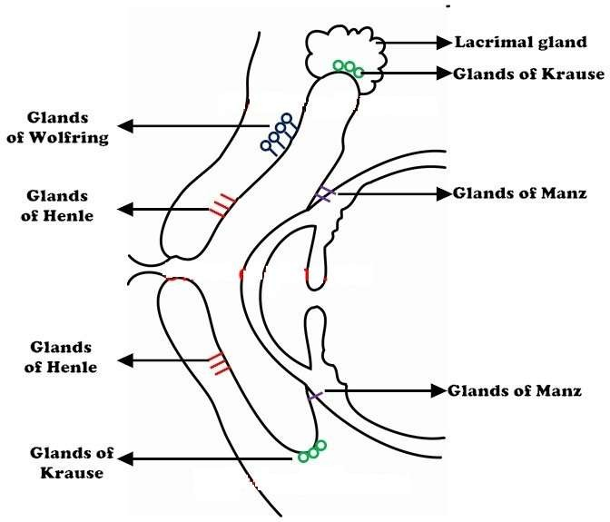

Slide 13


Artery supply : Lacrimal artery , branch of ophthalmic artery.
Venous drainages : Ophthalmic Vein.
Lymphatic drainage : Joins that of conjunctiva & drain into the preauricular lymph nodes.

Slide 14

Sensory nerve supply : lacrimal nerve
, branch of ophthalmic division of Vth nerve
Sympathetic nerve supply : carotid plexus
Secretomotor fibers : superior salivary nucleus

Slide 15




A small, round or oval orifice on the elevation, the papilla lacrimalis.
At medial end of lid margin at the junction of its ciliated and non-ciliated parts.
Upper punctum medial to lower, from the medial canthus being 6 and 6.5 mm.
The upper punctum opens inferoposteriorly, the lower superoposteriorly.

Slide 16
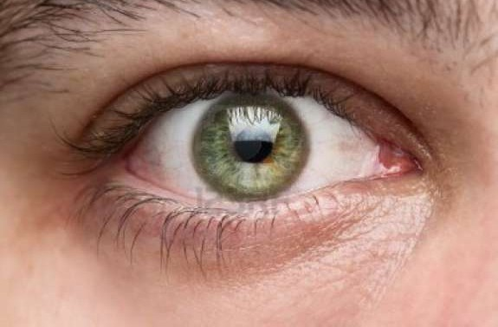
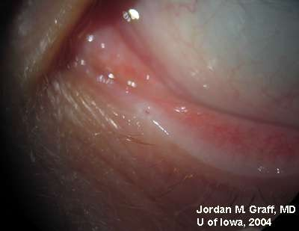

Slide 17
First vertical and then horizontal
Vertical part is 2 mm & turns medially at right-angle to become horizontal 8 mm
At angle - dilatation or ampulla.
The canaliculi pierce the fascia (i.e. the periorbita covering the lacrimal sac) separately,
Uniting to enter lacrimal sac.
Stratified squamous epithelium supported by elastic tissue.

Slide 18
Lacrimal fossa, formed by lacrimal bone and frontal process of maxilla .
The sac, closed above and open below, is continuous with the nasolacrimal duct.
The sac is enclosed by a periorbita, splits &form the lacrimal fascia .

Slide 19
Relations
Medial : periorbita and bone, arc of ethmoid sinuses.
Lateral : skin, orbicularis oculi, and lacrimal fascia.
Anterior: medial palpebral ligament and angular vein.
Posterior : lacrimal fascia and muscle

Slide 20

The nasolacrimal duct, continuation of lacrimal sac to the inferior meatus.
· 15 mm.
It lies in a canal formed by the maxilla, lacrimal bone and lacrimal process of inferior concha.
It descends posterolaterally, a surface indication a line from medial canthus to first upper molar.

Slide 21
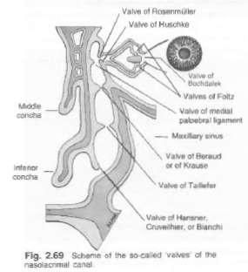
The valves
They are folds of mucous membrane with no valvular function.
The most constant is the 'valve' of Hasner at the lower end.
It prevents sudden blast of air (when blowing the nose) from entenng the lacrimal sac.

Slide 22
Structure
Double-layered Epithelium
The superficial layer composed of columnar cells, the deeper cells being flatter.
The membranous wall of the sac is of fibroelastic tissue, the elastic element being continued around the canaliculi.

Slide 23
Around the nasolacrimal duct is plexus of vessels, forming erectile tissue like that on the inferior concha.
Engorgement of these vessel obstruct the duct.
The course of the lacrimal sac and duct can be demonstrated by dacryocystography

Slide 24
Vessels
Artery supply : palpebral branches of the
ophthalmic, angular and infraorbital arteries and nasal branch of the sphenopalatine.
Venous drainages : Angular and infraorbital vessels above, below into the nasal veins
Lymphatic drainage: submandibular and deep cervical
nodes.
Nerves
Infratrochlear and anterior superior alveolar nerves.

Slide 25
Tears are lost from the conjunctiva sac by absorption, evaporation, and nasolacrimal system.
This is related to the size of the palpebral aperture, the blink rate, ambient temperature and humidity.

Slide 26
· Tears flow
○ the upper and lower marginal strips → upper and lower canaliculi (capillarity+suction)
Eyes close
  Pretarsal orbicularis oculi compresses the ampullae+ shortens and compresses canaliculi+puncta medially.
  Lacrimal part of the orbicularis oculi, contracts → compresses the sac,(positive pressure) tears → nasolacrimal duct → nose.
Eyes open
  Muscles relax → canaliculi and sac expand(negative
pressure)+capillarity= tears into sac.

Slide 27
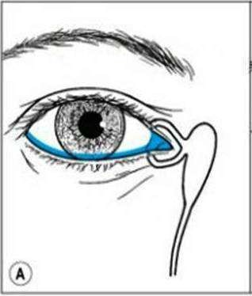
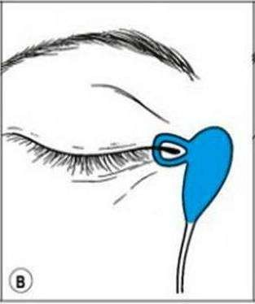
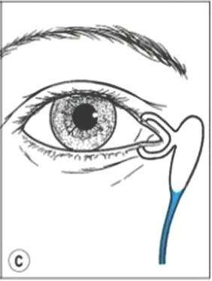

Slide 28
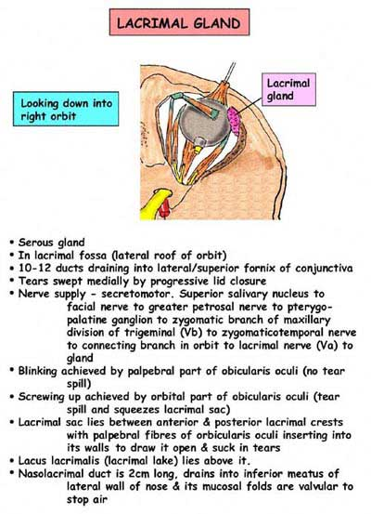

Slide 29


