Slide 1
Pharmacotherapy of Shock

Slide 2
Introduction
Definition: Complex acute circulatory failure associated with hypoperfusion of tissues, which is incompatible with life if untreated and persisting for more than a short time
Initiated by – trauma, acute blood loss, depletion of body fluids, severe infection or acute myocardial dysfunction
Mechanism of Shock: Hypovolemic, Cardiogenic, Obstructive, Distributive and Septic

Slide 3
Classification of Shock
Hypovolemic or Oligemic:
Acute blood loss – burns and haemorrhage
Dehydration and Sodium depletion – vomiting, diarrhoea, diabetic ketoacidosis and Addison`s disease
Bacteremic endotoxic or septic: Severe infections in gm –ve bacteria like E. coli, gm +ve resistant streptococci TSS. Deficiency of adrenal gland function and vasopressin production
Cardiogenic shock: MI, Acute myocarditis and severe paroxysmal tachycardia
Anaphylactic shock
Neurogenic shock: Spinal anaesthesia, spinl chord injury, abdominal and testicular trauma and perofration of hollow viscus
Haemo-obstructive shock – massive pulmonary embolism
i.
ii.
III.

Slide 4


Hypovolemia Mechanism
Hypovolemia – Reduction in circulating blood volume
Baroreceptor - Generalized
Compensatory Sympatho adrenal discharge
Peripheral vasoconstriction – clinical manifestations. Pooling of blood to periphery, sluggish micro circulation
Tissue hypoxia – acidosis – liberation of histamine, PG and cardio depressant peptides to circulation
Excessive sympatho- adrenal discharge
Slowing of blood flow, local haemoconcentration in capillaries – thrombi formation
Reduced blood flow to skin, kidneys and intestines

Slide 5
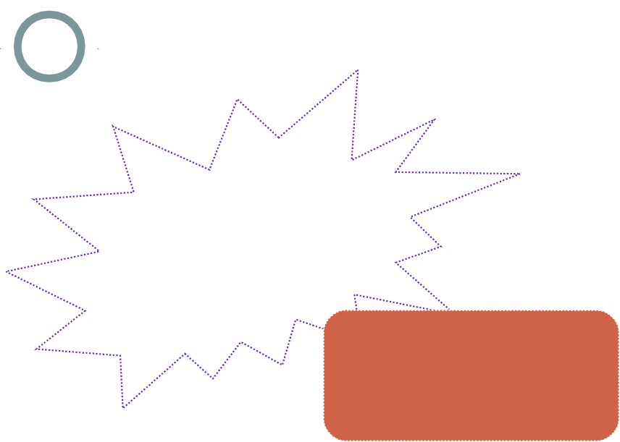
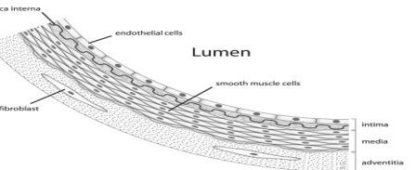


Septic Shock Mechanism
Toxins released by Microorganisms – Exotoxins (TSS) and Endotoxins (gm –ve)
PHAGOCYTES and ENDOTHELIAL CELLS
Release of Cytokines - TNFα, IL (IL-1β) and PAF
Depression of myocardium and Diffuse Cell Injury, – multiple organ failure
Release of LTs, PGs and TXA2
Injury to BV, inflammation, vasodilatation increased permeability, coagulation and complement cascades and fluid loss – hypovolemia

Slide 6
Management – Hypovolemic shock
Early recognition of shock state - Restoration of effective blood volume suitable fluids – CVP(Central venous pressure) measurement
ϒ
ϒ
Whole blood and plasma
Colloidal plasma substitutes – Dextran, hydroxyethyl starch, polyvinylpyrrolidone etc.
Crystalloid plasma substitutes – NaCl and 5% Dextrose
ϒ
Lactic acidosis correction - Sodium bicarbonate
Correction of causative factor – haemostasis, surgical removal of necrotic tissue, antibiotics, defibrillation etc.
Injection Morphine for pain relieving – except head injury and acute abdomen pain.
Vasopressor agents – Dopamine (0.2 – 1 mg/min) or Noradrenaline to correct hypotension – after fluid replacement only (NA – 4 mg in 50 ml)
Oxygen administration to correct tissue hypoxemia

Slide 7
IV Fluid
Severe hypovolemia, low/unrecordable BP, feeble/unpalpable pulse etc. IV fluid wide open rate (10 – 20 ml/min) for 1 hour (approx.) for fluid replacement
^{ϒ} If improvement – reduce to IV fluid and continue till 24 hours
^{ϒ} If no improvement – Increase/Prolong the IV fluid administration
^{ϒ} If no improvement – haemtocrit rise - IV Colloid 10 mg/kg/hour
^{ϒ} If no improvement – Blood/Plasma transfusion

Slide 8
Management - Bacteremic Shock
Endotoxic Shock: Severe infection and t issue hypoperfusion – organ dysfunction
Antibiotics – empirical to start with
Surgical Removal if required
Blood volume expansion, correction of acidosis, Vasopressor agents, correction of hypoglycaemia
Lung protective ventilation – low tidal volumes (6 ml/kg of ideal body weight)

Slide 9
Acute Myocardial Infarction
Before hospitalization
^{ϒ} Sublingual Nitroglycerine 0.4 mg every 5 minutes till pain subsides (max 3 doses)
^{ϒ} Relief of Pain: Morphine Injection 10 mg IV for 10 minutes together with IV Metoclopramide
Repeat after 30 minutes if necessary – alternatively Pethidine or Bupreonorphine (SC)
^{ϒ} Absolute confinement to bed - Oxygen 100% by face mask
^{ϒ} Antiplatelet therapy – 80 to 160 mg Aspirin to be chewed
⎟

Slide 10
AMI – after hospitalization
Bed Rest
Maintenance of blood volume and tissue perfusion – elevated lower limbs and I V fluid 5% Dextrose – CVP or PAOP
Treatment of hypotension (to decrease preload and increase CO) – IV inotropic drugs – Dopamine or Dobutamine or IV furosemide
Correction of acidosis – sod. Bicarbonate infusion
Prevention of arrhythmia – IV Beta blockers – Propranolol (0.1 mg/kg in 3 divided doses at 5-10 minutes interval followed by orally every 6 hourly) … .
Tachyarrhythmia (IV Lignocaine – 1 – 2 mg/minute IV or Procainamide)
Continue IV Vasodilators (GTN) or Nitroprusside
Thrombolytic Therapy – continue with Aspirin and start Streptokinase or Urokinase or Alteplase (rt-PA) or tenecteplase … 2.5 lac IU IV over 10 minutes followed by 5 Lac IU over next 60 minutes …. 100 mg for 1 hr 15 mg – 50 mg – 15 mg … PCI (stent implantation)
Prevention of remodeling and future attacks – ACEIs or ARBs Platelet inhibitors

Slide 11
Anaphylactic shock Management
Lay the patient flat and raise legs
Torniquet if possible to obstruct draining blood flow from the site of antigen deposition
Airway maintenance
Adrenaline Injection (1:1000) IM – 0.5 ml slowly - if severely ill give IV adrenaline (1:10,000) 3-5 ml slowly … can be repeated after 15-20 minutes
IF fluid – large fluid amount – colloids – with Dopamine or NA
Corticosteroids – IV Hydrocortisone 100 mg follwed by prednisolone
Antihistaminics: Chlorpheniramine 10 – 20 mg slow IV over 1 minute – can be repeated
Bronchodilators – aminophylline IV or nebulized salbutamol
Supportive measure – Oxygen and assisted ventilation

