Slide 1
Excreta Disposal in Unsewered areas

Slide 2
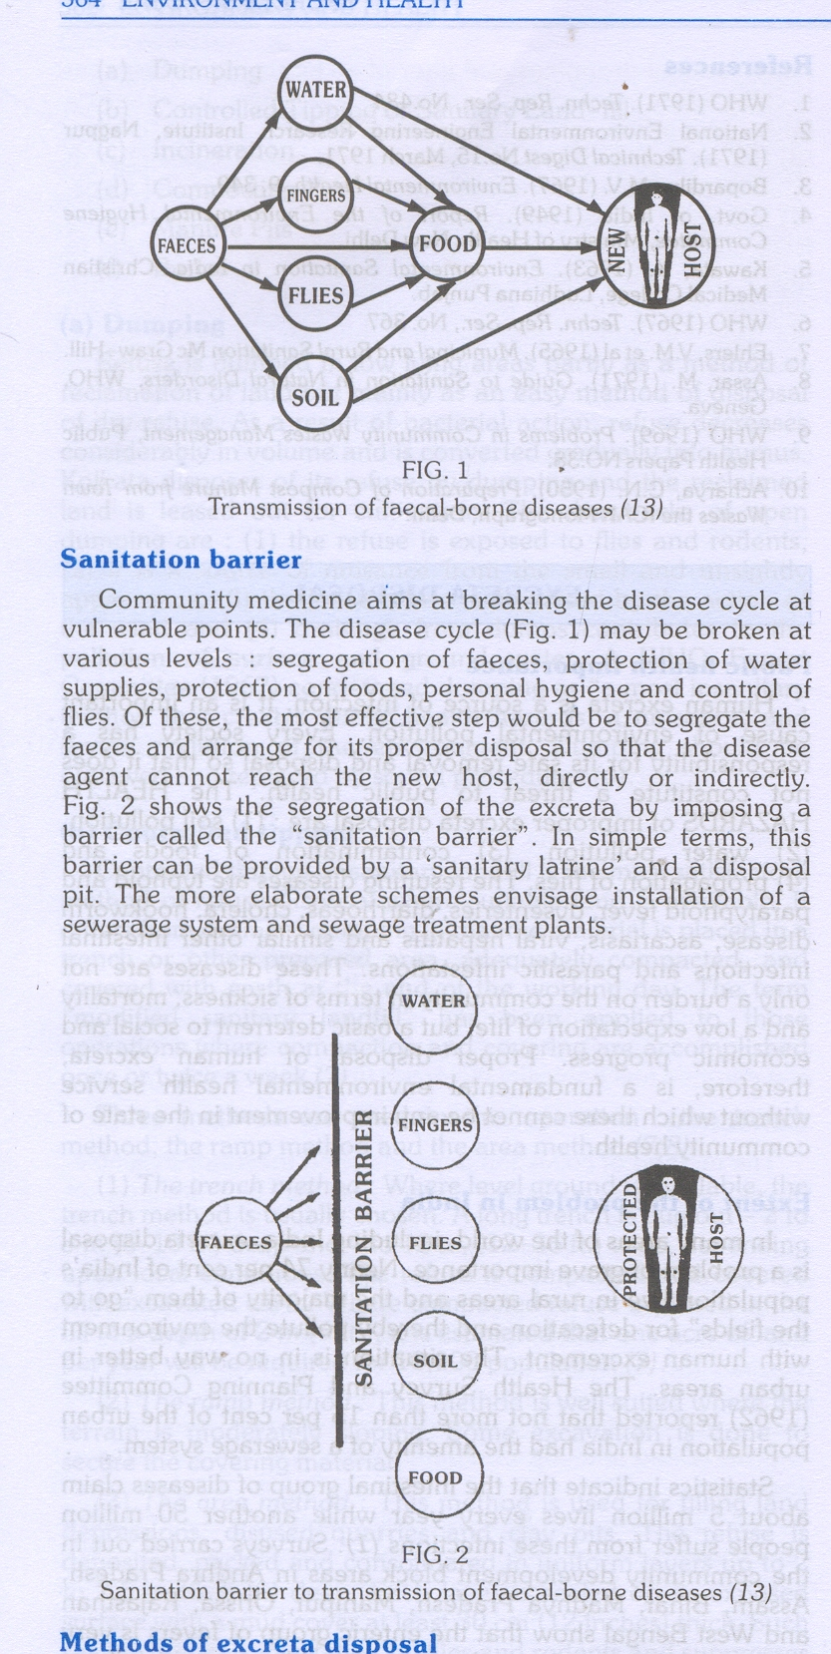
How disease is carried from excreta –
How the faecal-borne diseases are transmitted to a new host ?
The human excreta of a sick person or a carrier of disease is the main focus of infection.
It contains the disease agent which is transmitted to a new host through various channels:
(1) water
(2) fingers
(3) flies
(4) soil
(5) food

Slide 3
Sanitation barrier –
Community medicine aims at breaking the disease cycle at vulnerable points.
The disease cycle may be broken at various levels:
segregation of faeces,
protection of water supplies,
protection of foods,
personal hygiene
control of flies.

Slide 4
The most effective step would be to segregate the faeces and arrange for its proper disposal so that the disease agent can not reach the new host, directly or indirectly.
This barrier can be provided by a 'sanitary latrine' and a
disposal pit.
The more elaborate schemes envisage installation of a
sewerage system and sewage treatment plants.

Slide 5
Excreta disposal in unsewered areas –
SERVICE TYPE (CONSERVANCY SYSTEM) - The collection and removal of nightsoil from bucket or pail latrines by human agency is called the service type or conservancy system, and the latrines are called service latrines.
The nightsoil is transported in "nightsoil carts" to the place of final disposal, where it is disposed of by (I) composting or (ii) burial in shallow trenches.
Service latrines are a source of filth and insanitation. They have all the drawbacks and faults which tend to perpetuate the disease cycle of fecal-borne diseases in the community .

Slide 6
The night soil is exposed to flies; there is always the possibility of water and soil pollution. It is also difficult to recruit adequate staff needed for the collection of night soil.
The Environmental Hygiene Committee (1949) therefore, recommended that in unsewered areas the service latrines should be replaced by sanitary latrines which require no service, and in which excreta can be disposed off at the site of the latrine in a hygienic manner .

Slide 7
2. NON -SERVICE TYPE OF LATRINES (SANITARY LATRINES) –
A sanitary latrine is one which fulfils the following criteria:
(1) Excreta should not contaminate the ground or surface water
(2) Excreta should not pollute the soil
(3) Excreta should not be accessible to flies, rodents, animals (pigs, dogs, cattle, etc.) and other vehicles of transmission.
(4) Excreta should not create a nuisance due to odor or unsightly appearance.

Slide 8
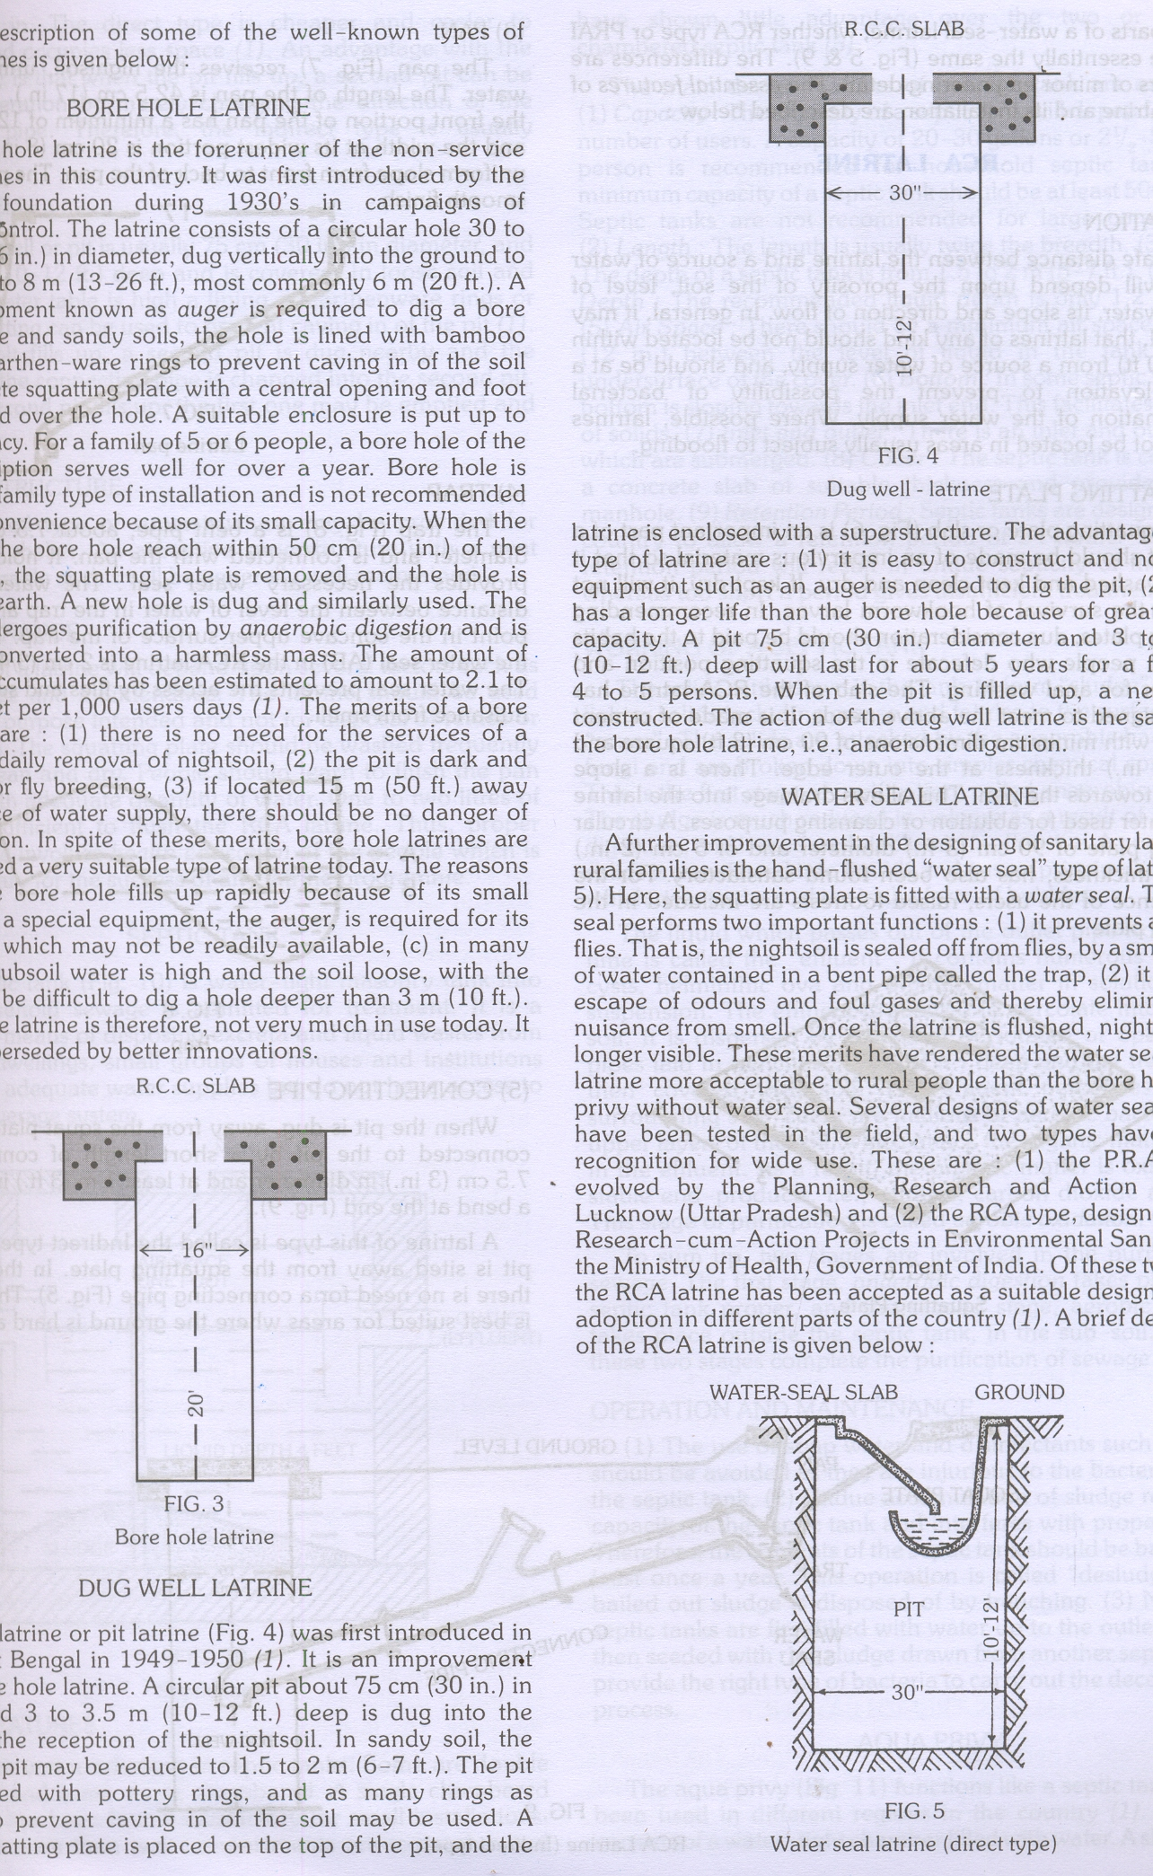
Methods of excreta disposal –
BORE HOLE LATRINE –
It was first introduced by the Rockefeller foundation during 1930's in campaigns of hookworm control.
The latrine consists of a circular hole 30 to 40 cm (12-16 in.) in diameter, dug vertically into the ground to a depth of 4 to 8 m (13-26 ft.), most commonly 6 m (20 ft.).
A special equipment known as auger is required to dig a bore hole.
In loose and sandy soils, the hole is lined with bamboo matting or earthen -ware rings to prevent caving in of the soil .

Slide 9
A concrete squatting plate with a central opening and foot rests is placed over the hole. A suitable enclosure is put up to provide privacy.
For a family of 5 or 6 people, a bore hole of the above description serves well for over a year.
Bore hole is essentially a family type of installation and is not recommended as a public convenience because of its small capacity.
When the contents of the bore hole reach within 50 cm (20 in.) of the ground level, the squatting plate is removed and the hole is closed with earth.
A new hole is dug and similarly used. The night soil undergoes putrification by anaerobic digestion and is eventually converted into a harmless mass.

Slide 10
Merits of a bore hole latrine:
there is no need far the services of a sweeper for daily removal of night soil,
(2) the pit is dark and unsuitable for fly breeding,
(3) if located 15 m (50 ft.) away from a source of water supply, there should be no danger of water pollution.

Slide 11
Demerits
(a) the bore hole fills up rapidly because of its small capacity,
(b).a special equipment, the auger, is required for its construction which may not be readily available,
(c) in many places, the subsoil water is high and the soil loose, with the result it may be difficult to dig a hole deeper than 3 m (10ft.).
The bore hole latrine is therefore, not very much in use today. It has been superseded by better innovations.

Slide 12
DUG WELL LATRINE –
Dug well latrine or pit latrine was first introduced in Singur, West Bengal in 1949-1950 . It is an improvement over the bore hole latrine.
A circular pit about 75 cm (30 in.) in diameter and 3 to 3.5 m (10-12 ft.) deep is dug into the ground for the reception of the night soil.
In sandy soil, the depth of the pit may be reduced to 1.5 to 2 m (6 - 7 ft.).
The pit may be lined with pottery rings, and as many rings as necessary to prevent caving in of the soil may be used.
A concrete squatting plate is placed on the top of the pit, and the latrine is enclosed with a superstructure.

Slide 13
Advantages of this type of latrine :
(1) it is easy to. construct and no special equipment such as an auger is needed to dig the pit,
(2) the pit has a longer life than the bore hole because of greater cubic capacity. A pit 75 cm (30 in.) diameter and 3 1.0 3.5 m (10-12 ft.) deep will last for about 5 years far a family of 4 to 5 persons.
When the pit is filled up, a new pit is constructed.
The action of the dug well latrine is the same as in the bore hole latrine, i.e., anaerobic digestion.

Slide 14
WATER SEAL LATRINE –
A further improvement in the designing of sanitary latrines for rural families is the hand -flushed "water seal" type of latrine .
Here, the squatting plate is fitted with a water seal. The water seal performs two important functions:
(1) it prevents access by flies. That is, the night soil is sealed off from flies, by a small depth of water contained in a bent pipe called the trap,
(2) it prevents escape of odors and foul gases and thereby eliminates the nuisance from smell. Once the latrine is flushed, night soil is no longer visible.
These merits have rendered the water seal type of latrine more acceptable to rural people than the bore hole or pit privy without water seal.

Slide 15
Several designs of water seal latrines have been tested in the field, and two types have gained recognition for wide use.
(1) P.R.A.I. type, evolved by the Planning, Research and Action Institute, Lucknow (Uttar Pradesh)
(2) RCA type, designed by the Research -cum -Action Projects in Environmental Sanitation of the Ministry of Health, Government of India.
The RCA latrine has been accepted as a suitable design for wide adoption in different parts of the country .

Slide 16
PRAI Type Latrine
It is direct type latrine.
It is modified type of traditional pit latrine developed by Planning Research and Action Institute, Lucknow .
The trap below the pan is turned in and opens directly into the pit.
There is no connecting pipe because the pit is directly under the squatting plate and not away from it.
It is cheaper than RCA type of latrine.
It is simple, sanitary, hand-flush water seal latrine, need about 1-2 liters of water per user to flush out the excreta.

Slide 17
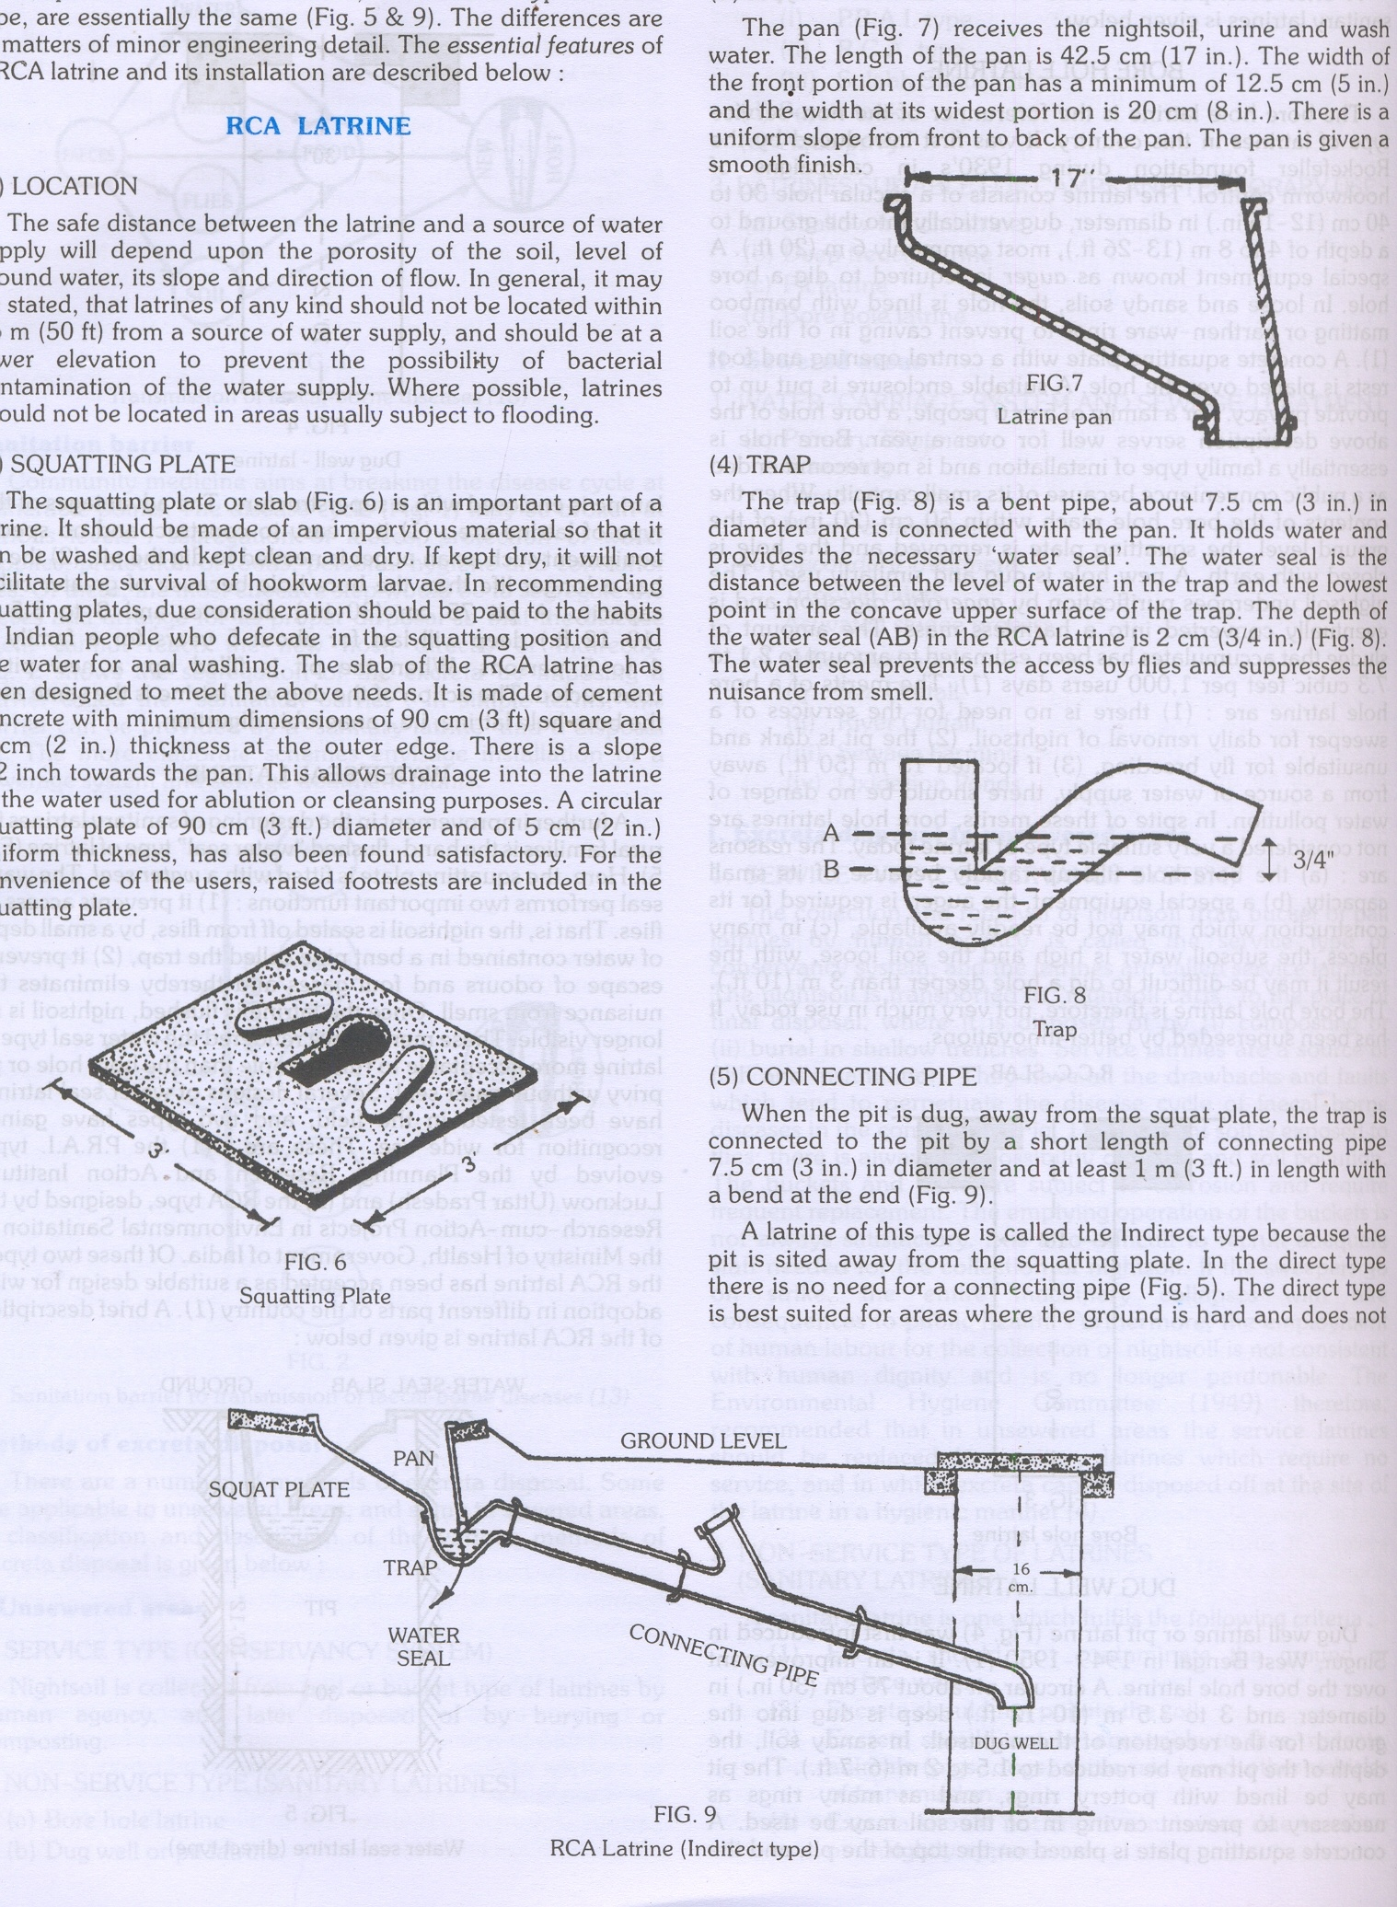
The parts of a water-seal latrine, whether RCA type or PRAI type, are essentially the same .
The differences are in matters of minor engineering detail.

Slide 18
RCA LATRINE –
It is indirect type latrine
(1) LOCATION - latrines of any kind should not be located within 15 m (50 ft) from a source of water supply, and should be at a lower elevation to prevent the possibility of bacterial contamination of the water supply.
(2) SQUATTING PLATE - It is made of cement concrete with minimum dimensions of 90 cm (3 ft) square and 5 cm (2 in.) thickness at the outer edge.
There is a slope 112 inch towards the pan. This allows drainage into the latrine of the water used for ablution or cleansing purposes.
A circular squatting plate of 90 cm (3 ft.) diameter and of 5 cm (2 in.) uniform thickness, has also been found satisfactory.

Slide 19
(3) PAN - The pan receives the night soil, urine and wash water. The length of the pan is 42.5 cm (17 in.). The width of the front portion of the pan has a minimum of 12.5 cm (5 in.) and the width at its widest portion is 20 cm (8 in.). There is a uniform slope from front to back of the pan. The pan is given a smooth finish.
(4) TRAP - The trap is a bent pipe, about 7.5 cm (3 in.) in diameter and is connected with the pan. It holds water and provides the necessary 'water seal'.
The water seal is the distance between the level of water in the trap and the lowest point in the concave upper surface of the trap. The depth of the water seal in the RCA latrine is 2 cm (3/4 in.). The water seal prevents the access by flies and suppresses the nuisance from smell.
(5) CONNECTING PIPE - When the pit is dug, away from the squat plate, the trap is connected to the pit by a short length of connecting pipe 7.5 cm (3 in.) in diameter and at least 1, m (3 ft.) in length with a bend at the end .

Slide 21
(6) DUG WELL - The dug well or pit is usually 75 cm (30 in.) in diameter, and 3 to 3.5 m (10-12 ft.) deep and is covered.
In loose soil and where the water table is high a lining of earthenware rings or bamboo matting can be used to prevent caving in of the pit .
When the pit fills up, a second pit is dug nearby and the direction of the connecting pipe is changed into the second pit.
When the second pit fills up, the first one may be emptied and reused.

Slide 22
(7) SUPERSTRUCTURE - The desired type of superstructure may be provided for privacy and shelter.
An attractive superstructure with a neat finish is desirable as this will be generally well maintained.
(8) MAINTENANCE The squatting plate should be washed frequently and kept clean and dry.
People should learn to flush the pan after use with adequate quantity of water.
One to two liters of water are sufficient to flush the RCA latrine.
Proper maintenance involves health education of the people which is very necessary for the success of any latrine programme.

Slide 23
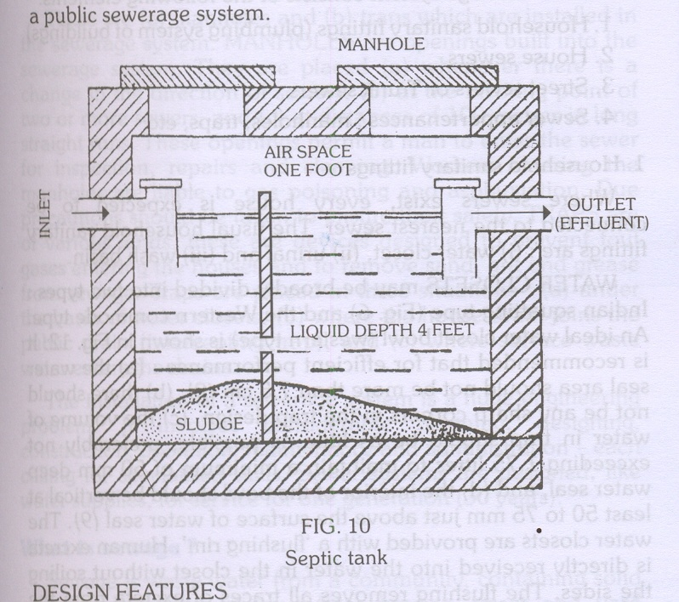
SEPTIC TANK –
The septic tank is water-tight masonry tank into' which household sewage is admitted for treatment.
It is a satisfactory means of disposing excreta and liquid wastes from individual dwellings, small groups of houses and institutions which have adequate water supplies but do not have access to a public sewerage system

Slide 24
DESIGN FEATURES – Two type of septic tanks. double chambered and single chambered. A single chambered septic tank has been found satisfactory for small installations.
The main design features of a septic tank are as follows.
(1) Capacity: The capacity of a septic tank will depend upon the number of users. A capacity of 20-30 gallons or 21/2-5 cuff. per person is recommended for household septic tanks. The minimum capacity of a septic tank should be at least 500 gallons. Septic tanks are not recommended for large communities.
(2) Length: The length is usually twice the breadth.
(3) Depth: The depth of a septic tank is from 1.5 to 2 m (5-7 ft.).

Slide 25
(4) Liquid Depth: The recommended liquid depth is only 1.2 m (4 ft.).
(5) Air Space: There should be a minimum air space of 30 cm (12 in.) between the level of liquid in the tank and the undersurface of the cover.
(6) Bottom: In some septic tanks, the bottom is sloping towards the inlet end. This facilitates retention of solids.
(7) Inlet and outlet: There is an-inlet and outlet pipe, which are submerged.
(8) Cover: The septic tank is covered by a concrete slab of suitable thickness and provided with a manhole.
(9) Retention Period: Septic tanks are designed in this country to allow a retention period of 24 hours. Too long a retention period will result in undue simplicity of the effluent whereas too short a period gives insufficient treatment.

Slide 26
WORKING OF A SEPTIC TANK –
The solids settle down in the tank, to form "sludge", while the lighter solids including grease and fat rise to the surface to form "scum".
The solids are attacked by the anaerobic bacteria and fungi and are broken down into simpler chemical compounds.
This is the first stage of purification, called anaerobic digestion.
The sludge is much reduced in volume as a result of anaerobic digestion, and is rendered stable and inoffensive. A portion of the solids is transferred into liquids and gases (principally methane) which rises to the surface in the form of bubbles.

Slide 27
The liquid which passes out of the outlet pipe from time to time is called the "effluent".
It contains numerous bacteria, cysts, helminthes ova and organic matter in solution or fine suspension.
The effluent is allowed to percolate into the sub­soil. There are millions of aerobic bacteria in the upper layers of the soil, which attack the organic matter present in the effluent.

Slide 28
As a result, the organic matter is oxidized into stable end-products, i.e., nitrates, carbon dioxide and water. This stage of purification is sailed aerobic oxidation.
To sum up, two stages are involved in the purification of sewage. The first stage, anaerobic digestion takes place in the septic tank proper, and the second stage, aerobic oxidation takes place outside the septic tank, in the sub-soil. Together, these two stages complete the purification of sewage.

Slide 29
OPERATION AND MAINTENANCE –
(1) The use of soap water and disinfectants such as phenol should be avoided as they are injurious to the bacterial flora in the septic tank,
(2) Undue accumulation of sludge reduces the capacity of the septic tank and interferes with proper working.
Therefore, the contents of the septic tank should be bailed out at least once a year.
This operation is called "dislodging". The bailed out sludge is disposed of by trenching.
(3) Newly built septic tanks are first filled with water up to the outlet level and then seeded with ripe sludge drawn from another septic tank, to provide the right type of bacteria to carry out the decomposition process.

Slide 30
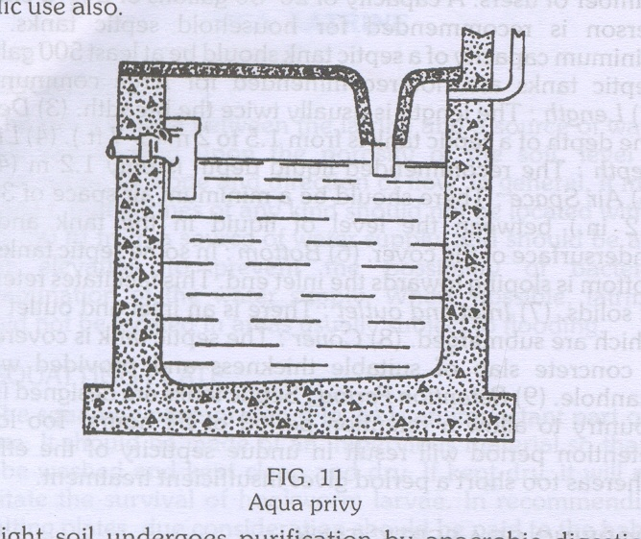
AQUA PRIVY –
The aqua privy functions like a septic tank and has been used in different regions in the country . The privy consists of a water-tight chamber filled with water. A short length of a drop pipe from the latrine floor dips into the water. The shape of the tank may be circular or rectangular.
The size of the tank depends upon the number of users. A capacity of one cubic metre (35 cuff.) is recommended for a small family, allowing 6 years or more for cleansing purposes. Aqua privies are designed for public use also.

Slide 31
Night soil undergoes purification by anaerobic digestion.
Since there is evolution of gases, a vent should be provided for the escape of gases into the atmosphere, the vent should be open above the roof of dwellings.
The effluent is far from innocuous. It contains finely divided faucal matter in suspension and may carry parasitic and infective agents.
It should be treated in the same manner as the effluent from a septic tank by sub-soil irrigation or absorption.
The digested sludge which accumulates in the tank should be removed at intervals

Slide 32
SULABH SHAUCHALAYA –
The "Slab Shauchalaya" model, is a low cost pour-flush, water-seal type of latrine, which is now being used in many parts of India.
Basically it is an improved version of the standard hand flush latrine (e.g., RCA type). It consists of a specially designed pan and a water-seal trap.
It is connected to a pit 3 feet square and as deep. Excreta undergoes bacterial decomposition and is converted to manure (compost). The method requires very little water.

Slide 33
Slab International, the investors, not only build but also maintain the system of Slab Community Latrines.
Their usual structure is a lavatory block of several dozen seats, with a bathing block adjoining.
Recently Delhi has opted for this system in all its slums. This system has drawn praise from ecologists and planners.

Slide 34
CHEMICAL CLOSET –
It has very limited use under Indian conditions. The closet consists of a metal tank containing a disinfectant fluid.
The active ingredients of the fluid are formaldehyde and quaternary ammonium compounds.
In addition, a harmless water dye and a deodorizing substance are usually incorporated .
A seat with a cover is placed directly over the tank. Nothing except the toilet paper should be thrown into the chemical closet.

Slide 35
SHALLOW TRENCH LATRINE –
This type of latrine is intended for camps of short duration about one week.
This is simply a trench dug with ordinary tools.
The trench is 30 cm (1 ft.) wide and 90-150 cm (3-5 ft.) deep. Its length depends on the number of users: 3-3.5 m (10-12 ft.) are necessary for 100 people.
Separate trenches should be provided for men and women. The earth from the trench should be piled up at the side.
People should be instructed to cover faces with earth each time they use the latrine.

Slide 36
These instructions may not be carried out, and it will be necessary to post sweepers in attendance to do this work. Ablution water should be provided.
The shallow trench is a rudimentary arrangement for a short period (up to one week).
When the trench is filled to 30 cm (12 in.) below ground level, it must be covered with earth, heaped above ground level and compacted.
if necessary, a new trench must be dug .

Slide 37
DEEP TRENCH LATRINE –
This type of latrine is intended for camps of longer duration, from a few weeks to a few months.
The trench is 1.8 to 2.5 m (6-8 ft.) deep and 75-90 cm (30-35 in.) wide.
Depending upon the local customs, a seat or a squatting plate is provided.
A superstructure is built for privacy and protection.
Other requirements are the same as for shallow trench latrine .

