Slide 1
DIURETICS
Manohar.Y
Assistant Professor
Deaprtment of Pharmacology
RMCH,Bareilly

Slide 2
DIURETICS
DEFINITION :
These are drugs which cause a net loss of Na+ and water in urine
There are several categories of diuretics. All diuretics increases the excretion of water from body.

Slide 3
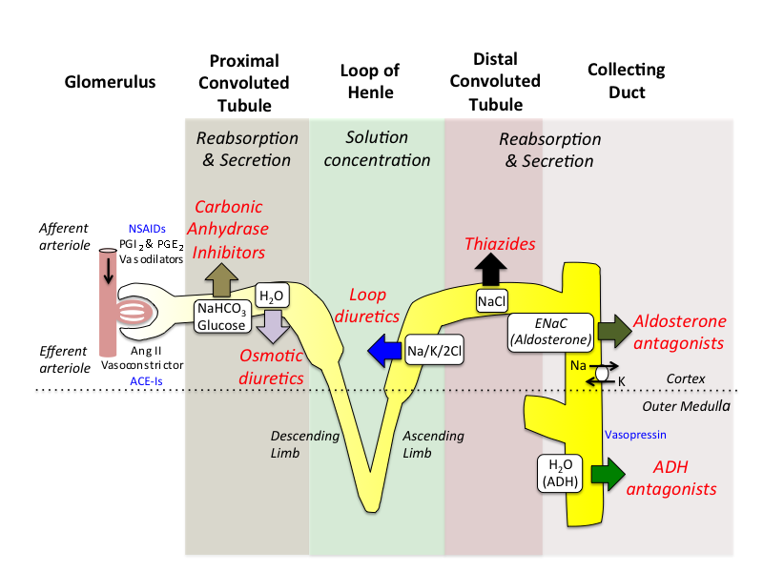

Slide 4
DIURETICS CLASSIFICATION
1.HIGH EFFICACY DIURETICS:
(Inhibitors of Na+,K+,2Cl- cotransport)
Sulphamoyl deravatives:
Furosemide. Bumetanide. Torasemide.
Phenoxyacetic acid derivative:
Ethacrynic acid.

Slide 5
MEDIUM EFFICACY DIURETICS
2.Medium efficacy diuretics :
( Inhibitors of Na+,Cl- symport)
Benzothiadiazines(THIAZIDES):
Hydrochloro thiazide. Benzthiazide.
Hydroflumethe thiazide. Ciopamide.
Thiazide: Chlorthalidone.
Metolazone.
Xipamide.
Indapamide.

Slide 6
WEAK OR ADJUNCTIVE DIURETICS
Weak or adjunctive diuretics:
  Carbonic anhydrase inhibitors:
Acetazolamide.
  (b)Potassium –sparing diuretics: (i)Aldosterone antagonist:
Spironolacton Eplerenone.
(ii)Inhibitors of renal epithial Na+ channel: Trimterene.
Amiloride.

Slide 7
Osmotic diuretics:
Mannitol. Isosorbide. Glycerol.
Xanthines:
Theophlline.

Slide 8
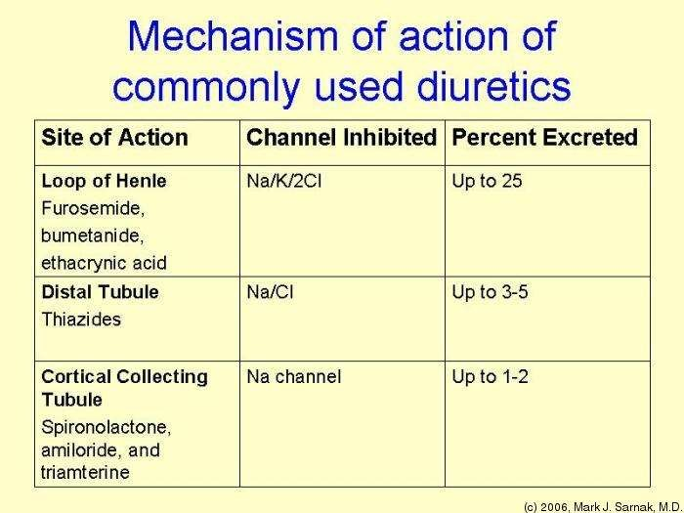
MECHANISM OF DIURETICS

Slide 9
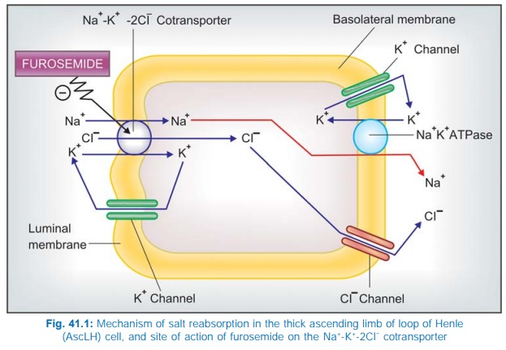
MECHANISM OF ACTION OF LOOP DIURETICS

Slide 10
Site: thick Ascending Limb of loop of Henle.
MOA:
Inhibitors of Na+-K+-2Cl¯ Cotransport
Maximum natriuretic effect than other diuretics .
They are faster acting with short duration.
Increased excretion of all ions: Na,K,Ca2+,Mg2+,Cl,H+ as well as HCO3

Slide 11
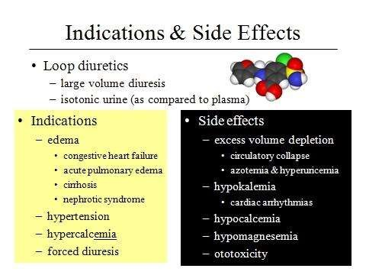

Slide 12
THIAZIDE(Medium efficacy) Hydrochloro thiazide
Site:
Distal convoluted tubules.
MOA:
Inhibitors of Na+-Cl¯ symport

Slide 13
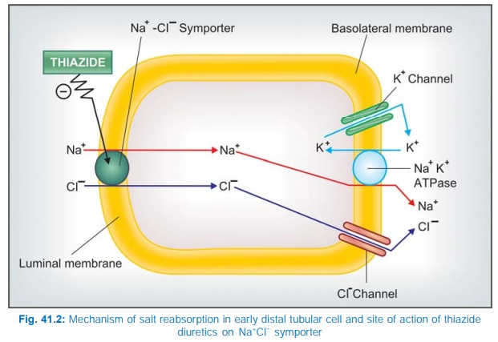
MECHANISM OF THIAZIDE DIURETICS

Slide 14
Uses and Side effects
USES: 1.Edema :Thiazides may be used for mild-to moderate cases.
2.Hypertension Thiazides and related diuretics, especially chlorthalidone are one of the first line drugs
3. Diabetes insipidus Thiazides decrease positive free water clearance and are the only drugs effective in nephrogenic diabetes insipidus.
4. Hypercalciuria with recurrent calcium stones in the kidney. Thiazides act by reducing Ca2+ excretion.
Side effects:
1. Acute saline depletion
2.Dilutional hyponatraemia
3. GIT and CNS disturbances
4. Hearing loss
5.Allergic manifestations
6.Hyperuricaemia
7.Hyperglycaemia and hyperlipidemia
8.Hypocalcaemia, Magnesium depletion, Hypokalaemia

Slide 15
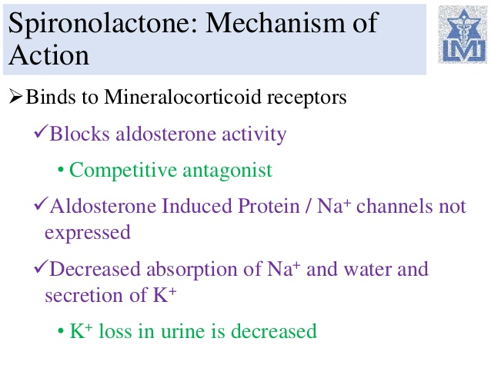
POTASSIUM- SPARING DIURETICS
Aldosterone antagonist: Spironolactone
Site : late DT and CD cells

Slide 16
Uses and Side effects uses:
1. To counteract K+ loss due to thiazide and loop diuretics.
2. Edema: It is more useful in cirrhotic and nephrotic edema.
3. Hypertension: Used as adjuvant to thiazide to prevent hypokalaemia.
4.CHF: As additional drug to conventional therapy in moderate to severe CHF
Side effects: drowsiness, ataxia, mental confusion, epigastric distress and loose motions.

Slide 17
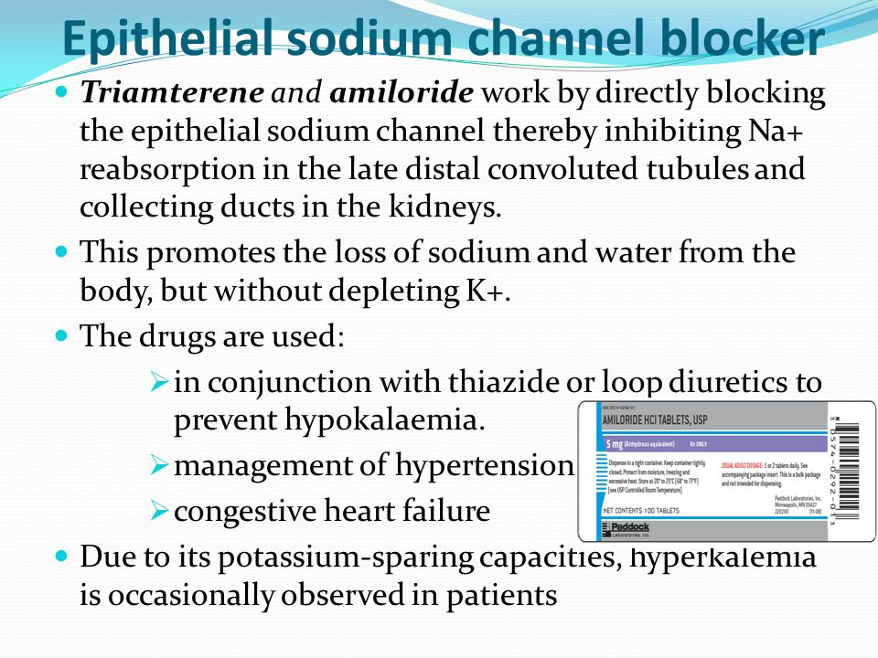

Slide 18
OSMOTIC DIURETICS (Mannitol) pharmacologically inert substance
Site: PT, thick AscLH
MOA:
1. Dilutes luminal fluid which opposes NaCl reabsorption.
2. Expands extracellular fluid volume (because it does not enter cells, mannitol draws water from the intracellular compartment)— increases g.f.r. and inhibits renin release.

Slide 19
Uses and Side effects
Uses:
1. Acute congestive glaucoma, head injury, stroke, etc.: movement of water from brain parenchyma, CSF and aqueous humour.
2.To maintain g.f.r. and urine flow in acute renal failure.
3. To counteract low osmolality of plasma/e.c.f. due to rapid haemodialysis.
Side effects:
Nausea and vomiting may occur; hypersensitivity reactions are rare.

