Slide 1
BRONCHIAL ASTHMA
MANOHAR.Y
ASSISTANT.PROFESSOR
DEPT.OF PHARMACOLOGY

Slide 2
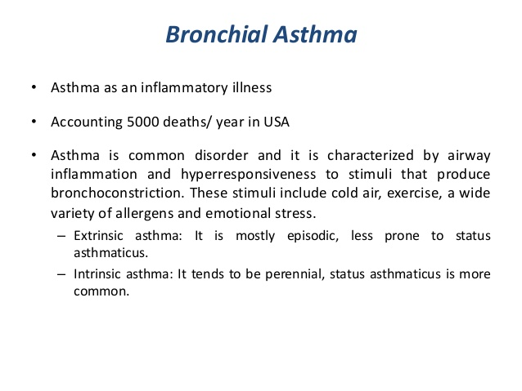

Slide 3
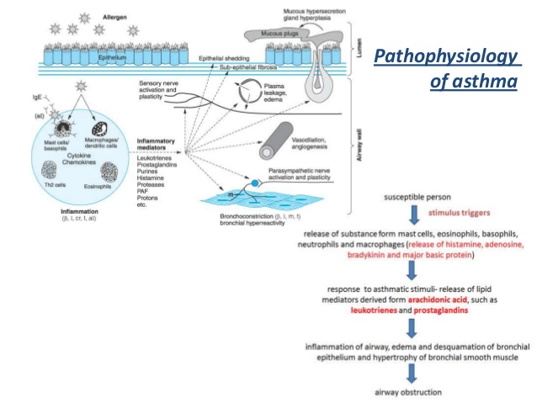

Slide 4
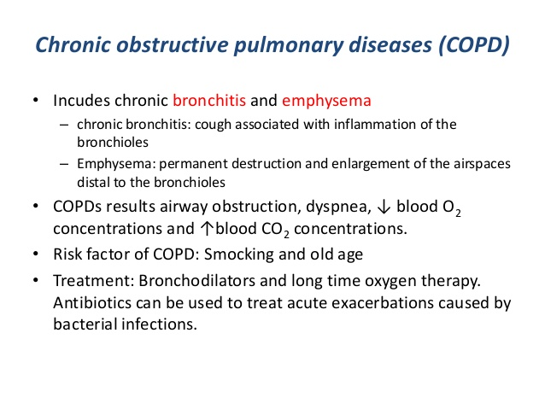

Slide 5
Bronchial asthma : Treatment approaches
1.Prevention of AB:AG reaction-
avoidance of antigen,hyposensitization.
2.Neutrlization of IgE:Omalizumab
3.Suppression of inflammation and bronchial hypersensitivity:
Corticosteroids
4.prevention of release of mediators: mast cell stabilizers
5.antagonism of release of mediators: leukotriene antagonists,antihistamines,PAF antagonists.
6.Blockade of constrictor neurotransmitter:anticholinergics.
7.Mimicking dilator neurotransmitter:sympathomimetics

Slide 6
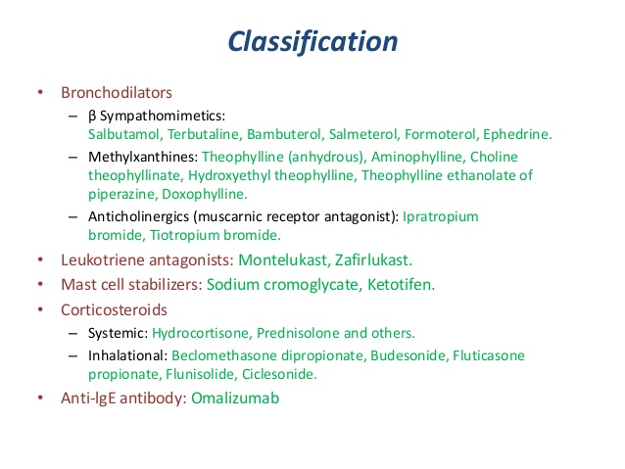

Slide 7
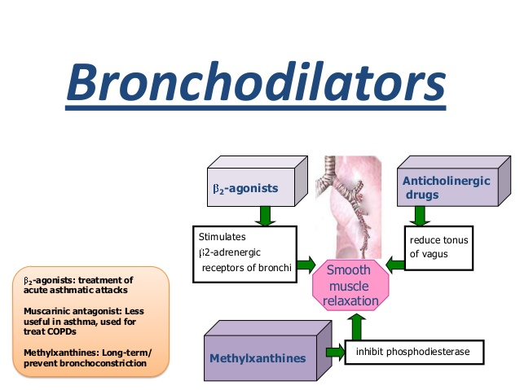

Slide 8
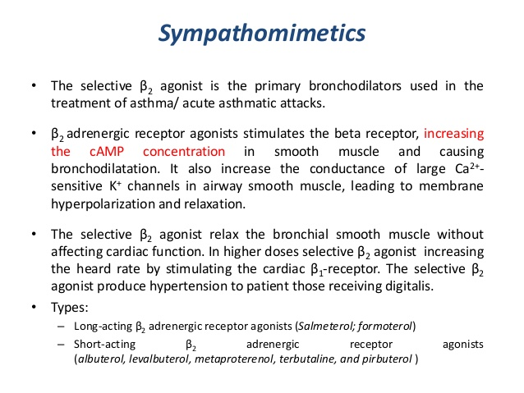

Slide 9
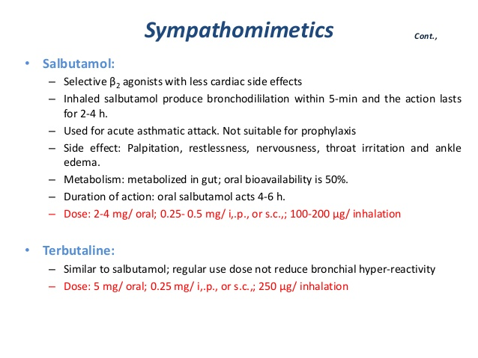

Slide 10
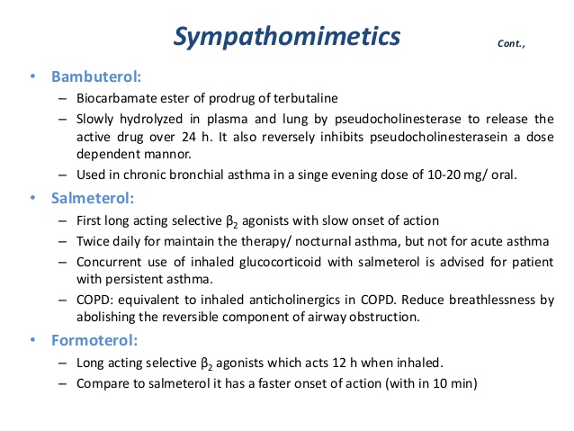

Slide 11
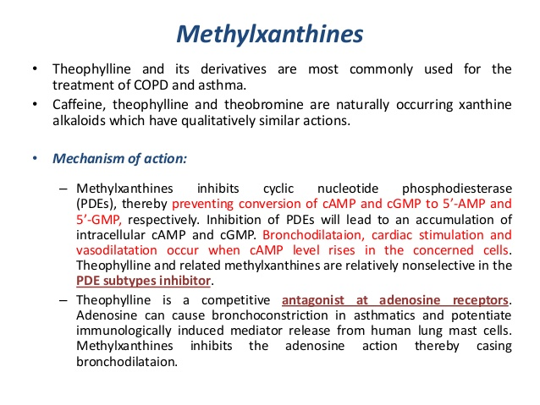

Slide 12
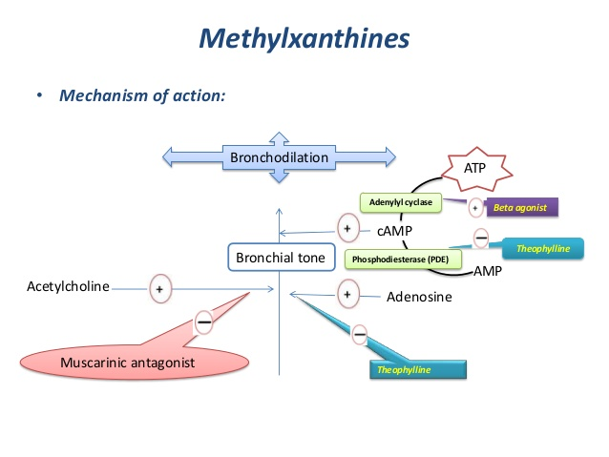

Slide 13
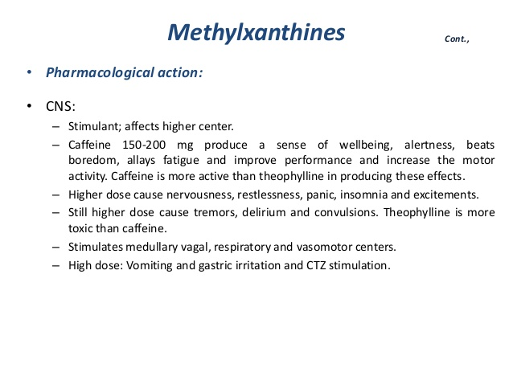

Slide 14
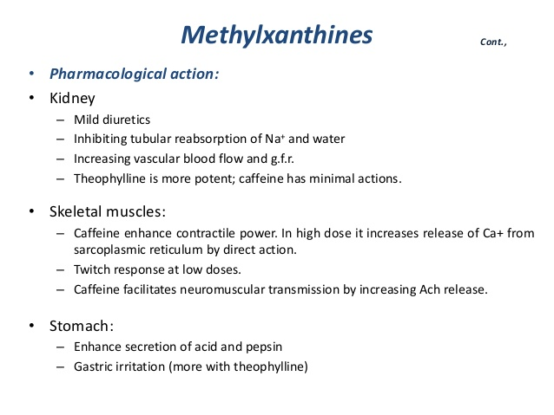

Slide 15
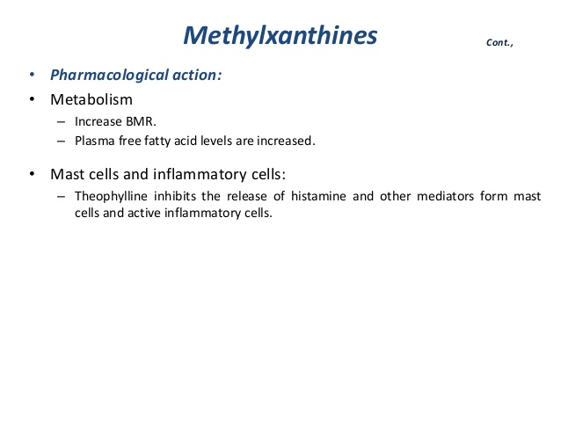

Slide 16
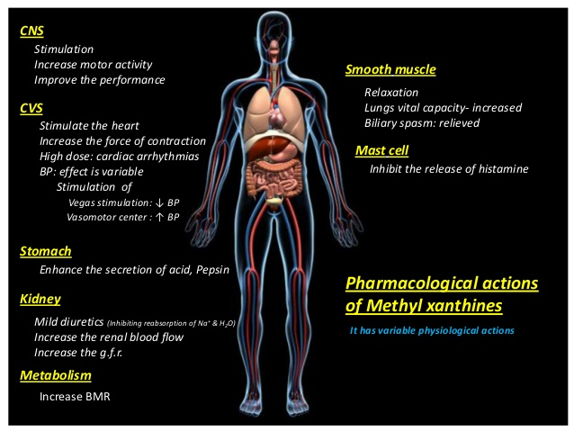

Slide 17
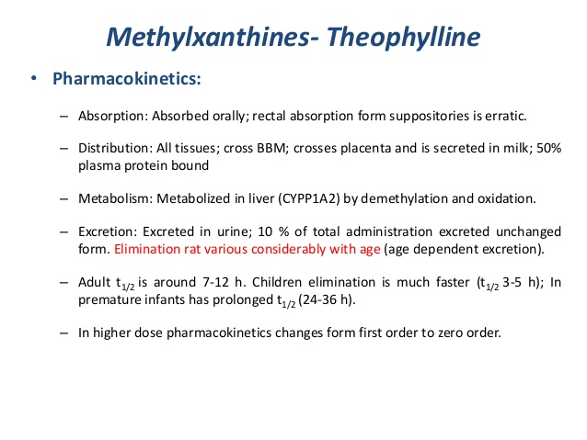

Slide 18
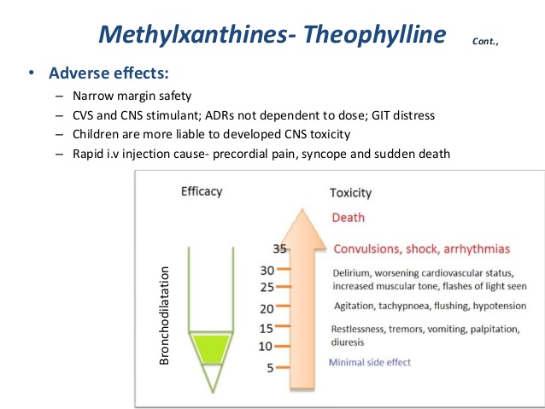

Slide 19
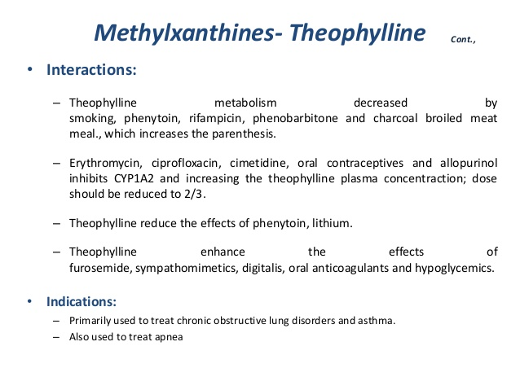

Slide 20
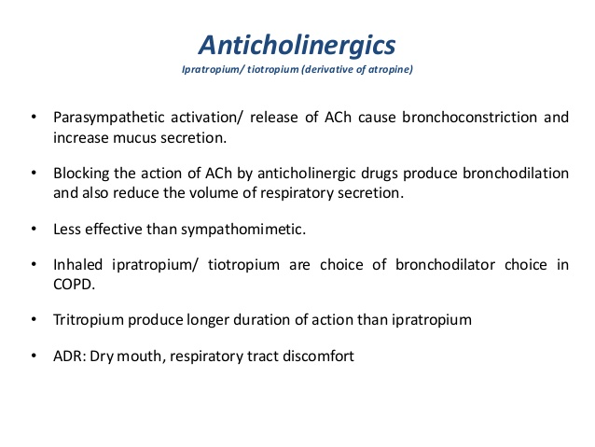

Slide 21
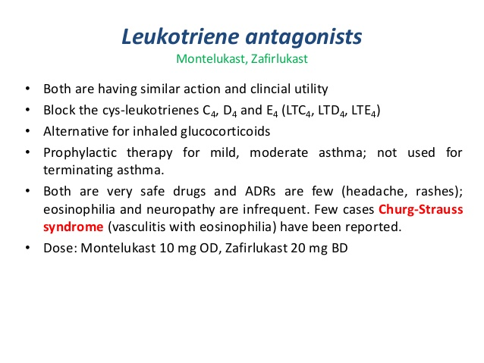

Slide 22
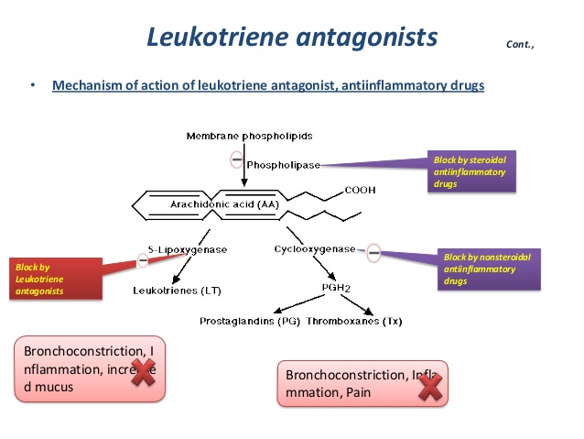

Slide 23
        Corticosteroids
        Corticosteroids are not bronchodilators benefit by reducing bronchial hyperactivity, mucosal oedema and suppressing inflammation
        1.Inhaled corticosteroids:
        High topical and low systemic toxicity(due to poor absorption/fast first pass metabolism)
        Inhaled corticosteroids are not recommended for patients with mild or episodic asthma.
        High dose inhaled corticosteroids are beneficial for advanced COPD with frequent exacerbations.

Slide 24
2.Systemic steroid therapy:
severe chronic asthma: not controlled by Bronchodilators and ICS.
Prednisolone 20-60 mg daily/2 weeks then shift onto an ICS.
Status asthmaticus:
Glucocorticoid high dose 100mg I.V –Stat followed by 100-200 mg 4-8hourly infusion.
Then oral therapy for 7 days.

Slide 25
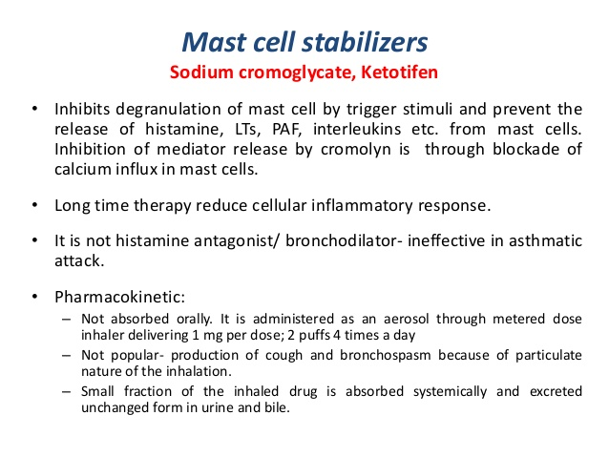

Slide 26
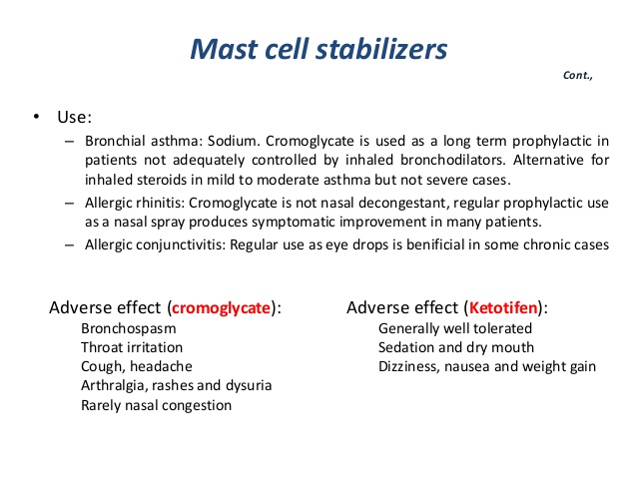

Slide 27
