Slide 1
Antihypertensive Drugs
Manohar.Y

Slide 2



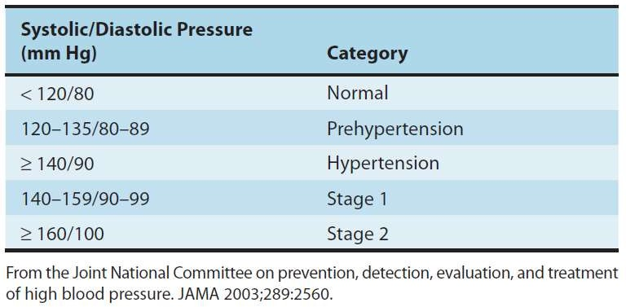
Classification of hypertension on the basis of blood pressure
JNC 7;
2003

Slide 3
Antihypertensive agents
Diuretics
  Thiazides: Hydrochlorothiazide, Chlorthalidone, Indapamide
  High ceiling: Furosemide, Torsemide, ethacrynic acid.
  K+ Sparing: Spironolactone, Amiloride
ACE inhibitors
  Captopril, Enalapril, Lisinopril, Perindopril, Ramipril, Fosinopril, etc.
Angiotensin (AT1 receptor) blockers: Losartan, Candesartan, Irbesartan, Valsartan, Telmisartan
Direct renin inhibitor: Aliskiren
β Adrenergic blockers: Propranolol, Metoprolol, Atenolol, etc.

Slide 4
Antihypertensive agents
Calcium channel blockers
– Verapamil, Diltiazem, Nifedipine, Felodipine, Nitrendipine, Lacidipine, etc.
β + α Adrenergic blockers: Labetalol, Carvedilol
α Adrenergic
Amlodipine,
blockers: Prazosin, Terazosin, Doxazosin,
Phentolamine, Phenoxybenzamine
Central sympatholytics: Clonidine, Methyldopa
Vasodilators
  Arteriolar: Hydralazine, Minoxidil, Diazoxide
  Arteriolar + venous: Sodium nitroprusside
Others: Adrenergic neurone blockers (Reserpine, Guanethidine, etc.), Ganglion blockers (Pentolinium, etc.)

Slide 5
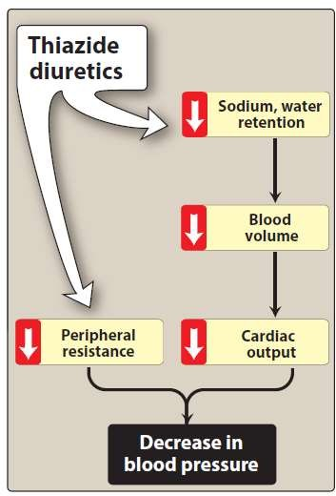
Diuretics
Thiazide diuretics: Thiazide
diuretics, such hydrochlorothiazide
as and
chlorthalidone, lower blood
pressure increasing
initially by
sodium and
water excretion. diuretics can
Thiazide induce
hypokalemia, hyperuricemia
and, to a lesser hyperglycemia in patients.
extent, some

Slide 6
Diuretics
Loop diuretics:
Inhibitors of epithelial sodium transport at the late distal and collecting ducts (furosemide, and ethacrynic acid) or antagonizing aldosterone receptor (spironolactone, and eplerenone) and reduce potassium loss in the urine.
Aldosterone antagonists have the additional benefit of diminishing the cardiac remodeling that occurs in heart failure.

Slide 7
Diuretics
Loop diuretics:
The loop diuretics act promptly by blocking sodium and chloride reabsorption in the kidneys, even in patients with poor renal function or those who have not responded to thiazide diuretics.

Slide 8
Diuretics
K+ Sparing:
potassium-sparing diuretics (spironolactone, and eplerenone) are competitive antagonists that either compete with aldosterone, or directly block epithelial sodium channel (amiloride).

Slide 9
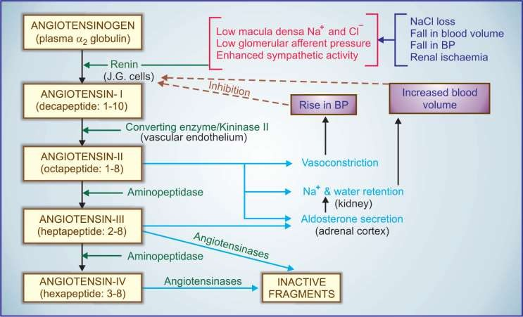
ACE inhibitors
Renin Inhibitors
ACE Inhibitors
Angiotensin blockers

Slide 10
ACE inhibitors
The ACE inhibitors, are recommended as first-line treatment of hypertension in patients with a variety of compelling indications, including
high coronary disease risk
history of diabetes, stroke, heart failure, myocardial infarction,
chronic kidney disease.

Slide 11
ACE inhibitors
ACE is also responsible for the breakdown of bradykinin, a peptide that increases the production of nitric oxide and prostacyclin by the blood vessels. Both nitric oxide and prostacyclin are potent vasodilators.

Slide 12
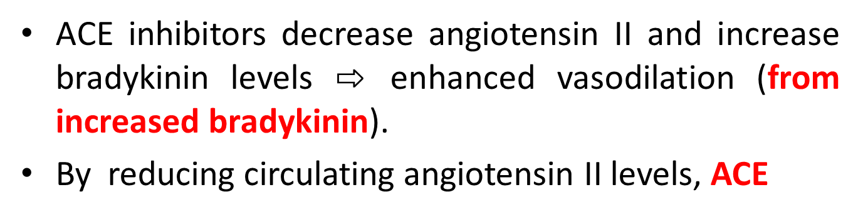
ACE inhibitors
ACE inhibitors decrease angiotensin II and increase bradykinin levels $⇨$ enhanced vasodilation (from increased bradykinin).
By reducing circulating angiotensin II levels, ACE
inhibitors also decrease the secretion of
and
aldosterone, resulting in decreased sodium
water retention.
ACE inhibitors reduce both cardiac preload and afterload, thereby decreasing cardiac work.

Slide 13
ACE inhibitors
Adverse effects of ACE inhibitors:
The adverse effect profile of all ACE inhibitors is similar. Captopril is well tolerated by most patients, especially if daily dose is kept below 150 mg.
Hypotension: An initial sharp fall in BP occurs especially in diuretic treated and CHF patients
Hyperkalaemia
Cough
Rashes, urticaria
Angioedema

Slide 14
ACE inhibitors
Adverse effects of ACE inhibitors:
Dysgeusia/ parageusia(complete lack/decrease of taste)
Foetopathic(fetal hypotension, growth restriction)
Headache, dizziness, nausea and bowel upset
Granulocytopenia and proteinuria (rare ADR)
Acute renal failure

Slide 15
ACE inhibitors
Advantages of ACE inhibitor:
Free of postural hypotension,
electrolyte
disturbances, feeling of weakness and CNS effects
Safety in asthmatics, diabetics and peripheral vascular disease patients
Long-term ACE inhibitor therapy has the potential to reduce incidence of type 2 diabetes in high risk subjects
No rebound hypertension on withdrawal

Slide 16
ACE inhibitors
Advantages of ACE inhibitor:
No hyperuricaemia, no deleterious effect on plasma lipid profile
ACE inhibitors are the most effective drugs for preventing sudden cardiac death in post-infarction patients.

Slide 17
Uses of ACE inhibitors
Hypertension:
  The ACE inhibitors are first line drugs in all grades of hypertension, but the angiotensin receptor blockers (ARBs) have now surpassed them in popularity.
  Essential hypertension respond to monotherapy with ACE inhibitors and majority of the rest to their combination with diuretics or beta blockers.

Slide 18
Uses of ACE inhibitors
Congestive Heart Failure (CHF): ACE inhibitors cause both arteriolar and venodilatation in CHF patients; reduce afterload as well as preload.
Myocardial infarction: Long-term ACE inhibitor therapy reduces recurrent MI.
Prophylaxis in high cardiovascular risk subjects: ACE inhibitors are protective in high cardiovascular risk subjects even when there is no associated hypertension or left ventricular dysfunction. ACE inhibitors may improved endothelial function.

Slide 19
Uses of ACE inhibitors
Diabetic nephropathy: Prolonged ACE inhibitor therapy has been found to prevent or delay end- stage renal disease in type I as well as type II diabetics.
Nondiabetic nephropathy: ACE inhibitors reducing proteinuria by decreasing pressure gradient across glomerular capillaries as well as by altering membrane permeability.
Scleroderma crisis: The marked rise in BP and deterioration of renal function in scleroderma crisis is mediated by Ang II. ACE inhibitors produce improvement and are life saving in this condition.

Slide 20
Angiotensin antagonists (ARBs)
Angiotensin antagonists: losartan, candesartan, valsartan, telmisartan, olmesartan and irbesartan.
Their pharmacologic effects of ARBs are similar to those of ACE inhibitors.
ARBs produce arteriolar and venous dilation and block aldosterone secretion, thus lowering blood pressure and decreasing salt and water retention.
ARBs do not increase bradykinin levels.
ARBs may be used as first-line agents for the treatment of hypertension, especially in patients with a compelling indication of diabetes, heart failure, or chronic kidney disease.

Slide 21
Direct renin inhibitor
A selective renin inhibitor, aliskiren directly inhibits renin and, thus, acts earlier in the renin– angiotensin–aldosterone system than ACE inhibitors or ARBs.
It lowers blood pressure about as effectively as ARBs, ACE inhibitors, and thiazides. Aliskiren should not be routinely combined with an ACE inhibitor or ARBs.
Aliskiren can cause diarrhea, especially at higher doses, and can also cause cough and angioedema, but probably less often than ACE inhibitors.
Aliskiren is contraindicated during pregnancy.

Slide 22
β-adrenergic blockers
β-adrenergic blockers are mild antihypertensives and do not significantly lower BP in normotensives. In stage 1 cases of hypertensive patients (30 - 40%), β- adrenergic blockers are used alone.

Slide 23
β-adrenergic blockers
Propranolol
Propranolol is a first β blocker showed effective in hypertension and ischemic heart disease.
Propranolol has now been largely replaced by cardioselective β blockers such as metoprolol and atenolol.
All β-adrenoceptor-blocking agents lowering blood pressure in mild hypertension.
In severe hypertension, β blockers
are useful for
to
moderate
are especially
useful in preventing the reflex tachycardia that often results from treatment with direct vasodilators.

Slide 24
β-adrenergic blockers
Metoprolol & Atenolol
Metoprolol and atenolol, which are cardioselective, are the most widely used β blockers in the treatment of hypertension.
Metoprolol is atenolol is inhibiting stimulation of β1 adrenoceptors.
Sustained-release metoprolol is effective in reducing mortality from heart failure and is particularly useful in patients with hypertension and heart failure.
Atenolol is reported metoprolol in
to be less effective than
preventing the complications of
hypertension.

Slide 25
β-adrenergic blockers
Other beta blockers
Nadolol and carteolol, nonselective antagonists
β-receptor
Betaxolol and bisoprolol are β1-selective blockers
Pindolol, acebutolol, agonists, ie, β
and penbutolol are partial
blockers with some intrinsic activity. These drugs are
with
sympathomimetic
particularly beneficial for patients
bradyarrhythmias or peripheral vascular disease.

Slide 26
β-adrenergic blockers
Other beta blockers
Nadolol and carteolol, nonselective antagonists
β-receptor
Betaxolol and bisoprolol are β1-selective blockers
Pindolol, acebutolol, agonists, ie, β
and penbutolol are partial
blockers with some intrinsic activity. These drugs are
with
sympathomimetic
particularly beneficial for patients
bradyarrhythmias or peripheral vascular disease.

Slide 27
β-adrenergic blockers
Other beta blockers
Labetalol, Carvedilol, & Nebivolol have blocking and vasodilating effects.
Esmolol is a β1-selective blocker that
both β-
metabolized via hydrolysis by red blood cell esterases. Esmolol is used for management of intraoperative and postoperative hypertension, and sometimes for hypertensive emergencies, particularly when hypertension is associated with tachycardia or when there is severe heart failure.
is rapidly

Slide 28
α-Adrenergic blockers
Prazosin, terazosin, and doxazosin
Prazosin is a prototype α₁-adrenergic blocking agent.
Terazosin and doxazosin are long-acting congeners of prazosin
Alpha blockers reduce arterial pressure by dilating both resistance and capacitance vessels.
Other alpha-adrenoceptorblocking agents
phentolamine (reversible nonselective α-adrenergic antagonist) and phenoxybenzamine (non-selective, irreversible alpha blocker) are useful in diagnosis and treatment of pheochromocytoma.

Slide 29
Centrally acting adrenergic drugs
Clonidine
Clonidine acts centrally as an α₂ agonist to produce inhibition of sympathetic vasomotor centers, decreasing sympathetic outflow to the periphery. This leads to reduced total peripheral resistance and decreased blood pressure. At present, it is occasionally used in combination with a diuretic.
Methyldopa
It is an α₂ agonist that is converted to methylnorepinephrine centrally to diminish adrenergic outflow from the CNS. It is mainly used for management of hypertension in pregnancy, where it has a record of safety.

Slide 30
Vasodilators
Hydralazine/Dihydralazine and minoxidil not used as primary drugs to treat hypertension. These vasodilators act by producing relaxation of vascular smooth muscle, primarily in arteries and arterioles. This results in decreased peripheral resistance.
Both agents produce reflex stimulation of the heart, resulting in the competing reflexes of increased myocardial contractility, heart rate, and oxygen consumption.
Hydralazine is an accepted medication for controlling blood pressure in pregnancy induced hypertension. This drug is used topically to treat male pattern baldness.

Slide 31
Treatment of hypertension
Hypertensive emergency:
It is rare but life-
threatening condition (systolic BP >180 mm Hg or diastolic BP >120 mm Hg with evidence of impending or progressive target organ damage such as stroke, myocardial infarction).
A variety of medications are used, including
Calcium channel blockers (nicardipine and clevidipine),
Nitric oxide vasodilators (nitroprusside and nitroglycerin),
Adrenergic receptor antagonists (phentolamine, esmolol, and labetalol),
Vasodilator hydralazine, and
Dopamine agonist fenoldopam.

Slide 32
Treatment of hypertension
Resistant hypertension:
Pressure that remains--------
It is defined as blood elevated despite
administration of an optimal three-drug regimen that includes a diuretic. The most common causes of resistant hypertension
poor compliance
excessive ethanol intake
concomitant conditions (diabetes, obesity, sleep apnea, hyperaldosteronism, high salt intake, metabolic syndrome)
concomitant medications (sympathomimetics, nonsteroidal anti-inflammatory drugs, or antidepressant medications)
insufficient dose/ drug…

Slide 33
Treatment of hypertension
Summary of WHO-ISH and British Hypertension Society (BHS) 2004, guidelines
  Except for stage II hypertension, start with a single most appropriate drug
  Follow A B C D rule (A—ACE inhibitor/ARB; B—β blocker; C—CCB, D—diuretic). While A and (in some cases) B are preferred in younger patients (<55 years), C and D are preferred in the older (> 55 years) for the step I or monotherapy.
  Initiate therapy at low dose; if needed increase dose
moderately.
  If only partial response is obtained, add a drug from another complimentary class or change to low dose combination

Slide 34
Treatment of hypertension
Summary of WHO-ISH and British Hypertension Society (BHS) 2004, guidelines
  If no response, change to a drug from another class, or low dose combination from other classes
  In case of side effect to the initially chosen drug, either substitute with drug of another class or reduce dose
  Majority of stage II hypertensives are started on a 2 drug combination

Slide 35
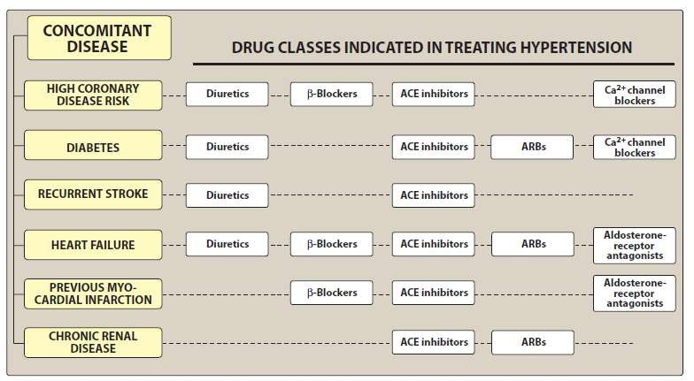
Treatment of hypertension in patients with concomitant diseases

Slide 36
Combinations to be avoided
Combination | Possible effects
An α or β adrenergic blocker with clonidine | Apparent antagonism of clonidine action has been observed.
Hydralazine with a dihydropyridine (DHP) or prazosin | haemodynamic action
Verapamil or diltiazem with β blocker | bradycardia, A-V block can
Methyldopa with clonidine or any two drugs of the same class

Slide 37
Antihypertensives & pregnancy
Antihypertensives to be avoided during pregnancy | Antihypertensives found safer during pregnancy
ACE inhibitors, ARBs: Risk of foetal damage, growth retardation. | Hydralazine Methyldopa
Diuretics: increase risk of foetal wastage, placental infarcts, miscarriage, stillbirth. | Dihydropyridine CCBs: if used, they should be discontinued before labour as they weaken uterine contractions.
Nonselective β blockers: Propranolol cause low birth weight, decreased placental size, neonatal bradycardia and hypoglycaemia. | Cardioselective β blockers and those with ISA, e.g. atenolol, metoprolol, pindolol, acebutolol: may be used if no other choice.
Sod. nitroprusside: Contraindicated in eclampsia. | Prazosin and clonidine-provided that postural hypotension can be avoided.

Slide 38
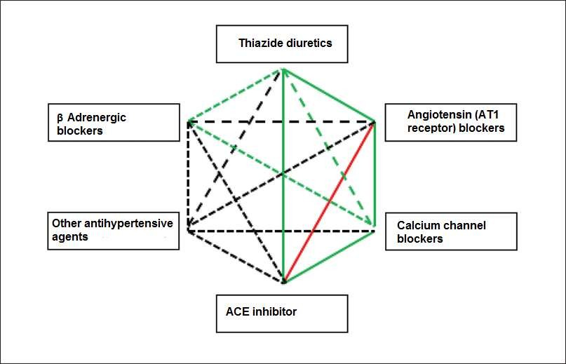
Possible combination of antihypertensive drugs: Continuous green line (preferential combinations); dotted green line (acceptable combinations); dotted black line (less usual combinations); red line (unusual combinations).
Ref: Póvoa R, Barroso WS, Brandão AA, et al. I brazilian position paper on antihypertensive drug combination. Arq Bras Cardiol. 2014;102(3):203-10.

Slide 39
