Slide 1

Manohar.Y Assistant Professor Department of Pharmacology
RMCH,Bareilly

Slide 2
Histamine - Introduction
Meaning “tissue amine” (histos – tissue) – abundantly present in animal tissues – also in plants like “stinging nettle”
Mediator of hypersensitivity and tissue potential tissue injury – Physiological role..
The primary site the mast cell granules (or basophils) – skin, intestinal and gastric mucosa, lungs, liver and placenta

Slide 3
Histamine – synthesis, storage and release
Synthesized locally from amino acid histidine
•
•
Histidine Histamine
L-histidine decarboxylase
Metabolized by P450 system, 2 pathways:
Methylation to N-me histamine (N-me transferase), and to N-me imidazole acetic acid (MAO) - eliminated in urine
Oxidative deamination to imidazole acetic acid (DAO), and to imidazole acetic acid riboside - eliminated in urine
Ineffective orally – liver destroys all absorbed from intestine
•

Slide 4
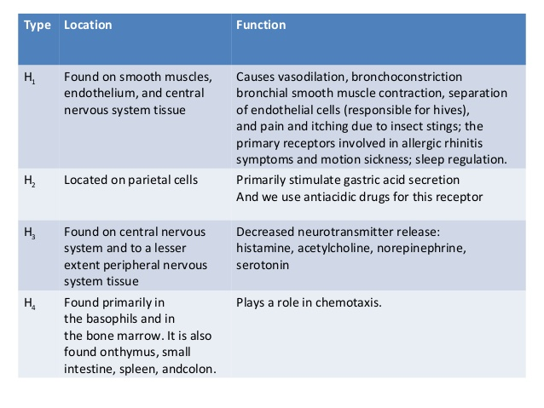

Slide 5
Histamine - Pharmacological actions
Blood vessels: Dilatation of small vessels – arterioles, capillaries and venules
S C administration – flushing, heat, increased HR and CO – little fall in BP
Rapid IV injection: Fall in BP early (H1) and persistent (H2) – only H1 effect with low dose
Dilatation of cranial vessels - headache
H1 component vasodilatation – mediated indirectly by EDRF .. But H2 component VD- mediation is directly on smooth muscle of blood vessels
Larger arteries and veins – constriction mediated by H1 receptor
Increased capillary permeability – exudation of plasma
•

Slide 6
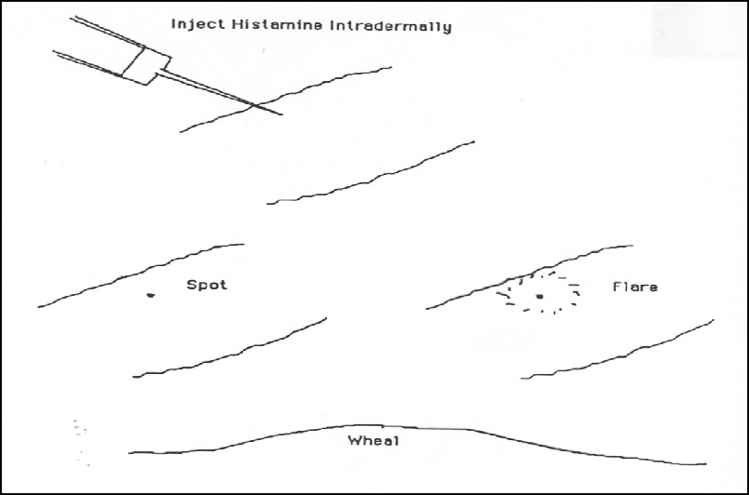
Histamine –
The Triple Response
Subdermal histamine injection causes:
Red spot (few mm) in seconds: direct vasodilation effect , H1 receptor mediated
Flare (1cm beyond site): axonal reflexes, indirect vasodilation, and itching, H1 receptor mediated
Wheal (1-2 min) same area as original spot, edema due to increased capillary permeability, H1 receptor mediated

Slide 7
Heart
•
Affects both cardiac contractility and electrical events directly
– It increases the force of contraction of both atrial and ventricular muscle by promoting the influx of Ca2+, and
Increased heart rate by quicken diastolic depolarization in the sinoatrial (SA) node.
It also acts directly to slow atrioventricular (AV) conduction, to increase automaticity, and in high doses especially - to elicit arrhythmias.
Overall: H1 – decreased AV conduction; H2 - Increased Chronotropy and automaticity
•
•
•

Slide 8
•
Visceral smooth muscles: Bronchoconstriction, intestinal contractions increased (colic), Uterus not affected
Glands: Gastric secretion (also pepsin) – H2 receptor mediated
– cAMP generation and proton pump activation
Sensory Nerve endings: Itching on injected; High doses – pain
Autonomic ganglia and Adrenal Medulla: Adrenaline release – rise in BP
C N S: Does not cross BBB – no C N S effects on IV
– intracerebral injection: Rise in B P, Cardiac stimulation, hypothermia, arousal, vomiting
•
•
•
•

Slide 9
Histamine H1-receptor antagonists
First Generation:
Sedating
Second Generation: Nonsedating

Slide 10
Classification
•
1st Generation:
Highly sedatives: Diphenhydramine, Dimenhydrate, Promethazine and Hydroxyzine
Moderately: Pheniramine, Cyproheptadine, Meclizine, Buclizine and Cinnarizine
Mild: Chlorpheniramine, Dexchlorpheniramine, Dimethindene, Cyclizine, Clemastine
2nd Generation:
Fexofenadine, Loratidine, Desloratidine, Cetirizine, Levocetrizine, Azelastine, Mizolastine, Ebastine and Rupatidine
•

Slide 11
Antihistaminics – Pharmacological actions
Antagonism of Histamine:
Effectively block bronchoconstriction, contraction of intestinal and other smooth muscles and triple response
Low dose BP fall antagonized, but needs H2 blockers to counter high dose fall in BP
Constriction of large vessels also antagonized
Gastric secretion – unchanged
Antiallergic action: Manifestations of Type 1 hypersensitivity reactions – suppressed
Urticaria, itching, angioedema – controlled
Anaphylactic fall in BP – partially prevented
Asthma in human – not affected (other mediators)
•
•

Slide 12
CNS: Variable degree of C N S depression (sedation)– depends on individual drugs – ability to cross BBB and CNS:Peripheral H1 receptor affinity
Inter-individual variation
Some Individuals: stimulant effects – restlessness and Insomnia etc. 2nd generation – Non-sedating
Promethazine – controls motion sickness and vomiting of pregnancy
Promethazine – controls rigidity and tremor in Parkinsonism
Anticholinergic: Many are anticholinergic properties – Promethazine highest – additive action with Atropine, TCAs etc.
Local anaesthetic: Pheniramine – membrane stabilizing effects – LA – but not used (Irritation) – also antiarrhytmic
BP: Fall in B P with IV injection (all) but not with Oral

Slide 13
Pharmacokinetics
Classically – lipid soluble, well absorbed orally and parenterally, metabolized in Liver and excreted in urine
Widely distributed in body and enters Brain and crosses BBB
Induce microsomal hepatic enzyme
Duration of action 4-6 Hours except meclozone,CPM,cetirizine,loratidine,fexofenadine which act for 12-24 or more
Cetirizine (C), loratadine (L), fexofenadine (F) - well absorbed and are excreted mainly unmetabolized form
C and L are primarily excreted in the urine
F is primarily excreted in the feces

Slide 14
ADRs - H1 - antgonists
•
Sedation (Paradoxical Excitation in children), diminished alertness, loss to concentrate, dizziness, motor incordination, tendency to fall asleep – commonest – say no to motor vehicle driving and operation
Alcohol synergises CNS effects
Tachydysrhythmias in overdose - rare
•
•
Allergic reactions with topical use (contact dermatitis) Peripheral antimuscarinic effects
–
–
Dryness of mouth, blurred Vision, constipation, urinary retention Epigastric distress and headache
•
Acute overdose: CNS excitation, tremor hallucinations – resemble Atropine poisoning - death due to respiratory failure and CVS failure

Slide 15
Therapeutic uses
•
Allergic reactions: Does not suppress AG:AB reaction – but blocks release of histamine – palliative
– Itching, urticaria, seasonal hay fever, allergic conjunctivitis, angioedema of lips-eyelids etc. --- Laryngeal angioedema (Adrenaline)
Anaphylactic shock
Less effective in perennial vasomotor rhinitis, atopic dermatitis, and chronic dermatitis – H2 antagonist combination
Bronchial asthma – no use – 1) other mediators than histamine
2) concentration at the site may not be sufficient
Not effective in humoral and cell mediated allergies
–
–
–
–
•
Other conditions : (histamine) – Insect bite, Ivy poisoning – symptomatic relief
Prunitides: Antipruritic - Independent of antihistaminic action Common cold: Symptomatic relief – older ones preferred
•
•

Slide 16
Motion Sickness: Promethazine, diphenhydramine, dimenhydrinate and cyclizine – 1 hour befor journey
Promethazine – morning sickness, drug induced and post operative vomiting and radiation vomiting
Vertigo: Cinnarizine Preanaesthetic medication
Cough: Chlorpheniraine maleate, diphenhydramine, promethazine etc.
Parkinsonism: Promethazine – anticholinergic and sedative
Acute muscular dystonia: Parenteral Promethazine – anti-dopamineric and antipsychotic drugs
Sedative-hypnotic: Promethazine – respiratory depression (not below 2 years) – not preferred ……. Hydroxyzine

Slide 17
2nd Generation antihistaminics
•
2nd generation (SGAs) – after 1980s
Higher affinity for H1 receptors: no anticholinergic side effects
Absence of CNS depressant property
Additional antiallergic – LT and P A F inhibition
Advantages over 1st generation:
No psychomotor impairment – driving etc. can be allowed
No sleep induction
Do not potentiate BDZ and alcohol etc.
•

Slide 18
Individual Antihistaminics
2nd Generation: in general, these agents have a much lower incidence of adverse effects than the first generation agents
Fexofenadine: First non-sedating SGA - banned – Torades de pointes … when co-administered with CYP 3A4 inhibitors – erythromycin, clarithromycin, ketoconazole and itraconazole etc.
–
–
Blocking of delayed rectifier K+ channel in Heart at high doses Terfenadine, Astimazole etc. – banned
•
Loratidine: Long acting, selective peripheral H1 blocker – fast acting and lacks CNS depression – metabolized by CYP3A4 (to an active metabolite)
No interaction with macrolides and no arrhythmias
Uses: Urticaria and atopic dermatitis
•
Desloratidine: Metabolite of Loratidine – with its double potency

Slide 19
Cetirizine:
Most commonly used these days (Levocetirizine – same with lesser side effects)
High affinity for Peripheral H1 receptor, but poor BBB cross, but sleepiness at high dose
Not metabolized in body, no cardiac action when given with macrolides etc.
Other anti-allergic action – inhibits histamine and cytotoxic material release from platelets and eosinophils(LTs,PGs,ILs)
High skin concentration – beneficial urticaria and atopic dermatitis
Longer half life – once daily dosing
Uses: Upper respiratory allergies, pollinosis(Allergic rhinitis), urticaria and atopic dermatitis and seasonal asthma..

Slide 20
•
Azelastine: H1 blocker with topical action – also inhibitor of inflammatory response mediated by LT and PAF
Down regulation of Intracellular adhesion molecule-1 (ICAM-1) expression on nasal mucosa – Intranasal application
Half-life 24 hours but action lasts longer due to active metabolites
Used intranasal in seasonal and perennial rhinitis(inflammation of nose)
•
Mizolastine: Non-sedating – effective in rhinitis and urticaria (no active metabolite)
– Half-life 8-10 Hours but single dosing
•
Ebastine: Newer SGA – converts to carbastine
Half-life: 10-16 Hrs and non-sedating
Used in nasal and skin allergies
Arrhythmogenic potential

Slide 21
H 2-receptor antagonists
Cimetidine, Ranitidine, Famotidine and
Roxatidine …….
….. Will be discussed later – in “Drugs for Peptic Ulcer”

