Slide 1




GENERAL METHODS OF DIETARY ASSESSMENT
Dr.Rashmi katyal
Professor
RMCH, Bareilly

Slide 2



Dietary Survey mean what people eat and how much they eat, what are their likes and dislikes and dietary beliefs as also dietary practices.
A nutritional survey is never complete without a diet survey.
A diet survey objectively defines importance of diet in various health state and disease.

Slide 3
Diet survey is nothing but the scientific assessment of food consumption, and using this data for various purposes including assessment of nutritional status.

Slide 4
NUTRITIONAL ASSESSMENT : more
comprehensive and includes determining nutritional status by analyzing the individual’s brief socio economic background, medical history, dietary, anthropometric, biochemical, clinical data and drug – nutrient interactions.

Slide 5
A DIETARY ASSESMENT : comprehensive evaluation of a persons food intake.
It is one of the established methods of nutritional assessment.
Dietary assessment techniques range from food records to questionnaires and biological markers.

Slide 6

Periodic dietary surveys done at time intervals provide information on trends of food consumption.
The surveys also help to know the special preference for a food and foods avoided or disliked and alternate foods consumed during the special conditions like droughts and in tribal areas.
When designing specific programme on nutrition, dietary surveys are needed to have evidence based data.

Slide 7




Methods of nutritional assessment
Various methods are available for the assessment of nutritional status.
ABCD… of Nutritional Status Assessment
Anthropometry
Biochemical & lab methods Clinical assessment
Diet survey/assessment
Ecological studies Functional assessment
Vital statistics

Slide 8

Ecology of malnutrition :
Jelliffe (1966) listed
the ecological factors related to malnutrition as follows
Conditioning
inf luences
, cultural influences, socio economic factors, food production and
health and other services.

Slide 9


OF DIET
TYPES SURVEY

Slide 10



Quantitative
Qualitative
Food items consumed, their frequency of consumption, food preferred or foodavoided.
Opinion and attitude towards food andcultural significance of anyfood.
Can have focused attention on dietary practices during infancy, young children, pregnancy and lactational period.
Exact amount of foods consumed in terms of grams or liters and their nutrient contentassessed
Comparison with RDA for adequacy/inadequacy.

Slide 11
Methods of dietary assessment
1. Food balance sheet method. 2.Inventory method. 3.Weighment method .
4. 24 hr Recall method .(Questionnaire method) 5.Dietary Score method .
Food Frequency Questionnaire method .(FFQ Method)
Dupliate Sample/ Chemical analysis method .
Expenditure pattern method . 9.Diet History .
10.Recording method.

Slide 12
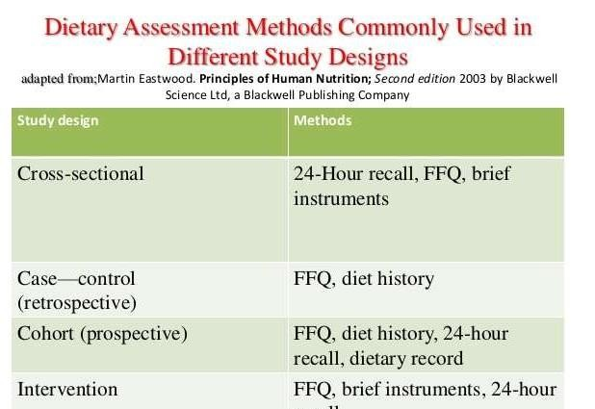

Slide 13
Dietary Assessment Methods
Method employed for collecting National Level Data
FOOD BALANCE SHEET
35

Slide 14
















INDIVIDUAL LEVEL
24-hour recall
Telephone recall
Dietary history
Food frequency and
semi quantitative food frequency questionnaire
Retrospective Methods
Weighed food record
Food diary
Duplicate portion analysis
Prospective Methods
36

Slide 15


Slide 16

This method is used when information regarding availability and consumption of food is required at amacro level like at the global, national, region or
state levels.

Slide 17
Maintained by each country.
Indicates the total food available in the country along with buffer stocks.
FAO – monitors at international level since 1949.
Gives the estimate of available food in the country per person per year or per day.

Slide 18
The total food supplies available and used up at a given level are taken into account in this method.
Effectively the difference between receipt (of food various sources) and expenditure over a given period of time gives the food consumed by population.

Slide 19


The consumption per capita/day is worked out as

Slide 20
These figures are used for various types of planning and budgeting, namely plans for agriculture, fertilizers, productions, imports and Public Distribution System (PDS).

Slide 21
Advantages :
Gives idea about food available with the country Helps national planners to take appropriate decisions to avert “food crisis”
Disadvantages :
Does not take into account the wastage of food and discarding of non edible portion of food
Does not give idea about food intake by an individual It is a gross method.
The consumption of rich and poor is equated and averaged out .
It gives the consumption pattern but doesn’t include purchasing power of the individual.

Slide 22


INVENTORY METHOD

Slide 23

The inventory method is carried out at an institutional level, on a homogenous group as present in a hostel, jail, mess, army barrack, orphanage etc.
It is essentially done from books.
Log book method /food list method
Actual amount of food stuffs issued by the in charge of institute are taken into account for consumption .

Slide 24
Method : 2 visits by an investigators
One at the beginning of survey-checklist of food stocks is prepared and handed over to housewife / incharge
Other at the end of a week
Purchased /discarded food is taken into account
9 September2014
46

Slide 25
Average intake of food/person/ day
stock at beginning
= of week
- stock at theend of week
total inmates participating in meal x noof days of survey
Advantage :Covers large area in short time .
it is fast, much easier, less cumbersome and faster than the weighment methods.
It is also fairly accurate. It may not indicate an accurate individual food consumption but is fairly satisfactory for the purposes of planning.
9 September2014
47

Slide 26

Disadvantage : Gives the estimate of food available rather than food consumed .
it doesn’t account for wastage.
it gives only the mean individual consumption but actual individual consumption is not
reflected.

Slide 27


WEIGHMENT
METHOD

Slide 28
In this method the foods are actually weighed using a grocer’s balance.
Both raw and cooked food are weighed.
In community surveys (at a family level), the raw food is weighed rather than the cooked food, since weighing cooked food is not acceptable to the families.
In an institution however, the cooked food can also be weighed, since cooking is carried out at a central kitchen.

Slide 29
While using weighment method at a family levelthe following points are important:
Convince the housewife of the need of the survey for the benefit of the family .
Avoid holidays/fares/festivals/feasts as the dietary practice of these days does not reflect the actual dietary practices.
It should be carried out for 3 to 7 days consecutively. 4.At least two visits a day for lunch and dinner have to be made.
Two investigators should be available - one talks and
weighs and the other records observations.
Any pets, breast fed children, guests etc. should be considered.

Slide 30

Advantages- More accurate than 24 hr recall Good to estimate caloric intake.
It accounts for the non edible parts of food as well. The wastage is also taken into account.
This method is more accurate than the inventory method. Disadvantage- Time consuming
Uncooperation from family
Aplicability to other nutrients like proteins, vitamins is limited
Can be adopted in institutions/hospitals

Slide 31






24 HOURS METHOD
RECALL

Slide 32
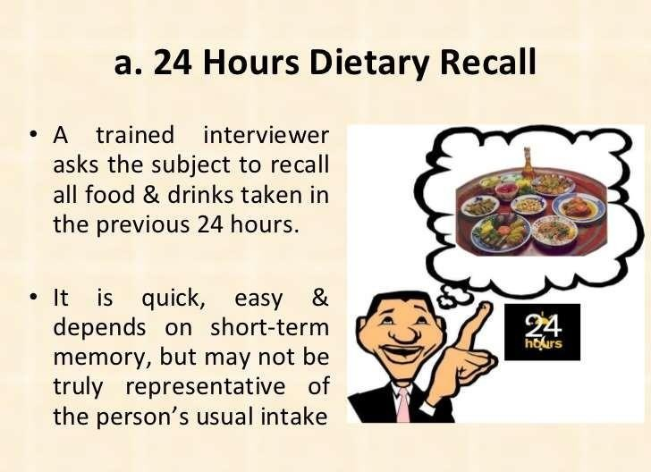

Slide 33

Enlist all the family members who partook the meals yesterday
Their completed age(in years for adults, in months for infants and young children)
Their physiological status(pregnancy, lactation)
Occupation- sedentary, moderate, heavy Economic status
This helps to arrive adult consumption units

Slide 34
Housewife/individual is asked which food and what amounts were consumed on previous day or yesterday
Avoid 3 F –
Festival
Fast
Feast days

Slide 35
An account of row ingredients used for each of the preparations is obtained with help of grocer’s balance
Information on total cooked amount of each preparation is noted in terms of standardized cups(s).

Slide 36
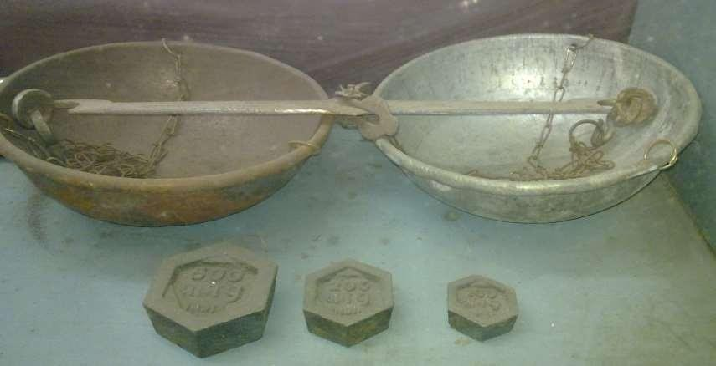
Grocer’s balance
9 September2014
58

Slide 37
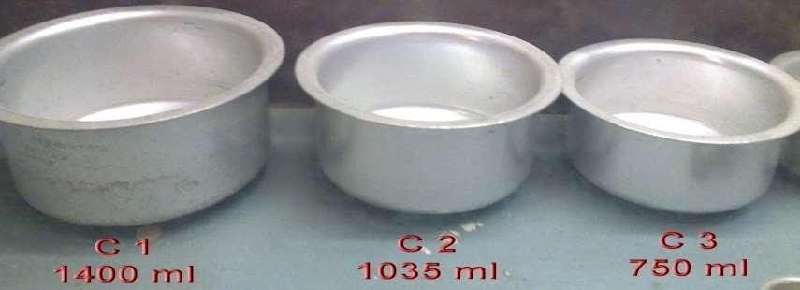
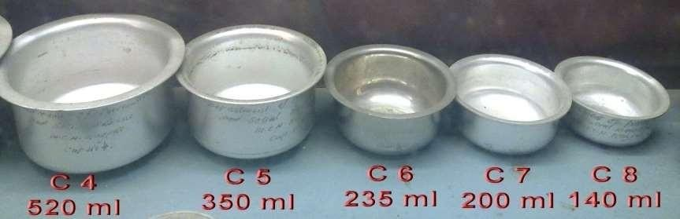
9 September2014
59

Slide 38
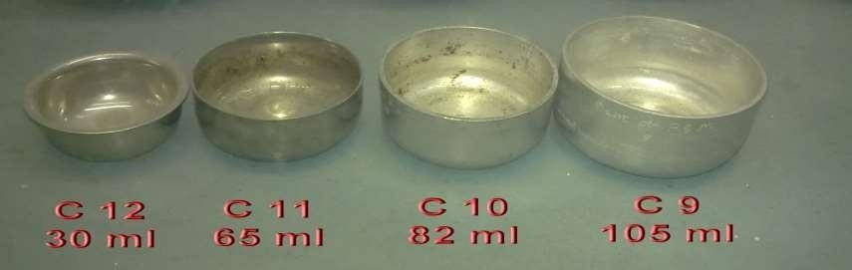
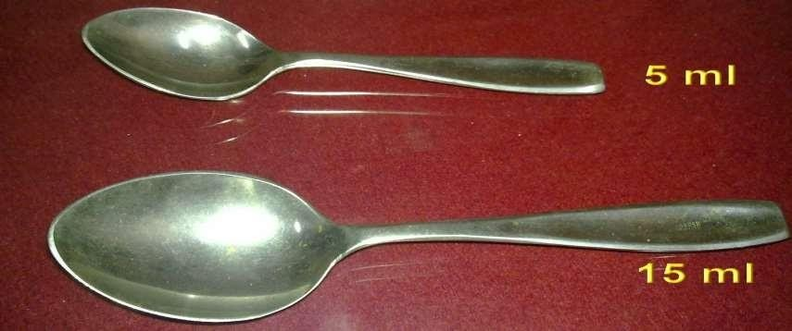
9 September2014
60

Slide 39
Example
Preparation: mixed curry prepared from potato, tomato, onion,etc
Get detail of ingredients with their approximate weight in raw form
Get total cooked amount with help of standardized
cups
Raw food ingredientsused in curry |  | Totalcooked volume | Individual intake
Potato | 250 gm | C4 520 ml | C8 140 ml
Onion | 100 gm
Tomato | 100 gm
Salt | 1 tsp
Chili powder | ½ tsp
Oil | 2 tbsp
9 September2014
61

Slide 40
Thus potatoes consumed by the individual
= 250 x 140 = 67.3 gm
520
Likewise tomato consumed will be
= 100 x 140 = 26.92 gm
520
9 September2014
62

Slide 41

24-hour recall
Advantages:
low respondent burden easy in administration
minimization of biases associated with altering food intake because of knowledge that one is being observed.
Limitations: forgetting
deliberate misreporting
need for atrained observer to administer
costs associated with computerized analysis of records need for several days of intakes to obtain estimate of usual diet
63

Slide 42


DIETARY
SCORE
Method

Slide 43

Assign arbitrary score to the foods(under consideration) on the basis of its nutrient content.
Consumption of the particular food is estimated through frequency method
Frequency of consumption of foods, the total score and percentage are calculated.
Better value if combined with quantitative methods

Slide 44
Food Frquency Questionnarie method

Slide 45
Food frequency questionnaire (FFQ) method is based on the principle as to how frequently an item is consumed over a period of time.
FF is a retrospective review of intake frequency– that is food consumed per day, week, per 15days, per month.
Report usual frequency of consumption of each food item from a list of food items in reference to a specified period (past wk/mo/yr)

Slide 46
organizes foods into groups that have common nutrients .
Face to face interview, telephone or by self administration .
Describes dietary patterns or food habits not nutrient intake .
Semi quantified tools can obtain information on portion size using household measures .

Slide 47
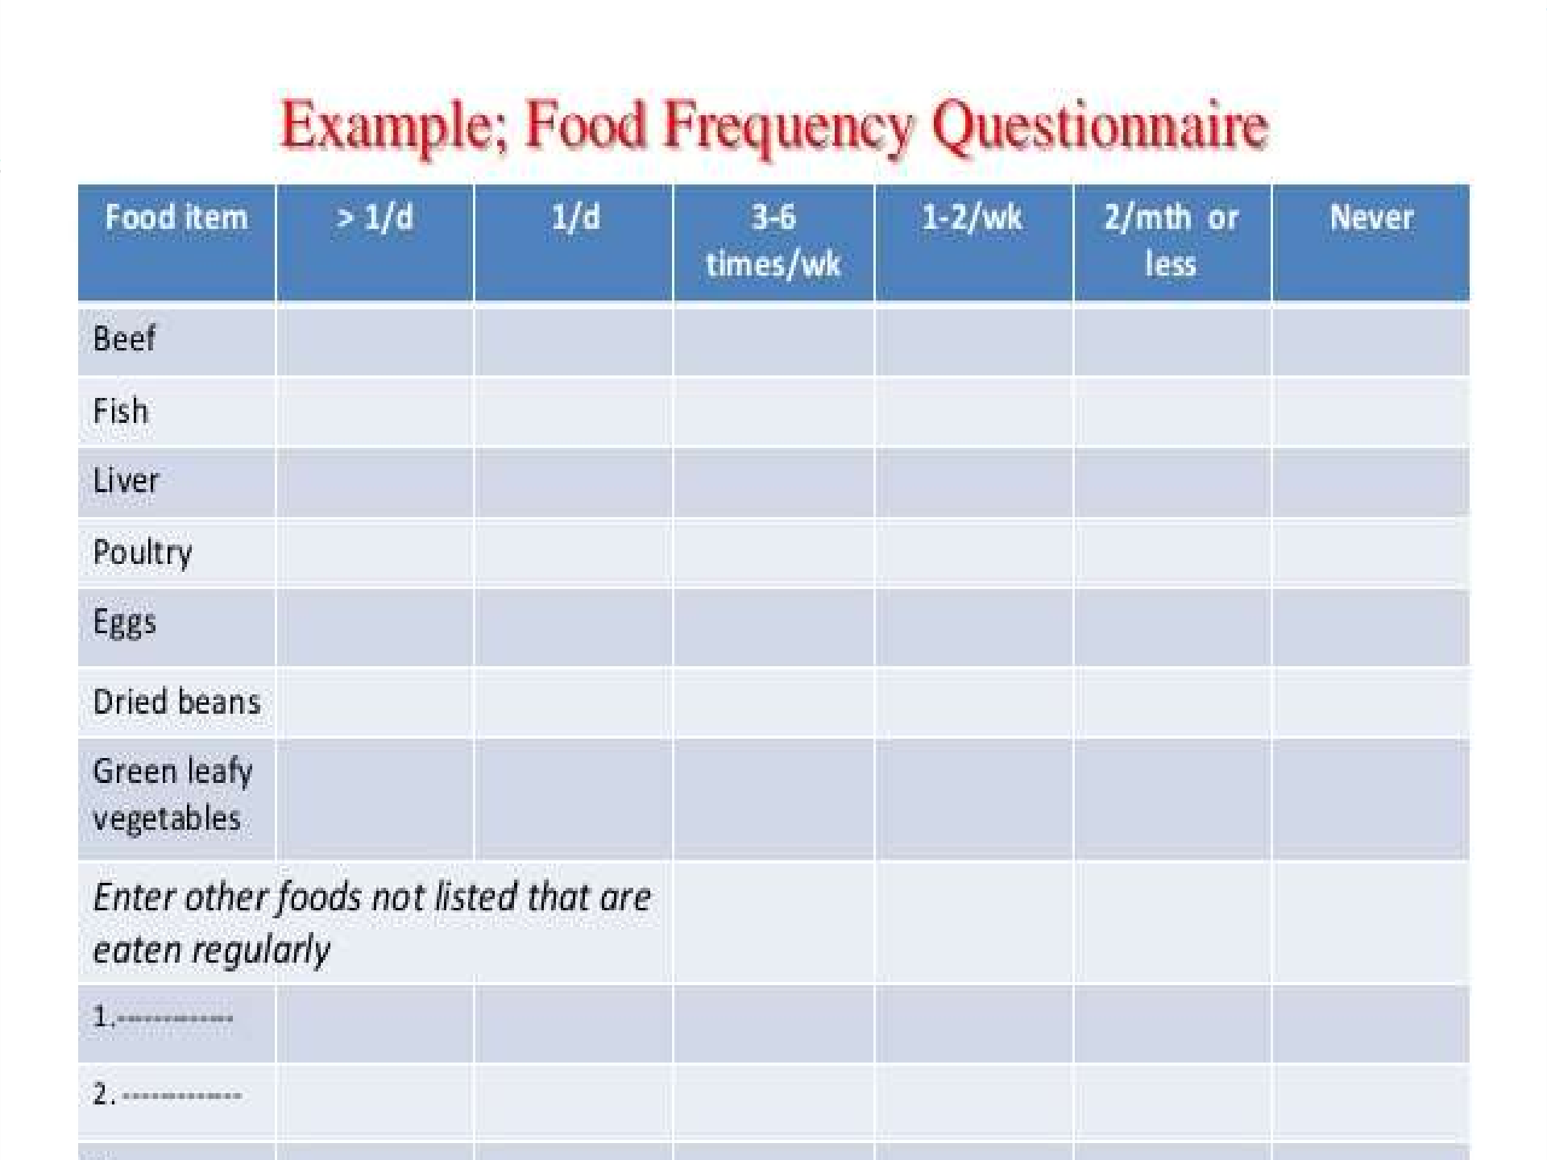

Slide 48
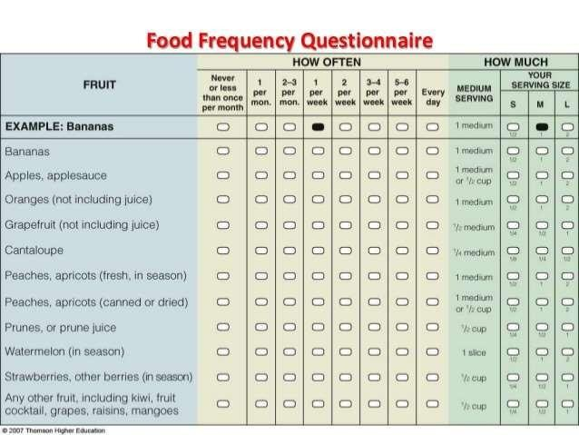

Slide 49
Limitation of Food Frequency Questionnaire
Relies on memory;
requires complex calculations to estimate frequencies;
requires literacy,
does not quantify intake.

Slide 50


DUPLICATE
SAMPLES Method

Slide 51
An observer takes duplicate portions of all foods consumed by the individual and weighs or measures them .
in some cases, these may also be chemically analyzed .

Slide 52
Chemical analysis
What is consumed in the family, the same amount of each food item is kept separately per day as a duplicate sample
These samples can be weighed
Can be sent to lab for analysis of nutrients.

Slide 53

Advantages: Most accurate method
Disadvantages: Costly method
Needs good laboratory support

Slide 54


EXPENDITURE PATTERN METHOD

Slide 55
Determine the money spent on food and non food items by questionnaire and compare the two .
Reference period is fixed (eg previous month/previous week) .
Indirect method .

Slide 56


DIET
HISTORY
Method

Slide 57

Respondent reports all foods and beverages consumed on a usual day to atrainedinterviewer.
The interviewer then probes further on the frequency amount and portion size consumed.
Diet diaries are sometimes used to assist respondents in recalling their intakes.

Slide 58
Assess qualitative intake of food items and their frequency of intake
Similar to diet history taken in personal history of a patient
Used to study :
Meal patterns Dietary habits
Peoples food preferences and avoidances during special physiological conditions .

Slide 59
Dietary History
Advantages:
respondent burden is low
complete intakes are provided Limitations:
time consuming
need for trained interviewers lack of standardization
81

Slide 60


RECORDING METHOD

Slide 61
Record of all items of food eaten by a family/individual is maintained by weighing of quantities eaten .
Advantages: If followed with proper instructions a large sample can be covered in short time
Mailed questionnaire can also be used for it Disadvantage: validity not established

Slide 62
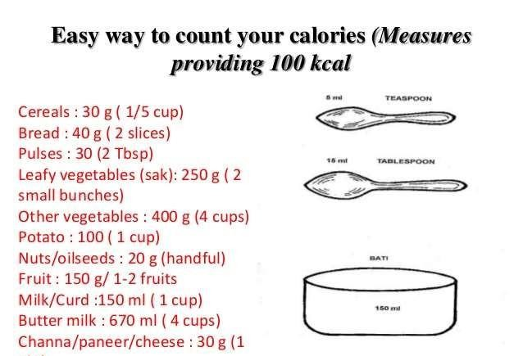

Slide 63
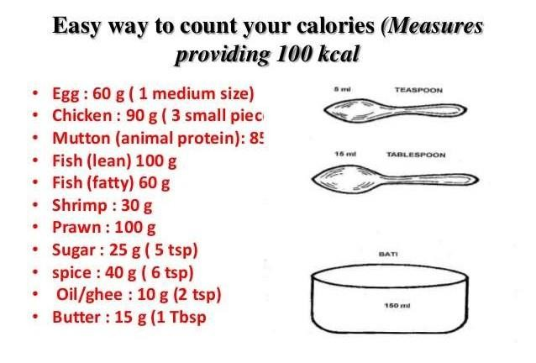

Slide 64
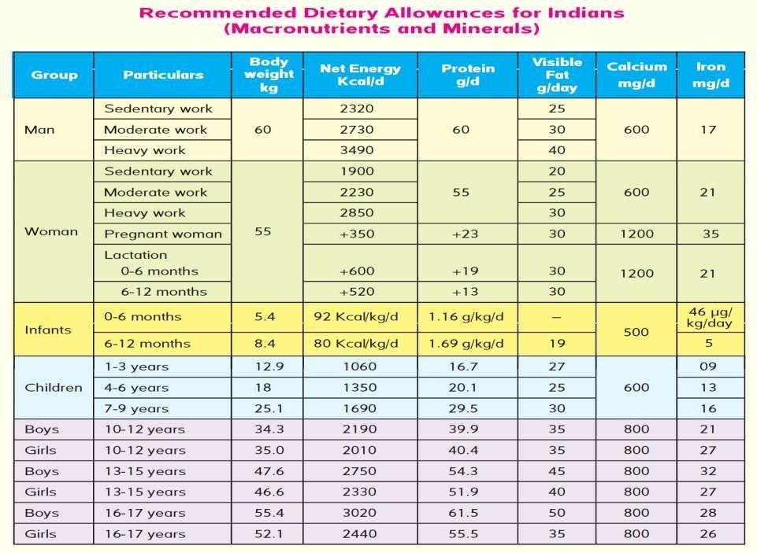

Slide 65
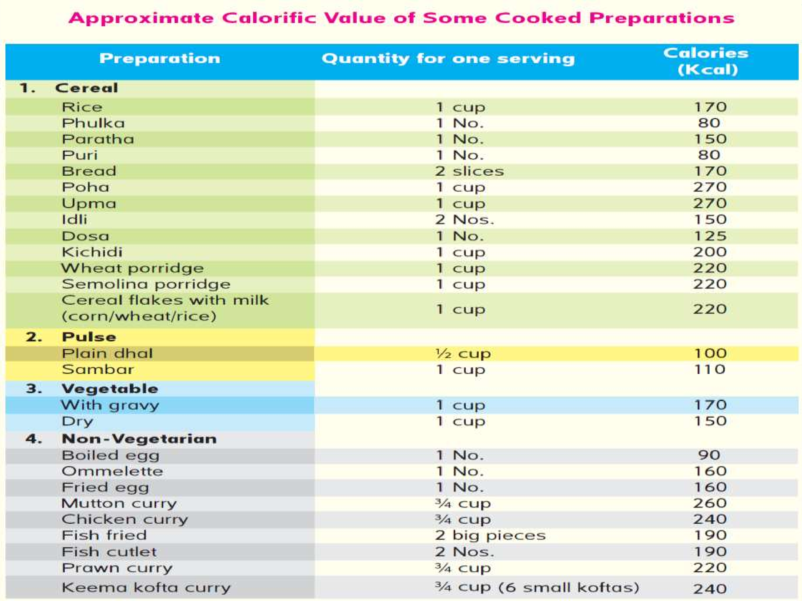

Slide 66
