Slide 1
Diet Survey

Slide 2
Why there is a need to Asses the Diet?
Adequate diet is mandatory for maintenance of a normal physiological state, growth & development of body
Certain physiological condition and stage of life where emphasis on diet important
Certain diseases where emphasis should be put on diet to decrease morbidity, prevent further aggravation of disease or to promote recovery

Slide 3
Diet Survey
Home visit is made by the investigator daily for 7 days, called ‘one dietary cycle', the data is recorded in a especially designed proforma and the average for one day is taken.

Slide 4
Diet Assessment
It involves reviewing the intake of food, and its individual dietary components, and comparing the amount consumed with reference values to see whether deficiency or excess is likely.

Slide 5
Various Diet Survey Methods
1. Weighment of raw food
2. Weighment of cooked food{ Recipe Method}
3. 24-Hour Dietary Recall\ Oral Questionaire method \ Interview method
4. Food Frequency questionnaire method
5. Food list method
6. Food Inventory Method ( logbook method)
7. Analysis of cooked food in laboratory

Slide 6
Weighment of Raw Foods
The investigator will weigh all the food- grains used for the day, just before cooking.
Disadvantage – the housewife may deliberatively put the things out or in for weighing, which are likely { or not likely } to be cooked.

Slide 7
Weighment of Cooked Foods
The left over cooked food also weighed.
Disadvantage- housewife or head of the family may not allow the investigator to touch the cooked food.

Slide 8
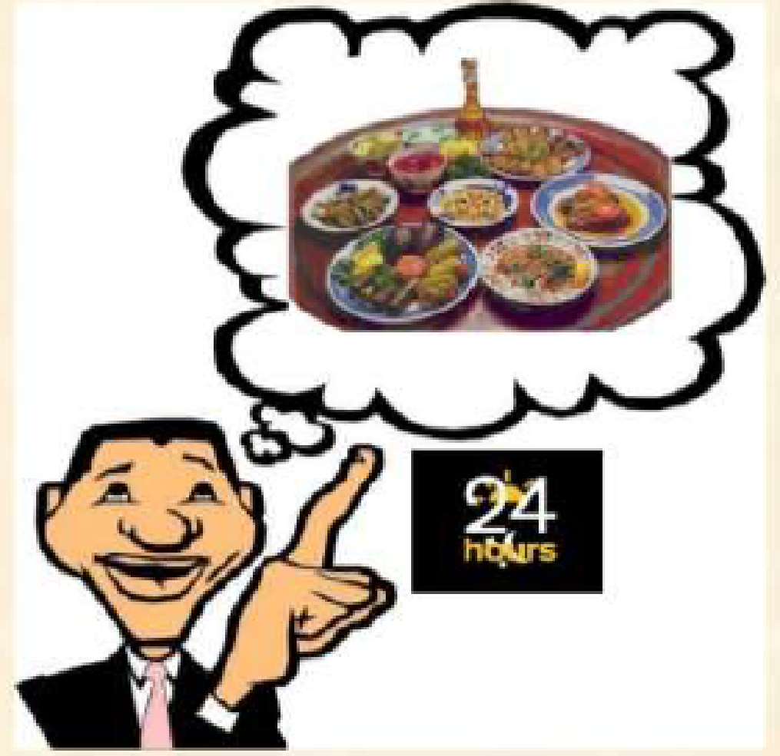
2. 24-Hour Dietary Recall

Slide 9
24-Hour Dietary Recall
-Respondent is asked to remember and report all the foods consumed in the preceding 24 hours or in the preceding day.
-Investigator can use probing for recall and details
Advantages
Intake quantified
Less potential for non response bias
Relatively low respondent burden
Does not affect eating behavior
Disadvantages
High investigator cost
May not represent individuals usual intake
Intake often underreported

Slide 10
Avoid 3 F
  Festival
  Fast
  Feast days

Slide 11
3. Food Frequency Questionnaire
.Investigator contributes proforma to be filled by each member for 1 week
Advantages
Usual individual intake
asked
Information on total diet
obtained
Does not affect eating
behavior
Disadvantages
Not quantifiably precise
Difficult cognitive task for respondent
Intake often misreported

Slide 12
4. Food list method investigator has a list of food items consumed by family
Advantages
Easy method
Disadvantages
Not quantifiably
Difficult cognitive task for respondent
Intake often misreported

Slide 13
Food Inventory\ Log Book Method
Used for the House hold survey where nutrition of whole family assessed as a unit.
Monthly, weekly, daily or yearly purchase of all food related items noted in amount converted into daily basis.
Advantages
Easy to conduct
Less time consuming
Can apply on wide basis
Refusal bias less
Advises to the family easily drawn
Disadvantages
Can not comment on individual’s diet
Not quantifiably precise
Recall bias

Slide 14
6. Analysis of cooked food in laboratory
Advantages
Most accurate method
Disadvantages
Time consuming
Costly method

Slide 15
Points to be noted while doing Diet Survey
Foods used for feeding the children should be recorded separately
Snacks consumed outside the house should be recorded
Absence of family members, during the period of survey should be recorded
Guests partaking in the family meals must be noted
Survey should not be made during occasions like marriage, birthday ceremonies and religious celebrations

Slide 16
Recommended Dietary Allowances (RDA) for energy, protein, fat and minerals for Indians
Group | Category/Age | Net Energy(kcal/day) | Protein (gm/d) | Visible fat (gm/d) | Calcium (mg/d) | Iron (mg/d)
Man | Sedentary work | 2320 | 60 | 25 | 600 | 17
 | Moderate work | 2730 |  | 30
 | Heavy work | 3490 |  | 40
Woman | Sedentary work | 1900 | 55 | 20 | 600 | 21
 | Moderate work | 2230 |  | 25
 | Heavy work | 2850 |  | 30
 | Pregnant | +350 |  | 30 | 1200 | 35
 | Lactation (0-6 m) | +600 |  | 30 |  | 21
 | Lactation (6-12 m) | +520 |  | 30

Slide 17
Balanced diet plan for Indians
(Quantities given in grams)
Food item | Adult man
 | Sedentary | Moderate | Heavy
Cereals | 460 | 520 | 670
Pulses | 40 | 50 | 60
Green leafy vegetables | 40 | 40 | 40
Other vegetables | 60 | 70 | 80
Roots and tubers | 50 | 60 | 80
Milk | 150 | 200 | 250
Oil and fat | 40 | 45 | 65
Sugar | 30 | 35 | 55

Slide 18
Balanced diet plan for Indians
(Quantities given in grams)
Food item | Adult woman
 | Sedentary | Moderate | Heavy | Pregnancy | Lactation
Cereals | 410 | 440 | 575 | +35 | +60
Pulses | 40 | 45 | 50 | +15 | +30
Green leafy vegetables | 100 | 100 | 100
Other vegetables | 40 | 40 | 100
Roots and tubers | 50 | 50 | 60
Milk | 100 | 150 | 200 | +100 | +100
Oil and fat | 20 | 25 | 40 |  | +10
Sugar | 20 | 20 | 40 | +10 | +10

Slide 19
Type of Activity
Heavy | Moderate | Sedentary
Stone cutter | Carpenter | Postman
Blacksmith | Electrician | Teacher
Wood cutter | Waiter | Tailor
Wire cutter | Coolie | Shoemaker
Mine worker | Agriculture | Housewife
 | Wood smith | Retired personnel
 | Housemaid | Peon
 | Industrial labour | Student
 | Agricultural labour
 | Welder
 | Driver
 | Rickshaw puller

Slide 20
Approximate calorific value of common cooked food
Preparation | Quantity | Calories (Kcal)
Cereals
Roti | 1 | 80
Paratha | 1 | 150
Puri | 1 | 100
Bread | 1 | 85
Rice | 1 cup | 170
Poha | 1 cup | 270
Khichdi | 1 cup | 200
Upma | 1 cup | 270
Dosa | 1 | 125
Idli | 1 | 75
Dhokla | 2 | 100

Slide 21
Preparation | Quantity | Calories (Kcal)
Pulses
Plain dhal | ½ cup | 100
Sambhar | 1 cup | 110
Vegetable
Dry | 1 cup | 150
With gravy | 1 cup | 170
Non vegetarian
Boiled egg | 1 | 90
Fried egg | 1 | 160
Omelette | 1 | 160
Mutton curry | ¾ cup | 240
Chicken curry | ¾ cup | 260
Fish fried | 2 no | 220

Slide 22
Preparation | Quantity | Calories (Kcal)
Savory snacks
Pakoda | 8 nos. | 280
Chat (dahi pakodi) | 5 nos. | 220
Cheese balls | 2 nos. | 250
Vada | 2 nos. | 140
Dahi vada | 2 nos. | 180
Masala dosa | 1 no. | 200
Kachori | 2 nos. | 380
Samosa | 1 no. | 200
Sandwich (butter) | 2 nos. | 200
Veg puff | 1 no. | 170
Pizza (cheese) | 1 slice | 200

Slide 23
Preparation | Quantity | Calories (Kcal)
Sweets and desserts
Besan barfi | 2 | 400
Fruit cake | 1 | 270
Chikki | 2 | 290
Srikhand | ½ cup | 200
Halwa | ½ cup | 320
Caramel | ½ cup | 160
Ice cream | ½ cup | 200
Milk chocolate | 25 gm | 140
Chutneys
Coconut/groundnut | 2 tbsp | 120
Tamarind+jaggery | 1 tbsp | 60
Tomato | 1 tbsp | 10

Slide 24
Preparation | Quantity | Calories (Kcal)
Beverages
Tea (2 tsp sugar) | 1 cup | 75
Coffee (2 tsp sugar) | 1 cup | 110
Cow’s milk (2 tsp sugar) | 1 cup | 180
Buffalo’s milk (2 tsp sugar) | 1 cup | 320
Lassi (2 tsp sugar) | 1 glass | 110
Buttermilk | 1 glass | 90
Sherbat | 1 glass | 200
Squash | 1 glass | 75
Fresh lime juice | 1 glass | 60
Cold drink | 200 ml | 150

Slide 25
Preparation | Quantity | Calories (Kcal)
Nuts
Almonds | 10 nos. | 85
Cashew nuts | 10 nos. | 95
Peanuts | 50 nos. | 90
Coconut | ¼ | 140
Fruits
Apple | 1 | 65
Mango | 1 | 180
Guava | 1 | 50
Banana | 1 | 90
Papaya | 1 | 80
Pineapple | 1 | 50
Custard apple | 1 | 130
Grapes | 30 nos. | 70

Slide 26
Major raw foods and their nutritive value
Foodstuff | Protein (g) | Fat (g) | Carbo (g) | Energy (kcal)
Cereals and millets (per 100 g)
Wheat, flour | 12 | 1.7 | 70 | 341
Rice, polish | 7 | 0.5 | 80 | 345
Maize, dry | 11 | 3.5 | 65 | 342
Bajra | 11 | 5 | 65 | 361
Jowar | 10 | 2 | 70 | 350
Pulses and legumes (per 100 g)
Red gram | 22 | 1.5 | 60 | 335
Green gram | 25 | 1 | 60 | 350
Bengal gram | 17 | 5 | 60 | 360
Black gram | 24 | 1.5 | 60 | 350
rajmah | 23 | 1 | 60 | 345
Soya bean | 43 | 20 | 20 | 430

Slide 27
Foodstuff | Protein (g) | Fat (g) | Carbo (g) | Energy (kcal)
Milk and milk products (per 100 ml)
Milk, buffalo | 4.3 | 6.5 | 5 | 120
Milk, cow | 3.2 | 4 | 4.5 | 70
Milk, human | 1.1 | 3.5 | 7.5 | 65
Curd | 3.1 | 4 | 3 | 60
Cheese | 24 | 25 | 6 | 350
Meat, fish and poultry (per 100 gm)
Egg, hen | 13 | 13 | - | 170
Fish, fried | 19 | 1 | - | 90
Mutton | 19 | 13 | - | 200
Pork | 19 | 5 | - | 115
Beef | 22 | 2.5 | - | 115

Slide 28
Foodstuff | Protein (g) | Fat (g) | Carbo (g) | Energy (kcal)
Fats and edible oils (per 100 gm)
Butter | - | 80 | - | 730
Ghee | - | 100 | - | 900
Cooking oils | - | 100 | - | 900
Nuts and oilseeds (per 100 gm)
Almond | 21 | 60 | 10 | 655
Cashew nut | 21 | 45 | 22 | 600
Walnut | 15 | 50 | 5 | 630
Pistachio | 20 | 55 | 16 | 620
Coconut, dry | 7 | 60 | 20 | 660
Groundnut | 25 | 40 | 25 | 570

Slide 29
Example Of Inventory Method
Step -1
Write down all family member with their age , sex, type of activity they done whole day.
Step-2
Calculate consumption
coefficient for family

Slide 30
Recommended Dietary Intake (RDI) per Consumption Unit (CU)
Food Article | Amount per day | K Cal
Cereals | 450 gms | 1575
Pulses | 50 gms | 175
Milk | 200 | 140
Vegetables- Roots GLV Non leafy | 50 gms 50 gms 50 gms | 60
Fats & oils | 40 gms | 360
Sugar & jegary | 30 | 120
Total |  | 2430

Slide 31
Consumption Unit (CU)
Adult | Male | Female
Sedentary work Moderate work Heavy work | 1 | 0.8
 | 1.2 | 0.9
 | 1.6 | 1.2
Adolescent (12-21 yrs) | 1 0.8 0.7 0.6 0.5 0.4
Children (9-12 yrs)
Children (7-9 yrs)
Children (5-7 yrs)
Children (3-5 yrs)
Children (1-3 yrs)

Slide 32
One unit of coefficient corresponds to energy requirements relative to that of a sedentary man and one unit of coefficient corresponds to an energy requirement of 2400kcal/day .
This unit is the ‘’Consumption Unit’’ ( CU)

Slide 33
Sr. no | Age (yrs) | sex | Type of activity | C.U.
1 | 55 | F | Moderate | 0.9
2 | 35 | M | Moderate | 1.2
3 | 32 | F | Moderate | 0.9
4 | 14 | M | Sedentary | 1
5 | 12 | F | Sedentary | 1
6 | 30 | M | Moderate | 1.2
7 | 26 | M | Moderate | 1.2
Total consumption unit of the family |  |  |  | 7.4

Slide 34
Type of Activity
Heavy | Moderate | Sedentary
Stone cutter | Carpenter | Postman
Blacksmith | Electrician | Teacher
Wood cutter | Waiter | Tailor
Wire cutter | Coolie | Shoemaker
Mine worker | Agriculture | Housewife
 | Wood smith | Retired personnel
 | Housemaid | Peon
 | Industrial labour | Student
 | Agricultural labour
 | Welder
 | Driver
 | Rickshaw puller

Slide 35
Requirement of calories for a family is
  2400 * CU Kcal/day

Slide 36
During Pregnancy: additional 350 kcal/day
During 1st six months of lactation: additional 600 kcal/day
During next 6 months of lactation: additional 520 kcal/day

Slide 37
Step-3
Family purchase related to food quantify and calculate each nutrient separately.

Slide 38
Family Dietary assessment
Name of the food articles |  | Total intake per month | Total intake per day | Calories/day | Carbohydrates gm/day | Protein gm/day | Fat gm/day | Iron mg/day
Cereals | Wheat | 40 Kg | 1333 gm | 4612 | 949 | 157.4 | 19.9 | 26.66
 | Rice | 10 Kg | 330 gm | 1138 | 258 | 22.44 | 1.65 | 13.2
 | Bajra | 5 Kg | 167 gm | 602 | 112.7 | 19.37 | 8.35 | 13.36
Pulses | Red gram | 1 Kg | 33 gm | 110 | 24.75 | 7.359 | 0.56 | 0.89
 | Green gram | -
 | Bengal gram | 1 Kg | 33 gm | 118.8 | 24.75 | 5.64 | 1.749 | 1.51
 | Black gram | -

Slide 39
Name of the food articles |  | Total intake per month | Total intake per day | Calories | Carbohydrates (gm) | Protein (gm) | Fat (gm) | Iron(mg)
Vegetables | Green leafy vegetables | 10 Kg | 330 gm | 132 | - | - | - | 3.3
 | Non leafy vegetables | 2 Kg | 67 gm | 66.8 | - | - | - | 0.67
 | Roots/tubers | 5 Kg | 167 gm | 100 | - | - | - | 1.67
Milk | 15 Liters | 500 gm (0.5 liter) | 585 | 25.5 | 21.5 | 32.5 | 1
Oil | 8 Kg | 267 gm | 2403 | - | - | 267 | -
Ghee | - | - | - | - | - | - | -
Sugar | 5 Kg | 167 gm | 668 | 668 | - | - | -
Total |  |  | 10555 | 2062 | 233.7 | 331.7 | 62.26

Slide 40
Step-4
Calculate ideal need of family for particular nutrient from total coefficient unit.
Step-5
-Compare b/w ideal need and actual consumption.
-Calculate any deficient or excess of nutrient.

Slide 41
Results
 | In Ideal Situation | In this Family | Deficit/excess |  | Percentage Deficient
 |  |  | In Kcal | In gms
Energy (Kcal/day) | (7.4*2400) =17760 | 10555 | -7205 | - | -40.56
Protein (Kcal/day) | (10% Of 17760) =1776 | 934.8 | -841.2 | -210.2 | -47.3
Visible Fats (Kcal/day) | (10%of 17760) =1776 | 2985.3 | +1209 | +134gm (excess) | +68
Carbohydrates (Kcal/day) | (80%of 17760) =12432 | 8248 | -4184 | -1046 | -33.65

Slide 42
Step-6
Identify problems and suggest changes appropriate as per their ethnic group, economic status and acceptability.

Slide 43
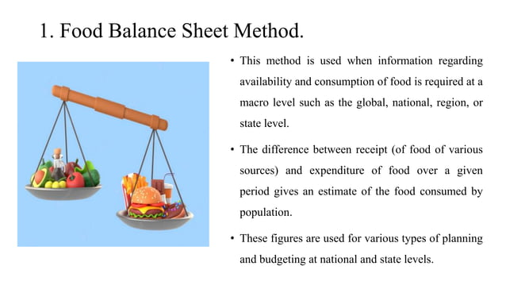

Slide 44
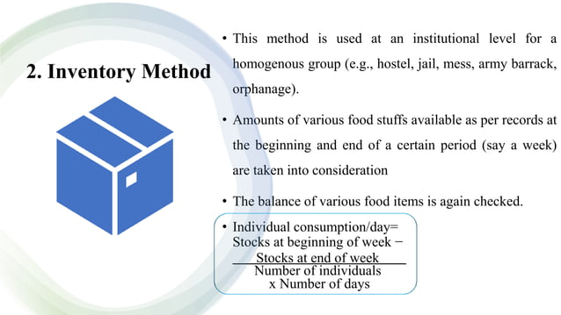

Slide 45
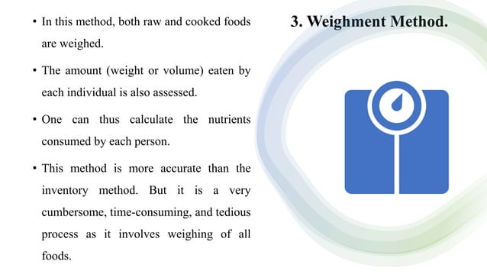

Slide 46
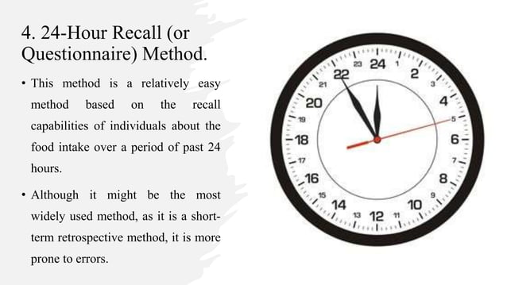

Slide 47
