Slide 1
DIABETES
MELLITUS

Slide 2
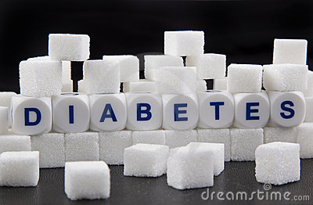

Slide 3
Greek- Diabetes-siphon, Mellitus-honey (sweet)
“State of chronic hyperglycemia, resulting from diversities of etiologies, environmental and genetic acting jointly.”
Underline cause is defective production or action of insulin, a hormone that controls glucose, fat and amino acid metabolism.
Metabolic syndrome-polyuria, polyphagia, polydypsia, hyperglycemia and glycosuria due to absolute or relative deficiency of insulin.
Chronic hyperglycemia leads to number of complications-cardiovascular, renal, neurological ocular and others such as intermittent infections.

Slide 4
CLASSIFICATION by WHO
1- DIABETES MELLITUS
a) Type I or insulin dependent diabetes mellitus (IDM)
b) Type II or Non-insulin dependent diabetes mellitus (NIDM) c) Malnutrition related diabetes mellitus (MRDM)
d) Others types-(secondary to pancreatic, hormonal, drug-induced, genetic or other abnormalities.)
2- Impaired Glucose Tolerance (IGT)
3-Gestational Diabetes Mellitus (GDM)

Slide 5
DIFFERENCE BETWEEN TYPE I AND TYPE II D.M.
TYPE I | TYPE II
IDDM | NIDDM
Juvenile type of DM | Maturity onset type DM
Common below 30 yrs of age | Among people above 30 yrs age
Sudden in onset | Gradual in onset
Thin built, obesity not risk factor | Usually obese, obesity risk factor
HLA linked genetic predisposition | Not HLA linked
Associated with other autoimmune diseases | Not associated with other autoimmune diseases
Acute metabolic decomposition-sudden death | Chronic metabolic decompensation leads to complication
Complication sudden and are fatal | Slowly resulting in irreversible disability and death
Not associated with obesity and under activity | Associated with obesity and under activity
Common among men | Common among women
No family history | Usually present

Slide 6
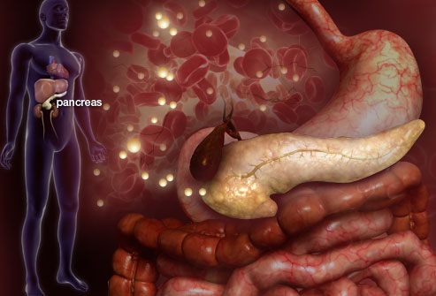

Slide 7
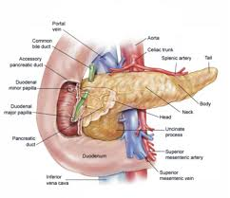

Slide 8
TYPE 1 DIABETES
Body does not make insulin
Usually develops in children or young adults
Normal Weight
Must take insulin daily to live

Slide 9
TYPE I DIABETES MELLITUS (IDDM)-
Most severe form of disease.
Onset abrupt.
Usually seen in individual less than 30 years of age.
Lethal unless promptly diagnosed and treated.
Immune-mediated over 90% and idiopathic in 10 %.
Proportion of IDDM is less than 15% mostly in children below 30 years.

Slide 10
SYMPTOMS OF TYPE 1 DIABETES MELLITUS
Feeling more thirsty than usual
Dry mouth
Fruity breath
Frequent urination
Unintentional weight loss
Increase in appetite
Lack of energy, drowsiness

Slide 11
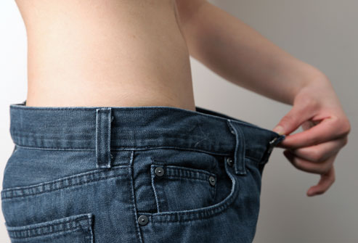

Slide 12
Skin Problems
Many people with type 1 diabetes experience uncomfortable skin conditions, including:
Bacterial infections
Fungal infections
Itching, dry skin, poor circulation

Slide 13
When blood sugars are not controlled, type 1 diabetes can cause more serious symptoms, such as:
Numbness or tingling in the feet
Blurred vision
Low blood sugar/hypoglycaemia
Loss of consciousness

Slide 14


Slide 15
More Dangerous Signs: Ketoacidosis
Without treatment, type 1 diabetes deprives cells of the sugar they need for energy.
Body starts burning fat for energy instead, which causes ketones to build up in the blood.
These are acids that can poison the body. High levels of acid in blood and the other abnormalities that result from the change in blood's pH level may trigger a life-threatening coma known as diabetic ketoacidosis.
This is an emergency that must be treated quickly and often times in the hospital.

Slide 16
Type 1 vs. Type 2 Diabetes
In type 1 diabetes, the body's immune system mistakenly attacks and destroys the pancreatic cells that produce insulin.
In type 2 diabetes, the pancreas is not under attack and usually produces enough insulin. But for numerous reasons, the body doesn’t use the insulin effectively.
The symptoms of the two forms are similar, but usually come on more rapidly in people with type 1.

Slide 17
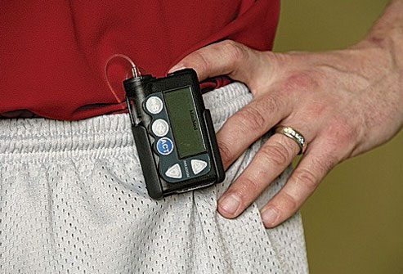

Slide 18
Rate of destruction of pancreatic ᵦ cell is quite variable.
Usually associated with ketosis in untreated state.
Mostly in children, highest among 10-15 years age group but occasionally in adults.
Catabolic disorder in which insulin is virtually absent, plasma glucagon is elevated and pancreatic ᵦ cells fail to respond to all insulinogenic stimuli.

Slide 19
Exogenous insulin is required to reverse the catabolic state, prevent ketosis, reduce hyperglycemia and reduce blood glucose.

Slide 20
TYPE 2 DIABETES
Cells do not use insulin properly
Not enough insulin being produced
Generally develops in adulthood
  Becoming more common in children due to obesity
Common in persons who are overweight
Many different ways to treat, including diet and exercise, pills, or insulin

Slide 21
TYPE II DIABETES (NIDM)-
More common.
Discovered by change.
Gradual in onset.
Mainly in middle aged and elderly.
Mild, slow to ketosis and compatible to long survival if treated adequately.
Clinical picture is complicated by present of other disease process.

Slide 22
IMPAIRED GLUCOSE TELERANCE (IGT)-
Intermediate “AT RISK GROUP”-between diabetes mellitus and normality.
Can only defined by oral glucose tolerance test.

Slide 23
The WHO recommendations for the diagnostic criteria for diabetes and intermediate hyperglycemia
Diabetes Fasting plasma glucose Or 2-h plasma glucose | ≥ 7.0 mmol/l (126 mg/dl) > 11.1 mmol/l (200mg/dl)
Impaired Glucose Tolerance (IGT) Fasting plasma glucose And 2-h plasma glucose | < 7.0 mmol/l (126 mg/dl) ≥ 7.8 mmol and <11,1 mmol/l (140mg/dl to 200 mg/dl)
Impaired Fasting Glucose (IFG) Fasting plasma glucose And ( if measured) 2-h plasma glucose | 6.1 to 6.9 mmol/l (110mg/dl to 125mg/dl) <7.8 mmol/l (140 mg/dl)

Slide 24
INSULIN RESISTANCE SYNDROME (SYNDROME X)
In obese patient with type 2 diabetes, the association with hyperglycemia, hyoerinsulinaemia, dyslipidaemia and hypertension, which leads to coronary artery disease and stroke may result from genetic defect producing insulin resistance, with later been exaggerated by obesity.

Slide 25
Insulin resistance predisposes to hyperglycemia, which results in hyoerinsulinaemia (which may or may not of sufficient magnitude to correct hyperglycemia) and this excessive insulin level contributes to high levels of triglycerides and increased sodium retention by renal tubules, inducing hypertension.
High level of insulin stimulate endothelial proliferation to initiate atheloscelosis.

Slide 26
PROBLEM STATEMENT
WORLD-
Diabetes is an “iceberg” disease.
Increase in both prevalence and incidence of type 2 diabetes occurred globally.
Dramatic in societies in economic transition, in newly industrialized and developing countries.
347 million cases, more than 90% are type 2 diabetes.

Slide 27
PROBLEM STATEMENT cont…..
In 2008 1.2 million people died from consequences of high blood sugar.
More than 80 % death occur in low and middle income countries.
Apparent prevalence depends upon diagnostic criteria used in epidemiological surveys.
Global prevalence of diabetes in 2008 10% in adults aged 25+

Slide 28
PREVALENCE OF DIABETES IN ADULT POPULATION (AGED ≥20 YEARS) BY YEAR AND REGION
Region | 1995 (%) | 2000 (%) | 2005 (%)
World | 4.0 | 4.2 | 5.4
Developed countries | 5.9 | 6.2 | 7.6
Developing countries | 3.3 | 3.5 | 4.9
India | 3.8 | 4.0 | 6.0

Slide 29
List of diabetes with highest number of estimated cases of diabetes for 2000 and 2030
2000 |  | 2030
Country | People with diabetes (million) | Country | People with diabetes (million)
India | 31.7 | India | 79.4
China | 20.8 | China | 42.3
US | 17.7 | US | 30.3
Indonesia | 8.4 | Indonesia | 21.3
Japan | 6.8 | Pakistan | 13.9
Pakistan | 5.2 | Brazil | 11.3
Russian federation | 4.6 | Bangladesh | 11.1
Brazil | 4.6 | Japan | 8.9
Italy | 4.3 | Philippines | 7.8
Bangladesh | 3.2 | Egypt | 6.7

Slide 30
PROBLEM STATEMENT cont…..
Highest prevalence in Eastern Mediterranean Region and Region of Americas (11% of both sexes) and lowest in WHO European and Western Pacific Region (9% of both sexes).
Magnitude of diabetes and other abnormalities of glucose tolerance are higher if impaired fasting and impaired glucose tolerance are included.
Low income countries-lowest prevalence (8% of both sexes) and upper-middle income group countries highest (10% of both sexes).

Slide 31
PROBLEM STATEMENT cont…..
Unfavorable lifestyles and dietary habits are associated with urbanization are most important factors for development of diabetes.
Twice in urban area than rural area.
Ethnic, presumably genetic vulnerability of Asians subjected to unfavorable lifestyles.
Bangladesh, India and Indonesia have shown increase in prevalence rate of disease in both rural and urban

Slide 32
PROBLEM STATEMENT cont…..
If undiagnosed or inadequately treated, develop multiple chronic complications leading to irreversible disability and death.
Coronary heart disease and stroke more common in diabetics.
Micro vascular complications-diabetic renal disease and diabetic retinopathy and neuropathy resulting in deterioration of quality of life and premature death.
Five most important determinants of cardiovascular disease.

Slide 33
PROBLEM STATEMENT cont…..
Lower limb amputation 10 times more common.
Metabolic disorders in pregnant women as well as those caused by gestational diabetes-a high health risk.
Unfortunately inadequate awareness about real dimension of problem among general population.
Lack of awareness about existing interventions for preventing disease and management of complications.

Slide 34
PROBLEM STATEMENT cont…..
Inadequacies in primary health care systems, not posed to design in to cope with additional challenges by non-communicable diseases results in poor detection of cases, suboptimal treatment and insufficient follow up leading to unnecessary disabilities and severe complications and early death.

Slide 35
PROBLEM STATEMENT cont…..
Age-adjusted mortality rate are 1.5-2.5 higher among diabetes as compared to general population.
Caucasian population mortality attributable to CVD.
Indian and American Indian renal diseases.
In some developing societies infection are important cause of death.

Slide 36
PROBLEM STATEMENT cont…..
NIDM-silent, chronic, often unidentified killer mostly among adult population.
Develop symptoms of ketoacidosis and often die since majority do not access to adequate medical treatment, since insulin is not available or too expensive.
Prevalence of type I diabetes in Asia is low, accounting 9.7% of all D.M. cases.

Slide 37
PROBLEM STATEMENT cont…..
INDIA-
An increased susceptibility to D.M.
In 2004-
37.7 million cases.
21.4 million in urban area and 16.3 million in rural area.
Mortality-1.09lac, 62.5 thousand in urban and 46.6 thousand in rural
2.2million DALY lost.

Slide 38
NATURAL HISTORY
EPIDEMIOLOGICAL DETERMINANTS-
1-AGENT-
Insulin deficiency-absolute in type I and partial in type 2 diabetes.

Slide 39
NATURAL HISTORY cont…
May be due to-
a) Pancreatic disorders-inflammatory, neoplastic and other disorders such as cystic fibrosis.
b) Defects in formation of insulin-synthesis of abnormal biologically less active insulin.
c) Destruction of beta cells-viral infection and chemical agents.
d) Decreased insulin sensibility-due to decreased number of adipocyte and monocyte insulin receptors.

Slide 40
NATURAL HISTORY cont…
e) Genetic defects-mutation of insulin gene.
f) Autoimmunity-insulin response to glucose is genetically controlled.
Overall effects-
Reduced utilization of glucose
hyperglycemia accompanied by glysuria

Slide 41
NATURAL HISTORY cont…
2-HOST FACTORS-
a) AGE-
Diabetes may occur at any age.
Prevalence rises steeply with age.
In middle years of life and thereafter begin to rise in frequency.
Malnutrition related diabetes affects large number of young people.
Prognosis poor in younger who tends to develop complications earlier.

Slide 42
NATURAL HISTORY cont…
b) SEX-
Some countries Male-female ratio equal-U.K.
In South East Asia male are more effected than female.
c) GENETIC FACTORS-
Genetic nature of diabetes.
d)GENTIC MARKER-
type I diabetes associated withHLA-B8and B15and more powerfully with HLA-DR3 and DR4.
Type2 diabetes not HLA-associated.

Slide 43
NATURAL HISTORY cont…
e) IMMUNE MECHANISM-
Both cell-mediated and humoral-activity against islet cells.
Defective immunological mechanism, under influence of some environmental “trigger”, attack their own insulin producing cells.
f) OBESITY-
Central adiposity risk factor of type 2 diabetes and risk to both duration and degree of obesity.

Slide 44
NATURAL HISTORY cont…
Waist circumference or waist to hip ratio more powerful determinant of type 2 diabetes than BMI.
Central obesity also determinant of insulin resistance.
Obesity reduces numbers of insulin receptors on target cells.
Voluntary weight loss improve insulin sensitivity and reduce risk of progression IGT to type 2 diabetes.

Slide 45
NATURAL HISTORY cont…
Some obese are not diabetic so obesity is not absolute cause of diabetes.
Physical inactivity and /or deficiencies of specific nutrients may also involved.
Obesity-no role in type I diabetes.
g) MATERNAL DIABETES-
Offsprings of diabetic pregnancies including gestational diabetes are large and heavy at birth, tend to develop obesity at childhood and at high risk of developing type 2 diabetes at early age.

Slide 46
NATURAL HISTORY cont…
3-fold higher risk in those children born after development of diabetes in mothers.
Maternal diabetes associated with IUGR and LBW when associated with rapid growth catch up later increase risk of developing diabetes.

Slide 47
NATURAL HISTORY cont…
ENVIRONMENTAL FACTORS-
a) SEDENTARY LIFE STYLE-
Lack of exercise may alter interaction between insulin and its receptors.
b) DIET-
High saturated fat intake.
Higher proportions of saturated fatty acids in serum lipids or muscle phospholipids- higher fasting insulin, lower insulin sensibility and higher risk of type 2 diabetes.

Slide 48
NATURAL HISTORY cont…
Higher unsaturated fatty acids from vegetable sources and polyunsaturated fatty acids reduce risk of type2 D.M. and lower fasting 2-hours glucose concentrations.
Higher proportion of long chain polyunsaturated fatty acid in skeleton muscle phospholipid increase insulin sensivity.
Replacement of saturated by unsaturated fatty acids leads to glucose tolerance and insulin sensivity.

Slide 49
NATURAL HISTORY cont…
Long-chain polyunsaturated fatty acid do not confer additional benefit over monounsaturated fatty acids.
When total fat intake (>37% of total energy intake) quality of dietary fat appear to have little effect.
c) DIETARY FIBRE-
High intake of dietary fibre reduce blood glucose and insulin level and IGT.
Minimum intake of 20 gram fibre is needed

Slide 50
NATURAL HISTORY cont…
d) MALNUTRITION-
Malnutrition in early infancy and childhood may result in partial failure of ᵦ cells function
e) ALCOHOL-
Can increase risk of diabetes by damaging pancreas and liver and increase in obesity.
f) VIRAL INFECTION-
Rubella, mums and human coxsackie virus B4.
Viral infection may trigger in immunogenetically susceptible people a sequence of events resulting in destruction of ᵦ cells

Slide 51
NATURAL HISTORY cont…
g) CHEMICAL AGENTS-
Toxic to beta cells-alloxan, streoptozotocin, the rodenticide VALCOR.
High intake of cyanide producing foods-cassava and certain beans.
h) STRESS-
Surgery, trauma and stress of situation-internal and external may bring out disease.

Slide 52
NATURAL HISTORY cont…
OTHERS FACTORS-
Social factors-occupation, marital status , religion, economic status , education, urbanization and changes in life styles-elements of social class.
Common in lower class, while 50 years ago it was reverse.

Slide 53
SUMMARY OF STRENGTH OF EVIDENCE OF LIFE-STYLE FACTORS AND RISK OF DEVELOPING TYPE 2 DIABETES
Evidence | Decreased risk | Increased risk
Convincing | Voluntary weight loss in overweight and obese people Physical activity | Overweight and obesity Abdominal obesity Physical inactivity Maternal diabetes
Probable | Non-starch polysaccharides | Saturated fats Intrauterine Growth retardation
Possible | n-3fatty acids Low glycaemic index foods Exclusive breast feeding | Total fat intake Trans-fatty acids
Insufficient | Vitamin E Chromium Magnesium Moderate alcohol | Excess alcohol

Slide 54
SCREENING FOR DIABETES
1-URINE EXAMINATION-
Urine test for glucose, 2 hours after a meal.
All those with glycosuria-diabetic unless Proved by standard oral glucose tolerance test.
Glucose in urine find in most severe cases of diabetes, often absent in milder cases and such cases missed by urine examination.-lack of sensitivity varies between 10-50%. Yields too many false-negatives. False positive as glycosuria in normal people. Specificity is over 90%

Slide 55
SCREENING FOR DIABETES cont…
2-BLOOD SUGAR TESTING-
“standard oral glucose test”.
Mass screening for glucose measurements of fasting, postprandial or random blood sample.
Measurement of random blood sample unsatisfactory for epidemiological use, it can give a crude estimate of frequency of diabetes in population.
Fasting level alone less reliable.

Slide 56
SCREENING FOR DIABETES cont…
For epidemiological purposes 2-hour value after 75 g oral glucose either alone or with fasting value.
Automated biochemistry –thousands of samples for glucose estimation

Slide 57
SCREENING FOR DIABETES cont…
Condition | 2 hour glucose | Fasting glucose | HbA_{1c}
 | mmol/l(mg/dl) | mmol/l(mg/dl) | %
Normal | <7.8 (<140) | <6.1 (<110) | <6.0
Impaired fasting glycaemia | <7.8 (<140) | ≥ 6.1(≥110) & <7.0(<126) | 6.0–6.4
Impaired glucose tolerance | ≥7.8 (≥140) | <7.0 (<126) | 6.0–6.4
Diabetes mellitus | ≥11.1 (≥200) | ≥7.0 (≥126) | ≥6.5

Slide 58
SCREENING FOR DIABETES cont…
TARGET POPULATION-
Screening of “high risk” groups-
1-those in age group of 40 years and over.
2- a family history of diabetes.
3-obese.
4-Women with baby 4.5 kg.
5-Women who weight gain during pregnancy
5-Patients with premature atherosclerolosis.

Slide 59
PREVENTION
1-PRIMARY PREVENTION-
Two strategies-
1-Population strategies
2-High-risk strategies
1-POPULATION STRATEGIES-
Development of prevention programme for type 2 diabetes based on elimination of environmental risk factors
Pressing need for primordial prevention-prevention of emergence of risk factors.

Slide 60
Maintenance of normal body weight through adoption of healthy nutritional habits and physical exercise, adequate protein intake, high intake of dietary fiber and avoidance of sweet foods and food toxins.
2-HIGH RISK STRATEGEIES-
No special high risk strategies for type I diabetes.
No practical justification of genetic counseling.
NIDDM linked with sedentary lifestyles, over nutrition and obesity, alcohol avoid diabetogenic drugs

Slide 61
2-SECONDARY PREVENTION-
When detected treated.
Aim of treatment-
To maintain blood sugar levels as close within normal limits as practicable
To maintain ideal body weight.
Treatment based on
1-diet alone
2-diet and oral ant diabetic drugs
3-diet and insulin

Slide 62
The main goal of diabetes management is to restore carbohydrate metabolism to as close to a normal state as possible.
To achieve this goal, individuals with an absolute deficiency of insulin require insulin replacement therapy, which is given through injections or an insulin pump.
Insulin resistance, in contrast, can be corrected by dietary modifications and exercise.

Slide 63
The treatment goals for type 2 diabetic patients are related to effective control of blood glucose, blood pressure and lipids, to minimize the risk of long-term consequences associated with diabetes

Slide 64
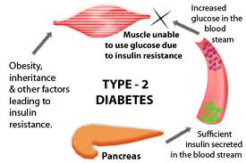

Slide 65
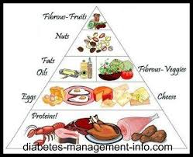

Slide 66
ICMR Guidelines for Management of type-2 Diabetes-2005
1-DIET-
The aim to achieve and maintain ideal body weight, euglycemia and desirable lipid profile, prevent and postpone complications related to diabetes and to provide optimal nutrition during pregnancy, lactation, growth, old age and associated condition.

Slide 67
ICMR Guidelines for Management of type-2 Diabetes-2005 Cont……
DIETARY RECOMMENDATIONS-
1 -TOTAL CALORIE INTAKE-
Depends upon physical and activity nutritional status as in normal individual, unless there is glycosuria.
with >120% of ideal weight is overweight and <90% is underweight.
Ideal Body Weight (IBW)= height incm.-100 X0.9
Calorie intake should be altered gradually, not more than 500 Kcal/day.

Slide 68
ICMR Guidelines for Management of type-2 Diabetes-2005 Cont……
2-TOTAL CALORIE DISTRIBUTION-
a) Carbohydrate (55-60% of total calorie requirement)
Avoid sugar, honey, jaggery and sweets.
Restrict processed refined food like maida based products.
Main source should be cereals, mixed coarse grains, whole pulses, salads and soybeans.
roots and tubers should be used sparingly.

Slide 69
ICMR Guidelines for Management of type-2 Diabetes-2005 Cont……
b) Protein (10-15% of total calorie requirement)
Protein from vegetable sources, low fat milk and milk products, fish and lean meat is preferable.

Slide 70
ICMR Guidelines for Management of type-2 Diabetes-2005 Cont……
c) FAT (20-25 %of total calorie requirement)
Saturated fat- <7% of total calorie intake (including ghee and butter).
Rest should be in form of MUFA and PUFA.
N6/N3 ratio 5-10
Trans-fatty acid (hydrogenated vegetable oils) should be avoided.

Slide 71
ICMR Guidelines for Management of type-2 Diabetes-2005 Cont……
Dietary cholesterol should be minimum and should not exceed 300 mg/day.
Use more than one edible oil.
Oils containing linoleic acid (n-6) only such as ground nut, sesame, cotton seed, rice bran and safflower should be used along with oils containing ά-linoleic acid (n-3) such as soybean, mustard, canola etc.

Slide 72
ICMR Guidelines for Management of type-2 Diabetes-2005 Cont……
d) FIBER-
Traditional Indian diet is rich in fibers.
Fiber rich foods whole grain(ragi, jowhar, barley. Oats etc.), whole pulses, soybean, green leafy vegetables and fenu-greek seeds.
e) FRUITS-
Whole fruits are recommended in moderation (1-2 servings) however very sweet fruits and fruit juices should be avoided.

Slide 73
ICMR Guidelines for Management of type-2 Diabetes-2005 Cont……
f) COMMON SALT-
Up to 6 gm/day is permitted
Restrict pickles, chatni and salty processed foods.
g) ALCOHOL-
Best avoided and if used must be in moderation.
It may exacerbate neuropathy, dyslipidaemia, obesity and may worsen control of diabetes.

Slide 74
ICMR Guidelines for Management of type-2 Diabetes-2005 Cont……
h) ARTIFICIAL SWEETENERS-
In limited quantity.
Avoided during pregnancy and lactation.
i) TOBACCO-
Smoking and use of tobacco in any form should be prohibited.

Slide 75
ICMR Guidelines for Management of type-2 Diabetes-2005 Cont……
DIETARY MODIFICATION IN SPECIAL SITUATION-
i) NEPHROPATHY-
Dietary protein restricted-0.6g/kg and salt to 4g/day.
ii) HYPERTENSION-
Salt restricted to minimum.

Slide 76
ICMR Guidelines for Management of type-2 Diabetes-2005 Cont……
iii) DYSLIPIDEMIA-
Total fat curtailed and diet by increasing MUFA and dietary fiber and reducing saturated fatty acids.
iv) INFECTION AND ACUTE ILLNESS-
Fasting should be avoided and adequate caloric intake must be ensured.

Slide 77
ICMR Guidelines for Management of type-2 Diabetes-2005 Cont……
PHYSICAL ACTIVITY-
Regular physical activity in management of type2 diabetes.
Careful assessment while incorporating an exercise programme.
Exercise programme should be individualized according to individual capacity and disabilities.
Wear appropriate footwear.
Stepwise increase of aerobic exercises.

Slide 78
ICMR Guidelines for Management of type-2 Diabetes-2005 Cont……
Several benefits from regular exercise schedule-improvement in insulin sensitivity, reduction of hypertension, reduction in weight, improvement in lipid profile, improvement in cardiovascular function, increase ion bone density, improvement in sense of physical and mental well being and improvement in quality of life

Slide 79
Exercise must be done regularly.
Brisk walk for 30-60 minutes or its equivalent physical activity.
Exercise schedule should be one that individual enjoys and which suits his/her needs.

Slide 80
Yoga is traditional Indian system-gaining international acceptance for stress coping skills.
Yoga help therapeutically and promotes physical and mental health.
Asanas (involving postures), Pranayama (involving breath), Dhyana (involving meditation) and Bhavana (involving visualization, which is also part of Bhavana)

Slide 81
Yoga should be learnt under expert guidance.
Person with diabetes should carry quick acting carbohydrates and a diabetes identification card.

Slide 82
Diabetic diet (1500 calories)
Food stuffs | Veg ( gms ) | Non –veg (gms)
Cereals | 225 | 250
Pulses | 60 | 20
Green-leafy vegetables | 200 | 200
Other vegetables | 200 | 200
Fruits | 100 | 100
Milk | 300 | 150
Oil | 15 | 20
Flesh foods | --- | 70

Slide 83
Bed tea | Coffee /Tea 1 cup
Breakfast | Tea 1 cup, 2 toast with little butter
Lunch | Fulka 2, rice medium bowl 1,Dal ¾ th medium bowl ,leafy vegetables 1 bowl, oil for cooking 1½ T.S.F.
Afternoon | Light tea without sugar
Evening | Fruit one
Dinner | Fulka 2 small, Rice 1 medium bowl or 2 more fulka, Dal ¾ medium bowl, Salad, other vegetable -1 medium bowl
Bed time | Toned milk without sugar
Approximate calories 1,500

Slide 84
Diabetic diet
This diabetic diet provides | Gms. | % calories
Protein | 60 | 15.5%
Fats | 37 | 21.5%
Carbohydrates | 244 | 63.0%

Slide 85
TARGET FOR CONTROL OF DIABETES
General guidelines and individualized targets are to be established.
Tight control in pregnancy, post-renal transplant and retinopathy is desired.
In elderly relaxed control is recommended.

Slide 86
TARGETS FOR CONTROL OF DIABETES
 | Ideal | Satisfactory | Unsatisfactory
FPG (mg/dl) | 80-110 | 111-125 | >125
2hr PPG (mg/dl) | 120-140 | 140-180 | >180
BP (mm of Hg) | <130/180 | <140/90 | >140/90
Body Mass Index (Kg/m²) | 20-23
Waist Hip Ratio | Men <0.90 Women <0.85
Hb A 1c (%) | <7 | 7-8 | >8

Slide 87
TARGETS FOR CONTROL OF LIPIDS
Total Cholesterol (mg/dl) | <180
HDL Cholesterol (mg/dl) | >45
LDL Cholesterol (mg/dl) | <100
Serum Triglycerides (mg/dl) | <150
ICMR Guidelines for Management of Type-2 Diabetes -2005

Slide 88
INDIVIDUAL INTERVENTION IN DIABETES WITH EVIDENCE OF EFFICAC Y
INTERVENTION WITH EVIDENCE OF EFFICACY | BENEFIT
Life style intervention for preventing type 2 diabetes in people of high risk | Reduction of 35-58% in incidence
Metformin for preventing type 2 diabetes for people at high risk | Reduction of 25-31 % in incidence
Glycaemic control for people with HbA1c >9 | Reduction of 30% in microvascular/1% drop in HbA1c
Blood pressure control in people whose blood pressure >than 130/80 mm of Hg | Reduction of 35% in macrovascular microvascular disease/10 mm Hb drop in blood pressure
Annual eye examinations | Reduction of 60-70% in serious vision loss
Foot care in people with high risk of ulcer | Reduction of 50-60% in serious foot disease
Angiotensin converting enzyme inhibitor use in all people with diabetes | Reduction of 42% in nephropathy, 22% drop in cardiovascular disease.

Slide 89
Good control of blood glucose protects against development of complications.
Routine checking of blood sugar, of urine for proteins and ketones, of blood pressure, visual acuity and weight should be done periodically. Feet should be examined for blood circulation, loss of sensation and health of skin.

Slide 90
GLYCOSYLATED HAEMOGLOBIN-
At half yearly intervals.
Long-term index of glucose control.
Glucose in blood is complexed to a certain fraction of hemoglobin to an extent proportion to blood glucose concentration.
The percentage of such glycosylated hemoglobin reflects mean blood glucose levels during red cell life time-2-3 months.

Slide 91
What is the target HbA1c level?
No clear single HbA1c target applies to all patients
  Adjust targets to life expectancy + comorbid conditions
  Most organizations and quality measurement groups advocate a target ≤7% for most patients
Moderate control (HbA1c 7%-8.5%) probably provides the most benefit for most patients
  Patients with long life expectancy (≥20 years) may eventually realize benefit from more intensive control (HbA1c <7%)
  But more aggressive control may increase mortality
Notes:
What is the target HbA1c level?
There is no clear single HbA1c target that applies to all patients with type 2 diabetes. Most organizations and quality measurement groups advocate a target ≤7% for most patients, based on the results of the U.K. Prospective Diabetes Study (UKPDS) (18); however, this was a study of newly diagnosed patients, who typically have milder disease. By the end of the study (10 years), mean HbA1c levels were close to 8% in the intensive-therapy group—only a minority of patients was able to maintain a level <7%. Persons maintaining better control had reduced risk for early, asymptomatic microvascular complications but did not have clear benefits on either cardiovascular outcomes or symptomatic microvascular complications, such as vision loss, amputation, or end-stage renal disease.
In a 20-year follow-up of the UKPDS study, the group that was initially assigned to intensive control had lower rates of myocardial infarction (16.8 vs. 19.6 per 1000 patient years) and death (26.8 vs. 30.3 per 1000 patient years), even though differences in glycemic control were not maintained between groups (16).
This implies that early control may have a “memory” effect and may provide distant benefits, but it also implies that significant benefits take at least 15–20 years to occur.
Some experts advocate more aggressive targets for glycemic control, or to treat where possible to near-normal glucose levels. Three trials, all of which were done in patients with existing diabetes (in contrast to the UKPDS, which studied those with newly diagnosed diabetes) evaluated this approach.
In ACCORD, a study of 10 251 U.S. patients (mean age, 62.2 years), the group assigned to intensive therapy had target HbA1c levels less than 6.0%, whereas the group assigned to conventional therapy had target levels ranging from 7.0%–7.9%. The achieved levels of control were 6.4% and 7.5%. The trial was stopped early due to a 22% increase in total mortality in the intensive-control group (5.0% vs. 4.0%; P = 0.04). The overall main end point (nonfatal myocardial infarction, nonfatal stroke, and cardiovascular death) did not differ between the groups. Hypoglycemia and weight gain were also more prevalent in the intensive control group (21).
The Veterans Affairs Diabetes Trial (VADT) studied 1791 veterans (mean age, 60.4 years). The group assigned to intensive control was assigned a target HbA1c level 1.5% lower than the control group. The achieved levels of control were 6.9% in the intensive group and 8.4% in the control group. No significant effects on the primary end point (a composite of cardiovascular events, heart failure, vascular surgery, and amputation), total mortality, or microvascular events were found (22).
ADVANCE, a multinational study of 11 140 patients, comprised a group assigned to intensive care with a target HbA1c level ≤6.5% as well as a control group. The HbA1c level in the intensive-control group was 6.5% and 7.3% in the control group. The intensive-control group had reduced nephropathy (4.1% vs. 5.2%; P = 0.006), but there were no differences in cardiovascular events or mortality (23).
Interpretation and reconciliation of the results of the 4 major glucose-lowering trials is difficult. It seems that moderate glucose control early in the disease course (mean HbA1c level 7% over the first 10 years but with a worsening trend over that time frame) does eventually—after about 2 decades—provide benefit in lowering cardiovascular events and mortality. More aggressive control, at least in the shorter term, does not seem to provide substantial benefit and may increase mortality. It is unclear whether specific subgroups of patients are more prone to harms or benefits as the result of aggressive control. The most logical conclusion from these studies is that moderate levels of control (HbA1c level between 7% and 8.5%, which may vary depending on diabetes duration) will probably provide the most benefit for most patients. However, because patients with a long life expectancy (≥20 years) may eventually realize benefit from more intensive control (e.g., HbA1c level <7%), glycemic targets should be adjusted depending on life expectancy and comorbid conditions. Evidence from modeling studies suggests that a long time horizon for benefit may cause the burden of therapy—particularly injectable agents—to outweigh the benefits for many patients with type 2 diabetes (24).

Slide 92
SELF CARE-
Crucial element is self-care.
HOME BLOOD GLUCOSE MONITORING-
Assessment of control aided by recent facility of immediate reasonable accurate, capillary blood glucose measurement either by many meters available or direct reading Haemoglukotest strips.

Slide 93
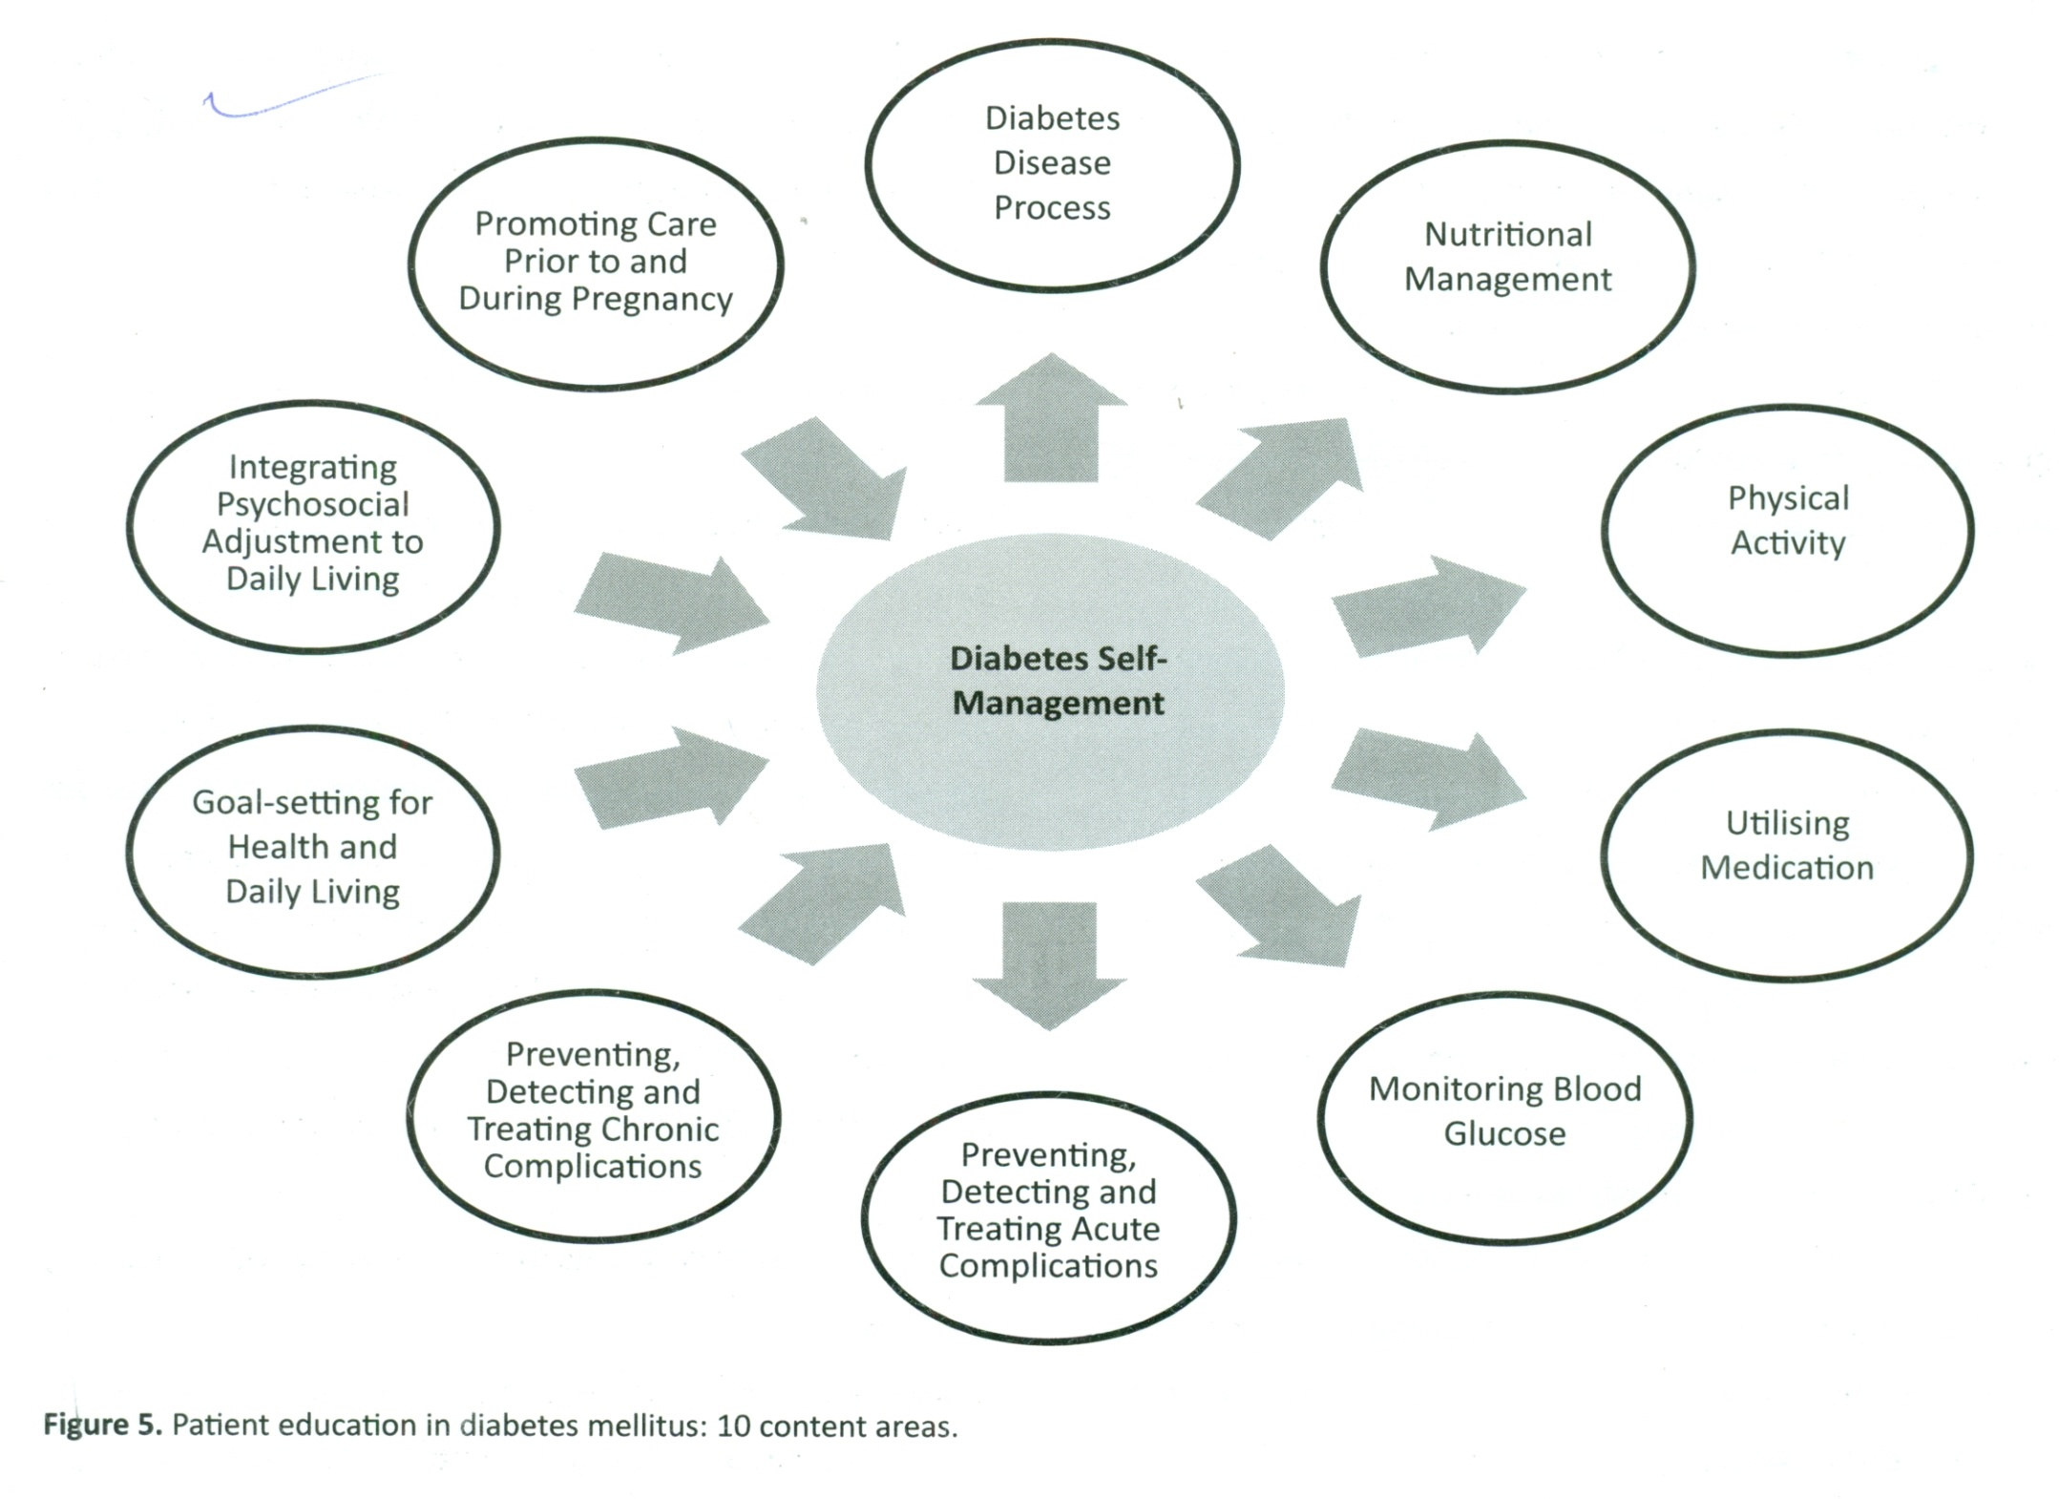

Slide 94
Diabetes self-management education (DSME)
DMSE help the patient to achieve glycaemic control, prevent and manage complications, improve quality of life and is also cost-effective
Ongoing process that imparts diabetic patients with Knowledge, skill and ability to self manage
Helps in informed decision making, self care, problem solving and in co-ordination with health care team

Slide 95
Glucose monitoring
Self monitoring of blood glucose (SMBG)
Essential to assess the glycaemic control and effectiveness of treatment
SMBG should be available to all newly diagnosed type 2 diabetes and those on insulin treatment
SMBG for3-4 times a day for insulin injectors or pump therapy
Act as a guide for successful therapy in less frequent insulin injections or non-insulin therapy or medical nutritional therapy
In patient on oral anti diabetic drugs

Slide 96
Information on hypoglycemia
Assess fluctuation in glucose as a result of medication and life style changes
Monitor changes during intercurrent illness
Continuous glucose monitoring (CGM) monitoring glycaemic control on intensive insulin regimens

Slide 97
HbA1c measurement
At least 2 times a year who has achieved target
4 times a year in those who have not achieved target or change in treatment
Strongly predicts complications
Recommended 6.5%-7%

Slide 98
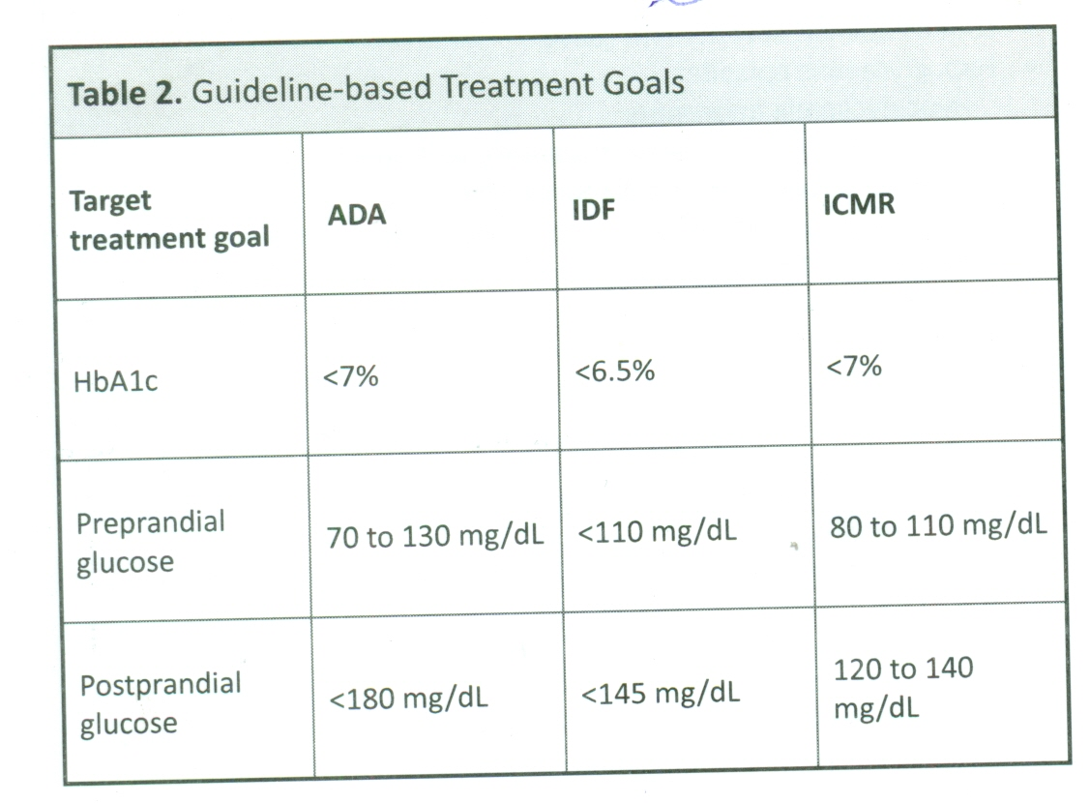

Slide 99
PSYCHOLOGICAL CARE
Patient attitudes towards having diabetes, expectations from treatment, general well- being, quality of life, financial and social resources should be evaluated .
Should be also evaluated for diabetes related psychological problems as depression, anxiety and eating disorders

Slide 100
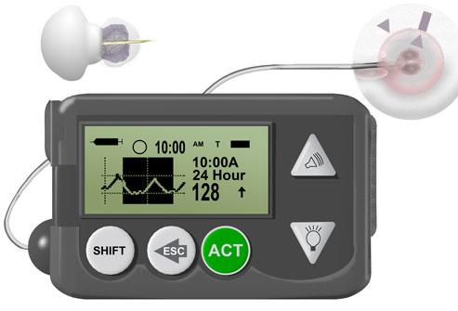

Slide 101
Should carry an identification card showing his name, address, telephone number and detail of treatment.
These education to optimize effectiveness of primary health care services.

Slide 102
3- TERTIARY TREATMENT-
Major cause of disabilities through complications-blindness, Kidney failure. Coronary thrombosis, gangrene of lower extremities etc.
Organize specialized diabetic clinics and units capable of providing diagnostic and management skills of high order.

Slide 103
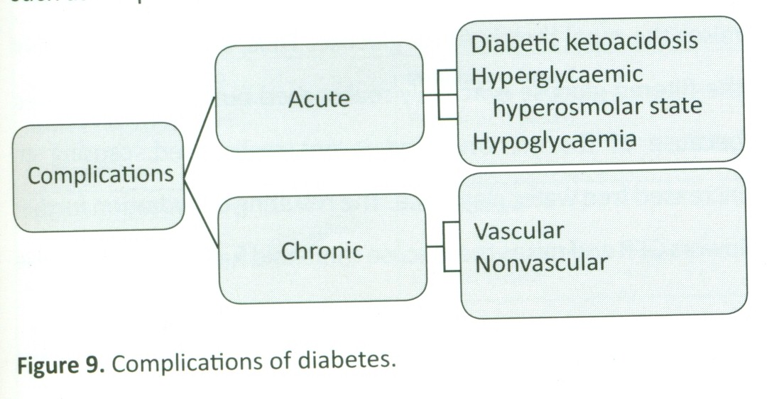

Slide 104
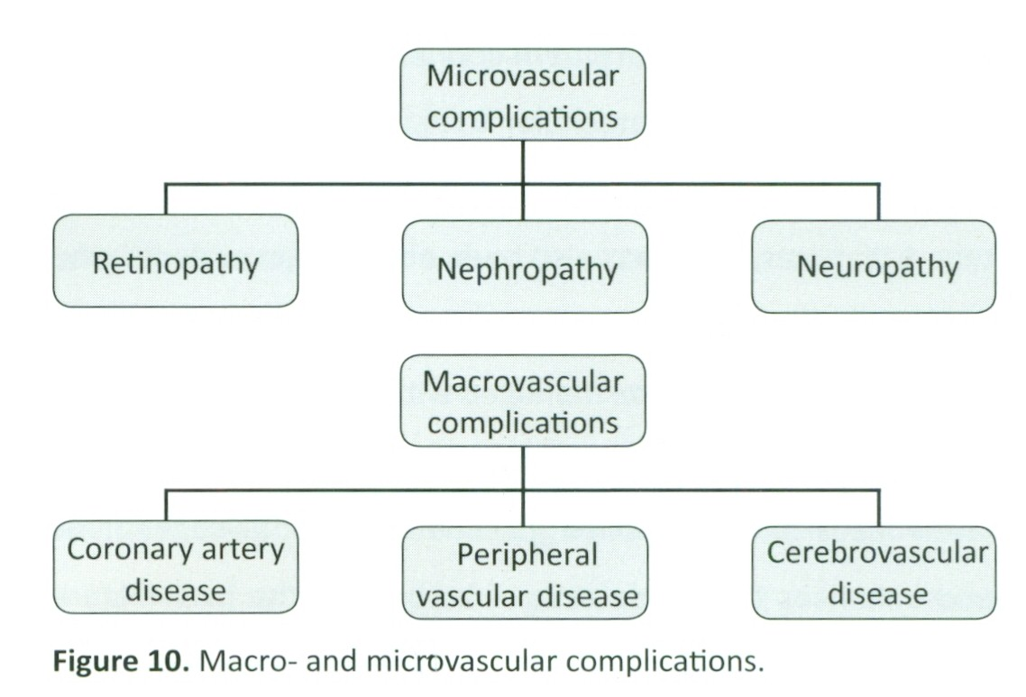

Slide 105
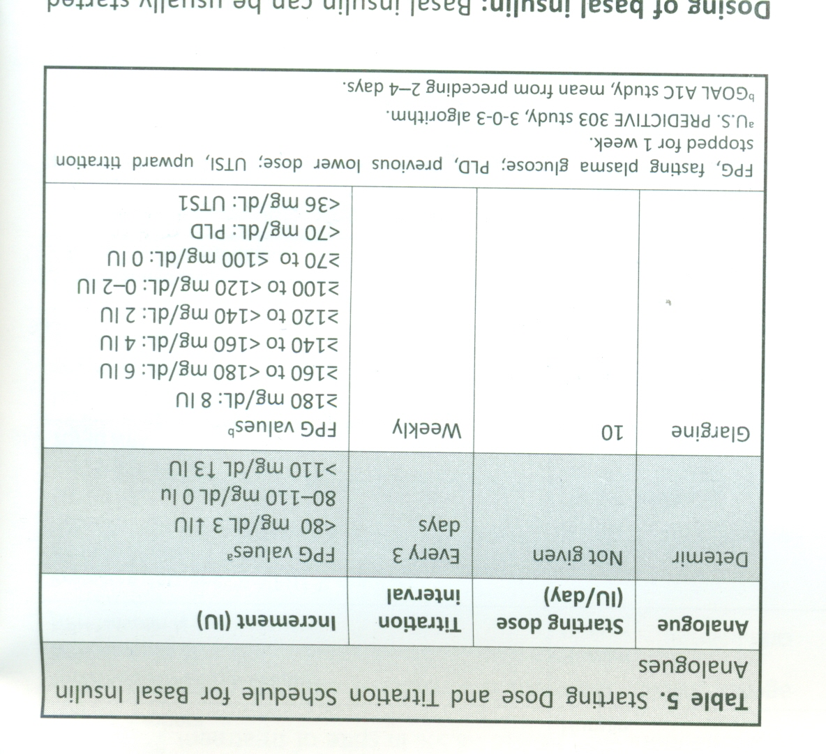

Slide 106
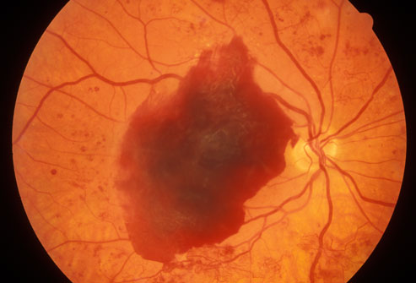
Eye complications

Slide 107
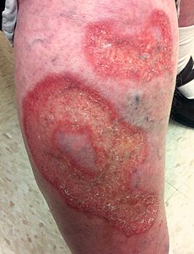

Slide 108
Involved in basic, clinical and epidemiological research.
Local and national registers should be established.

