Slide 1
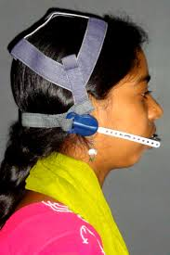
ORTHOPEDIC APPLIANCES
By:
Dr. Ravi Bhandari
Department of Orthodontics

Slide 2
INTRODUCTION
There are essentially 3 alternatives for treating any skeletal malocclusion –
(i) orthognathic surgery
(ii) dental camouflage
(iii) growth modification
Growth modification……………the best option !!!

Slide 3
Goal of growth modification ???
There are 2 types of orthodontic appliances that can be used for modifying the growth of maxilla/mandible-
(i) orthopedic appliances
(ii) functional appliances

Slide 4
ORTHODONTIC FORCE VS ORTHOPEDIC FORCE
There are 2 types of forces used in orthodontics-
1) orthodontic force
2) orthopedic force - bring about change in position of jaws.

Slide 5
The appliances that produce skeletal changes by applying orthopedic forces are known as orthopedic appliances.
Since they employ heavy forces, adequate anchorage required is gained by extra oral means using occipital, parietal, frontal & cranial bones.
The most widely used orthopedic appliances are-
a) Headgear
b) Protraction Face Mask (reverse pull headgear)
c) Chin Cup

Slide 6
BASIS OF ORTHOPEDIC APPLIANCE THERAPY
Orthopedic appliances generally use teeth as “handles”.
Basis of orthopedic appliance therapy resides in the use of intermittent forces of very high magnitude.
Such heavy forces when directed to the basal bone via teeth tend to alter the magnitude & direction of the jaws by modifying the pattern of bone apposition at periosteal sutures & growth sites.

Slide 7
Orthopedic appliances are worn intermittently for only about 12-14 hours a day.
Tooth movement is also reduced significantly by replenishment of normal circulation when the appliance is not worn.
Thus, skeletal changes rather than tooth movement occur during orthopedic appliance therapy, although some tooth movement is inevitable.

Slide 8
PRINCIPLES OF USING ORTHOPEDIC APPLIANCES
The following are the basic principles of using orthopedic appliances effectively –
Magnitude of force –
Extra oral forces of much greater magnitude, in excess of 250-400gms per side is required to bring about skeletal changes.
Most orthopedic appliances employ forces in the range of 250-400 gm per side to maximize skeletal

Slide 9
changes and to minimize dental change.
Such heavy force compress the periodontal ligament on the pressure side & cause hyalinization, which prevents tooth movement.
2) Duration of force –
Orthopedic changes are best produced by employing intermittent heavy forces.
Intermittent forces of 12-14 hours duration per day appear to be effective in producing orthopedic changes.

Slide 10
An intermittent heavy force is less damaging to the teeth and periodontium than a continuous heavy force.
3) Direction of force –
Orthopedic force should be applied in the appropriate direction to have a maximum skeletal effect.
The desired changes are best achieved when the line of force passes through the center of resistance of the skeletal structures to be moved.

Slide 11
The force direction or force vector should be decided depending on the clinical needs.
4) Age of the patient –
It is advisable to begin orthopedic appliance therapy while patient is still in the mixed dentition period, to make most of the active growth occurring prepubertal growth spurt.
Treatment may have to be continued until the completion of adolescent growth, so as to prevent relapse caused by the re-expression of patients fundamental growth pattern after cessation of

Slide 12
orthopedic therapy
5) Timing of force application –
Optimum timing of extra oral force application is considered to be during evening & night.
This is because, an increase release of growth hormone and other growth promoting endocrine factors has been observed to occur during the evening & night rather than during the day.
Evidence suggest that skeletal growth is associated with sleep onset & follows circadian pattern.

Slide 13
ORTHOPEDIC APPLIANCES
The following are the commonly used orthopedic appliances –
a) Headgears
b) Protraction Face Mask
c) Chin Cup Appliance

Slide 14
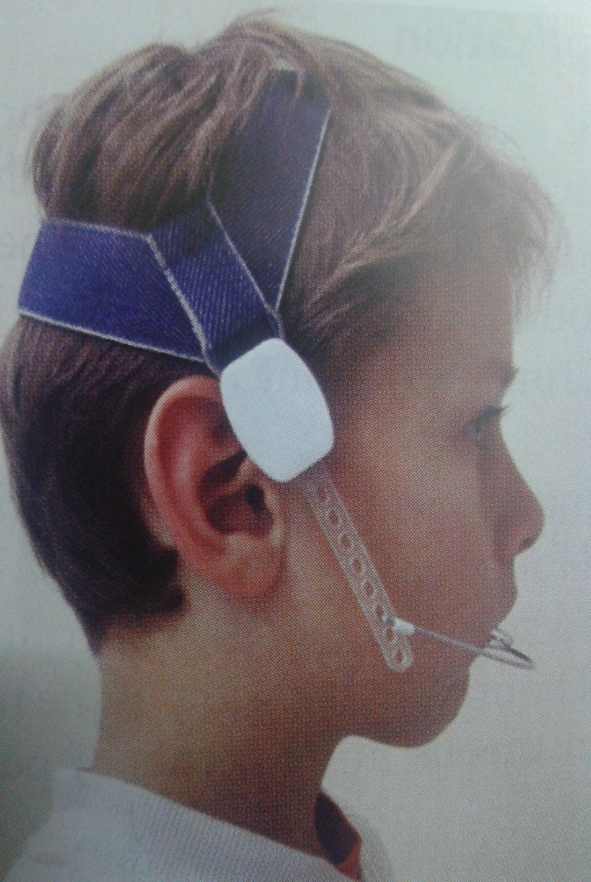
HEADGEAR
Headgears are the most widely used extra oral orthopedic appliances.
They are mainly used in the management of skeletal class II malocclusion (maxillary prognathism) by growth modification.
They are also used for distalization of maxillary molars.

Slide 15
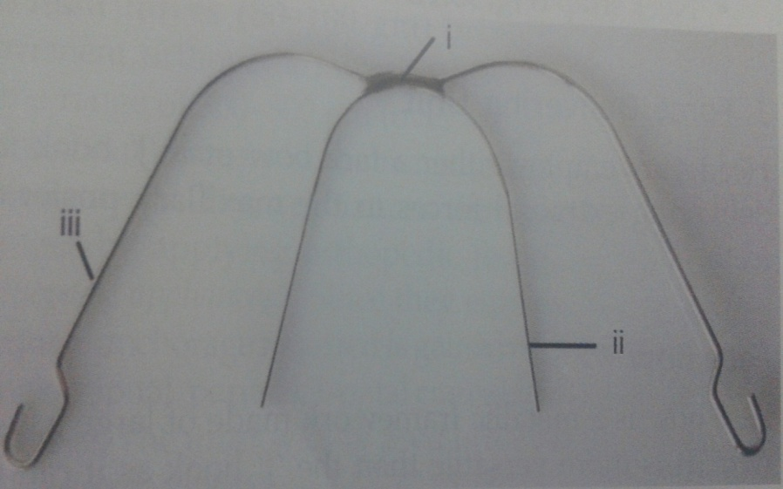
Components of headgear –
1) Force delivering unit
a) Face bow
b) ‘J’ hook
2) Force generating unit
3) Anchor unit
a) Head cap or
b) Neck strap
1)a) Face bow
It is a metallic framework made of large gauge wire.

Slide 16
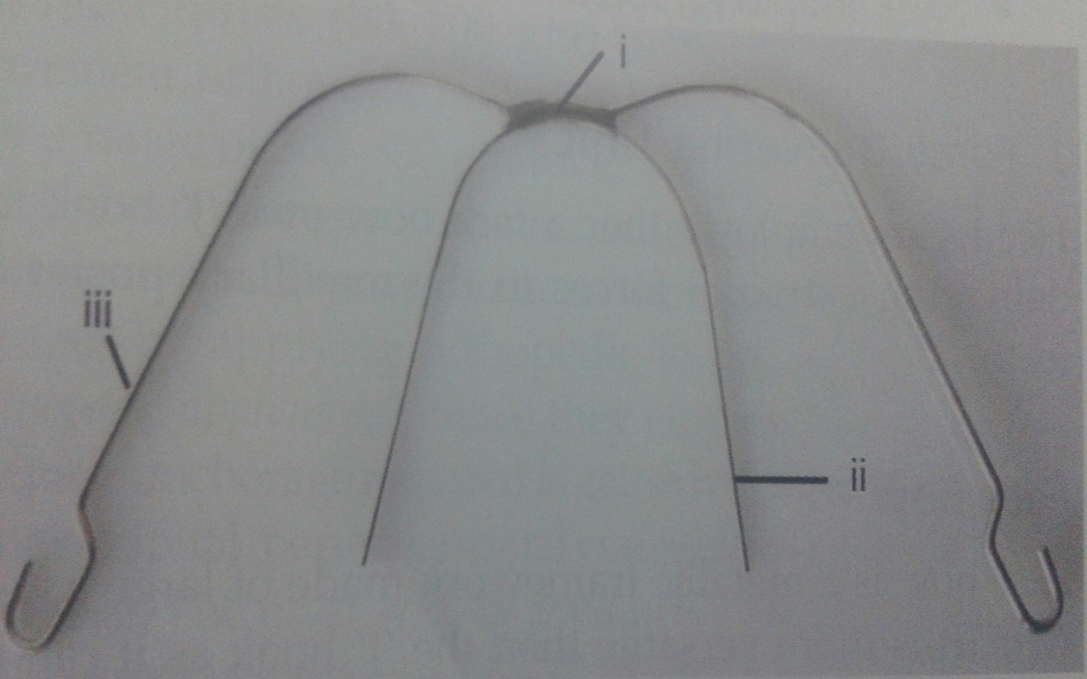
It can be attached to teeth either via brackets ( fixed orthodontic appliance ) or removable appliance.
Parts of face bow –
i- junction
ii- inner bow
iii- outer bow

Slide 17
i) Junction –
it is the point of attachment of the inner and outer bow, which may be soldered or welded.
The junction is situated in the midline of the bows, although it can be shifted either right or left side depending upon asymmetrical force need.
ii) Inner bow –
it is made up of 0.045” or 0.052” round stainless steel wire and is countered to follow the shape of dental arch.

Slide 18
Friction stops are placed in the bow mesial to the buccal tube of first permanent molar to prevent the inner bow from sliding too far distally through the buccal tube.
iii) Outer bow/ Whisker bow –
it is made of a round stainless steel wire of 0.051” or 0.062” that is contoured to fit around the face.
The length of the outer bow can be adjusted to produce the desired force vector/ line of force.

Slide 19

Outer bow on both sides at the distal end is curved to form a hook that gives attachment to the force generating unit.
The outer bow can be short, medium or long.
Short – outer bow is lesser in length than inner bow.
Medium – outer bow length is equal to inner bow.
Long – outer bow is longer than inner bow.

Slide 20
2) Force generating unit
It produces heavy forces to effect skeletal changes.
It also connects the face bow to the anchor unit ( head cap or neck strap )

Slide 21
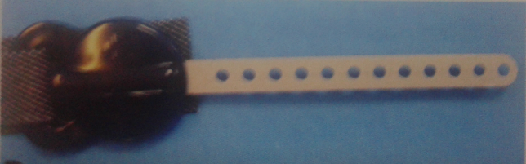
Force generating unit may be in the form of:
i) springs
ii) elastics or
iii) other stretchable material
fig : force generating unit
Springs are preferred as they provide a constant force whereas elastics tend to undergo force decay.

Slide 22
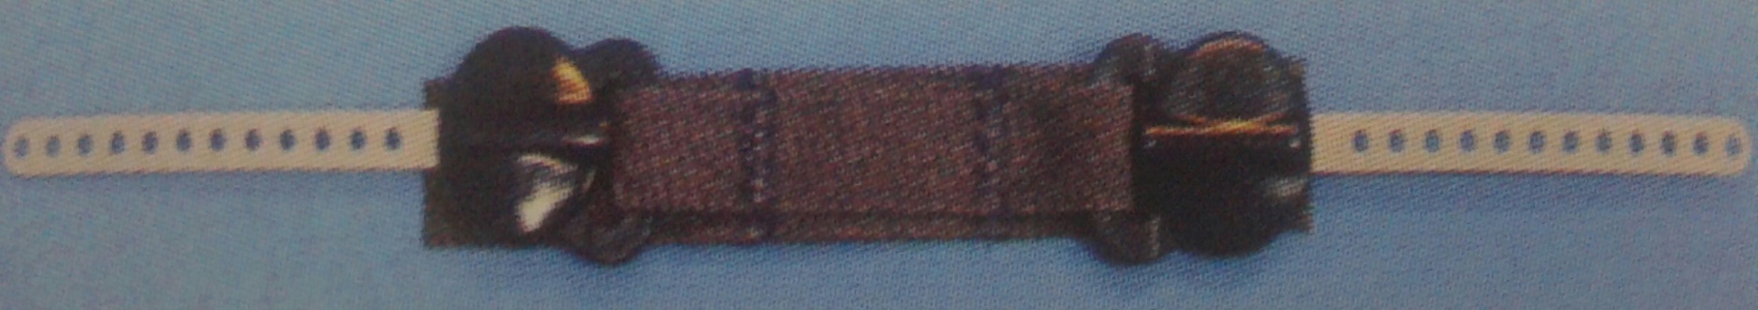
3) Anchor unit
Headgear appliance derives anchorage from extra oral sites using the rigid bones of skull or back of the neck.
Two basic types of extra oral attachments that provide anchorage for headgear are :
1. cervical attachment / neck strap

Slide 23
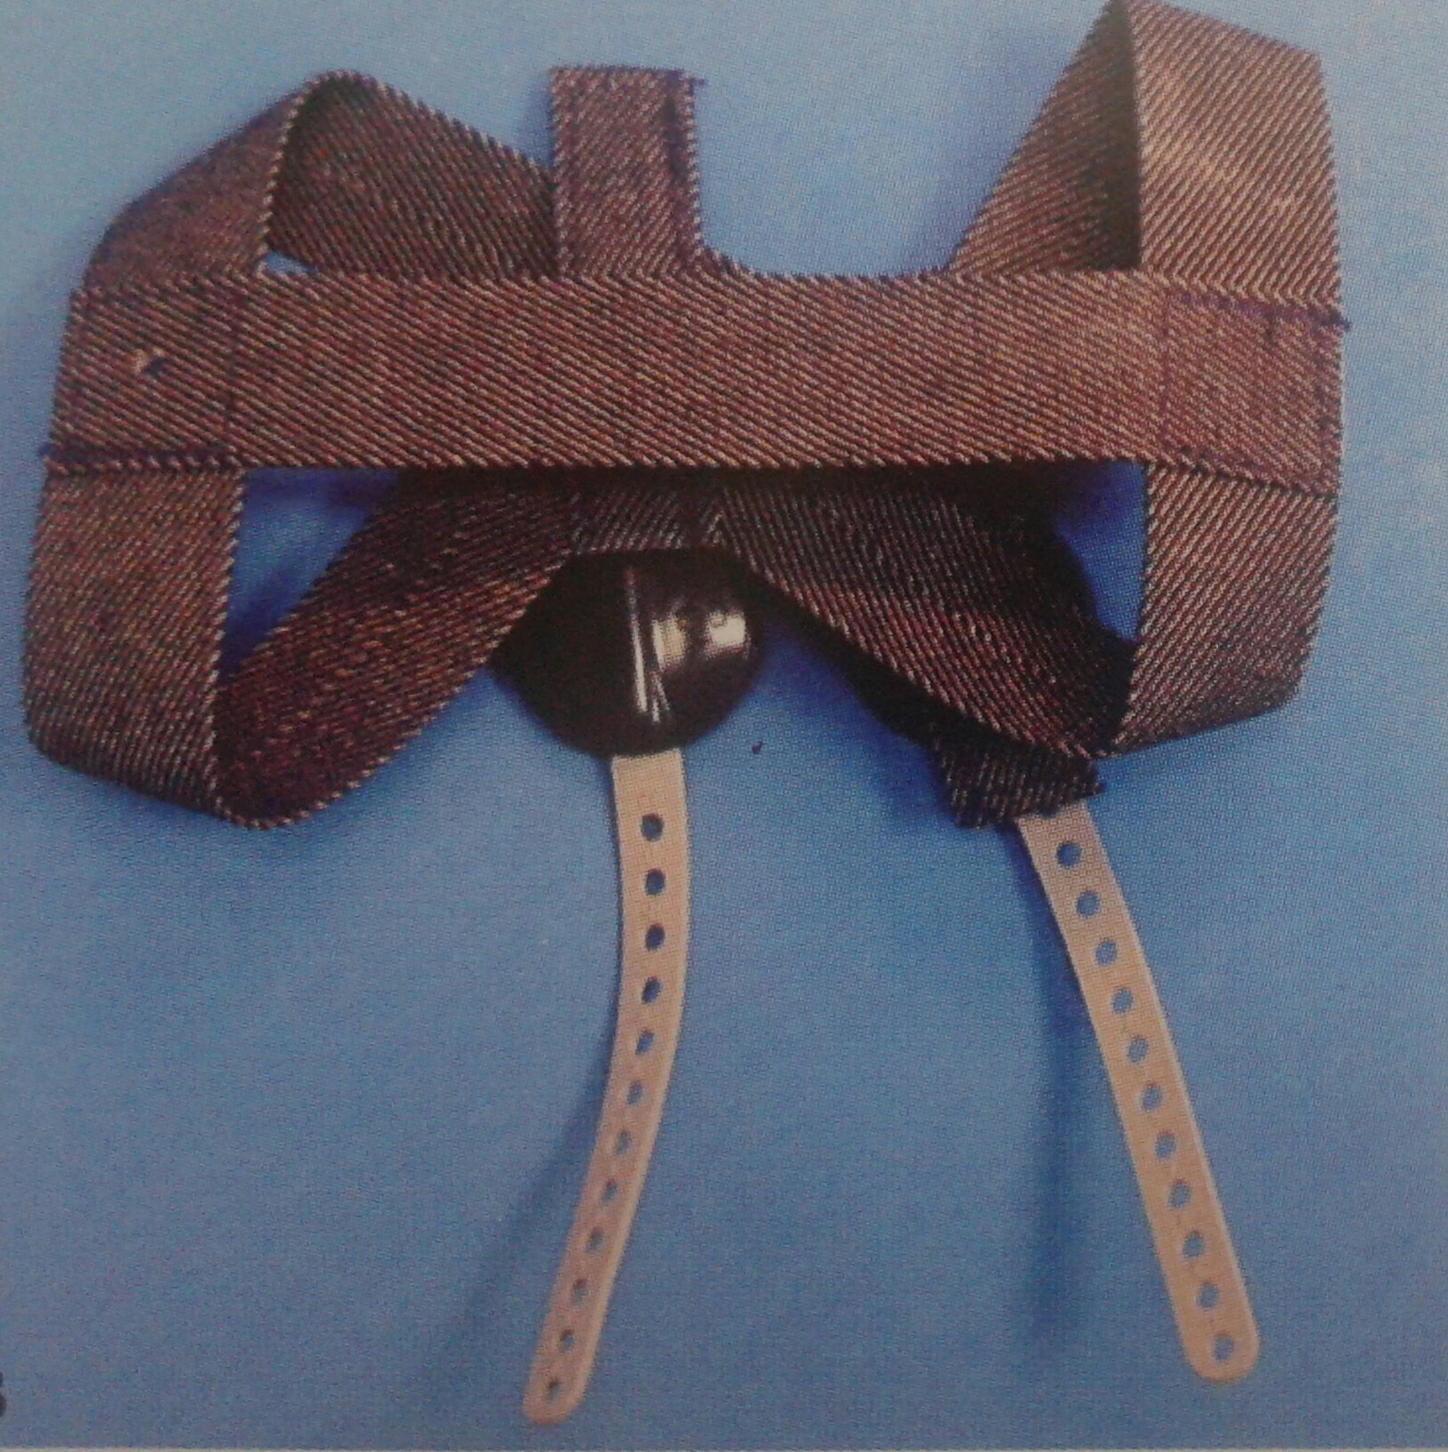
2. occipital attachment / head cap
A combination of cervical & occipital attachments may also be used to distribute the external forces over a wide surface area.

Slide 24
Principles in the use of headgear :
The following factors should be considered when planning the use of headgears :
Centre of resistance of the dentition
The inner bow is generally attached to the maxillary first permanent molars through buccal tubes on these teeth.
Force acting on the molars tends to displace them. A decision should be made as to whether bodily movement or tipping of the teeth is required.

Slide 25
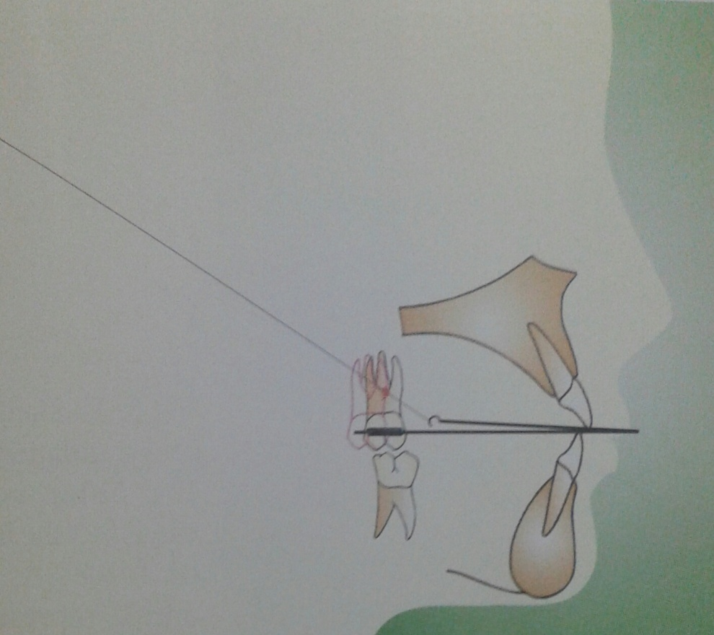
The centre of resistance for a molar is usually at the mid root region.
fig : line of forces passing through the centre of resistance of the molars results in their bodily movement.

Slide 26
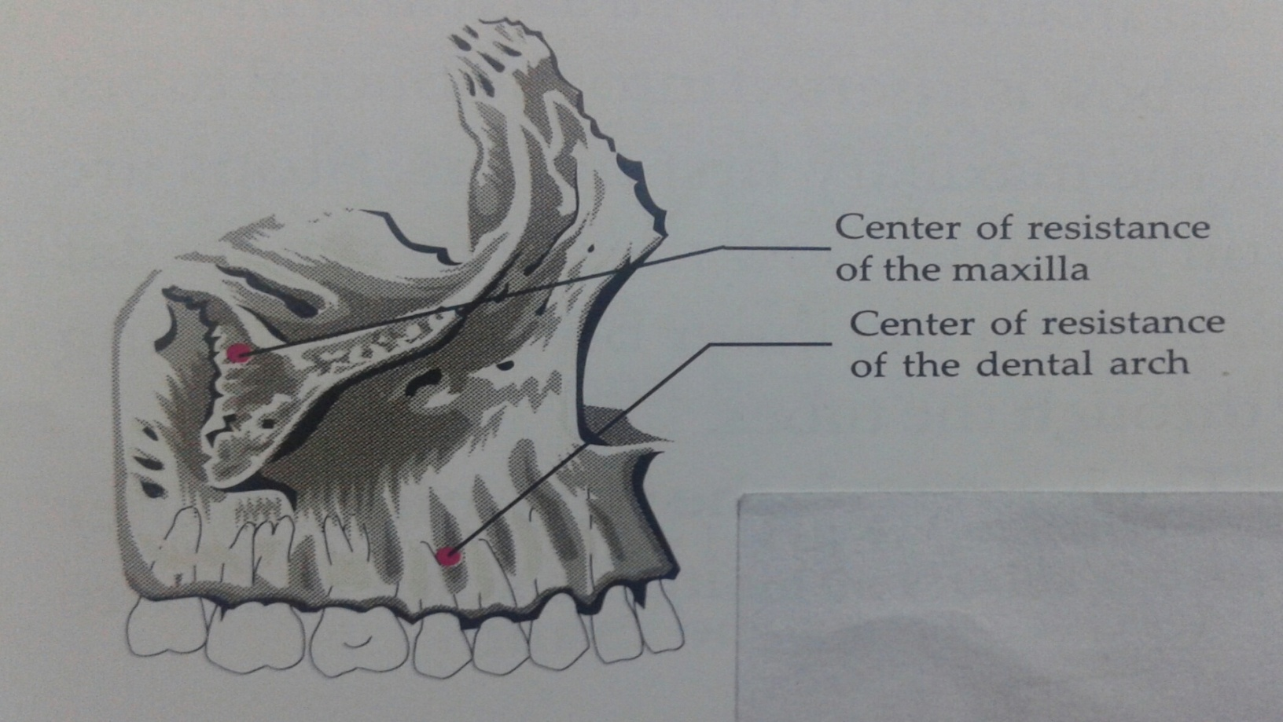
2) Centre of resistance of maxilla
Centre of maxilla is believed to exist at the posterosuperior aspect of zygomaticomaxillary suture.

Slide 27
4) Point of attachment
It refers to the hook present on the distal end of the outer bow to which the force generating unit is attached.
It is possible to alter the direction of force to the maxilla and the dentition by altering the point of attachment.

Slide 28
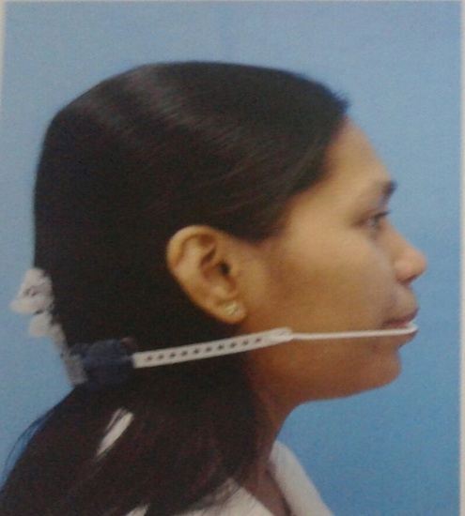
Types of headgears
Cervical headgears –
They obtain anchorage from nape of the neck.
They cause extrusion of the
maxillary molars leading to an
increase in the lower facial
height.
They move the maxillary dentition & maxilla in a distal direction.

Slide 29
Indications
Short face, class II malocclusion with maxillary protrusion, low mandibular plane angle and deep bite.
Anchorage conservation.
Distalization of molar to correct class II condition.

Slide 30
Contraindications
Open bite cases
High mandibular plane angle cases
Increased LAFH

Slide 31
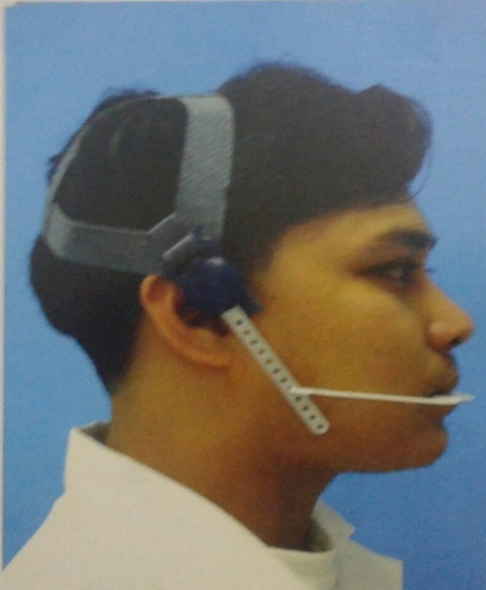
2) Occipital Headgears-
They derive anchorage from the back of the head.
They produces a distal and superiorly
directed force on the maxillary teeth
& the maxilla.
Produce a more vertically directed
force & thus used in individuals in whom an increase in vertical dimension is to be avoided.

Slide 32
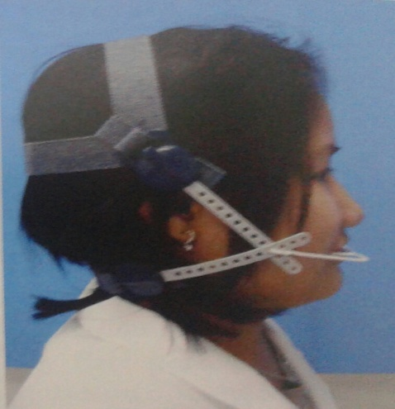
3) Combination Headgears –
Occipital & cervical anchorage is combined.
Distal and slight upward force is
exerted on the maxilla & maxillary
dentition.
Resultant force direction can be altered by varying the proportions of total force derived from head cap & the neck strap.

Slide 33
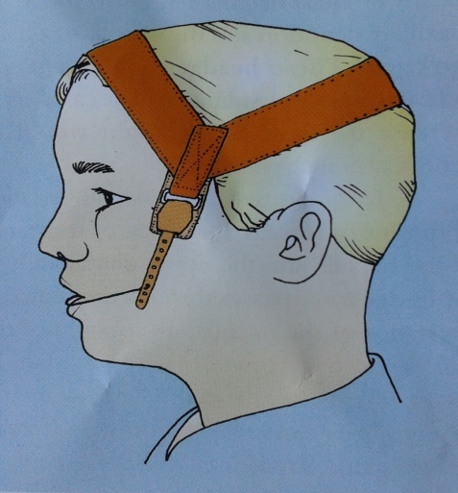
4) Vertical pull headgear –
They derive anchorage from the parietal region of the cranium .
Produce a vertically directed force on
maxilla & the maxillary dentition.
Used to produce intrusive forces on the anterior region of the maxilla thereby producing a counter clockwise moment of the maxilla.

Slide 34
5) Asymmetrical Headgears –
They are used when differential anchorage is required on both sides of the maxillary arch.
Example – a patient with Class II molar relation on one side and a Class I molar relation on the other side can be given an asymmetric headgear.

Slide 35
Uses of headgears
Orthopedic effect : forces applied on to the maxilla can be used to restrict its downward & forward growth.
2. Anchorage augmentation : extra oral forces are used to reinforce anchorage when those obtained from intra oral sources are insufficient.
3. Distalization of molars : extra oral forces can effectively be used for distal movement of upper molars required for correction of molar relation or to gain space for correction of crowding or retraction of anteriors.

Slide 36
4. Molar rotation : in order to derotate a molar, correction is achieved by adjustment of the inner bow so that it produces a rotational force on the molar. As soon as the correction is achieved, the face bow should be readjusted to apply a direct distal force.
5. Space maintenance : most effective method of maintaining arch length is by the use of extra oral forces, mesial moment of molars is prevented & the face bow does not interfere with erupting teeth. Daily wear of 8 hours is sufficient.

Slide 37
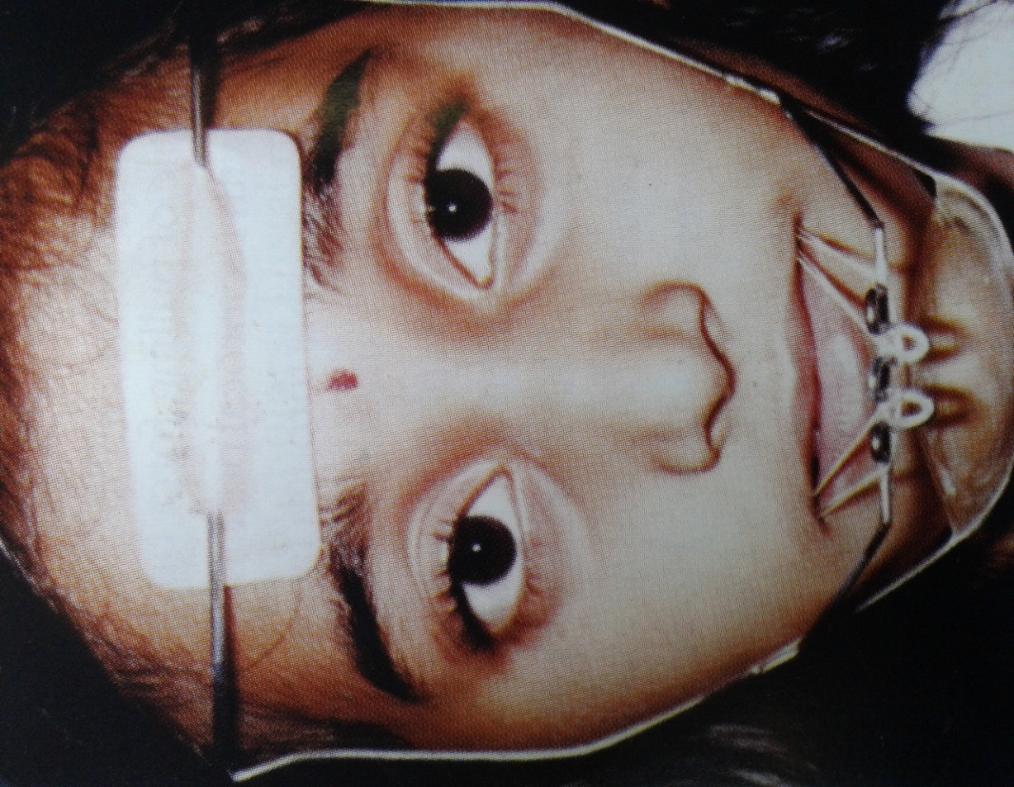
PROTRACTION FACE MASK
also called as “reverse pull headgear” or “protraction headgear”
When an anterior protraction force is required, a protraction
headgear is used.
Principle – pulling force on the maxillary structures with reciprocal pushing force on the forehead or mandible through facial anchorage.

Slide 38
It is simple and mechanically sound enough to be used as a therapeutic procedure for treatment of maxillary retrusions, clefts & mandibular prognathism.
HICKHAM (1972) claims he was the first to use a reverse headgear. However this modality was made popular by DELAIRE around the same time.
A reverse pull headgear basically consists of a rigid framework, which takes anchorage from chin or forehead or both for anterior traction of maxilla using extra oral elastics that generate large amounts of force.

Slide 39
Indications for face mask
Growing patients having a prognathic mandible and a retrusive maxilla ( class III malocclusion)
For selective rearrangement of the palatal shelves in cleft patients.
Correction of post-surgical relapse after osteotomies.
To treat certain accessory problems associated with nose morphology such as lateral deviations.

Slide 40

Biomechanical considerations
Amount of force- the amount of force required to bring about skeletal changes is about 250-400 gms per side.
2. Direction of force- 15 – 20 degree downward pull to the occlusal plane to produce a pure forward translatory motion of the maxilla. If the line of force is parallel to the occlusal plane, a forward translation as well as an upward rotation takes place.

Slide 41
Duration of force- ranges between 3 – 16 months (8-12 months).
Frequency of use- 12 to 14 hours of wear a day.
Age of patient:
Parts of reverse pull headgear
1. Chin cup : is used to take anchorage from the chin area. It can be ready made or can be fabricated from an impression of patients genial region. It is connected to the rest of the face mask assembly by means of metal rods.

Slide 42
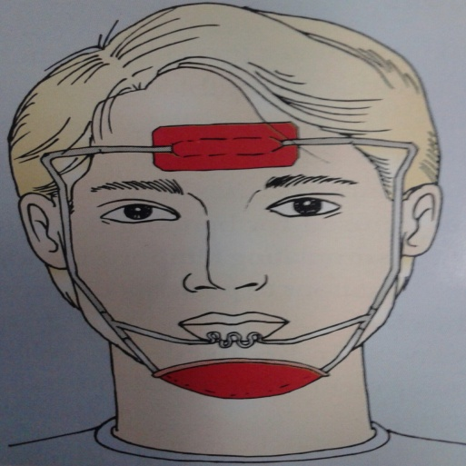

Forehead cap : use to derive anchorage from the forehead.
Elastics : used to apply a forward traction on the upper arch. Vertical posts of the chin cup are used to attach the elastics onto the molar tubes or hook soldered on the arch wire. It is purely for tooth movement.
Intraoral appliance : traction hooks are placed either in the molar or premolar region.

Slide 43
5. Metal frame : It connects the various components such as the chin cup and forehead cap. It also has provision to receive elastics from intraoral appliance.
Types of reverse pull headgear
Protraction headgear by Hickham :
Uses the chin and top of the head for anchorage.
Consists of 2 short arms in front of the mouth to engage maxillary protraction elastics.
2 long arms run parallel to the lower border of the mandible & go vertically up from the angle of the

Slide 44
mandible and end behind the ears.
An elastic strap is attached to the end of the long arms to encircle the head.
Advantages –
1) better aesthetics
2) comfort

Slide 45
Face mask of Delaire:
Uses the chin and forehead for support.
Appliance is made up of a rigid wire framework, which is squarish & kept away from the face.
It has a forehead cap and a chin cup with a wire running in front of the mouth used for elastic attachment.

Slide 46
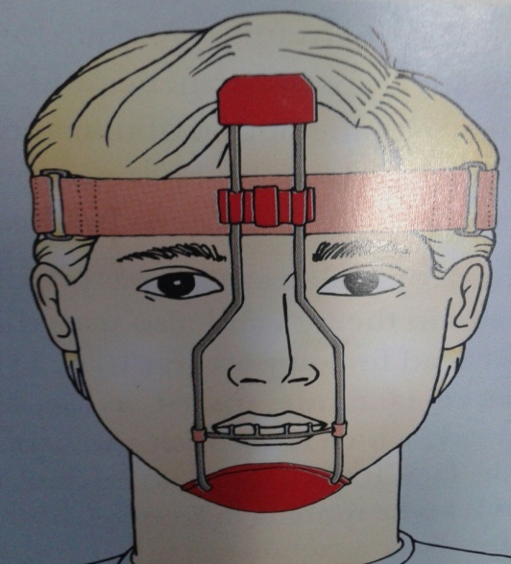
3) Tubinger model :
Modified type of Delaire face mask.
Consists of a chin cup from which
originates 2 rods that run in the
midline & is shaped to avoid the
interference of nose.
The superior ends of the 2 rods house
a forehead cap from which elastics encircle the
head.

Slide 47
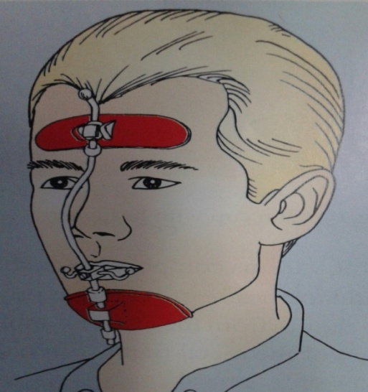
Petit type of face mask :
Modified Delaire face mask.
Consists of a chin cup & a forehead
cap with a single rod running in the
midline from forehead cap to chin
cup.
A crossbar at the level of the mouth is used to engage elastics.
Advantage – forehead cap, chin cup & the cross bar can be adjusted to suit the patient.

Slide 48
CHIN CUP APPLIANCE
Also referred to as chin cap.
It is an extra oral orthopedic device that covers the chin and is used to restrict the forward and downward growth of the mandible.
Parts : chin cup and force module
Types of chin cups
Chin cups are of two types :

Slide 49
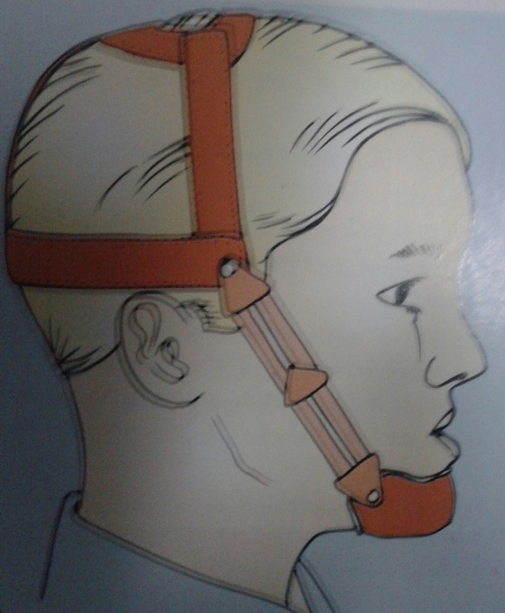
Occipital pull chin cup –
Derives anchorage from the occipital region.
Used in class III malocclusions associated with mild to moderate mandibular prognathism.
Also indicated in patients with
slightly protrusive lower incisors
as they invariably produce
lingual tipping of the lower
incisors.

Slide 50
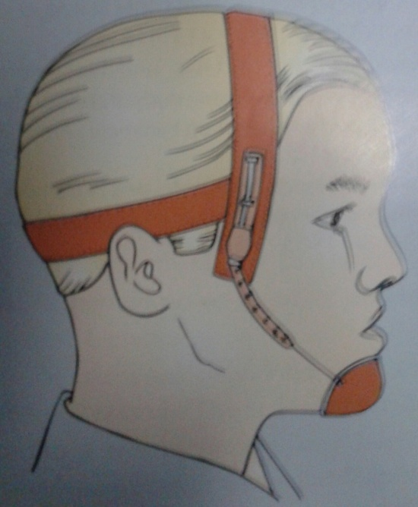
2) Vertical pull chin cup –
Derives anchorage from the parietal region of the head.
Indicated in patients with steep mandibular plane angle and excessive anterior facial height.
These patients usually exhibit
an anterior open bite.

Slide 51
Fabrication of the chin cup :
Chin cups are fabricated individually for the patient or pre- fabricated commercially available chin cups are used.
The fabrication of chin cup requires an impression to be taken of the chin area.
The cast is poured and the chin cup is fabricated using self cure acrylic resins.

Slide 52
Force magnitude & duration of wear :
At the time of appliance delivery a force of 150-200 grams per side is used.
Over the next 2 months the force is gradually increased to 300-500 grams per side.
The patient is asked to wear the appliance for 12-14 hours a day to achieve the desired results.

Slide 53
Indications
Patients with mild skeletal prognathism of the mandible.
In case of increased facial height.
Patients who has well aligned or protrusive, but not retroclined mandibular incisors.

Slide 54
Line of force
1. line of force acting directly through the condyles. Here no opening of the mandibular plane takes place.
2. Line of force acting below the condyle:
Chin rotated downward and backwards.
Increase in facial height.
3. Line of force acting above the condyles:
Decrease in mand plane angle
Decrease in lower ant facial height.

Slide 55
MCQ’S
1)Orthodontic force, which when applied brings about
A. dental change
B. skeletal change
C. both A& B
D. none of the above

Slide 56
3) Which of the following is the anchor unit of headgear
A. facebow
B. J hook
C. force generating unit
D. head cap/ neck strap
4) Following are the parts of facebow except
A. outer bow
B. inner bow
C. outer wire joint
D. junction

Slide 57
5) Following are the types of headgear except
A. cervical headgear
B. occipital headgear
C. high pull headgear
D. Pulling headgear
6)Face mask is also known as
A. reverse pull headgear
B. protraction headgear
C. both A & B
D. none of the above

Slide 58
7) Face mask is used in the treatment of patients with
A. class I malocclusion
B. class II malocclusion
C. class III malocclusion
D. all of the above
8) Orthopedic appliance wear usually recommended for how many hours in a day
A. 10-12 hours
B. whole day
C. 6-8 hours
D. 2-3 hours

Slide 59
9) Orthopedic appliance wear usually recommended for what time in a day
A. during evening & night
B. during morning & afternoon
C. any time during day
D. none of the above
10) Cervical headgear derives anchorage from
A. back of the neck
B. front of the neck
C. fore head
D. none of the above

Slide 60
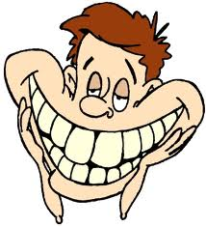
THANK YOU

