Slide 1
MODEL ANALYSIS

Slide 2

Introduction
Success in orthodontic treatment – Diagnosis.
Many diagnostic aids are available today but study models are oldest.
Model analysis is an adjunct in diagnosis and treatment planning. It should hence be correlated with the other data in the diagnosis before formulating any treatment plan.

Slide 3
Definition
Model analysis is the study of dental casts, which helps to study the occlusion & dentition from all three dimensions & analyze the degree & severity of malocclusion & to derive the diagnosis & plan for treatment.

Slide 4
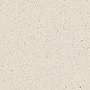


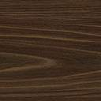


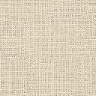
Case History
Clinical Examination
Study Cast Analysis
Comprehensive diagnosis
Roentgeno-Cephalo-MetricAna-lysis
Radiographic Examination
Photographic Analysis

Slide 5
OBJECTIVES OF IDEAL STUDY MODELS
Models should accurately reproduce the teeth & their surrounding soft tissue.
Models should be well finished.

Slide 6
ADVANTAGES
They are the only three dimensional records of the patient’s dentition.
Occlusion can be visualized from the lingual aspect.
They provide a permanent record of the intermaxillary relationship.
Helps to motivate the patients,as they can visualized the treatment progress.

Slide 7
They are needed for comparison purposes at the end of treatment & act as a reference for post treatment changes.
They serve as reminder for the parent & the patient of the condition present at the start of treatment.
In case the patient has to be transferred to another clinician, study model are an important record.

Slide 8
USES OF STUDY MODELS
Assist & record dental anatomy, intercuspation, arch form and curves of occlusion
Evaluate occlusion with the aid of articulators
Measure progress during treatment
Detect abnormalities
eg- localized enlargement, distortion of arch form
Calculate space analyses
Provide records for the purpose of studying treatment stability

Slide 9
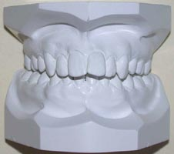
PARTS OF THE STUDY MODELS
Study models can be divided into two parts:
The anatomic portion.
The artistic portion.

Slide 10
MODEL ANALYSES
PERMANENT DENTITION ANALYSIS
Pont’s analysis
Linder Harth index
Korkhaus analysis
Ashley Howe’s analysis
Wayne A. Bolton analysis
Carey’s analysis
Arch perimeter analysis
MIXED DENTITION ANALYSIS
Moyer’s mixed dentition analysis
Tanaka & johnson analysis
Radiographic Method

Slide 11
PERMANENT DENTITION ANALYSIS

Slide 12
ARCH PERIMETER ANALYSIS
Same as Carey’s analysis when carried out in the upper arch

Slide 13
CAREY’S ANALYSIS
the arch-length-tooth material discrepancy is the main cause for most malocclusion & can be calculated with the help of carey’s analysis
PROCEDURE:-
the arch length is measured anterior to the first permanent molar using a soft brass wire
the wire is placed touching the mesial aspect of lower first permanent molar, then passed along the buccal cusps of premolars, incisal edges of the anteriors & finally continued the some way upto mesial of the first molar of the contra lateral side

Slide 14
The brass wire should be passed along the cingulum of anterior teeth if anteriors are proclined & along the labial surface if anteriors are retroclined
The mesiodistal width of teeth anterior to first molar are measured & summed up as total tooth material
The difference between the arch length & the actual measured tooth material gives the discrepancy

Slide 15
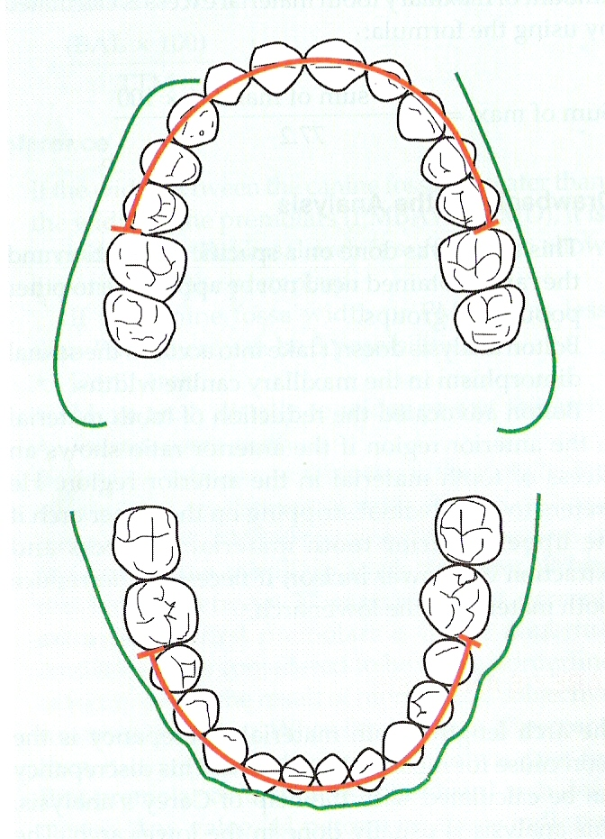

Slide 16
INTERPRETATION
If the arch length discrepancy is:-
a) 0-2.5mm:- proximal stripping can be carried out to reduce the total tooth material
b) 2.5-5mm:- extraction of second premolar is indicated
c) Greater than 5mm:- extraction of first premolar is usually required

Slide 17
PONT’S ANALYSIS
In 1909 Pont presented a method whereby the mere measurement of four maxillary incisors automatically established the width of the arch in the premolar & molar region

Slide 18
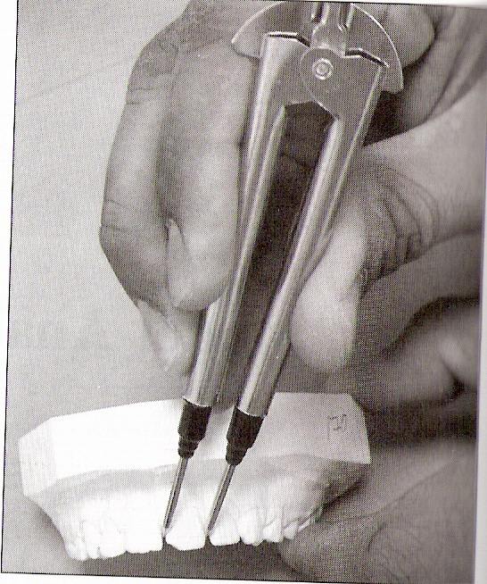
PROCEDURE
The greatest width of incisors is measured with calipers recorded on a line, & their sums when recorded in millimeters
this is termed as “sum of incisors” (SI)

Slide 19
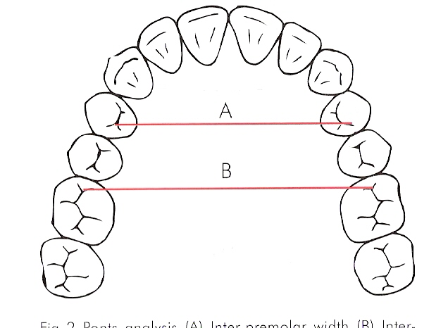
The distance between the upper right first premolar & upper left first premolar (that is the distal end of the occlusal grove) is recorded & called as “measured premolar value” (MPV)

Slide 20
The distance between the upper right first molar & upper left first molar (that is the mesial pit on the occlusal surface in maxillary arch ) is recorded & is termed as “measured molar value” (MMV)

Slide 21
Calculated premolar value (CPV)
The expected arch width in the premolar region is calculated by formula:-
SI X 100
80
Calculated molar value (MV)
the expected arch width in the molar region:-
SI X 100
64

Slide 22
INFERENCES
Difference between the measured & calculated values determines the needs for expansion
1) if measured value is less, expansion is required
2) if measured value is more, no need for expansion

Slide 23
DRAWBACKS
Maxillary incisors are the teeth most commonly missing
Maxillary laterals may undergo morphogenetic alterations like ‘peg’ shaped laterals
Does not take skeletal malrelationship into consideration
Analysis is derived solely from the French population

Slide 24
LINDER HARTH INDEX
It is v. similar to Pont’s analysis however he made a variation in the formula to determine the calculated premolar & molar value
Calculated premolar value:-
SI X 100
85
Calculated molar value:-
SI X 100
64

Slide 25
ASHLEY HOWE’S ANALYSIS
Howe’s considered tooth crowding to be due to deficiency in arch width rather than arch length
He found a relationship to exist between the total width of mesiodistal diameter of teeth anterior to the second permanent molar & the width of the dental arch in the first premolar region

Slide 26
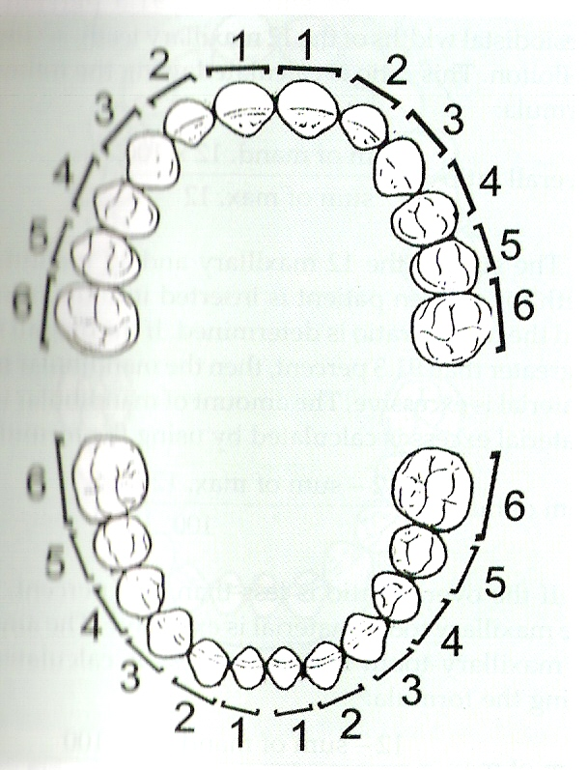
PROCEDURE
TTM:- Total Tooth Material
Refers to sum of the mesiodistal width of the teeth from first molar to first molar

Slide 27
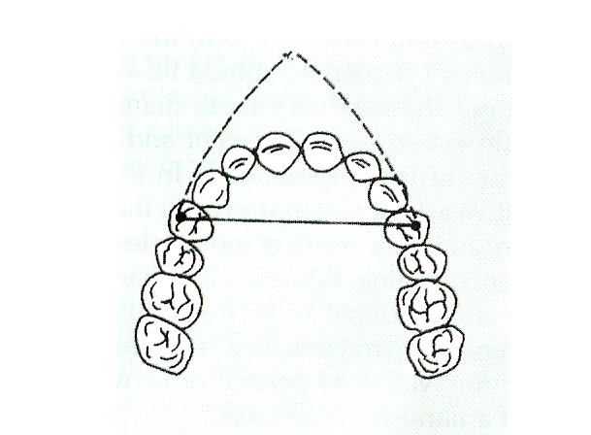
PMD:- Premolar Diameter
arch width measured from the buccal cusp tips of the first premolar on one side to the buccal cusp tip on other side

Slide 28
PMBAW:-Premolar basal ach Width
Measured from canine fossa on one side to the canine fossa of other side.
Or
Taken from a point 8mm below crest of marginal gingiva b/w canine and premolar of one side to other side.

Slide 29
Following measures have to be obtained
percentage of PMBAW to TTM
PMBAW X 100
TTM

Slide 30
INFERENCES
If PMBAW > PMD :-
indication that basal arch is sufficient to allow expansion of premolars
If PMD > PMBAW :-
can be three possibilities
1) contraindicated for expansion
2) move teeth distally
3) extract some teeth

Slide 31
If PMBAW X100 / TTM
a) less than 37% -------- require extraction
b) if 44% an ideal case -------- extraction not require
c) if between 37-44% (border line case) --------- may or may not require extraction

Slide 32
WAYNE A. BOLTON ANALYSIS
Bolton pointed out that the extraction of one tooth or several teeth should be done according to the ratio of tooth material between the maxillary & mandibular arch
to get ideal interdigitation, overjet, overbite & alignment of teeth
to attain an optimum interarch relationship
Bolton’s analysis helps to determine the disproportion between the size of maxillary & mandibular teeth

Slide 33
PROCEDURE
the sum of mesiodistal diameter of the 12 maxillary teeth & the sum of the mesiodistal diameter of the 12 mandibular teeth are determined

Slide 34
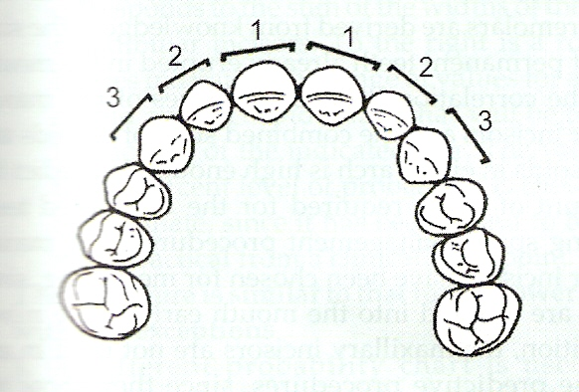
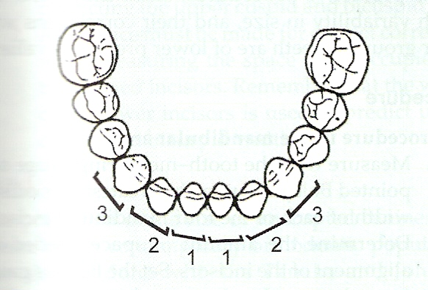
In same manner the sum of 6 maxillary anterior teeth & the sum of 6 mandibular teeth is determined.

Slide 35
OVERALL RATIO:-
sum of mesiodistal width of mandibular 12 teeth X 100
sum of mesiodistal width of maxillary 12 teeth
MEAN = 91.3%
ANTERIOR RATIO:-
sum of mesiodistal width of mandibular 6 teeth X 100
sum of mesiodistal width of maxillary 6 teeth
MEAN = 77.2%

Slide 36
INFERENCES
If the ratio is more than mean value, then the mandibular tooth material is excessive
If the ratio is less than mean value, then the maxillary tooth material is excessive
Bolton prefers to do proximal stripping on the upper arch if the upper anterior tooth material is in excess &
extraction of lower incisor, if necessary, to reduce tooth material in the lower arch

Slide 37
DRAWBACK’S
study was done on a specific population & ratio obtained need not be applicable to other population group
the analysis doesn’t take into account the sexual dimorphism in the maxillary canine width

Slide 38
MIXED DENTITION ANALYSIS

Slide 39
The purpose of mixed dentition analysis is to evaluate the amount of space available in the arch for succeeding permanent teeth & necessary occlusal adjustment
2 methods have been suggested:-
Those in which the sizes of unerupted cuspids & premolars are estimated from measurements of the radiographic image &
those in which the sizes of the cuspids & premolar are derived from knowledge of the sizes of permanent teeth already erupted in the mouth

Slide 40
MOYER’S MIXED DENTITION ANALYSIS
According to Moyer a high correlation exists among the sizes of different groups of teeth in an individual thus by measuring one group of teeth, it is possible to make a prediction of the other group of teeth

Slide 41
PROCEDURE
Measure the mesiodistal width of each of maxillary & mandibular incisor
Measure the space left from the distal aspect of lateral incisor to mesial aspect of first permanent molar
By using Moyer’s chart, find out the mesiodistal width of cuspids & bicuspids for the given sum of mesiodistal width of sum of incisor
Compare the space available & space required to determine the arch length discrepancy

Slide 42
TANAKA & JOHNSON ANALYSIS
Tanaka & Johnson did a study to repeat Moyer’s observation to validate its equation on a new sample
The possibility of secular changes with in the past 20 yrs was to be examined & they found Moyer’s prediction table to be equally appropriate for contemporary population

Slide 43
They have simplified Moyer’s 75% level of prediction table into a formula
Predicted width of maxillary canine & premolar
= sum of mandibular incisor +11
2
Predicted width of mandibular canine & premolar
= sum of mandibular incisor + 10.5
2

Slide 44
RADIOGRAPHIC METHOD:-
PROPORTIONAL EQUATION PREDICTION METHOD
If most of the canines & premolars have erupted & if one or two succedaneous teeth are still unerupted, an alternative prediction method can be used to estimate the mesiodistal width of the unerupted permanent tooth

Slide 45
PROCEDURE
the width of an unerupted teeth & an erupted tooth is measured on the same periapical film
the width of erupted tooth is measured on the plaster cast
These three measurements comprise the elements of a proportion that can be solved to obtain the width of unerupted tooth on the cast

Slide 46
Unerupted tooth width Erupted tooth width(cast)
Unerupted tooth width(in x-ray) Erupted tooth width(x ray)
Unerupted tooth width= ETW(cast) X UTW(x-ray)
ETW (x-ray)

Slide 47
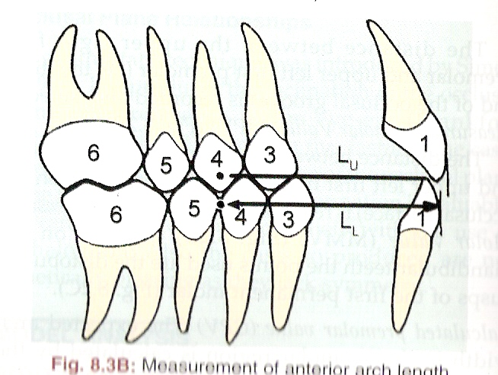
KORKHAUS ANALYSIS
This analysis makes use of the Linder Harth’s formula
an addition measurement is made from the mid point of the inter-premolar line to a point between the incisal edge of two maxillary incisors “incision”

Slide 48
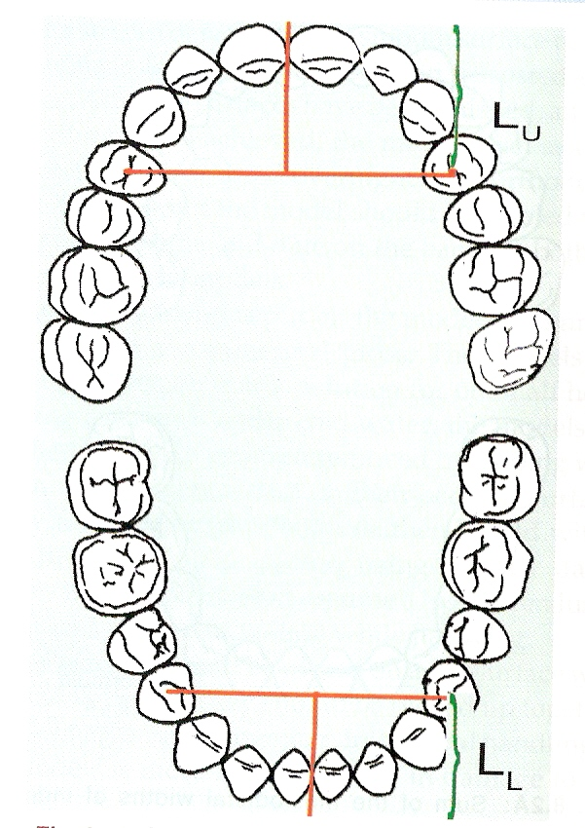

Slide 49
INFERENCES
If distance between interpremolar line to incision is more than the upper incisors are proclined &
if decreased value denotes retroclined upper incisors
Mandibular value = maxillary value- 2mm

