Slide 1
CONTRACEPTIVES
Contraceptive methods are preventive methods to help women avoid pregnancies.

Slide 2
An ideal contraceptive method is one, which is safe, effective, acceptable, inexpensive, reliable, reversible, simple, long lasting, independent of coitus and requires less medical supervision.
A method may be suitable to one may not be to other.

Slide 3
CONTRACEPTIVES
OBJECTIVES---
1 --To avoid unwanted births.
2—To bring about wanted births.
3---To regulate the intreval between pregnancies.
4---To determine the number of children in the family.
METHODS—
1—Spacing methods (non-terminal method)
2—Terminal methods

Slide 4
SPACING METHODS
1 BARRIER METHODS:-
1—physical methods
2---chemical methods
3---combined methods
2 INTRA-UTERINE DEVICES
3—HORMONAL METHODS
4—POSTCONCEPTIONAL METHODS
5—MISCELLANEOUS

Slide 5
TERMINAL METHODS
1—MALE STERLIZATION
2---FEMALE STERLIZATION

Slide 6
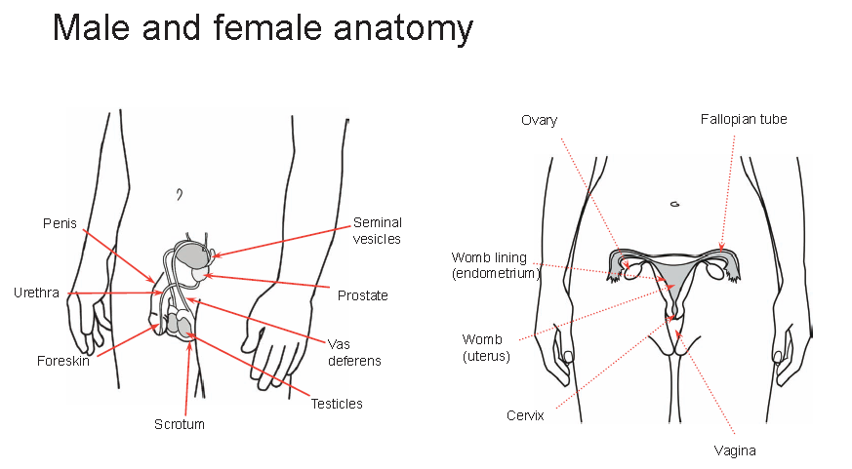

Slide 7
PHYSICAL METHODS
CONDOM-Sheath of thin rubber put on males erect penis before intercourse
ADVANTAGES
1—Easily available
2---Safe and inexpensive
3—Easy to use.
4—No side effects
5—Protects against S.T.D
6—Can be used soon after childbirth.
7 --Can be used by men of any age

Slide 8
DISADVANTAGES
1—It may slip off or tear during coitus due to incorrect use.
2—Interferes with sex sensation.
3—Failure rate 2-3 per 100 women per year
TYPES---Ordinary, deluxe and super deluxe

Slide 9
FEMALE CONDOM
it is a pouch made of polyurethane which lines the vagina
An internal ring in the close end of the pouch covers the cervix and external ring remains outside the vagina
ADVANTAGE-
-effective barrier to STD

Slide 10
DISADVANTAGE
Costly
Failure rate 5%.

Slide 11
DIAPHRAGM
It is a vaginal barrier
It is a shallow cup made of synthetic rubber or plastic material
The diaphragm is inserted before sexual intercourse and must remain in place for not less than 6 hours after intercourse.
A spermicidal jelly is always used along with the diaphragm.
The diaphragm holds the spermicide over the cervix.

Slide 12
DIAPHRAGM cont…
ADVANTAGES OF DIAPHRAGM
1-Total absence of risks and medical Contraindications.
No side effects
DISADVANTAGES
Initially a trained person is needed to demonstrate the technique of insertion.
After delivery it can be used only after involution of uterus.
Failure rate 6-10%

Slide 13
VAGINAL SPONGE
TODAY
Small polyurethane foam sponge measuring 5 cm X 2.5 cm saturated with spermicide
Failure rate is 20-40%.

Slide 14
CHEMICAL METHODS
I—FOAMS—foam tablets, foam aerosols
2—CREAMS ,JELLIES AND PASTES— squeezed from a tube
3—SUPPOSITORIES—Inserted manually
3—SOLUBLE FILMS—C-films inserted manually.
DISADVANTAGE—High failure rate
They may cause burning or irritation.
Used before each sex.

Slide 15
INTRA-UTERINE DEVICES
These are of 2 types
1—medicated
2—non medicated
These are classified as
A—First generation I.U.D
B---Second generation I.U.D
C—Third generation I.U.D
FIRST GENERATION IUD—These comprise non-medicated devices ex-Loops,spirals coils,rings and bows
LIPPES LOOP---—It is double Shaped device made of polyethylene.The loop has attached threads made of nylon.These thread project into vagina and can be felt by the patient.
SIDE EFFECT—Pain and bleeding.

Slide 16
SECOND GENERATION I.U Ds
EARLIER DEVICES-
COPPER—7
COPPER T- 200
NEWER DEVICES—
1—T CU-220 C
2—T CU-380 A
NOVA-T
MULTILOAD DEVICES
1—ML-CU 250
2—ML-CU-375
The number refer to the surface area of the copper on the device.

Slide 17
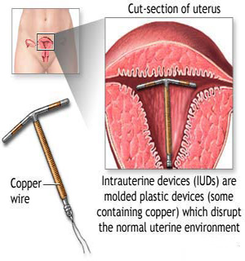
COPPER -T

Slide 18
COPPER-T
ADVANTAGES
Simplicity in insertion
Inexpensive
Contraceptive effect is reversible.—
Low expulsion rate
Lower incidence of side effects,e.g.pain and bleeding
Easier to fit even in nulliparous women
Better tolerated by nullipara.
Effective as post-coital contraceptive,if inserted within 3-5 days of unprotected intercourse.

Slide 19
COPPER-T cont….
MECHANISM OF ACTION OF COPPER T
IUD causes foreign body reaction in the uterus.
Copper seems to enhance the cellular response in the endometrium. It also effects the enzymes in the endometrium
By altering the biochemical composition of cervical mucus,copper ions may affect sperm motility and survival.

Slide 20
THIRD GENERATION I.U Ds
These release hormone.
Progestasert—T shaped device filled with progesterone,which is released slowly in the uterus.
LNG-20(Mirena)-- releasing levonorgesterol.
MECHANISM OF ACTION---They increase the viscosity of cervical mucus and prevent sperm from entering the cervix.

Slide 21
SIDE EFFECTS AND COMPLICATIONS OF IUD
Bleeding—Increased vaginal bleeding.
Pain—second major cause of IUD removal.
Pelvic infection—2 to 8% more.
Uterine perforation—1 in 150 to 1 in 9000
Pregnancy—3%
Ectopic pregnancy—slightly more
Expulsion-12to 20%
Fertility after removal—Does not seems to be impaired.
Mortality—1 per100,000

Slide 22
CONTRAINDICATIONS OF IUD
ABSOLUTE---
Suspected pregnancy
PID
Vaginal bleeding of unknown etiology
Cancer of cervix ,uterus or adenoma or pelvic tumours.
Previous ectopic pregnancy.
RELATIVE
Anaemia
Menorrhagia
PID
Fibroids

Slide 23
HORMONAL METHODS
ORAL PILLS
1—COMBINED PILL
2---PROGESTOGEN ONLY PILL
3---POST COITAL PILL
4—ONCE –A- MONTH PILL
5--MALE PILL
DEPOT FORMULATIONS
1—INJECTABLES
2---SUBCUTANEOUS IMPLANTS
3—VAGINAL RINGS.

Slide 24
COMBINED PILL
Most formulations contain 30-35 mcg of synthetic estrogen and 0.5to1.0mg of progestogen.
The pill is given orally for 21 days beginning on the 5th day of menstrual cycle,followed by break of 7 days during which period menstruation occur.
The pill should be taken everyday at a fixed time.
Govt.supplies ---MALA-N which contains Levonorgestrel0.15mg and ethinil oestradiol 0.03mg.It is a package of 28 tab(21o.c pills and 7 brown ferrous fumerate tab.)

Slide 25
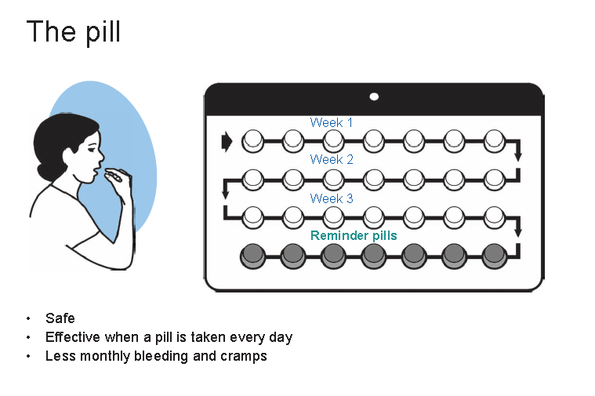

Slide 26
COMBINED PILL cont…..
MODE OF ACTION OF COMBINED Oral Contaceptives
The mode of action of combined oral pills is to prevent release of the ovum from the ovary.
EFFECTIVENESS—
Combined Oral Contraceptives is 100 % effective.

Slide 27
COMBINED PILL cont…..
ADVERSE EFFECTS
1-COMMON SIDE EFFECTS— Breast tenderness, Weight gain, Headache and migraine and Bleeding disturbances
2-CARDIOVASCULAR EFFECTS- Increased risk of Myocardial infarction, cerebral thrombosis, and venous thrombosis.
3--CARCINOGENESIS---No clear evidence but trend toward increased risk of cancer cervix

Slide 28
COMBINED PILL cont…..
4--METABOLIC EFFECTS—Elevated Blood Pressure, Elevation of blood glucose and plasma insulin .these are related to progestogen component.
OTHER ADVERSE EFFECTS—
A –liver disorder—hepatocellular adenoma and gall bladder disease.
B—lactation---decreased milk secreation,and excrete small amount of hormones in their breast milk.

Slide 29
PROGESTOGEN –ONLY PILL
It contains only progestogen.this pill is called “minipill.It is taken everyday . Commonly used progestogens are norethisterone and levonorgesterol.
MODE OF ACTION—--Makes cervical mucus thick and scanty and inhibits sperm penetration.

Slide 30
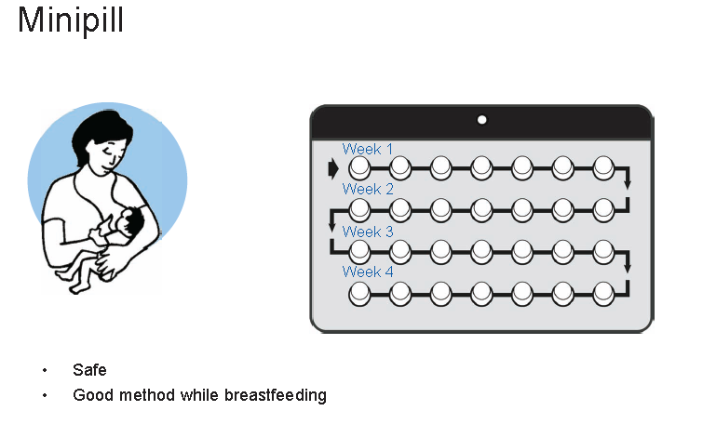

Slide 31
PROGESTOGEN –ONLY PILL cont…
ADVANTAGE—1-they could be prescribed to older women for whom combined o.c is contraindicated because of cardiovascular risks.
2—They may also be considered in young women with risk factors for neoplasia.
DISADVANTAGE—Poor cycle control and increased pregnancy rate

Slide 32
POSTCOITAL CONTRACEPTION
POSTCOITAL CONTRACEPTION---is recommended within 72 hours of unprotected intercourse.It is called( “ morning after ‘)
1—HORMONAL—More often a hormonal method is preferable.
In India Levonorgestrel 0.75mg tab.is approved for emergency contraception.
A).It is used as one tab.of 0.75 mg within 72 hours of unprotected sex and 2nd tab after 12 hours of 1st dose.
OR
B)Two oral contraceptive pills containing 50 mg of ethinyl estradiol within 72 hours and the same dose after 12 hours.
OR
Mifepristone 10 mg once within 72 hours.

Slide 33
POSTCOITAL CONTRACEPTION cont…
2-IUD-To insert an IUD within 5 days especially a copper device within 5 days.

Slide 34
POSTCOITAL CONTRACEPTION cont…
INDICATIONS-
Unprotected intercourse
Rape
Contraceptive failure
FAILURE---Less than 1%.

Slide 35
INJECTABLE CONTRACEPTIVE
2 TYPES:-1 –PROGESTOGEN-ONLY INJECABLES
2—NEWER ONCE A MONTH COMBINED INJECTABLE
PROGESTOGEN ONLY INJECTABLES
A—DMPA
B---NET-EN
C—DMPA-SC

Slide 36
DMPA
DEPOT-MEDROXYPROGESTERONE ACETATE— - DOSE—The standard dose is 150 mg every 3 months deep I /m into the gluteus maximus during first 5 days of menstrual cycle
PROTECTION---99%
MODE OF ACTION---Suppression of ovulation
ADVANTAGES--
1---Safe ,effective method.
2—Requires a minimum of motivation or none at all.
3---Does not affect lactation.

Slide 37
DMPA cont….
DISADVANTAGE—
1-Weight gain
2-Irregular menstrual bleeding –amenorrhea or excessive bleeding
3-prolonged infertility after its use

Slide 38
DMPA cont….
CONTRAINDICATIONS
Cancer of breast
All genital cancers
Undiagnosed abnormal uterine bleeding.
Suspected malignancy
Hypertension
Post partum-less than 6 weeks.

Slide 39
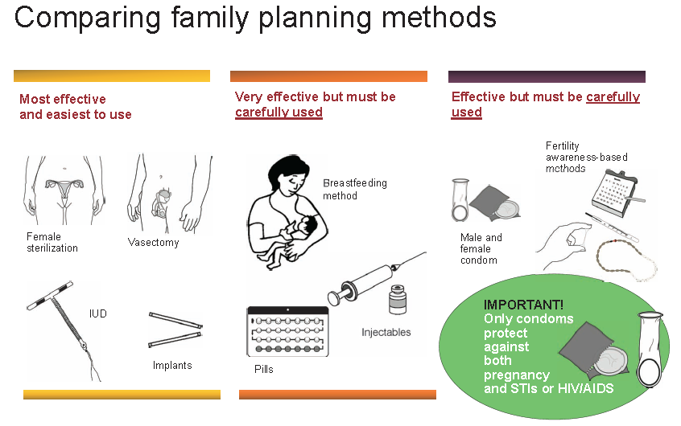

Slide 40


