Slide 1
REMOVABLE APPLIANCES

Slide 2
CONTENTS
Introduction
Advantage
Disadvantage
General principles
Appliance design
Components
Delivery of appliance
Instructions to patient
Common failures
Problems encountered

Slide 3
INTRODUCTION
Appliances that can be removed by the patient without any supervision
Useful in a variety of situations
Disadvantage
- treatment in control of the patient
-movement of teeth in all the three planes of space cannot be carried out simultaneously

Slide 4
ADVANTAGES
The patient can continue with routine oral hygiene procedures without any hindrance.
The oral cavity as well as the appliance can be kept clean.
All restorative procedures can also be carried out during such an orthodontic appliance therapy.
Most forms of tipping movement can be carried out successfully.
These appliances are less conspicuous than fixed appliances and hence, generally more acceptable to the patients.
Since these are relatively simple appliances they can be delivered and monitored by the general dentist.

Slide 5
chair side time for appliance delivery is less than the fixed appliances.
The patient can remove a broken or otherwise uncomfortable/impinging appliance. Thus, a broken appliance is never an emergency for the clinician.
These appliances require a limited inventory to be maintained as compared to more complex fixed appliances.
Relatively cheap as compared to the fixed appliances.

Slide 6
DISADVANATAGES
Patient cooperation is the key word in removable appliance therapy. Hence, the treatment can become prolonged depending on patient compliance.
These appliances are capable of only certain types of movements, and do not give three-dimensional control over teeth.
Multiple movements are difficult, if not impossible to carryout.
The patient has to have a certain amount of dexterity and skill to be able to remove and replace the appliance for successful treatment to be possible.
The chance of appliance loss and/or breakage is more.

Slide 7
GENERAL PRINCIPLES OF
REMOVABLE APPLIANCES
A removable appliance works by tipping a tooth around its center of resistance, which is located between 30 and 40 percent from the root apex when considering the whole length of the tooth.
The forces exerted are dependent on:
  The kind of appliance
  The harnessing of forces from the adjacent soft and hard tissues or incorporation of springs or elastics
  The type of contact the active component makes with the tooth/teeth to be moved

Slide 8
APPLIANCE DESIGN

Slide 9
COMPONENTS
Detailed plan of the tooth movement to be carried out
The morphologic characteristics, the age and eruption status of the patient
Psychologic findings and the treatment objectives.
Three components:
  Force or active components comprises of springs, screws or elastics.
  Fixation or retentive components-usually include clasps.
  Base plate or framework-s-can be made of cold cure or heat cure acrylic.

Slide 10
ACTIVE COMPONENTS
apply forces to the teeth to bring about the desired tooth movement.
Include:
  Springs-made up of 0.5, 0.6 or 0.7 mm diameter stainless steel wire
  Bows-made from 0.5 or 0.7mm diameter stainless steel wire
  Screws
  Elastics

Slide 11
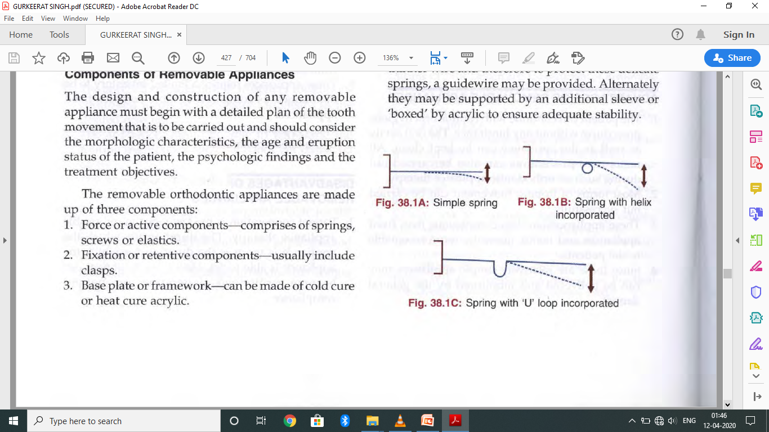
SPRINGS
Can be broadly classified into:
Based on the presence of helices
  Simple spring (Fig. a)-no helix present
  Compound spring (Fig. b)-helix incorporated
  HelicaI springs (Fig. b)-helix is present
  Looped spring (Fig. c)-no helix, but a loop is included in the design
Based on the mode of support
  Self-supported springs-these springs are made up of thicker wire to avoid distortion by the patient.
  Supported springs-these springs are made up of thinner wire

Slide 12
DESIGNING A SPRING
Suitable material- 18/8 stainless steel (ss) wire with the properties
  Elasticity
  Malleability
  Tasteless
  immune to corrosion by oral secretions.
Relationship between the length, diameter and amount of deflection of a spring which is expressed as:
D ∝ PL³
T⁴
Where,
  D = amount of deflection
  P = amount of pressure
  L = length of spring
  T = thickness Idiameter of spring

Slide 13
Thickness/diameter of spring (T)
  if the diameter is doubled, the deflection/flexibility of a spring decreases by 16 times, i.e.
  thinner wire generates less force, has increased flexibility, thus, remaining active over a longer time period

Slide 14
Length of wire (L) Doubling the length of the wire
  increases the flexibility of the spring by eight times
  reduces the force exerted
  Increasing the length of wire increases the range of action
  A double helix provides further increase in flexibility by incorporating more wire in a given length of spring

Slide 15
Pressure/force (P) Deflection of a spring is double,
  when the pressure is doubled. The pressure to be applied is on an average 20 gm/cm² of root area and can vary according to the number of teeth to be moved, root surface area and patient comfort.

Slide 16
Other requirements for a spring are:
  Ensure that the spring will act over the distance and the direction needed to move the teeth, e.g. To move a teeth labially a spring should be palatally positioned and vice versa.
  The spring should be mechanically strong to withstand interferences that occur due to eating, speaking and cleaning.

Slide 17
TYPES OF SPRINGS

Slide 18
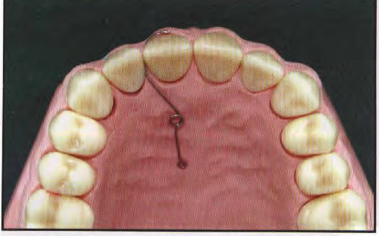
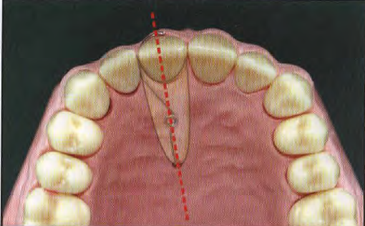
FINGER SPRING
The most useful spring for removable appliance (Fig. a).
Constructed using 0.5 or 0.6 mm hard round SS wire.
made up of a coil or helix near the point of attachment and a free end, which moves, in a well-defined arc.
The free end is the active arm, 12-15mm in length, placed towards the tissue, the helix is about 3 mm in internal diameter and the retentive arm (minimum of 4-5 mm in length) is placed away from the tissue and ends in a retentive tag.
Construction
  The spring is constructed such that the helix is positioned opposite to the direction of intended tooth movement. The helix should also be placed along the long axis of the tooth to be moved and perpendicular to the direction of tooth movement (Fig. B)

Slide 19
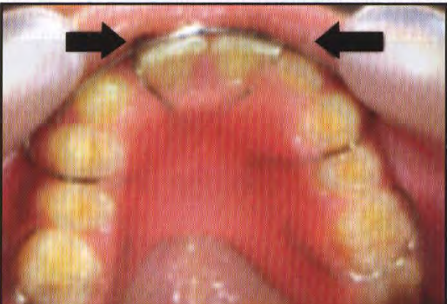
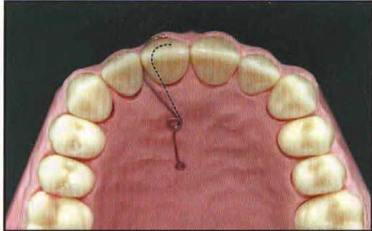
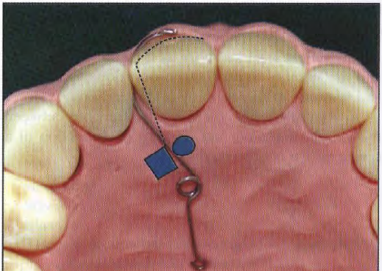
the spring should be either boxed in wax or guards should be made.
Indication
  Mesiodistal movement of teeth, e.g. closure of anterior diastemas (Fig. a)
Activation
  by opening the coil (Fig. b) or moving the active area towards the tooth to be moved (Fig. c).
  About 3 mm of activation is considered optimum.

Slide 20
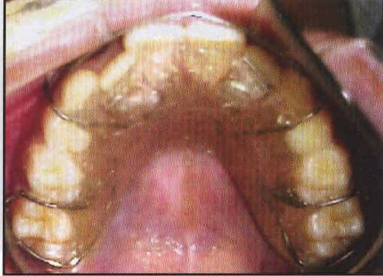
DOUBLE CANTILEVER SPRING
A variation of the cantilever spring, where a second limb is formed with a second coil. Such a spring can also be used to move 2 or more teeth in the same direction over equal distances as when proclining 2 or more upper incisors.
Construction
  made up of 0.5 mm hard round SS wire.
  consists of 2 helices of small internal diameter
  can be made for one, two or more incisors.
  positioned perpendicular to the palatal surface of the tooth with a long retentive arm (placed away from tissue) about 12mm in length.
It is a supported spring and needs to be boxed in wax prior to acrylization
activated by opening both the helices up to 2-3 mm at a time. Only one helix may be activated to correct mild rotations.

Slide 21
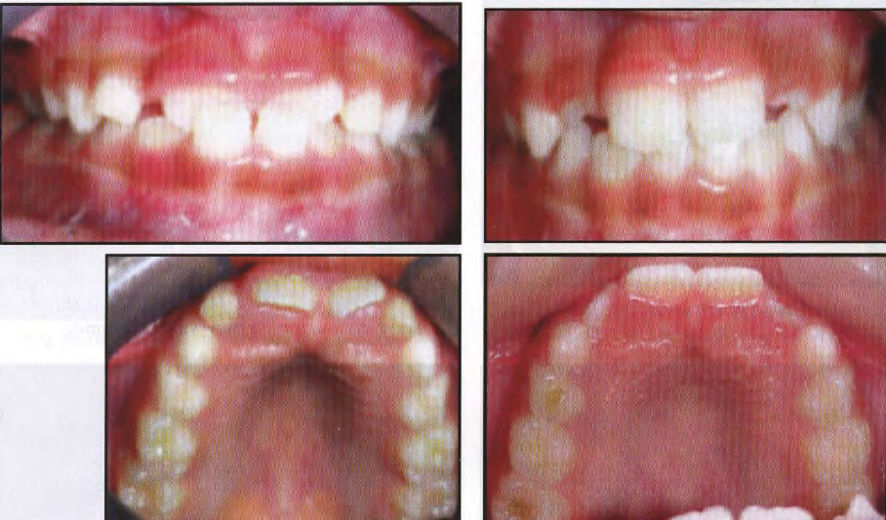
It is ideal for the correction of anterior tooth crossbites where the overlap is less than the free way space

Slide 22
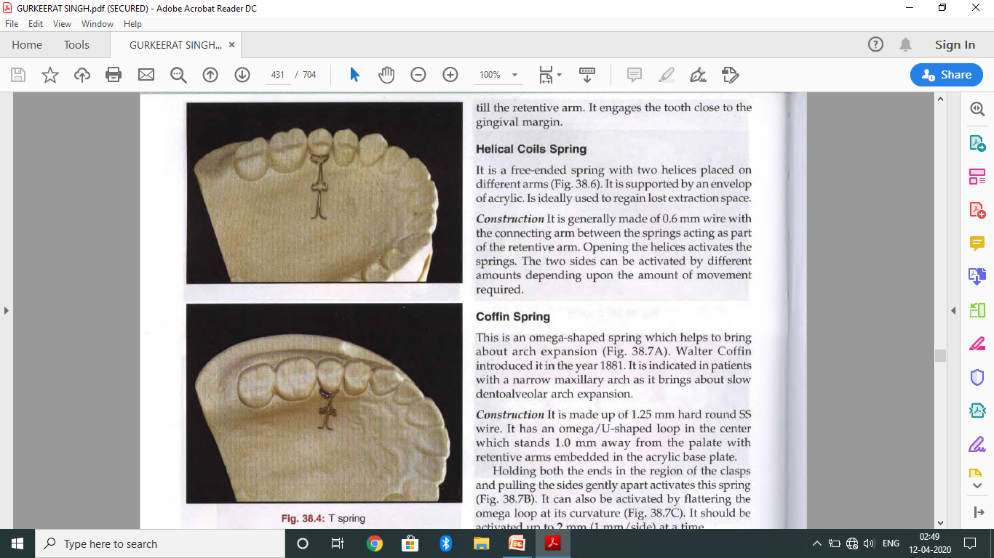
T spring
made up of 0.5 mm hard round SS wire
used for buccal movement of premolars and sometimes canines.
has a T-shaped arm, the ends of which is embedded in the baseplate
Loops incorporated in the arms of the T-loops can be opened up to remain in contact with the tooth as it moves buccally.
Activation is done by pulling the free end of the 'T' towards the intended direction of tooth movement.

Slide 23
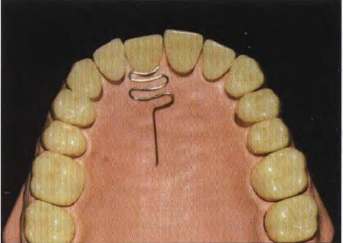
MATTRESS SPRING
used for the correction of the labial movement of teeth in crossbite.
usually used in cases where sufficient space exists for the correction of the crossbite and if the tooth in question is sufficiently complete in its development
Construction
  Usually made of 0.6 mm diameter wire.
  It is shaped like a mattress with 'U' loops extending till the retentive arm.
  engages the tooth close to the gingival margin

Slide 24

HELICAL COIL SPRING
It is a free-ended spring with two helices placed on different arms
supported by an envelop of acrylic.
ideally used to regain lost extraction space.
Construction
generally made of 0.6 mm wire with the connecting arm between the springs acting as part of the retentive arm. Opening the helices activates the springs.
The two sides can be activated by different amounts depending upon the amount of movement required.

Slide 25
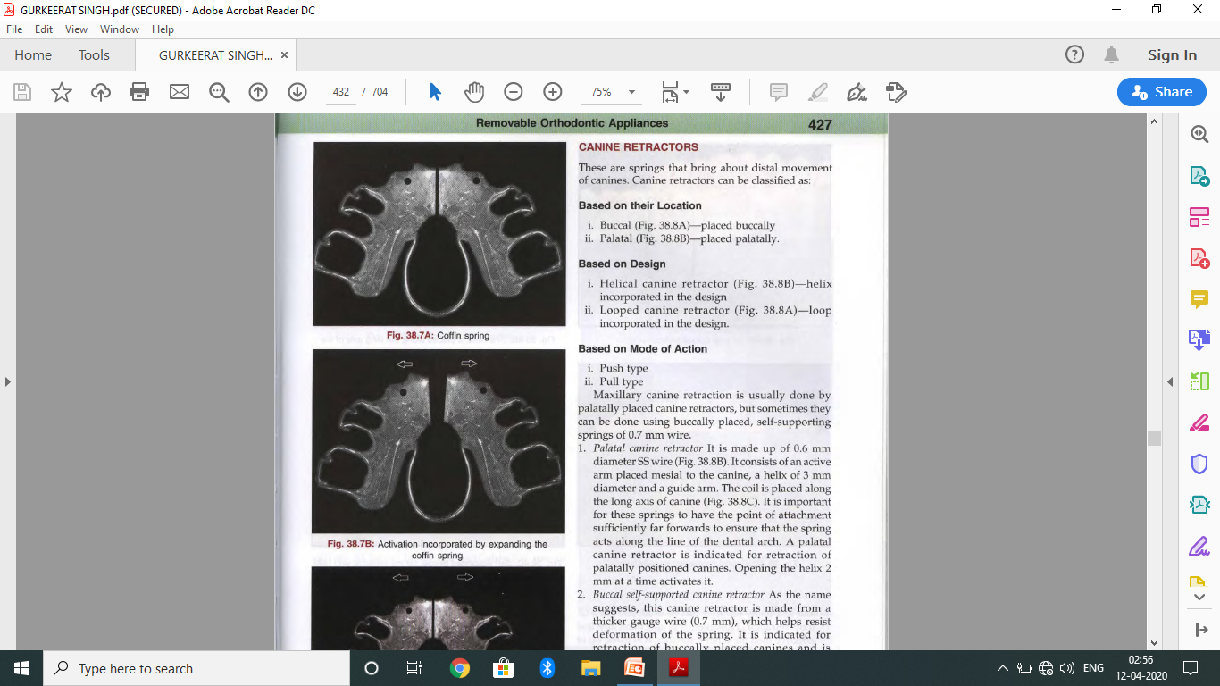
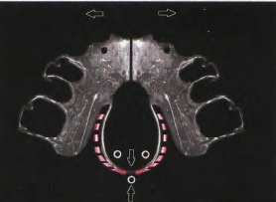
COFFIN SPRING
This is an omega-shaped spring
helps to bring about arch expansion (Fig. a).
Waiter Coffin introduced it in the year 1881.
indicated in patients with a narrow maxillary arch
Construction
  made up of 1.25mm hard round SS wire.
  has an omega/V-shaped loop in the center which stands 1.0 mm away from the palate with retentive arms embedded in the acrylic base plate.
activation
  Holding both the ends in the region of the clasps and pulling the sides gently apart activates this spring (Fig. b).
  can also be activated by flattering the omega loop at its curvature (Fig. c).
  It should be activated up to 2 mm (1 mm/side) at a time

Slide 26
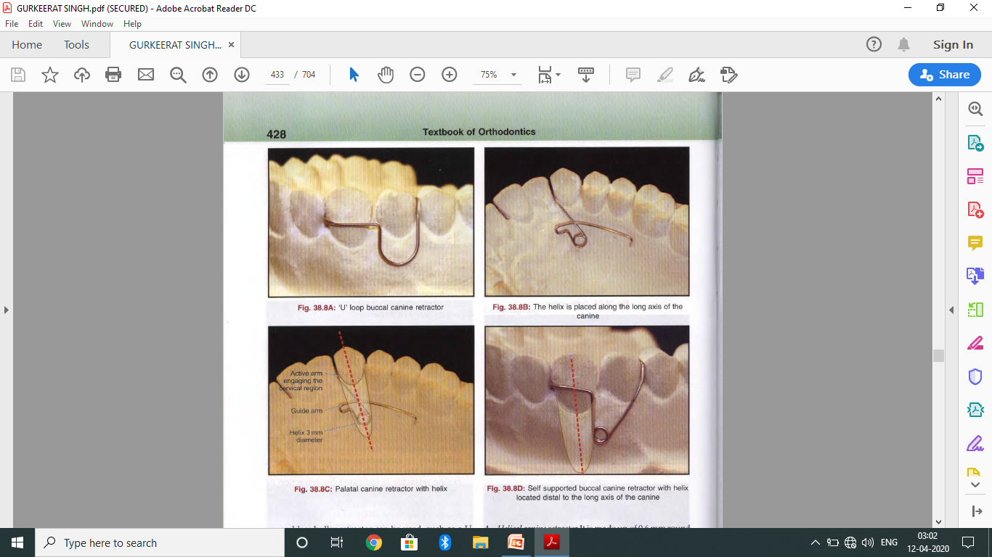
CANINE RETRACTORS
These are springs that bring about distal movement of canines. Canine retractors can be classified as:
  Based on their Location
    i. Buccal (Fig. a)-placed buccally
    ii. Palatal (Fig. b)-placed palatally.
  Based on Design
    1. Helical canine retractor (Fig. b)-helix incorporated in the design
    ii. Looped canine retractor (Fig. a)-100p incorporated in the design.
  Based on Mode of Action
    i. Push type
    ii. Pull type

Slide 27
1. Palatal canine retractor
  It is made up of 0.6 mm diameter Sswire (Fig. a)
  It consists of an active arm placed mesial to the canine, a helix of 3 mm diameter and a guide arm.
  The coil is placed along the long axis of canine (Fig. b).
  Important for these springs to have the point of attachment sufficiently far forwards to ensure that the spring acts along the line of the dental arch.
  indicated for retraction of palatally positioned canines.
  Opening the helix 2 mm at a time activates it.

Slide 28
2. Buccal self-supported canine retractor
  made from a thicker gauge wire (0.7 mm), which helps resist deformation of the spring.
  indicated for retraction of buccally placed canines
  made up of an active arm, a helix of 3 mm diameter and a retentive arm
  The active arm is placed away from the tissues and the helix is positioned distal to the long axis of the canine.

Slide 29
3. "U" loop canine retractor
  When minimal canine retraction (1-2mm) is required, a relatively simple and less bulky retractor can be used, such as a U loop retractor.
  mechanically less effective than the other retractors.
  made up of 0.6 or 0.7 mm SS wire and consists of an active arm, U-loop and a retentive arm.
  The base of the U'-loop is placed 2-3 mm below the cervical margin,
  the active arm is bent at right angles from the mesial leg of the loop and adapted around the canine
  The distal leg of the loop extends as the retentive arm.
  This retractor is activated by compressing the loop or by cutting the free end of the active arm by 2 mm and readapting it

Slide 30
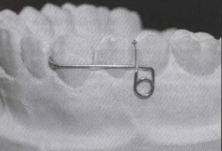
4. Helical canine retractor
  made up of 0.6mm round SS wire and consists of an active arm (towards the tissue), a helix of 3 mm diameter and a retentive arm.
  designed as a loop with the helix at its base; the distal arm is bent at right angles to form the active arm, which engages the canine
  The mesial arm is adapted between the premolars and ends in a retentive tag.
  helix is placed 3-4 mm below the gingival margin.
Activation is done by opening the helix by 2 mm or by cutting off 2 mm from the end of the active arm and readapting it around the canine.

Slide 31
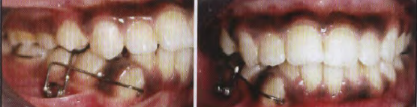
For the canine retractors, to be successful,
  canine to be mesially angulated prior to treatment
Notes:
If the canine is normal or distally angulated prior to treatment, a removable canine retractor will cause an unsightly distal angulation of the canine at the completion of retraction, which in turn will take a long time to correct with fixed appliances. For this reason, use of removable appliances for canine retraction is declining as fixed appliances ha ve greater control over tooth movement.

Slide 32
LABIAL BOWS

Slide 33
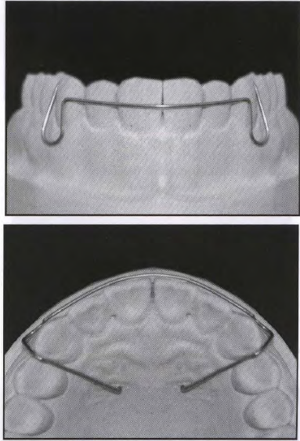
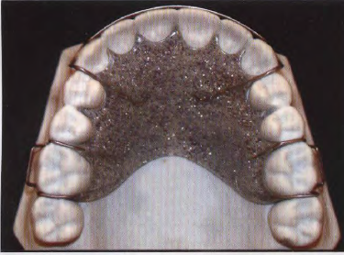
SHORT LABIAL BOW
made from 0.7 mm round SS wire.
bow contacts the most prominent labial surfaces of the anterior teeth and ends in two U'-shaped loops that extend as retentive arm between the canine and premolar before getting embedded in the acrylic base plate (Fig. a).
used for retention purposes (Fig. b) and
can bring about minor overjet reduction and anterior space closure.
Their range of action is limited because of stiffness and low flexibility.
For space closure, the bow is activated by compressing the loops of the bow by 1-2 mm

Slide 34
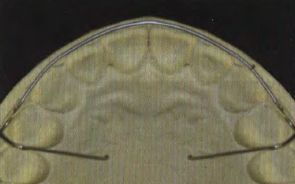
LONG LABIAL BOW
extends from the first premolar of one side to that of the contralateral side
The distal arm of the U-loop extends between the two premolars and ends as the retentive arm.
It can be used as an active and retentive component of the removable appliance.
indicated in minor overjet reduction, small amounts of anterior space closure, closure of space distal to canine and also for guidance of canine during canine retraction.
activated by compressing the loop 1-2mm so that the bow is displaced palatally by 1 mm

Slide 35

MODIFICATIONS OF LABIAL BOW
Labial bow soldered to Adams' clasp
  In extraction cases following orthodontic treatment, closed spaces can be retained with a Hawley's retainer in which a long labial bow is soldered to the bridge of the Adams' clasp
  short labial bow is not feasible in such cases

Slide 36
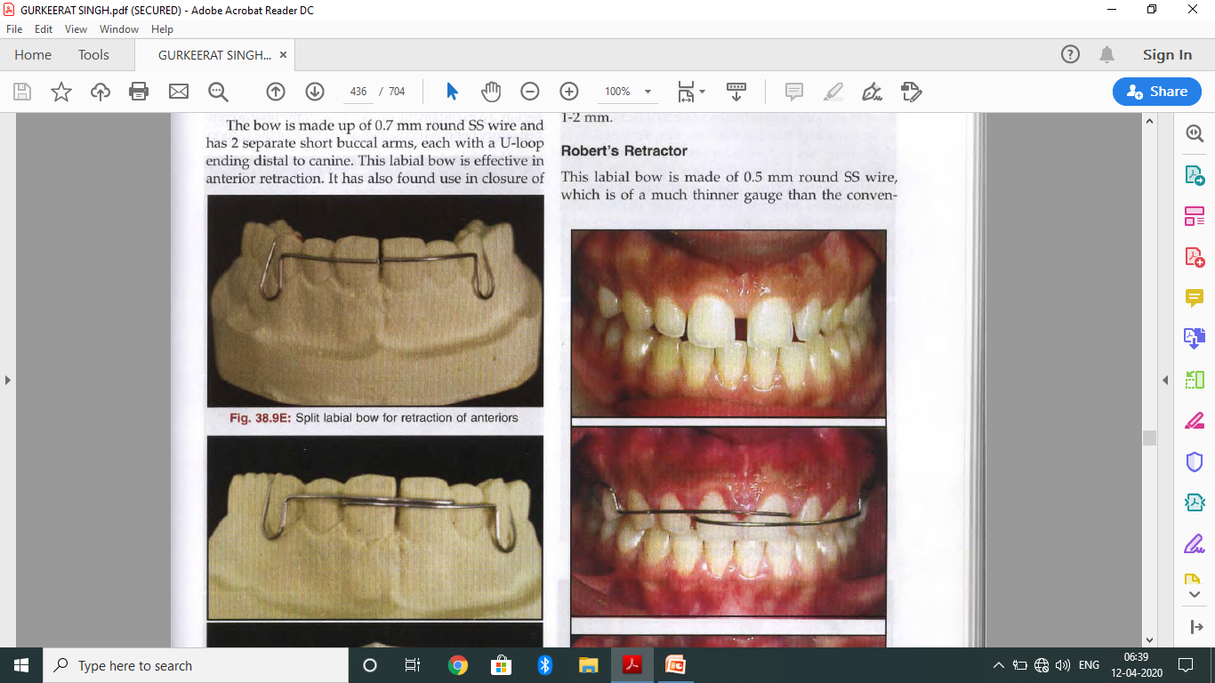
SPLIT LABIAL BOW
modification of the conventional short labial bow in that it is split in the middle
done to increase the flexibility of the otherwise stiff short labial bow.
made up of 0.7 mm round SS wire and has 2 separate short buccal arms, each with a V-loop ending distal to canine.
effective in anterior retraction, midline diastema
Activation is done by compressing the 'V' loop by 1-2 mm.

Slide 37
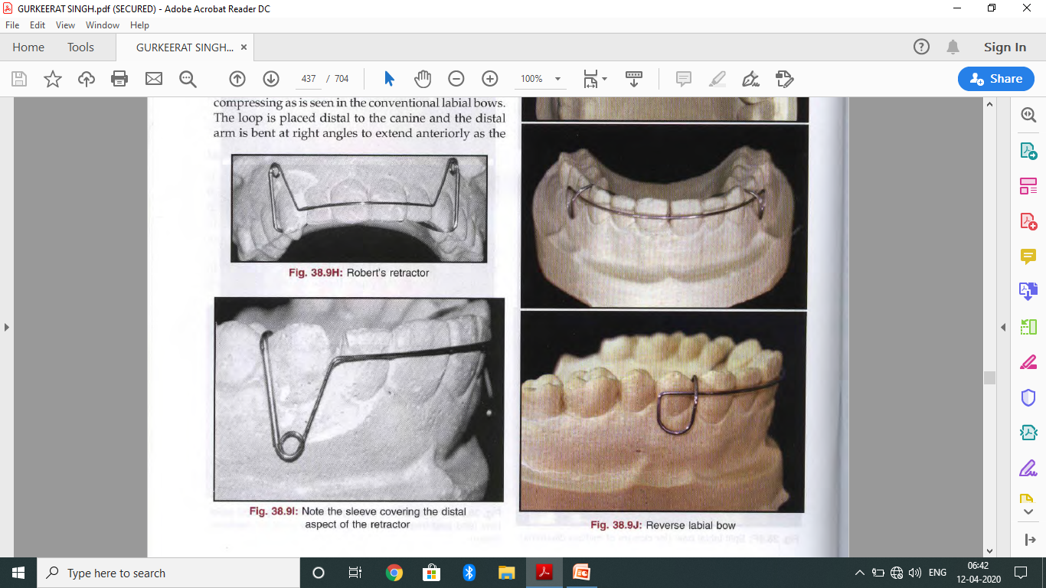
ROBERT’S RETRACTOR
made of 0.5 mm round SS wire, which is of a much thinner gauge than the conventional labial bows.
extends over the labial surfaces from canine to canine and instead of a regular loop it incorporates a 3mm internal diameter helix at the base of the loop (Fig. a).
The combination of a thin gauge wire and a helix makes this labial bow highly flexible and susceptible to distortion as it lacks stability in the vertical plane.
To overcome this, the distal arms of the loops are supported in softened stainless steel tubes of 0.5 mm internal diameter (Fig. b).
Along with Adams' clasp on the buccal teeth for retention, this retractor can be used in patients with severe anterior proclination as it produces lighter forces over a longer span of activation. It can also be used in adult patients for the same reason

Slide 38

REVERSE LABIAL BOW
Activation of the bow is done by opening the V-loop, instead of compressing
The loop is placed distal to the canine and the distal arm is bent at right angles to extend anteriorly as the labial part of the bow
The free end of mesial arm is adapted between the canine and first premolar and eventually gets embedded in the acrylic base plate.
Activation is done by opening the loop which results in lowering of the labial bow in the incisor region.
To maintain the proper level of the bow, a compensatory bend is then given at the base of the V-loop.

Slide 39
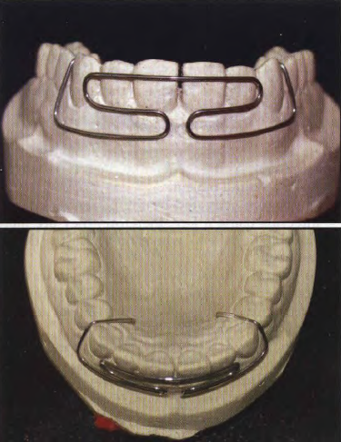
MILL’S RETRACTOR
made of 0.7 mm SSwire which has extensive looping in its design to increase the flexibility and range of action of the retractor
The anterior part of the bow extends till mesial of the canine and then forms a complex loop gingivally before ending in a retentive arm distal to the canine.
indicated in patients with increased overjet.
However, due to difficulty in construction and poor patient compliance, it is not widely used.

Slide 40
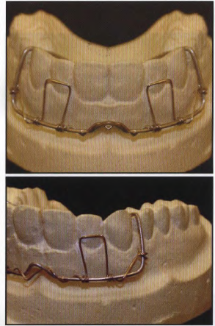
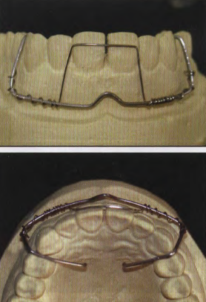
HIGH LABIAL BOW WITH APRON SPRINGS
Extends high into the labial vestibule.
Made of a thicker gauge SS wire (0.9-1 mm).
bow acts as a support onto which apron springs (made from 0.4mm wire) are attached/ wound (Fig. a).Apron springs
help in retraction of one or more upper anteriors (Fig. b).
made highly flexible because of the springs and is therefore used for retraction in cases with large overjet.
Apron spring is activated by bending it towards the teeth, up to 3 mm at a time.
Since it generates light forces, it is also useful in adult patients
difficult to construct and can cause soft tissue injury.
may also lack patient compliance as too much wire is visible.

Slide 41
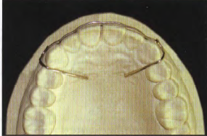
FITTED LABIAL BOW
adapted to the contours of the labial surface of anteriors
for retention after completion of fixed orthodontic treatment.
The U-Ioop is smaller compared to the conventional labial bows

Slide 42
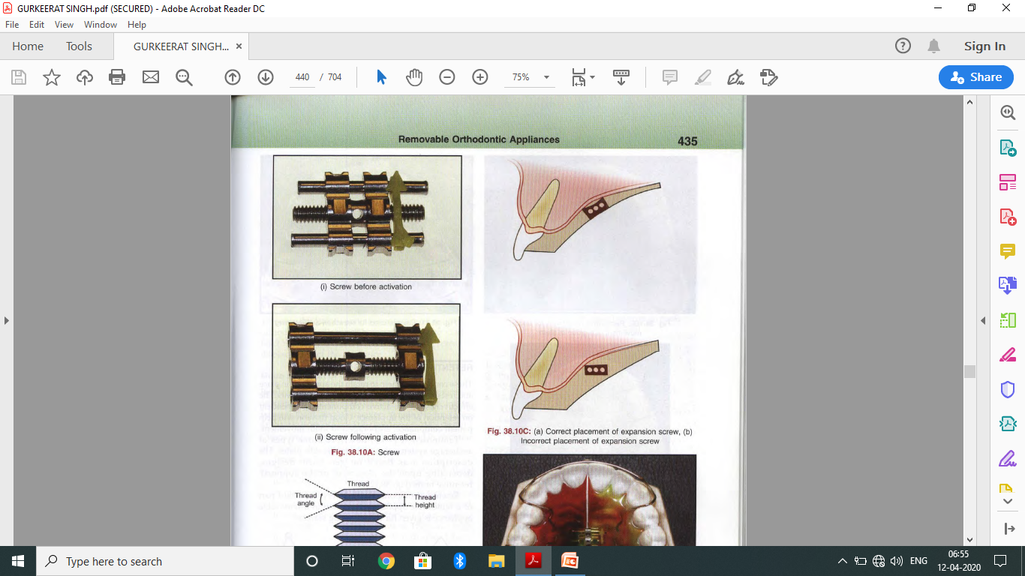
SCREWS
active components that are used to provide intermittent forces in removable appliances.
can be used to bring about various kinds of tooth movement.
consists of a rod with left and right hand threads at both ends and a nut in the center, which is turned for activation
The threads turn in metal blocks that are embedded in the baseplate, which is split at right angles to the screw.
appliance is retained with Adams' clasps on posterior teeth.
When the screw is turned, the two parts of the base plate separate and put pressure on the teeth.
causes the teeth to get slightly displaced and over time teeth move to 'new positions by remodeling of the overlying bone.
wide variety of tooth movements are possible based on the location of the screw, number of screws and location of the split in the plate.

Slide 43
ADVANTAGE OF SCREW OVER SPRINGS
easier to manage than those with springs. Therefore, they are useful in the less skillful patient.
Screws are activated by the patient at regular intervals using a key, therefore, they are more valuable in patients who cannot visit the dentist frequently.
fewer tendencies to get dislodged, offer more stability for moving several adjacent teeth in the same direction.
Forces generated can be controlled, based on the amount of activation done.

Slide 44
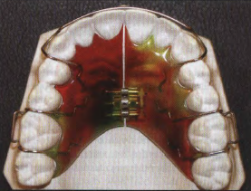
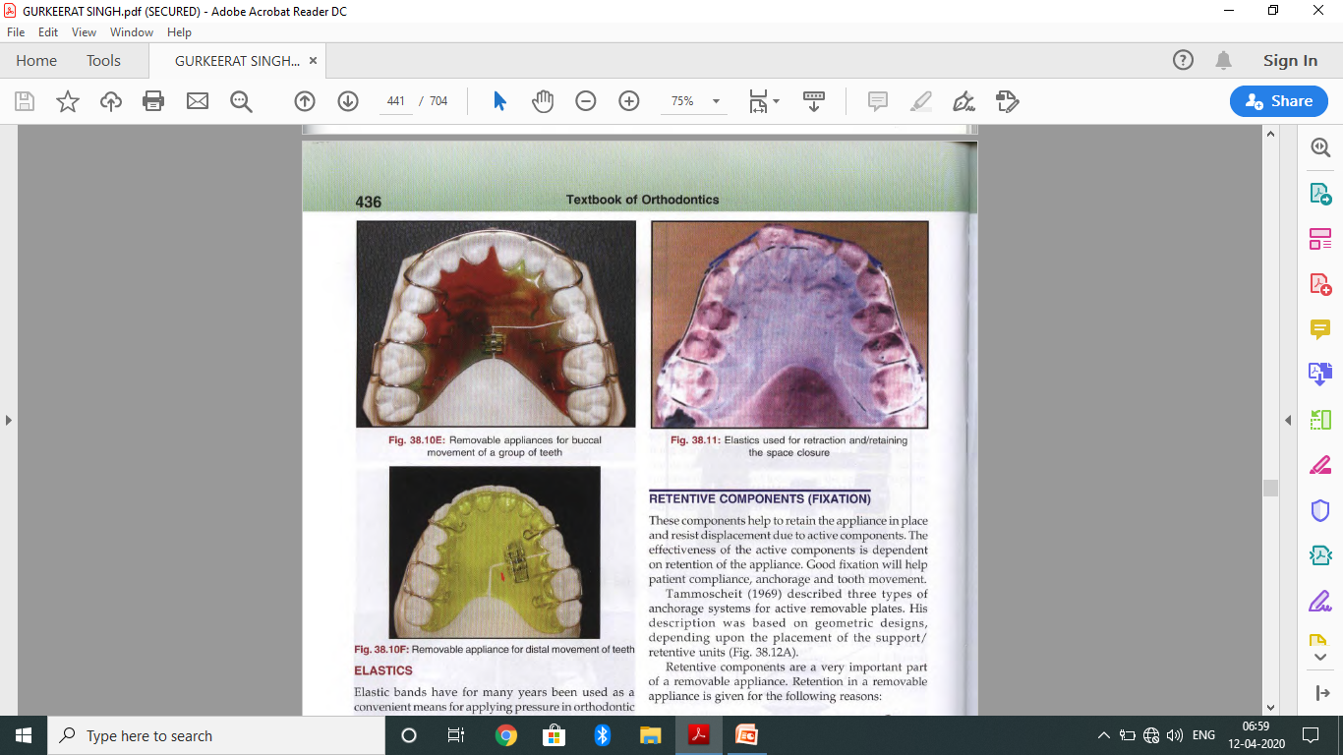
three types of tooth movements can be brought about by screw appliances:
  Arch expansion (Fig. a)-screw placed in the center of the arch.
  Labial/buccal movement of one or a group of teeth (Fig. b).
  Mesial/distal movement of one or more teeth (Fig. c).

Slide 45
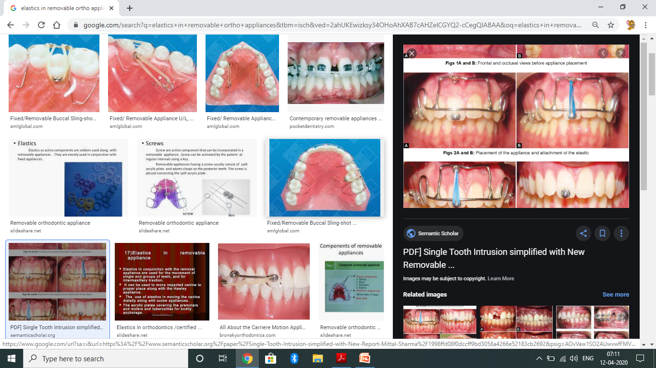
ELASTICS
can provide the force component in removable appliances.
can be used along with removable appliances for retraction of anterior teeth
attached to hook made in the labial bow distal to the canine.
stretched across the incisors, between the canines. However, drawbacks of such appliances are:
  Flattening of the arch form due to lack of control
  Gingival stripping due to slippage of the elastics.
Advantage
  Better esthetics, as they are less visible.

Slide 46
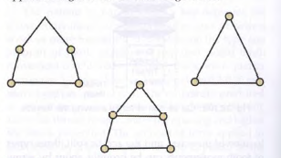
RETENTIVE COMPONENTS
help to retain the appliance in place and resist displacement due to active components.
effectiveness of the active components is dependent on retention of the appliance.
Good fixation will help patient compliance, anchorage and tooth movement.
Tammoscheit (1969) described three types of anchorage systems for active removable plates. His description was based on geometric designs, depending upon the placement of the support/ retentive units (Fig)

Slide 47
Retention in a removable appliance is given for the following reasons
  1. Active forces from bows, springs, screws and elastics can displace the appliance and make it ill fitting.
  2. A loose-fitting appliance is uncomfortable and if it is continually moving in the mouth, it can lead to metal fatigue and failure.
  3. Because of the above reasons, patient compliance will be poor and necessary tooth movements will not take place.
Good fixation is required to minimize such problems.
Adequate retention in a removable appliance is aided by wire components, which are known as clasps

Slide 48
CLASPS
retentive components of most removable orthodontic appliances.
supposed to 'clasp' /hold the teeth in such a manner so as to resist the displacement of the appliance

Slide 49
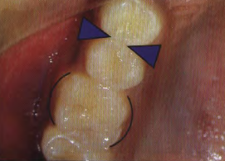
Mode of Action of Clasps
Between the maximum circumference of any tooth and anatomical neck, there are surfaces which slope inward towards the tooth axis on every side to produce areas of the teeth that are called undercuts
Clasps engage these undercut areas to aid in retention of a removable appliance.
There are 2 types of undercuts:
  a. The proximal undercuts
    extend from the contact area to the neck of the tooth.
    appear soon after a tooth has erupted, more pronounced than cervical undercuts
    visible from the buccal aspect
    The Adams‘ clasp and Crozat's clasp make use of these Undercuts,

Slide 50
  b. The ceruical undercuts
    are present on the buccal and lingual surfaces of the teeth below the area of maximum circumference
    visible from the mesial aspect
    less extensive than the proximal undercuts and therefore less retentive.
    cannot be used until the teeth are fully erupted to the anatomical neck.
    Circumferential and Jackson's clasps are examples of clasps that engage the cervical undercuts.

Slide 51
Requirements of an ideal clasp
  Easy to fabricate.
  Provide adequate retention.
  No interference with occlusion.
  Should not apply active force.
  Able to use on both fully and partially erupted teeth.
  No impingement on soft tissues.

Slide 52
DIFFERENT TYPES OF CLASP

Slide 53
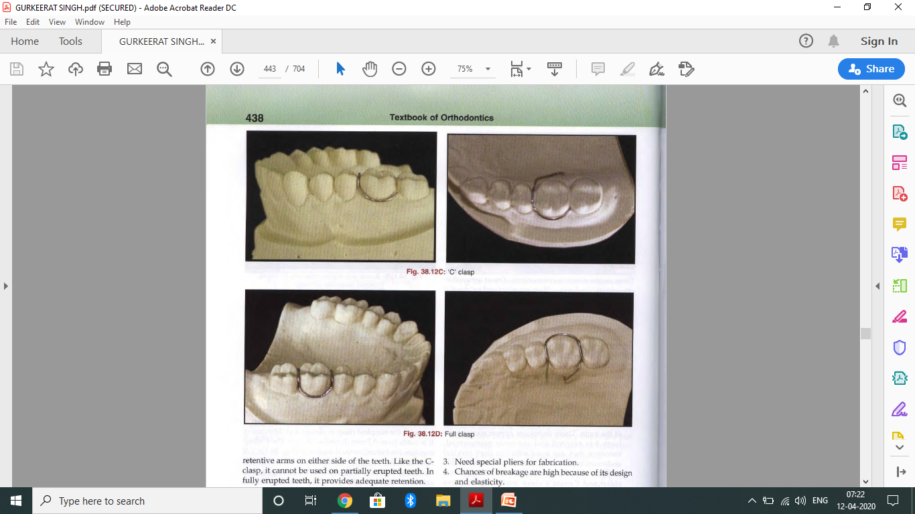
CIRCUMFERENTIAL/ C-CLASP
also known as the three quarter clasp.
one of the simplest clasp in design and fabrication.
It is made from 0.7mm diameter SSwire.
engages the buccal cervical undercut (Fig. 38.l2C).
extends in the form of a "C" from one proximal undercut along the cervical margin to the other proximal side and is then brought occlusally over the embrasure to end as the retentive arm.
normally starts from the mesial side and ends on the distal side However, it cannot be used in teeth that are partially erupted, as the cervical undercut cannot be seen

Slide 54
JACKSON’S CLASP
Introduced by Jackson in 1906.
made from 0.7 mm SS wire.
adapted along the buccal cervical margin and extends along the mesial and distal undercuts (Fig.38.120), over the occlusal embrasure to end in two retentive arms on either side of the teeth.
cannot be used on partially erupted teeth
In fully erupted teeth, it provides adequate retention.

Slide 55
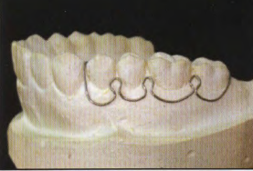
SCHWARZ CLASP
made up of a number of arrowheads which make use of the proximal undercuts between the molars and between premolars and molars
also called the arrowhead clasp.
drawbacks:
  It occupies a lot of space in the buccal vestibule.
  It can irritate the soft tissues - patient compliance is not good.
  Need special pliers for fabrication.
  Chances of breakage are high because of its design and elasticity.
  Difficult to fabricate and (time consuming).

Slide 56
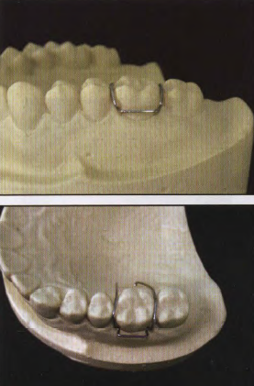
ADAMS CLASP
Devised by Professor C Philip Adams in 1948
one of the most effective clasps.
makes use of the mesial and distal proximal undercuts
of the first permanent molars
Also known as modified arrowhead, universal and Liverpool clasp.
It is made from 0.7mm round SSwire.
offers maximum retention as it engages the undercuts on the mesial and distal embrasures of first permanent molars.
can be used on premolars, permanent molars and even deciduous molars in which case 0.6 mm diameter wire is used.

Slide 57
advantages over other clasps, which are:
  It is simple, strong and easily constructed.
  It offers excellent retention.
  It can be used on any tooth be it incisor, premolars or molars.
  It is neat and unobtrusive and it makes an appliance easy to insert and remove using the bridges of the clasp.
  Good patient compliance as it is comfortable to wear and resistant to breakage.
  It can be used on both deciduous and permanent teeth.
  A number of modifications enable its use in a wide variety of appliances.
  No special instrument is required for its fabrication.

Slide 58
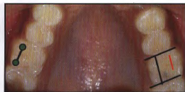
FABRICATING THE ADAMS' CLASP
The Adams' clasp is made of the following constituents:
  a. Two arrowheads
  b. Connecting bridge
  c. Two retentive arms with tags.
There are 3 stages in the formation of Adams' clasp
and each arrowhead is made by 3 distinct bends:
A 7-8 cm long piece of wire is taken.
i. The 1st bend is a little more than a right angle. Two such bends are made, which are connected by a bridge long enough to span the tooth. The length of the bridge is usually two/third the mesiodistal width of the tooth or the distance between the two buccal cusptips
ii. The 2nd bend is made in 2 stages of 90°each. The wire is first bent at right angles. The clasp is tilted downwards against the pliers and the arrowhead is formed by bending outside the tip of the beak. This second bend forms a V-turn in the wire of 180°. The slope of the arrowheads is adjusted to follow the gingival margin.

Slide 59
iii. The 3rd bend is given to bring the tags of the clasp over the embrasure between the teeth and on to the lingual side to get embedded in the base plate. The arrowhead is grasped from the inside of the clasp with half the length of the arrowhead between the beaks of the pliers and the tag is bent through 900- Holding the arrowhead at the top of the pliers, the tag is bent through a further 45° and then tried on the tooth. The retentive arm is kept slightly away from the mucosa and tags are made at the ends.

Slide 60
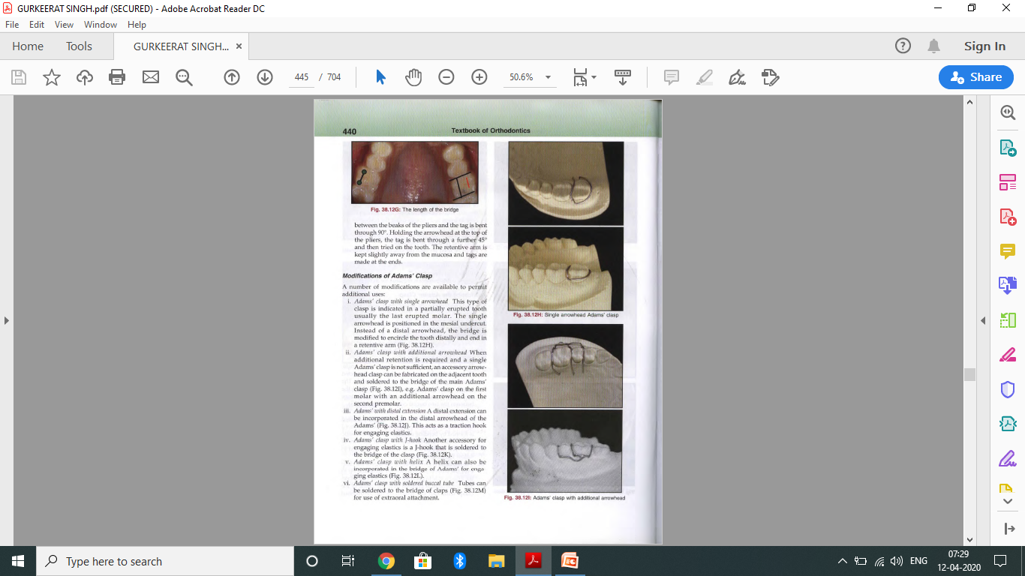
MODIFICATIONS OF ADAMS' CLASP
A number of modifications are available to permit additional uses:
  i. Adams' clasp with single arrowhead This type of clasp is indicated in a partially erupted tooth usually the last erupted molar. The single arrowhead is positioned in the mesial undercut. Instead of a distal arrowhead, the bridge is modified to encircle the tooth distally and end in a retentive arm (Fig. a).
  ii. Adams' clasp with additional arrowhead When additional retention is required and a single Adams' clasp is not sufficient, an accessory arrowhead clasp can be fabricated on the adjacent tooth and soldered to the bridge of the main Adams’ clasp (Fig. b), e.g. Adams' clasp on the first molar with an additional arrowhead on the second premolar.

Slide 61
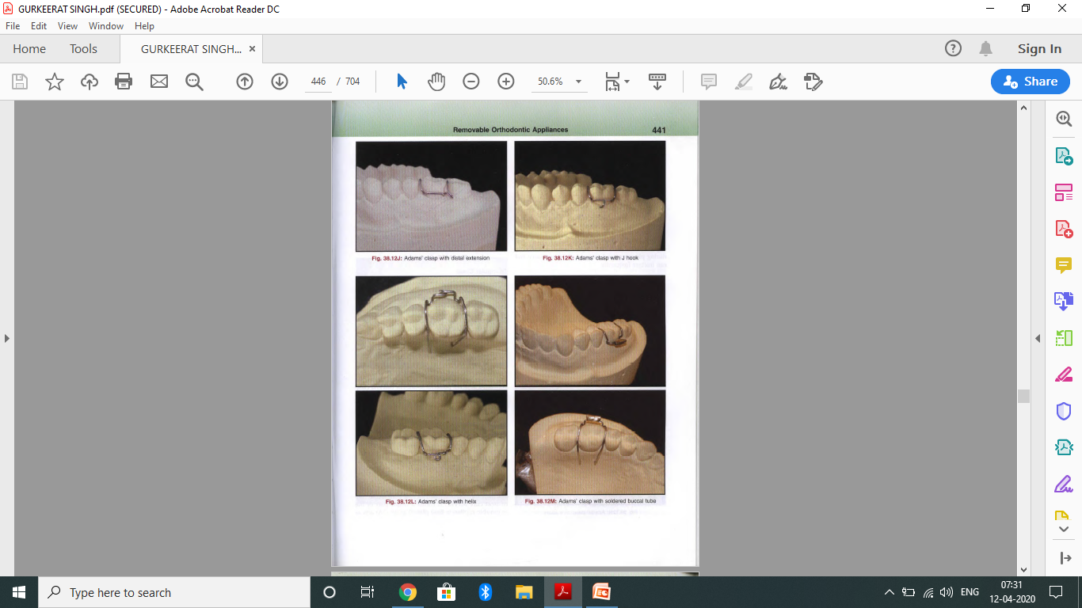

  iii. Adams' with distal extension A distal extension can be incorporated in the distal arrowhead of the Adams' (Fig. a). This acts as a traction hook for engaging elastics.
  iv. Adams' clasp with J-hook Another accessory for engaging elastics is a J-hook that is soldered to the bridge of the clasp (Fig. b).
  v. Adams' clasp with helix A helix can also be incorporated in the bridge of Adarns' for engaging elastics (Fig. c).

Slide 62
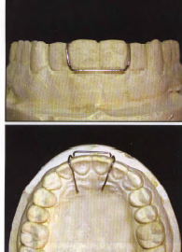
  vi. Adams' clasp with soldered buccal tube Tubes can be soldered to the bridge of claps (Fig. a) for use of extraoral attachment.
  vii. Adams' clasp on incisors and premolars Adams' can be fabricated on any tooth and for even a span of two teeth (Fig. b).
In every case, the basic form of the clasp is maintained so that clasping efficiency is undiminished

Slide 63

SOUTHEND CLASP
used for retention in the anterior region.
constructed along the gingival margin of both the maxillary central incisors and the distal ends end as retentive areas on the palatal side. This clasp can be used when upper incisors are not proclined and there is a limited undercut. In case of proclined incisors, the clasp is flexed unnecessarily during placement and removal of the appliance and can fracture frequently.

Slide 64
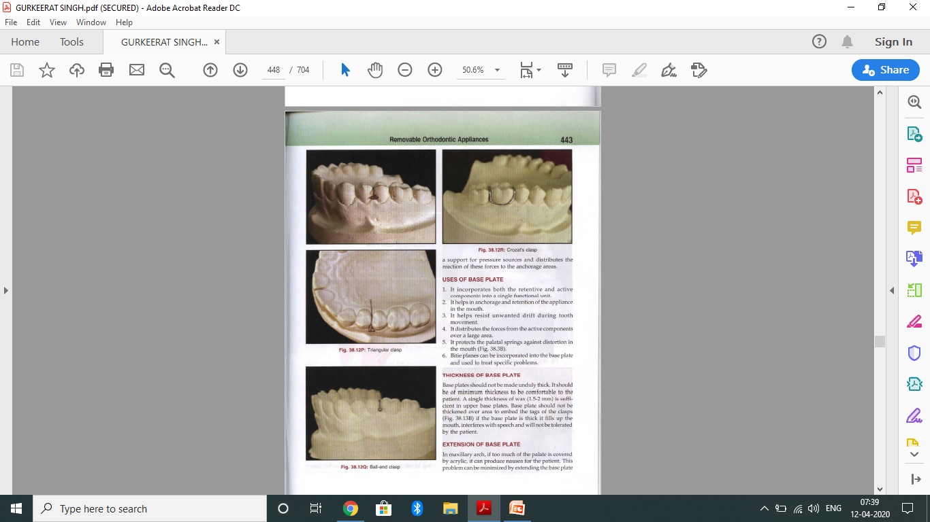
TRIANGULAR CLASP
used to provide additional retention.
Used alone, they cannot provide adequate retention and are therefore used as accessory clasps.
This clasp engages the proximal undercuts between the 2 posterior teeth and is carried over the occlusal embrasure to end as a retentive arm on the palatal aspect

Slide 65
BALL END CLASP
made up of a stainless steel wire (0.7 mm diameter) with a sphere or ball-like structure on one end
makes use of the mesial and distal undercuts between 2 adjacent posterior teeth.
ball end clasp can be fabricated with a silver solder and is also available in a preformed state.
also provide additional retention

Slide 66

CROZAT CLASP
It looks like Jackson's clasp, which has a piece of wire, soldered at the base
This wire engages the mesial and distal proximal undercut.
Advantage- offers better retention than the full clasp.

Slide 67
FRAMEWORK/BASE PLATE
material most often used- cold cure or heat cure acrylic.
forms a major part of the removable appliance.
acts as a support for pressure sources and distributes the reaction of these forces to the anchorage areas

Slide 68
USES OF BASE PLATE
  It incorporates both the retentive and active components into a single functional unit.
  It helps in anchorage and retention of the appliance in the mouth.
  It helps resist unwanted drift during tooth movement.
  It distributes the forces from the active components over a large area.
  It protects the palatal springs against distortion in the mouth
  Bite planes can be incorporated into the base plate and used to treat specific problems

Slide 69
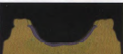
  THICKNESS OF BASE PLATE
should not be made unduly thick.
Should be of minimum thickness to be comfortable to the patient.
A single thickness of wax (1.5-2 mm) is sufficient in upper base plates. Base plate should not be thickened over area to embed the tags of the clasps
if the base plate is thick it fills up the mouth, interferes with speech and will not be tolerated by the patient.

Slide 70
EXTENSION OF BASE PLATE
In maxillary arch, if too much of the palate is covered by acrylic, it can produce nausea for the patient. This problem can be minimized by extending the base plate till the distal of the first molar and slightly cutting it forward in the midline
This ensures adequate strength and gains maximum anchorage at the same time.
The lower base plate is not extended too deep to avoid irritation to the sulcus and displacement by the tongue. In case of a lingual undercut, the undercut should be blocked before acrylization to facilitate easy removal. The edges should be rounded to avoid tissue injury

Slide 71
MODIFICATION OF BASE PLATE

Slide 72
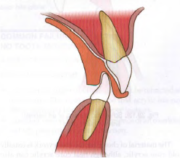
ANTERIOR BITE PLANES
required for overbite reduction and are made behind the incisors and canines.
should be flat and not inclined, to avoid proclining forces on the mandibular incisor teeth.
thickness should be sufficient to open the bite in the premolar region by 4-5 mm.
As the overbite reduces, additional acrylic can be added to raise the platform and continue overbite reduction.
Grooves can be provided in the anterior bite plane to support the incisal tips of the mandibular incisors

Slide 73
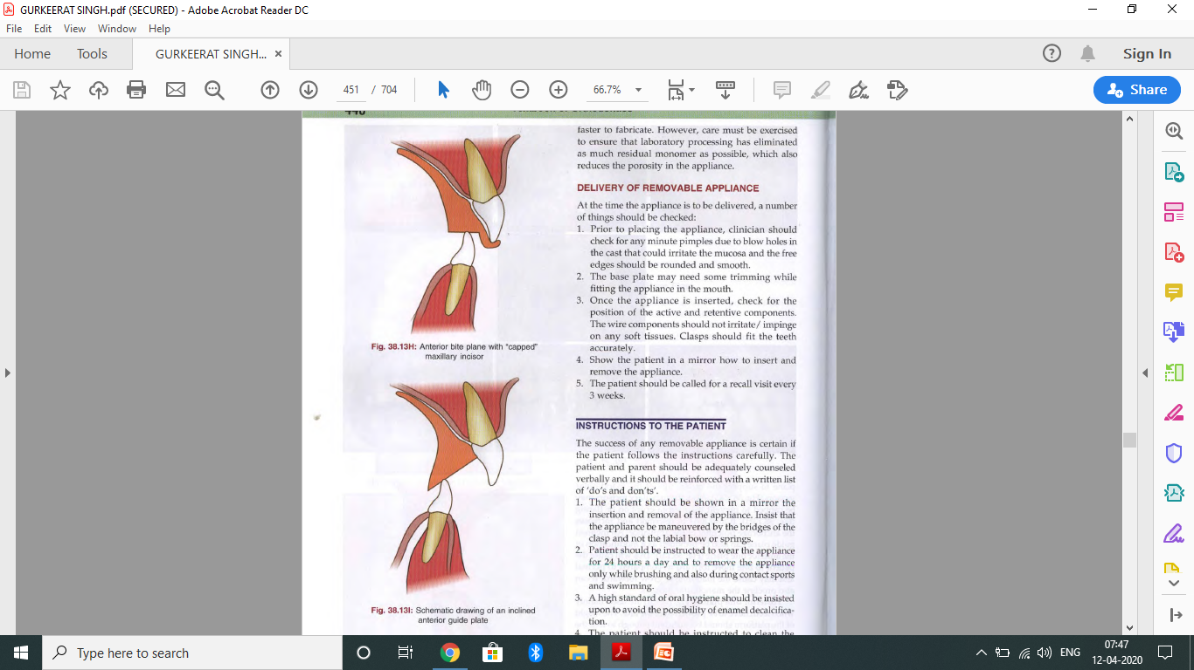
Also, the maxillary incisors may be capped to prevent their supra-eruption or flaring (Fig. a).
It also aids in retention and increases the anchorage potential of the appliance.
An inclined guide plane can also be provided as a modification of the anterior bite plane (Fig. b).
This will cause the patient to bite more forward as compared to normal and may cause the mandible to grow forward. It can also procline the mandibular incisors.

Slide 74
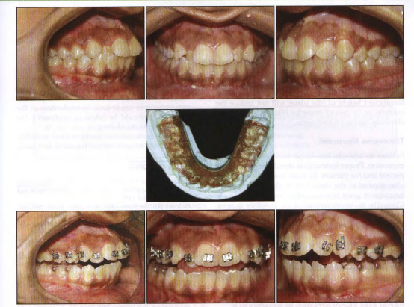
POSTERIOR BITE PLANE
are used mainly when teeth have to be pushed over the bite.
The height of the platform should be sufficient enough to free the teeth, that are to be moved, from occlusal interference with the opposing teeth.
It is better to adjust the posterior bite planes to obliterate the freeway space to aid compliance.
material of choice- cold cure acrylic, although heat cure acrylic can also be used.
However, care must be exercised to ensure that laboratory processing has eliminated as much residual monomer as possible, which also reduces the porosity in the appliance

Slide 75
DELIVERY OF REMOVABLE APPLIANCE
At the time the appliance is to be delivered, a number of things should be checked:
  Prior to placing the appliance, clinician should check for any minute pimples due to blow holes in the cast that could irritate the mucosa and the free edges should be rounded and smooth.
  The base plate may need some trimming while fitting the appliance in the mouth.
  Once the appliance is inserted, check for the position of the active and retentive components. The wire components should not irritate/ impinge on any soft tissues. Clasps should fit the teeth accurately.
  Show the patient in a mirror how to insert and remove the appliance.
  The patient should be called for a recall visit every 3 weeks.

Slide 76
INSTRUCTIONS TO THE PATIENT
The success of any removable appliance is certain if the patient follows the instructions carefully. The patient and parent should be adequately counseled verbally and it should be reinforced with a written list of 'do's and don'ts'.
  1. The patient should be shown in a mirror the insertion and removal of the appliance. Insist that the appliance be maneuvered by the bridges of the clasp and not the labial bow or springs.
  2. Patient should be instructed to wear the appliance for 24 hours a day and to remove the appliance only while brushing and also during contact sports and swimming.
  3. A high standard of oral hygiene should be insisted upon to avoid the possibility of enamel decalcification.

Slide 77
  The patient should be instructed to clean the appliance by brushing it with soap and water. Care should be taken while cleaning so as not to bend/ distort any component
  In case of pain or appliance damage, patient must be told to report immediately to the clinic.
  Patients having an appliance with screws should be given instructions on how to activate the screw.
  Patients should be instructed not to leave the appliance out of the mouth for a long period of time as it enhances chances of it getting damaged or distorted.
  Care should also be taken to keep the appliance away from pet animals when the appliance is not being worn.

Slide 78
COMMON FAILURES FOR
NO TOOTH MOVEMENT
          ANTEROPOSTERIOR MOVEMENT
Reduction in Overjet
  Sometimes, upper incisors may not be retracted as efficiently. The reason may be that acrylic has not been removed behind the upper incisors.
  Another reason may be the presence of an overbite, which prevents incisor retraction
Proclination of upper anteriors
  Inadequate clearance of occlusion prevents teeth from moving anteriorly.
Vertical
  The anterior /posterior bite planes should be of such a height that they do not obliterate the freeway space.
  Thickness of the bite plane can be increased once neurophysiological adaptation has taken place.
  If the bite plane is too thick it will not be worn by the patient.
  Insufficient height of bite plane will not reduce the overbite or, in case of posterior bite planes, will not eliminate occlusal interference.

Slide 79
Transverse Movement
  Failure to activate the screw will lead to lack of expansion. Proper instructions should be given to the patient and/or parents.
  In some cases, lower molars also expand at the same rate as the upper molars because of good intercuspation between the two.
Patient Compliance
  The success of any removable appliance is dependent on patient compliance. Compliance can be improved by providing a good fitting, well-designed appliance and giving clear instructions to the patient.

Slide 80
PROBLEMS ENCOUNTERED
i. Lack of oral hygiene maintenance
  gingival inflammation
  enamel hypoplasia
  caries
ii. Soft tissue irritation can result if the appliance
Iii. pain or tenderness in the teeth
iv. tooth mobility

