Slide 1
Case history & clinical examination
Dr. Ravi Bhandari
Dept. Of Orthodontics & Dentofacial orthopedics

Slide 2
Case history
Clinical examination
Model analysis
Radiographic examination
Diagnosis

Slide 3
Diagnosis :
involves development of a comprehensive & concise database of pertinent information , sufficient to understand the patient’s problem as well as answer questions arising in the treating clinicians mind.

Slide 4
ESSENTIAL DIAGNOSTIC AIDS:
Case History
Clinical Examination
Study Models
Radiographs:
  Periapical radiographs
  Lateral radiographs
  Orthopantomograms
  Bite wing radiographs
Facial photographs

Slide 5
SUPPLEMENTAL DIAGNOSTIC AIDS:
Specialized radiographs:
  Occlusal views
  Selected lateral jaw views
Electromyographic examination of muscle activity
Hand – wrist radiographs
Computed axial tomography ( CT scan)
Magnetic Resonance Imaging (MRI)
Endocrine tests – other blood tests
Sensitivity/ vitality tests
Biopsy

Slide 6
CASE HISTORY
Case history :
information gathered from the patient &/ or parent & / or guardian to aid in the overall diagnosis of the case.

Slide 7
Personal details
NAME :
  For the purpose of communication
  Identification
  Record keeping
  Personal touch to the conversation
DATE OF BIRTH & AGE:
  Chronologic age helps in diagnosis & growth prediction.
  Dictates the treatment plan – growth modulation / surgical.
  Self correcting anomelies.

Slide 8
TYPES OF AGES:
Biological age
Skeletal age
Dental age
Chronological age

Slide 9
SEX: Male / Female
  Girls pubertal peak – 10-12 yrs
  Boys pubertal peak – 12-14 yrs
  Helps in deciding growth modulation timing
ADDRESS & OCCUPATION:
  Communication
  Assessing socioeconomic status- affordability of the patient
  Records

Slide 10
CHIEF COMPLAINT
Helps in identifying the priorities & desires of the patient
Patients perception of malocclusion- pt motivation
Helps in setting treatment objectives

Slide 11
PRENATAL HISTORY
Condition of mother during pregnancy & type of delivery- forceps delivery
Nutritional status & any infections during pregnancy.
Certain drugs , excessive vitamins – congenital malformations.
Tetracycline : staining of teeth
Thalidomide: defective limbs

Slide 12
POSTNATAL HISTORY
Type of feeding
Abnormal habits – digit / thumb sucking, tongue thrusting , mouth breathing
Milestones of normal development

Slide 13
DENTAL HISTORY
Information on age of eruption & exfoliation of deciduous & permanent teeth
Reasons for exfoliation – oral hygiene maintenance
Past dental history – pts attitude towards dental health

Slide 14
MEDICAL HISTORY
Long term medication
Allergies/ hypersensitivity reactions
Systemic diseases:
  Rheumatic fever & cardiac anomalies.
  Controlled diabetes- periodontal breakdown
  Arthritis or osteoporosis- medication impedes orthodontic therapy
  Endocrinal imbalances

Slide 15
FAMILY HISTORY
Certain malocclusion have genetic predisposition & run in families-
  Skeletal class III malocclusion
  Cleft lip & palate

Slide 16
CLINICAL EXAMINATION:
GENERAL EXAMINATION:
  Gait - abnormality due to neuromuscular disorders
  Posture-
  Height & Weight – to assess physical development on growth development charts
  Body Build

Slide 17
BODY BUILD:
Sheldon classification:
  Ectomorphic : tall & thin physique
  Mesomorphic : average physique
  Endomorphic : short & obese physique

Slide 18
SHAPE OF THE HEAD
Cephalic Index by Martin & Saller (1957):
Index values :
  Mesocephalic ( average): 76 – 80.9
  Brachycephalic (short , broad skull): 81 – 85.4
  Dolicocephalic ( long , narrow skull): < 75.9
I = Maximum skull width x 100
Maximim skull length

Slide 19
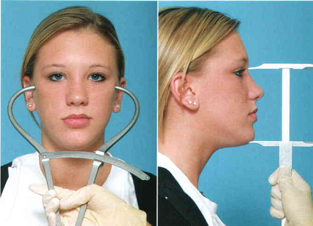
FACIAL TYPE:
Morphologic facial index by Martin & Saller (1957):
Index values:
  Euryprosopic ( broad & short ): 79 – 83
  Mesoprosopic ( average) : 84 – 87.9
  Leptoprosopic ( long & narrow) : 88 - 92
I = Facial height ( N- Me)
Bizygomatic width

Slide 20
CLINICAL IMPLICATION:
Euryprosopic face : broad , square arches
--border line crowding - Rx expansion
Leptoprosopic face : narrow arches
-- border line crowding -Rx extraction

Slide 21
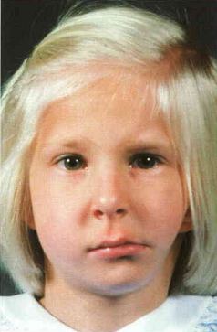
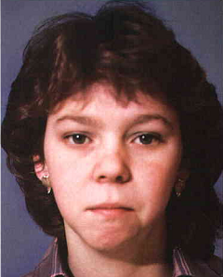
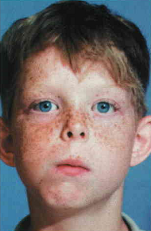
FACIAL SYMMETRY
Certain degree of asymmetry btw right & left sides of face is normal
Gross facial asymmetries:
  Hemifacial hypertrophy / atrophy
  Congenital defects
  Unilateral condylar hyperplasia
  Unilateral ankylosis
Hemifacial microsomia
Condylar fracture
Rheumatoid arthritis

Slide 22
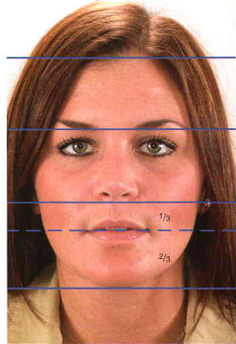
EXAMINATION OF LIPS :
Lip length – upper lip 1/3rd & lower lip 2/3rd
Lip posture – protrusive / normal / retrusive
Lip tonicity – everted / hypertrophied
    Class II div1- upper lip is hypotonic
    Class III- lower lip is everted

Slide 23
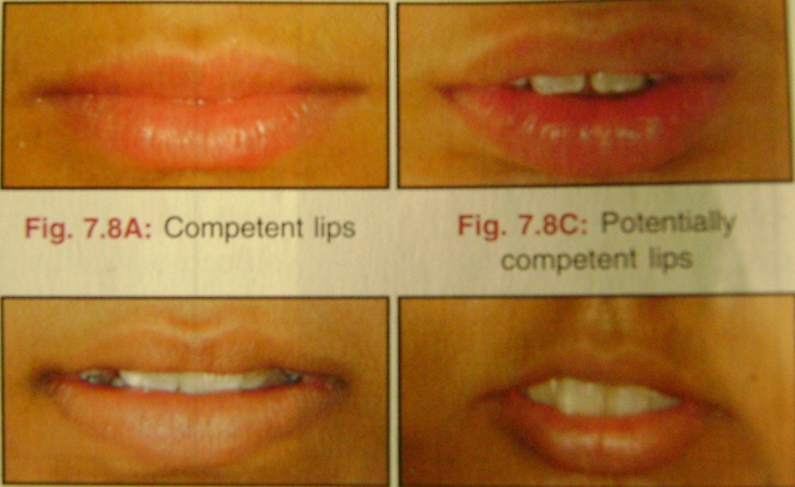
Lip seal –
  competent
  incompetent
  potentially competent lips

Slide 24
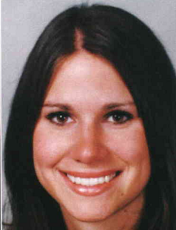
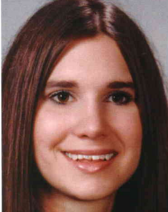
SMILE ARC
It is defined as the contour of the incisal edges of the maxillary anterior teeth relative to the curvature of the lower lip during a social smile.
3 types :
  Consonant / ideal –when the lip and dental contours match.
  Flat
  Reverse

Slide 25
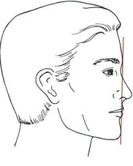
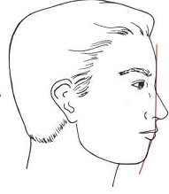
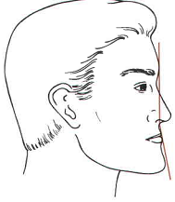
PROFILE
Patient sitting upright with FH plane parallel to floor.
2 refernce lines are joined:
  From glabella to soft tissue point A
  From point A to soft tissue pogonion
3 types:
Orthognathic / straight
Convex profile
Concave

Slide 26
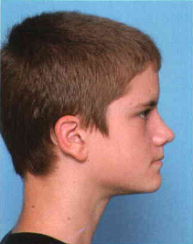
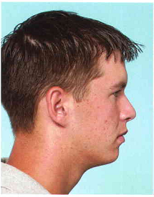
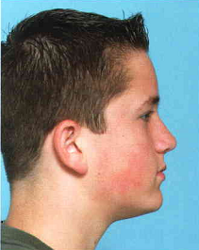
FACIAL DIVERGENCE
Defined as anterior or posterior inclination of lower face relative to forehead
Straight profile :
  Posteriorly divergent
  Straight
  Anteriorly divergent
It is a racial & ethnic characteristic

Slide 27
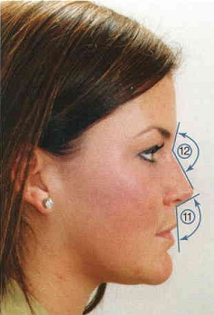
NOSE & NASOLABIAL ANGLE
Angle formed btw tangent to lower border of the nose & a line joining the subnasale with the tip of upper lip
Normal value – 102 +/- 4
Reduced/ acute angle – proclined incisors
Increased /obtuse angle – retroclined incisors

Slide 28
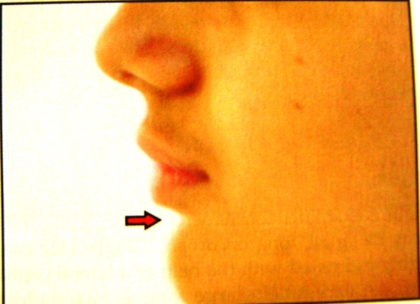
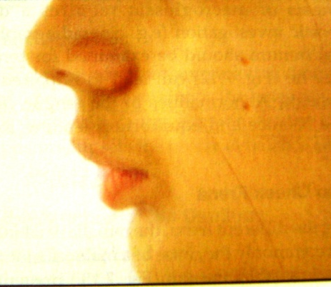
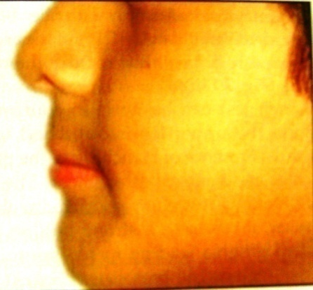
MENTOLABIAL SULCUS :
It is the concavity present below the lower lip.
Deep sulcus – class II div1
Shallow sulcus – bimaxillary protrusion/ class III

Slide 29
POSITION OF CHIN
Prominent chin – class III malocclusion
Recessive chin - class II malocclusion

Slide 30
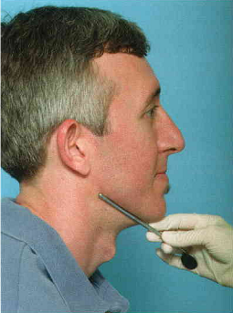
MANDIBULAR PLANE ANGLE:
The mandibular plane angle can be visualized
clinically by placing a mirror handle or other instrument along the border of the mandible.
Clinical significance:
  a steep mandibular plane angle -long anterior facial vertical dimensions and a skeletal open bite tendency
  a flat mandibular plane angle- short anterior facial height and deep bite malocclusion.

Slide 31
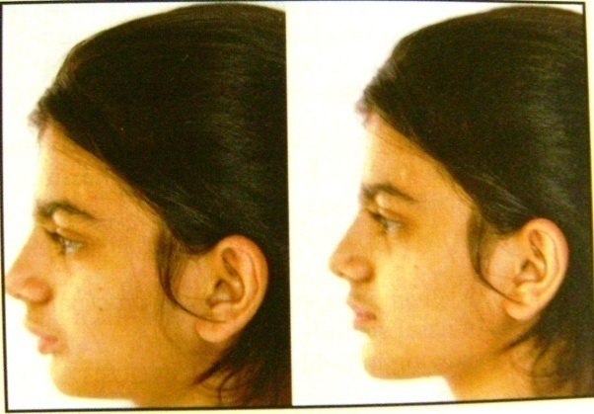
VTO
VISUAL TREATMENT OBJECTIVE :
  POSITIVE – profile of the patient improves noticeably when the pt advances the mand. voluntarily
  NEGATIVE- profile worsens
  Important criteria for case selection for functional appliance therapy

Slide 33
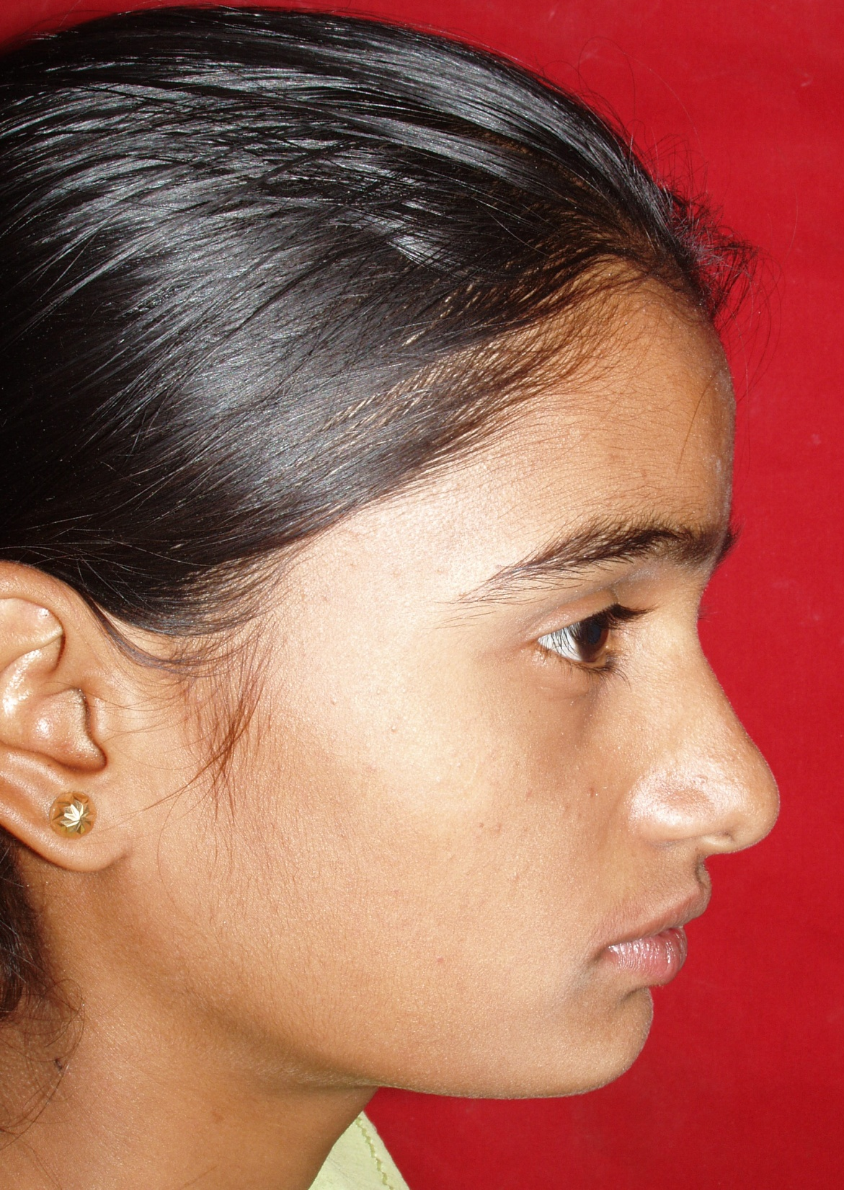
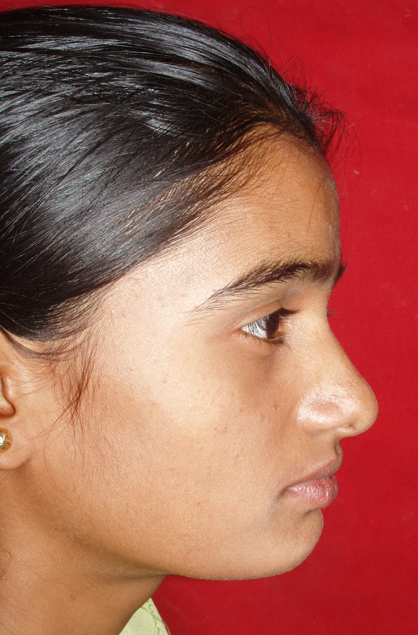

Slide 34
INTRAORAL EXAMINATION:
SOFT TISSUE EXAMINATION :
  Gingiva
  Palate
  Tongue
  Frenum
  Tonsils

Slide 35
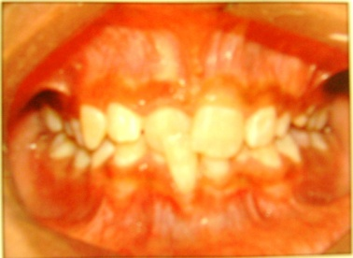
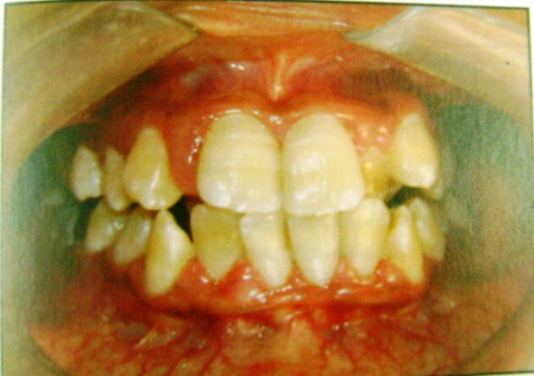
GINGIVA
Type of gingiva – thick fibrous / thin fragile
Local gingival lesions – recession
  Indicative of –occlusal trauma , abnormal functional loading , medication ( dilantin, phenytoin sod.)
Ant . Marginal gingivitis – mouth breathers

Slide 36
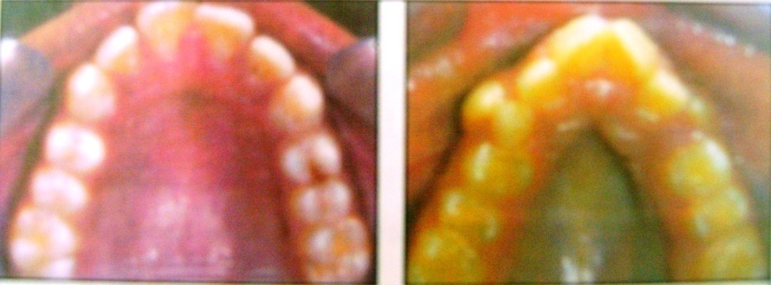
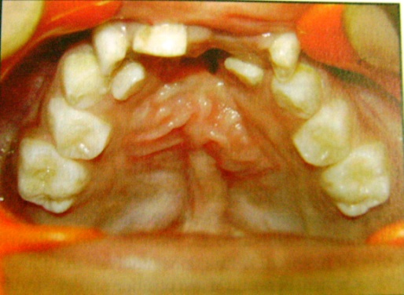
PALATE
Pathologic swellings – impacted canine / cyst
Mucosal ulcerations – traumatic deep bite
Palatal depth & shape – broad & shallow / high palatal vault
Cleft palate

Slide 37
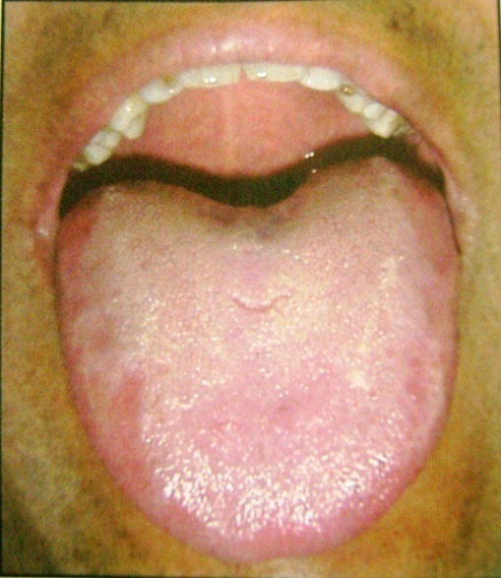
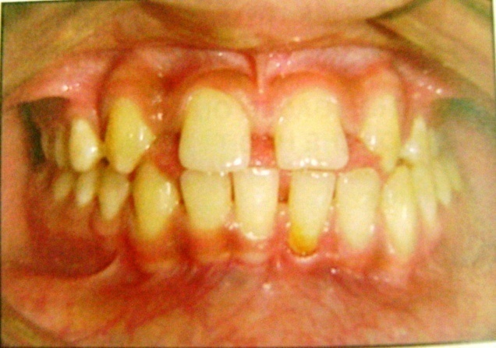
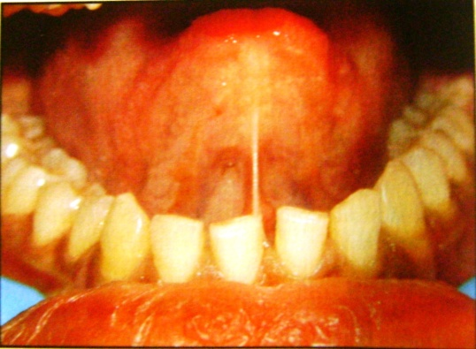
TONGUE
Small / long / broad
Macroglossia – proclination & spacing. Scalloped margins
Tongue tie
Abnormalities of tongue can upset muscle balance & equilibrium, leading to malocclusion

Slide 38
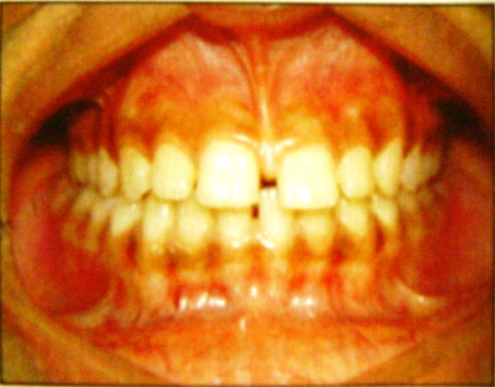
FRENUM
Thick , fibrous labial frenum – midline diastema
Diagnosis – blanch test + ve
IOPA shows interdental notching
Treatment - Frenectomy

Slide 39
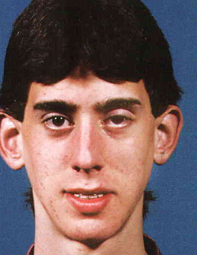
TONSILS
Prolonged inflammation of tonsils can cause alteration of the tongue & jaw posture , upsets the orofacial balance – adenoid facies / long face syndrome

Slide 40
DENTAL / HARD TISSUE EXAMINATION :
  MAXILLARY & MANDIBULAR ARCH
  Arch form : U / average / V shaped
  Teeth present
  Teeth unerupted
  Teeth missing
  Teeth over-retained
  Caries / restoration
  Malformations / fracture

Slide 41
MAXILLARY ARCH :
Shape : average / V- shape / U –shape
Arch symmetry : symmetrical / asymmetrical
Arch alignment : spacing / crowding / rotation
MANDIBULAR ARCH :
Shape : average / V- shape / U –shape
Arch symmetry : symmetrical / asymmetrical
Arch alignment : spacing / crowding / rotation

Slide 42
MIDLINE RELATIONSHIPS:
Skeletal midline
Dental midline
INTERARCH RELATIONSHIPS:
Antero-posterior:
Molar relation
Canine relation
Overjet
Vertical :
Open bite/deep bite
Transverse :
Crossbite/scissors bite

Slide 43
FUNCTIONAL EXAMINATION :
Respiration :
Swallowing :
T.M.J:
Path of closure
Speech

Slide 44
RESPIRATION:
Nasal mode of respiration-
Mouth breathing -
Method of examination:
  Mirror test
  Cotton / massler’s butterfly test
  Water test

Slide 45
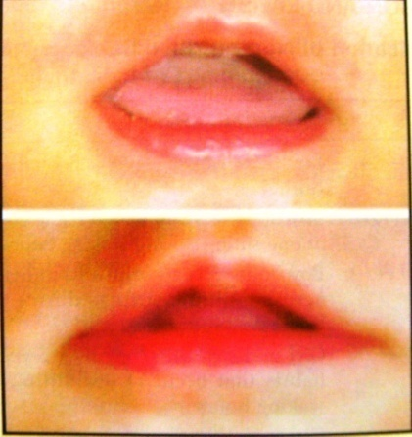
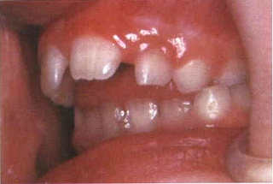
SWALLOWING :
Infantile swallow – tongue btw the gum
pads/ teeth
Mature swallow – tongue touching the palate
Transition from infantile to mature – during deciduous dentition ( 1 ½ to 2 yrs )
If it persists beyond --- tongue thrust habit

Slide 46
TMJ
Examined by – auscultation & palpation .
  History of pain
  Tenderness over joint
  Clicking sounds
  Deviation
  Dislocation
  Max. incisal opening
  Protrusion
  Lateral excursions

Slide 47
Assessment of postural rest position
Space b/w upper and lower teeth when the mandible is in rest position is k/a freeway space (3mm)
To determine the Postural rest position the patient should be seated upright with head positioned with FHP parallel to floor.

Slide 48
Methods to record postural rest position
Phonetic method : M or Missisippi repeatedly
Command method : pt is asked to swallow
Non command method: clinician talks to patient.
Combined methods : tapping the mandible or holding the chin with index finger and thumb and opens /closes the mandible.

Slide 49
PROBLEM LIST WITH DIAGNOSIS:
TREATMENT OBJECTIVES:
TREATMENT PLAN:
  Growth modulation
  Orthodontic decompensation & orthognathic surgery
  Orthodontic camouflage

Slide 50
CEPHALOMETRICS

Slide 51
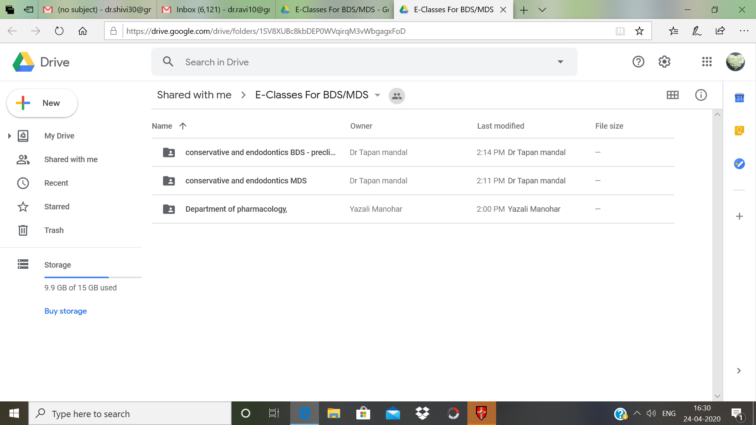

Slide 52
Thank you

