Slide 1


Slide 2
BASICS OF IMMUNOLOGY

Slide 3
CONTENTS
INTRODUCTION
HISTORICAL BACKGROUND
TYPES OF IMMUNITY
CELLS OF IMMUNE SYSTEM
ANTIGEN
ANTIBODY
CYTOKINES
COMPLEMENT SYSTEM
CONCLUSION
REFERENCES

Slide 4
INTRODUCTION
Immunology is the study of host defense mechanism.

Slide 5
Historical background :
1798 EDWARD JENNER initiates smallpox vaccination.
1877 PAUL ERLICH recognizes mast cells.
1879 LOUIS PASTEUR develops an attenuated chicken cholera vaccine.
1883 E. METCHIN KOFF developed the first theory of cell mediated immunity.
1891 ROBERT KOCH explored delayed type hypersensitivity.
1908 PAUL ERLICH proposed the humoral theory of antibody formation.

Slide 6
1938 JOHN MERRACK formulates antigen antibody binding hypothesis.
1957 ALICK ISAACS & JEAN LINDEMANN discover interferon (cytokine).
1962 RODNEY PORTER and team discovered the structure of antibodies.
1968 ANTHONY DAVIS and team discover T cell and B cell cooperation in immune response.
1987 LEROY HOOD and team identify genes for the T cell receptor.

Slide 7
TYPES OF IMMUNITY
INNATE IMMUNITY
a) nonspecific immunity
b) specific immunity
- species immunity
- racial immunity
- individual immunity
ACQUIRED IMMUNITY
a) active immunity
- natural active immunity
- artificial active immunity
b) passive immunity
- natural passive immunity
- artificial passive immunity

Slide 8
INNATE IMMUNITY
Is the resistance to infections which an individual possess by virtue of his genetics and constitutional make up.
It is not affected by prior contact with microorganisms or immunization.
It may be non specific, when it indicates a degree of resistance to infections in general, or specific where resistance to a particular pathogens is concerned.

Slide 9
SPECIES IMMUNITY
It refers to the total or relative refractoriness to a pathogen, shown by all members of a species. The mechanisms of species immunity are not clearly understood but may be due to physiological and biochemical differences between the tissues of the different host species, which determine whether or not a pathogen can multiply in them.

Slide 10
RACIAL IMMUNITY
Within a species, different races may show differences in susceptibility to infections. This is known as racial immunity.
Such racial differences are known to be genetic in origin, and by selection and inbreeding, it is possible to develop, at will, races that possess high degree of resistance or susceptibility to various pathogens. It is difficult to demonstrate marked differences in immunity in human races, as controlled breeding is not possible in the human species.

Slide 11
INDIVIDUAL IMMUNITY
The differences in innate immunity exhibited by different individuals in a race is known as individual immunity. The genetic basis of individual immunity is evident from studies on the incidence of infectious diseases in twins.
It is well documented that homozygous twins exhibit similar degree of resistance or susceptibility to lepromatous leprosy and tuberculosis. Such correlation is not seen in heterozygous twins.

Slide 12
ACQUIRED IMMUNITY
The resistance that an individual acquires during life is known as acquired
immunity.
Acquired immunity is of two types, active and passive.

Slide 13
ACTIVE IMMUITY
It is the resistance developed by an individual as a result of an antigenic stimulus.
It is also known as adaptive immunity as it represents an adaptive response of the host to a specific pathogen or other antigen.
This involves the active functioning of the host’s immune apparatus leading to the synthesis of antibodies and/or the production of immunologically active cells.

Slide 14
Natural active immunity:
It results from either a clinical or an inapparent infection by a parasite. Such immunity is usually long lasting but the duration varies with the type of pathogen.
Artificial active immunity:
It is the resistance induced by vaccines. Vaccines are preparations of live or
killed microorganisms or their products used for immunisation.

Slide 15
PASSIVE IMMUNITY
The resistance that is transmitted to a recipient in a ‘readymade’ form is known as passive immunity.
Here the recipient’s immune system plays no active role. There is no antigenic stimulus; instead, preformed antibodies are administered.
There is no latent period in passive immunity, protection being effective immediately after passive immunisation.
Passive immunity may be natural or artificial.

Slide 16
Natural passive immunity:
It is the resistance passively transferred from mother to baby. In human infants,
maternal antibodies are transmitted predominantly through the placenta.
Artificial passive immunity:
It is the resistance passively transferred to a recipient by the administration of antibodies.

Slide 17
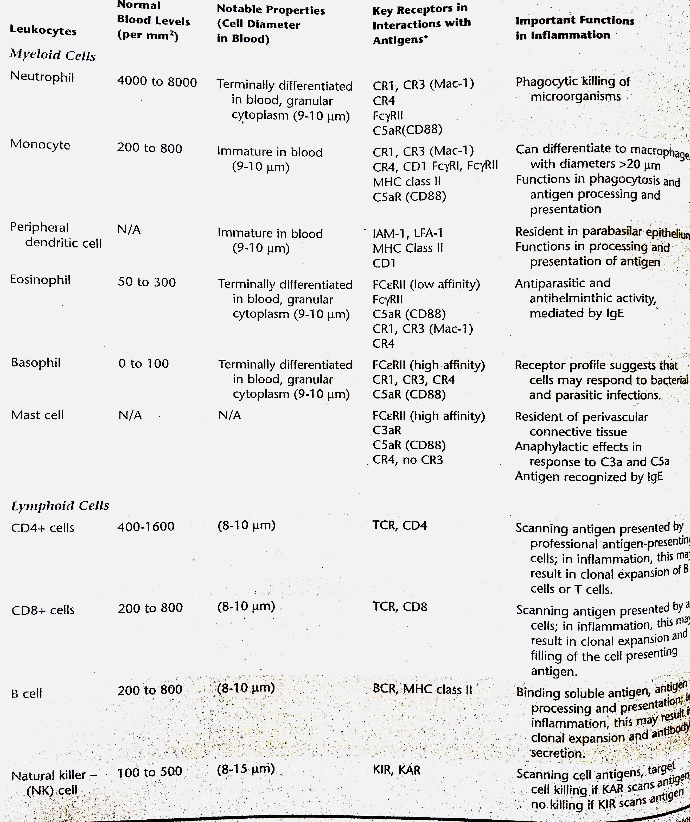
CELLS

Slide 18
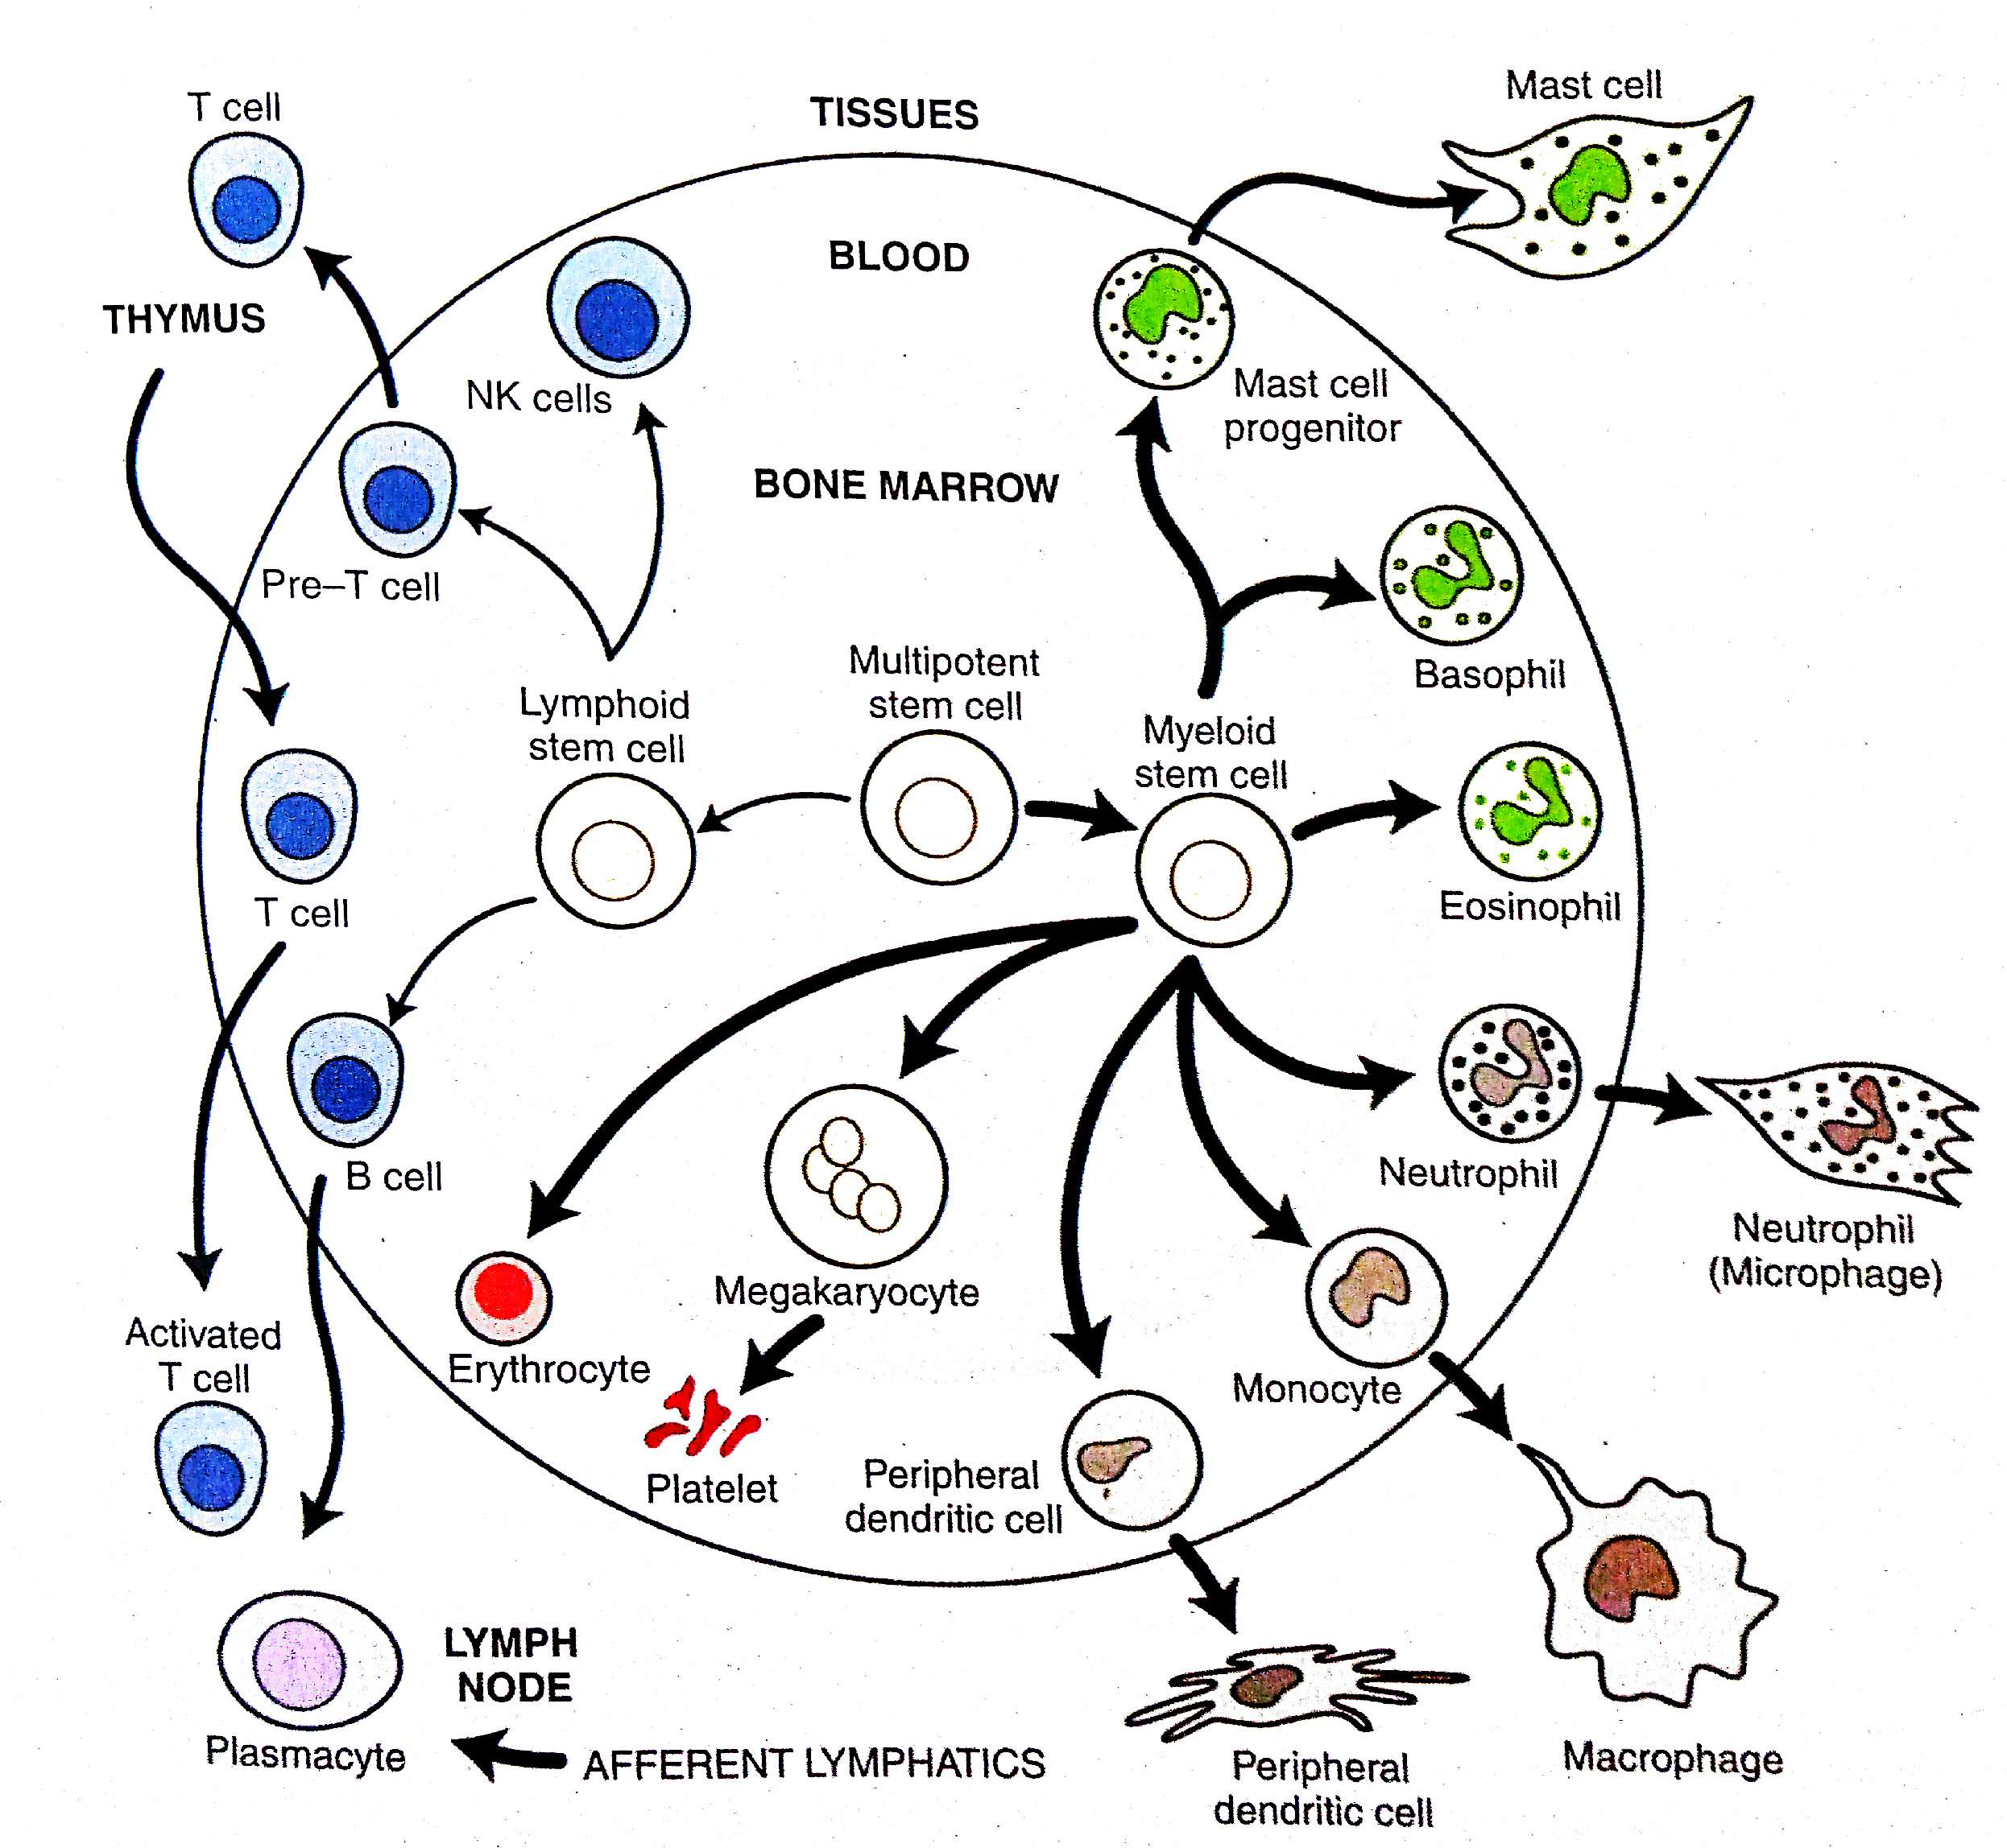

Slide 19
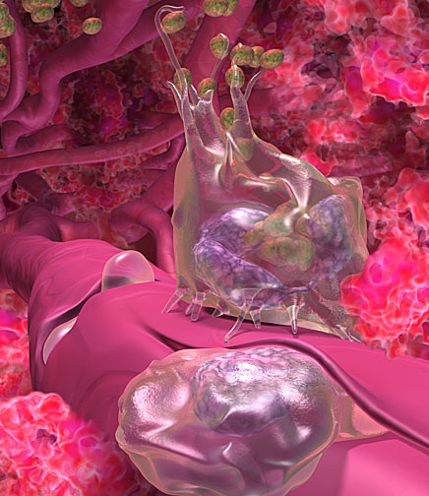
NEUTROPHILS
Are closely related phagocytic leukocytes.
Differentiate almost completely within the bone marrow(14 days)
Are almost 10µm diameter in size in the blood
Also known as polymorphonuclear leukocytes, accounting for about two thirds of all blood leukocytes(4000- 8000 cells/mm3)
They posses various lysosomes within their cytoplasm
They recruited from the blood, locate offending agents, and ingest (phagocytose) and kill the offending agents.

Slide 20
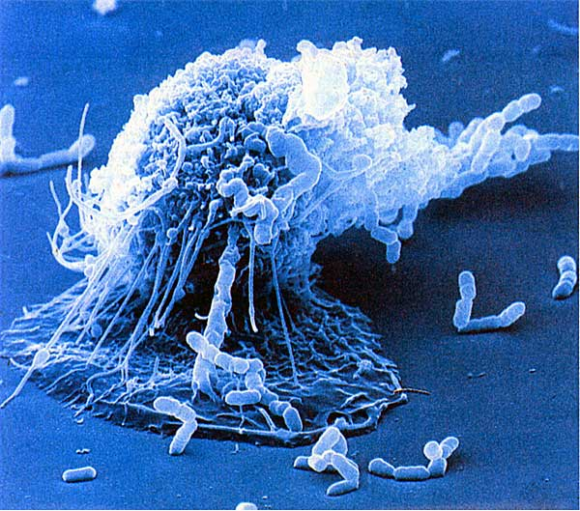
MONOCYTES/ MACROPHAGES
Are closely related phagocytic leukocytes
Exits the bone marrow after 2 days in a relatively immature state and may differentiate in the tissue
Are referred to as macrophages when they leave the blood
Are almost 10µm in diameter and may become greater than 22µm in diameter after completing their differentiation in the local tissues
As they differentiate and live in the local tissues, they are suited for communicating with lymphocytes and other surrounding cells
Macrophages live long enough to present antigen to T cells

Slide 21
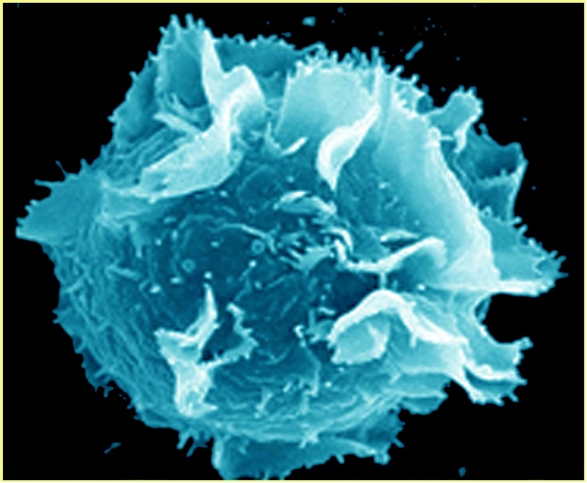
MAST CELLS
Are important in immediate inflammation.
Mast cells have been shown to express toll like receptors that allows the innate immune system to adapt
Mast cells feature prominent cytoplasmic granules, termed lysosomes, which store inflammatory mediators such as histamin, eosinophils chemotactic factor, neutrophils chemotactic factor and heparin.
Also synthesise other inflammatory mediators, such as IL-6, TNF alpha, and leukotriene C4.

Slide 22
PERIPHERAL DENDRITIC CELLS
Are leukocytes with cytoplasmic projections, or dendrites
Dendritic cells ingest antigen locally and transport the antigen to the lymph nodes through the afferent lymphatics

Slide 23
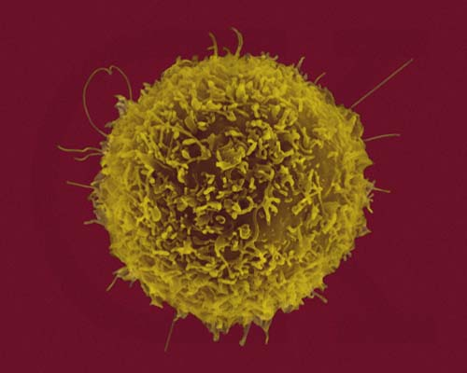
LYMPHOCYTES
The three main types of lymphocytes are distinguished on the basis of their receptors for antigens: T lymphocytes, B lymphocytes, and natural killer cells.
In the blood B cells and T cells are inactive and fairly small (8-10µm)
Natural killer cells may differentiate extensively in the bone marrow and appeare in blood as large, granular lymphocytes; and are larger than any other leukocytes in the blood with a diameter of 15µm.

Slide 24
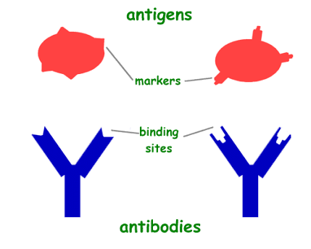
ANTIGEN AND ANTIBODY

Slide 25
ANTIGENS
Any substance which, when introduced partially into the body, stimulates the production of an antibody with which it react specifically and in an observable manner.
Reacts only with those particular immunocytes which carry the specific marker for that antigen and which produce antibody complimentary to that antigen only.
The discrete portions of the antigen that bind to the antibodies antigen combining site are called epitopes.
An antigen may posess several epitopes.
The containing area on the antibody molecule corresponding to the epitope is called paratope.

Slide 26
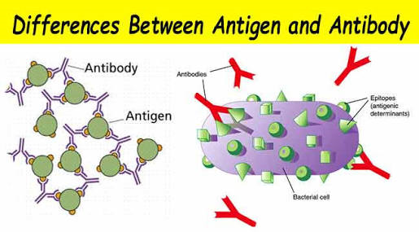

Slide 27
ANTIBODIES
The host responds to oral bacteria and their products by plasma cell production of immunoglobulins or antibodies.
Antibodies which are glycoproteins, are found in blood, tissue fluids and secretions and are the effectors of humoral immunity.
They are highly specific and sensitive.
All classes and subsets of immunoglobulins have similar structural organizations.
Every antibody molecule has a variable region which allows it to react highly specifically with a particular antigen.

Slide 28
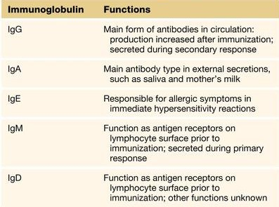
IMMUNOGLOBINS

Slide 29
CYTOKINES AND OTHER MOLECULAR COMPONENTS :
Cytokines :
  The complex interactions among lymphocytes, inflammatory cells and other cellular elements in connective tissue are mediated by a series of low-molecular weight proteins called cytokines.
  Cytokines assist in regulation and development of immune effector cells, cell to cell communication and direct effector functions.

Slide 30
    Interleukins are a diverse group of cytokines
    Lymphocytes, fibroblasts and macrophages produce IL-1. Its functions are :
        Stimulation of the production of endothelial adhesion molecules to begin the inflammatory process
        Production of prostaglandins by fibroblasts and osteoclasts
        Activation of phagocytes that makes T cell surfaces more receptive to antigens
        Stimulation of the release of IL-2 by T cells and NK cells

Slide 31
    IL-2 enhances T cell and NK cell growth and activation.
    IL-3 stimulates multilineage hematopoiesis and is also known as multicolony stimulating factor.
    IL-4 causes B cells to activate and divide. It promotes immunoglobulin and is also a growth factor for mast cell.
    IL-5 causes proliferation of activated B cells.
  IL-6 is produced by macrophages and CD4+T cells and stimulates the production of B cells and mast cells.
  IL-8 is produced by fibroblasts, endothelial cells and monocytes and stimulates activation and chemotaxis by macrophages, PMNs and T cells.

Slide 32
  IL-10 is produced by CD4+ cells and inhibits the production of cytokines by CD8+T cells.
Interferons are cytokines usually associated with antiviral activity. Interferon-gamma released by the CD4+T cells and enhances phagocytosis.
Migration inhibitory factor (MIF) is produced by activated T cells and prevents the migration of macrophages from an area of inflammation or infection.
Tumor necrosis factor (TNF) aids in the formation of selectins & aids in migration of leukocytes.
Lymphotoxin (LT) is produced by activated T cells. It works together with IFN-gamma to activate leukocytes.

Slide 33
Transforming growth factor-beta (TGF-beta) , produced by macrophages and platelets. Its primary role appears to be the inhibition of the immune system.
Matrix metalloproteins (MMPs) are a group of enzymes that degrade collagen, the ground substance and other structures.
Elastase, glucoronidase and hyaluronidase are lysosomal enzymes produced by the destruction of PMNs and fibroblasts.
Colony stimulating factors (CSFs) exist for granulocytes, lymphocytes and macrophages. They are cytokines derived from T cells that control hematopoiesis.

Slide 34
COMPLEMENT SYSTEM
The term ‘complement’ refer to a system of factors which occur in normal serum that are activated characteristically by antigen antibody interaction
The function of the system includes control of inflammatory cellular activation and antimicrobial defense complexes.
The complement system consists of atleast of 20 chemically and immunologically distinct serum proteins.

Slide 35
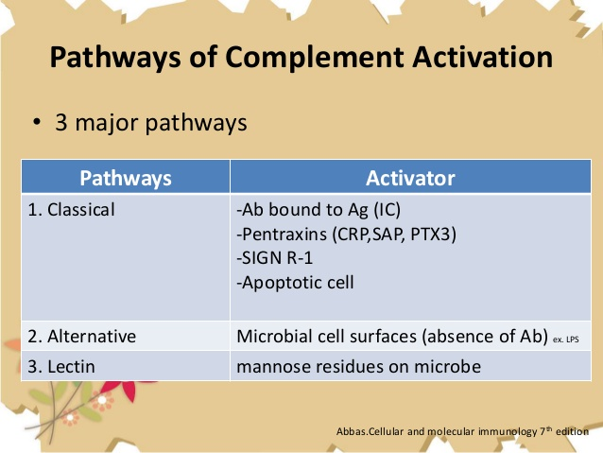

Slide 36
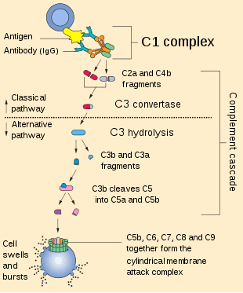

Slide 37
CONCLUSION
The immune system is a complicated network of special cells and organs that make up a vital part in our bodily systems.
The immune systems defence mechanisms are well designed to allow sufficient protection for the body.
If all lines of body defence fail then the body is then open to attack and may result in a serious infection or disease.

Slide 38
REFERENCES
CARRANZAS Clinical periodontology:11th edition.
Textbook of Microbiology-Anantnarayan,Paniker:7th edition.
Textbook of Medical Physiology- Guyton & Hall: 10th edition
Vivier E, Raulet DH, Moretta A, Caligiuri MA, Zitvogel L, Lanier LL et al. Innate or adaptive immunity? The example of natural killer cells. Science. 2011;331:44-49.

Slide 39


