Slide 1

DEFENCE MECHANISM OF THE GINGIVA
By
Dr. Ashutosh Agarwal
MDS

Slide 2
CONTENTS
INTRODUCTION
ROLE OF GINGIVAL EPITHELIUM
ROLE OF SALIVA
CONCLUSION
REFERENCES

Slide 3
INTRODUCTION
The oral cavity represent the entry portal for a wide array of antigenic challenges both transient and more permanent which are represented by substantial bacterial colonization that exist in the oral cavity.
Many members of the complex microbiota maintain a symboitic relationship with the host ;however select individual species are clearly pathogens (i.e. Streptococcus mutans and Actinobacillus actinomycetemcomitans)
So for the host to maintain homeostasis within the oral cavity various immune response system contribute to controlling the microbial colonization.
These system represent three interrelated entities that include salivary, systemic( serum) and gingival tissue immune system.

Slide 4
INTRODUCTION
The gingival tissue is constantly subjected to mechanical and bacterial aggressions.
Resistance to these action is provided by:
GINGIVAL EPITHELIUM
SALIVA
GINGIVAL CREVICULAR FLUID

Slide 5
The local defense against the bacterial and mechanical aggression rests on –
Structural protection
Mechanical protection
Chemical protection
Cellular protection

Slide 6
And, these are subsequently provided by following structures-
Gingival tissue
Leukocyte cells.
Gingival crevicular fluid- with its components.
Saliva

Slide 7
Gingival tissue
Clinically, the gingiva may be regarded as a combination of epithelial and connective tissues that forms a collar of masticatory mucosa around the teeth of the complete deciduous or permanent dentition and is attached to both teeth and the alveolar process.

Slide 8
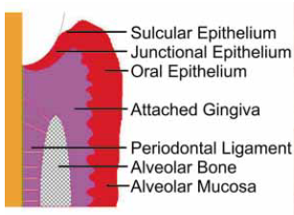
Clinically healthy, gingiva consists, on average,
4% Junctional epithelium,
27% Oral gingival epithelium
69% Connective tissue including a cellular infiltrate occupying about 3-6% of the gingival volume

Slide 9
Gingival Epithelium
Every epithelial tissue is characterized by three critical features
.
.
First, the cells are closely opposed and attached via specialized cell–cell junctions.
Second, epithelial cells secrete a basal lamina on which the cells become organized as a tissue, and which separates the epithelium from the adjacent connective tissue.
Third, epithelial cells are characterized by the presence of a cytoskeleton composed of keratin intermediate filaments in addition to the typical actin filaments and microtubules
.
Notes:
Each of these features contributes to the architectural integrity of the tissue and to its barrier function

Slide 10
Active role of gingival epithelium in innate host defense:
Actively responding to infection
By increased cell proliferation
Alteration of cell signaling events
Changes in differentiation and cell death
Alteration of tissue homeostasis
Signaling further host reactions
In integrating innate and acquired immune response
Notes:
The main function of gingival epithelium is to protect the deeper structures, while allowing selective interchange with the oral environment.

Slide 11
If the epithelial barrier is breached by an injury, the invading pathogens are eliminated first by the innate, followed by adaptive immune reactions.
The innate immune network of the epithelium consists of a range of preexisting, rapidly mobilized host defense components including keratinocytes, neutrophils, defensins etc.

Slide 12
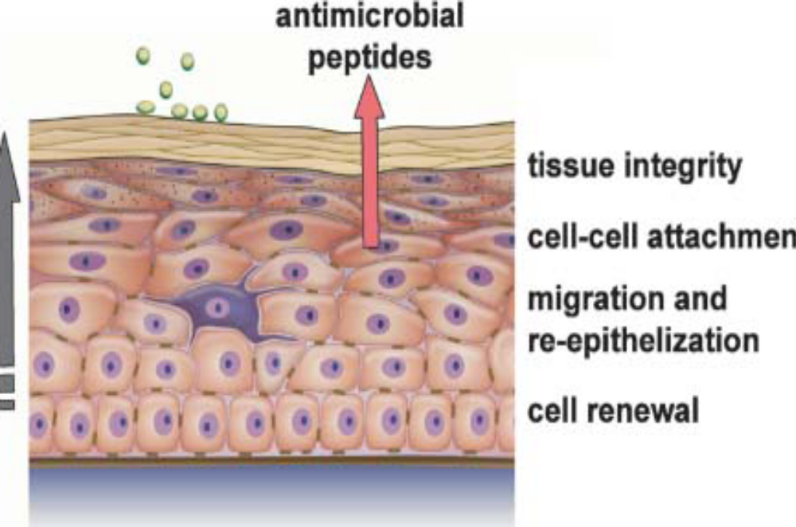
The structure of the gingival epithelium itself plays an important role in defense mechanism.
Notes:
By its turnover rate, keratinizing potential, tooth-epithelial interface, permeability of junctional and sulcular epithelium and different cells and signaling molecules it contributes to a substantial level in defense mechanism.

Slide 13
ROLE OF
GINGIVAL EPITHELIUM

Slide 14
Junctional epithelium is a unique tissue. Nowhere else in the body does nonkeratinizing epithelium face an inert hard tissue.
This situations possess an exceptional challenge to the junctional epithelium in the dentogingival area to protect the periodontium against the several hundred bacterial species that are present in the oral cavity.

Slide 15
The oral epithelium, sulcular epithelium and junctional epithelium have specific characteristic role in the defense of the gingival sulcus.
THE GINGIVAL EPITHELIUM- faces the oral cavity and extends from the free gingival margin to the mucogingival junction.
ROLE- the surface of gingival epithelium is keratinized and function as mechanical defense of the periodontium

Slide 16
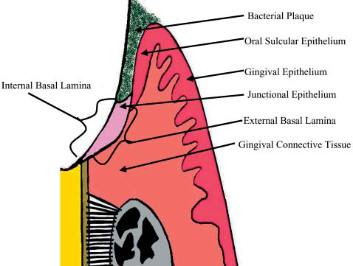
At the free gingival margin, entrance to the gingival sulcus/pocket is found and this potential ‘space’ spans from the free gingival margin to the CEJ.
THIS INNER LINING OF THE SULCUS/POCKET WALL IS COMPOSED OF 2 TYPES OF EPITHELIUM
1. Sulcular epithelium
2. Junctional epithelium

Slide 17
ORAL SULCULAR EPITHELIUM- which faces the tooth but is not directly in contact with tooth structure and is found from free gingival margin to the base of the histologic sulcus.
ROLE-
1.these cells have potential to undergo keratinization so act as a mechanical barrier against oral microbes and their metabolic by-product .
2. Cells contain lysosomes and can exhibit limited phagocytic activity.

Slide 18
The junctional epithelium which run from the base of the histologic sulcus to the CEJ under normal healthy condition.
It exhibit several unique structural and functional features that contribute to preventing pathogenic bacterial flora from colonizing the subgingival tooth surface.

Slide 19
1. INTACT EPITHELIUM BARRIER OF JUNCTIONAL EPITHELIUM
Usually prevents bacterial invasion of the periodontal tissue and under normal conditions is an effective barrier against penetration of bacterial components and metabolites.
This seal operates because of the function of the dense type I collagen gingival fibers which provide the mass and tensile strength to hold the tissue in tight apposition to the neck of the tooth.

Slide 20
2. HIGH TURNOVER RATE:
The oral epithelium undergoes continual renewal.
Its thickness is maintained by a balance between new cell formation in the basal layer & the shedding of old cells at the surface.
Important factor in the microbial defense of junctional epithelium.
It is a result of the fact that the area from which cells can desquamate is much smaller than the area of the basal layer where new cells are generated (at least 50 times larger than the area through which the epithelial cells desquamate into the gingival sulcus) so there is a strong funnelling effect that contributes to the flow of epithelial cells.

Slide 21
This permits rapid replacement of cells and tissue components that are damaged by the microbial challenge.
Bacteria are routinely found attached to the outer cells .With the shedding of these outermost cells, the organisms attached with it automatically sheds & hence it’s a measure of self defense.
TURNOVER RATE OF:
Oral sulcular epithelium: 10-14 days
Junctional epithelium: 4-6 days

Slide 22
3. PERMEABILITY OF JUNCTIONAL EPITHELIUM
Histologically, JE does not display the high degree of stratifications seen in other types of epithelium and because there are few intercellular adhesions between adjacent cells, it acts as permeable membrane.
Sulcular fluid from connective tissue enters the sulcus through the permeable JE. So it function as diffusion pathway for the GCF and its components- such as chemotactic agents, antibodies, complement components and other host derived enzymes which form antibacterial defense system.

Slide 23
In case of inflammation these intercellular spaces increases 2-5% and are infiltrated by neutrophils, monocytes and lymphocytes. In addition these spaces of JE can be distended and act as reservoirs for the GCF.
This prevents the penetration of bacteria into the epithelium and can acts as diffusion barrier to micro-organism, bacterial enzymes, metabolic byproduct or any other antigenic substances.

Slide 24
RICH VASCULATURE IN GINGIVA
PRESENCE OF LYMPHATIC DRAINAGE IN GINGIVA
Removes excess fluid, cellular and proteins debris, microorganism and other elements which is important in controlling diffusion and the resolution of inflammatory processes.

Slide 25
ROLE OF SALIVA

Slide 26
Salivary secretion are protective in nature because they maintain the oral tissue in a physiologic state.
Saliva exerts major influences:
On plaque by mechanically cleansing the expose oral surfaces.
By buffering acids produced by bacteria.
By controlling bacterial activity

Slide 27
CONTENTS OF SALIVA
(I) ANTIBACTERIAL FACTOR:
Saliva contains lysozymes, myeloperoxidase, lactoperoxidase, glucoproteins, mucins & antibodies etc.
(a) Lysosomes:
Lysosomes is a hydrolytic enzyme that cleaves the linkage between structural components of the glycopeptide muramic acid-containing region of the cell wall of certain bacteria.
Lysozyme works on both gram negative and gram positive organism.
It probably repels certain transient bacterial invaders of the mouth.

Slide 28
(b) Lacto- peroxidase –thiocyanate:
In saliva has been shown to be bactericidal to some strains of Lactobacillus & Streptococcus, by preventing the accumulation of lysin and glutamic acid, both are which are essential for bacterial growth.
(c) Myeloperoxidase:
An enzyme similar to salivary peroxidase, released by leukocytes and is bacteriocidal for Actinobacillus but has added effect of inhibiting the attachment of Actinomyces strains to hydroxyapatite.
(d) Lactoferrin:
Is effective against Actinobacillus species

Slide 29
(II) SALIVARY ANTIBODIES
Saliva contains IgG, IgM & IgA antibodies.
IgA preponderant immunoglobulin found in saliva, however IgG is more prevalent in GCF.
ROLE
Antibodies causes opsonization of bacteria.It has been suggested that antibodies present in saliva impairs the ability of several bacterial species to attach to mucosal or dental surfaces.

Slide 30
(III) SALIVARY ENZYMES
Enzymes normally found in the saliva are derived from the salivary glands, bacteria, leukocytes, oral tissues and ingested substances; the major enzymes is parotid amylase.
Salivary enzymes that are reported in the periodontal disease are-
Hyaluronidase, lipase, β-glucuronidase, chondroitin sulfatase, amino acid decarboxylases,,catalase, peroxidase and collagenase.

Slide 31
Proteolytic enzymes in the saliva are generated by both the host and oral bacteria.
These enzymes have been recognized as contributers to the initiation and progression of periodontal disease.
To combat these enzymes, saliva contains antiproteases that inhibit cysteine proteases such as cathepsins and antileukoproteases that inhibit elastase. And TIMP that inhibit the activity of collagen degrading enzymes.

Slide 32
(IV) SALIVARY BUFFERS AND COAGULATION FACTORS
Salivary buffer bicarbonate – carbonic acid system maintain the physiologic pH of oral cavity. Its function is to maintain the pH at the mucosal epithelial surface & the tooth surface.
Protective role in dental caries.
Saliva contains coagulation factor- factor VIII, IX, X and Plasma thromboplastin antecedent [ PTA] & Hagman factor that hasten blood coagulation & protect wound from bacterial invasion.
.

Slide 33
(V) LEUKOCYTES
Leukocytes reach the oral cavity migrating through the gingival sulcus.
PMNs leukocytes chiefly found in saliva that causes the phagocytosis.
Living PMNs in saliva are sometimes referred to as orogranulocytes, & their rate of migration into the oral cavity is termed the orogranulocytic migratory rate.

Slide 34
CONCLUSION
The defence mechanism of GCF, leukocytes, saliva and the epithelial barrier of the gingival sulcus are generally effective in controlling the deliterious effects of the heavy concentration of bacteria found in dental plaque. If this balance between host and parasites is slightly changed, the result can be progressive periodontal disease.

Slide 35
REFERENCES
Bulkacz & Carranza, Defence mechanism of Gingiva; Carranza 10th edition
Uitto et al Gingival crevice fluid – an introduction Periodontology 2000, Vol. 31, 2003, 9–11
Griffiths et al Formation, collection and significance of gingival crevice fluid. Periodontology 2000, Vol. 31, 2003, 32–42
Goodson et al Gingival crevice fluid flow Periodontology 2000, Vol. 31, 2003, 43–54
Delima et al Origin and function of the cellular components in gingival crevice fluid Periodontology 2000, Vol. 31, 2003, 55–76
Uitto et al. Proteolytic host cell enzymes in gingival crevice fluid Periodontology 2000, Vol. 31, 2003, 77–104
Ebersole Humoral immune responses in gingival crevice fluid: local and systemic implications Periodontology 2000, Vol. 31, 2003, 135–166

