Slide 1

GOOD MORNING

Slide 2

SALIVA

Slide 3
CONTENTS
History
Anatomy of salivary glands
Salivary reflex
Mechanism of saliva secretion
Composition
Functions
Factors influencing salivary flow
Role of saliva in periodontal health
Role of saliva in periodontal disease
Methods of collection of saliva
Diagnostic biomarker
Emerging salivary diagnostics
Chair side tests
Artificial saliva

Slide 4
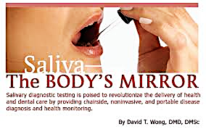
STEDMAN- clean, tasteless, odorless, slightly acidic viscous fluid, consisting of secretions from parotid, SM and SL salivary glands & the mucous glands of oral cavity

Slide 5
Greeks 2000 years ago
1898, Chittenden et al
19th century
20th century
Sialochemical studies- Micheals and Kirk

Slide 6
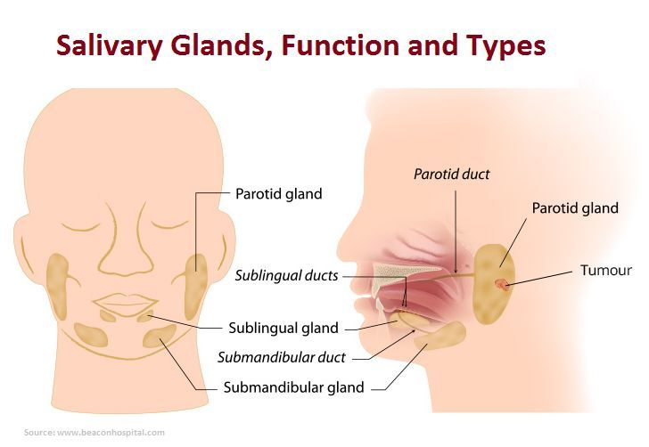
ANATOMY & STRUCTURE OF SALIVARY GLANDS

Slide 7
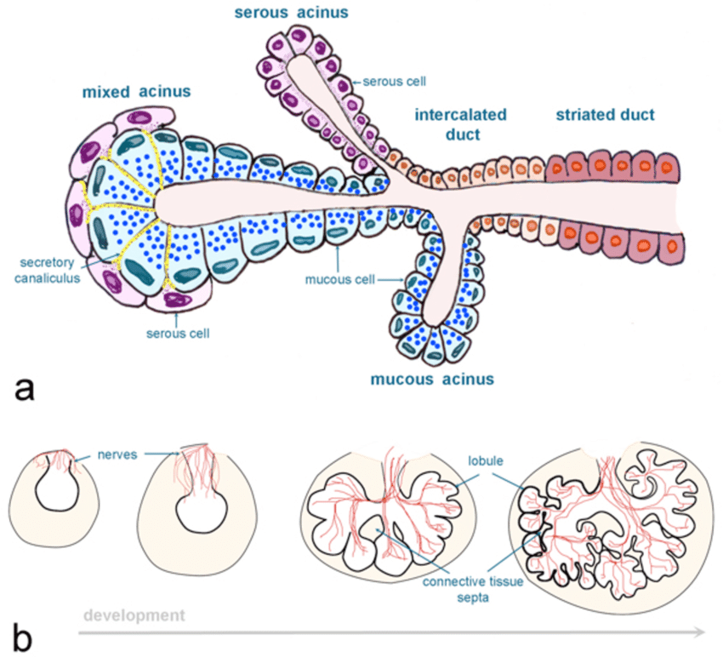

Slide 8
THE SALIVARY REFLEX
Secretions from Major SG evoked by interaction of tastants with different receptors on taste buds located in epithelium on dorsum of tongue & following activation of mechanoreceptors in PDL and mucosa
Secretions from Minor SG may also be increased in response to taste stimulation but movement & tactile stimulation of mucosa play a more important role

Slide 9
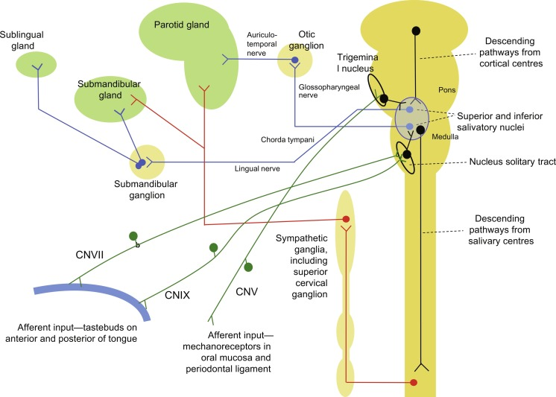

Slide 10
PHYSIOLOGY OF SALIVARY SECRETION INCLUDES
Salivary gland cells associated with ANS
0.5 – 1.0l of saliva secreted per day
Salivation stimulated/inhibited by release of neurotransmitters
Cholinergic parasympathetic & adrenergic sympathetic autonomic nerve evoke salivary secretion, signaling through muscarinic M3 & adrenoceptors on salivary acinar cells leading to secretion of fluid & salivary proteins

Slide 11
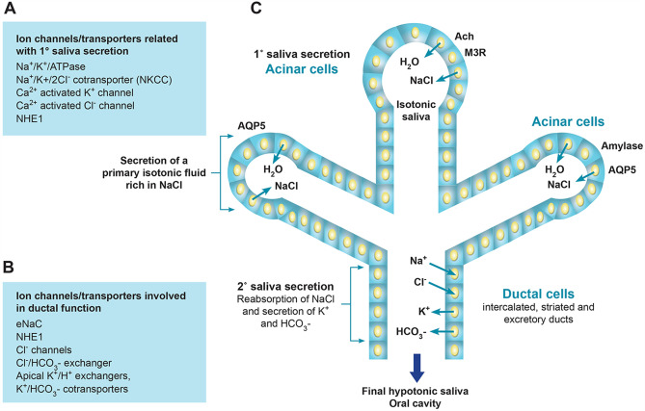
MECHANISM OF FORMATION OF SALIVA

Slide 12
Stimulation of beta-adrenoreceptors – increase CAMP- which is primary second messenger for amylase secretion
CAMP – activates protein kinase – release of proteins from secretory granules (which have biological functions)

Slide 13
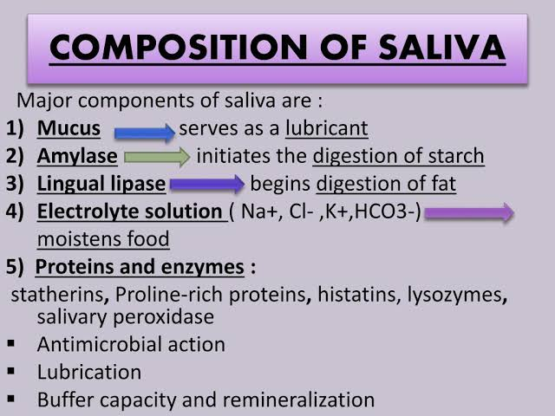
COMPOSITION OF SALIVA

Slide 15
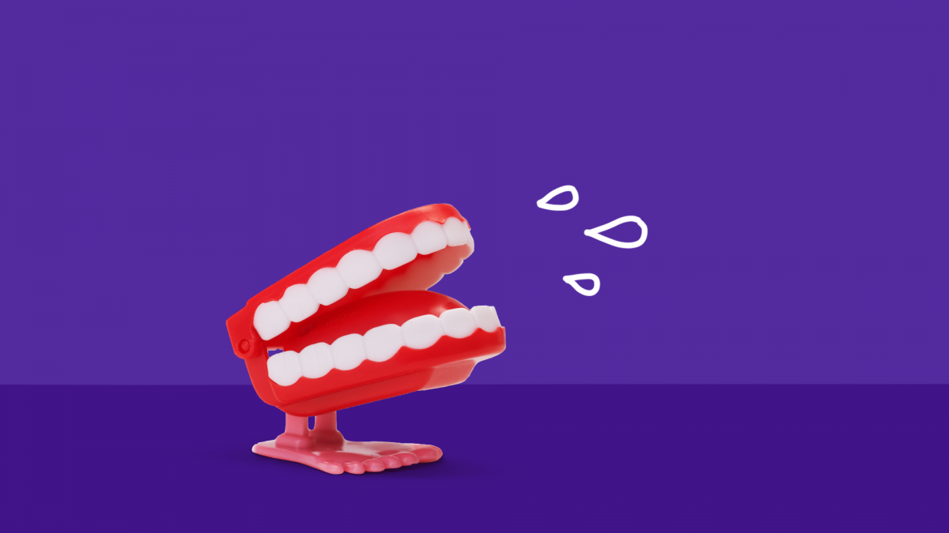
Taste
water balance
Protection & lubrication
excretory functions
Dilution & cleaning
Antibacterial properties
Buffer capacity
Integrity of tooth enamel, mucous membrane
Ecological balance
FUNCTIONS OF SALIVA
Tissue repair
Digestion

Slide 16
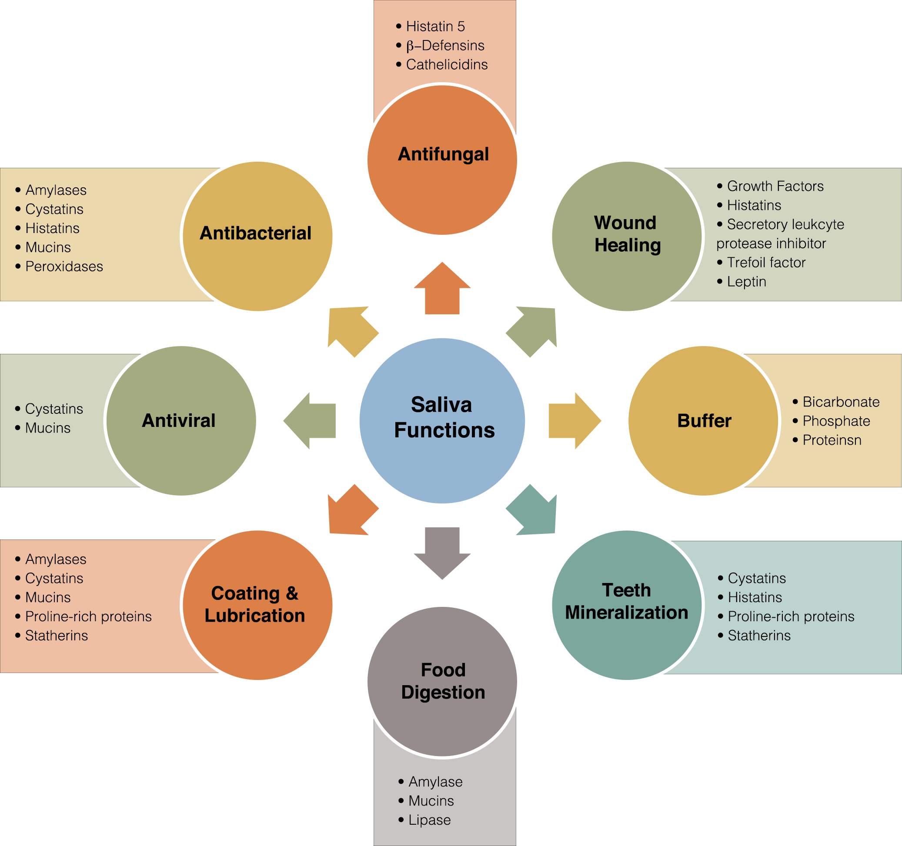

Slide 17
FLOWRATE OF SALIVA INTO THE MOUTH
500 – 1500 ml/day
Regional variations ”salivary highways” & byways
Origin of saliva | Resting ml/min | Resting (%) | Stimulated(ml/min) | Stimulated (%)
Whole mouth saliva | 0.35 | 100 | 2.0 | 100
Parotid glands | 0.1 | 28 | 1.05 | 53
Submandibular/sublingual glands | 0.24 | 68 | 0.92 | 46
Minor glands | <0.05 | 4 | <0.1 | 1

Slide 18

FACTORS INFLUENCING SALIVARY FLOW
Body posture, lighting and smoking
Circadian & circannual cycle
Medications
Thinking of food & visual stimulation
Regular stimulation of salivary flow
Size of salivary gland and body weight
Individual hydration
Salivary flow index
Contribution of different salivary glands
Physical exercise
Alcohol
Systemic diseases & nutrition
Fasting and nausea
Age
Gender

Slide 19
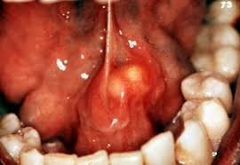
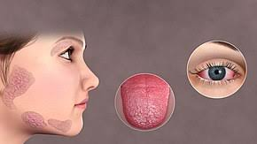
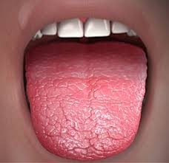
CHANGES IN SALIVA COMPOSITION IN SALIVARY GLAND DISEASES
Sialadenitis
Sjogren’s syndrome
Xerostomia

Slide 20
CAUSES OF REDUCED SALIVARY FLOW
Local causes of gland and duct damage
Systemic causes of gland damage
Systemic factors affecting normal gland function

Slide 21
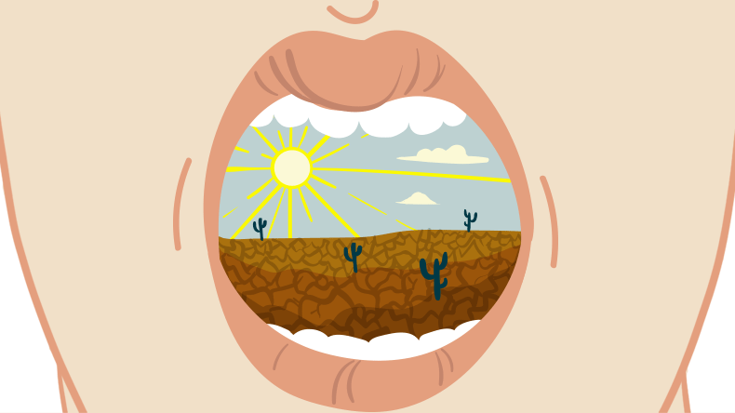
HYPOSALIVATION

Slide 22
ROLE OF SALIVA IN PERIODONTAL HEALTH
Enzymes:
Antibacterial properties of saliva
Lysozyme
Lactoferrin
Peroxidase
Mucin glycoproteins
Agglutinins
Non – immunologic salivary protein components includes
Secretory IGA – largest immunologic component of saliva
Histatins
Proline- rich proteins
Statherins
Cystatine
Sailin (a tetrapeptide)
Cathelicidins

Slide 23
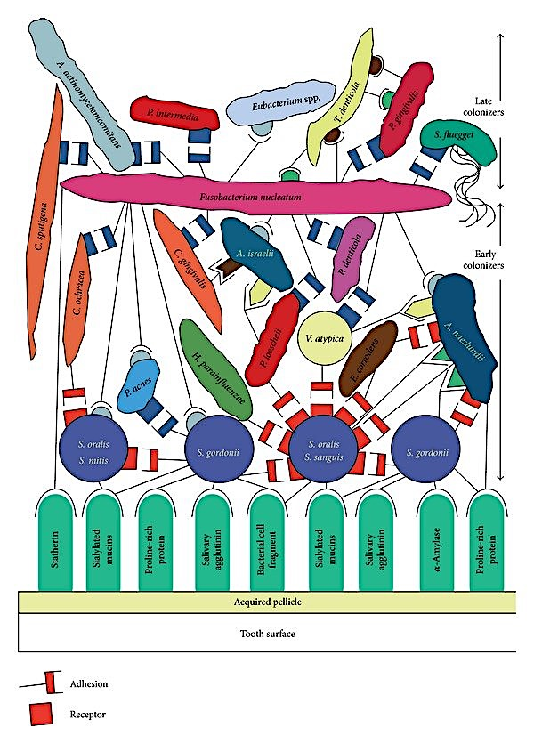
ROLE OF SALIVA IN PERIODONTAL DISEASE
Saliva in bacterial plaque formation

Slide 24
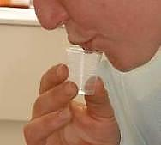
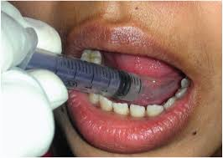
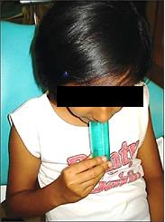
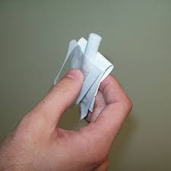
METHODS OF COLLECTION OF SALIVA
Unstimulated
Stimulated
Masticatory
Gustatory
1.Draining method
3.Suction
2.Spitting
4.Swab

Slide 25
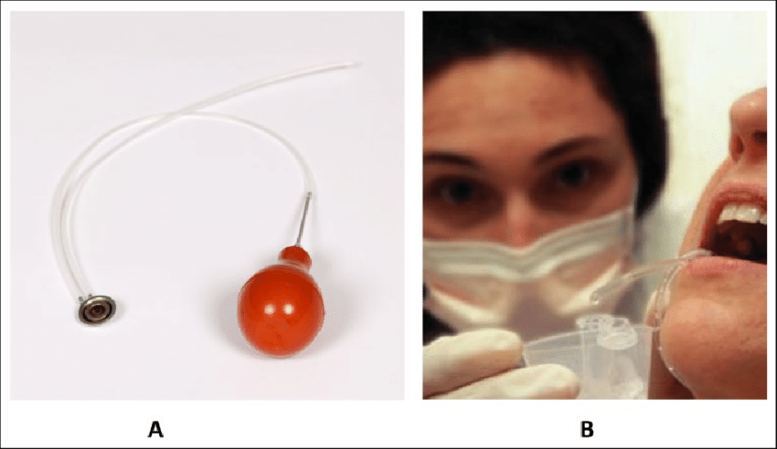
GLAND SPECIFIC SALIVA
PAROTID SALIVA
Carlson Crittenden cannula
SUB-MANDIBULAR/ SUB- LINGUAL GLAND SALIVA
  Suction
  Cannulation
  Segregator method
MINOR SALIVARY GLAND SALIVA

Slide 26
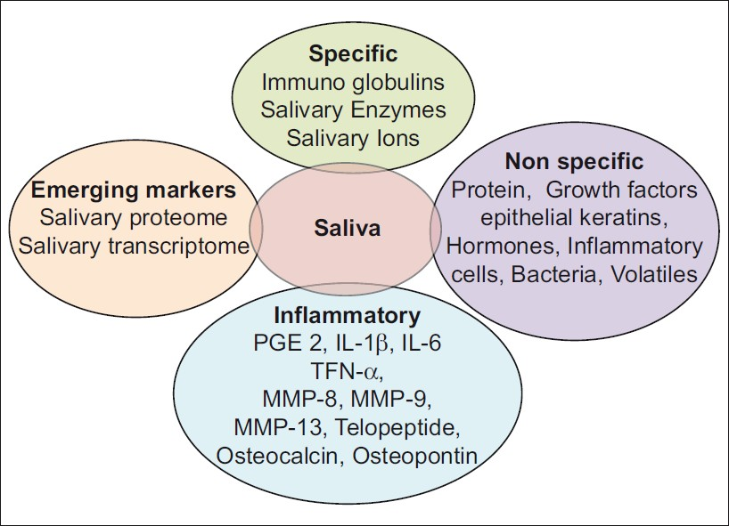
SALIVA
A diagnostic biomarker of periodontal disease

Slide 27
Markers of periodontal soft tissue inflammation
Markers of alveolar bone loss
Markers in saliva via GCF

Slide 28
C-Reactive protein
Systemic markers
Oxidative stress marker
Anti-oxidative capacity of saliva- uric acid, albumin, ascorbic acid, glutathione etc,.

Slide 29
EMERGING SALIVARY DIAGNOSTIC TOOLS
Salivary proteome- Hu et al. identified 309 distinct proteins. Studies also detected S100 calcium binding protein P, plastin-2 and neutrophil defensin – chronic periodontitis
Interleukin-8, interleukin-1b, MAC-2 binding protein – oral cancer
Salivary transcriptome - Hu et al. reported three mRNA biomarkers : myeloid cell nuclear differentiation antigen, guanylate binding protein 2 and low affinity IIIb receptor for Fc fragment of IgG- elevated in primary Sjogren’s syndrome.
Gomes et al. reported – increase expression mRNA for interferon gamma in saliva of patients with chronic periodontitis and type-2 DM.
Genetic biomarkers
Interleukin polymorphisms – Korman et al
Cathepsin C polymorphisms
TNF- a gene polymorphism
CD14 gene polymorphism

Slide 30
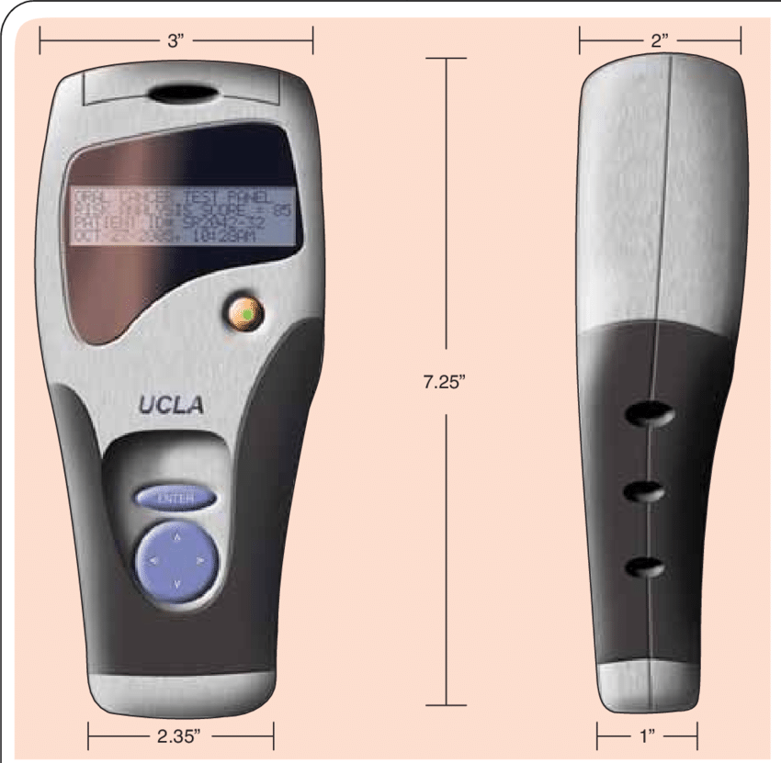
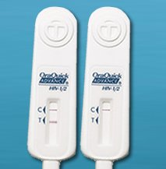
CHAIRSIDE/CARE TEST
Periosafe
Oral fluid nanosensor test
Ora quick
IMPOD ( integrated microfluidic platform for oral diagnostics
Myperio path
Omnigene
Myperio ID

Slide 31
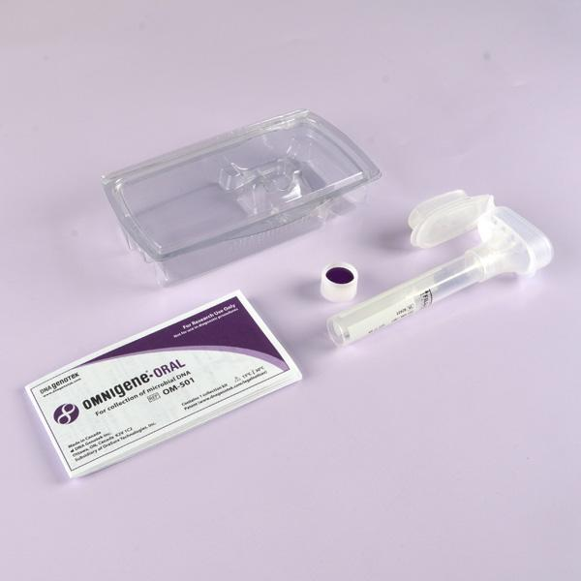
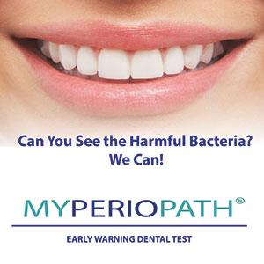
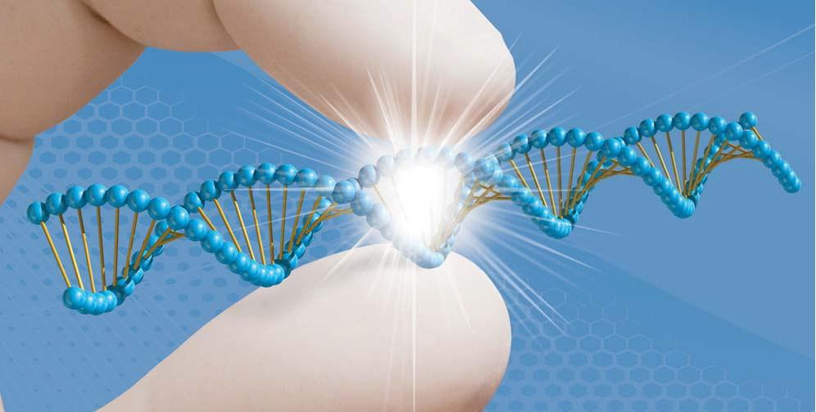
My Perio path
Omnigene
My Perio ID

Slide 32
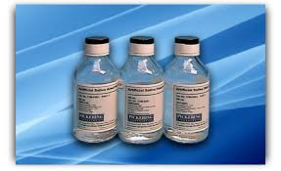
ARTIFICIAL SALIVA
Carboxymethyl cellulose
Glycerin
Minerals
Xylitol
Flavoring agents

Slide 33
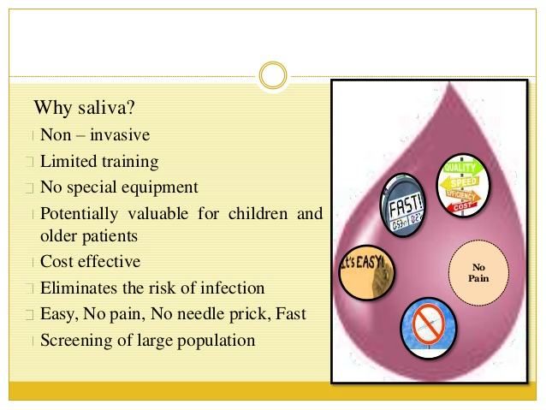

Slide 34
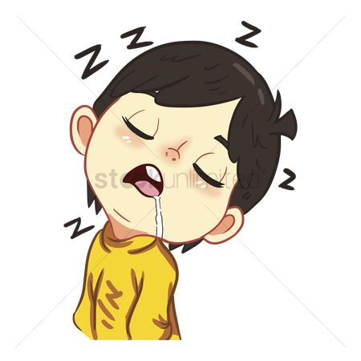
CONCLUSION
The contributions it makes to the preservation and maintenance of oral and systemic health shows that saliva a valuable fluid.
The necessity for new markers of periodontal disease activity and the discovery of some of them in saliva has strengthened the periodontists trust in the fluid.

Slide 35
REFERENCES
Caranzas text book of periodontology- 10th edition
Salivary secretion in health and disease -A. M. L. Pedersen-j oral rehabil. 2018;1–17.
The salivary gland fluid secretion mechanism -Marcelo a catalán- the journal of medical investigation vol. 56 supplement 2009.
The physiology of salivary secretion Gordon b. Proctor-periodontology 2000, vol. 70, 2016, 11–25
Methods of collection of saliva - A review - Yamuna Priya K
Personalized medicine: an update of salivary biomarkers for periodontal diseases DINA L. KORTE & JANET kinney-periodontology 2000, vol. 70, 2016, 26–37.
The emerging landscape of salivary diagnostics Yong zhang, Jie sun, Chien-chung lin-periodontology 2000, vol. 70, 2016, 38–52.
Saliva as a diagnostic tool for periodontal disease: current state and future directions William v. Giannobile, periodontology 2000, vol. 50, 2009, 52–64.

Slide 36


