Slide 1
CONCEPT OF PUBLIC HEALTH & INTRODUCTION TO COMMUNITY
By
Dr. Ajay Agarwal
Department of Community Medicine

Slide 2


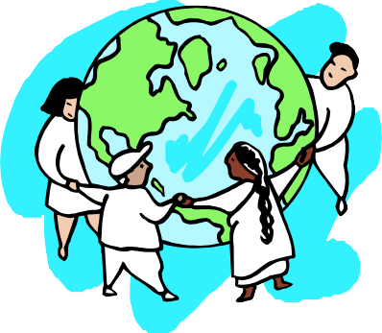






PUBLIC HEALTH
The “Big Picture”

Slide 3
WHAT IS PUBLIC HEALTH?
The sum of all official or governmental efforts to promote, protect, and preserve the people’s health.

Slide 4
PUBLIC HEALTH
“The science and art of preventing disease, prolonging life and promoting health and efficiency through organized community effort.”
-CEA Winslow, 1920
“The process of mobilizing and engaging local, state, national, and international resources to assure the conditions in which people can be healthy”
-The Oxford Textbook of Public Health

Slide 5
PUBLIC HEALTH
“The science and practice of protecting and improving the health of the community, as by preventive medicine, health education, control of communicable diseases, application of sanitary measures, and monitoring of environmental hazards.” -The American Heritage Dictionary of Public Health

Slide 6
PUBLIC HEALTH
“Public health is what we, as a society, do collectively to assure the conditions in which people can be healthy.”
-Source: Institute of Medicine Report (IOM). THE FUTURE OF PUBLIC HEALTH. Washington DC: National Academy Press. 1988.
Public health is a science and art of saving the lives of millions at once by single decision or intervention.

Slide 7
PUBLIC HEALTH
A System
A Profession A Method
Government Service
The Health of the Public

Slide 8
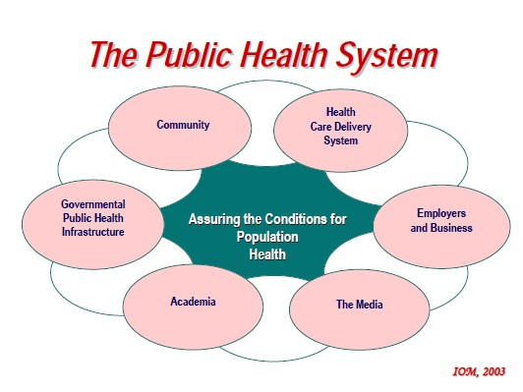

Slide 9


PUBLIC HEALTH APPROACH
Public Health Model
Medical Model
Versus

Slide 10
PUBLIC HEALTH APPROACH
Public Health Model
Population
Disease Prevention
Health Promotion
Interventions
Environment
Human behavior
Public (Some p r i v a t e)
Medical Model
Individual
Diagnosis
Treatment
Intervention
Medical care
Private (Some p u b l i c)

Slide 11
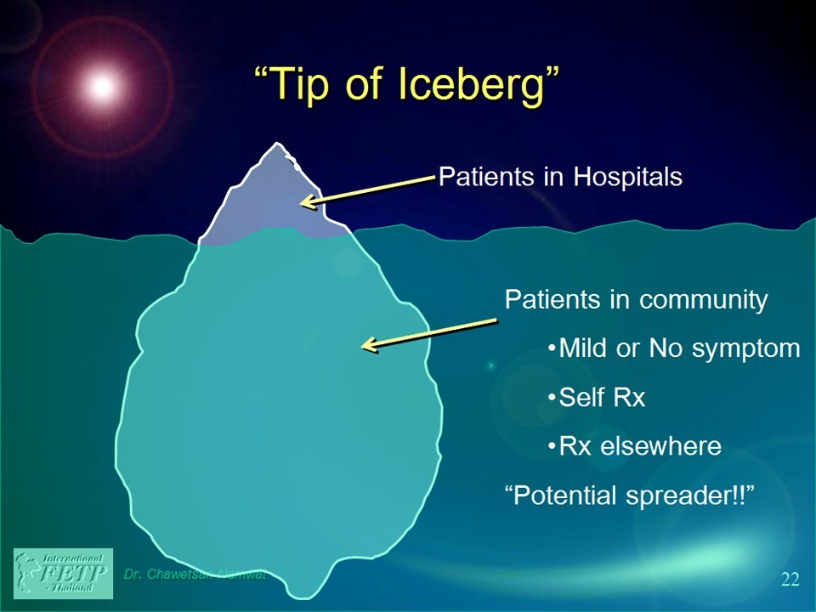
What physician sees?
What the physician does not see ?
11

Slide 12
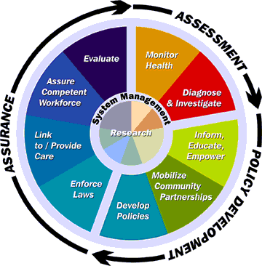
CORE FUNCTIONS OF PUBLIC HEALTH

Slide 13






CORE ACTIVITIES OF PUBLIC HEALTH
Prevents epidemics and the spread of disease
Protects against environmental hazards
Responds to disasters and assists communities in recovery
Prevents injuries
Promotes healthy behaviors
Assures the quality, accessibility and accountability of health services

Slide 14
CORE ACTIVITIES OF PUBLIC HEALTH
Monitoring the health status of the population
Mobilizing community action
Reaching out to link high-risk and hard-to-reach people to needed services
Researching to develop new insights and innovative solutions
Leading the development of sound health policy and planning

Slide 15
GREAT PUBLIC HEALTH ACHIEVEMENTS
Vaccination
Motor-vehicle safety
Safer workplaces
Control of infectious diseases
Decline in deaths f r o m coronary heart disease and stroke
Safer and healthie r foods
Healthier mothers a n d babies
Family planning
Fluoridation of drinkin g water
Recognition of tob acco use as a health hazard
CDC, 1999

Slide 16
PUBLIC HEALTH PROBLEMS AND DISEASES
Communicable disease
Non communicable diseases
Environmental pollution
MCH problems
Malnutrition and micronutrient deficiency
Municipal and hospital waste
Geriatric health problems
Population problems
Measles
Influenza
Poliomyelitis
Tuberculosis
Cholera
Dengue
Malaria
HIV/AIDS
Obesity
Cancer
Diabetes

Slide 17
PUBLIC HEALTH ORGANIZATIONS
Non Governmental
National
NFHP
FPAN
Nepal Red Cross
PLAN Nepal
International
CARE
United Mission to Nepal
Save the Children
Marie Stopes International
Family Health International
United Nation
  WHO
  WFP
  FAO
  UNICEF
  UNDP

Slide 18
PUBLIC HEALTH ORGANIZATIONS
Governmental
District health office
Public health office
Regional health directorate
Regional training center
Department of health services
Ministry of health and population
Primary health care institutions
Others
Academic institutions
Research organizations
Community development organizations
Quality control offices
Health training centers
Local development offices

Slide 19
SAMPLING OF PUBLIC HEALTH PROFESSIONS
Population, Family Planning & Reproductive Health
Maternal Child health
Public Health Education and Health Promotion
Community health planning and policy development
Public health administration
Epidemiology and disease control
Alcohol, tobacco and other drugs
Environmental & occupational health and safety
Food and nutrition
Gerontological health
HIV/AIDS
Injury control and emergency health Services
International Health
Mental Health
Oral Health
Public Health Nursing
School Health Education and Services
Women’s health and gender development

Slide 20
RISE OF PUBLIC HEALTH
Johanna Peter Frank (1745-1821) public health as good health laws & “State is responsible for health of its people
Public Health Act 1848
Cholera epidemic of 1832 & report of Chadwick is called “ father of public health”
John Snow 1848-1854 studied the role of polluted drinking water in the spread of cholera
William Budd 1856 outbreak of typhoid fever spread by drinking water

Slide 21
Public Health Act of 1875 for control of man’ s physical environment
Sir John Simon (1816-1904) first medical officer of Health of London done sanitary reforms & built up system of public health in London
“disease control phase” (1880-1920) lemuel Shattuck (1793-1859 ) in America published report on health condition to improvement of public health
Clean water , clean surrounding, wholesome condition of houses, control of offensive trades
establishment of W.H.O .provide a Health Charter for all people

Slide 22
CHANGING CONCEPTS IN PUBLIC HEALTH
FOUR PHASES
1-DISEASE CONTROL PHASE (1880-1920) during 19th century sanitary legislation & sanitary reforms aimed at control of man’s physical environment –water supply sewage disposal etc.
2-HEALTH PROMOTIONAL PHASE (1920-1960) public health had neglected the citizen as individual , & state has direct responsibility for the health of individual health, promotion of individual & Mother & child health services, school health services, industrial health services mental health & rehabilitation services

Slide 23
Winslow (1920) ‘the science & art of preventing disease, prolonging life & promoting health & efficacy through organizing community effort’
Provision of “ basic health services “through primary health centre & subcentres for rural & urban area
Community Development Programme to promote through active participation of whole community & on the initiative of the community

Slide 24
CHANGING CONCEPTS IN PUBLIC HEALTH
3-SOCIAL ENGINEERING PHASE –(1960-1980)
acute illness problems were solved new health problems in form of chronic diseases began to emerge so new concept as “risk factors” as detriments of these diseases.
Social & behavioral aspect of disease & health
Prevention of disease, promotion of health & prolongation of life.

Slide 25
4- HEALTH FOR ALL PHASE (1981-200A.D.)-
contrast in health of developed & developing country enjoys all detriments of good health –adequate income , nutrition, education, sanitation safe drinking water & comprehensive health care in contrast only 10-20% in developing country
W.H.O. to provide Health For All by year 2000

Slide 26

INTRODUCTION TO COMMUNITY AND COMMUNITY HEALTH CONCEPTS

Slide 27
DEFINITION
“ A community is a social group determined by geographical boundaries and/ or common values and interest. Its members know and interact with each other. It functions within a particular structure and exhibits and creates certain norms, values and social institutions”.. WHO expert Committee (1974)

Slide 28
FAMILY AND COMMUNITY MEDICINE
1923 Dr. Francis Peabody specialization had already reached its apex & for rapid return of general physician ( family physician) who would give comprehensive & personalized care.

Slide 29
FAMILY MEDICINE
Human, social & cultural aspect of health & disease & recognition of family as a focal point of health care & for integrating preventive, promotive & curative services.
“a field of specialization in medicine which is neither disease nor organ oriented medicine or health care centered on family as a unit –from first contact to on going care of chronic problem (from preventive to rehabilitation )

Slide 30
COMMUNITY MEDICINE
Successor of public health, community health, preventive & social medicine –prevention of disease & promotion of health
“specialty which deals with populations & comprises those doctors who try to measure the need of population, both sick & well, who plan & administer services to meet these needs, & those who are engaged in research & teaching in the field”

Slide 31
CHARACTERISTICS
1. The community has a defined geographical boundaries which has the beginning and the end.

Slide 32
The boundaries of a small community such as hamlet, village etc are distinct whereas that of a large community such as town, city etc are indistinct.

Slide 33
2. The community is composed of people who live together in the defined boundaries of the community.

Slide 34
3. The community people have common psychological characteristics i.e., there is similarity in language, life style, customs and traditions etc.
They share common interests, values, moral norms and codes.

Slide 35
4. The people in the community interact with each other and have free communication.

Slide 36
5. The community has organized social structure and system and common organization which carry various functions such as housing, food, agriculture, animal husbandry, health, education, marketing, banking etc.

Slide 37
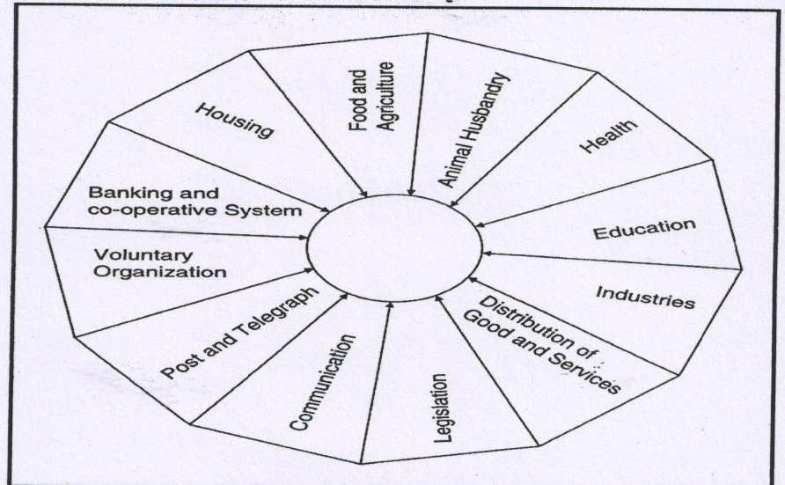
COMMUNITY A SOCIAL UNIT

Slide 38
FUNCTIONS
It provides space for housing, shelter, socialization and recreation.
It provides means and facilities for livelihood.

Slide 39
3. Community provides opportunity for employment.
4. It takes care off socialization and education of its members.

Slide 40
It provides safety and security for its members by enforcement of norms and legislation formulated by the society.
It provides opportunities for people participation and communication.

Slide 41
COMMUNITY HEALTH- DEFINITION
“Community HEALTH REFERS TO THE HEALTH Status of the members of the community, to the problems affecting their health and to the totality of health care provided to the
community”.. WHO (1971)

Slide 42
C.E.A WINSLOW
Is the father of public health.
He defines public health as follows.

Slide 43
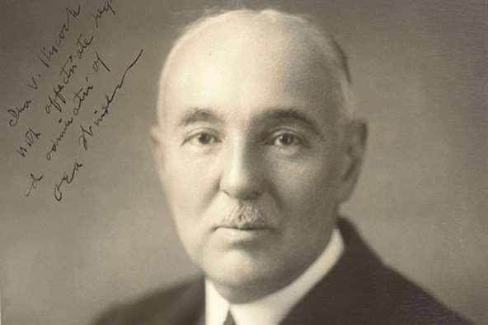
PROF C.E.A WINSLOW

Slide 44
“Public health is the science and art of preventing diseases, prolonging life and promoting health and efficiency through organized community efforts for the sanitation of environment
the control of diseases, the education of individuals in personal hygiene, the organization of medical and nursing services for early diagnosis and preventive treatment of diseases and

Slide 45
Cont…
the control of diseases, the education of individuals in personal hygiene, the organization of medical and nursing services for early diagnosis and preventive treatment of diseases and the development of social machinery to ensure for every individual a standard of living adequate for maintenance of health, so organizing these benefits as to enable every citizen to realize the birth right of health and longevity”

Slide 46
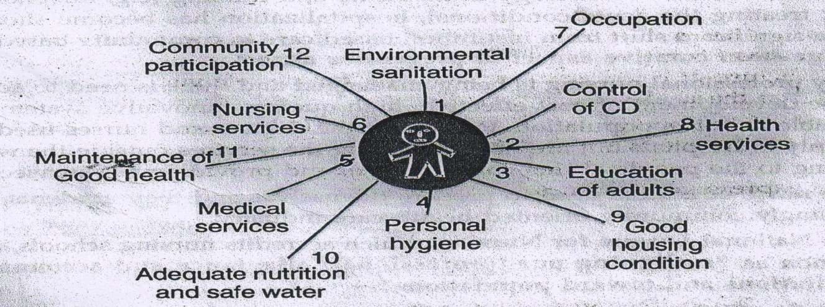
C.E.A WINSLOW CONCEPT OF COMMUNITY HEALTH

Slide 47
OBJECTIVE
The objective of community health is to provide need based comprehensive services which include the following.
1. Promotion and protection of health
i.e. PRIMARY LEVEL PREVENTION.
2. Early diagnosis and treatment and control of further spread of disease i.e. SECONDARY LEVEL PREVENTION.
3. Control of disability and rehabilitation ie. TERTIARY LEVEL OF PREVENTION.

Slide 48
1. Know the community
(COMMUNITY IDENTIFICATION).
2. Identify the health needs of the community (COMMUNITY DIAGNOSIS).

Slide 49
COMMUNITY
1. Know the community
(COMMUNITY IDENTIFICATION).
2. Identify the health needs of the community (COMMUNITY DIAGNOSIS).
3. Understand underlying factors affecting health problems.
4. Plan and implement comprehensive services.

Slide 50
SOCIAL MEDICINE
Neumann(1847) & Virchow (1948) – medicine is a social science
Alfred Grotjahn (1869-1931) showed that social factor in aetiology of disease
1912 Rene Sand founded Belgian Social Medicine Association ‘man is not only a biological animal, but also a social being, & disease has social causes, social consequences & social therapy’
‘social medicine is the study of man as a social being in his total environment’
Social medicine on two pillars medicine & sociology

Slide 51
SOCIAL ANATOMY
DEALS WITH STRUCTURE OF SOCIETY-
which consists of total population,
their age and sex wise distribution,
socioeconomic classification,
types of housing,
occupation,
industries,
temples,
school etc.

Slide 52
SOCIAL PHYSIOLOGY
DEALS WITH FUNCTION OF SOCIETY.
Air, Ventilation, Housing
Nutrition and health
Disposal of refuse, sewage, excreta, dead bodies etc.
Family welfare services
Demography and population dynamics
Customs, habits, tradition, beliefs, cultural practice etc.

Slide 53
SOCIAL PATHOLOGY
Study of defects in the society-
Strikes, lock-out, theft, murder, robbery, sexual assaults, juvenile delinquency etc.

Slide 54
SOCIAL THERAPHY
Adoption of social and political actions in the community.
SOCIAL ACTION-
Giving health education to the community, launching immunization program, improvement of sanitation etc.
POLITICAL ACTIONS-
Implementation of legal measures for health, safety and welfare of people

