Slide 1
Host microbial interactions

Slide 2
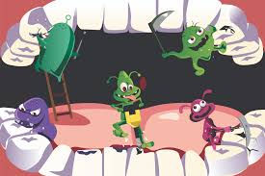
INTRODUCTION
A dynamic equilibrium exists between dental plaque bacterium and innate host defense system. Dental plaque bacteria have adapted survival strategies favoring growth, while the host limits growth by combination of innate and adaptive immune responses. This interaction represents a highly evolved interaction between bacteria and host.
It was found that degradation of host tissue results from this bacterial-host interaction. (Casey Hein 2004)
The host response is essentially protective, but both hypo- responsiveness and hyper-responsiveness of certain pathways can result in enhanced tissue destruction (Bruce l Pihlstrom 2005 ).

Slide 3
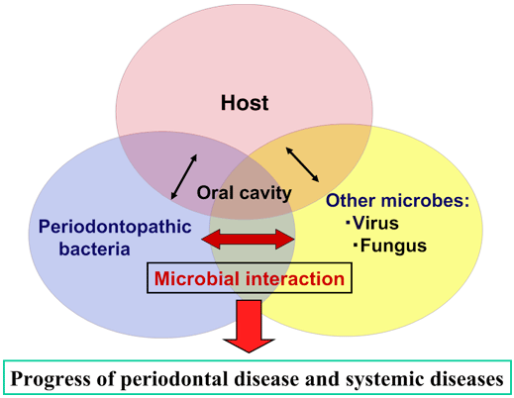
Formation of plaque
Host tissue invasion
Bacterial evasion of host defense mechanism
Virulence factors of different micro-organisms

Slide 4
HOST TISSUE INVASION
MODE OF ENTRY OF BACTERIA:
ORGANISMS CAPABLE OF INVADING TISSUES DIRECTLY:(AAP 1996)
Aggregatibacter actinomycetemcomitans
P. gingivilis
Fusobacterium nucleatum
Trepanoma denticola
Direct penetration of microorganisms
Through periodontal pockets
Through gingival sulcus
Through the ulceration in the epithelium
Notes:
Advantages: Tissues can provide reservoir for colonization
Can not be eliminated easily by mechanical methods.
Systemic antibodies are required to eliminate bacteria
The presence of bacteria within the tissue makes periodontitis more resistance to the treatment
. Some investigators have speculated that the “bursts of disease activity” observed in periodontitis may be related to phases of bacterial invasion of tissues

Slide 5
HOST DAMAGE
DIRECT TISSUE DAMAGE
Periodontal pathogens - capable of enzymatic degradation of collagen, immunoglobulins and several complement components, lysis of human neutrophils.
Gram negative bacteria possess LPS complexes (endotoxins) - cell breakdown & tissue destruction
stimulation of collagenase release from macrophages
activation of complement via the alternative pathway
stimulation of bone resorption

Slide 6
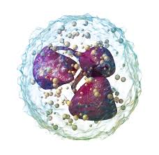
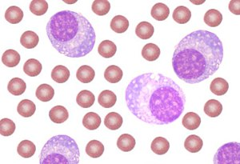
INDIRECT DAMAGE
BACTERIALLY TRIGGERED AUTO-DESTRUCTION
NEUTROPHIL CONTRIBUTES TO MECHANICAL TISSUE DAMAGE AND CONCOMITANT RELEASE OF LYSOSOMAL ENZYMES AND ROS
EXTRACELLULAR DISCHARGE OF GRANULAR CONTENTS, & RELEASE OF PRO-INFLAMMATORY MEDIATORS CAUSE FURTHER DAMAGE.
MACROPHAGES/MONOCYTES , SECRETE IL-1 AND PGE₂
B-CELL AND PLASMA CELL
DENDRITIC CELLS
CHEMOTACTIC FACTORS (SUCH AS LEUKOTRIENE B₄) THAT ATTRACT INCREASING NUMBERS OF NEUTROPHILS.

Slide 7
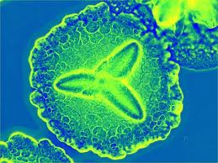
PERIODONTAL PATHOGENS & THEIR VIRULENCE FACTORS
AGGREGATIBACTER ACTINOMYCETUMCOMITANS
6 SEROTYPES
POLYSACCHARIDE AND LIPOPOLYSACCHARIDE
LEUKOTOXIN
EXTRACELLULAR PROTEOLYTIC ENZYMES
GROEL HEAT SHOCK PROTEIN
FIMBRIAE

Slide 8
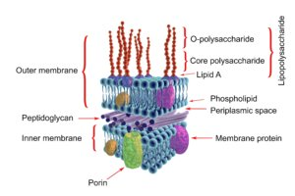
LPS
Ito et al have reported that lipopolysaccharide from A. Actinomycetemcomitans promotes differentiation of osteoclasts in vitro in the presence of 1,25-dihydroxyvitamin D3 and dexamethasone

Slide 9
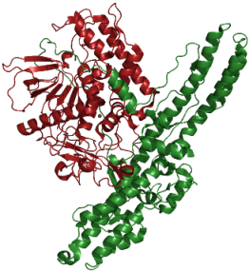
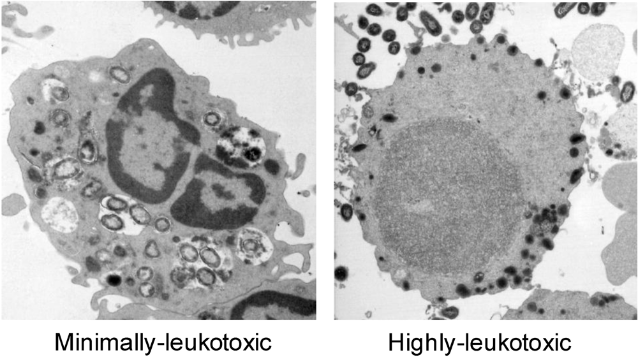
LEUKOTOXIN
In a study by Zambon Et Al. Fifty-five percent of localized aggressive periodontitis patients were shown to be infected with A. Actinomycetemcomitans strains that produced a leukotoxin that was able to lyse human peripheral blood polymorphonuclear leukocytes.

Slide 10
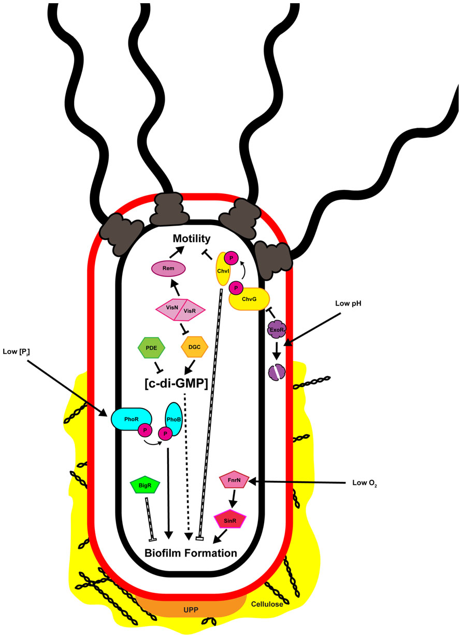
Extracellular proteolytic enzymes of AA
Trypsin-like proteolytic activity
Reported to degrade IgG (all four subclasses), Serum (but not secretory) Iga, IgM but not IgD or IgE in vitro
Fimbriae of AA
Important role in colonization
Role in invasion of epithelial cells by receptor-mediated endocytosis.

Slide 11
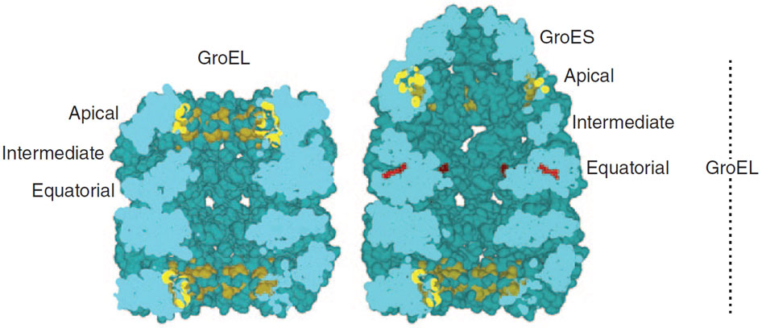
GroeL heat shock protein of AA
Kirby et al. Reported the potent osteolytic active component in the surface-associated material was identified as Groel, as a monoclonal antibody inhibited A. Actinomycetemcomitans induced bone resorption. GroEl stimulates the recruitment and activation of osteoclasts in a dose dependent manner.

Slide 12
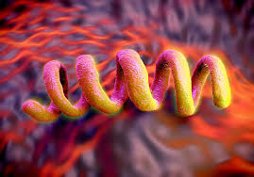
Treponema denticola
Major sheath protein
Flagellum
Extracellular proteolytic enzymes
Other antigenic proteins
Lipopolysachrides
Peculiarity of cell membrane

Slide 13
Lipopolysachharides of T.denticola
Gopalsami et al have reported that the outer membrane lipid of T. Denticola was able to induce bone resorption .

Slide 14
Major sheath protein of TD
The 53-kda protein also enhances the inflammatory response by triggering degranulation of polymorphonuclear cells and the specific release of collagenase, gelatinase and matrix metalloproteinases mmp-8 and mmp-9.

Slide 15
Flagellum of T d
FlaA has been suggested to have a role in adherence of T. Denticola to host cells as it binds fibronectin .

Slide 16
Extracellular proteolytic enzymes of TD
Helps t. Denticola to bind to the ground substance glycosaminoglycan, hyaluronate
Induce apoptosis in epithelial cells.
Dysregulate the inflammatory response by degrading vasoactive peptides, hormones and neuropeptide

Slide 17
Other antigenic proteins of TD
A putative hemolysin, a 46-kda antigenic protein named CYSTALYSIN is suggested to play a central role in Iron acquisition by T. Denticola and Cause the oxidation and sulphuration of hemoglobin.

Slide 18
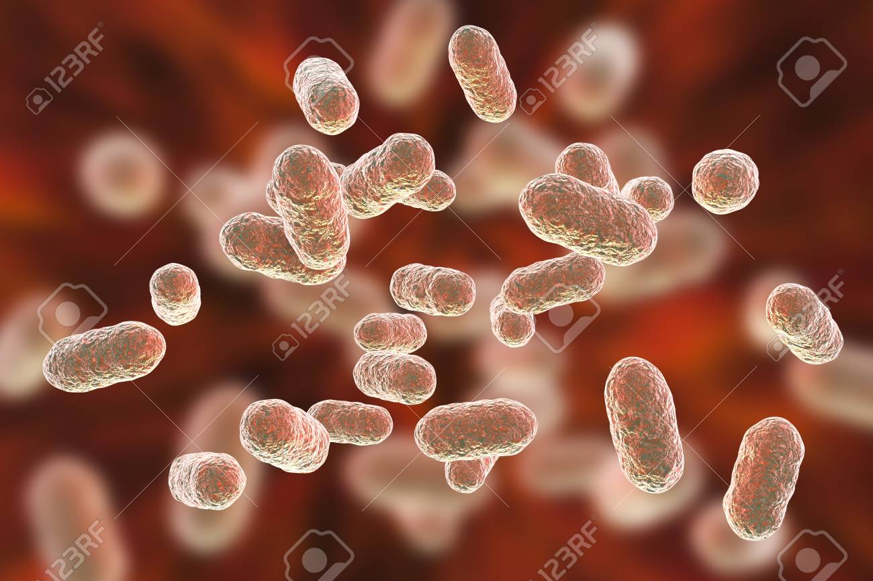
P. gingivalis
Capsule
Lipopolysaccharide
Fimbriae
Extracellular proteolytic enzymes
Heat shock protein
Haemagglutinins
Antigenic outer membrane proteins
P. GINGIVALIS ANTIGENS

Slide 19
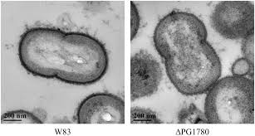
Capsule of PG
Inhibits the attachment of pdl fibroblasts to the tooth root surface
More resistant to phagocytosis

Slide 20
Lipopolysaccharide OF PG
Induces secretion of pro-inflammatory cytokines.
Induces secretion of nitric oxide, TNF-α, PGE-2 and IL-1 from macrophages
Induces secretion of a higher amount of IL-6 via toll-like receptors.
Potent inducer of bone resorption by the stimulation of local Il-1α and Il-1β

Slide 21
Fimbriae of pg
Active invasion of endothelial cells by P. Gingivalis
mediated via fimbriae
enhancing the inflammatory response

Slide 22
Extracellular proteolytic enzymes of pg
Pick et al. (1994) separated the trypsin-like activity in P. Gingivalis culture supernatants called' GINGIPAIN' and found that there were two separate cysteine proteinase activities, one with arginine and one with lysine specificity.

Slide 23

ARG-GINGIPAIN
Enhance vascular permeability.
These enzymes increase GCF production and thus provide a continuous supply of nutrients for the bacterium, enhancing its growth and virulence.
Arg-gingipain - potent chemotactic factor c5a by directly cleaving the C5 component of complement.
Degrades C3,and eliminates the creation of c3-derived opsonins. This render sp. Gingivalis more resistant to phagocytosis by neutrophils

Slide 24
LYS-GINGIPAIN
Fibrinogen is a major target for lys-gingipain and it thus increases the local clotting time, leading to gingival bleeding.
Gingipains act as adhesins and have a strong binding affinity for fibrinogen , fibronectin and laminin. It inhibits haemagglutination.
Since these complexes are present on the surfaces of both the vesicles and membranes of P. Gingivalis , they may play an important role in the attachment of this bacterium to host cells.
The bleeding of periodontal sites ensures the rich source of haem and iron that it requires for survival.

Slide 25
Heat shock protein of pg
Heat shock protein GroEl is highly antigenic and anti-p. Gingivalis GroEl antibodies have been detected in gingival tissue extracts.
P. Gingivalis GroEl may lead to an autoimmune reaction
Haemagglutinins
The cell surface Haemagglutinating adhesin, HA-AG2, is a surface antigen of P. Gingivalis.
Specific antibodies to HA-AG2 have been shown to inhibit haemagglutination and binding of P. Gingivalis to epithelial cells.

Slide 26
Antigenic outer membrane proteins
Curtis and co-workers, have identified a 55 kDa major antigenic outer membrane protein of P. Gingivalis .
Identified a range of immunodominant proteins by their molecular mass.
The 46 kDa antigen was suggested to be the predominant immunoreactive protein with sera from patients with severe periodontitis

Slide 27
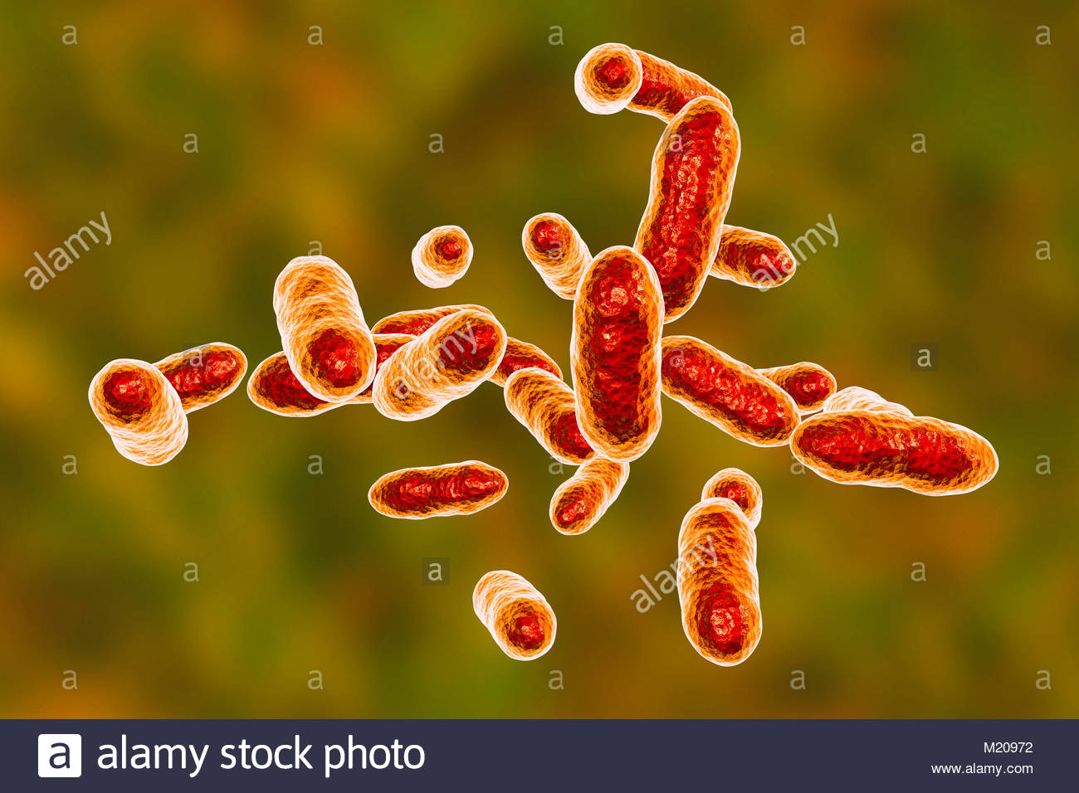
T. forsythia
T. Forsythia is a gram-negative, anaerobic, saccharolytic fusiform bacterium.
T. forsythea antigens
Other antigenic outer membrane proteins
Lipopolysachrides
Extracellular proteolytic enzymes

Slide 28
Lipopolysachrides of T. forsythia
Vasel Et Al indicated that T. Forsythia lipopolysaccharide may be similar to P. Gingivalis lipopolysaccharide.
EXTRACELLULAR PROTEOLYTIC ENZYMES OF T.F
Produces trypsin-like serine proteases and hemolytic cysteine–protease
Play a role in binding of T. Forsythia to erythrocytes, polymorphonucleocytes and fibroblasts .
Using PCR Tan Et Al. Showed that T. Forsythia occurred in 91% of subgingival plaque samples from chronic periodontitis patients whereas only 9% of subgingival plaque samples from healthy patients contained this genotype.

Slide 29
Other antigenic outer membrane proteins
A GroEL-like protein with a molecular mass of 58 kDa is produced by T. Forsythia which may have important implications for the immune response and induce apoptosis especially in lymphocytes by the formation of membrane pores.
BspA, a 98-kDa protein sera from chronic periodontitis patients, but not from healthy individuals, recognized recombinant BspA in a western blot analysis.
BspA also stimulate proinflammatory cytokine production in THP-1 mononuclear cells via interaction with CD14 and Toll-like receptor

Slide 30
Capnocytophaga species
Capnocytophaga species is a group of facultative gram-negative fusiform rods.
Capnocytophaga ochracea has been correlated with the presence of disease in localized juvenile periodontitis patients and was not found in healthy subjects in a family study by Williams Et Al.

Slide 31
IMMUNOLOGICAL ASPECTS OF HMI
COMPLEMENT
RESIDENT LEUKOCYTES & MAST CELLS
NEUTROPHILS
MACROPHAGES & LYMPHOCYTES

Slide 32
DEFENCE MECHANISMS
NON-SPECIFIC MECHANISMS-
Bacterial balance
Surface integrity
Surface fluid and enzymes
Phagocytosis
Inflammatory reaction
MECHANISMS SPECIFIC TO INVADING FOREIGN PROTEINS CALLED ANTIGENS WHICH STIMULATE THE IMMUNE SYSTEM
Adaptive immune system
Humoral immunity

Slide 33
Bacterial Colonization and Survival in the Periodontal Region
Bacterial adherence in the Periodontal Environment
Host Tissue Invasion
Bacterial Evasion of Host Defense Mechanisms

Slide 34
bacterial challenge phase
The epithelial and vascular elements response to bacterial challenge
The intact epithelial barrier of the gingival, sulcular and junctional epithelium prevents bacterial invasion.
Salivary secretions provides continuous flushing and supply of agglutinins and specific antibodies.
The gingival crevicular fluid flushes the sulcus or pocket and delivers complement proteins and specific antibodies.
There is a very high turnover of epithelium -that permits rapid replacement of cells and tissue components damaged by microbial challenge.

Slide 35
inflammatory response
Vascular leakage enhances the localized response:
Leukocytes selectively emigrate from the vessels to alter the immuno-inflammatory cell populations in the gingival tissues
Neutrophil migration into the gingival sulcus:
The inflammatory infiltrate within the tissues:
Opsonization AND Phagocytosis

Slide 36
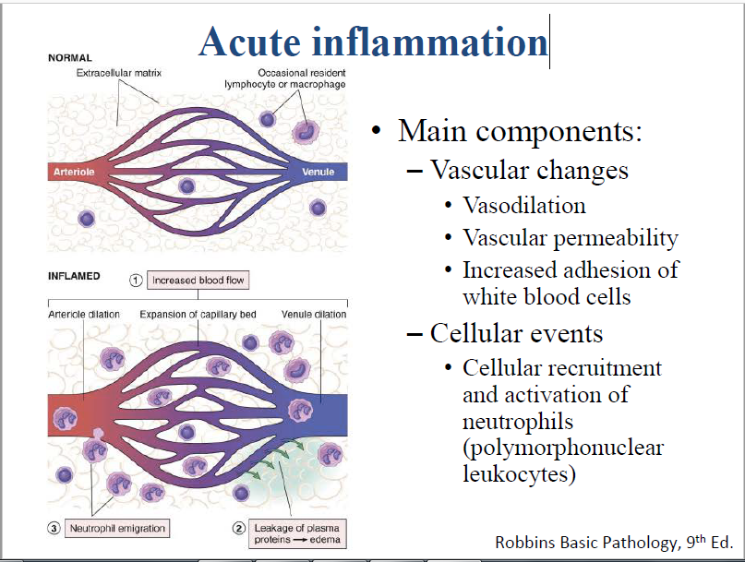
Vascular Leakage Enhances The Localized Response
In the presence of LPS , the endothelial cells of the microcirculation become activated. The vessels of the microcirculation become inflamed, dilated and engorged with blood, and the blood flow slows.
The endothelial cell junctions open and protein-rich fluid leaves the vessels at the site of the post-capillary venules /and accumulates in the extra cellular matrix.
Leukocytes selectively emigrate from the vessels to alter the immune inflammatory cell populations in the gingival tissues

Slide 37
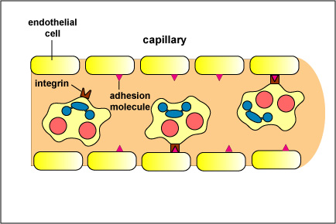
Neutrophils exit the inflamed vessel of the' microcirculation and migrate through the connective tissues and junctional epithelium, to form a barrier between the subgingval microbial plaque and the gingival tissue.
There is specific interactions among vascular cell adhesion molecules and leukocyte integrins and thus the chance of inducing leukocyte extravasation by diapedesis into the extravascular spaces.
Following extravasation, neutrophils seem to gain access to the more coronal portion of the junctional epithelium and to selectively migrate through this multilayered epithelium to gain access to the bacterial flora.
Notes:
Two mechanisms of possible importance in the regulation of neutrophil migration towards the gingival sulcus or the periodontal pocket following neutrophil extravasation:
The expression of leukocyte adhesion molecules such as the intercellular adhesion molecule I, in epithelial cells.
Cytokines with potent and cell type-specific leukocyte chemotactic properties: the chemokines and the neutrophil-selective interleukin 8, in particular.

Slide 38
Opsonization
Opsonization- refers to the coating of particles, such as bacteria, with host proteins that facilitate phagocytosis.

Slide 39
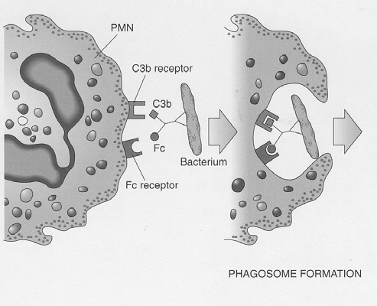
Phagocytosis
Once the bacterial cell is bound to the neutrophil , ingestion (phagocytosis) results in entrapment of the bacterial cell into the membrane delimited structure known as the phagosome.
Bacteria within the phagosome and phagolysosome may be killed by oxidative or nonoxidative mechanisms

Slide 40
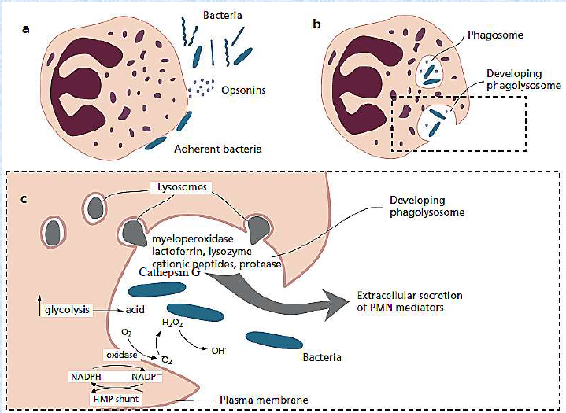

Slide 41
Respiratory burst
Respiratory burst (sometimes called oxidative burst) is the rapid release of ROS (superoxide radical and hydrogen peroxide) from different types of cells.
Usually it denotes the release of these chemicals from immune cells, e.G., Neutrophils and monocytes, as they come into contact with different bacteria or fungi .
NADPH oxidase, an enzyme family in the vasculature (in particular, in vascular disease), produces superoxide, which spontaneously recombines with other molecules to produce reactive free radicals.

Slide 42
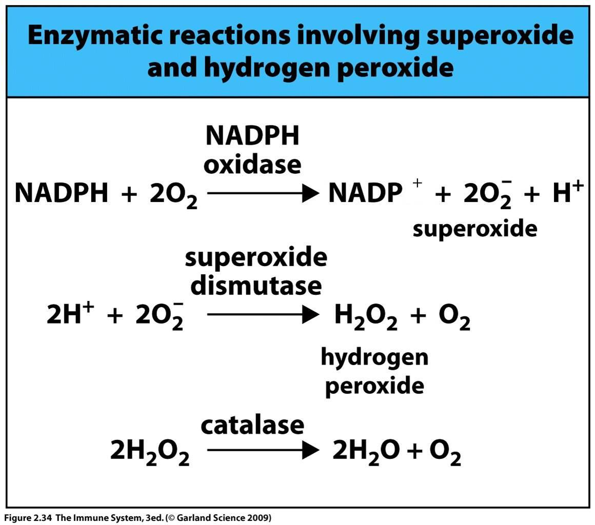
Neutrophils and monocytes utilize myeloperoxidase to further combine H₂O₂ with cl⁻ to produce hypochlorite, which plays a role in destroying bacteria. Absence of NADPH oxidase will prevent the formation of reactive oxygen species.

Slide 43
Reactive oxygen species
Any species capable of independent existence that contain one or more unpaired electrons.
Inflammatory cells and in particular PMN once stimulated produce reactive oxygen species via metabolic pathway of the respiratory burst, which occurs in the process of phagocytosis.
These includes superoxide anion, hydrogen peroxide, hydroxyl radicle and hyporchlorus acid.
ROS can cause
Protein damage
Lipid Peroxidation
DNA damage

Slide 44
NEUTROPHIL MEDIATED TISSUE INJURY :
PMN secretes cytoplasmic granules. Fusion of the granules and phagosome release granule contents into the phagosome.
Many of the neutrophil granule contents like MPO, lysosome, β-glucuronidase, elastase, collagenase, lactoferrin and cathepsin G have been found at sites of periodontal destruction.
Primary granules are released intracellularly and secondary and secretory granules are released extracellularly. These extracellularly released granules have the potential to cause localized tissue destruction.

Slide 45
Oxygen radical species produced by PMNs can attack every biologically relevant molecule like proteins, lipids, carbohydrates and nucleic acids.
These molecules include superoxide anion (O2⁻), hydrogen peroxide (H2O2) and hypochlorous acid & play an important role in mediating tissue injury, not only by inducing direct oxidative damage to cells but also by initiating a series of events that result in tissue injury.
PMN degranulation also releases several proteolytic enzymes which hydrolyse extracellular proteins like elastin, fibronectin, and collagen Type III and IV.
Collagenases released by neutrophils also degrade tissue collagen. Cleavage of matrix molecules by collagenase and elastase generate peptide fragments that are chemotactic for monocytes.

Slide 46
PMNs also have the potential to release other pro-inflammatory mediators like 5-lipoxygenase, leukotriene B4, and platelet-activating factor (PAF).
These are potent stimulants of neutrophil chemotaxis, adhesion, oxygen burst, and degranulation and may amplify neutrophil mediated tissue injury and vascular permeability.

Slide 47
persistently elevated levels of β-glucornidase are associated with continued attachment loss in patients with adult periodontitis.
Lactoferrin is an iron binding protein present in PMN granules. Lactoferrin facilitate phagocytosis of plaque bacteria.
The amount of lactoferrin in gingival crevicular fluid of patients with periodontal disease is increased and may contribute to tissue damage in the periodontium.

Slide 48
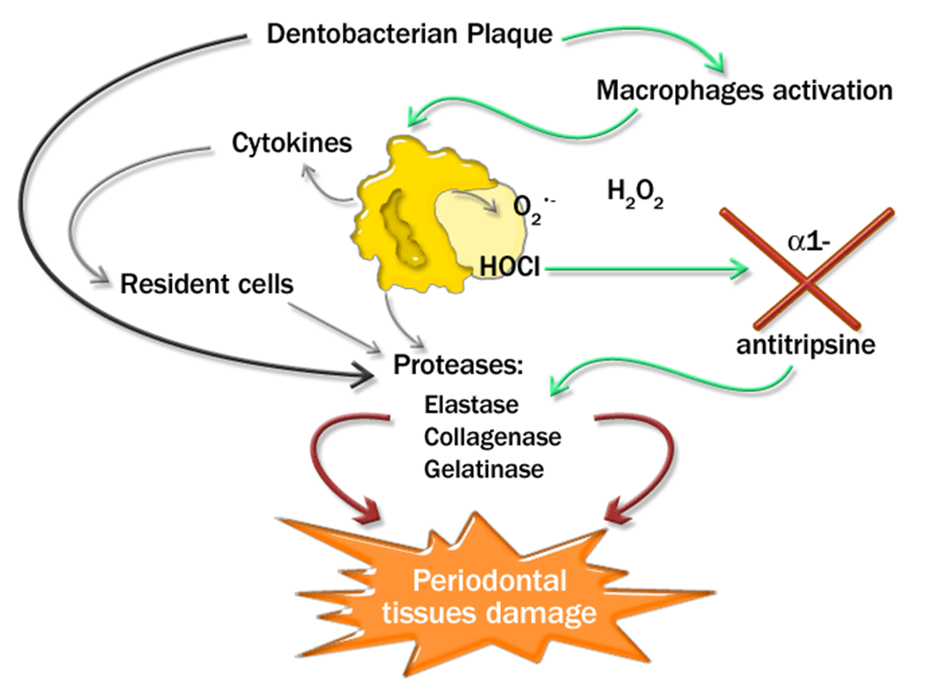
Immune response phase
The bacterial products and epithelial derived cytokines
Activate the local tissue mononuclear cells

Slide 49
Bacterial products
Degrade basement membrane and extracellular matrix proteins including collagen, proteoglycans, and glycoproteins.
Destroyes periodontal connective tissue and facilitates bacterial invasion.
Interferes with tissue repair by inhibiting clot formation or lysing the fibrin matrix in periodontal lesions.
Activates latent host tissue collagenase which would enhance host-tissue enzyme mediated tissue destruction.
Inactivates proteins important in host defense.

Slide 50
Proteinases
Matrix metalloproteinases MMPs
They degrade extracellular matrix molecules, such as collagen, gelatin and elastin.
MMP-8 and MMP-l both collagenase are elevated in tissues and GCF associated with periodontitis
Elastase is capable of degrading wide range of molecules including elastin, collagen, and fibronectin.
Chymotrypsin-like protease produced by treponema denticola, cathepsin G, neutrophil serine proteinase.
Endogenous inhibitors of elastase and cathepsin G (eg α₁-proteinsase inhibitor, α₁-antichymotrypsin, α₂-macroglobulin) are found in plasma and GCF.

Slide 51
Matrix metalloproteinases (MMPs) are primary proteinases associated with C.T. remodelling.
They are produced by
  Neutrophils
  Macrophages
  Fibroblasts
  Epithelial cells
  Osteoblast
  Osteoclasts
  P.Gingivalis and A.a
They degrade collagen, elastin and gelatin

Slide 52
Cytokines
Both IL-I and TNF-a induce production of proteinases in mesenchymal cells, including MMPs, which may contribute to connective tissue destruction.
Il-I and TNF-a found in significant concentrations in GCF from periodontally diseased sites.
Increasing severity of periodontitis is associated with increased concentrations' of IL-I and decreasing concentrations of IL-Ira .

Slide 53
IL-1α and IL-1β - osteoclast-activating factor.”
The pro-inflammatory effects of Il-1 and TNF-α include-
Stimulation of endothelial cells to express selectins that facilitate recruitment of leukocytes.
Activation of macrophage IL-1 production.
Induction of prostaglandin E₂ (PGE₂) by macrophages and gingival fibroblasts.

Slide 54
Prostaglandins
Prostaglandins are arachidonic acid metabolites generated by cyclooxygenases (COX-I, COX-2).
Cox-2 is upregulated by IL-Ib , TNF-a and bacterial LPS and appears to be responsible for generating the prostaglandin PGE2 that is associated with inflammation.
PGE2 is increased in periodontal sites demonstrating inflammation and attachment loss.
Goodson et al. Reported a 10-fold increase of prostaglandin E2 levels in inflamed gingival tissue, compared with healthy gingival tissue

Slide 55
BONE RESORPTION FACTORS
Bone loss in periodontal disease are listed by Haussmann in 1974
Bacterial factors
Capsular and surface associated material
LPS
Lipoteichoic acid
Peptodoglycans
Muramyl dipeptide
Lipoprotein
Host factors
Inflammatory mediators
PGE2
Leukotrienes
Heparin
Thrombin
Bradykinin
IL-1
IL-6
TNF
TGF β
PGDF
Cytokines

Slide 56
Role of NO in bone resorption
There is good evidence to suggest that NO(nitric oxide) has biphasic effects on osteoclastic bone resorption.
Low concentrations of NO have been shown to potentiate IL-1 induced bone resorption,

Slide 57
Thank you

