Slide 1
CERVICAL CANCER VACCINATION ROLE OF COMMUNITY MEDICINE
By-Dr.Hasan Asghar Zaidi
JR-1(Community Medicine)

Slide 2
Cervical Cancer
Magnitude of the Problem: -
Cervical cancer is the third most common cancer worldwide
500,000 new cases identified each year
80% of the new cases occur in developing countries
At least 200,000 women die of cervical cancer each year

Slide 3
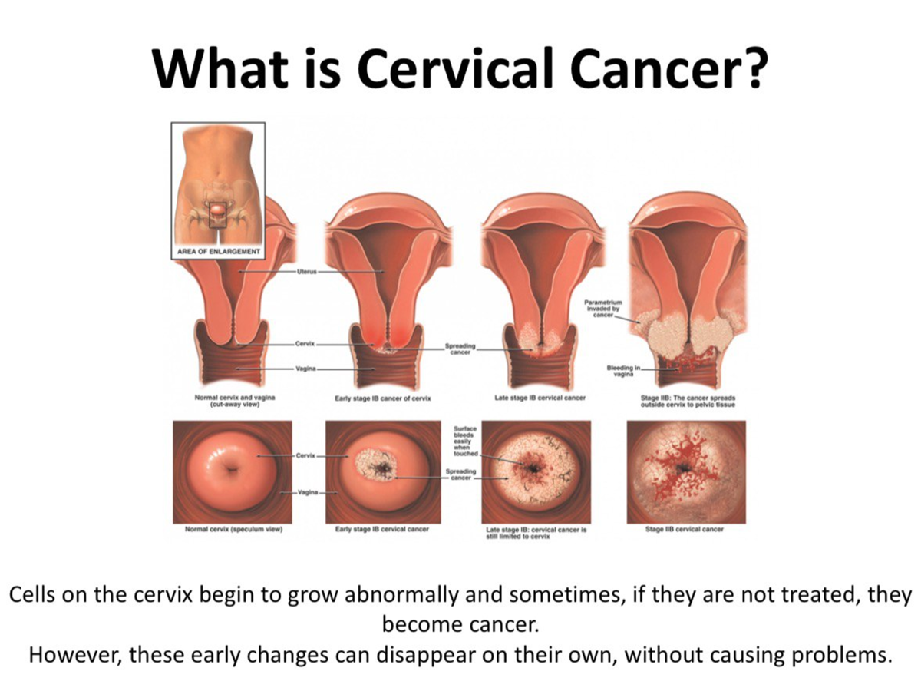

Slide 4
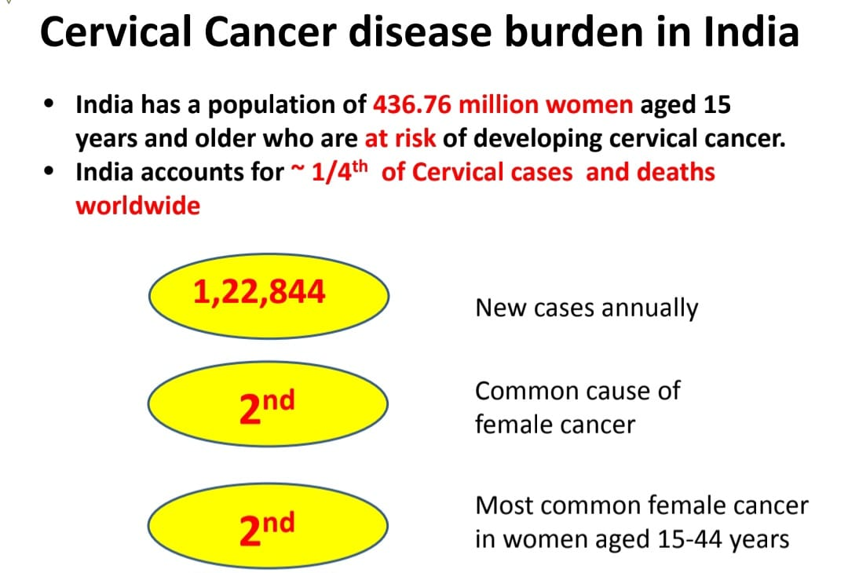

Slide 5
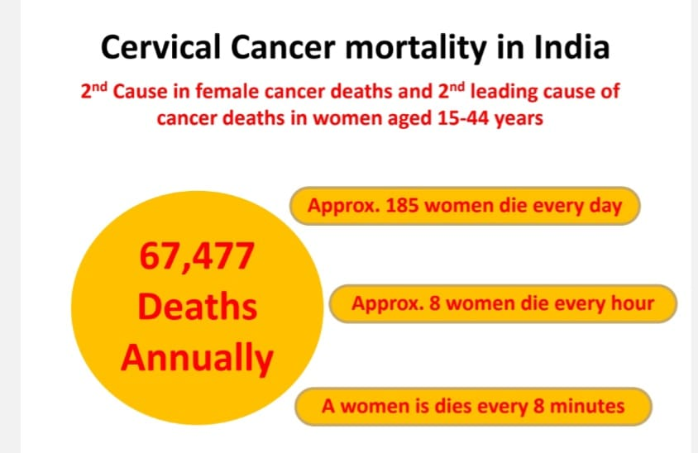

Slide 6
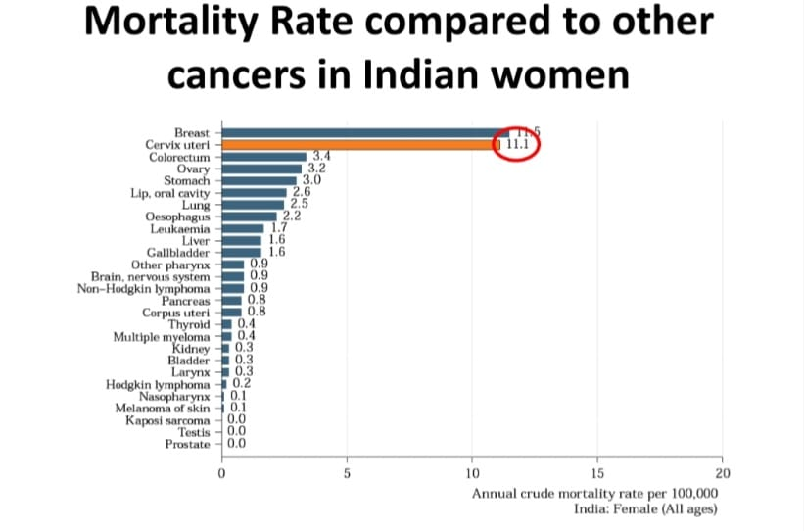

Slide 7
Cervical Cancer
The irony of the Problem: -
Cervical cancer is easily accessible to early diagnosis and treatment which can drastically reduce the mortality.
More importantly, to a large extent Cervical cancer is a preventable disease
Notes:
It had been anticipated that widespread implementation of screening programs and treatment of cervical precancers would lead to the virtual elimination of invasive cervical cancer. Large segments of the population who do not undergo regular screening account for most of the patients with invasive cancers worldwide. However, invasive squamous cervical cancers develop even in screened populations, and adenocarcinoma of the cervix, is on the rise. Thus, given present methodology, it is unlikely that invasive cervical cancer is an entirely preventable disease. The screening-prevention system for cervical neoplasia is prone to several sources of error: the false-negative rate of the Pap smear; precancers and cancers arising high in the endocervical canal that may escape sampling; a rapid transit from a preinvasive to an invasive lesion in some cases; and de novo development of invasive cancers without a preliminary preinvasive state.
It is within our grasp to make cervical cancer a largely preventable disease. Future directions in cervical cancer screening should include efforts at inclusion of the entire population at risk and improvements in screening methodology. Incorporating the unscreened population into screening programs will involve resource allocation and education. Methods that will reduce the false-negative and false-positive rates to more acceptable levels are needed to improve the effectiveness of screening. Biochemical changes in the cervix develop prior to the development of the earliest histopathologic change, but so far, a test based on biochemical indicators such as pentose shunt enzymes has eluded us.

Slide 8
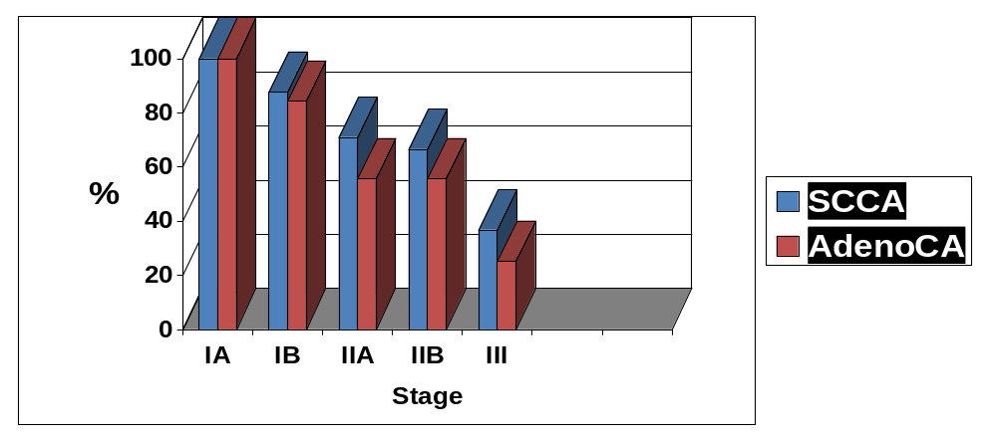
Five-Year Survival: -
Notes:
The extent of reduction in cervical cancer mortality is in proportion to the number of women being screened, with no decrease in incidence or mortality in unscreened populations.
The reasons for the reduction in cervical cancer mortality in screened populations are not clear. Although identification of invasive cancer at an earlier and more curable stage certainly contributes to the lower rate, most of the benefit is thought to be the result of identification and treatment of precancerous cervical lesions, thereby preventing invasive disease.

Slide 9


Risk Factors: -
HPV
  Women are generally infected with HPV in their teens, 20s, 30s
  Cervical cancer can develop up to 20 years after HPV infection
Smoking
Immunosuppressants
Imbalance of Free radicals (+) & Antioxidants (-)
Notes:
Cause of the majority of precancerous and cancerous squamous lesions of the cervix appears to be a sexually transmitted factor or cofactors. Agents such as herpes simplex virus 2 have been implicated previously. The sexually transmitted factor that currently is most seriously considered in the development of cervical squamous neoplasia is human papilloma virus (HPV). Over the past few decades, much information has accumulated regarding this virus.
Approximately 70 different types of HPVs have been identified through DNA technology, with 20 of these affecting the woman's genital tract. Only a few of these HPVs have a strong association with high-grade CIN or invasive cancer and are therefore considered "high-risk" types (HPV 16, 18, 45, 56). Several HPV types have demonstrated an intermediate degree of risk while others are associated with a low risk of cancer.
Cytopathic changes (koilocytosis) resulting from the virus are recognized with light microscopy and are noted in a large percentage of low-grade CIN. Grouping low-grade CIN and early viral-type changes in the epithelium as indistinguishable and basically the same disease process has become generally accepted. The Bethesda System (TBS) has improved communications between cytopathologists and clinicians, and all agree that "the high-grade squamous epithelial lesions" are clear-cut, but controversy exists regarding the "low-grade squamous epithelial lesions." As the degree of CIN becomes more severe, the viral cytopathic changes are less pronounced and are generally not recognizable in invasive cancers. As DNA technology has advanced, incorporation of portions of the HPV-16 DNA into the abnormal cells has been recognized.
The majority of CIN and invasive squamous cell lesions have been shown to be associated with the HPV. Low-grade and high-grade related HPV types are demonstrable in low-grade CIN, while high-grade CIN is associated with predominantly high- and intermediate-risk types. The majority of invasive lesions are positive for high-risk HPV types. Evidence further implicating the high-risk HPV types is a markedly increased risk for progression of low-grade CIN to high-grade CIN when these viruses are present. In addition, women who have negative cervical cytology but whose cervical sample tests positive for HPV (especially type 16 or 18) demonstrate a markedly increased risk of developing CIN II or CIN III within two years. Applying Koch's postulates for disease causation to viruses such as HPVs that will not grow in cell culture is problematic. Histologic and molecular transformation has been demonstrated after transfection of a keratinocyte cell culture with HPV-16 DNA.
While there is strong evidence to support the etiologic role of certain HPV types, other factors or circumstances must also be at work in order for cervical neoplasia to occur. A large percentage of women test positively for the virus, and yet only a small percent develop cervical neoplasia.

Slide 10
Natural History of Cancer Cx.
Current Understanding: -
Normal Cervix
About 60% regress within
2-3 yrs
HPV Infection
HPV-related Changes
Low-Grade SIL (Atypia, CIN I)
Cofactors
High-Risk HPV
(Types 16, 18, etc.)
About 15% progress within 3-4 yrs
High-Grade SIL (CIN II, III/CIS)
30% - 70% progress within 10 yrs
Invasive Cancer
.
Notes:
While there is strong evidence to support the etiologic role of certain HPV types, other factors or circumstances must also be at work in order for cervical neoplasia to occur. A large percentage of women test positively for the virus, and yet only a small percent develop cervical neoplasia.
****
Adenocarcinoma in situ also is a well-described lesion arising from the endocervical epithelium that is less common than CIN. Although less is known about its natural history,adenocarcinoma-in-situ is associated with the development of invasive adenocarcinoma.

Slide 11
Natural History of Cancer Cx.
Different Terminologies: -
PAP Smear Grade | Dysplasia | CIN | Histological Change | Bethesda
I |  | Normal | Normal | Normal
II |  | Inflammatory | Inflammation | ASCUS
III | Mild | CIN I | Basal1/3 | Low SIL
 | Moderate | CIN II | <Basal2/3 | High SIL
 | Sever | CIN III | W .thickness
IV | CIS
V | SCC | SCC | SCC | SCC
Notes:
The majority of squamous cell carcinomas are thought to emanate from a precancerous cervical condition. Such lesions have been termed "cervical dysplasia" or "cervical intraepithelial neoplasia" (CIN). CIN is graded according to the degree of involvement of the epithelium as CIN I, II or III, with CIN III representing full thickness neoplastic change of the epithelium. The likelihood of progression to invasive cancer is much greater with CIN III. Severe dysplasia and carcinoma-in-situ (CIS) have the same prognosis, so both are graded as CIN III.
The Bethesda System (TBS) has improved communications between cytopathologists and clinicians, and all agree that "the high-grade squamous epithelial lesions" are clear-cut, but controversy exists regarding the "low-grade squamous epithelial lesions."

Slide 12
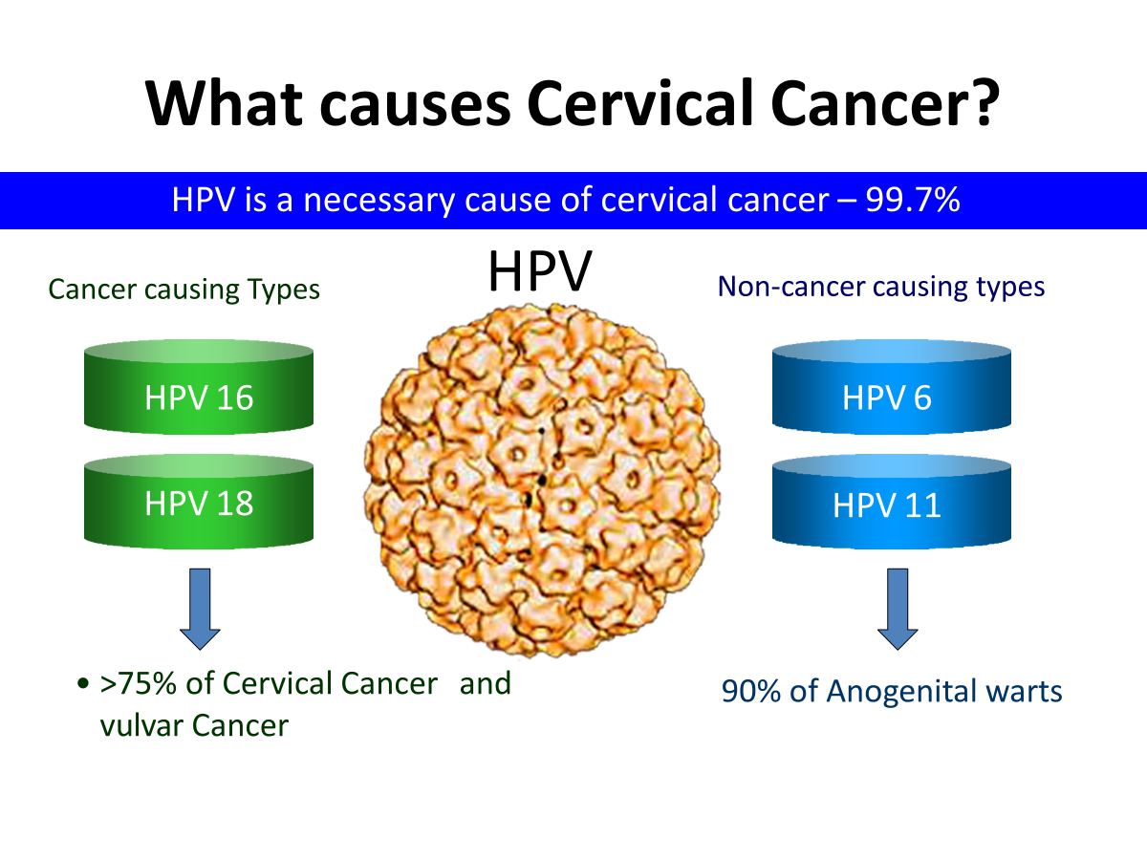


Slide 13
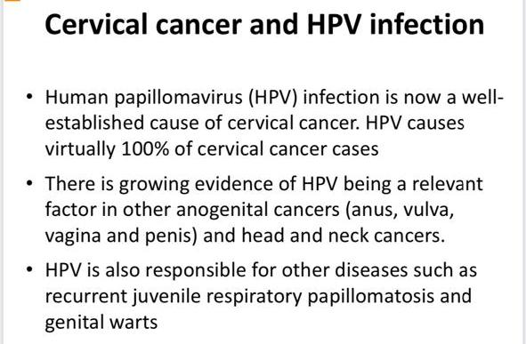

Slide 14
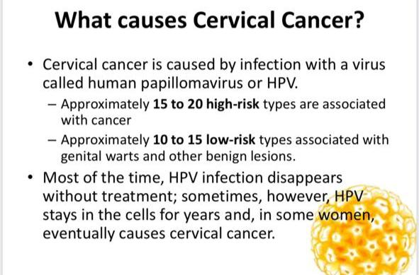

Slide 15
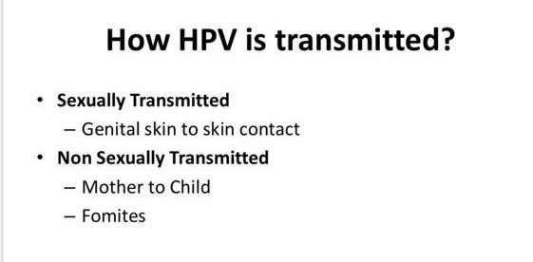

Slide 16
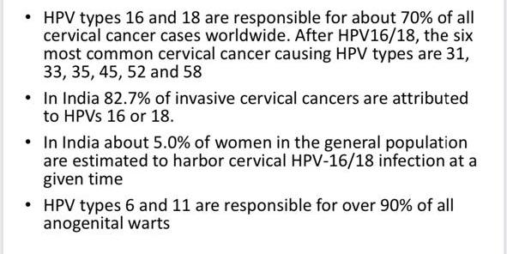

Slide 17
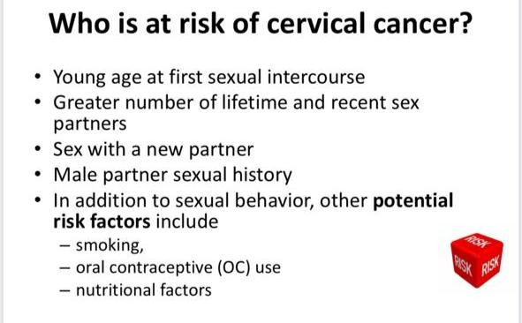

Slide 18
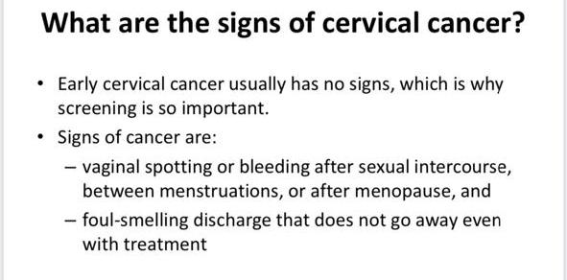

Slide 19
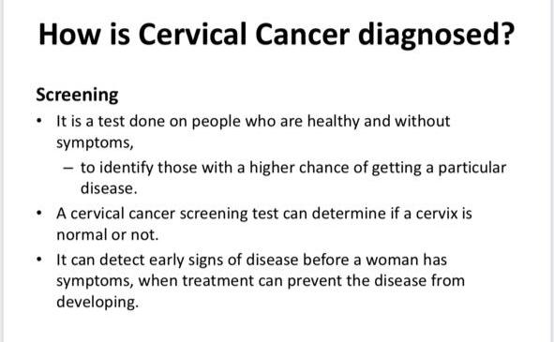

Slide 20
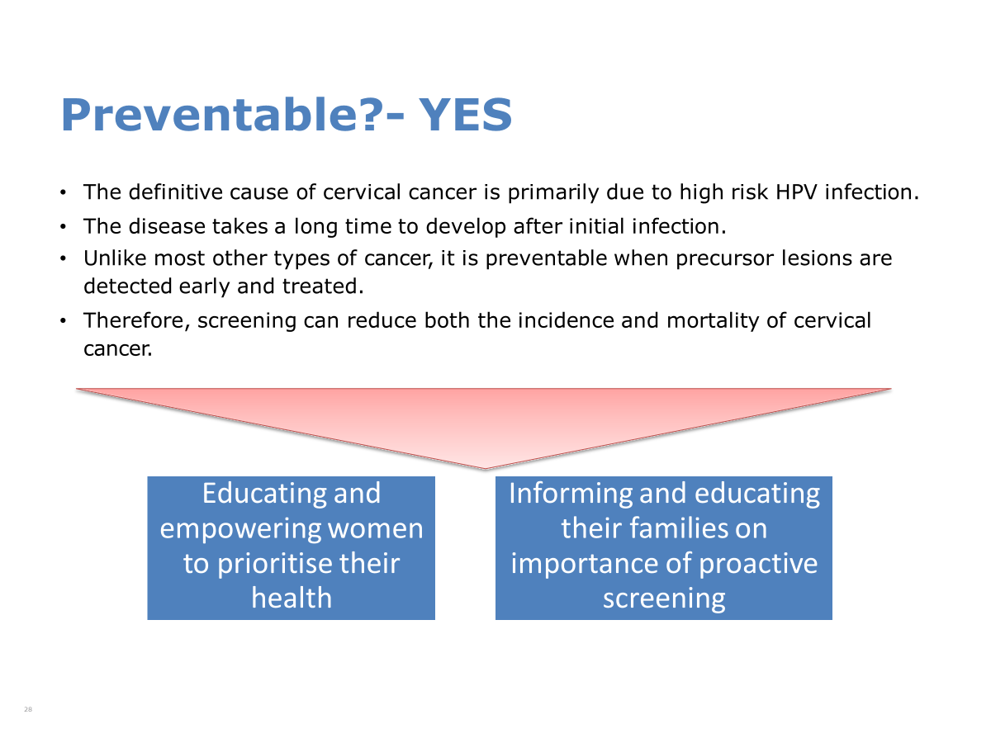

Slide 21
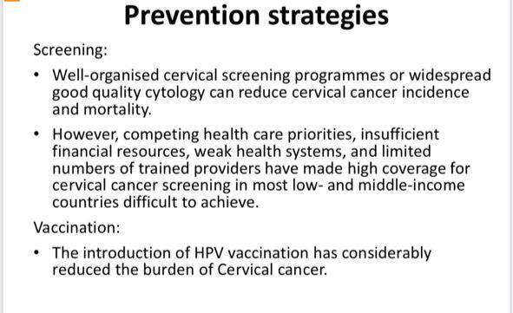

Slide 22
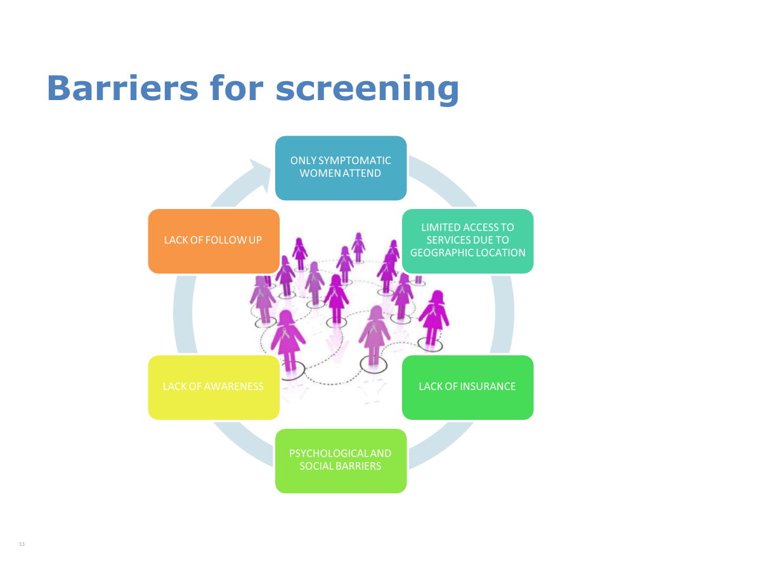

Slide 23
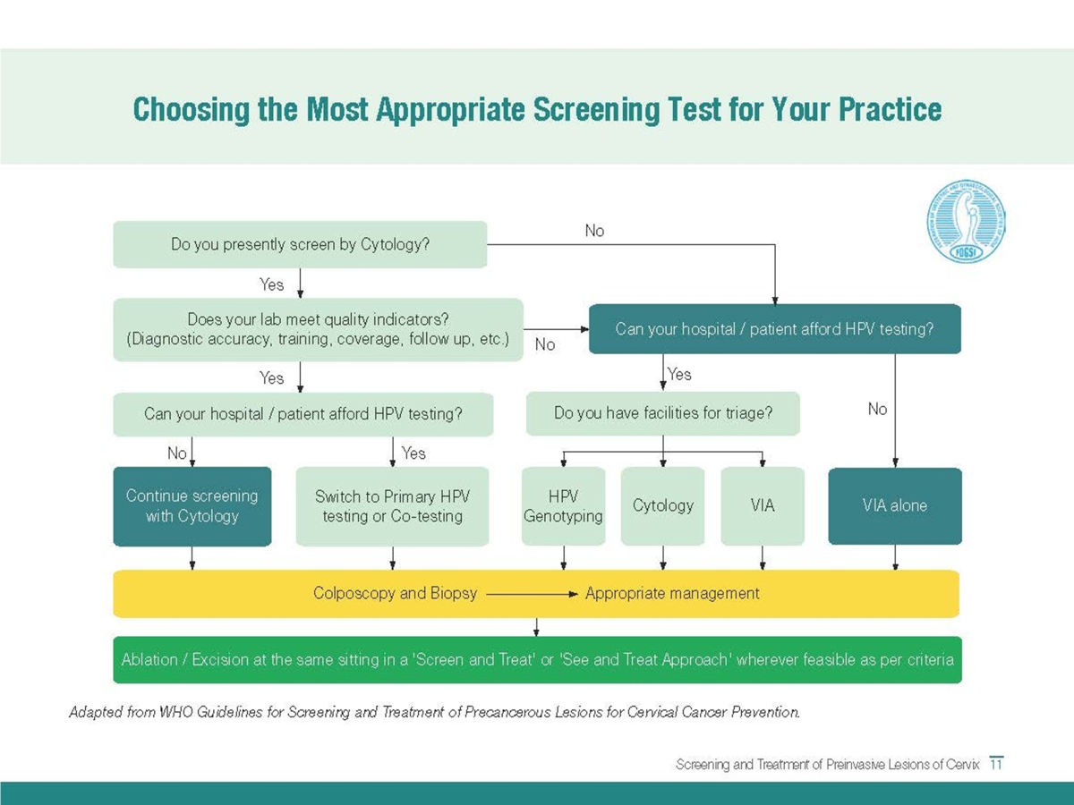


Slide 24
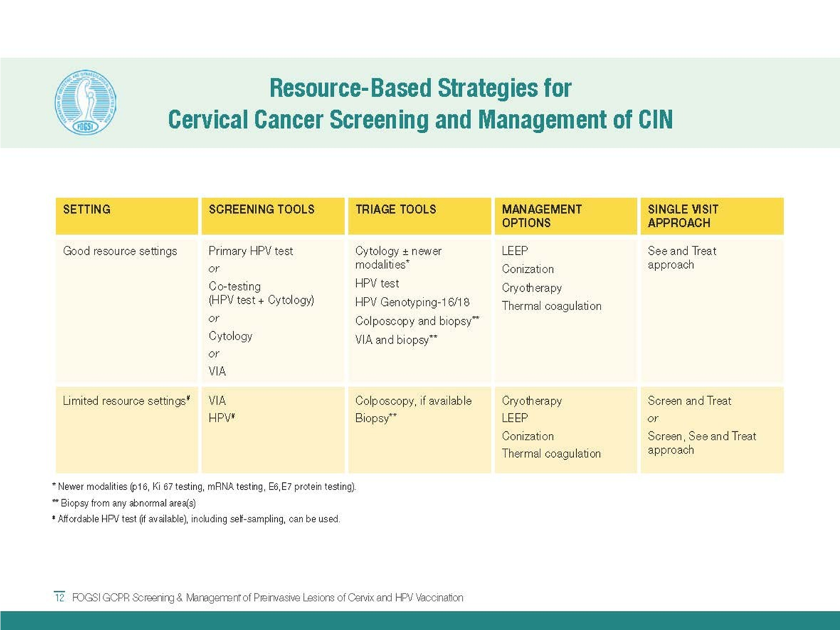

Slide 25
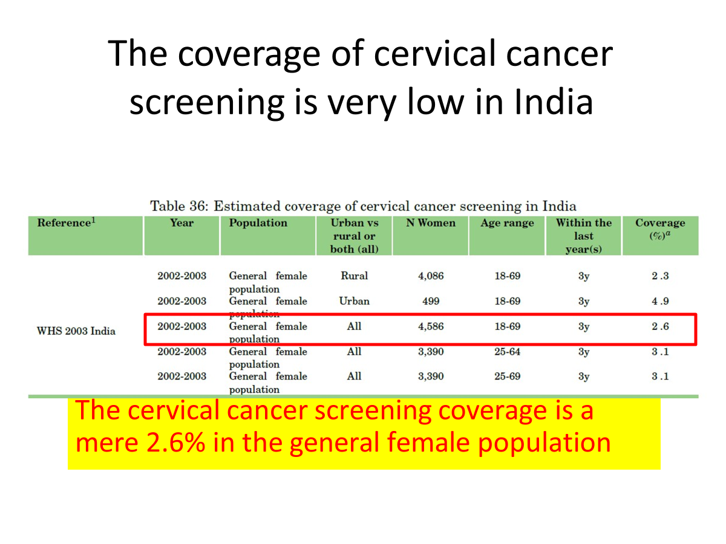

Slide 26
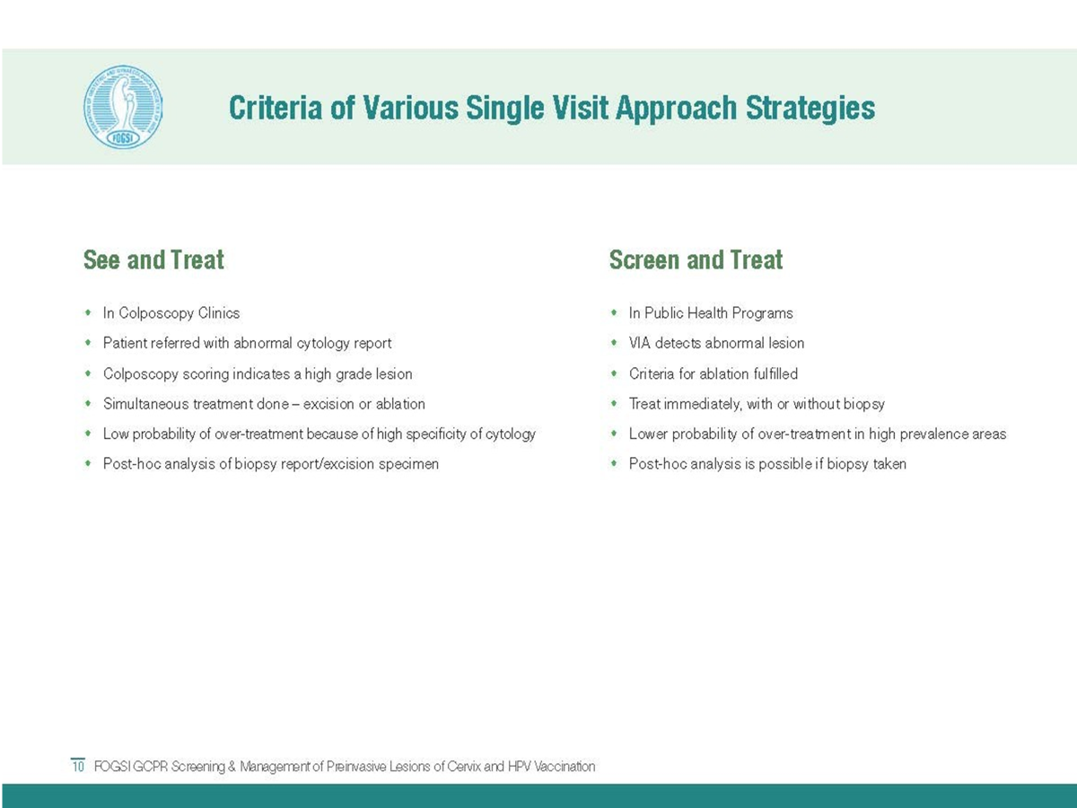

Slide 28
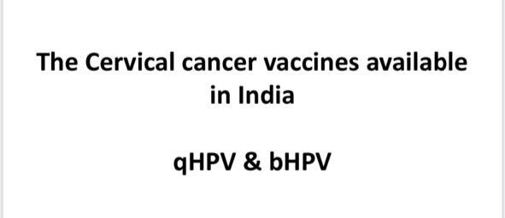

Slide 29
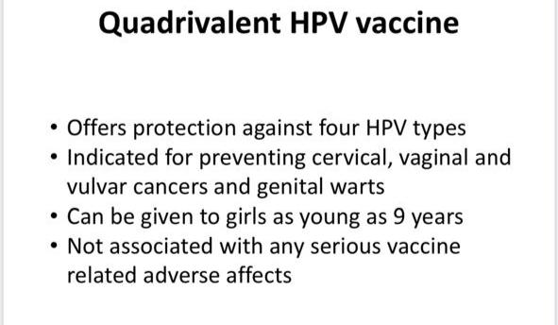

Slide 30
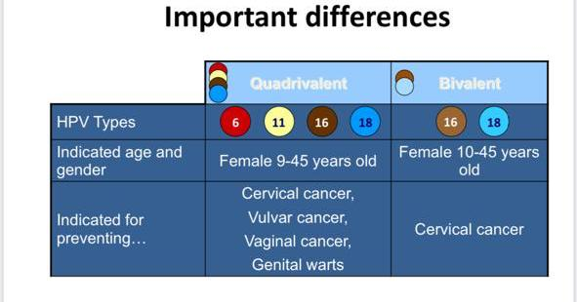

Slide 31


Slide 32
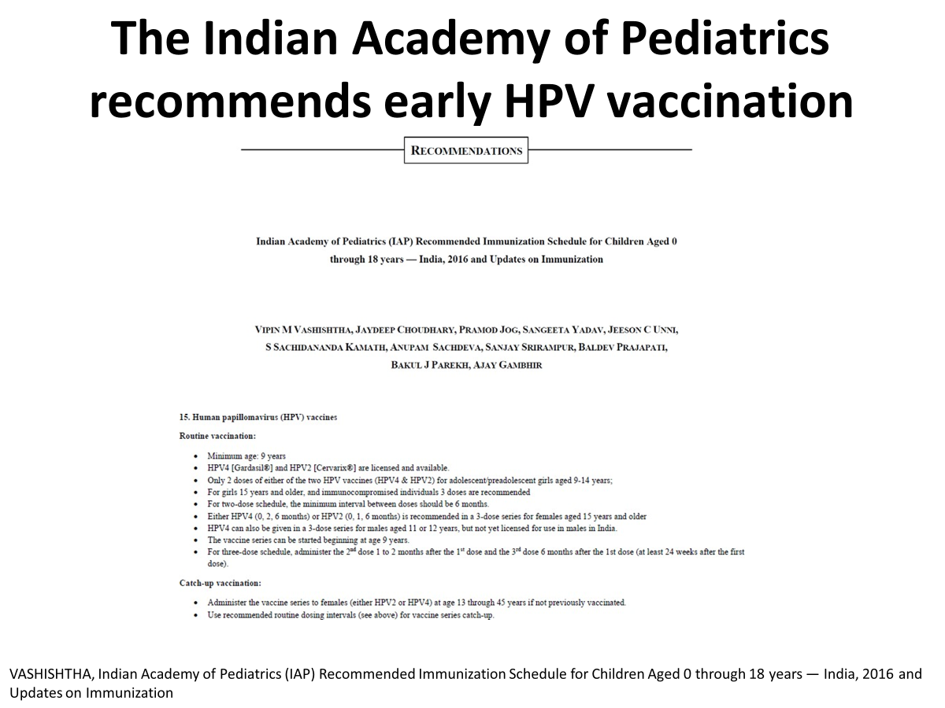

Slide 33
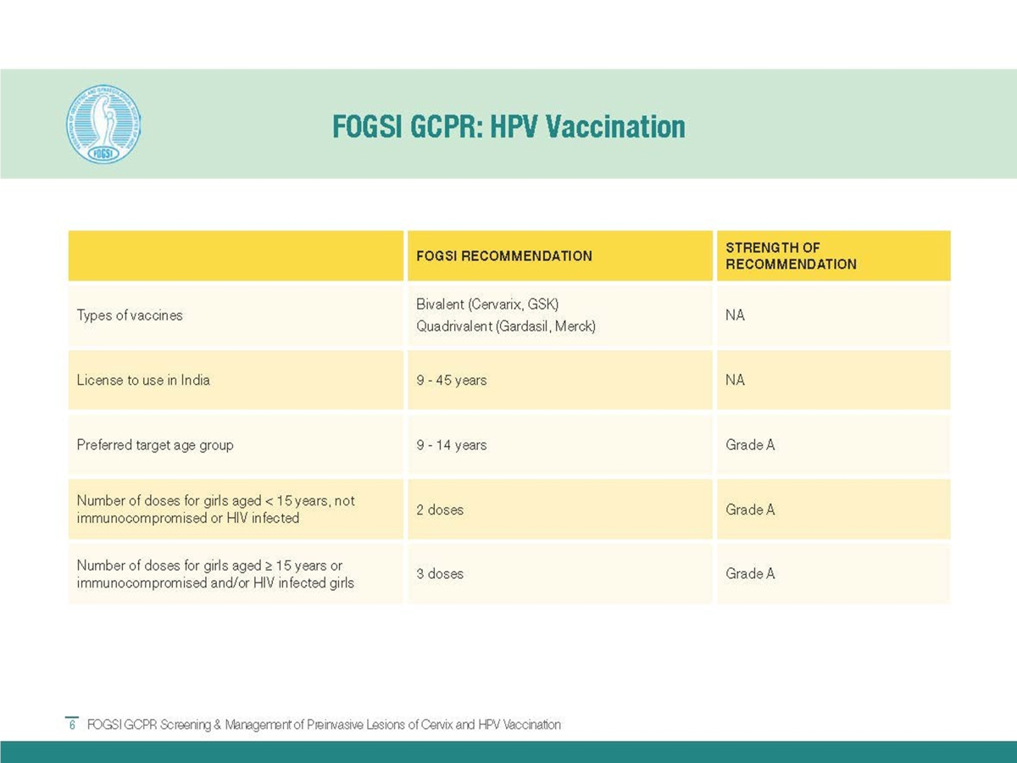

Slide 34
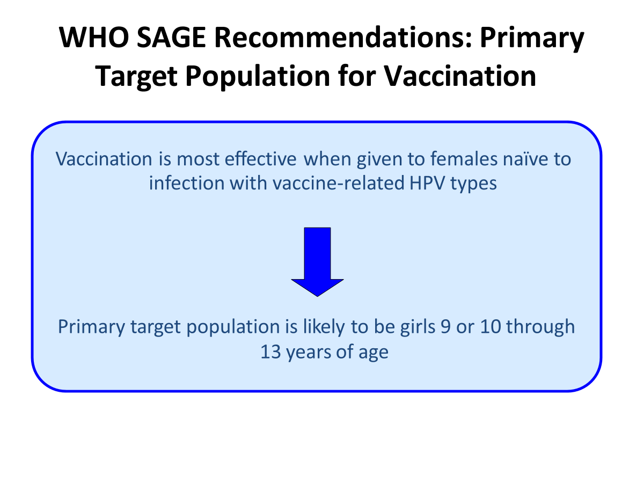

Slide 35
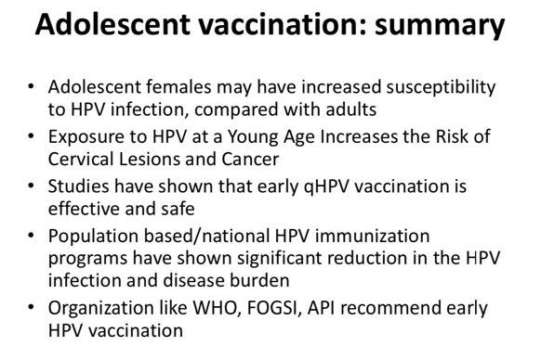

Slide 36
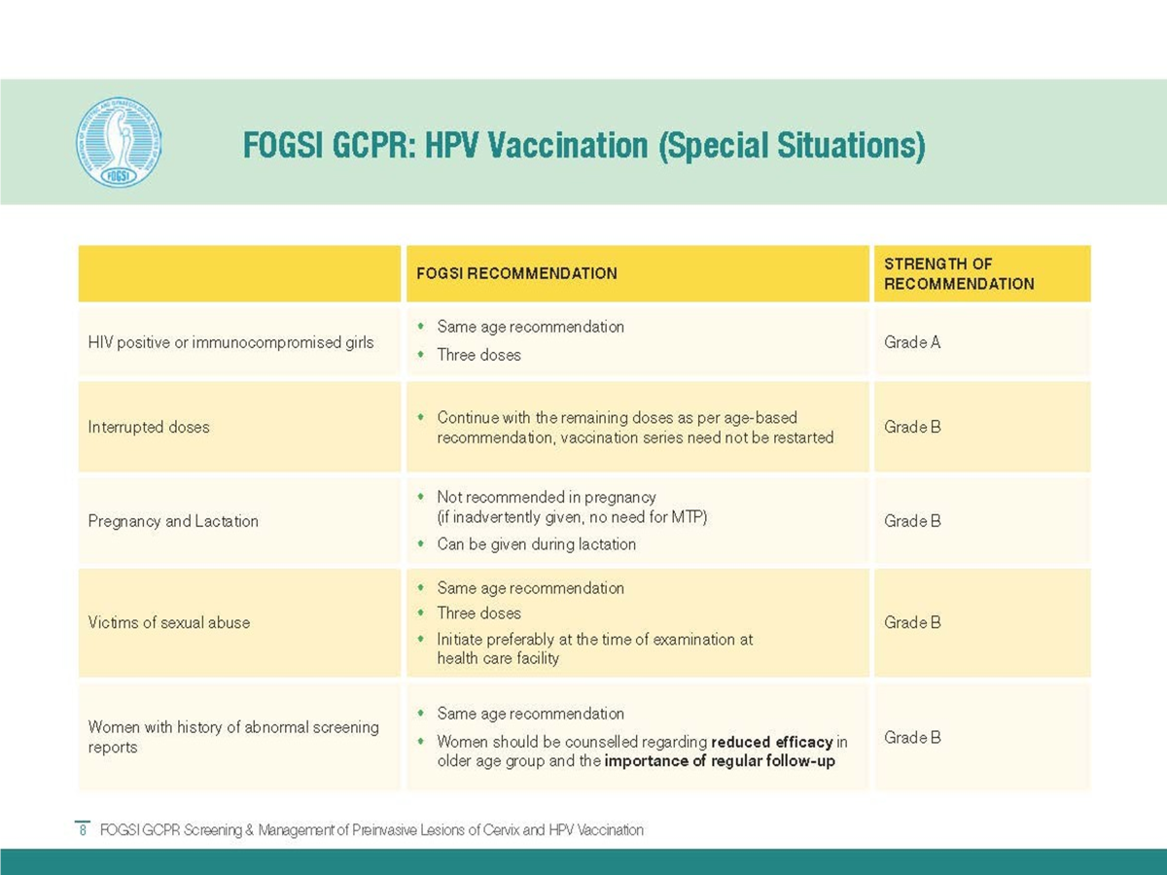

Slide 37
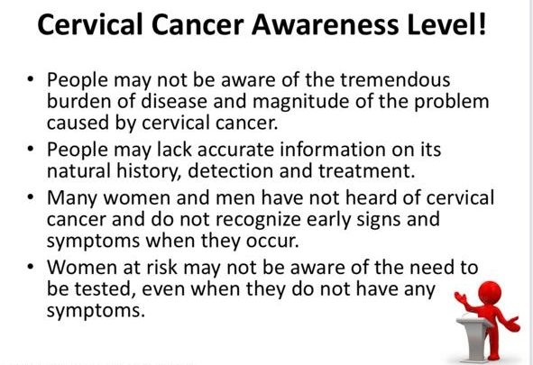

Slide 38
Natural History of Cancer Cx.
Progression of Dysplasia: -
Attribute Mild Moderate CIS
No. of studies 17 12 21
No. pts 4,505 2,247 767 Regress 57% 43% 32%
Persist 32% 35% 56%
Progress to CIN 3 11% 22% 12%
Progress to Inv. Ca. 1% 5% 12%

Slide 39
Natural History of Cancer Cx.
Progression of Dysplasia: -
> 80% of CIN I & II regress by 10 yrs
about 10% of CIN I progress to CIS
about 20% of CIN II progress to CIS
about 5% of CIN I progress to invasive cancer
about 10% of CIN II progress to invasive cancer
about 50% of CIN III progress to invasive cancer
progression is a slow process
Summary of studies
Notes:
Adenocarcinoma in situ also is a well-described lesion arising from the endocervical epithelium that is less common than CIN. Although less is known about its natural history,adenocarcinoma-in-situ is associated with the development of invasive adenocarcinoma.

Slide 40
Prevention of Cervical Cancer
Strategies: -
Primary prevention
Education to reduce high risk sexual behaviour.
Measures to reduce/avoid exposure to HPV and other STIs.
Avoiding / minimising other risk factors, like early marriage / child bearing, smoking
Administration of Antioxidants.
HPV vaccine (*Futuristic ?) –
  Prophylactic- antibody against capsid proteins L1, L2
  Therapeutic- antibody against E6 & E7
Notes:
The rapid advances in molecular biology techniques will lead to a greater understanding of the molecular pathogenesis of cervical lesions and the possible implementation in clinical practice. Results of new strategies using HPV vaccine are eagerly awaited and the next decade will probably witness this development.

Slide 41
DIAGNOSIS OF HPV INFECTION
  Macroscopic
  Cytological
  HPV DNA testing by ultra spectrophotometry
  Colposcopy
  Histological

Slide 42
TREATMENT OF HPV INFECTION -No specific therapy.
  Surgical removal
  Local Ablation (See later): -
    Cryotherapy
    Diathermy
    Laser
  Administration of Interferon

Slide 43
Prevention of Cervical Cancer
Strategies: -
Secondary prevention
Treatment of precancerous lesions before they progress to malignancy. which is simple, easy and effective.
Key Point is “SCREENING” to detect precancerous lesions.
Implies a good screening test, which is Effective, Safe, Practical, Affordable and easily Available.
Notes:
It had been anticipated that widespread implementation of screening programs and treatment of cervical precancers would lead to the virtual elimination of invasive cervical cancer. Large segments of the population who do not undergo regular screening account for most of the patients with invasive cancers worldwide. However, invasive squamous cervical cancers develop even in screened populations, and adenocarcinoma of the cervix, is on the rise. Thus, given present methodology, it is unlikely that invasive cervical cancer is an entirely preventable disease. The screening-prevention system for cervical neoplasia is prone to several sources of error: the false-negative rate of the Pap smear; precancers and cancers arising high in the endocervical canal that may escape sampling; a rapid transit from a preinvasive to an invasive lesion in some cases; and de novo development of invasive cancers without a preliminary preinvasive state.
It is within our grasp to make cervical cancer a largely preventable disease. Future directions in cervical cancer screening should include efforts at inclusion of the entire population at risk and improvements in screening methodology. Incorporating the unscreened population into screening programs will involve resource allocation and education. Methods that will reduce the false-negative and false-positive rates to more acceptable levels are needed to improve the effectiveness of screening. Biochemical changes in the cervix develop prior to the development of the earliest histopathologic change, but so far, a test based on biochemical indicators such as pentose shunt enzymes has eluded us.

Slide 44
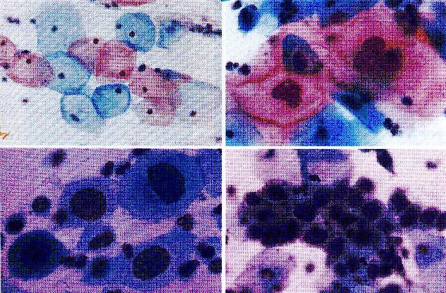
Secondary Prevention
Screening for Pre malignant Lesions
PAP smear test is the gold standard – But has limitations.
Notes:
Initially using vaginal pool smears to study hormonal status, Dr. George Papanicolaou reported the usefulness of the technique for detecting neoplastic cervical cells in 1941. Using a modeled wooden spatula, Ayre proposed direct sampling of the cervix, which produced an improved sample.
In the late 1940s to early 1950s, the Pap smear became widely used as a screening technique for cervical precancers and cancers. The concept of the Pap smear evolved into a technique to screen for cervical precancers that are then histologically confirmed and treated with the idea of preventing progression to invasive cancer.
It is a misconception that the Pap smear is highly accurate and that errors in sampling or interpretation are uncommon. The test involves cytologic interpretation of a smear of cells taken from the cervix and is subject to error at many levels. The false-negative rate of the Pap smear is estimated to be approximately 10% to 20%.
The false-positive rate of the Pap smear also may be substantial and presents different problems, such as the anxiety and expense associated with a futile investigation and, in some cases, unnecessary treatment.

Slide 45
Other Options: -
Visual inspection with acetic acid (VIA)
Visual inspection with acetic acid and magnification (VIAM): Gynescope or Aviscope
Colposcopy
Cervicography
Automated pap smears
Molecular (HPV/DNA) tests

Slide 46
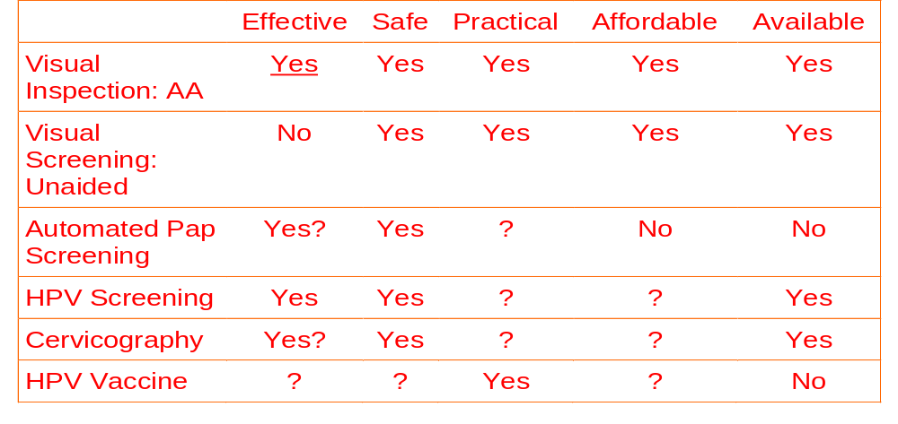
Screening for Pre malignant Lesions
Alternatives to Pap Smear: -

Slide 47
Screening for Pre malignant Lesions
WHOM TO SCREEN?
  From - onset of sexual activity/adolescent girl ( age of 18years) - to 65years.
HOW FREQUENTLY?
  Yearly.
  If Consecutive 2- 3 Smears are Negative, then at 3 - 5 years interval..

Slide 48
Types of Screening
Ideal and Desirable-Mass screening –
  Conducted on whole population & is expensive.
Selective screening –
  Segment of population at high risk.
Multiphalic screening –
  Screening for several conditions in the same sitting.
Opportunistic screening – when patients are coming for other treatment-Very useful.

Slide 49
Diagnosis of CIN
Colposcopy and biopsy
Direct biopsy – Excisional / ?Multiple punch biopsy taken after application of Lugol’s iodine / Acetic acid on the cervix
Cone biopsy with knife Laser.
Endocervical Curettage along with Biopsy, a must in all cytology positive cases.
Regardless of severity, CIN generally is asymptomatic and not grossly visible on examination

Slide 50
Treatment of CIN- Multi options
C I N I
C I N II
C I N III
Local Ablative / Destructive Procedures
Local Excisional Procedures
Hysterectomy + vaginal cuff
Cytology, Colposcopy & Biopsy reports must tally to perform Ablative / Excisional procedures.
Tissue removed at Excisional procedures must be studied again.

Slide 51
Treatment of CIN I & II
No Ablative procedure without histological confirmation of nature and grade of disease
Preferably be done Under Colposcopy
Methods : -
  Cryosurgery-90% effective.
  Electo surgical Fulguration/ Coagulation-90-95% effective.
  Co2 Laser ablation-90-97% effective.
Local Destructive Procedures

Slide 52
Treatment of CIN II & III
Local Excisional Procedures
Methods: -
  Large Loop Excision of the Transformation Zone (LLETZ) also known as Loop Electrosurgical Excision Procedure (LEEP)
  Therapeutic Conization– Cold Knife / Laser
Cure rate: - 90-95 %.
Advantage- Tissue is available for HP study.

Slide 53
Treatment of CIN III
Hysterectomy
Hysterectomy without / with removal of vaginal cuff for: -
  Women over 40
  No further childbearing required
  Women who do not want to come for follow up
  Other associated pathology
  Residual lesion after excisional procedures
Vaginal route is preferable.
Ovaries need not be removed.

Slide 54
Follow Up of CIN II & III
Women treated conservatively by Ablative or Excisional procedures have to be followed up regularly: -
Criteria for cure: - Two consecutive normal PAP smears in follow up.
First Visit - After 2-3 Months
Rest of the life – 3 yearly
  PAP smear at each visit
  Avoid risk factors

Slide 55
Conclusion
Stage for stage, little progress has been made in lowering mortality rates from cervical cancer.
However the overall mortality rate is decreasing because more patients are having their cancers diagnosed in early states of disease.
The opportunity is there for all physicians to make an early diagnosis in Ca Cx and to protect the women from this dreadful disease.

Slide 56
But more importantly, all attempts should be made to prevent the occurrence of the disease in the first place,
  by screening for precancerous lesions and
  effectively treating them, by methods which are very safe, simple and easy.
“Prevention is better than cure” - Never more True
Those women saved from the ravages of cervical cancer shall call their physicians blessed.
Notes:
It had been anticipated that widespread implementation of screening programs and treatment of cervical precancers would lead to the virtual elimination of invasive cervical cancer. Large segments of the population who do not undergo regular screening account for most of the patients with invasive cancers worldwide. However, invasive squamous cervical cancers develop even in screened populations, and adenocarcinoma of the cervix, is on the rise. Thus, given present methodology, it is unlikely that invasive cervical cancer is an entirely preventable disease. The screening-prevention system for cervical neoplasia is prone to several sources of error: the false-negative rate of the Pap smear; precancers and cancers arising high in the endocervical canal that may escape sampling; a rapid transit from a preinvasive to an invasive lesion in some cases; and de novo development of invasive cancers without a preliminary preinvasive state.
It is within our grasp to make cervical cancer a largely preventable disease. Future directions in cervical cancer screening should include efforts at inclusion of the entire population at risk and improvements in screening methodology. Incorporating the unscreened population into screening programs will involve resource allocation and education. Methods that will reduce the false-negative and false-positive rates to more acceptable levels are needed to improve the effectiveness of screening. Biochemical changes in the cervix develop prior to the development of the earliest histopathologic change, but so far, a test based on biochemical indicators such as pentose shunt enzymes has eluded us.

Slide 57

Thank You

