Slide 1
TOPICAL FLUORIDE
PART- 1 (FROM SLIDE 1 ) Dated – 13 April 2019
PART-2 (FROM SLIDE 21) Dated – 20 April 2019
Timings – 9-10 A.M.
BDS III YEAR
Taken By – DR. ANSHUL
DEPTT. OF PEDIATRIC & PREVENTIVE DENTISTRY

Slide 2



Topical Fluoride
Part 1
Dated – 13 April 2019
These are placed directly on the teeth
preparations provide high or low concentrations of fluoride over a short period of time
Lecture by Dr. Anshul
Dept. of Pediartic and Preventive Dentistry

Slide 3
Topical fluoride
Professionally applied
Solutions
Varnish
Self Applied
fluoride dentifrices
Gel and Foam
Prophylactic Paste
mouth rinses & gels
2% Sodium Fluoride (NaF)
8% Stannous Fluoride(SnF₂)
1.23% Acidulated Phosphate Fluoride (APF)

Slide 4
2% SODIUM FLUORIDE was the first topically applied agent studied independently by Knutson and Armstrong (1943) and Bibby (1944)
Fluoride concentration - 9200ppm
METHOD OF PREPARATION
It is prepared by dissolving 20 gms of NaF powder in
1L of distilled water in a plastic bottle
(if stored in glass containers, the fluoride ion of solution can react with silica of glass forming SiF2 ,thus reducing the availability of free active F for anticaries action)

Slide 5
TECHNIQUE - KNUTSON’S TECHNIQUE
At the initial appointment teeth are cleaned with pumice slurry & then isolated with cotton rolls & dried with compressed air.
Using cotton-tipped applicator sticks ,the 2% NaF is painted on air dried teeth so that all tooth surfaces are visibly wet. The solution is allowed to dry for 3-4 min.
This procedure is repeated for each of the isolated segments until all the teeth are treated.
A 2nd, 3rd and 4th fluoride application, each not preceded by a prophylaxis, is scheduled at intervals of approximately one week;

Slide 6
MECHANISM OF ACTION :
When NaF is applied on tooth surface it reacts with hydroxy -apatite crystals in enamel to for CaF₂(dominant product) :Ca₁₀(PO₄)₆ (OH)₂ + 20F  10CaF₂ + 6PO₄ ⁻ + 2OH⁻
As thick layer of Caf₂ forms, it interferes with further diffusion of fluoride from the topical fluoride solution to react with hydroxy-apatite and blocks further entry of fluoride ions. This sudden stop of the entry of fluoride is termed as ‘chocking off effect’
CaF₂ acts as a reservoir and fluoride slowly leeches out of it
The CaF₂ reacts with hydroxyapatite :
CaF₂ + 2Ca₅ (PO₄)₃ OH  2Ca₅ (PO₄)₃ F + Ca(OH)₂
leads to formation of fluorapatite.

Slide 7
ADVANTAGES :
It is relatively stable when kept in a plastic container and there is no need to prepare a fresh solution for each patient.
The taste is well accepted by patients.
The solution is non-irritating to the gingiva;
It does not cause discoloration of tooth structure.
The series of treatments must be repeated only 4 times at the age of 3 ,7,11, 13
DISADVANTAGE:
The major disadvantage of the use of sodium fluoride is that the patient must make 4 visits within a relatively short period of time.

Slide 8
2) STANNOUS FLUORIDE (SnF₂)
Fluoride concentration-19500ppm
METHOD OF PREPARATION:
  Solutions of stannous fluoride are not stable. Soon after mixing they become cloudy due to the formation of tin hydroxide.
  A fresh solution of stannous fluoride be prepared for each
patient.
  To prepare 8% stannous fluoride solution, the content of one capsule which is prefilled 0.8 grams SnF₂(‘0’ No. of gelation capsule) is dissolved in 10 ml of distilled water in a plastic container. The 10 ml of solution is sufficient to treat the whole mouth of a single patient if any remains it should discarded and not used again.

Slide 9
TECHNIQUE - MUHLER’S TECHNIQUE
Each tooth surface is cleaned with pumice or other dental cleaning agent for 5 to 10 seconds;
Unwaxed dental floss is passed between the
interproximal areas;
Teeth are isolated and dried with air;
Stannous fluoride is applied using the paint-on technique and the solution is kept for 4 minutes a reaplication of solution to a particular tooth is done every 15-30 sec.
The recommended frequency of 8% SnF2 application is one per year.

Slide 10
MECHANISM OF ACTION
When SnF₂ is applied in low concentration
Ca₅(PO₄)₃OH+2SnF₂ 2CaF₂ + Sn₂(OH) (PO₄) + Ca₃(PO4)₃
Tin hydroxy phosphate formed
At high concentration
Ca₅(PO₄)₃OH+16SnF₂ CaF₂ + Sn₂F₃PO₄ + Sn₂(OH)(PO₄) + 4CaF₂(SnF₃)₂
main end product Tin trifluoro Tinhydroxy calcium
Phosphate phosphate trifluorostanate
CaF₂ is the end product both at low and high concentration which reacts with hydroxyapatite and a small fraction of fluorhydroxyapatite also gets formed 2Ca₅(PO₄)₃OH+CaF₂  2Ca₅ (PO₄)₃F+ Ca(OH)₂
Tin hyrdroxyphosphate gets dissolved in oral fluids and is responsible for the metallic taste.
The main end product i.e Tin-Tri-fluorophosphate is responsible for making the tooth structure more resistance to decay

Slide 11
ADVANTAGES :
Using an 8% stannous fluoride solution at 6 to 12 months intervals conforms to the practicing dentist’s usual patient – recall system;
Administrative difficulties are avoided.
  DISADVANTAGES :
In aqueous solution the material is not stable;
8% solution is quite astringent and disagreeable in taste, its application is unpleasant;
The solution occasionally causes a reversible tissue
irritation manifested by gingival blanching;
Causes pigmentation of teeth which has a characteristic light brown colour

Slide 12
3) ACIDULATED PHOSPHATE FLUORIDE (APF)
Fluoride concentration-12300 ppm
METHOD OF PREPARATION
An aqueous solution is acidulated phosphate fluoride is prepared by dissolving 20 grams of sodium fluoride in 1 liter of 0.1 M phosphoric acid and to this is added 50% hydrofluoric acid to adjust the pH at 3.0 and fluoride ion concentration at 1.23%. It is also called as
Brudevold’s solution

Slide 13
TECHNIQUE
After thorough prophylaxis the teeth are isolated with cotton rolls on both lingual and buccal sides, dried and APF solution is continuosly and repeatedly applied with cotton applicators and the teeth are kept moist for 4 min.
It is reapplied every 15-30sec so as to keep the teeth moist with the fluoride solution throughout the four min period .Floss may be drawn through each inter-proximal embrasures to ensure wetting to these surfaces
The patient is instructed to eat, drink or rinse his
mouth for atleast 30 min.
The recommended frequency of APF topical application is semi annually.

Slide 14
MECHANISM OF ACTION
When APF is applied to teeth it initially leads to hydrolysis and shrinkage in the vol of hydroxyapatite crystals which on hydrolysis forms an intermediate product called Dicalcium phosphate dihydrate(DCPD)
(i) Ca₅(PO₄)₃OH+4H⁺  5Ca⁺⁺+3HPO₄ ⁻⁻+H₂O(hydrolysis&shrinkage)
(ii)Ca⁺⁺ + HPO₄ ²-  Ca.HPO₄.2H₂O(DCPD) (highly reactive )
Ca₅(PO₄)₃F + 2HPO₄²⁻ (Fluor apatite)
Fluoride penetrates into the crystals more deeply through
the openings produced by shrinkage and forms fluorapatite
For the conversion of whole DCPD formed into fluorapatite, a deeper penetration and continuous supply of fluoride is required. Because of this reason APF is applied every 30 sec and the teeth have to be kept wet for 4 min
Notes:
Fluoride penetrates into the crystals more deeply through
the openings produced by shrinkage and forms fluorapatite

Slide 15
Comparison of fluoride solution
Characteristics | NaF | SnF₂ | APF
Percentage | 2% | 8% | 1.23%
Fluoride concentration (ppm) | 9200 | 19500 | 12300
ph | neutral | 2.4-2.8 | 3.0
Frequency of application | 4 at weekly intervals 3,7,11 & 13 yrs | biannually | biannually
Adverse effects | no | Tooth pigmentation Gingival irritation | no
Taste | Bland | Disagreeable | Acidic
Stability Stable Unstable Stable in plastic container
Gingival irritation No Occasional Transient No

Slide 16
23%APF Gel-Thixotropic Gel
Fluoride concentration-12300 ppm
Thyxotrophic gel are not true gels but have high viscosity under storage conditions and become fluid under
high stress ( under biting force)
For the preparation of APF gel - a gelling agent Methycellulose or Hydroxyethyl cellulose is to be added to the solution and the pH is to be adjust between 4-5

Slide 17
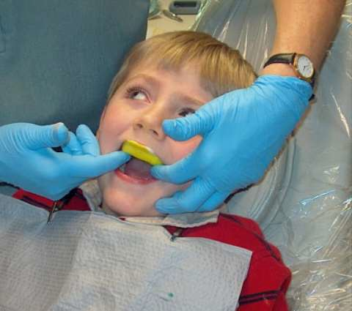
Gel adheres to the tooth surface for a considerable amount of time and eliminates the continuous wetting of enamel surfaces when solutions are used
2 or 4 quadrants can be treated simultaneously when trays are used for gel application which results in substantial saving of time
After thorough prophylaxis,dried the teeth
Fill disposable tray with gel ( 5ml)
& simultaneously insert into mouth
The patient is asked to exert pressure
On biting movement gel flows into
Interproximal areas.

Slide 18
ADVANTAGES
Requires only 2 application in a year;
The gel preparation can be self applied and thus the
cost of application also gets reduced;
It has the ability to deposit fluoride in enamel to a deeper depth;
DISADVANTAGES :
Practical difficulties like the teeth should be kept wet
for for 4 minutes;
It is acidic, sour and bitter in taste;
It cannot be stored in glass containers.

Slide 19
APF FOAM 0.92% (9200ppm) ph -4.5
In a professional setting, a dentist will load the foam into a tray then insert it into the patient’s mouth ( same as gel) The patient bites down on the tray for about four minutes. Afterwards, patients are advised not to rinse, eat, or drink for about 30 minutes in order to prolong contact between the fluoride and tooth enamel.
ADVANTAGES:
minimize the risk of fluoride over dosage
Less dense than gel and better flowability
Semiannual application

Slide 20
Topical Fluoride Contd…
To recapitulate …
professionally applied
F Solutions:
2% NaF
8% SnF
1.23% APF
F Gel:
23% APF
F Foam:
0.92% APF
Toady’ topic
professionally applied
F varnish
F prophylactic paste
Self applied
F Dentrifice
F Mouthwash
F Gel
Dated – 20 April 2019
Lecture by Dr. Anshul
Deptt. of Pediartic and Preventive Dentistry

Slide 21
FLUORIDE VARNISH
It was first developed by Schimdt in Europe in 1964
Aim - to prolong the contact between fluoride and the
tooth enamel and promote the remineralization of damaged enamel
Indications - active caries, root surface caries, xerostomia patients, hypersensitive areas of enamel and dentine, and physically or mentally handicapped patients.
Resin-based varnishes have a sticky texture, which prolongs the contact time between the fluoride and the enamel. The concentration of fluoride in varnish ranges from 7,000 ppm (Fluor Protector) to 56,300 ppm (Bifluorid 12).
The fluoride formulations that are found in most commercially available varnishes are:
a) 5% sodium fluoride (Duraphat, Colgate Palmolive)
b) 0.7% difluorsilane (Fluor Protector, Ivoclar-Vivadent)
c) 6% sodium fluoride plus 6% calcium fluoride (Bifluorid 12, VOCO GmbH)
1. aqueous solutions (e.g. Bifluorid 12)
2. non-aqueous solutions
of natural resins (e.g. Duraphat, Lawefluor)

Slide 22
DURAPHAT:
It s a viscous yellow material, containing 22,600 ppm fluoride as 5%sodium fluoride in an alcoholic solution of natural organic base. 0.5ml contain 11.3mg F
FLUORPROTECTOR:
It is a clear polyurethane based product (0.7%difluorosilane. containing 7000 ppm fluoride from difluorosilane. 0.5ml contain 3.1mg F
Method of Application:
After prophylaxis teeth are dried & isolated (not isolated with cotton rolls since varnish sticks to cotton)
Total of 0.3-0.5 ml of varnish is required to cover full dentition
Application is done first done on lower arch then upper, using single tufted small brush/microapplictor, starting with proximal surfaces
Patient is asked to sit with mouth open for 4 min to let set on teeth
Instruction - patients are advised to avoid brushing or flossing until the next day. For the first four hours after applications, patients are recommended to only drink water and eat soft foods. The following day, they should resume brushing twice daily with fluoridated toothpaste

Slide 23
No.of application – semiannual ( every 6 months to both primary and permanent teeth in high caries risk individuals
Mechanism of action :
The application of concentrated fluoride ions in fluoride varnish forms globules of calcium fluoride-like material on the tooth surface.These globules are stabilized by protein phosphate in the mouth. They are fairly insoluble and act as an insoluble reservoir of fluoride at neutral pH.
When there is pH is lowered and the dissolution rate of these globules increases. Fluoride is thus released and this increases the saturation of calcium and phosphate ions in plaque fluid by lowering the solubility constant of calcium and phosphate ions.
This helps to prevent the dissolution of calcium and phosphate from the tooth mineral and/or increases the rate of remineralization or reprecipitation of the lost minerals.
This mechanism can explain how the topical application of a fluoride varnish, two to three times a year, can result in long-term caries reduction

Slide 24
Advantages: a) Well tolerated by infants and young children
b) Has a prolonged therapeutic effect
c) The application method is simple and quick requiring no special equipment
d) Well received by patients (less discomfort)
e) Slow release of fluoride over time
f) It is suitable for the special needs populations and very young children,
Disadvantages: a) Poor aesthetic effect because yellow film of varnish remains on the teeth for several hours after application and this needs to be removed by brushing.
b) There is also a temporary discoloration of teeth after varnish application.
c) Fluoride varnishes may have an effect on colour stability of aesthetic restorative materials.
d) Some patients dislike its presence as a thin film on their teeth
e) Taste of the varnish objectionable

Slide 25
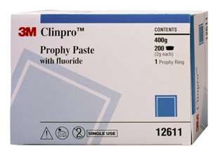
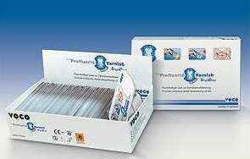
FLUORIDATED PROPHYLACTIC PASTES
Prophylatic pasts with fluoride were developed to allow the practitioner the opportunity to provide both the cleaning and the fluoride application one step to replenish the lost fluoride & thus there is a significant gain in the concentration of fluoride.

Slide 26
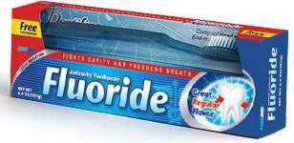
SELF APPLIED TOPICAL FLUORIDES
DENTIFRICES
Fluoride dentifrices have been shown in numerous clinical have been widely adopted around the world as the principle means of delivering topical fluoride and obtaining caries preventive benefits.
Studies showed that daily toothbrushing using fluoridated toothpaste (1000 ppm F) could arrest non-cavitated lesions as well as dentin caries lesions .
The first clinical trial of fluoride dentifrice was initiated
by Bibby in1942

Slide 27
Composition of Fluoride Dentifrices =>
Abrasive Agents :
The type of abrasive used in the fluoride dentifrice must be compatible with the fluoride agent used. The various type of abrasive agents used are Ca- pyrophosphate,Na- metaphospate , Silica
2. Fluoride Agents in Dentifrice:
1. Sodium fluoride (NaF).
2. Stannous fluoride (SnF2)
3. Sodium monofluorophosphate (MPF)
4. Amine fluoride
5. Combination of NaF and MPF
the fluoride concentration of over-the-counter toothpaste ranges from 1000 to 1500 ppm.

Slide 28
The amount should be pea sized and the paste should be pressed into the bristles and not on top of the brush
Tooth-brushing should be supervised by an adult .
Recommended use of fluoride toothpaste in children
Below 4 yr | Not recommended
4-6 yr | Once daily with f toothpaste other times non f
6-10 yr | twice daily with F toothnpaste ,once non F
Above 10 yr | Using f tooth paste

Slide 29
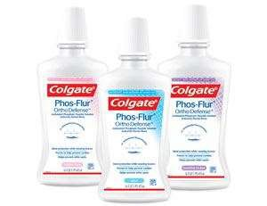
MOUTHRINSES
Fluoride mouthrinsing is one of the most widely used caries preventive public health methods
Caries preventive agents used are Neutral sodium fluoride, Acidulated phosphate fluoride and Stannous fluor
ide
Sodium fluoride mouthrinses
Formulated at concentrations of 0.2%(900 ppm F) for weekly use 0.05%(225 ppm F) for daily use
These are used by forcefully swishing 10ml of the liquid
around the mouth for 60 sec before expectorating it

Slide 30
Uses of Fluoride Mouthrinses:
a) Primary preventive programs for children and adults
b) In subjects with high risk to dental caries.
c) Patients with rampant caries.
d) Patients with hyposalivations or xerostomia.
e) Patients with sensitive teeth due to tooth wear as (abrasion, attrition, erosion) or
because of exposed root.
f) Patients with periodontits and root caries.
g) Patients with orthodontic appliance
Fluoridated mouth rinse should not be given
1. To children under six years of age, as they cannot control muscles of swallowing.
2. Children living in fluoridated area or receiving fluoride supplements. Fluoridated

Slide 31
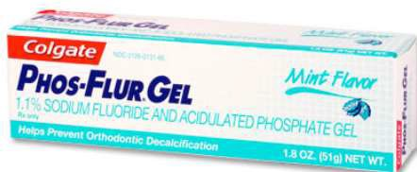
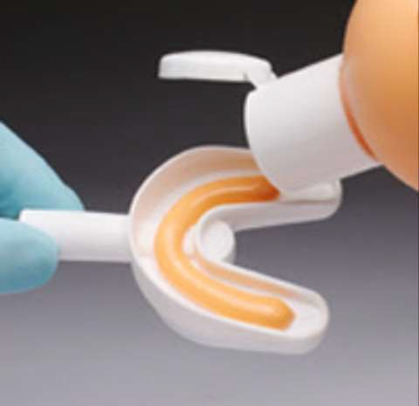
FLUORIDE GELS
Fluoride gel products include neutral sodium fluoride and acidulated phosphate fluoride with a fluoride concentration of 5000 ppm and stannous fluoride with a concentration of 1000 ppm
Self applied – once a day or more
Fluoride gels a are often recommended by practitioners for patients:
1. With severe early childhood caries;
3. With rampant caries in the mixed and permanent dentitions;
4. With reduced salivary flow;
5. Wearing prosthetic or orthodontic appliances; and
6. Who may be at high risk for dental caries.

Slide 32
The gels are either applied in trays or brushed on teeth
In tray applications, only the minimum amount of gel necessary to cover the teeth should be used. Tray application should not exceed 4 minutes
In a brush-on technique with young children, only a pea sized amount should be used.
Rinsing, eating, and drinking should be delayed for 30 minutes
Ideally, gel application should occur just prior to bedtime.
Caution is advised regarding the use of prescription fluoride gels and pastes in children younger than 6 years
patients should be evaluated periodically to determine when self-application can be terminated.

Slide 33
Next lecture will be on deflouridation

