Slide 1
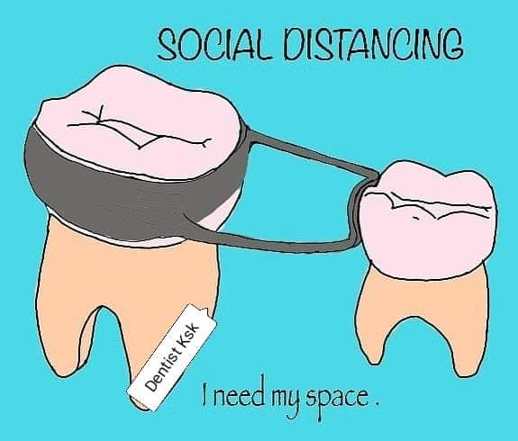
PEDIATRIC SPACE MANAGEMENT

Slide 2
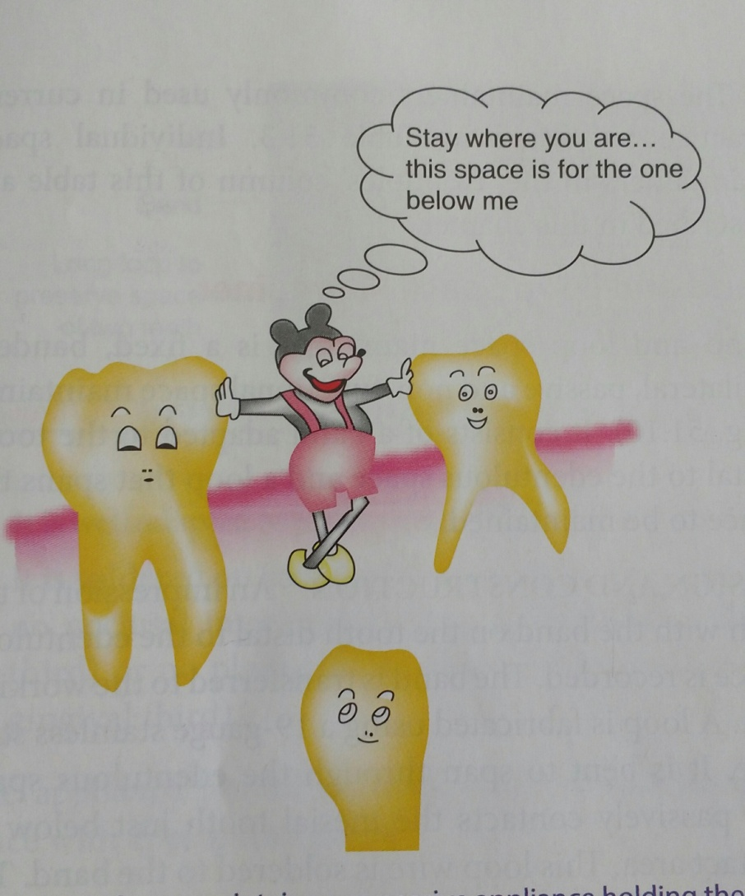
INTRODUCTION
PREMATURE LOSS
↓ DISTRUBANCES
ERUPTION, ALIGNMENT & FUNCTION
SITUATION ↓ PREVENTED
MALOCCLUSION
SPACE- PREMATURE↓
PRESEVED↓
INTERGRITY OF DENTAL ARCH

Slide 3
DEFINITIONS
SPACE MAINTENANCE;[ J C BRAUER 1941] Defined as the process of maintaining a space in a given arch previously occupied by a tooth or a group of teeth.
SPACE CONTROL; [GAINSFORTH 1955] Defined as careful supervision of the developing dentition as it reflects an understanding of the dynamic nature of occlusal development.
SPACE MAINTAINER; [BOUCHER] Defined as a fixed or removable appliance designed to preserve the space created by premature loss of a primary tooth or a group of teeth.

Slide 4
OBJECTIVES OF SPACE MAINTENANCE
Preserve space created by premature loss of tooth/teeth.
2. Preserve the integrity of the dental arches.
3. Preserve normal occlusion.
4. In case of anterior space maintenance, it should aid in esthetics and phonetics.
5. Prevent abnormal habits.

Slide 5
INDICATIONS OF SPACE MAINTAINER
1] When root development of the successor tooth is less than one –third; A tooth does not begin its journey before 1/3 of its root formation is complete. Eruption is likely to take considerable time if less than 1/3 root is formed. This time is sufficient to allow the neighbouring teeth to migrate into space originally occupied by the lost tooth.
2] When the assessed eruption time of the permanent tooth is not within 3-4 months; 1 mm thickness of bone covering the erupting tooth takes at least 4 -5 months to resorbe. Considering this fact , a SM is required when the bone thickness is more than 1mm.
3] Space discrepancy; When some space discrepancy like crowding or closed primary dentition already exist, more space loss cannot be affored. The available space has to be maintained to avoid undesirable loss of space.
4] Unilateral congenitally missing tooth; Congenital absence of a tooth on one side of the arch can cause migration of teeth, leading to unesthetic shift of the dental midline.
5] When functions are affected; Loss of incisors can affect speech while loss of posterior teeth may affect mastication.
6] If the use of space maintainer will aid in or make further orthodontic treatment less complicated.
7] If the space after premature loss of deciduous teeth shows signs of closing.
Notes:
.

Slide 6
CONTRAINDICATION
1] If the radiograph of extraction region shows that the succedaneous tooth will erupt soon.[ NO BONE COVERING]
2] If the radiograph of extraction region shows three-fourth of the root formation or one-third of root calcification of the succedaneous tooth.
3] When the space left by the prematurely lost primary tooth is greater than the space needed for the permanent successor as indicated radiographically.
4] If the space shows no signs of closing.
5] When succedaneous tooth is absent.

Slide 7
PREREQUISITES FOR SPACE MAINTAINERS
1. They should maintain the mesiodistal dimension of the space created by the lost tooth.
2. They should be function if possible, at least to the extent of preventing the over eruption of the opposing tooth or teeth.
3. They should be simple and as strong as possible.
4. They should not interfere with normal occlusion adjustments
.
5. They must not endanger the remaining teeth by imposing excessive stress on them.
6. They should not interfere with the erupting teeth.
7. They should maintain the individual functional movement of the teeth.
8. They should not interfere with the normal vertical eruption of the adjacent teeth.
9. They should provide mesiodistal space opening if required.

Slide 8
10. They should have a simple design permitting easy construction and placement.
11. They should be easily adjustable.
12. Their construction must be such that they do no restrict normal growth and development processes.
13. They should not interfere with such functions as mastrication, speech or deglutition.
14. They must be cleaned and not serve as traps for food debris etc. which enhances dental caries and soft tissue pathology.
15. They should be durable and corrosion resistant.
16. They should be reasonable in cost.
17. They should have universal application.
Notes:
NO SPACE MAINTAINER WILL FULFILL ALL OF THESE REQUIREMENT, EXCEPT THE PRIMARY TOOTH IN SOUND CONDITION WITH GOOD CONTACT RELATIONS.

Slide 9
CLASSIFACTION OF SPACE MAINTAINERS
ACCORDING TO HITCHCOCK.
1. Removable or fixed or semi fixed.
2. With bands or without bands.
3. Functional or nonfunctional.
4. Active or passive.
5. Certain combination of the above.

Slide 10
ACCORDING TO RAYMOND C THUROW
1. Removable. Ex. Acrylic partial denture
2. Complete arch
a. Lingual arch
3. Individual tooth. Ex. Band & loop SM

Slide 11
According to HINRICHSEN
1. Fixed appliances
CLASS 1 a] Nonfunctional
i] Bar type
b] Functional
i] Pontic type
CLASS 2 Cantilever type Ex. Band & loop SM
2. Removable appliance
Acrylic partial denture

Slide 12
FACTORS AFFECTING PLANNING FOR SPACE MAINTAINER
Time elapsed since loss;
If space closure occurs, it usually takes place during first 6 months after extraction. When primary tooth is removed and all factors indicate the need for the SM, it is best to insert an appliance as soon as possible after extraction.
Dental age of the patient;
Several studies have indicated that the loss of primary molar before 7 year of age will lead to delay in eruption of succedaneous teeth whereas loss after 7 yrs of age leads to early eruption of succedaneous tooth.
Amount of bone covering the unerupted tooth;
If the bone covering the developing permanent tooth is destroyed because of infection- tooth eruption is accelerated. If the bone covering the tooth is not destroyed, it takes at least 4-5 months to move through 1mm of bone.
Sequence of eruption of teeth;
The dentist should observe the relationship of developing and erupting teeth adjacent to the space created by untimely loss of a tooth. Ex. If 1st primary molar is lost prematurly and the permanent lateral incisor is in an active stage of eruption will often result in distal movement of primary canine and an encroachment on space needed by 1st premolar.
Delayed eruption of permanent tooth;
Over retained or deviation in eruption or impacted permanent teeth can result in delay of eruption process. With removal of primary tooth an appliance may be need to hold the space until the permanent tooth erupts into normal position.
Congenital absence of permanent tooth;
If permanent tooth is congenitally absent, the dentist must decide whether to hold the space until a fixed replacement can be provided or allow the space to close.

Slide 13
ADVANTAGES AND DISADVANTAGES OF SPACE MAINTAINERS
FIXED TYPE;
ADVANTAGES;
1. Easy manipulation.
2. The band are used without tooth preparation or with minimum tooth preparation.
3. It does not interfere with passive eruption of abutment.
4. The jaw growth is not hampered.
5. The succedaneous permanent teeth are well guided to their positions.
6. They can be used for uncooperative patient from the stand point of loss, breakage or failure to wear the appliance.

Slide 14
DISADVANTAGE;
1. Elaborate instrumentation with expert skill is needed.
2. They may result in decalcification of tooth material under the bands.
3. May be harmful to the abutment tooth due to development of torque forces resulting in appliance breakage.
4. Supra eruption of opposing teeth if pontics are not used.
5. If pontics are used,
a] Interfere with vertical eruption of abutment.
b] Prevents eruption of replacing permanent teeth if the patient fails to report.

Slide 15
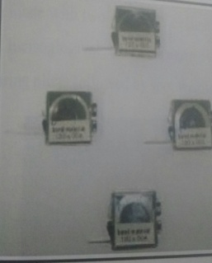
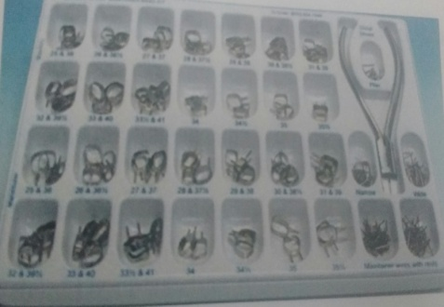
FABRICATION OF FIXED SPACE MAINTAINER
ARMAMENTARIUM;
1. STAINLESS BAND MATERIAL / PREFORMED BANDS.
ACCORDING TO FABRICATION
LOOP BANDS
TAILORED BANDS
PREFORMED BANDS
ACCORDING TO BAND MATERIAL
ANTERIOR TEETH; 0.003X0.125X2 INCHES
BICUSPID TEETH; 0.004X0.150X2 INCHES
PRIMARY MOLARS; 0.005X0.180X2 INCHES
PERMANENT MOLARS; 0.006X0.180X2 INCHES

Slide 16
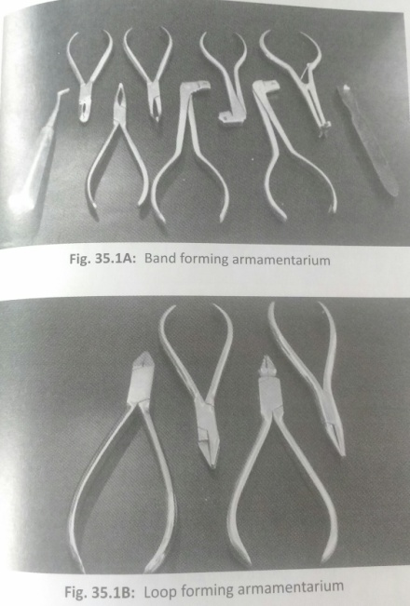
2. PLIERS;
Contouring plier
Hoe plier- Straight, curved
Band seating plier
Band adapter/pusher
Band cutting scissors
Bird beak pliers
Crimping pliers
3. STAINLESS STEEL WIRE, WIRE CUTTER, THREE JAW PLIER, UNIVERSAL PLIER.
4. SPOTWELDING UNIT, SOLDERING UNIT/TORCH,SILVER SOLDER, FLUX.
5. HEAVY DUTY MICROMOTOR, FINISHING BURS, POLISHING STONES

Slide 17
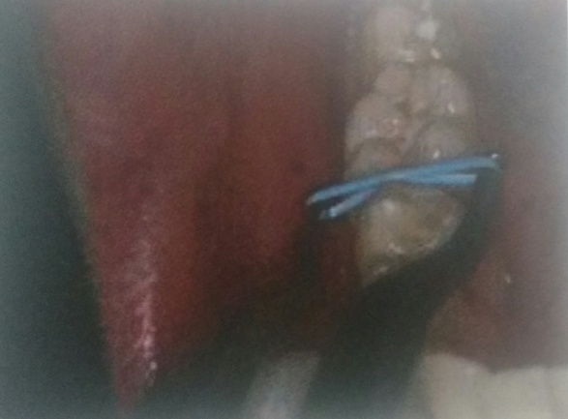
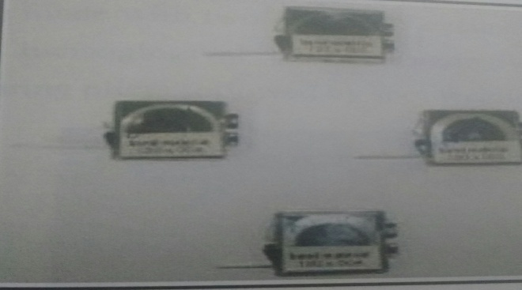
STEP BY STEP PROCEDURE
Placement of separators
Selection of band material

Slide 18
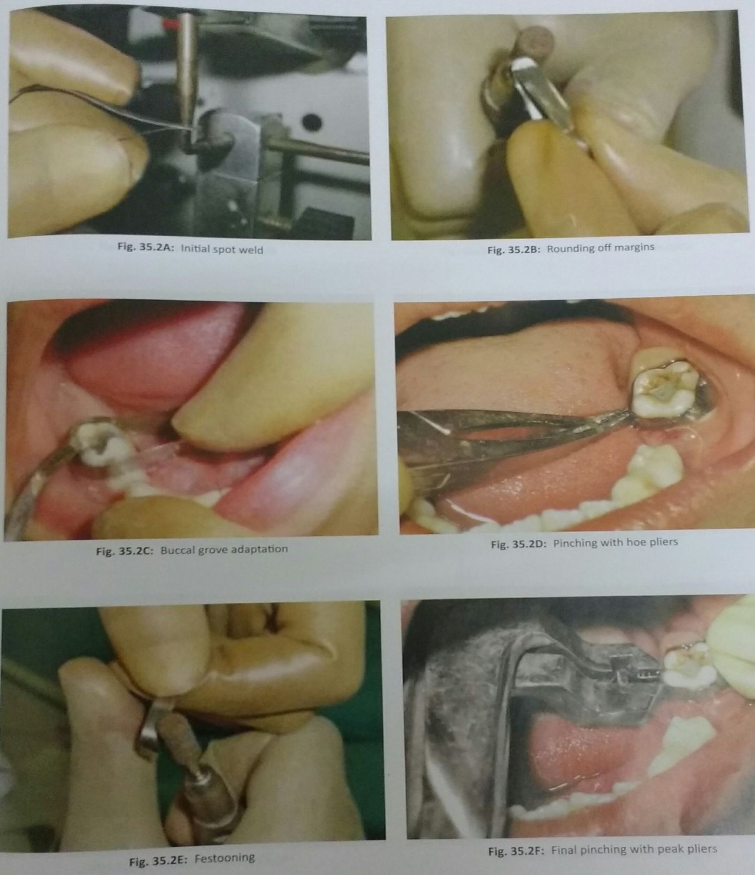

Slide 19
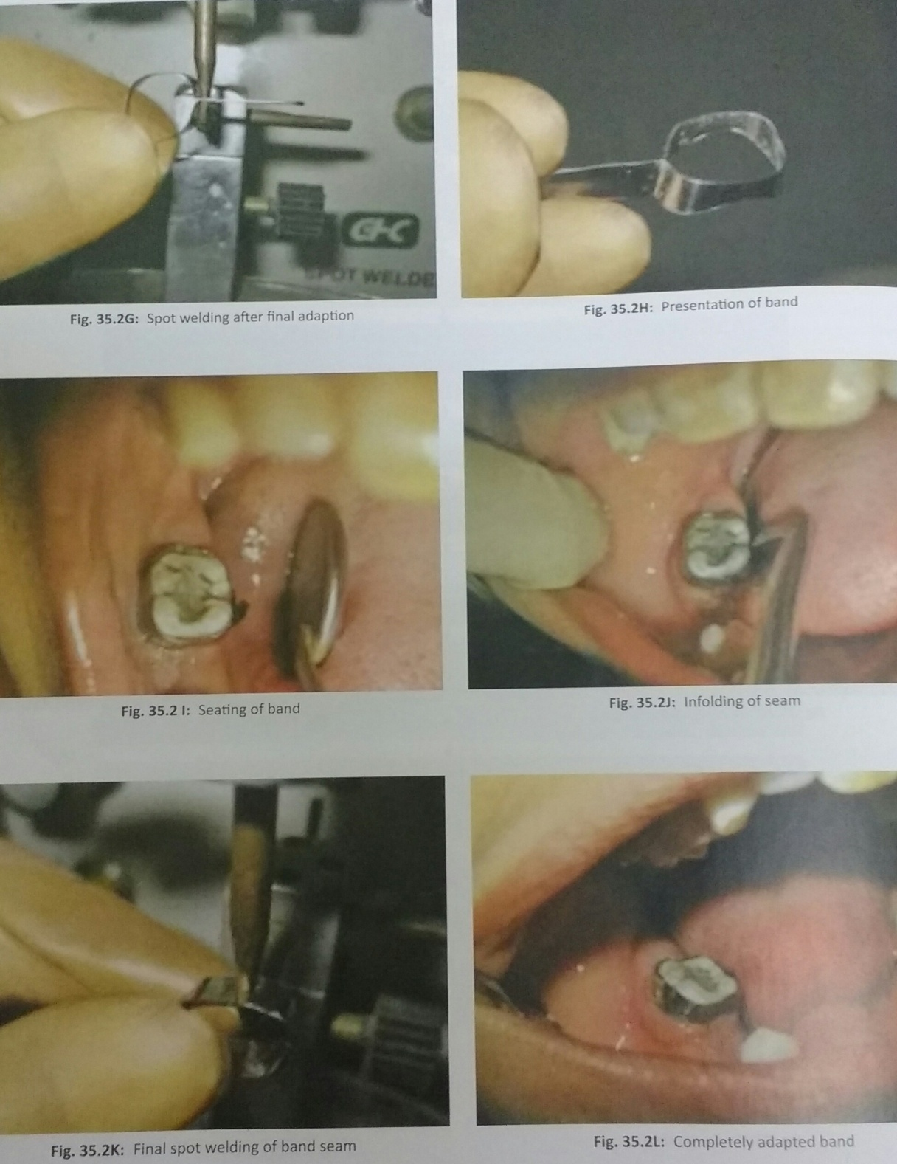

Slide 20
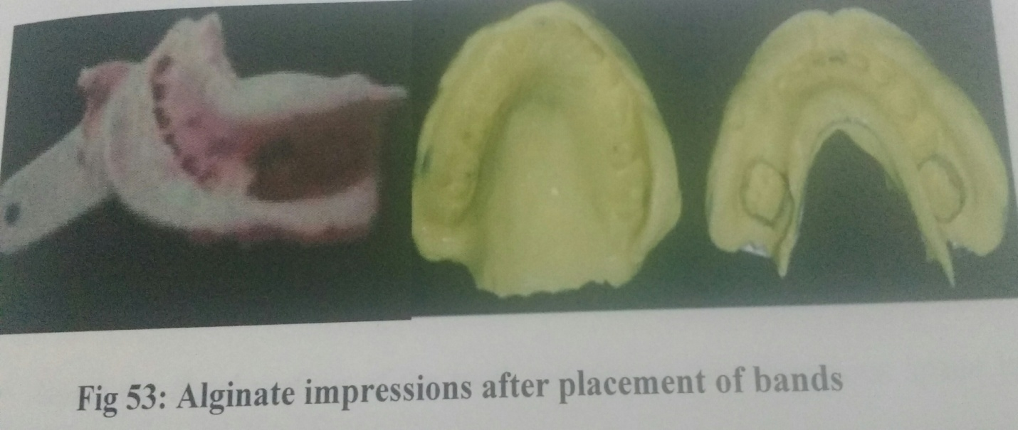
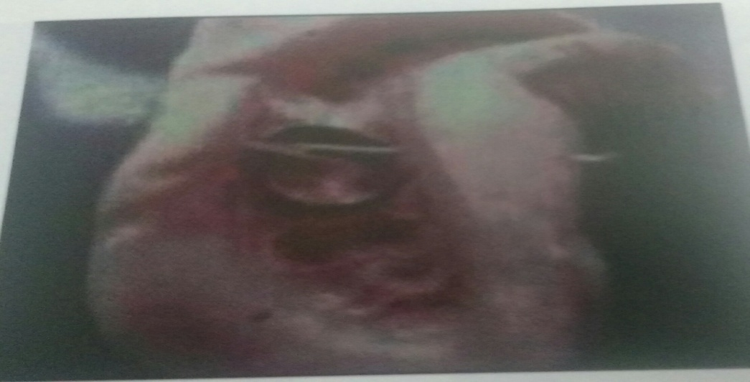

Slide 21
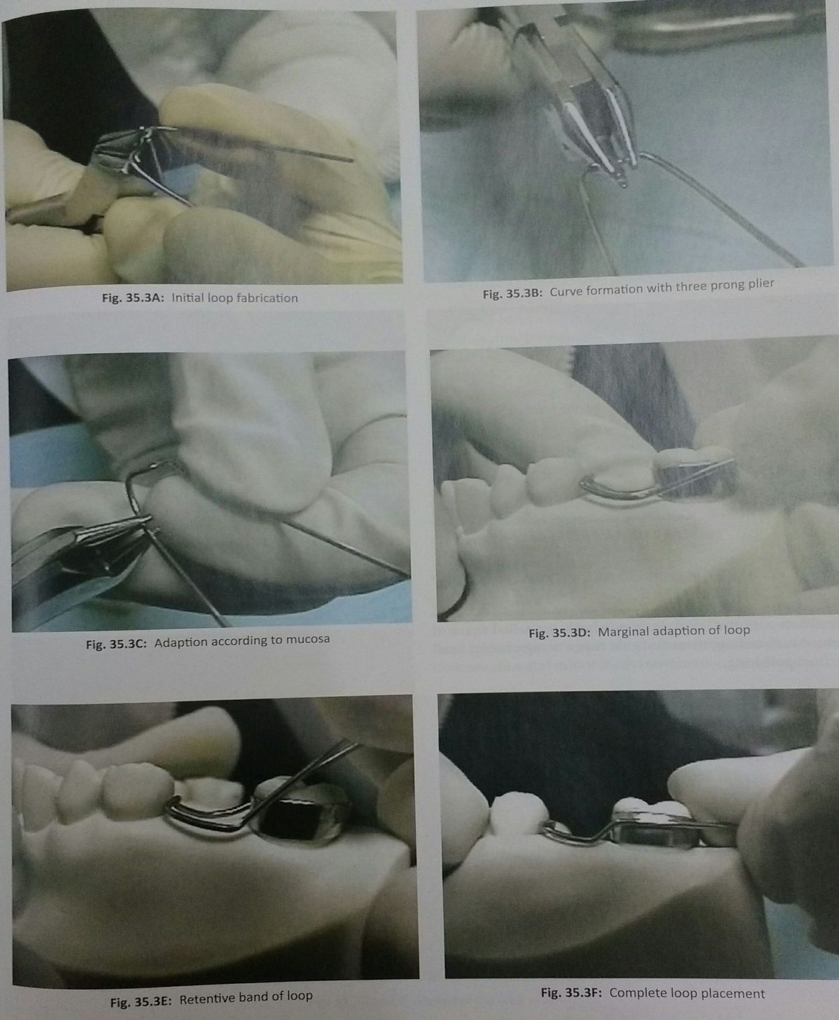

Slide 22
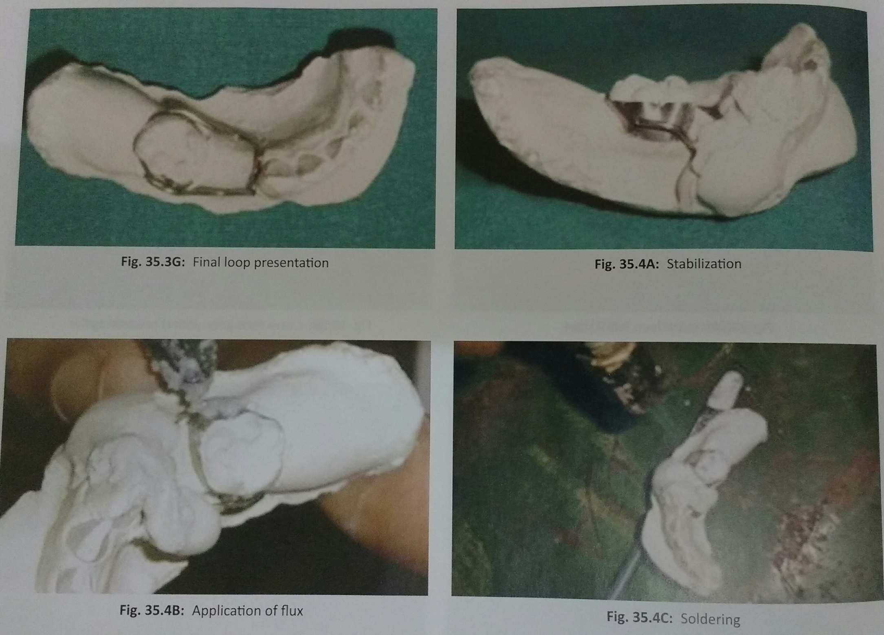

Slide 23
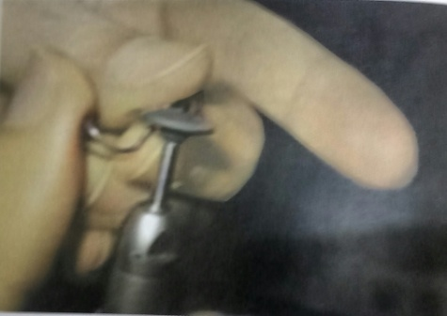
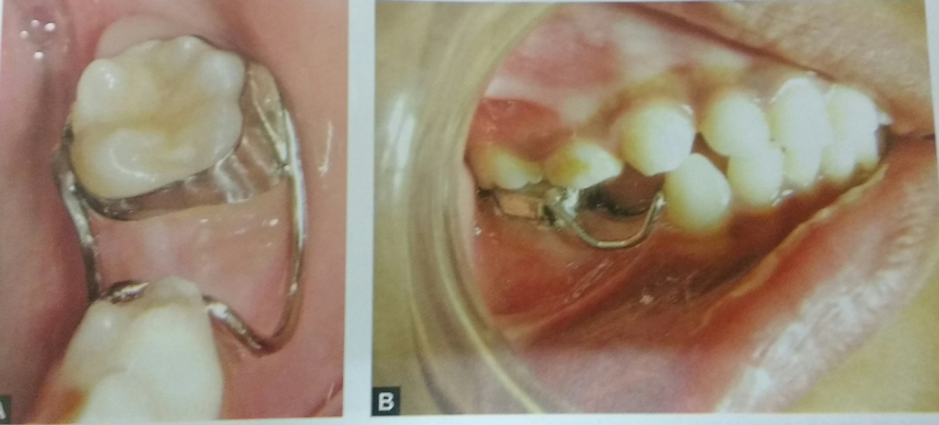

Slide 24
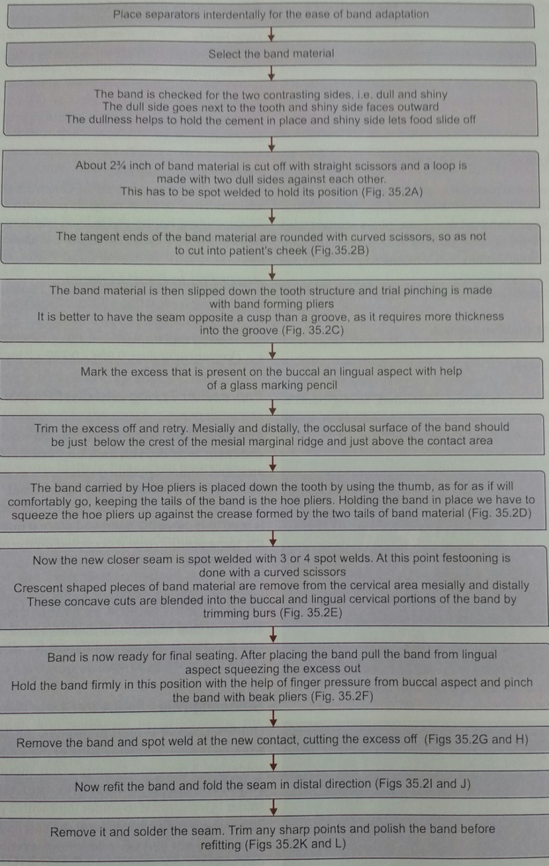

Slide 25
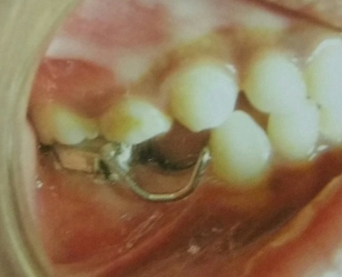
BAND AND LOOP SPACE MAINTAINER
It is one of the commonest space controlling appliance used.
It is a fixed, banded, unilateral or bilateral passive non-functional SM.
INDICATIONS;
Premature loss of primary 1st molar in primary dentition.
Premature loss of primary 2nd molar after the eruption of permanent 1st molar.
Some times it can be given in case of premature loss of primary canine .
Bilateral loss of mandibular primary molars before eruption of permanent incisors.
CONTRAINDICATION;
An occlusion that is extremely crowded or already exhibits marked space loss.
High dental caries activity.
Replacement of primary anterior teeth.
Replacement of primary 2nd molar without the eruption of permanent 1st molar.

Slide 26
ADVANTAGES;
It is an effective SM for unilateral/bilateral loss of tooth/teeth in buccal segment.
It is economical to make and construction is simple.
It take little chair time if preformed bands are used.
It can be adjusted easily to accommadate the changing dentition.
DISADVANTAGES;
It is not functional as it does not restore mastricatory needs of the replacing tooth.
It does not prevent the continued eruption of opposing tooth.
In case of fixed SM ,decalcification under the bands is a problem.
It is a passive SM.
It is more prone to slip gingivally during mastication.

Slide 27
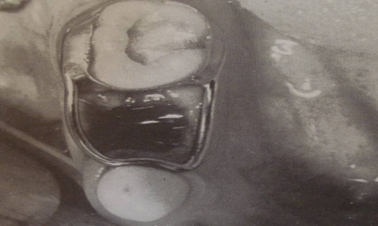
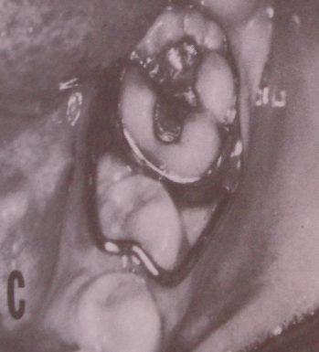
DESIGN AND CONSTRUCTION;
- An impression of the arch with band on the tooth distal to the edentulous space is recorded.
-The band is transferred to the working cast.
- A loop is fabricated using 19 gauge SS wire.
- The contour of the loop should be similar and as close as possible to the gingival contour.
-The disatl arms of the loop should be placed in the junction of middle and cervical third, at the same time not interfere with occlusion.
- The mesial arm loop should be placed just above the contact area of the supporting tooth in a passive manner.
-The final width of the loop should be wide enough [around 8mm] to allow eruption of premolar inside the loop
- After soldering the loop, the appliance is finished and polished before cementing.

Slide 28
MODIFICATIONS OF BAND AND LOOP SPACE MAINTAINER
CROWN AND LOOP SM
CROWN- BAND AND LOOP SM
BAND AND BAR SM
REVERSE BAND AND LOOP SM
MEYNE’S SM
LONG BAND AND LOOP SM
BAND AND LOOP WITH OCCLUSAL REST

Slide 29
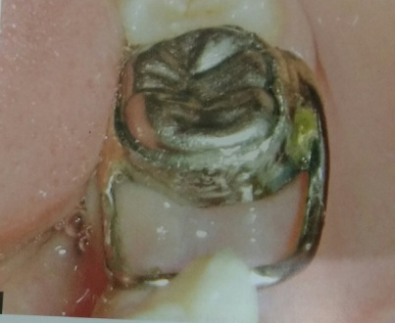
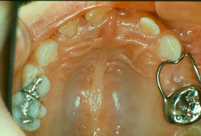
CROWN AND LOOP SPACE MAINTAINER
- Crown and loop SM is a fixed, unilateral, passive , non- functional SM.
- It is similar to band & loop SM in all respects except that Stainless Steel Crown is used instead of band.
INDICATIONS;
Most of the indications of band & loop SM apply to crown & loop SM. The crown is used in preference to band when the abutment tooth is
[a] High carious activity
[b] Exhibits marked hypoplasia
[c] Endodontically treated tooth.
DESIGN AND CONSTRUCTION;
- A Stainless steel crown is adapted onto the tooth abutting the space of the lost tooth and an impression is recorded.
-The crown is transferred to a working cast and the loop is soldered to the crown.
-The appliance is finished and polished before cementing it in the arch.

Slide 30
CROWN- BAND AND LOOP SPACE MAINTAINER
Similar to crown and loop SM except that the band is adopted on the S S Crown and the loop is soldered on the band.
ADVANTAGE; If any distortion occur only the band & loop can be removed.
DISADVANTAGE; Bonding between the crown and band is difficult.

Slide 31
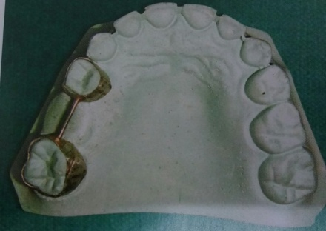
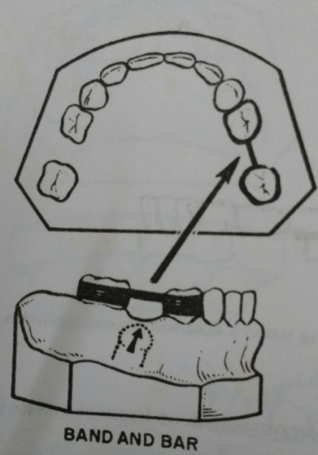
BAND AND BAR SPACE MAINTAINER
It is an fixed, banded, unilateral, passive functional space maintainer.
The teeth mesial and distal to the eduntulous space are banded with a bar between the bands.
DESIGN & CONSTRUCTION;
- Two bands on mesial and distal teeth are transferred to the working cast .
-A bar connecting the bands is soldered at the occlusal level to contact the opposing tooth.
- The appliance is finished, polished and luted with suitable cement.
CLINICAL APPLICATION;
Band and bar appliance is used to preserve posterior space, while preventing supra eruption of opposing teeth.

Slide 32
ADVANTAGES;
There is no possibility of harming the gingiva, such as band and loop appliance.
It is a passive functional appliance and prevents supra eruption of the opposing tooth.
DISADVANTAGES;
It is possibly more caries conductive than a band loop as it has two bands.

Slide 33
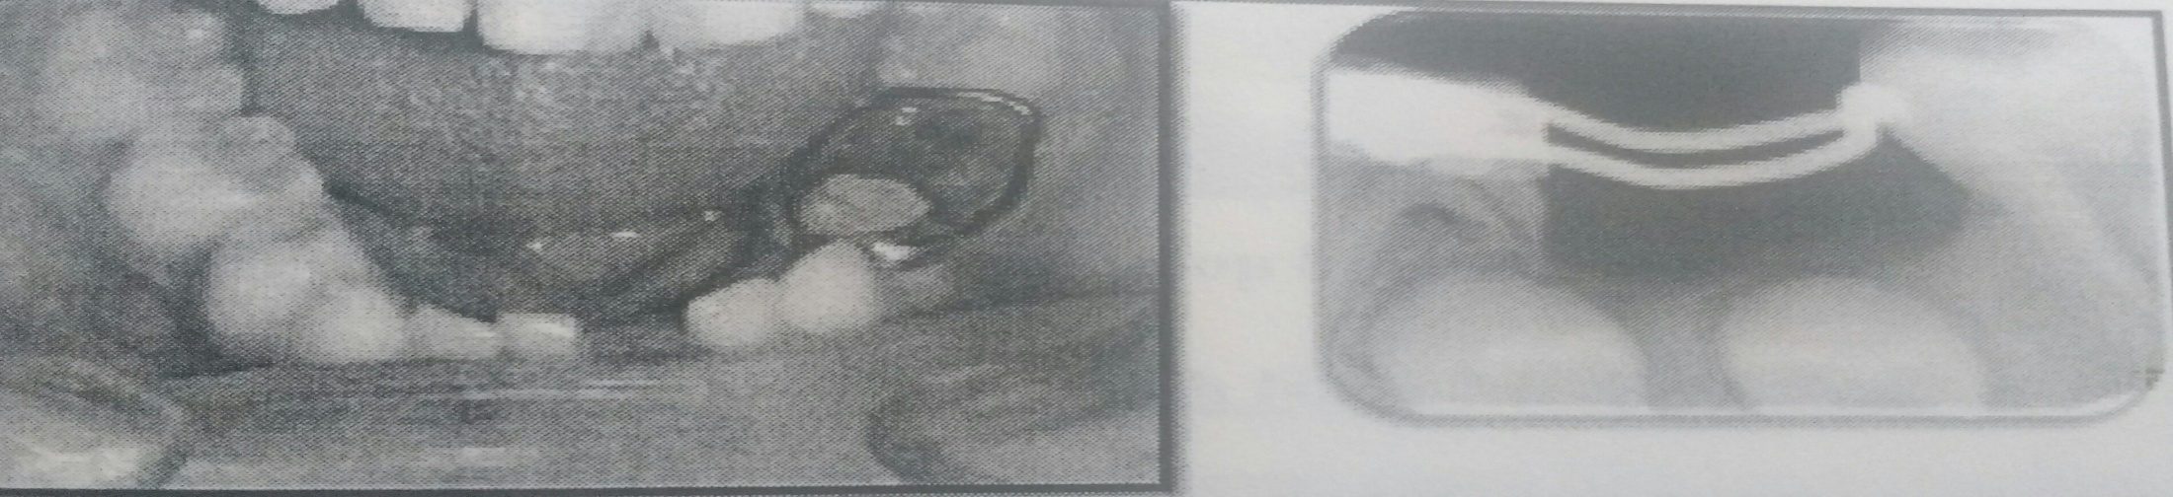
REVERSE BAND AND LOOP SPACE MAINTAINER
It is a fixed , banded, unilateral, passive non-functional space maintainer.
INDICATION;
-Given when there is premature loss of 2nd primary molar and the permanent molar has not erupted fully to support a band.
-In such cases primary 1st molar is banded and a loop is made that touches just below the marginal ridge of permanent molar.

Slide 34
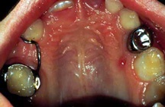
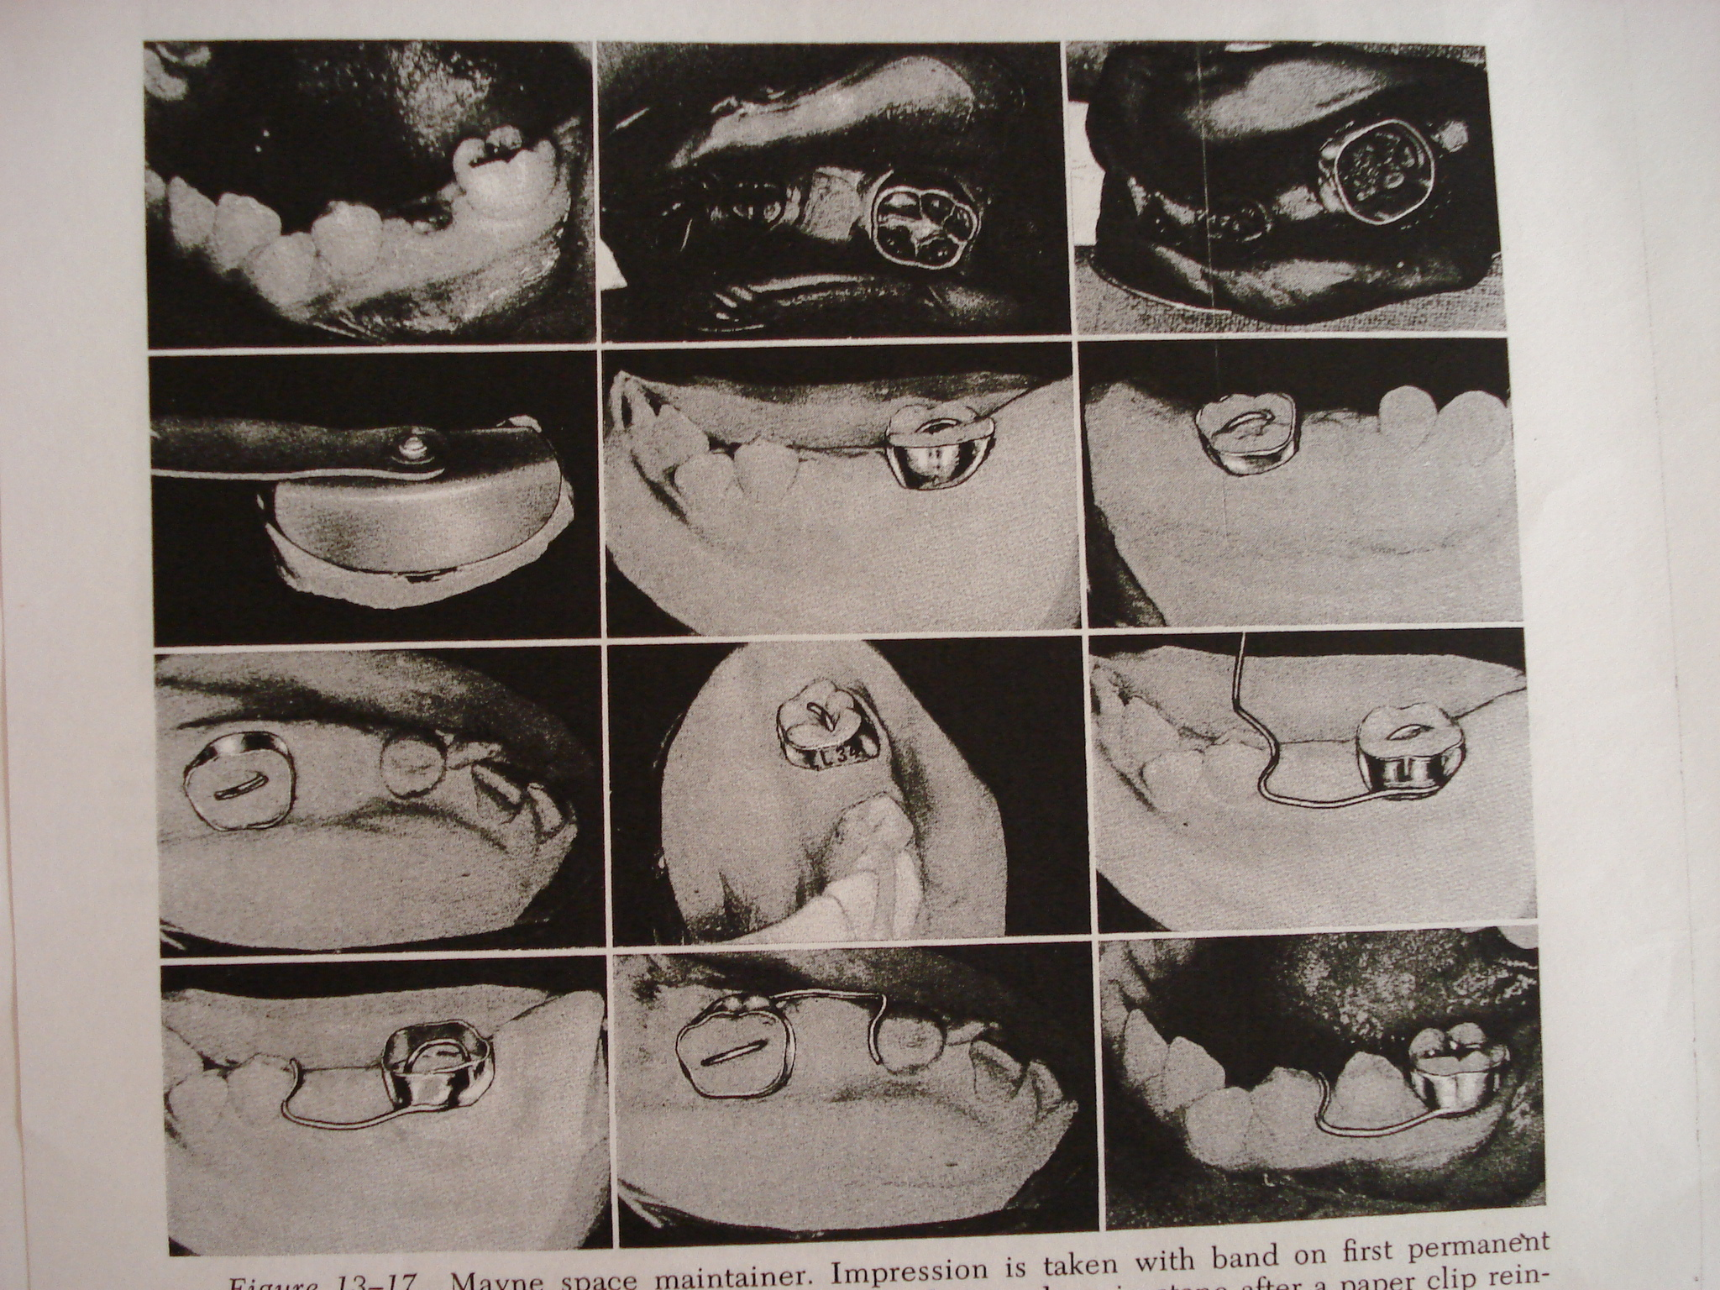
MEYNE’S SPACE MAINTAINER
Similar to band and loop SM but the loop is half.
Designed by W R MEYNE.
Type of fixed, banded, unilateral non functional SM that permits minor adjustments for space control while the tooth in question is erupting.
ADVANTAGE;
Less bulky
DISADVANTAGE;
Less stable

Slide 35
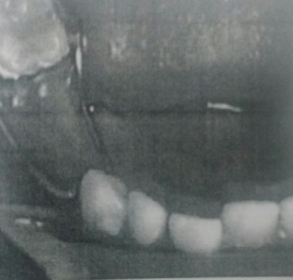
LONG BAND AND LOOP SM
Used in cases where there is multiple loss of teeth in one segment and an arch stabilizing appliance like lingual arch cannot be given considering the eruption status.

Slide 36
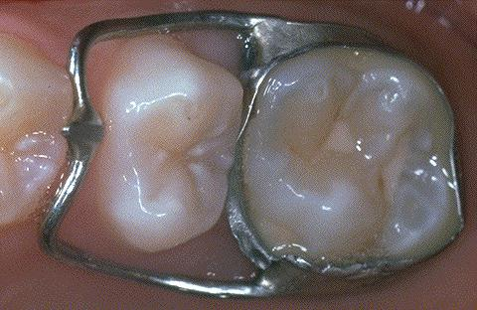
BAND AND LOOP WITH OCCLUSAL REST

Slide 37
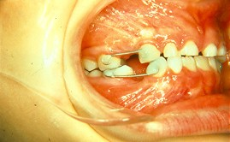
BONDED SPACE MAINTAINER
ADVANTAGES; ---Easily fabricated chairside.
-Less time consuming
-Economic.
-Eliminates slippage. -Better gingival health.
DISADVANTAGES;
-Debonding because of shearing occlusal forces.
-Difficult to adjust.

Slide 38
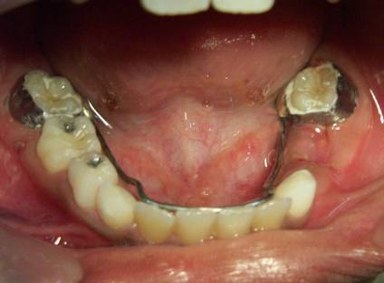
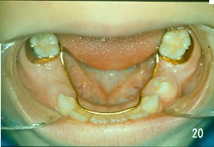
LINGUAL HOLDING ARCH
It is a fixed, bilateral, passive/ active non-functional mandibular space maintainer.
It is the most effective appliance for space maintenance and minor tooth movement in lower arch.
INDICATION;
1.Multiple unilateral loss of primary molars in mandibular arch after the eruption of permanent lower incisors.
2. Bilateral loss of primary molars in mandibular arch after the eruption of permanent lower incisors.
3.Minor space regaining.

Slide 39
ADVANTAGES;
1. It is an excellent source of anchorage, because it incorporates resistance of several teeth.
2. It serves as a space maintainer for more than one succedaneous teeth in the arch.
3. It causes little or no inconvenience to the patient.
4. It is less bulky than removable acrylic SM.
5. It helps to maintain arch perimeter by preventing both mesial drifting and lingual movement of the molar teeth and also lingual collapse of anterior teeth.
DISADVANTAGES;
1. As with other fixed appliances, prolonged use of bands on tooth may facilitate decalcification .
2. The arch wire may become embedded in the soft tissue in patients with poor oral hygiene.
3. The wire may be distorted by mastricatory forces.
4. It cannot be indicated until permanent lower anterior’s have erupted.

Slide 40
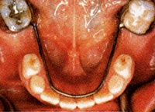
DESIGN AND CONSTRUCTION;
-Bands are fabricated on the teeth distal to the edentulous space.
-A wire is bent in a “U” shape and adapted close to the tissues on the lingual gingiva, passively touching the cingulae of the permanent incisors.
-The wire is soldered to the lingual surfaces of the lower molar bands on either sides.
-The appliance is then trimmed and polished before luting.

Slide 41
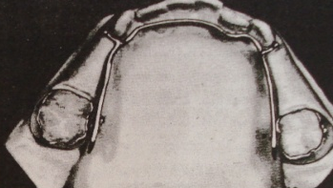
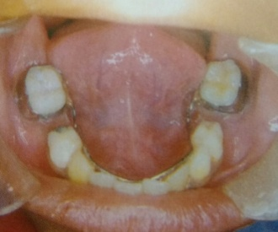
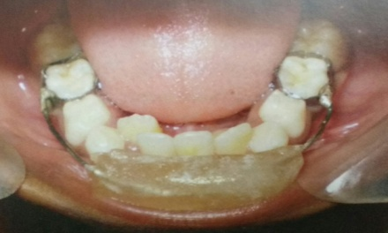
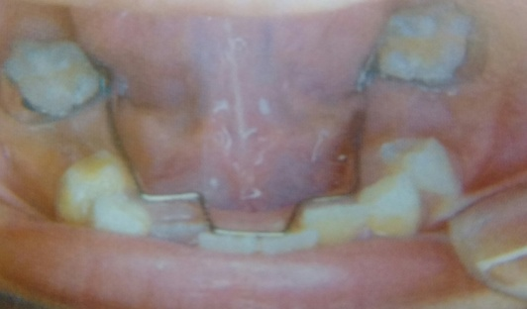
MODIFICATIONS;
LINGUAL HOLDING ARCH WITH SPUR.
ACTIVE LINGUAL ARCH SPACE REGAINER.
LIP PADS / LIP BUMPER ANCHOR.
WIRE MODIFICATION FOR LATERAL INCISOR ERUPTION.

Slide 42
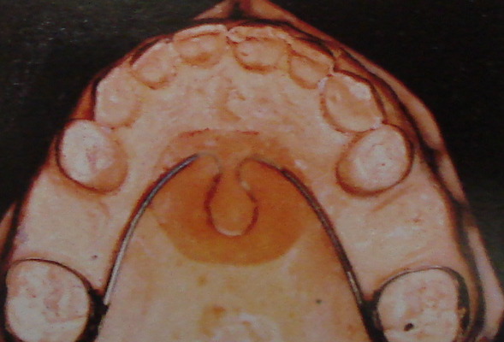
NANCE PALATAL ARCH SPACE MAINTAINER
It is a fixed, bilateral, passive maxillary non-functional SM.
INDICATION;
- Bilateral premature loss of maxillary primary posterior teeth when the spaces are immediately mesial to the teeth on which bands has to be fabricated.
Contraindication;
- If the patient is allergic to acrylic.
Advantage;
-Effective SM when ever there is multiple loss of posterior teeth in maxillary arch.
Disadvantage;
-Decalcification like any other fixed space maintainers.
-Soft tissue irritation.

Slide 43
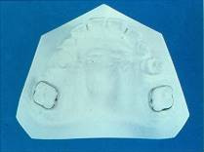
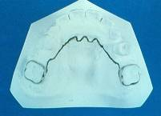
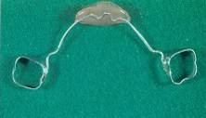
DESIGN AND CONSTRUCTION;
It consists of bands fabricated on molars distal to the edentulous spaces on either sides of the arch.
The bands are connected to each other with a ‘U’ shaped stainless steel wire running from one molar to the anterior palatal area and then to the other molar. At the rugae area, a small U / W shaped bend is incorporated approximately 1mm away from the soft tissue. The bend will enhance the retention of the acrylic botton to the wire .
The acrylic button, 0.5 inch in diameter is placed usually on the descending portion of the palatal vault 1 to 2 mm below the incisive papilla.
The appliance is then trimmed and polished before luting.

Slide 44
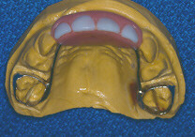
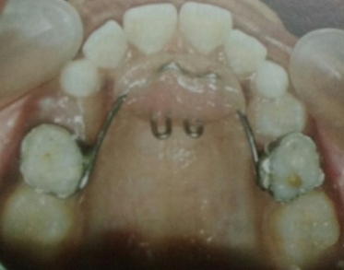
MODIFICATIONS;
NANCE HOLDING ARCH SPURS.
FIXED FUNCTIONAL SPACE MAINTAINER.
HABIT BREAKING COMBO APPLIANCE.

Slide 45
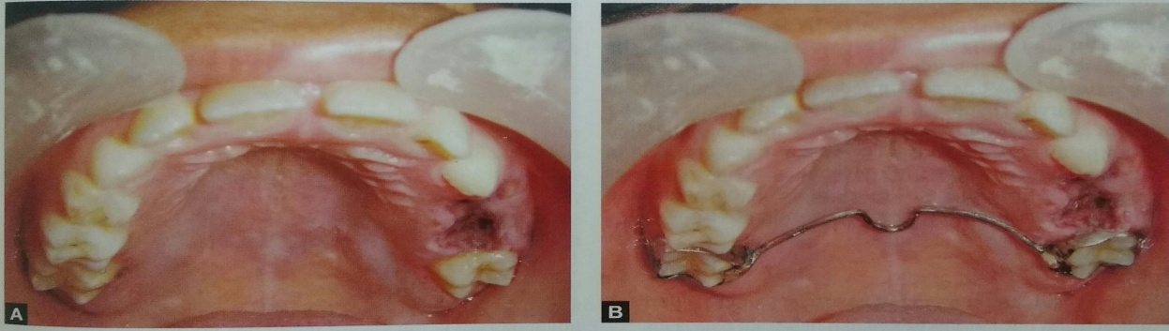
TRANSPALATAL ARCH
It is a maxillary fixed, bilateral, passive and non-functional SM.
INDICATION;
When one side of the arch is intact and several primary teeth on the other side is missing.
In arch expansion.
Correction of rotated molar.
DESIGN AND CONSTRUCTION;
It consists of bands on the teeth distal to edentulous space
A 19 guage SS wire is bent and well adapted to follow the contour of the palate avoiding the soft tissue.
- The wire is incorporated with U- shaped bend in the middle of the palate if any manipulation is required and is soldered to the molar bands on either sides.
The appliance is finished and polished before cementing.

Slide 46
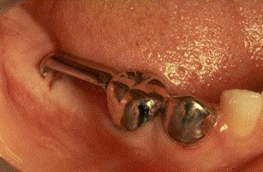
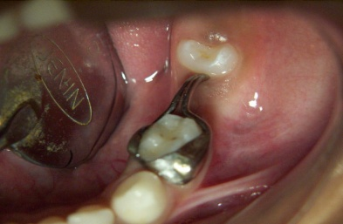
DISTAL SHOE SPACE MAINTAINER
It is also called as Willet’s/ Intral-alveolar/ Eruption guidance appliance.
Introduced by WILLET’S in 1932.
It is called intral-alveolar appliance because the distal vertical extension is embedded in the alveolus.
It is called guidance appliance because it guides the erupting permanent 1st molar.
It is a fixed/ semi-fixed, passive non functional SM.
The Willet’s distal shoe appliance is rarely used these days because of increased cost of material, difficulties in tooth preparation and more complicated fabrication procedure.
The appliance which is in practice now is ROCHE’S distal shoe appliance introduced in 1942.
The major difference between the two appliance is the intra alveolar extension. The Willet’s appliance offers Bar type vertical extension whereas Roche’s appliance offers V –shaped vertical extension which has a broader surface which prevents rotation of the erupting tooth.

Slide 47
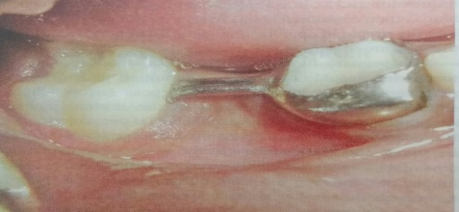
INDICATION;
When the 2nd primary molar is lost/ extracted before the eruption of 1st permanent molar.
[Distal surface of the 2nd primary molar provides a guide for un-erupted 1st permanent molar. When the 2nd primary molar is removed prior to the eruption of the 1st permanent molar, the intra alveolar appliance provides greater control of path of eruption of un-erupted tooth and prevents undesirable mesial migration.]
CONTRAINDICATION;
Inadequate abutment due to multiple loss of teeth.
Poor oral hygiene.
Lack of parent and patient cooperation.
Medically compromised patients with congenital heart disease, juveneile diabetes, hemophilia etc
Congenitally missing 1st permanent tooth.

Slide 48
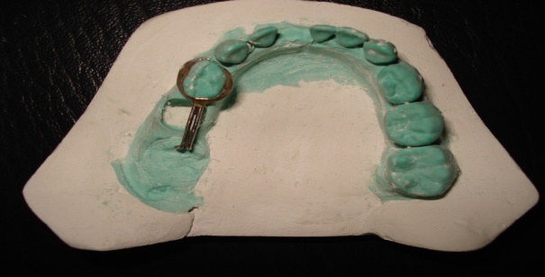
ADVANTAGES;
Only SM which can be used if there is premature loss of 2nd primary molar before the eruption of 1st permanent molar.
DISADVANTAGES;
1 .It may permit tipping if not placed properly.
2. It may interferes with epitheliazation of the socket.
3. It can cause infection.
4. Its construction is difficult.
5. It may cause trauma and damage to the unerupted tooth bud if not placed properly.
6. It may prevent the tooth from erupting if not placed properly.

Slide 49
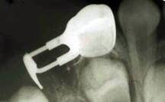
DESIGN AND CONSTRUCTION;
STEP 1; An IOPAR is taken to calculate the length of the arm and depth of the shoe to be designed.
STEP 2; A band/crown is fabricated on 1st primary molar .
STEP 3; 1. An impression is taken along with band/crown on 1st primary molar[D].
2. Band/crown is transferred to the prepared working cast.
3. In the cast, 2nd primary molar is scraped off and a hole corresponding to the distal surface 2nd primary molar as calculated , is created.
4. A SS wire is bent accordingly. It consists of a horizontal[distal extension] and vertical arm. It is stabilized and soldered .
5. The prepared appliance is removed from the cast and trimmed.
6. The appliance is polished, sterilized and kept ready before extraction of 2nd primary molar for cementation immediately after the extraction procedure.

Slide 50
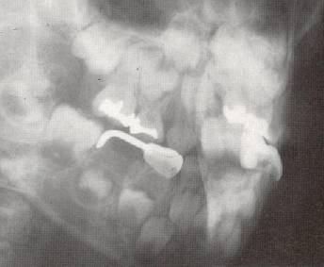
STEP 4; The 2nd primary molar is extracted.
1.When the bleeding is controlled, the distal shoe appliance is placed in the arch and a IOPAR is taken.
2. The gingival extension should extend about 1mm below the mesial marginal ridge of 1st permanent molar.
3. Necessary adjustment of the wire is done until a satisfactory position of the appliance of the appliance is confirmed with IOPAR.
STEP 5; The distal shoe appliance is cemented on the 1st primary molar and it is mandatory to check the eruption of the permanent tooth periodically.

Slide 51
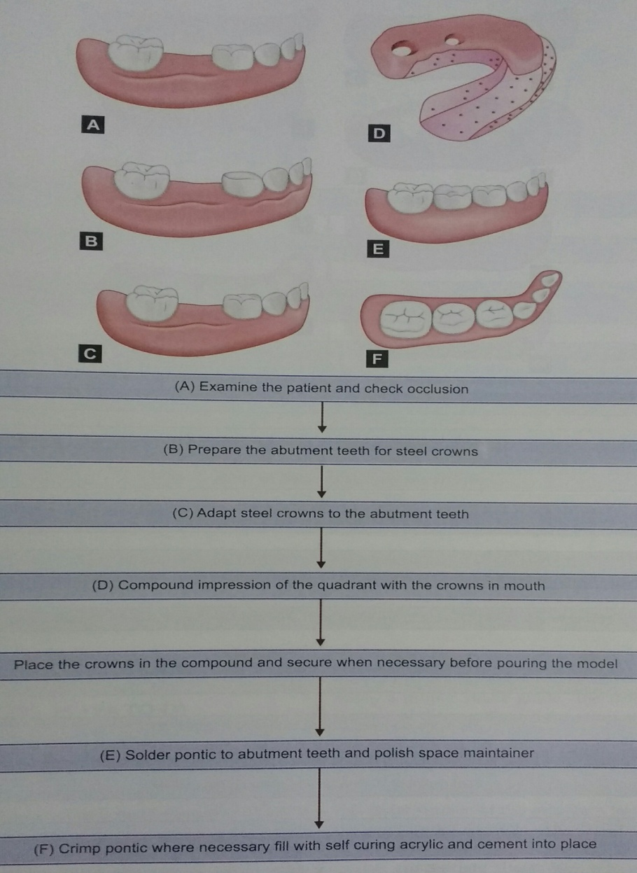
FUNCTIONAL SPACE MAINTAINER FOR MISSING POSTERIOR TOOTH

Slide 52
ANTERIOR ESTHETIC FUNCTIONAL SPACE MAINTAINER
GLASS FIBER REINFORCED COMPOSITE RESIN SPACE MAINTAINER;
-Simple and effective SM fabricated chairside mainly used in anterior region.
Indications;
-Unilateral loss of 1 or 2 teeth in maxillary or mandibular arch.
Advantages;
Time saving.
Need for lab procedure is eliminated.
Single sitting procedure.
Easy to clean.
Esthetic.
Helps in phonation.
Disadvantages;
Cost.
Invasive technique.

Slide 53



PROCEDURE;

Slide 54




FIXED FUNCTIONAL ANTERIOR SPACE MAINTAINER;
This SM consists of a polycarbonate/acrylic tooth processed onto a Nance palatal / Lingual arch which in turn is attached to bands on molars.

Slide 55
REMOVABLE SPACE MAINTAINERS
They are SM that can be removed and reinserted into the oral cavity by the patient.
CLASSIFICATION;
1 - Functional or non functional
- With claps or without claps
2. BRAUER CLASSIFICATION
Class 1; Unilateral maxillary posterior
Class 2; Unilateral mandibular posterior
Class 3; Bilateral maxillary posterior
Class 4; Bilateral mandibular posterior
Class 5; Bilateral maxillary anterior posterior
Class 6; Bilateral mandibular anterior posterior
Class 7; One or more of Permanent anterior
Class 8; Complete primary.

Slide 56
INDICATIONS;
Aesthetics is important
The abutment tooth/teeth cannot support a fixed appliance.
A cleft palate patient.
Permanent teeth are not fully erupted for adaptation of bands.
Multiple loss of deciduous tooth.
CONTRAINDICATIONS;
Lack of patient / parent cooperation.
If the child has not attained a mental age 2.5 years.
If the patients are allergic to acrylic.
Epileptic patients.

Slide 57
ADVANTAGES;
1. It is easy to clean and permit the teeth to be cleaned.
2. It restores and maintains the vertical dimension.
3. It can be used with combination with other preventive procedures
4. It can be worn part time allowing circulation of the blood to the soft tissues.
5. It serves in other important functions like esthetics, phonation and mastication.
6. It helps keeping the tongue in bounds.
7. Band construction is not necessary.
8. Dental check ups for caries detection can be made easily.
9. Room can be made for the permanent teeth to erupt without changing the appliance.

Slide 58
DISADVANTAGE;
1. It may be lost or can be broken by the patient.
2. The patient may not wear it
3. The lateral jaw growth may be restricted, if claps are incorporated.
4. It may irritate the underlying soft tissue.

Slide 59
SPACE REGAINERS
It is used to regain the lost space. Earlier the distalization better is the result.
Broadly divided into two group
1. Fixed space regainers.
2 Removable space regainers

Slide 60
FIXED SPACE REGAINERS
OPEN COIL SPACE REGAINER [ HERBST SPACE REGAINER];
Band is adapted on the tooth to be distalized, generally permanent molar.
Buccal and lingual tubes[0.25 long flanges] are spot welded to the band.
The tubes should be parallel.
Impression of band and tube is taken.[The holes in the tube are plugged with wax to prevent them from getting blocked by dental plaster].
Dental plaster is poured to prepare working cast.
A 0.7mm SS wire is bent to a U shape, which will fit passively in both the buccal and lingual tubes.
The anterior part of the U shaped wire should have a reverse bend where it contacts the distal outline of the supporting tooth[1st premolar].
A t the junction of the straight part and the curved part of the wire, both buccally and lingually , flow enough solder to make a stop.
Then cut open coil spring so as to extend from the stop to a point about 2mm distal to the anterior limit of the tube.
The band with tube is trimmed, polished and cemented on the abutment tooth.
The coil spring is slipped on the wire .
The wire is then put in the tubes and the distal end is bent downwards so that it will not lacerate the tissue.
The compressed spring will exert reciprocal pressure mesially to the premolar and distally to the permanent molar.

Slide 61




