Slide 1
Pulpotomy
Dr Pallavi Vashisth
Department of Pedodntics

Slide 2
Pulpotomy
The surgical removal of the coronal portion of a vital pulp as a means of preserving the vitality of the remaining radicular portion.
short-term success rates are favourable
This procedure is generally advocated for deciduous teeth
Success of pulpotomy is largely dependent on the diagnosis of residual pulp to be healthy or reversible inflammed

Slide 3
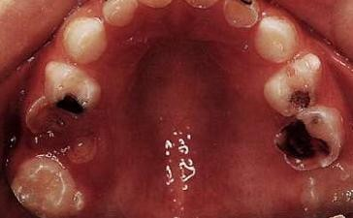
Indications
Pulp exposure on primary teeth in which the inflammation or infection is diagnosed to be confined to the coronal pulp
If inflammation has spread into the tissues within the root canals
  pulpectomy or
  root canal filling or
  extraction.

Slide 4
Contraindication of Pulpotomy
A history of spontaneous toothache (not caused by papillitis
resulting from food impaction)
Nonrestorable tooth where postpulpotomy coronal seal would be inadequate
A tooth near to exfoliation or if no bone overlies the crown of the
permanent successor tooth
Evidence of periapical or furcal pathosis
Evidence of pathologic root resorption
pulp that does not bleed (necrotic)
Inability to control radicular pulp hemorrhage following a coronal
pulp amputation
A pulp with serous or purulent drainage
Presence of a sinus tract

Slide 5
Technique
accurate diagnosis of pulp status is very important in aiding appropriate pulpal management
  An accurate pain history
  Radiographic findings
  Clinically,
success of vital pulp therapy in the primary dentition depends upon:
  effective control of infection.
  Complete removal of inflamed coronal pulp tissue.
  Appropriate wound dressing.
  effective coronal seal during and after treatment

Slide 6
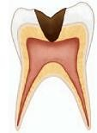
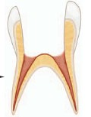
Coronal Pulp Amputation
After complete isolation and under L.A., complete removal of caries is done
Unroofing of pulp chamber with non-cutting high speed bur under copious water irrigation
  bleeding indicates vital (if inflamed) coronal pulp tissue
coronal pulp is amputated with a slow-speed #6 or #8 round bur or spoon excavator
  Care is taken not to leave a single strain of filament of coronal pulp – bleeding impossible to control

Slide 7
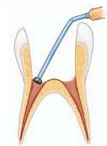
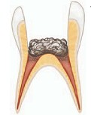
Coronal Pulp Amputation
Thoroughly washed with sterile water or saline to remove all debris, and the site is dried by vacuum and sterile cotton pellets
Hemorrhage should be controlled in this manner within 3 minutes, but if bleeding persists
  check that all filaments of the pulp were removed from the pulp chamber
  the amputation site is clean.
  If after doing this hemostasis is not achieved within 2 to 3 minutes, then tooth is not a candidate of pulpotomy
    Pulpectomy or
    tooth should be extracted

Slide 8
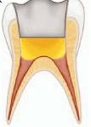
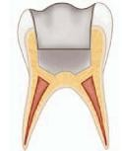
Coronal Pulp Amputation
Once bleeding has stopped at the radicular pulp stumps, either of the following technique
  dilute formocresol solution for 5 minutes
  15% ferric sulfate solution for 15 seconds
  MTA pulpotomy
  electrosurgical pulpotomy
  Laser pulpotomy

Slide 9
Formocresol Pulpotomy
Formocresol Solution
  Full-Strength Buckley’s Formocresol : Formaldehyde 19%,
Tricresol 35%, Glycerin 15%, Water 31%
  One-Fifth Dilution of Formocresol Solution: 1 part Buckley’s formocresol solution + 1part distilled water and 3 part glycerin
one-fifth dilution formocresol solution on a cotton pellet is blotted to remove excess formocresol and then placed in direct contact with the pulp stumps for 5 minutes
pellet is removed - tissue appears brown
A cement base of ZOe is placed over the pulp stumps and allowed to set
tooth may then be restored permanently

Slide 10
Formocresol Pulpotomy
Toxic and corrosive, especially at the point of contact
Increased penetration radicular root
FAD is genotoxic, inducing mutations and DNA damage
fear of damage to the succedaneous tooth
Unlike the tissue response to Ca(OH)₂, no dentin bridge should be anticipated after applying formocresol to exposed pulp tissue
narrowing of the root canal through the continued deposition of dentin by the preserved radicular pulp may be observed in some case

Slide 11
Prognosis
internal resorption - formocresol was applied
accompanied by external resorption,
May becomes excessively mobile;
a sinus tract
Rare occurrence of pain – so formocresol failure can be detected only clinically detected by chance
The development of cystic lesions is evidenced in some cases
Above findings emphasize the importance of periodic follow-up to endodontic treatment on primary teeth

Slide 12
Glutaraldehyde Pulpotomy
Glutaraldehyde has been a suggested alternative to formocresol as a tissue fixative
little toxic effect
antigenic action similar to formocresol,
it is of a lower potential – unstable
increasing failure rates

Slide 13
Ferric Sulfate Pulpotomy
After completion of coronal pulp amputation and achievement of hemostasis with moist cotton pellets, a 15.5% solution of ferric sulfate is applied to the radicular pulp stumps for 10 to 15 seconds
small droplets of the solution to drip from a burnisher tip onto the surface of the pulp tissue
dento-infuser tip for this purpose

Slide 14
Ferric Sulfate Pulpotomy
hemostatic agent
blood reacts with ferric and sulfate ions within the acidic pH of the solution
form plugs that occlude the capillary orifices and prevent blood clot formation
hemostatic agent during the Ca(OH)2 pulpotomy

Slide 15
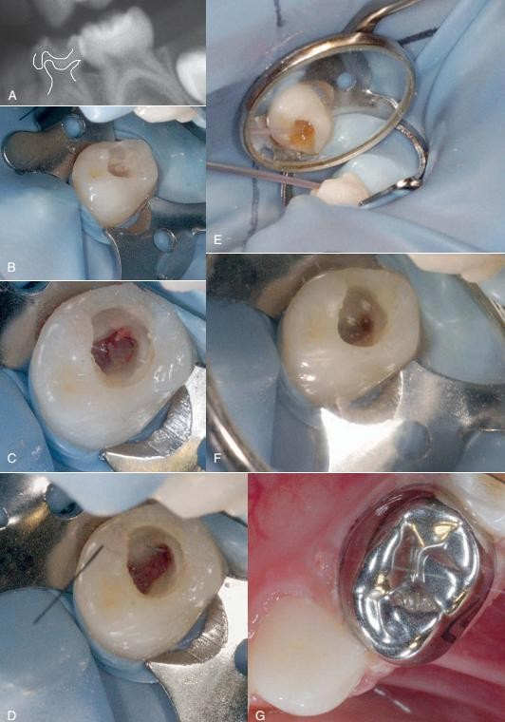
A, extensive dental caries affecting a mandibular first primary
molar. note proximity of radiographic lesion to the mesial pulp horn.
B, Caries removal showing a carious pulpal exposure; bleeding is evident.
C,Partial unroofing of the pulp chamber; note bleeding coronal pulp prior to amputation.
D,Roof of pulp chamber removed completely.
E, 15.5% solution of ferric sulfate is applied to radicular pulp stumps using a dento-infuser tip supplied by the manufacturer.
F,Hemostasis is evident at radicular pulp stumps.
G,Definitive restoration involves placement of zinc oxide eugenol, overlaid with glass ionomer intracoronally, followed by a preformed metal (stainless steel) crown

Slide 16
Mineral Trioxide Aggregate Pulpotomy
MTA powder is mixed with sterile water until the powder is adherent
excess moisture is removed from the powder by placing a dry paper point into the mixture to act as a moisture wick.
Using an excavator or retrograde amalgam carrier - depth of 3 to 4 mm
Gently packed by blunt end of a large paper point and a broad ended amalgam compactor.

Slide 17
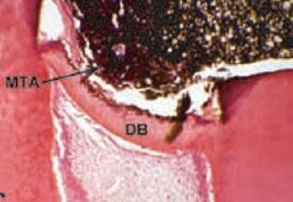
Mineral Trioxide Aggregate Pulpotomy
ZOe or glass ionomer cement is placed gently over the MTA and allowed to set
It takes several hours to reach its optimum physical strength, once its set the cavity is restored with permanent restoration
pulp tissue responses to MTA to be superior to those produced using Ca(OH)2

Slide 18
Electrosurgical Pulpotomy
large sterile cotton pellets are placed in contact with the pulp, and pressure is applied to obtain hemostasis
The Hyfrecator Plus 7-797 - set at 40% power (high at 12 W)
The cotton pellets are quickly removed, and the electrode is placed 1 to 2 mm above the pulpal stump
Heat and electrical transfer are minimized by keeping the electrode as far away from the pulpal stump and tooth structure as possible while still allowing electric arcing to occur.
may be repeated up to a maximum of three times
dry and completely blackened
ZOE applied and restored as earlier

Slide 19

Electrosurgical Pulpotomy
coagulation, or electrofulguration can occur
carbonizes and denatures pulp tissue, producing a layer of coagulative necrosis.
acts as a barrier between the lining material and healthy pulp tissue below
produced results comparable to those found with the use of formocresol

Slide 20
Laser Pulpotomy
carbon dioxide laser for performing vital pulpotomies on primary teeth
viable alternative to formocresol
the carbon dioxide laser appeared to compare favorably with formocresol treatment
Clinical trials still under way

Slide 21
PARTIAL PULPOTOMY
Cvek pulpotomy
the surgical removal of a small portion of the coronal portion of a vital pulp as a means of preserving the remaining coronal and radicular pulp
expose deeper, healthy coronal pulp tissue
Direct pulp capping and partial pulpotomy are considered similar procedures and differ only in the amount of undestroyed tissue remaining after treatmen

Slide 22
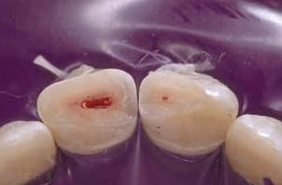
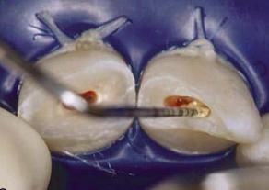
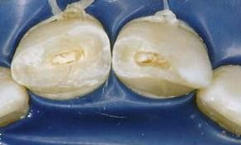
Partial pulpotomy
immature teeth which have been subject to pulp exposing trauma
1- to 2-mm deep cavity is prepared into the pulp, using a high-speed handpiece with a sterile diamond bur of appropriate size with copious water coolant
pulp is amputated deeper until only moderate hemorrhage is seen
5% sodium hypochlorite (NaOCl; bleach) has been recommended - chemical amputation of the blood coagulum,
remove damaged pulp cells, dentin chips, and other debris, and provides hemorrhage c_{f}o_{ace}n_{bo}t_{o}r_{k.}o_{com}l _{/notesdental}

Slide 23
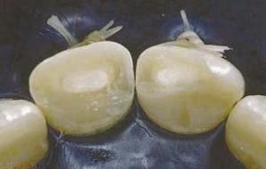
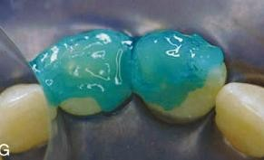
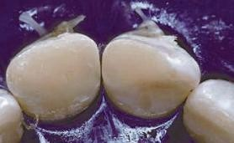
Partial Pulpotomy
Care must be taken not to allow a blood clot to develop
Thin layer of pure calcium hydroxide is mixed with sterile saline or anesthetic solution to a thick mix and carefully placed onto the pulp stump
Alternatively MTA can be used.
Cavity preparation is filled with GIC.
Exposed dentin is acid-etched
Composite is applied

Slide 24
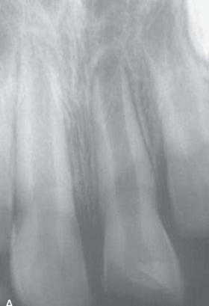
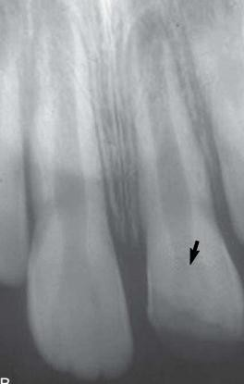
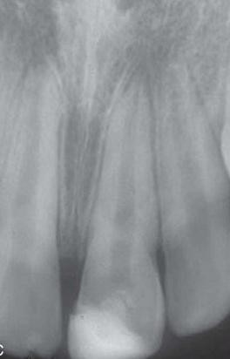
Follow up
Evidence of maintenance of responses to sensitivity tests
radiographic evidence of continued root development
  pre-op b) peri-op c) 6 months post-op

