Slide 1

GOOD MORNING

Slide 2
PULPECTOMY- Part 2
Dr Pallavi Vashisth

Slide 3

Biomechanical Preparation

Slide 4
“What you remove from the root canals, is more important than what you place back………”
- Old axiom in Endodontics

Slide 5
Principles
Apex –enlarged three times the size of the first binding instrument
Periodic recapitulation
Instru quarter to half turn and withdrawn with pull stroke
Barbed broaches – with caution
Rubber stops
Instrumentation in wet canal
Debris not forced to PA area
Avoid trauma to PA area
Notes:
Direct straight line access
Length accurately determined
Sequential hand instrumentation with periodic recapitulation
Instru with quarter to half turn and withdrawn with pull stroke
Barbed broaches – with caution
Rubber stops
Apex –enlarged three times the size of the first binding instrument
Instrumentation in wet canal
Debris not forced to PA area
Avoid trauma to PA area

Slide 6
In primary teeth………
H files widely used compared to K files
Crown down preparation
Canals enlarged to size 35 or 40
Cleaning the canals—utmost importance as against shaping
Shaping done on canal walls away from furcation
Zipping & perforation common

Slide 7

TYPES OF ENDODONTIC IRRIGANTS:
Sodium hypochlorite.
Hydrogen peroxide.
Chelating Agents:
# EDTA
# RC Prep
Acid cleansers:
2% potentiated acid.
# Phosphoric acid.
# Lactic acid.
# Citric acid.
# Tannic acid.
Saline / Water.
Anesthetic solution.
Glyoxide.
Chlorhexidine gluconate.
Notes:
Salvizol
Is a chelating agent containing N,N decamethylene -Bis - Aminoquinaldinium diacetate .
Has a broad antimicrobial spectrum and yet a low general toxicity.
Salvizol has a low surface tension and aids in the removal of smear layer .
It is active against most gram +ve and -ve micro-organisms, fungi and thus is a suitable non-specific potential root canal antiseptic ..

Slide 8
Obturation

Slide 9
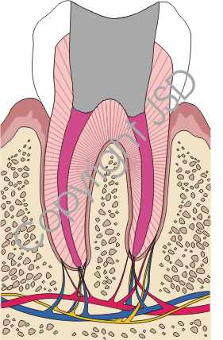
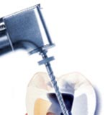
Obturation
Aim
  Recontamination of the root canal- coronally / apically
  Isolate and neutralize any residual bacteria
  Should assure complete filling of the canal without overfill and with minimal number of voids Guelmann et al 2004
Notes:
Ideal Filling Technique

Slide 10
Criteria For Ideal Root Canal Filling Material
Castagnola et al, Rifkin 1980
Resorbable
Antiseptic
Harmless to adjacent tooth germ
Radio opaque
Does not set to a hard mass-deflect succedaneous teeth
Easily inserted
Easily removed if necessary
Induce vital PA tissue to seal canal with calcified tissue
Non inflammatory
Not discolour tooth
Non water soluble

Slide 11
Obturating Materials

Slide 12
Zinc oxide eugenol
Calcium Hydroxide
Walkoff Paste
KRI paste
Maisto’s paste
Vitapex/Metapex
Endoflas
Gutta percha points / silver points contraindicated for primary teeth

Slide 13
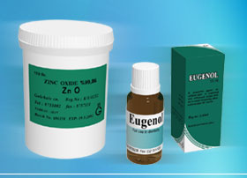
Zinc Oxide Eugenol
Bonastre (1837)
Dentistry-Chisholm(1876)
Composition
  Powder
    Zinc oxide 42%
    Staybelite resin 27%
    Bismuth carbonate 15%
    Barium sulphate 15%
    Sodium borate 1%
  Liquid
    Eugenol
Notes:
Resorbable
Radioopaque
Most popular today

Slide 14
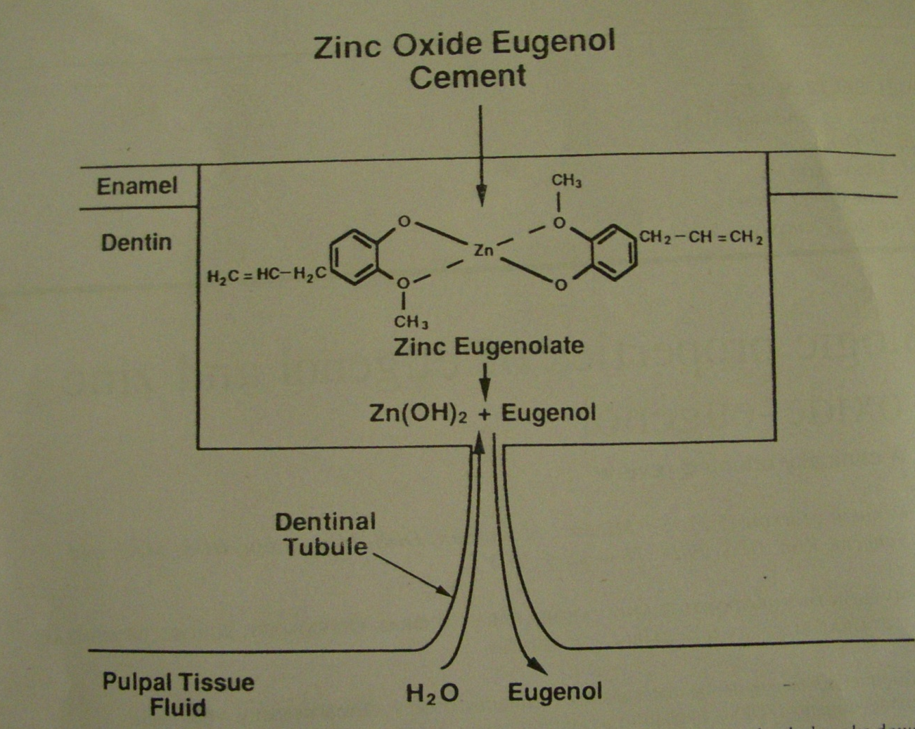
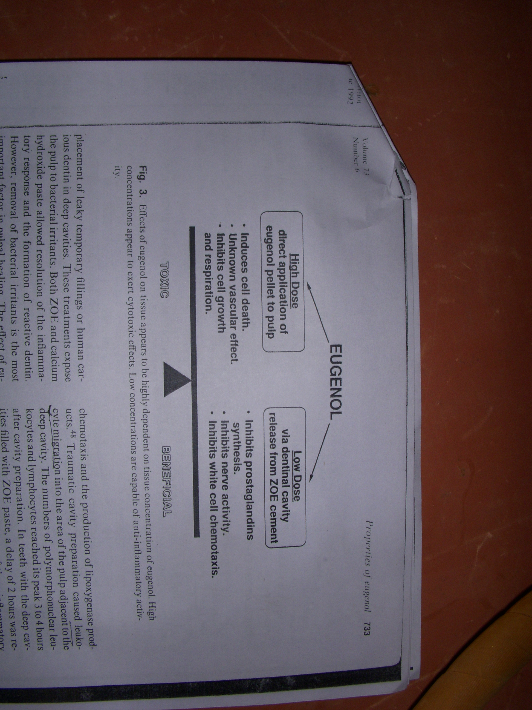
Biological properties of ZOE
Notes:
Eugenol is found in oil of clove and is primarily used to add spice in the foods wnen it is mixed with zinc oxide a chelation reaction occurs and inc eugenolate is formed which are held together by vander waals forces which are weak forces and make the cement machanically weak. When exposed to aqueous media like saliva and dentinal fluid hydrolysis of the cement occurs yeilding eugenol & Zinc hydroxide. this eugenol which is liberated can diffuse through dentin and perirad area.in a relative dry env. Free Eugenol is released slowly in contrast when it is used for obturation Zoe lies in direct contact with healthy or inflammed tissues.this type of wet interface allows release of large amount of eugenol into the periapical tissues in short duration of time.at higher conc eugenol can cause cyto toxic effects. Thus the effect of eugenol on apical tissue is dependent on the distance from yhe source

Slide 15
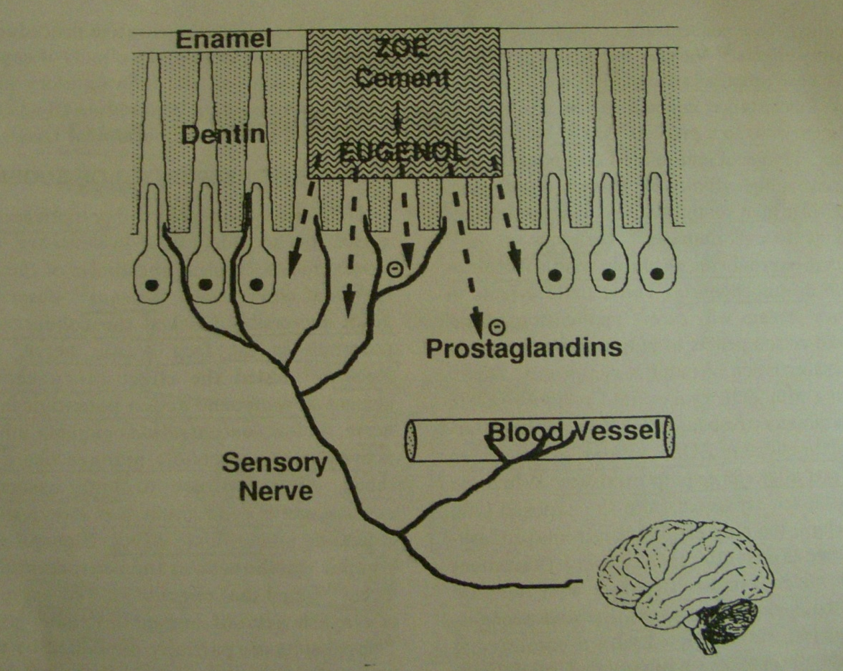
Benificial effects
Antibacterial
Decrease pain perception
Resolves periapical inflamm.& prevent bone resorption – PGE2
Notes:
Eugenol in addition to b antibacterial may also have other benificial effects
The fibroblasts in the periapical area are known to synthesize prostaglandins especially PGE2 which then stimulates osteoclasts to cause bone resorption. Eugenol is known to cause inhibition of prostaglandins & leucotrienes which assist in resolution of periapical inflammation.

Slide 16
Calcium Hydroxide
Herman 1930
Stimulates dentin formation - apexogenesis & apexification
Resorption ability of the material --alternative
Internal root resorption
Well tolerated periapically, causing some degree of apical hard tissue deposition
Intracanal medicament
Notes:
Herman 1930
Stimulates dentin formation when contacts pulp tissue
Used mainly for apexogenesis & apexification
Earlier, use limited to nonvital apexification in permanent teeth
Resorption ability of the material --alternative for primary teeth root canal filling
Internal root resorption
Well tolerated periapically, causing some degree of apical hard tissue deposition
Mainly serves as an intracanal medicam Earlier, its use in pulpectomies was limited to nonvital apexification techniques in permanent teeth. This technique, termed the Frank technique, used calcium hydroxide and camphorated monochloroparaphenol. Its use in treating nonvital primary teeth in dogs exhibited less inflammation, less pathologic root resorption, and more hard tissue apposition than ZOE and control-treated teeth. Calcium hydroxide was generally not used in pulp therapy for primary teeth, due to the frequent occurrence of internal root resorption.33
Not used in pulp therapy for primary teeth, due to the frequent occurrence of
Calcium hydroxide (Ca(OH)2) was also stated to be well tolerated periapically, causing some degree of apical hard tissue deposition. Because of the resorption ability of the material, it can be an alternative for primary teeth root canal filling

Slide 17
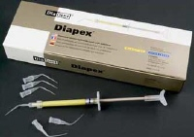
KRI Paste (Iodoform Paste)
Composition
Iodoform – 80.8%
Camphor – 4.86%
Parachlorophenol – 2.02%
Menthol – 1.2%
Barker 1971 – dogs
Rifkin- penetrates tissues & controls infection –
antibacterial
Highly resorbable, bactericidal, healthy tissue growth at apex
Smooth viscous material – spun in with lentulospiral / injected with pressure syringe
Notes:
Dogs and found that it resorbs in 1-2 weeks

Slide 18
Advantages
Bactericidal
Resorbs from the apical tissues
Resorbs in synchrony with root
Harmless to permanent tooth germs
Radio opaque
Does not set to a hard mass
Easily inserted and removed
Disadvantage
Rapid resorption from canals caused voids -- microleakage
Notes:
Therefore overfilling does not has any effect on success of the treatment.

Slide 19
Maisto Paste
Zinc-oxide 14g
Iodoform 42g
Thymol 2g
Chlorophenol Camphor 3cc
Lanolin 0.50 g
Notes:
It is also Used successfully in treatment of infected primary teeth

Slide 20
(JISPPD 1996)
REDDY VVS & FERNANDES
  Maistos paste -100%
  ZOE – 80%
Bone regeneration
  Maistos paste - 93%
  ZOE - 26.7%
Mass & Zilberman
  Modification of Maisto’s paste – ZnO reagent
  Successful in badly infected molars
  Furcation bone loss
  Fast resorption
Notes:
Evaluated clinically and radiographically ZOE & Maistos paste in infected primary teeth –9 months Maistos paste –complete resorption
Zoe sets in hard mass –no resorption

Slide 21
Holan and Fuks
Clinically & Radiographically - KRI paste & ZOE in human primary molars after 48 months postoperatively.
  84% - Kri paste group
  65% - ZOE group
Kri paste almost twice as successful in prim molars as ZOE
Overfills
  Kri paste - 79% success Vs 41% success with ZOE
Iodoform -potential advantage over ZOE
Notes:
Holan and Fuks clinically and radiographically compared Kri paste with ZOE in human primary molars after 48 months postoperatively. They found overall success rates of 84% with the Kri paste group versus 65% with the ZOE group. Kri paste was almost twice as successful
in primary first molars as ZOE. However, no significant differences between these two agents occurred in primary second molars. Overfills with Kri paste resulted in 79% success versus 41% success with ZOE. They concluded that iodoform-containing paste had a potential advantage over ZOE in the pulpectomy procedure for primary teeth

Slide 22
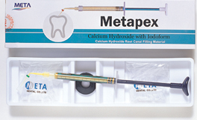
Vitapex / Metapex
Iodoform - 40.4%
Calcium hydroxide - 30.3%
Silicone - 22.4%
In Japan, U.S.A - good clinical and radiographic results
Mortazavi & Mesbahi (2004)
  Vitapex - 100%
  ZOE - 78.5%

Slide 23
Endoflas
Vitapex + ZOE
Powder
  Tri iodomethane
  ZNO
  CH
  Barium sulfate
  Iodine di butyl orthocresol
Liquid
  Eugenol
  MCP
Merkovitz 2005 – high success in primary molars
Fuks -2002 under filled 83% success : overfilled-58%
Notes:
Resorbable

Slide 24
PROPERTIES | ZOE | Ca[OH]₂ with Iodoform [VITAPEX] | KRI paste
1. Resorbs at the same rate as the tooth.
2. Harmless | Y | Y | Y
3. Overfill resorbs |  | Y | Y
4. Antiseptic | Y | Y | Y
5. Easily applied |  | Y | Y
6. Adheres to the wall | Y | Y | Y
7. Easily removed |  | Y | Y
8. Radiopaque | Y | Y | Y
9. No discolouration | Y | Y | Y

Slide 25
Pulpectomy techniques

Slide 26
Pulpectomy Techniques
Groter (1967) - avoid use of instruments
Spedding (1973) - instruments used
Garcia-Godoy (1987) - enlarge canals only to the level of occlusal plane of permanent tooth germ
Flaitz et al (1989) -1mm short of apex
Yacobi et al (1991) - minimal biomechanical cleansing

Slide 27
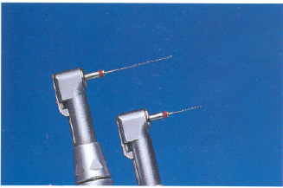
Methods of Obturation
Endodontic Pressure syringe
  developed Greenberg (1963)
  described Spedding and Krakow et al (1965)
Mechanical syringe (Greenberg 1971)
Tuberculin syringe (Aylord & Johnson1987)
Jiffy tube (Rifficin 1980)
Incremental filling technique- using endodontic plugger and putty mix of ZOE in increments (Gould 1972)
Lentulospiral technique (Kopel 1970)
Paper points, amalgam pluggers
Notes:
Endo pressure….A needle that binds the approx 1mm short of the apex is used ,filling material is mixed to obtain a heavy putty like consistency the hub of the needle is loaded with the paste and threaded with syringe barrel and with a slow motion needle is withdrawn until the canal is visibly filled at the orifice.
Mechanical syringe….here Znoe was loaded into the syringe and expressed into the canal with a continuous pressure with a 30 gauge needle while withdrawing it.
Tubberculin syringe… Zoe was back-loaded in a26g syringe 3/8th inch needle and material was expressed into the canal untill it was visibly filled
Jiffy tubes.. Zoe was back-loaded into the tube and was expressed into the canal by slow finger pressure on the plunger until it was visibly filled
Incremental filling…..an endodontic plugger corosponding to the size of the canal with a rubber stop is used to place a thick mix of cement in to the canal.thick mix was prepared into flame shape corrosponding to size and shape of the canal and then tapped gently into the apical area with the help of a plugger.
Lentulospiral…here a lentulospiral is dipped into a cement mixture and then introduced into the canal to its pre determined length and rotated. Additional paste is added to the canal till it is filled
Other techniques which utilize paper…….. Have also been advocated by various authors but lentulospirals mounted on a slow rotating hand piece are commonly used these days.

Slide 28
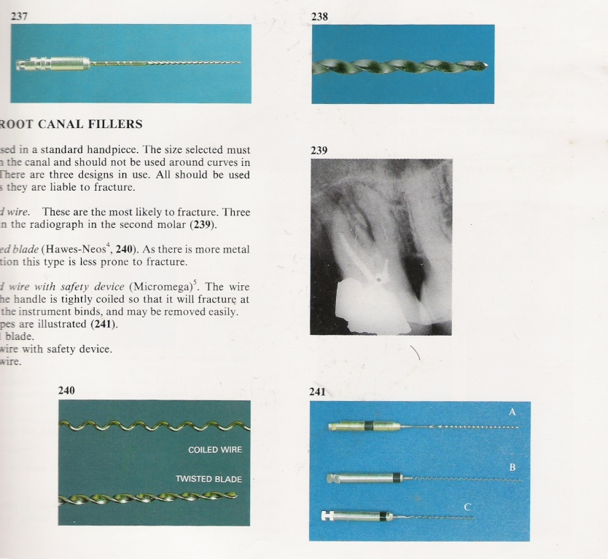
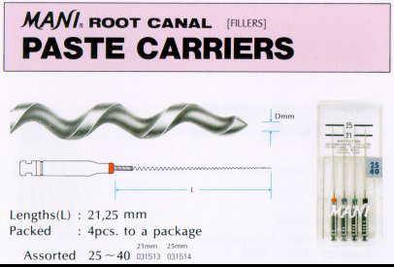
Lentulospirals
Must fit loosely
3 types
  Coiled
  Twisted blades
  Coiled with safety device
Notes:
THESE ARE USED IN A STANDARD HANDPIECE.the selected size must loosely fit in the canal and shud not b used around curves in the canal as they r liable to fracture.3 designs r commonly used. The coiled ones r more likely to fracture and twisted as thr is more metal cross section is less prone to fracture. 3rd type – the coil nearest to the handle is tightly coiled so that it will fracture at this point if instrument binds.

Slide 29
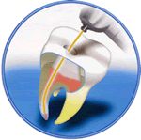
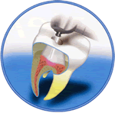
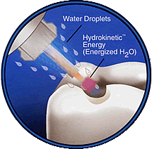
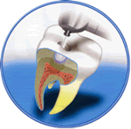
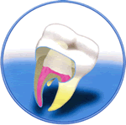
Laser Pulpectomy
. Pulpectomy
Access Preparations
Enlargements and Shaping
Obturation &
Restoration Placement
Notes:
Safe and Cool cutting
With water energy Waterlase™ uses the Hydrokinetic™ process which gently washes away decay with laser-energized water droplets. Hydrokinetic™ energy is produced by combining a spray of atomized water with laser energy. The resulting Waterlase™ (Hydrokinetic™) energy gently and precisely removes a wide range of human tissue including tooth enamel (the hardest substance in the body), and soft tissue (gum tissue) with no heat or discomfort in most cases.
Benifits
Superior intra-operative and post-operative patient comfort
Reduced post-operative complications such as inflammation, swelling and pain
Versatile and effective for root canal preparation
No vibration and pressure as found with conventional instruments
Little or no anesthesia
More healthy tooth structure is preserved

Slide 30
Pulpectomy Techniques
One- stage- single -visit Pulpectomy
Two -stage –two- visit Pulpectomy

Slide 31
Indication For Single Visit
Presence of inflammed but vital radicular pulp
An asymptomatic primary tooth with without any acute symptoms such as cellulitis

Slide 32
Indication for two visit
Presence of an acute abscess with or without associated cellulitis, necrotic pulp.
Presence of active and persistent discharge from root canals

Slide 33
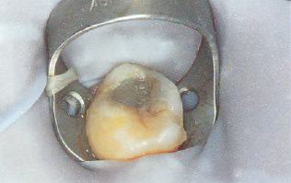
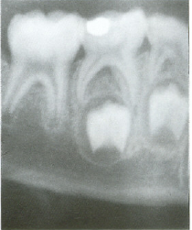
Isolation

Slide 34
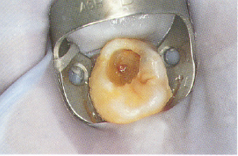
Remove Caries And Identify Exposure Site

Slide 35
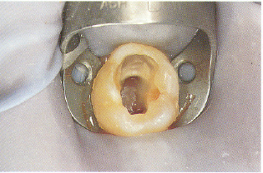
Remove Roof Of Pulp Chamber And Identify Opening Of Canals

Slide 36
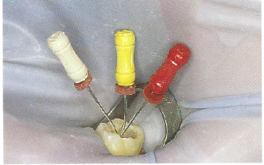
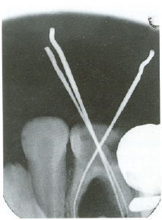
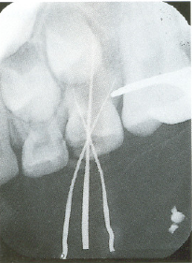
Diagnostic Radiograph With Files

Slide 37
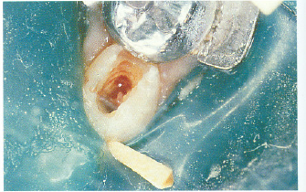
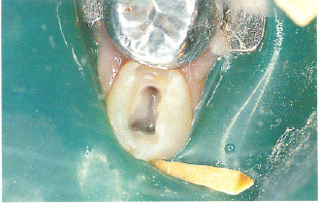
Debridement of Root canals and Irrigate

Slide 38
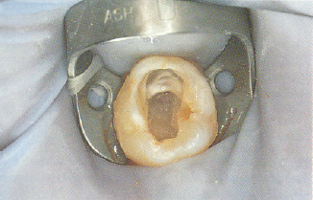
Dry with paper points

Slide 39
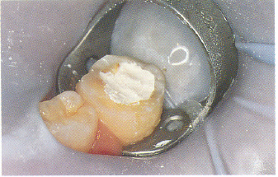
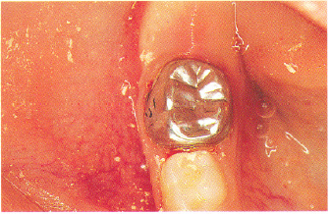
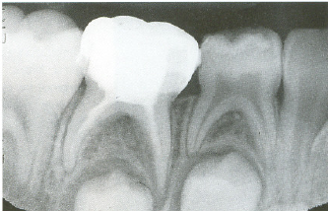
Fill Pulp Chamber With Cement &
Restore With SSC

Slide 40
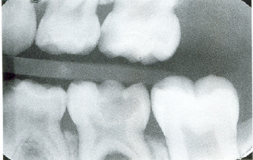
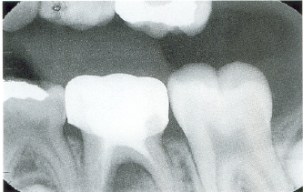
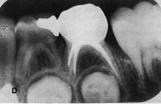
Pre-op & post op

