Slide 1

GOOD MORNING

Slide 2
PULPECTOMY
Dr Pallavi Vashisth

Slide 3
OBJECTIVES
Need for Pulpectomy
Instruments, Procedure, materials
Multi & single – visit

Slide 4
Pulp Therapy in Pediatric Dentistry
  Mesial drift
  Aid in mastication.
  Absence of a succedaneous tooth.
  Speech problems.
  Esthetics.
  Aberrant tongue habits
  Psychological effects
  Maintain normal eruption time of the succedaneous teeth.
Notes:
Reduce the likelihood of mesial drift and the resultant malocclusion.
Aid in mastication.
Preserve a pulpally involved primary tooth in the absence of a succedaneous tooth.
Prevent possible speech problems.
Maintain esthetics.
Prevent aberrant tongue habits
Prevent the psychological effects associated with early tooth loss.
Maintain normal eruption time of the succedaneous teeth.

Slide 5
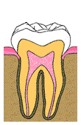
What is ………pulpectomy???
….the extirpation of the vital pulp, normal or abnormal followed by sterilization and filling of the root canal.
….complete removal of the necrotic pulp from the root canals and the coronal portion of the dental primary teeth in order to maintain the tooth in the dental arch.
….the removal of all pulpal tissue from the coronal and radicular portions of the tooth.
Complete removal of pulp tissue followed
by filling the root canals with resorbable cement

Slide 6
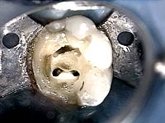
Rationale
Treatment Objectives
Maintain tooth free of infection
Biomechanically cleanse & obturate root canals
Promote physiologic root resorption
Hold space for the erupting perm tooth
Notes:
To gain access to the root canals
To remove as much as dead and infected material as possible
Fill root canals with a suitable material to maintain primary tooth in a non-infected
ingle
Goal:
Eliminate infection and maintain tooth in a functional state until it is normally exfoliated , without endangering the perm dentition or health of the child.

Slide 7
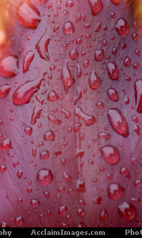
Indications
&
Contraindications

Slide 8
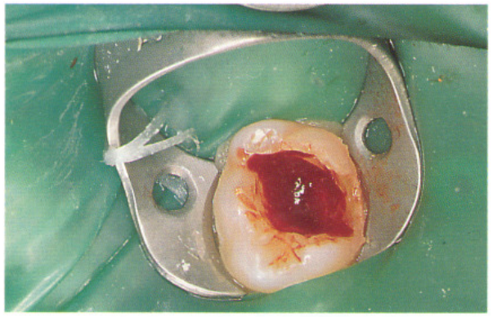
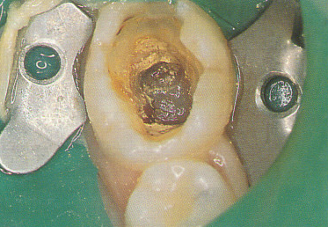
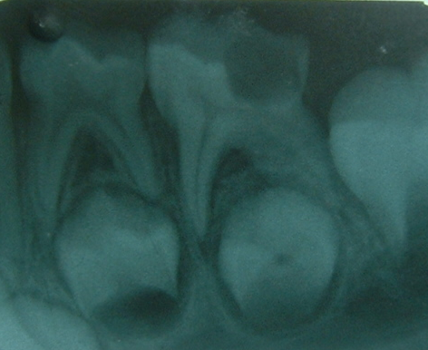
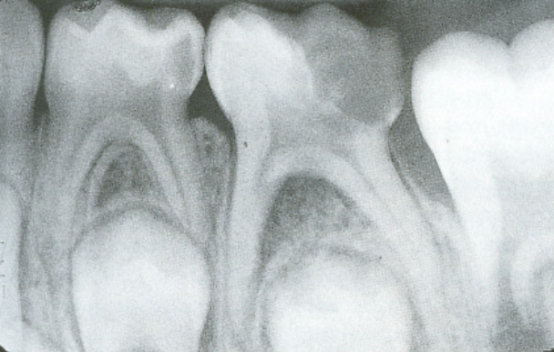
Major Indications…
Primary teeth with pulpal inflammation extending beyond the coronal pulp but with roots and alveolar bone free of pathologic resorption
Primary teeth with necrotic pulps, minimum root resorption, and minimum bony destruction in bifurcation area
Notes:
After removal of the coronal pulp. The haemorrhage from the root canal tissue should be pale red and easy to control. Extensive and persistent bleeding even after four minute application of formocresol implies irreversible inflammation of the radicular tissue. and is an indication for a pulpectomy.
Sometimes patients present with carious, asymptomatic primary teeth that, on accessing the pulp chamber, are found to be pulpless with necrotic pulps. as shown in the photograph. A pulpectomy should be carried out on such teeth.

Slide 9
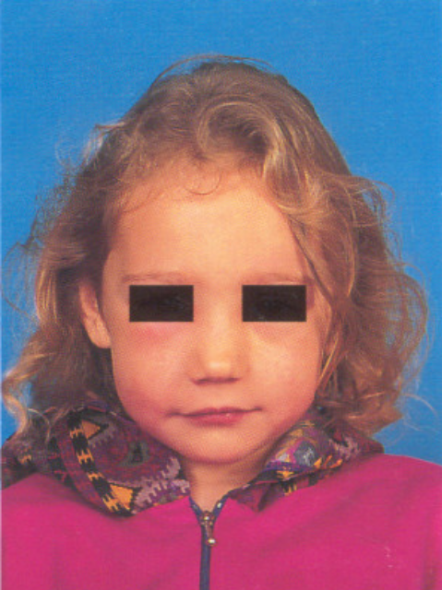
Presence of an abscess
Notes:
Infection in primary teeth usually manifests in the bi/trifurcation region, as opposed to the periapical pathology usually seen in permanent molars. This is because many fine channels of communication exist between the pulp chamber and the bone in the furcation area. (b) illustrates this point in an extracted primary molar. Note granulation tissue from the abscess in the bifurcation.
The presence of a chronic, draining sinus (a) or an acute abscess with or without an associated cellulitis (b) is also an indication for a pulpectomy.

Slide 10
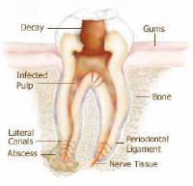
Other Indications….
Teeth with poor chance of vital pulp treatment
Strategic importance for space maintenance
Absence of surrounding bone loss from infection
Pulpless primary teeth
  without permanent successors
  in hemophiliacs
  anterior teeth when speech, crowded arches, or esthetics are a factor
  when space maintainers or continued supervision are not feasible (handicapped or isolated children)
Pulpless primary molars
  supporting orthodontic appliances
  when arch length is deficient
  second molars before eruption of perm
  first molar

Slide 11
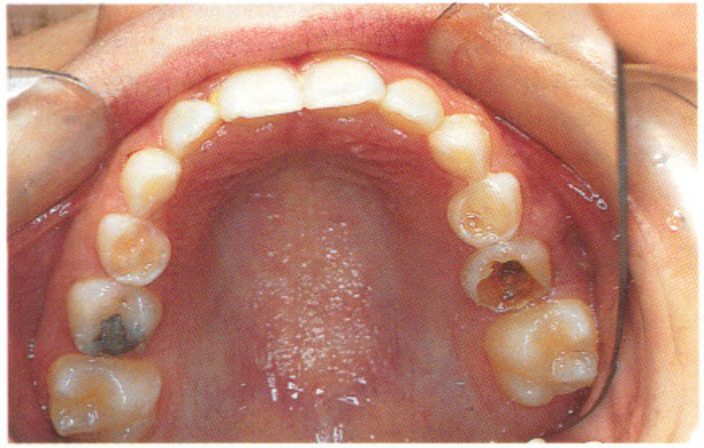
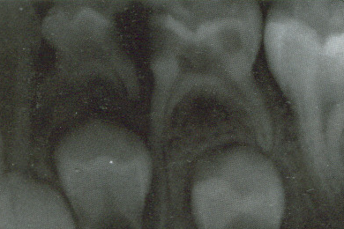
Major Contraindications…
Unrestorable crown
Advanced pathological root resorption
Notes:
invaded

Slide 12
Other Contraindications…
Periradicular involvement extending to the permanent tooth bud
Pathologic resorption of at least 1/3rd of root with a fistulous sinus tract, underlying dentigerous or follicular cysts
Excessive internal resorption
Extensive pulp floor opening into bifurcation
Communication b/w oral cavity & furcation area

Slide 13
Medical contraindications
Heart disease
  a child with a heart defect, or any history of heart disease, heart surgery, rheumatic fever etc.
Immuno-compromised children
  malignant disease (e.g. leukaemia)
  neutropenic for considerable periods
Systemic illness like hepatitis & children on long-term corticosteroid therapy
Notes:
Medical contra;ndicat;ons
.Heart disease: a pulpotomy should not be performed in a child with a heart defect, or if there is any history of heart disease, heart surgery, rheumatic fever etc. This is because these children are at risk of developing bacterial endocarditis from any invasive procedures.
Immuno-compromised children, such as those with malignant disease (e.g. leukaemia) who are neutropenic for considerable periods during the treatment of the condition. Even a low grade infection such as that from an unsuccessful pulpotomy can make such children seriously ill,and therefore should not be undertaken.

Slide 14
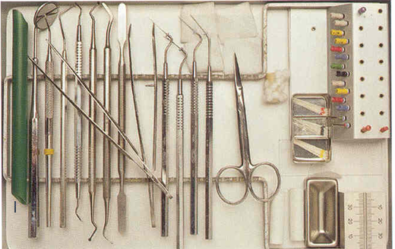
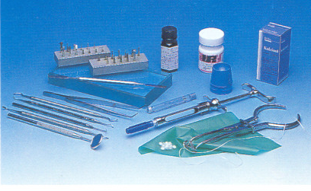
Armamentarium

Slide 15
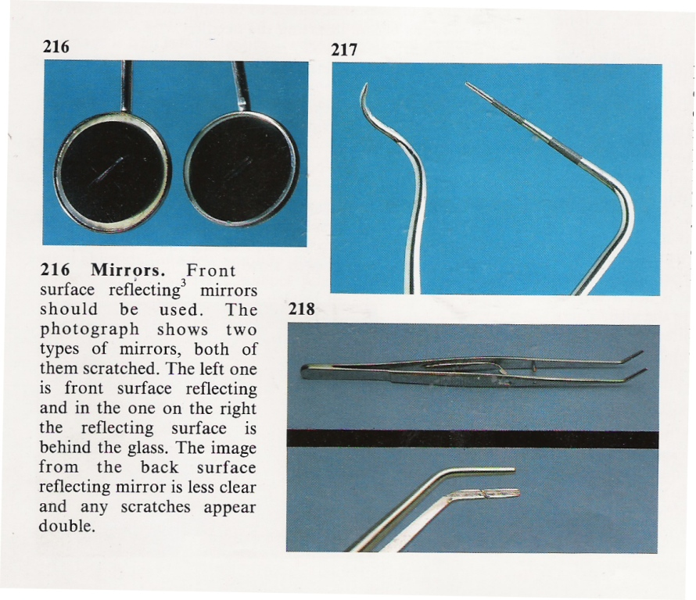
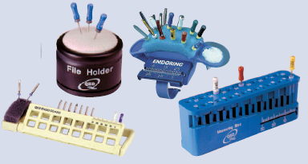
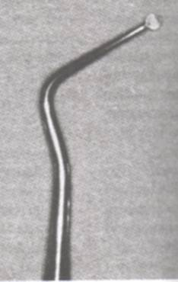
Instrument Pack
Front surface reflecting mouth mirror
Endo locking tweezers
Probes/Explorers
Excavators
Endo ring
Miscellaneous
Notes:
HAND INSTRUMENTS FOR ENDODONTICS (INSTRUMENT PACK)
A basic pack of instruments must be available specifically for routine root canal procedures.
A front surface reflecting mouth mirror is preferable to prevent the double image of the fine detail in an access cavity that occurs with a conventional mirror.
Endolocking tweezers allow small items to be gripped safely and passed between nurse and operator.te tip of the beak should be blunt and containing grooves. They are important for four handed transference between operator and the assistant. The regular Perry or College Plier is also required for working inside the pulp chamber because the working ends of the “Points Pliers” are often too large.
A D-5(cohen 9) explorer , No 23-16 (Grossman), DG16 endodontic probe is required to detect canal orifices. The endodontic explorer has two straight very sharp ends that are angled in different directions form the long axis of the instruments. It has a right angled and a binagled end. A CK-17 explorer serves the same purpose, but its thinner stiffer tip can be used to identify calcified orifices. A #17 operative explorer can be used to detect any pulp chamber roof especially in area of pulp horn.
* NEW: a new addition to the finding and enlarging orifices, is the MICRO-OPENER with K type flutes, in 0.04 and 0.06 tapers, mounted like a spreader that can be used to uncover, enlarge and flare the orifices. This is followed by the MICRO – DEBRIDER with H file type flutes, and ISO 0.02 taper to further open and flare down the canal.
The excavator is long shanked, with a small blade to allow access into the pulp chamber. They have a much longer offset from long axis of the instruments(for better reach inside the constricted canal chambers) than the regular spoons. They are used to remove carious material and excise pulp tissue. , therefore they should be kept well sharpened.
The pocket-measuring probe is useful, a routine CPITN probe with clearly visible gradations is ideal.
A furcation probe is useful to check for the presence of furcation involvement.
Handy Endoring worn by dentist working alone.
Premeasured instruments are arranged in order in sterile, disposable
plastic sponge
Miscellaneous: Other items usually included are a flat plastic, sterile cotton wool rolls, sterile cotton wool pledgets, artery forceps to grip a periapical radiograph and a metal ruler, or other measuring device that may be sterilized.
A clean-stand or other device such as the endoring is required to hold the endodontic instruments.
Paper points are also required, and the simplest method of storage and use is to purchase presterilized packs with five points in each pack.
it is useful to have all endodontic instruments in sterilized containers, such as the clean stand or endodontic ring shown in Figure of file holders. This allows the instruments to be easily controlled, and accessed by both the operator and assistant during treatment.
Other Instruments required are :
Rubber dam kit
Radiographic equipment

Slide 16
Access Cavity Preparation

Slide 17
The access preparation
3 major objectives
Obtaining straight line access preparation
Conservation of tooth structure
Unroofing the chamber, followed by exposure and removal of pulp horns

Slide 18
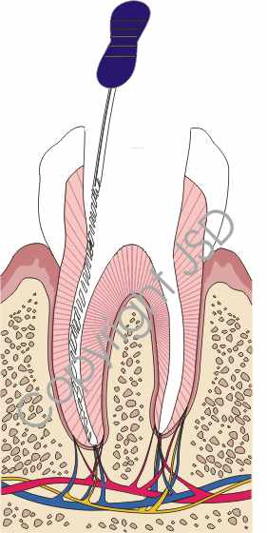
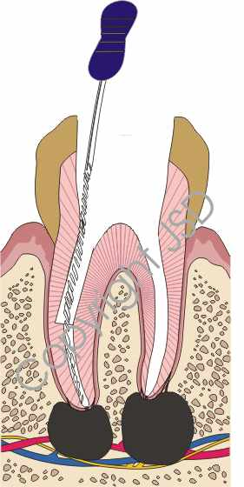
Need to obtain a straight access???
Notes:
Unroofing the chamber permits adequate access to the canals . St line access is the Most critical aspect
Eases introduction of instrument
Improves Obturation
Decreases procedural errors like ledges, perforations
Shape of access cavity shud b such that instruments r not deflected by access cavity walls as they r passed to the apex.

Slide 19
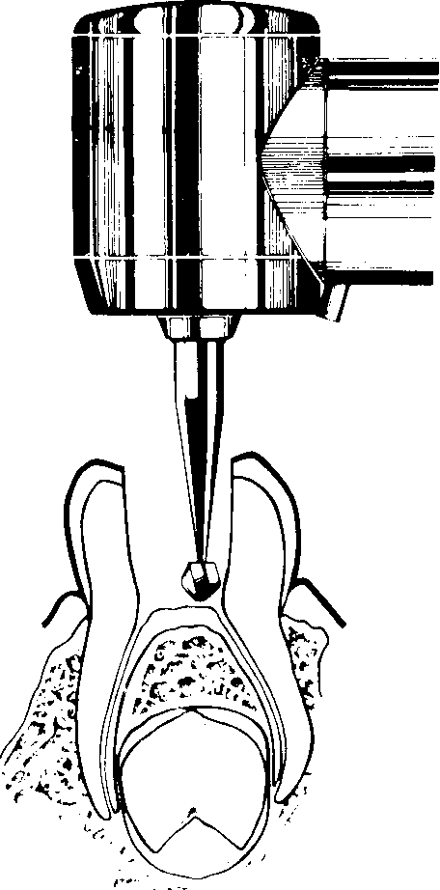
Imp diff b/w prim and perm teeth
Length and shape of crowns
Dentinal wall at pulpal floor and root
Depth ,distance from occlusal surface
Notes:
Length and bulbous shape of crowns
Very thin dentinal wall at pulpal floor and root
Depth necessary to penetrate into pulp chamber - quite less than in perm teeth
Distance from occlusal surface to pulp floor of pulp chamber -- much less than in perm teeth
Avoid perforation

Slide 20
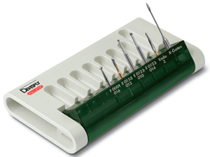
Access Cavity Instruments

Slide 21
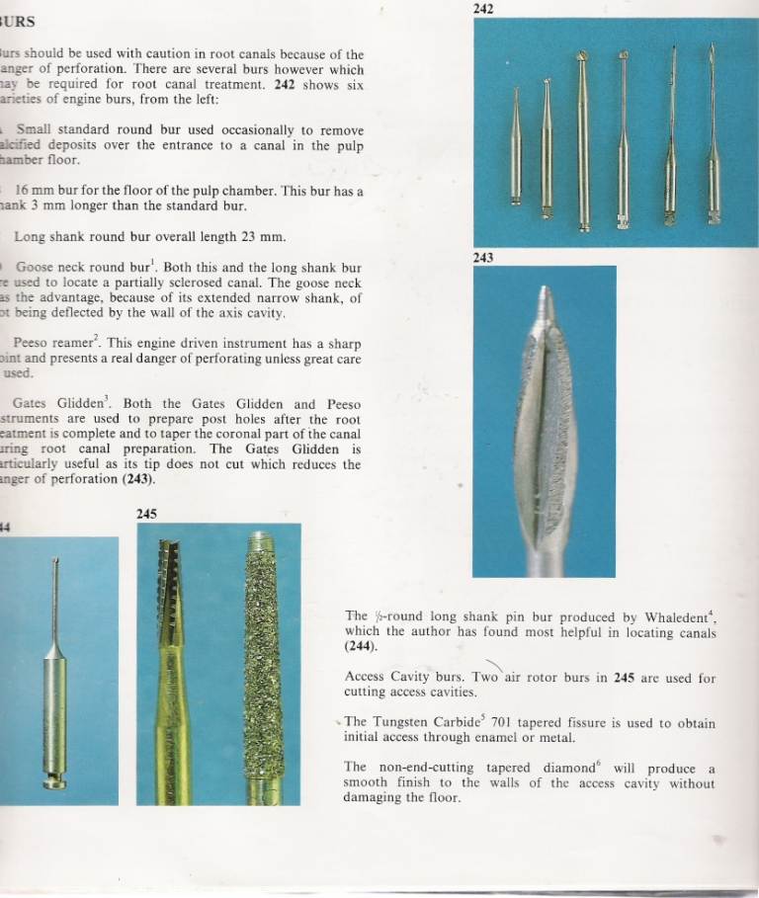
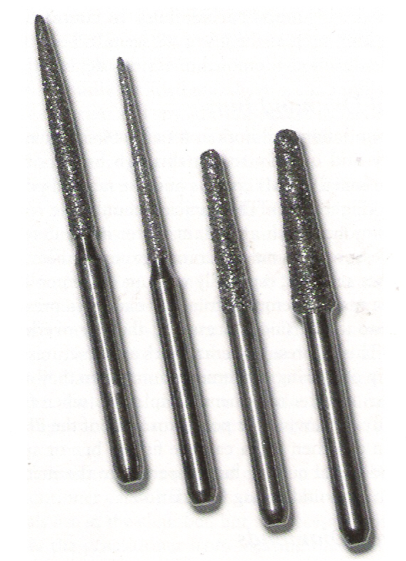

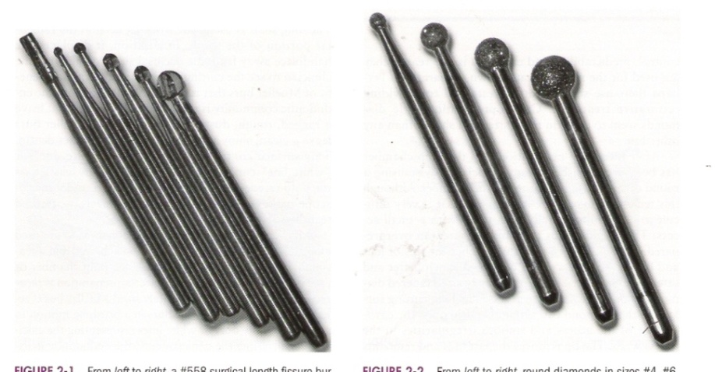
Round carbide burs
Fissure carbide burs
Tapered diamond burs
  ENDO ACCESS BUR
Notes:
HANDPIECES:
High speed handpiece: for penetration of dentin
Slow speed handpiece: increased tactile awareness , for removal of pulp chamber roof
Ultrasonics: for constricted/receded and calcified chambers
BURS:
Round carbide burs (# 2, 4, 6, 8): remove caries (better control than fissure carbides), create initial external outline shape, penetrate the roof, removal of the roof. These are: (Messing)
Standard bur: for removing calcified deposits at entrance of canal at pulp floor
16 mm bur for floor of pulp chamber: Shank is 3 mm longer than standard bur
Long shank round bur: Overall length is 23 mm
Goose neck round bur : for locating sclerosed canals, extended narrow shank does not get deflected by the wall of access cavity
Fissure carbides (#558, #57) : produce less “chatter” when penetrating intact enamel or dentin as compared to round carbides. Also for extension of the axial walls.
Tapered diamonds: a round carbide may result in uneven gouged walls when used to finish the unroofing of the pulp chamber. The long cutting surface of the diamond can open the cavosurface of the access and smoothen the walls. The tapered rounded end diamond is also used (Endo access bur: Is a friction grip, stainless steel bur with special diamond coated round tip that matches round burs of size No. 2, No.4 and No 6 with a diamond shaft for smoothening and shaping the access walls ,these burs are useful for initial and final access preparations . These burs combine both penetration and smoothening capabilities.)
However, both the carbide and diamond fissure burs can gouge the pulp floor and the walls if used improperly.

Slide 22
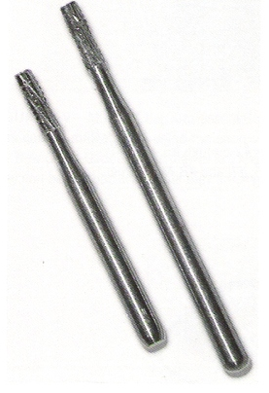
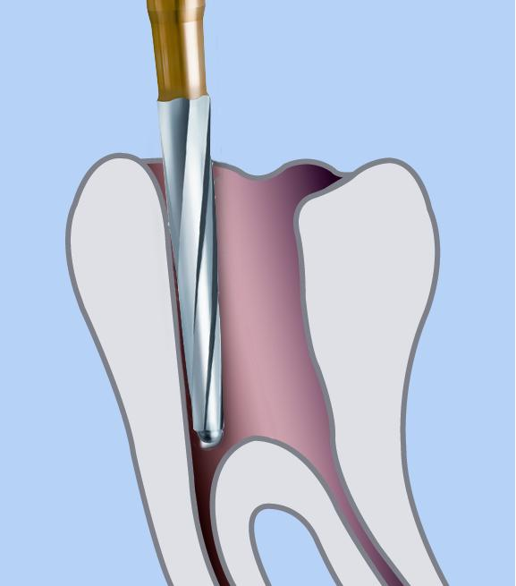

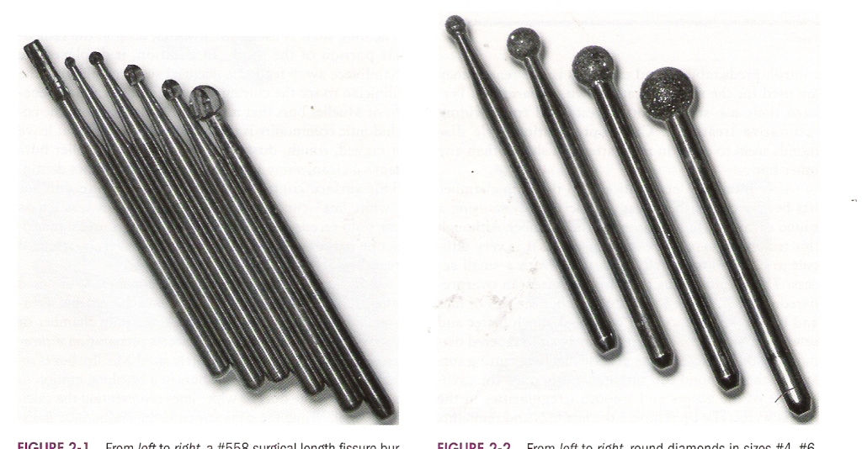
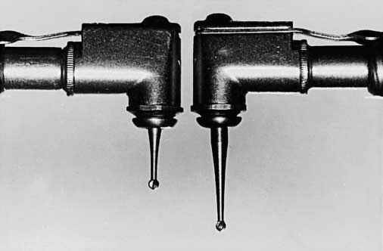
Fissure carbide & diamond with safety tips
Round diamond
Surgical length bur
Notes:
Fissure carbide and diamond with safety tips: safer choice for axial wall extensions .(ENDO Z BUR: A safe ended diamond or tungsten carbide bur, with a non cutting tip, is used to taper the access cavity preparations. The non cutting tip prevents gauging on the floor of pulp chambers and cavity walls)
Round diamonds (#4, 6): to cut through PFM and all porcelain crowns. Diamond burs are less traumatic to porcelain than carbides and are more likely to penetrate it without cracking or fracturing it.
After removing the porcelain, a carbide fissure bur of special metal cutting bur can be used to penetrate the metal.
Metal cutting burs: includes the Great White, Beaver bur, Transmetal bur (the bur has extra fine crosscuts ), Brassler H34L. They have round ended, cross cut design, that minimizes chatter. Used to penetrate metal restorations like amalgam, all metal cast restorations and metal copings of PFM’s.
Surgical length burs (round and fissure): increases the visibility of the cutting tip of the instrument by moving the head of the handpiece away from the tooth. Care should be taken when extended burs are used to prevent perforation. The regular-length bur on the left will reach 9 mm. The surgical-length bur will reach 14 mm.
Brasseler also manufactures latch-type, 34-mm-long round burs with standard shafts of 2.4-mm diameters. These are 4 mm longer than standard, 30-mm, surgical length, slow-speed round burs. These burs are available in sizes from No. 8 round down to 1/2-round. As manufactured, they have little use in troughing or deep-exploration operations, because the bulky shaft tends to impinge on the walls of the access cavity
Mueller Burs: long shaft , carbide tipped burs used in latch type handpiece. The 34 mm Muller bur is a right angle but similar in design and function to the LN bur. Its round bur, mounted on a long neck is available on six diameter sizes. Used for working deep in radicular part. It displaces the handpiece away and enhances visibility. They leave a clean shiny surface on the dentin unlike ultrasonics (which leave ragged, roug, debris filled , dusty areas). Used for calcified teeth. Used in brushing motion to search for white dots - Calcified canals without water and with the use of Stropko irrigator or air only syringe.
Disadv: 1) However, the shaft of the smallest Mueller bur is only ~0.5 mm in diameter, and as such, these bur shafts are excessively flexible during use. 2) Additionally, at a tip diameter of 0.8 mm, the smallest Mueller bur tip is just slightly smaller than the No. 2 round bur (0.9 mm). And very often, round burs of much smaller diameter are required for these delicate, deep operations.
LN burs: . It is a 1/2-round bur with a shaft diameter similar to that of the smallest Mueller burs (~0.55 mm). It is a right angled, tungsten steel half round bur mounted on along neck. The 28 mm length allows deep drilling alongside posts or broken instruments for easier removal and for locating small canal in the roots. However, because the narrowed portion of the LN bur shaft is only 8 mm long as compared to the narrowed portion of the Mueller bur, which is 15 mm long, the LN shaft is considerably stiffer. The overall length of the LN bur, however, is only 28 mm (Figure 3), and that renders it far less useful for troughing and deep exploration.
Multipurpose™ bur: The Maillefer Multi-Purpose Bur is a versatile instrument made from Tungsten Carbide. The bur is excellent for a variety of procedures including:
Initial endodontic access
Sectioning of impacted molars
Cutting of teeth at root level
Root separation and amputation of broken roots
Munce Discovery Bur: However, custom-modification of the shaft of the 34 mm round burs of 2.4 mm diameter at chairside (with a long carbide or diamond bur) down to ~1 mm in diameter preserves adequate shaft stiffness while providing relief from impingement on access cavity walls. They are 34mm-long narrow-shafted non-flexible tiny round carbide burs. The added length provides a functional view corridor beyond the handpiece head. Available in 4 head sizes (#1/2, #1, #2, #4) . ADV:
Uncover hidden canals
Provide positive control for deep troughing
Avoid the heat and fine dust of ultrasonic tips
Ultrasonics :

Slide 23
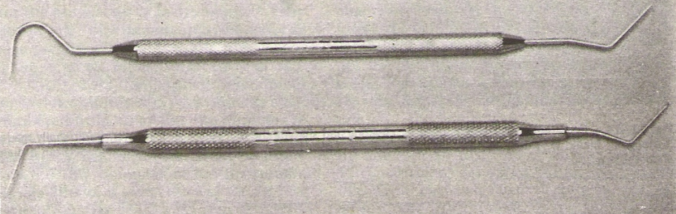
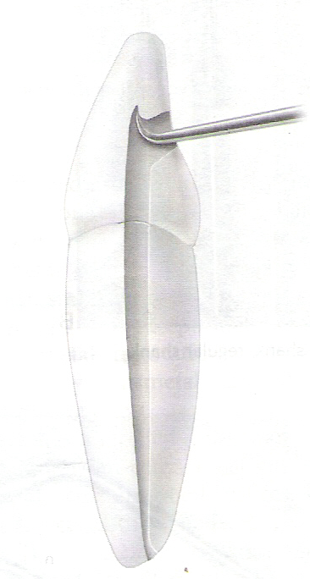
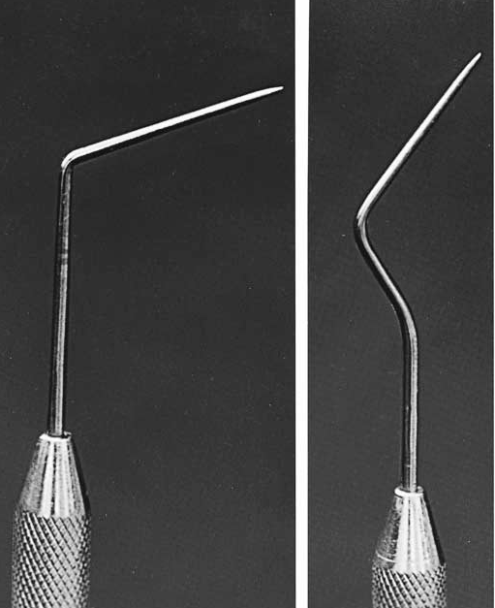
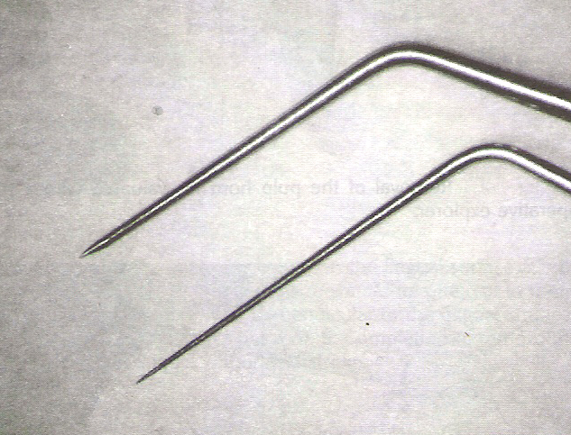
Exploration of the canal orifice
Endodontic Explorer
Explorer:
No. 23-16
DG 16
Explorer: CK 17
DG 16
Right angle Binangle
# 17 operative explorer
Notes:
Endo explorer has two straight very sharp ends that are angled in two different directions from the long axis of the instrument.

Slide 24

Curved path finder file
  Explore the walls
  Length or direction
  Establish tentative working length.
  Curvature of canal

Slide 25
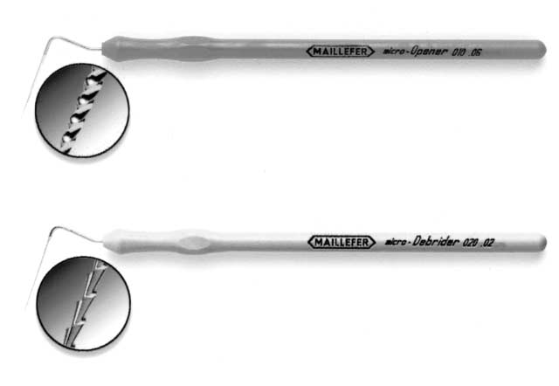
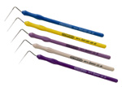
Micro opener & Debrider
Micro opener
  7 mm K type flutes
  # 10, 15, 0.04, 0.06 tapers
Micro debrider
  Hedstrom cutting configuration
  .02 taper, sizes #20, 30
  16mm cutting flutes
  For hard-to-reach, hard-to-visualize canals
Notes:
Ingle ch 10
new addition to finding and enlarging canal orifices is the Micro-Opener (Dentsply/Maillefer; Tulsa, Okla.) (Figure 10-44, A), with K-type flutes in 0.04 and 0.06 tapers, mounted like a spreader, that can be used to uncover, enlarge, and flare orifices. This can be followed
by the Micro-Debrider in ISO 0.02 taper, Hedstroem-type flutes (Figure 10-44, B) to further flaredown the canal.

Slide 26
Hand Instruments

Slide 27
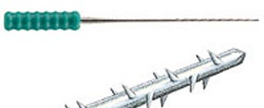
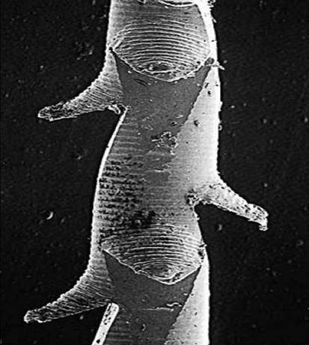
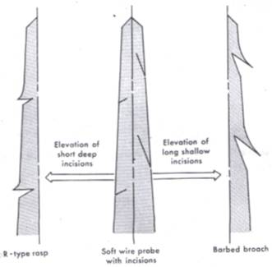
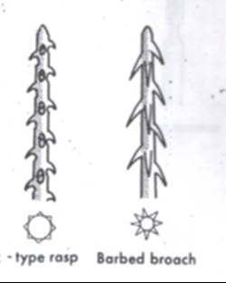
Barbed broaches
R-type Rasps
Probes
Applicators
Notes:
BARBED BROACHES & RASPS (ANSI 63)
Broaches and Rasps, probes and applicators are the older endodontic intra canal instruments still being manufactured. The broaches and rasps are designed to extract pulp tissue from the root canal by attaching to the pulp remnants. They have a different taper and length of the working portion than K or H files (length of working head: 10 mm)
Barbed broaches:
These are made from soft steel wire of varying diameters. The barbs are formed by cutting into the metal and forcing the cut portion away from the shaft such that barb faces towards the handle. The incisive cuts are a series of sharp pointed barbs along the operating head, curving backwards and obliquely. The cuts are made eccentrically around the shaft so that it is not excessively weak at one point. Clean a broach by scrubbing or dip in 5.25% NaOCl for 30 min.
Broaches are of two types:
Smooth: used to locate canals as a pathfinder (EG Pathfinder CS: made of carbon steel, so less likely to collapse when forced down the canal) . Also to explore patency of canal .However, it is now preferable to first remove the tissue bulk before placement of any instrument near the apex to avoid forcing any necrotic tissue beyond the apex. Thus, smooth broaches are rarely used today.
Barbed.: it was originally used for canal preparation. But due to ease of breakage, it is now used only for soft tissue removal.
Uses: Primarily used for removal of intact pulp tissue (especially that which is fibrous. It is difficult to remove an inflamed vital pulp as it results in further laceration of the tissues). Other uses:
To loosen debris in necrotic canals.
To remove paper points or cotton pellets, loose GP points from within the canals.
Available in sizes fine, xx fine, x fine, medium and coarse. (The smallest size broach corresponds to a No.20 file-Weine).
Rasps:
Tapered , pointed instruments in which incisive cuts are shallow and nearly perpendicular to the shaft. Thus, the cutting edges are as series of semicircular/ovoid elevations along the operating head. They are used to enlarge the root canal by abrasive action on the dentin. Earlier called RATTAIL FILES. Now it is superceded by the H files.
DIFF TABLE : Although similar in design there are significant differences in taper and barb size:
Broach Barbs are about 1/2 the core diameter. Taper is 0.007 -0.01mm/mm. More fragile due to deeper cut.
Rasp Barb height should be equal to 1/3rd the diameter of the tip. Taper is 0.015-0.02 mm/mm. Shallower cuts and more rounded barbs.
Probes: (cohen 4th)
It is a light, slender, fairly flexible , smooth or edged , metal hand instrument usually pointed and tapered , made of soft iron wire. It is used for exploration of the canal. Now it is mainly replaced by the use of a smallest size K file for canal exploration.
Applicators: they are light slender, tapering fairly flexible pointed instruments that are circular in cross section, the working head is rough to aid in holding cotton fibres or liquids for application in the root canal. Similar to probes, except for the s\rough surface of their working section. The incisive cuts of the instrument are shallow and elevation of these cuts (like broaches/rasps) is slight.
Broaches, Rasps, probes and applicators are of limited usefulness toady. Usually out of these 4, only the broaches may be used.

Slide 28
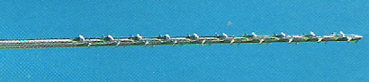
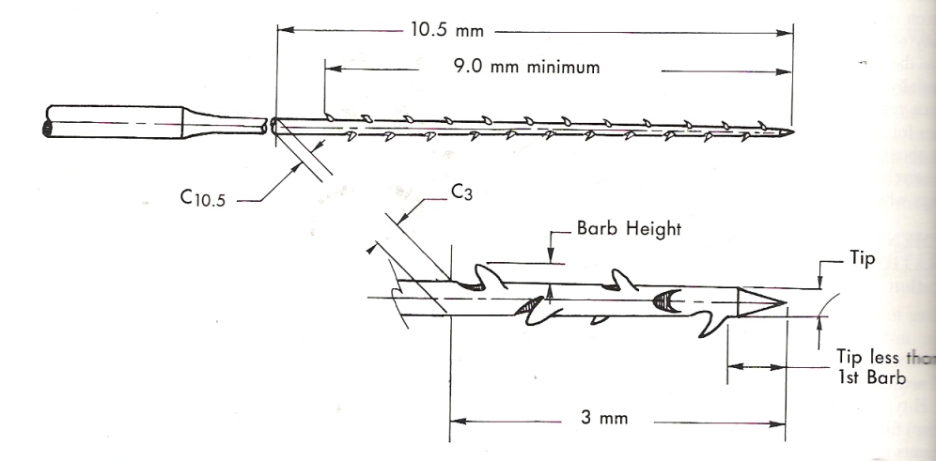
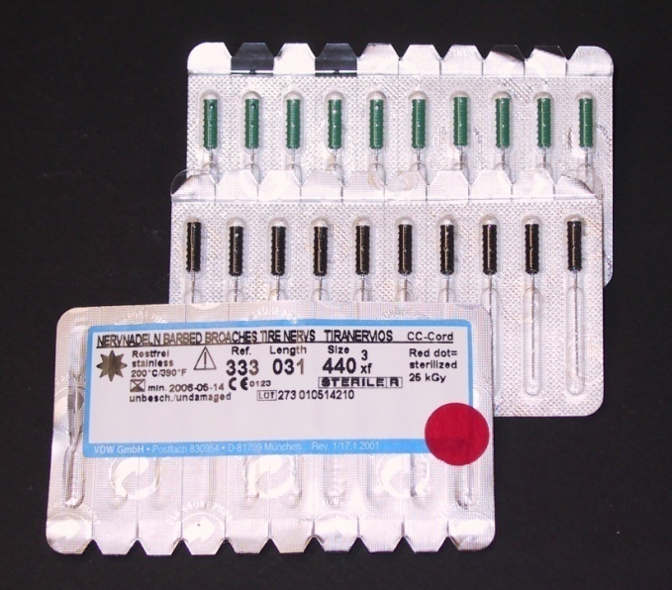
Notes:
Acc to ISO specifi. Barb height for broaches shud b ½ the core diameter whereas rasps shud hav barbs equal to 1/3 the diameter of the tip.moreover the taper of broaches is slightly less than that of rasps.

Slide 29
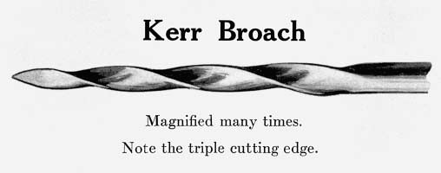
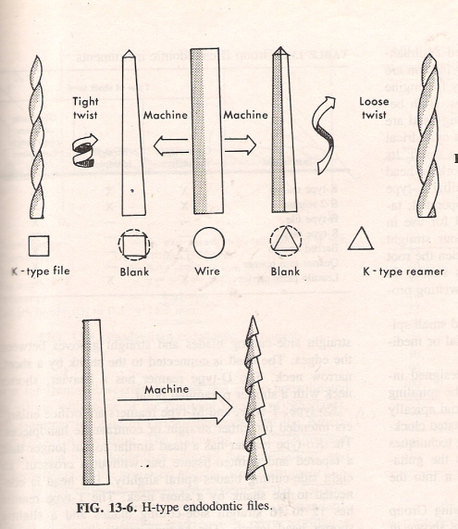
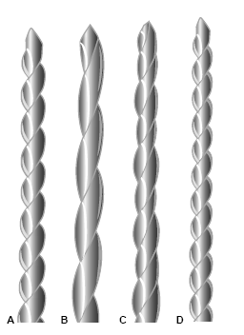
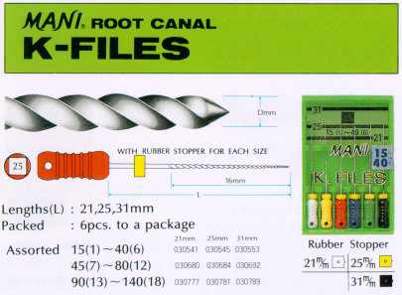
K –Type Reamers & Files (Ansi 28)
History- 1904
Manufacturing – 2 types
  Rake
Reamers
Files
Notes:
K –TYPE REAMERS & FILES (ANSI 28)
First designed as early as 1904 by the Kerr Manufacturing Company, K-style files and reamers are the most widely copied and extensively manufactured endodontic instruments worldwide. Hence are universally known as K-files. Kerr manufactured No. 1-12 file. Kerr No. 1 → Pathfinder used for fine sclerotic canals 0.015mm/mm) Made of carbon steel.
Now made universally of nickel titanium and stainless steel rather than carbon steel, K-type instruments are produced using one of two techniques.
Manufacturing:
1)The more traditional is produced by grinding graduated sizes of round “piano” wire into various shapes such as square, triangular, or rhomboid. A second grinding operation properly tapers these pieces. To give the instruments the spirals that provide the cutting edges, the square or triangular stock is then grasped by a machine that twists it counterclockwise a programmed number of times—tight spirals for files, loose spirals for reamers. The cutting blades that are produced are the sharp edges of either the square or the triangle. In any instrument, these edges are known as the “rake” of the blade. The more acute the angle of the rake, the sharper the blade. There are approximately twice the number of spirals on a file than on a reamer of a corresponding size.
2) The second and newer manufacturing method is to grind the spirals into the tapered wire rather than twist the wire to produce the cutting blades. Grinding is totally necessary for nickel-titanium instruments. Because of their superelasticity, they cannot be twisted. Originally, the cross-section of the K file was square and the reamer triangular. Recently, manufacturers have started using many configurations to achieve better cutting and/or flexibility.
As K type reamers and files are made by twisting, the steel is WORK HARDENED during this process. Work hardening depends on:
Size: larger instrument of the same shape is more work hardened
Shape: square is more than triangular
Tightness of twists: more the no. , more is the work hardening. Thus, reamer has half the amount of work hardening than K file.
Reamers:
It is the original endodontic instrument, made from a triangular blank (60º angle). They are more efficient in removing tooth structure than files (2.5 times more) because of triangular cross section. This is because the triangular shaft gives a deeper cut with thicker dentin chips, as it has a smaller contact angle with the canal wall.
Less flutes (1/10 and 1/4 of a spiral / mm or 0.80- 0.28 mm).
They cut efficiently in a reaming motion. Traditional endodontic reamers cut by being tightly inserted into the canal, twisted clockwise one quarter- to one halfturn to engage their blades into the dentin, and then withdrawn—penetration, rotation, and retraction. The cut is made during retraction. Reaming is the only method that produces a round, tapered preparation.
Reamers do not work in a filing motion as their flutes are too widespread to rasp.
Adv over file: they are more flexible.
Files:
Files are usually made from square cross section. The wire is grasped by a machine and twisted counter clockwise to produce the cutting edges. The instruments have between 1/4 and just over 1/2 spiral/ mm (1.93-­0.88 mm).
The tighter spiral of a file establishes a cutting angle (rake) that achieves its primary action on withdrawal. Files are efficient in removal of tooth structure and can be used in anyone of the following methods.
Pure filing actions (push and pull)/rasping .
Quarter turn filing.
Pure reaming action. The file tends to set in the dentin more readily than the reamer and must therefore be treated more gingerly.
IMP : Basically the instrument works by compression –and-release destruction of the dentin surrounding the canal. Generally a reaming motion causes less transportation than a filing motion.
With the square blank design, files resist fracture more easily and therefore are used for the smaller fragile instruments. In larger sizes where the fracture of file is not critical, triangular blanks are used as they are more efficient at cutting. According to Weine the square blank which has 90° angle does not cut as well as a reamer. But since flutes are twisted to produce more flutes per mm, files remove tooth structure faster.

Slide 30
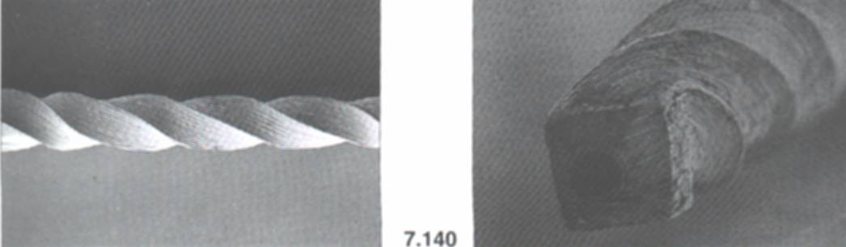

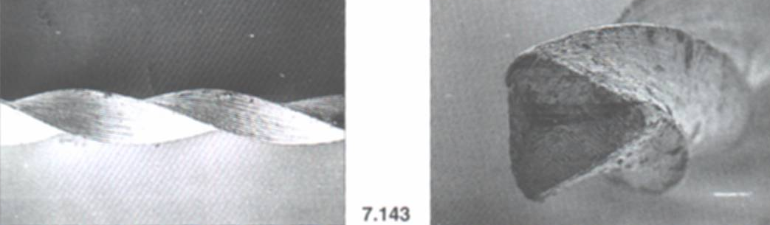
Differences in files and reamers
Fracture
90°
60°
Notes:
DIFF TABLE: Files Reamers Square cross section Triangular cross sectionTighter flutes (1.93-0.88 mm)Loose spirals (.08-0.28 mm)Resists fracture betterFracture easilyLess flexible More flexibleLower cutting efficiency, work best in rasping motionBetter cutting efficiency (2.5 times more efficient), best in reaming motion. But loose sharpness easily.
Breakage:
Reamers and K files do not break until the instrument is deformed , i.e., rotated on its axis when bound in the canal for several 360° twists. The more flexible the instrument steel, the more full turns a blade can withstand before breaking. Instrument fracture during clockwise motion after plastic deformation, when the instrument becomes bound while the rotation continues. Interestingly, failure occurs in the counterclockwise direction (fracture is a clean break of the instrument-Cohen 4th) at half the no. of rotations required for failure in the clockwise direction (here splintering of the file occurs) (Cohen 9th). Thus, K type instruments should be operated more carefully e\when pressure is applied in the counterclockwise rotation. The instrument temper is not affected by salt or glass bead sterilization.

Slide 31
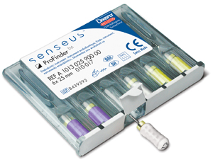
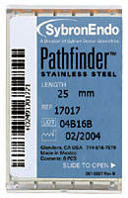
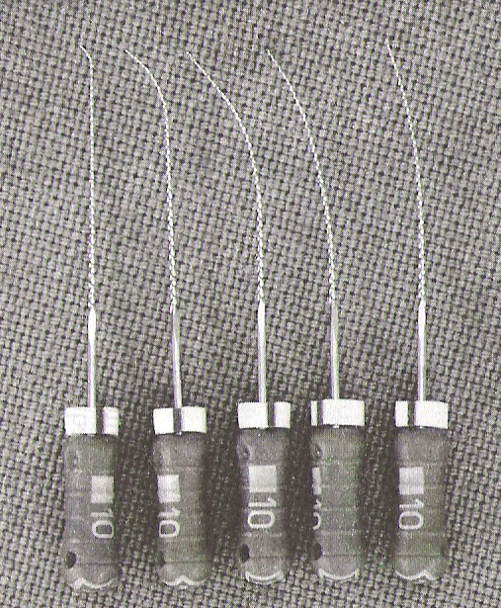
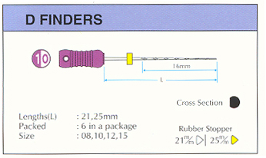
Pathfinder
  Narrower taper
  Used to negotiate calcified, constricted canals
  ProFinder: variable minimal taper, #10,13,17, lengths: 18, 21, 25 mm
Senseus ProFinder
Notes:
There is also a smooth broach, sometimes used as a pathfinder. The newly released Pathfinder CS (Sybron-Endo/Kerr; Orange, Calif.), made of carbon steel, is less likely to collapse when forced down a fine canal. Carbon steel will rust and cannot be left in sodium Hypochlorite.

Slide 32



Hedstrom Files (ANSI 58)
Milled instrument- multiaxial grinding
Positive rake angle
Cuts in pull motion
Notes:
ground from tapered blank by grinding single continuous flute. Computer assisted machining technology has allowed the development of H- file with very complex forms this process called as multiaxial grinding allow adjustment of rake angle, multiple flutes and tapers. H- type of intrument has a more positive rake angle and are better for cutting than K-type. These instruments have spiral edges arranged to allow cutting only during pulling stroke. Prevent apical packing of the debris. Greater cutting efficiency is achieved in filing motion as helical angle approaches 90 degree to dentinal surface.

Slide 33

H file
Notes:
H – file usually has a tear drop shaped cross- section. While Modifications have also been made to overcome the clinical difficulties encountered such as ledging, perforation especially for severely curved canals. These consist of either changes in cross-section,depth or angle of cutting edges changes in design of the tip of the instruments. These minute variations have significant effect on physical & mechanical properties of the files.

Slide 34


Safety Hedstrom File
Safe sided
Notes:
The “S” File (J-S Dental; Ridgefield, Conn.) also appears to be a variation of the Unifile in its double-helix configuration. Reports on this instrument are very favorable. 109,113 Buchanan has further modified theHedstroem file, the Safety Hedstrom (Sybron Endo/Kerr; Orange, Calif.), which has a noncutting side to prevent ledging in curved canals

Slide 35

Power Driven Instruments
Latch-type rotary instruments for conventional handpieces
  Paste fillers, Ni Ti rotary systems ,GG , Peeso drills
Endodontic files, reamers for reciprocal or oscillating handpieces
Instruments in specialized vibratory endodontic devices
Notes:
Desire to inc the speed & efficiency of treatment has led to resurgence of power drivven intr which can b gen divided into 3 groups……..
Two of the most historic and popular engine-driven instruments are Gates-Glidden drills and Peeso reamers (drills) (Figure 10-31, A and B).Gates-Glidden drills are an integral part of new instrumentation techniques for both initial opening of canal orifices and deeper penetration in both straight and curved canals. Gates-Glidden drills are designed to have a weak spot in the part of the shaft closest to the handpiece so that, if the instrument separates, the separated part can be easily removed from the canal. They come in sizes 1 through 6, although these sizes arebeing converted to the ISO instrument sizes and colors.
The Peeso reamer (Dentsply/Maillefer; Tulsa, Okla.)
is most often used in preparing the coronal portion of the root canal for a post and core. One must be careful to use the “safe-ended” Peeso drill to prevent lateral perforation. Gutta-percha should have previously been removed to post depth with a hot plugger. Round burs should never be used.
Since some of these instruments (stainless) do not readily bend, they should be used in perfectly straightcanals. Because they are often misdirected or forced beyond their limits, they notoriously cause perforationsor break in the hands of neophytes
Easy to use
Reduction in fatigue
Reduction in treatment time
Disadv
Ledging and perforations
Hand instrumentation necessary
Loss of tactile sense
Apical packing of debris

Slide 36
Nickel Titanium Rotary Systems
Advantages
Disadvantages
2-3 times elastic flexibility
Better fracture resistance
Resistance to angular deflection
More strength, toughness
Resilient
Shape memory
Superelasticity
Cutting efficiency-1/2 to 1/3
No indication of fracture
More wear
Not heat treatable
Allergy- Ni
Cost
Barr ES et al (2000)
  More effective in debriding
  Provide consistently uniform , predictable fill
Notes:
Cohen 305
The flexibility of these files allow them to closely follow root canal path
The properties of niti that are of particular interest in endo are superelasticity & high resistence to cyclic fatigue due to which they can b easily used in curved canals and sustantially reduce the incidence of ledges,transportation & perforation.
But cost of these is high and one needs to master the technique properly

Slide 37
Working Length Determination

Slide 38


Significance
Working length determines
  Depth to which instruments are placed in canal
  Depth to which canal filling
Importance
Notes:
Def: measurements made from fixed coronal reference point to a point where preparation and obturation should terminate
Importance
Apical perforation
Over filling / under filling
Incomplete instrumentation
Ledge formation
And inc chances of failure of the treatment
Therefore the method shud b accurate and easy to perform.
If calculated properly -- success of treatment
If calculated incorrectly-- treatment failure

Slide 39
Ideal method
Rapid location of the apical constriction
Easy measurement
Rapid periodic monitoring and confirmation
Patient and clinician comfort
Minimal radiation to the patient
Ease of use in special patients such as those with severe gag reflex, reduced mouth opening, pregnancy
Cost effectiveness
Notes:
The requirements of an ideal method for determining working length might include rapid location of the apical constriction in all pulpal conditions and all canal contents; easy measurement, even when the relationship between the apical constriction and the radiographic apex is unusual;
rapid periodic monitoring and confirmation; patient and clinician comfort; minimal radiation to the patient; easy of use in special patients such as those with severe gag reflex, reduced mouth opening, pregnancy etc, and Cost effectiveness

Slide 40
Methods of working length determination
RADIOGRAPHIC
METHODS
  Conventional method
    Ingle method
    Grossman method
  Digital radiography
  Xeroradiograpy
NON RADIOGRAPHIC
METHODS
  Tactile sense
  Paper point
  Apical PDL sensitivity
  APEX LOCATORS
Notes:
To achieve the highest degree of accuracy in working length determination, a combination of several methodsshould be used.
OTHER METHODS
BEST(1960)
BRESMAN(1950)
BRAMANTE
EVERELL & FIXOT(1963)

Slide 41
Conventional radiography – Ingle’s method
Notes:
Method
1. Measure the tooth on the preoperative radiograph(Figure 10-58, A).
2. Subtract at least 1.0 mm “safety allowance” for possible image distortion or magnification.331
3. Set the endodontic ruler at this tentative working length and adjust the stop on the instrument at that
level (Figure 10-58, B).
4. Place the instrument in the canal until the stop is at the plane of reference unless pain is felt (if anesthesia has not been used), in which case, the instrument is left at that level and the rubber stop readjusted to this new point of reference.
5. Expose, develop, and clear the radiograph.
6. On the radiograph, measure the difference between the end of the instrument and the end of the root and add this amount to the original measured length the instrument extended into the tooth (Figure 10-58, C). If, through some oversight, the exploring instrument has gone beyond the apex, subtract this difference.
7. From this adjusted length of tooth, subtract a 1.0 mm “safety factor” to conform with the apical terminationof the root canal at the apical constriction(see Figure 10-58, C).332
8. Set the endodontic ruler at this new corrected length and readjust the stop on the exploring instrument (Figure 10-58, D).
9. Because of the possibility of radiographic distortion, sharply curving roots, and operator measuring error, a confirmatory radiograph of the adjusted length is highly desirable. In many instances, an added investment of a few minutes will prevent the discomfort and failure that stem from inaccuracy.
10.When the length of the tooth has been accurately confirmed, reset the endodontic ruler at this measurement.
11. Record this final working length and the coronal point of reference on the patient’s record.
12. Once again, it is important to emphasize that the final working length may shorten by as much as 1 mm as a curved canal is straightened out by instrumentation.314,315 It is therefore recommended that the “length of the tooth” in a curved canal be reconfirmed after instrumentation is completed.

Slide 42

Weine’s modification
Grossman method
actual length of tooth is determined by mathematical formula
Actual length of tooth =
actual length of the instrument X x-ray length of tooth
x ray length of the instrument
Notes:
Weine has made a sensible improvement in this determination: If, radiographically, there is no resorptionof the root end or bone, shorten the length by the standard 1.0 mm.332 If periapical bone resorption is apparent, shorten by 1.5 mm, and if both root and bone resorption are apparent, shorten by 2.0 mm (Figure 10-59). The reasoning behind this suggestionis thoughtful. If there is root resorption, the apical constriction is probably destroyed—hence the shorter move back up the canal. Also,when bone resorption is apparent, there probably is also root resorption, even though it may not be apparent radiographically.
No reorption -1mm
Periradicular bone resorption –1.5 mm
Bone and root resorption –2 mm
Working length is determined by subtracting 1-1.5 mm from the tooth length.

Slide 43
Digital radiography & Xeroradiography:
Advantages
  Decrease in radiation exposure
  No dark room
  Time saving
  Duplication with out loss of the image quality
  Positive and negative image possible
Notes:
3 types
direct digital
storage phosphor
indirect digital
Advantages
Decrease in radiation exposure
No dark room
Time saving
Duplication with out loss of the image quality
Xero : charged selenium alloy photoreceptor plate used
When exposed to x ray, charge on the photo receptor is dissipated according to tissue density and a latent electrostatic image formed

Slide 44
Non Radiographic Methods
Tactile sense
Paper point ( Baggeh et al 1996)
  Used to seek out apical moisture and bleeding
Apical periodontal sensitivity
    Painful method
    Apical abscess no pain on reaching apex
Notes:
Tactile sense: crude method for working length determination, depends on the skill of the operator this method is possible bcoz of the apical anatomy of the canal that allows the operator to feel the apical constriction.
Not recommended.
Paper point :here paper point is used for working length measurements ,paper point get wet on reaching the apical area. so depending on the wet area that much length has to be reduced for proper working length .
Apical periodontal sensitivity: as instrument reaches the apex patient gets pain and this principle is used fro working length determination
Crude method , in case of apical abscess patient may not get pain on reaching apex and painful method not recommended

Slide 45
Apex Locators
Notes:
All apex locators function by using the human body to complete an electrical circuit. One side of the apexlocator’s circuitry is connected to an endodontic instrument.The other side is connected to the patient’s body, either by a contact to the patient’s lip or by an electrode held in the patient’s hand. The electrical circuit is complete when the endodontic instrument is advanced apically inside the root canal until it touches periodontal tissue (Figure 10-61). The display on the apex locator indicates that the apical area has been reached.

