Slide 1
Pulp Therapy
Dr Pallavi Vashisth
Department of Pedodontics

Slide 2
Classfication
It may be
  Direct pulp therapy
  Indirect Pulp therapy
Its also classified as
Vital pulp therapy
  Indirect pulp capping (IPC)
  Direct Pulp Caping (DPC)
  Pulpotomy
  Pupectomy
  Apexogenesis
Non-vital therapy
  Apexofication
  SCAP (stem cell of apical papilla)

Slide 3
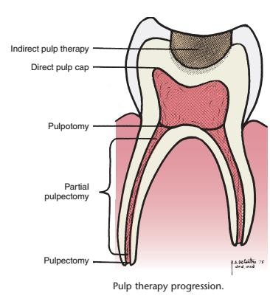

Slide 4
Pulp Capping

Slide 5
Its of either two types based on remaining dentin thickness (RDT):
Indirect pulp capping (2 – 0.25 mm)
Direct Pulp capping (0 – 0.25 mm)

Slide 6
Indirect Pulp Capping
a procedure in which a material is placed on a thin partition of remaining carious dentin that, if removed, might expose the pulp in immature permanent teeth.
deep carious lesions where caries excavation was conservative and direct pulp exposures were avoided
either Ca(OH)2 or zinc oxide–eugenol (ZOE) in a one- or two-stage procedure.

Slide 7
Rational and objective
Removal of infected dentin (dimineralized and invaded by bacteria)
Disinfection of residual affected dentin (dimineralized dentin not yet invaded by bacteria).
Sealing by restorative material causes removal of substrate on which bacteria act.
Arrest of carious process causes activation of reparative mechanism to lay additional dentin and avoid pulp exposure

Slide 8
INDICATIONS
History
Mild discomfort from chemical & thermal stimuli
Negative h/o spontaneous pain
O/E
Positive pulp sensitivity test
Negative TOP
Large carious lesion
Absence of lymphadenopath
Normal color of gingiva & tooth
R/F
Large carious lesion in close proximity of the pulp
Normal lamina dura & PDL space
No interradicular or periradicular radiolucency

Slide 9
CONTRAINDICATIONS
History
Sharp penetrating pain that persists after withdarwing stimulus
Prolonged spontaneous pain ,particularly at night
O/E
Excessive tooth mobility
Discolored
Nonresponsiveness to pulp testing techniques
R/E
Large carious lesion with apparent pulp exposure
Widened PDL space & interrupted or broken lamina duraa
Radiolucency at the root apices or furcation areas

Slide 10
Clinical Procedure : 1st Appointment
Two sitting caries exavation is recommended using slow speed hand piece # 6 or # 8 round burs
Peripheral dentin is removed with sharp spoon exacavator
The cavity is flushed and dried with cotton pellet
Exposure site is covered with hard set calcium hydroxide prep (Ex: Dycal, Caulk, Milford) and sealed with overlying reinforced ZOE prep ( Ex: IRM )
Patient recalled after 6-8 weeks

Slide 11
Clinical Procedure : 2nd Appointment
Between two appointment, history must be negative and intermediary restoration must be intact
After clinical and radiological(bitewing) examination, all the restorative material is removed
There must be change of color and hardness of affected dentin from deep brownish red and soft to lighter brownish grey color and harder
The preparation is cleaned and dried
Hard setting calcium hydroxide is placed followed final restoration

Slide 12
Features
One appointment
difficulty with the procedure is to determine at what point excavation is halted
voids under the restorative material result during the remineralization process, in which the carious dentin dries out and loses volume
Restoration failure and rapid reactivation of a dormant lesion
not recommended as a predictable treatment for permanent teeth
Two appointment
Unintended pulp exposure –
worsen the prognosis
Clinically assesed the reaction of tooth and progress of dentin bridge formation
The final exacavation of caries is safer in 2nd appointment when sufficient formation of dentin has taken place
•

Slide 13
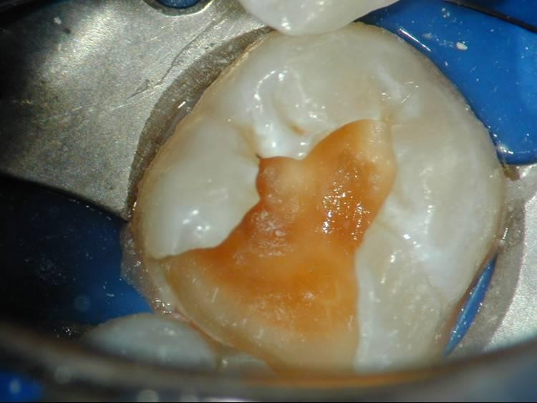
Direct Pulp Capping
treatment of an exposed vital pulp by sealing the pulpal wound with a dental material placed directly on a mechanical or traumatic exposure to facilitate the formation of reparative dentin a maintenance of the vital pulp

Slide 14
Indication
Iatrogenic mechanical exposure – assymptomatic vital tooth with sound dentin
Small carious exposure assymptomatic permanent tooth with incomplete root formation
R/r there should be no thickening of PDL space and evidence of periradicular lesion

Slide 15
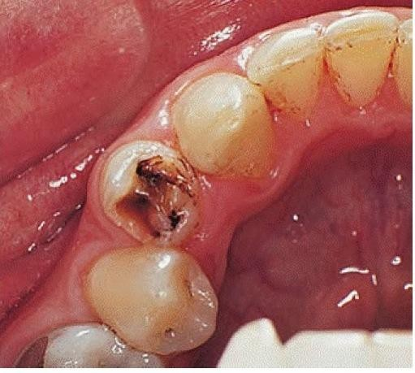
Contraindication
Carious exposure of primary
tooth
Large carious exposure in symptomatic permanent teeth Severe Tooth ache at night
Spontaneous pain
Excessive tooth mobility
Thickening of PDL space
Radiographic evidence of furcal or periradicular degeneration
Excessive hemorrhage
Purulent or serous exudate from the exposure site

Slide 16
Factors affecting prognosis
Seltzer and Bender
  Area and size of exposure
  Microleakage
  Carious v/s mechanical exposure : mechanical has better prognosis
  Time of exposure
  Bacterial contamination
  Treatment Plan

Slide 17
Factors associated with mechanical pulp exposure
Heat : closer the cavity is to pulp, more likely its to injure the tooth.
Pressure: pulp damage directly proportional to pressure exerted by bur or instrumentation
Damage to pulp
Hemorrhage
Intrussion of dentin chip

Slide 18



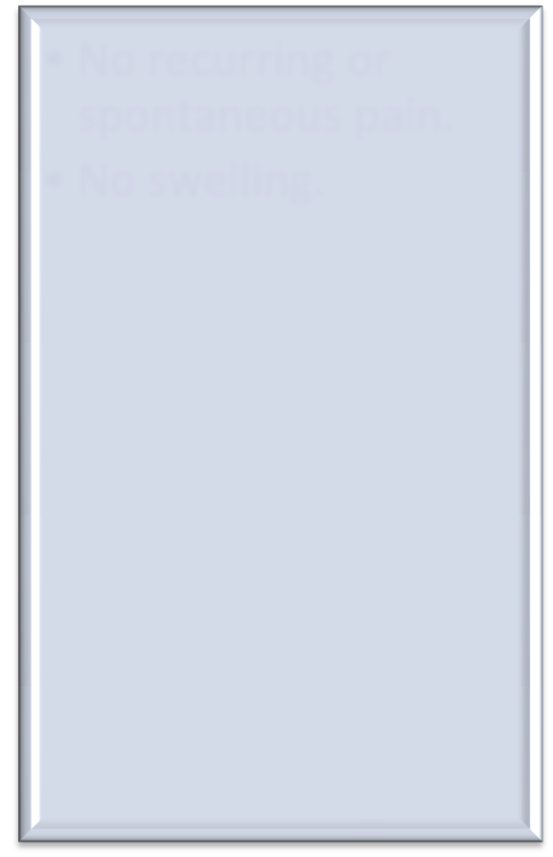
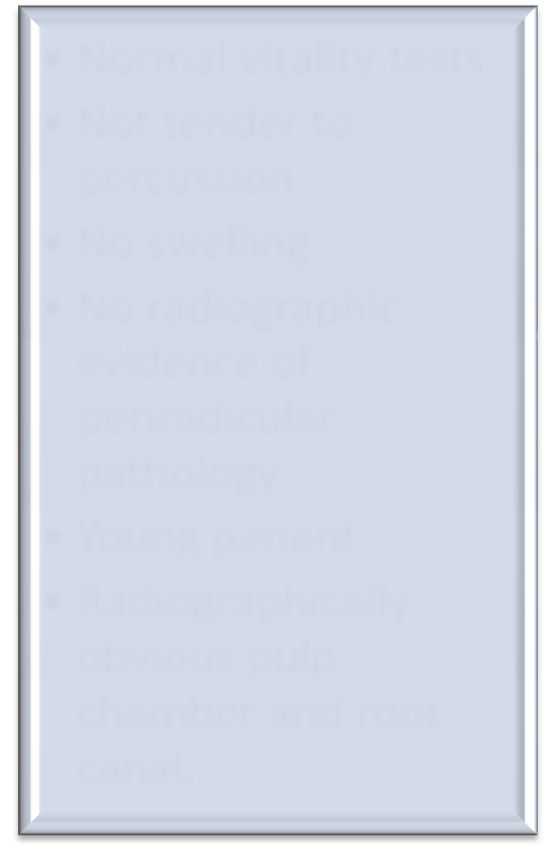
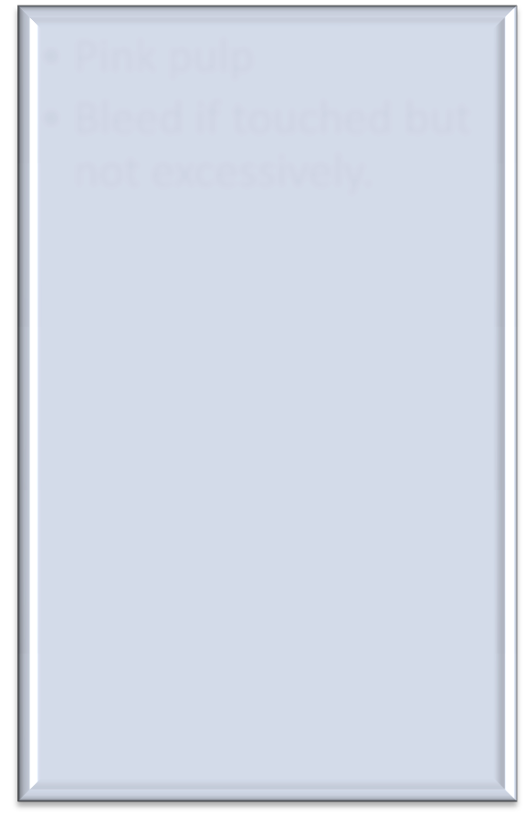
Criteria essential for a successful direct pulp cap.
Lin and Langland (1981)
BDJ 2001 , Vol 191 ,No 11
History
Preoperative assessment
Clinical findings.
No recurring or spontaneous pain.
No swelling.
Normal vitality tests.
Not tender to percussion.
No swelling.
No radiographic evidence of periradicular pathology.
Young patient.
Radiographically obvious pulp chamber and root canal.
Pink pulp
Bleed if touched but not excessively.

Slide 19
Pulp capping agent
CaOH, CaOH with antibiotics and corticosteroid, ZOE and MTA
Ideal properties of pulp capping agent (Cohen and Combe)
  Maintain pulp vitality
  Stimulate reparative dentin formation
  Bacteriocidal and bacteriostatic, ability to provide bacterial seal
  Adhere well to dentin and restorative material
  Resist force under restoration
  Radiopaque and sterile

Slide 20
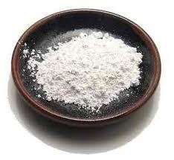
Calcium hydroxide
Introduced by Hermann in 1930 as a pulp capping agent.
Used as:
  Aqueous suspension of calcium hydroxide
  Commercial products:
    Dycal [Caulk/Dentsply]
    Prisma VLC Dycal [Caulk/Dentsply]
    Life [SybronEndo/ Kerr]
    Nu-Cap [Coe]

Slide 21
Acts by:
  Forming prtotective barrier for pulp tissue
  Blocking patent dentin tubules
  Neutralizing the attack of inorganic acids & their leached
products
  Stimulates formation of - reparative dentin
  Reduction in number of microorganisms remaining in the dentin.
  Stimulates remineralization of demineralized dentinal tubules,
–

Slide 22
Calcium hydroxide
Calcium Ions
Hydroxyl ions
Reduced capillarity permeability
Neutralizes acid produced by osteoclast
ACTION OF CALCIUM IONS
Reduced serum flow
Optimum pH for Pyrophosphatase activity
Reduced level of
inhibitory pyrophatase
Increase level of calcium ion dependent pyrophosphatase
Mineralization

Slide 23
Healing with Ca(OH)₂
Zone of obliteration
  caustic effect causes derangement of contacting pulpal tissue.
  This zone consist of debris, dentinal fragments, blood clots, blood pigments and particles of calcium hydroxide
Zone of Coagulation necrosis
  chemical thrust of CaOH causes necrosis of plasma
protein and thrombosis
  Also known as Schroder layer of firm necrosis or
Stanley’s mummified zone
  0.3-0.7 mm thickness
Zone of Demarcation
  a line develops between deepest zone of cogulation necrosis and subjacent vital pulp
  Glass and Zander : line is a result of reaction between
tissue protein to f_{fac}o_{e}r_{b}m_{ook.c}p_{om}r/o_{no}t_{tes}e_{d}i_{e}n_{nta}g_{l} lobules

Slide 24
Corticosteroids and Antibiotics
for direct pulp capping and also as mixed in with calcium hydroxide with the thought of reducing or preventing pulp inflammation
Barker BCW, Lockett BC: reaction of dog pulp and periapical tissue to two glucocorticoid preparations. Oral surg 33:249, 1972
No dentinal bridge formation has been reported.
Baume LJ: survey of dentin biology. Brit Dent J 116:254, 1964

Slide 25
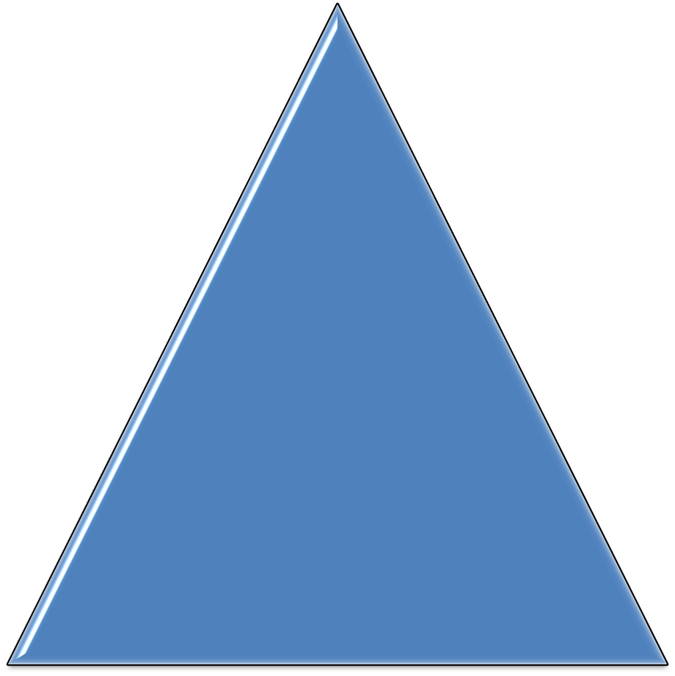


Polycarboxylate Cements
Lack an antibacterial
effect and
Did not stimulate calcific bridging in the pulps of monkey primary and permanent teeth

Slide 26
Mineral trioxide aggregate
Composed of
  Tricalcium silicate
  Dicalcium silicate
  Tricalcium aluminate
  Tetracalcium aluminoferrite
  Bismuth oxide
Exhibits many favourable characteristics which make it a superior material when used as a direct pulp capping material in adult teeth.
  Sets in the presence of blood and moisture.
  Superior marginal adaptation
  Nonabsorbable
High alkalinity and sustained pH at 12.5 is
  Responsible for preventing microbial growth.
  Extracts growth factors from adjacent dentin

Slide 27
Mineral trioxide aggregate
Superior marginal adaptation
Non absorbable
Sustained alkaline ph
Small particle size
Slow release of calcium ions
Promotes hard tissue formation
Osteoinductive, osteoconductive

Slide 28
Technique of DPC
Excavation of caries is done with # 2 carbide bur and spoon exacavators
In case of bleeding, hemostasis is achieved with cotton pellet dipped in 3-6% NaOCl for 1-10 min.
– If bleeding doesn’t stops then other invasive procedure is performed
After control of Bleeding, pulp capping agent is applied followed by GIC
Bonded restoration – CaOH
Composite restoration - MTA

