Slide 1
Biomedical Waste Management

Slide 2
Biomedical Waste
Any waste which is generated during the diagnosis, treatment or immunization of human beings or animals or in research activities pertaining there to or in the production or testing of biologicals or in health camps.

Slide 3
Biomedical waste statistics
Developed Countries- 1-5kg/bed/day, with variation
among countries.
In India-
- 1-2kg/bed/day with variation among Govt. and
private establishments.
- Approximately 506.74 tons/day wastes
generated.
- Out of which only 57% waste undergoes
proper treatment

Slide 4
Sources
Hospitals
Nursing Homes
Clinics
Dispensaries
Veterinary Institutions
Animal Houses
Pathology Laboratories
Blood Banks
AYUSH Hospitals
Clinical Establishments
Research Institutions
Educational Institutions
Health Camps
Medical Camps
Surgical Camps
Vaccination Camps
Blood Donation Camps
First Aids Rooms of Schools
Forensic Labs
Research Labs

Slide 5
Comparison of Bio-medical Waste (Management & Handling) Rules, 1998 with Bio-medical Waste Management Rules, 2016
Bio-medical Waste Management Rules, 2016
Bio-medical Waste (Management & Handling) Rules, 1998
Occupier with more than 1000 patients per month or more to obtain authorization.
Operator duties absent.
Bio-medical waste classified into 10 categories.
Every occupier generating BMW, including health camp and Ayush require to obtain authorization.
Duties of the operator listed.
Bio-medical waste divided into 4 categories.

Slide 6
Bio-medical Waste (Management & Handling) Rules, 1998
Bio-medical Waste Management Rules, 2016
Rules restricted to HCE’s with more than 1000 patients per month.
Rules permits on-site treatment and disposal of biomedical waste through common bio-medical waste treatment facility (CBMWTF)
Treatment and disposal of biomedical waste mandatory for all HCE’s.
Permits HCF to have on-site treatment provided if there is no CBMWTF within a distance of 75 kms.

Slide 7
Bio-medical Waste (Management & Handling) Rules, 1998
Bio-medical Waste Management Rules, 2016
No format for annual report prescribed.
Schedule I, II, III, IV & V.
Prescribed authority i.e., State Pollution Control Board/ Pollution Control Board.
A format for annual report appended with rules.
Changes incorporated in schedule I, II, III & IV.
List of prescribed authorities and the corresponding duties prescribed under the rules.

Slide 8
Biomedical Waste Management Rules, 2016
Aim:
To protect the public health and environment.
Objectives:
To reduce the magnitude of hazardous wastes.
To reduce the health and environmental risks.

Slide 9
Bio-Medical Waste Management Rules-2016
Schedules: 1 to 4
Form: 1 to 5
Rules: 1 to 18
Central Pollution Control Board (CPCB)
http://cpcb.nic.in/bio-medical-waste-rules/

Slide 10
Schedules
Biomedical waste categories and their segregation, collection, treatment, processing and disposal options.
Standards for treatment and disposal of bio-medical wastes.
List of prescribed authorities and the corresponding duties.
Label for bio-medical waste containers or bags & label for transporting bio-medical waste bags or containers.

Slide 11
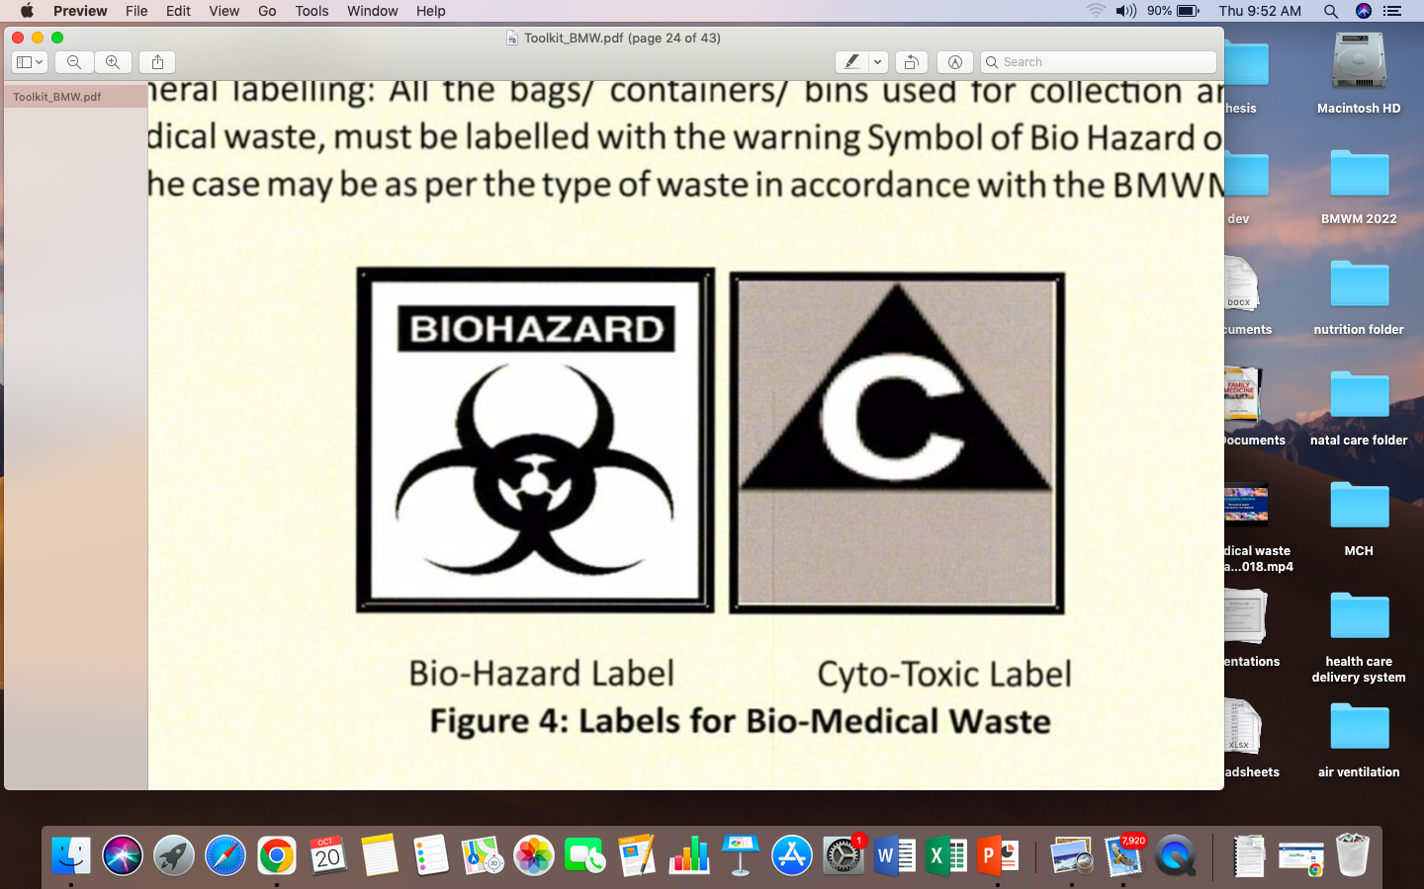
Label for bio-medical waste
Bio-hazard label
Cytotoxic label

Slide 12
Forms
Accident reporting
Application for authorization or renewal of authorization
Authorization
Annual report
Application for filing appeal against order passed by the prescribed authority

Slide 13
Rules
Short title and commencement
Application
Definitions
Duties of the Occupier
Duties of the operator of a common bio-medical waste treatment and disposal facility
6. Duties of authorities
7. Treatment and disposal
8. Segregation, packaging, transportation and storage
9. Prescribed authority

Slide 14
Procedure for authorization
Advisory Committee
Monitoring of implementation of rules in health care facilities
Annual report
Maintenance of records
15. Accident reporting
16. Appeal
17. Site for common bio-medical waste treatment and disposal facility
18. Liability of the occupier, operator of a facility

Slide 15
Biomedical Waste Hazards:
Environmental hazards
Health hazards

Slide 16
Environmental Hazards
The improper management of biomedical waste causes serious environmental problems in terms of:
Air pollution
Water pollution
Land pollution

Slide 17
Health Hazards
Infection ( G.I.T, RTI, Skin infection, Blood born infections- AIDS, Hepatitis B &C)
Genotoxicity and Cytotoxicity
Chemical toxicity
Radioactivity hazards
Physical injuries
Public sensitivity

Slide 18
Steps of Biomedical Wastes Management
Characterization
Quantification
Segregation
Storage
Transportation
Treatment
Disposal

Slide 19
Quantification, Characterization
Biomedical Wastes (15%)
Municipal solid wastes (85%)
Infectious waste
Pathological waste
Sharps
Pharmaceuticals
Genotoxic waste
Chemical waste
Radioactive waste
Food waste
Vegetables & Fruits
Paper
Cardboard
Bottles, jars
Cans, foils,
Plastics, clothes

Slide 20
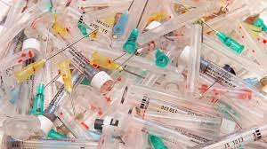
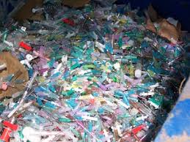

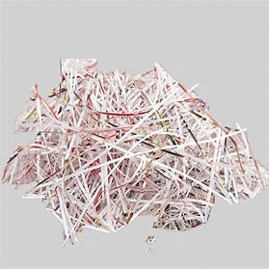
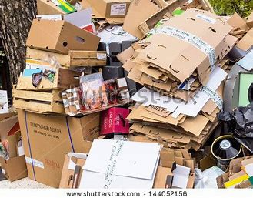
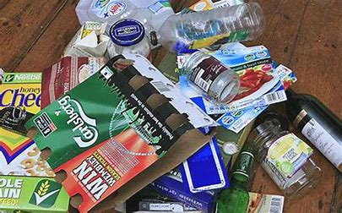
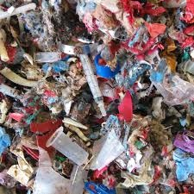
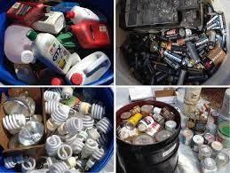


Wastes
Biomedical wastes
Municipal solid wastes

Slide 21
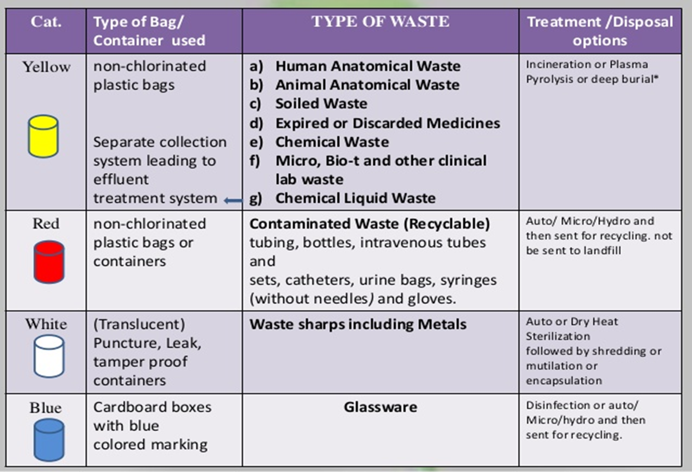
Segregation

Slide 22
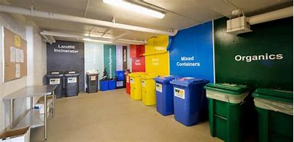
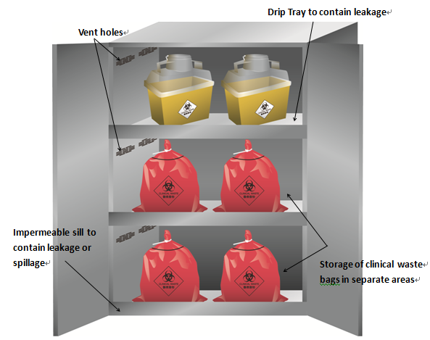
Local Storage Room

Slide 23
Disposal Methods of Bio-Medical Wastes
Incineration (High temperature dry oxidation)
Chemical disinfection
Inertisation (65% waste, 15% lime,15%cement, 5% water)
Autoclave
Microwave
Shredder
Plasma pyrolysis
Deep burial

Slide 24
THANK YOU!

